Slide 1


PARLIAMENTARY PORTFOLIO COMMITTEE ON HIGHER EDUCATION, SCIENCE AND TECHNOLOGY
PRESENTED BY
PROFESSOR VIVIENNE LAWACK
(ACTING RECTOR AND VICE-CHANCELLOR)

Slide 2
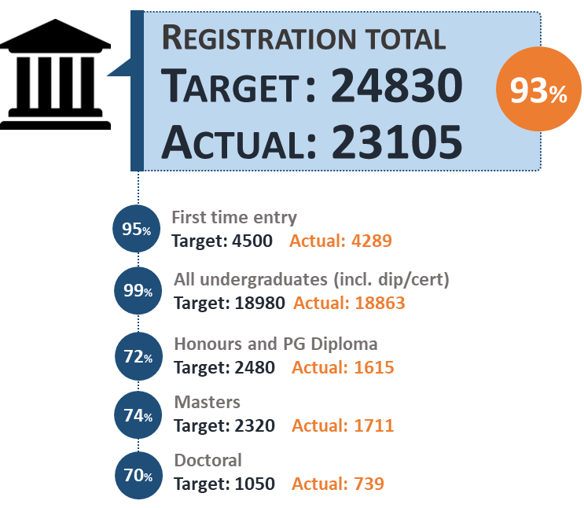
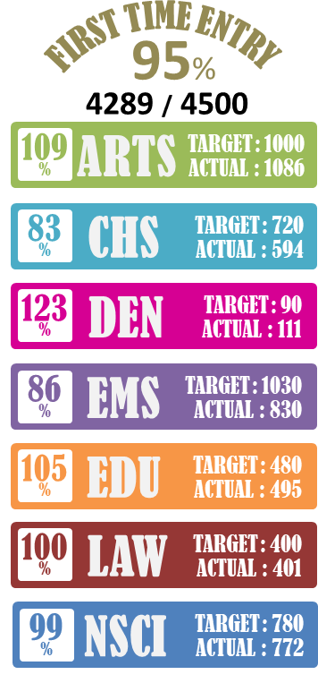
REGISTRATION STATISTICS
OVERALL REGISTRATION 2020
TOTAL OFFERS MADE: 9501
TOTAL OFFERS ACCEPTED: 6044
Declining pool of qualifying students with requisite Mathematics marks as opposed to Maths Literacy has resulted in:
Increased competition for qualifying applicants and not all applicants registering
Under-enrolment in EMS, CHS and Sciences
Systemic impact of Professional bodies on enrolment: The SA Nursing Council (SANC) has reduced the Nursing target by more than 50% effective from 2020
CHS target reduced from 720 to 550
Postgraduate Registration
Continues throughout the year
Over the last 5 years UWC has exceeded Masters and Doctoral targets
Competition for Postgraduate up to Masters poses some challenges

Slide 3

ENROLMENT MANDATE
2015 - 2025
2019 – 2020 PLANNED SHIFTS
Headcount totals increase from 23 788 to 24 800 representing an annual increase of 4.3% between 2019 and 2020
Unweighted FTEs increase from 18 183 to 18 851
Headcount enrolment by major field of study: 35% in SET; 11.5% in business and management; 9.5% in education; and 44% in humanities
Total graduate output is projected to increase from 5 480 to 5 557
20 382
26 740
25 060
23 788
22 443
20 382

Slide 4


RESIDENTIAL SERVICES
ACCOMMODATION
KOVACS – 1 100 bed spaces (PPP development on the main campus)
PRIVATE PROVIDERS – 983 bed spaces (1 -49 bed spaces)
10 UWC RESIDENCES
3 LONG-TERM LEASE AGREEMENTS
3 393 BEDS
NEW 2020 LEASE AGREEMENTS
2 YEAR lease agreement – 1 199 bed spaces available
SOLARIS
Spaces allocated 128, Moved in 128
HAAZENDAL (Available from 26 Feb 2020)
Spaces available 680
Spaces allocated 100, Moved in 100
SAPHIRE (on standby)
Spaces 391
CURRENT PLACEMENT
SENIORS - 2 702
FIRST YEARS - 691
ANNUAL APPLICATIONS
2018 – 14 522
2019 – 17 012
2020 – 22 528
812 students in 2019
578 qualify for residence in 2020
234 do not qualify (due to academic performance)
432 have been placed to date
146 have not requested placements through the UWC process
FUTURE DEVELOPMENTS
UNIBELL RESIDENCE – 2700 bed spaces

Slide 5

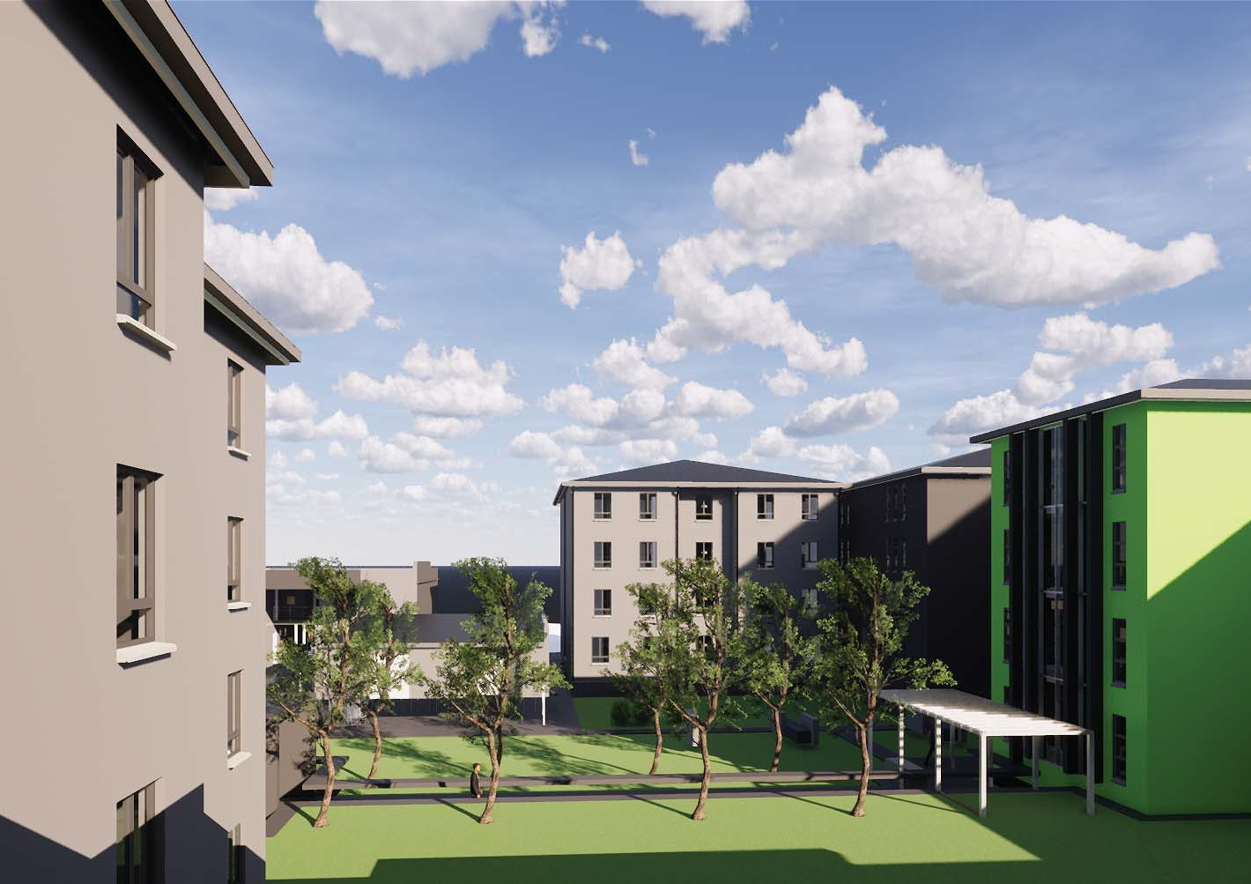
INFRASTRUCTURE DEVELOPMENT
UNIBELL RESIDENCE DEVELOPMENT
13 RESIDENCE BLOCKS
2700 BEDS
2022 PLANNED COMPLETION
In March 2019 the University Council approved:
  The finalization and signing of contracts with the Provincial department, the Developer, the Development Bank of South Africa (DBSA) and related contracts.
  Enter into land swap arrangements and purchase land adjacent to the campus (see next slide).
On 28 February 2020 UWC received the loan approval letter of R375 million from the DBSA subject to:
  UWC agreeing to the terms
  Ministerial approval
Site handover is scheduled for 1 April 2020.

Slide 6
INFRASTRUCTURE DEVELOPMENT
UNIBELL RESIDENCE DEVELOPMENT

Slide 7
INFRASTRUCTURE DEVELOPMENT
FUTURE STUDENT ACCOMMODATION
Short-term
(1 – 2 years)
Current stock and Kovacs
Medium-term
(3 – 5 years)
Completion and occupation of Unibell project
Long-term
(5 + years )
Upgrading of existing residences
Supplemented with lease agreements
Construction of Unibell
Pursue funding opportunities (DHET and others) for additional residences
Position UWC as an anchor institution in the region (multi-site strategy)
Continue to pursue funding opportunities (DHET) and others for additional residences
Development of UWC-owned land -explore different business models

Slide 8
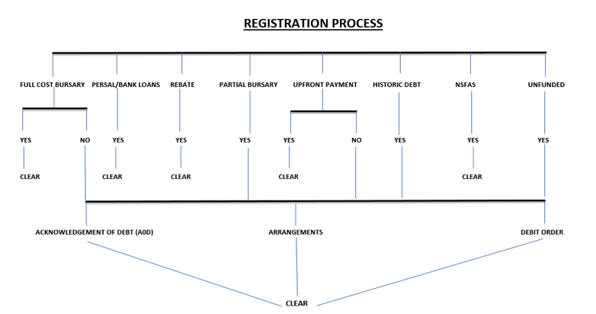
NSFAS, REGISTRATION AND FINANCES
CURRENT STATUS
UWC is amongst the lowest for tuition fees and residence fees in South Africa
The UWC residences averages between R25 000 to R28 000 per annum
UWC residences cross subsidised by 12,5% loss on turnover
UWC does not exclude academically qualifying students on financial grounds
Gross student debt outstanding amounts R396m
NSFAS PAYMENTS MADE TO DATE
SENIOR STUDENTS – R37 431 500
NEW FIRST YEARS – R8 120 400
OTHER NSFAS MATTERS
At the beginning of 2020, 344 new applications (walk-ins) - closed on 21 February 2020
Currently NSFAS appeals are being attended to, closing date was 28 February 2020 (1060 appeals)
NSFAS issues a list of funded students last week that indicates that approx. 250 students who were funded at the beginning of the year, are now no longer funded. The matter is being pursued with NSFAS

Slide 9
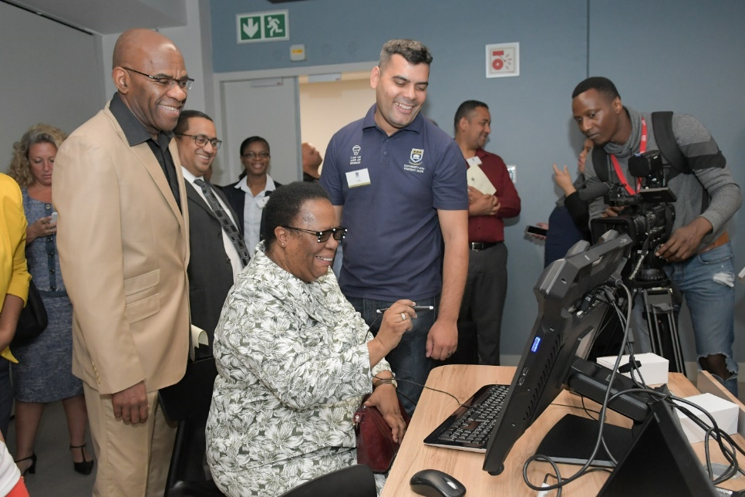
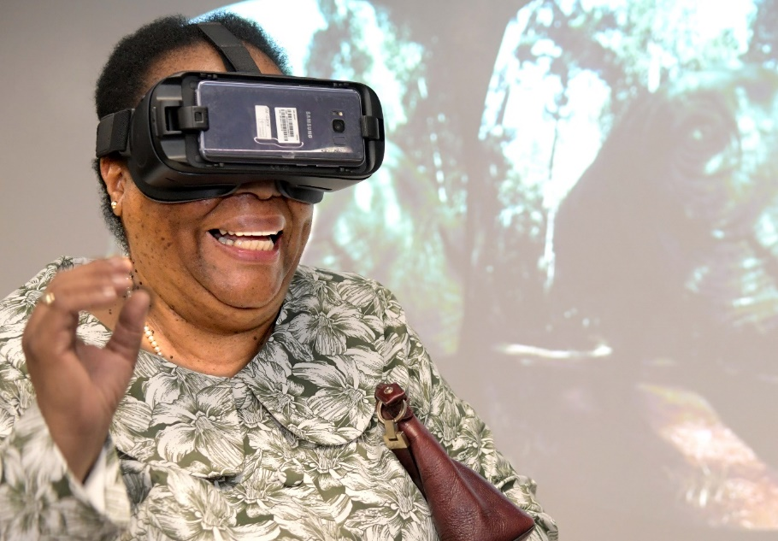
LEARNING AND TEACHING AT UWC
VISION AND FOCUS AREAS
FOCUS AREAS
Learning with technology (emerging technologies)
  Promote enhanced learning opportunities through innovative use of emerging technologies
  Learning Management System: more than 1200 modules are online and in 2019 there were more than 20 500 active users per month
  Augmented and Virtual reality
  Science pre-lab online preparation (international partner)
  Dentistry simulation labs
Research-led learning and teaching
  Enhance and promote the profile of learning and teaching and our academic programmes
  Develop a framework for integrated scholarship at UWC (integration of learning and teaching, research and community engagement)
UWC’s intellectual identity – transformation and renewal of the curriculum
  Shape the academic curriculum to support the development of the 21st century graduate attributes
VISION
To provide opportunities for an excellent learning and teaching experience that is contextually responsive to the challenges of globalisation and of a society in transition, and which enhances the students’ capacities as change agents in the 21st century.

Slide 10
LEARNING AND TEACHING AT UWC
VISION AND FOCUS AREAS (CONT.)
Excellence and student success
  Develop a conducive environment for excellence in learning and teaching, embracing pedagogies that would enable graduates to acquire attributes of the 21st century graduate in support of student success and retention
  Focus areas:
  Student retention and success framework
  Tutor enhancement programme
  First year student experience programme commenced in January 2019
  Focus on the “entire student walk”

Slide 11
Thank you

