Slide 2
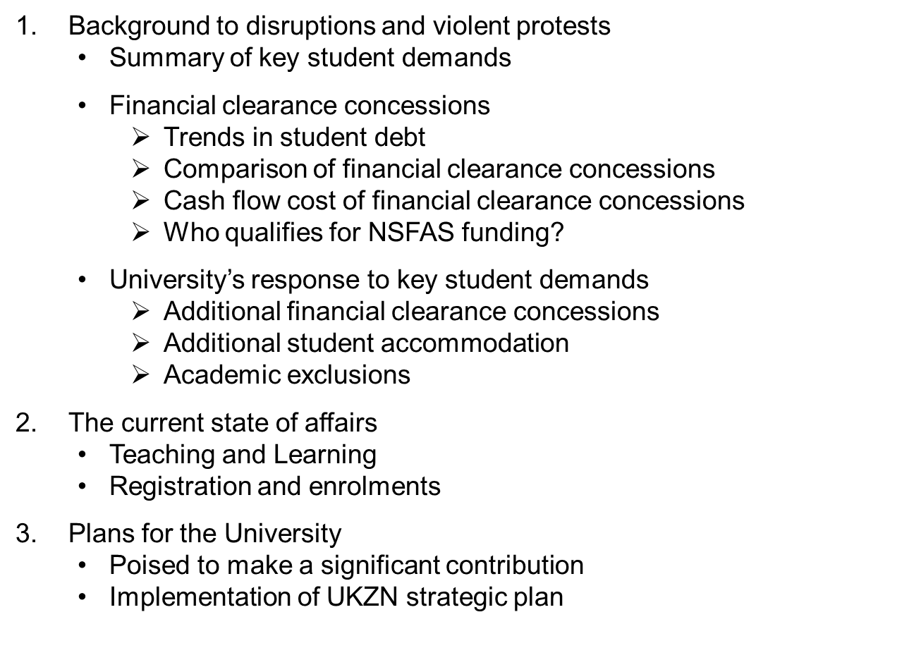
Contents

Slide 4
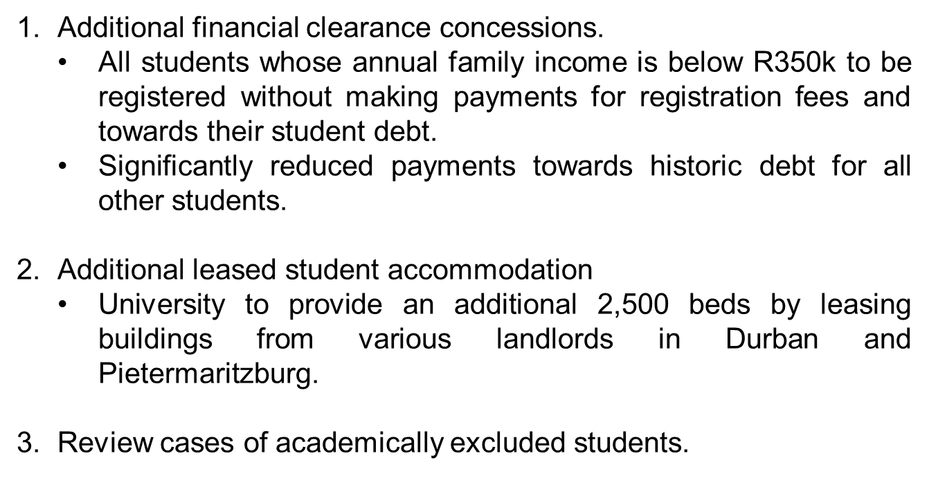
Summary of key student demands

Slide 5
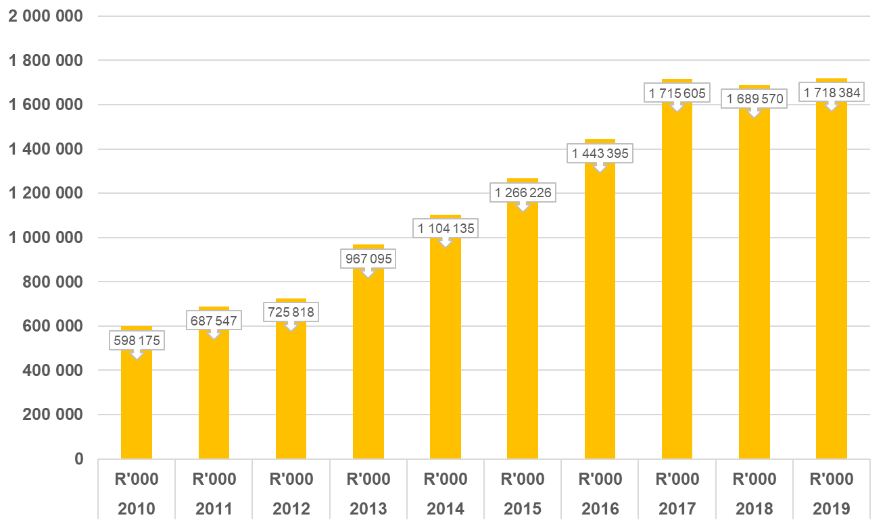
Financial clearance concessions Trends in student debt

Slide 6
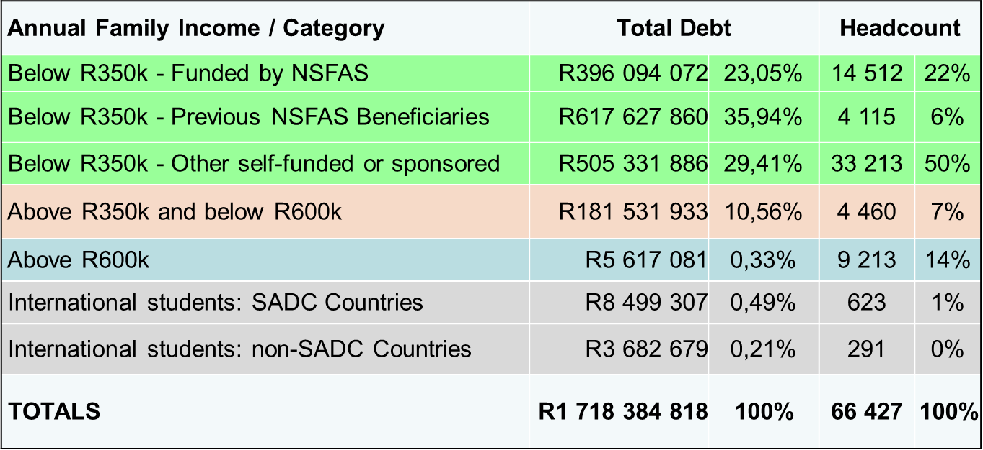
Analysis of student debt as at 31 December 2019

Slide 7
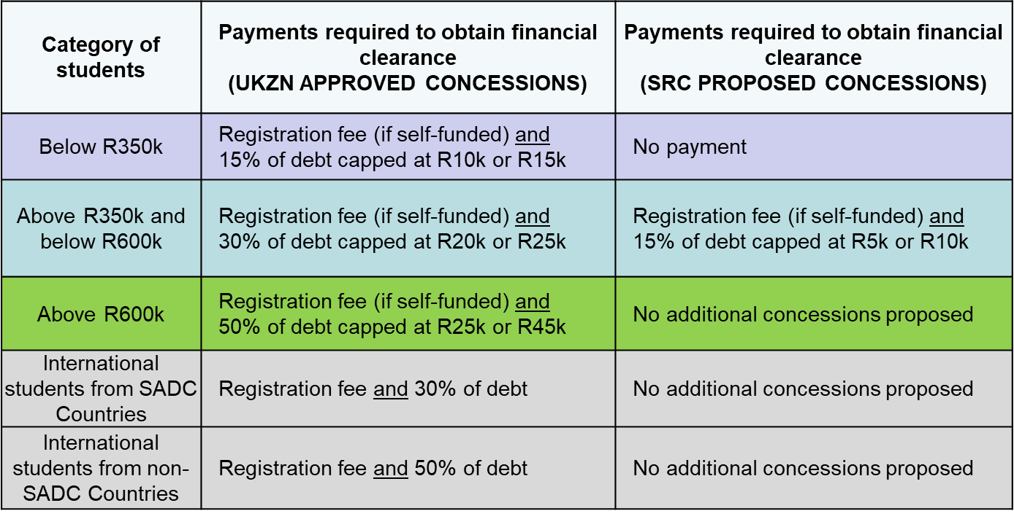
Financial clearance concessions Comparisons

Slide 8
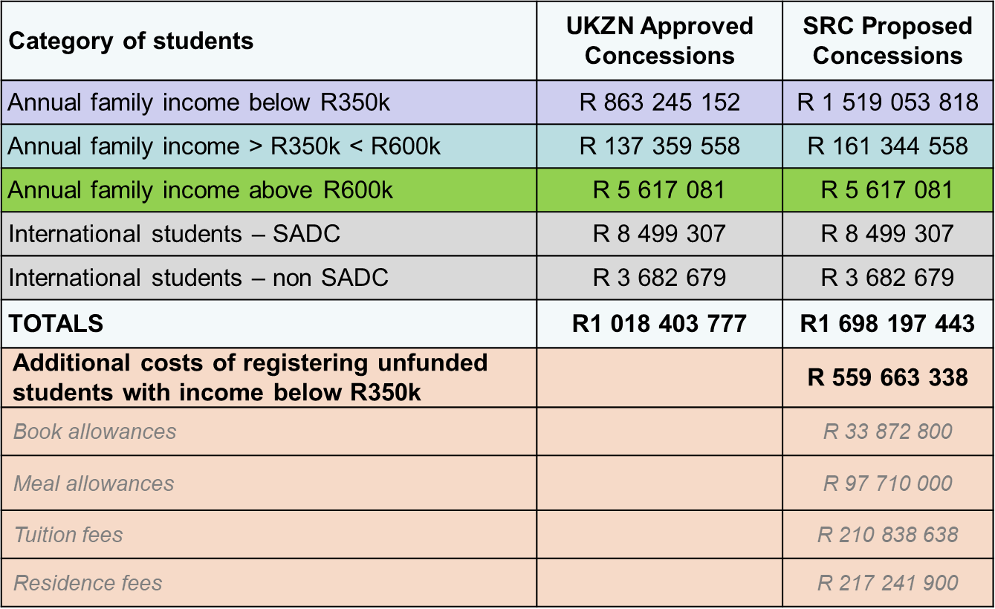
Financial clearance concessions Cash flow cost

Slide 9
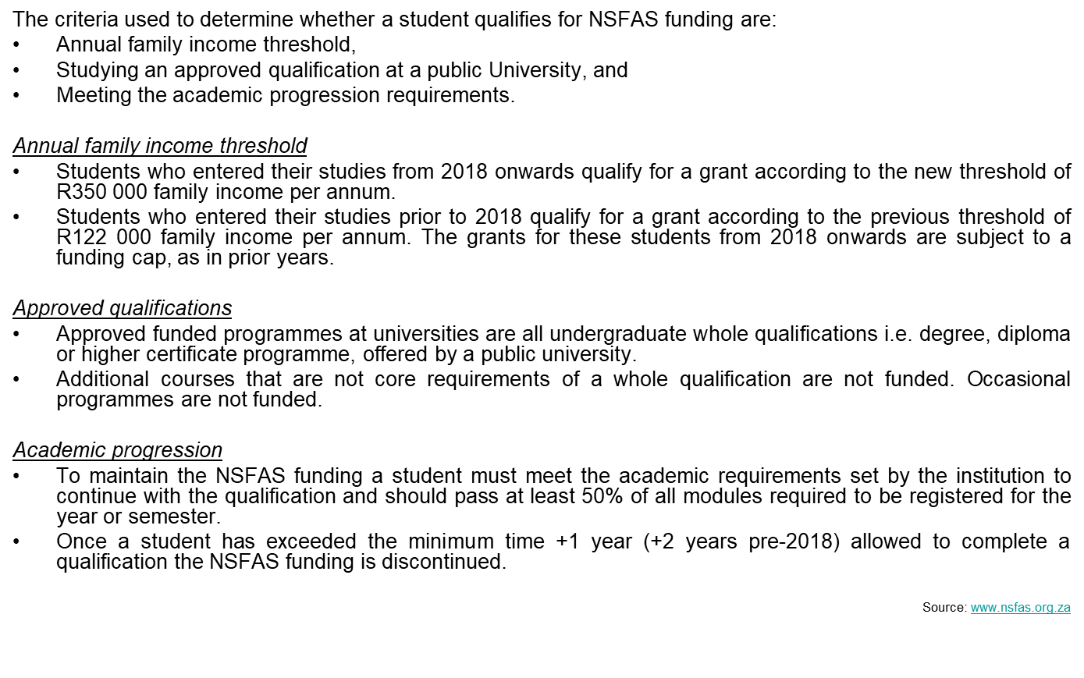
Financial clearance concessions Who qualifies for NSFAS funding?
Notes:
What is important to note is that having an annual family income below R350k does not necessarily mean that a student qualifies for NSFAS funding.
As a result, the University system has numerous students who fall under the R350k annual family income threshold who do not qualify for NSFAS funding and/or have accumulated student debt.

Slide 10
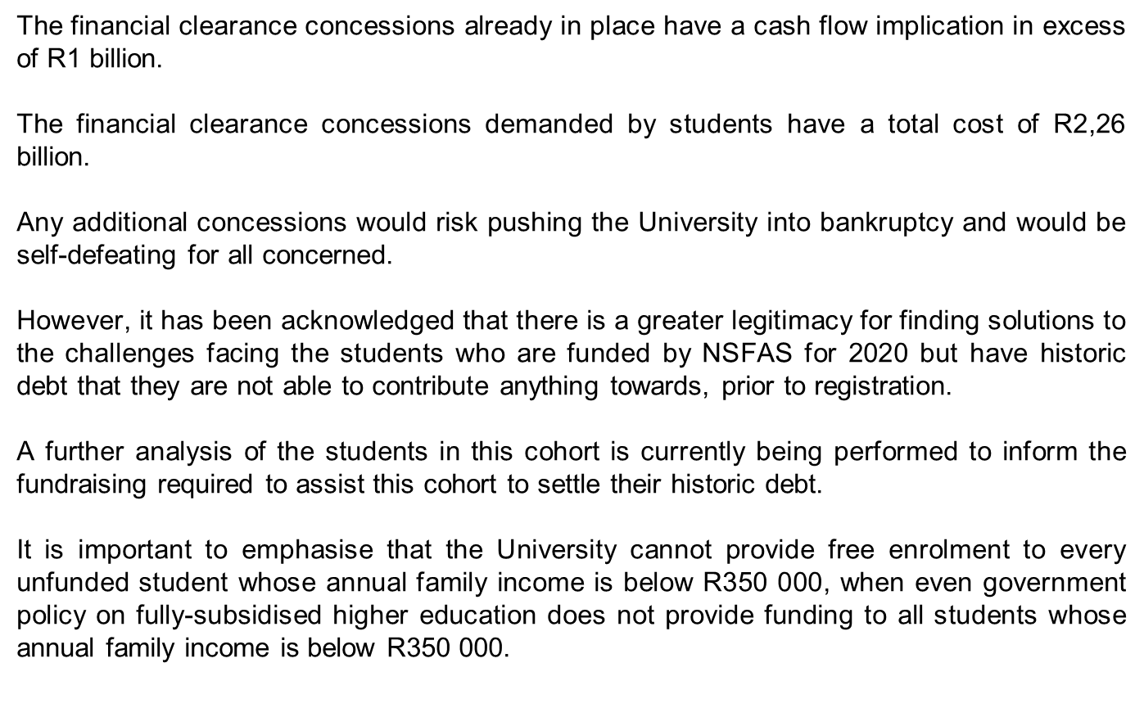
Financial clearance concessions – summary University response

Slide 11
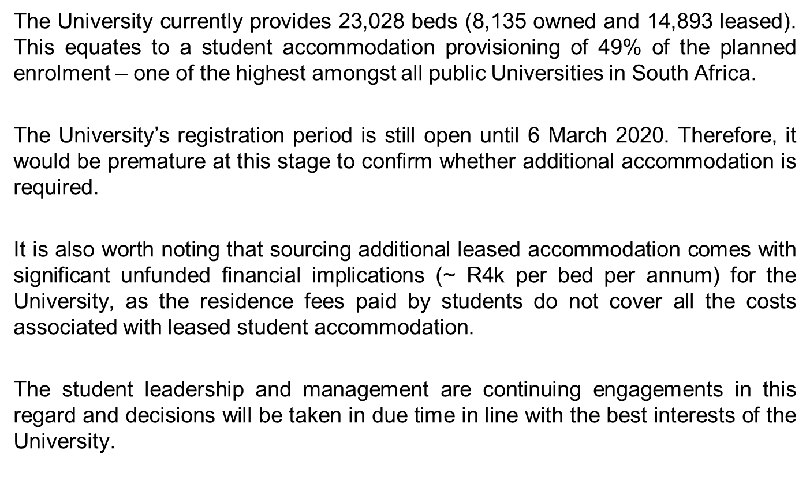
Additional student accommodation – summary University response

Slide 12
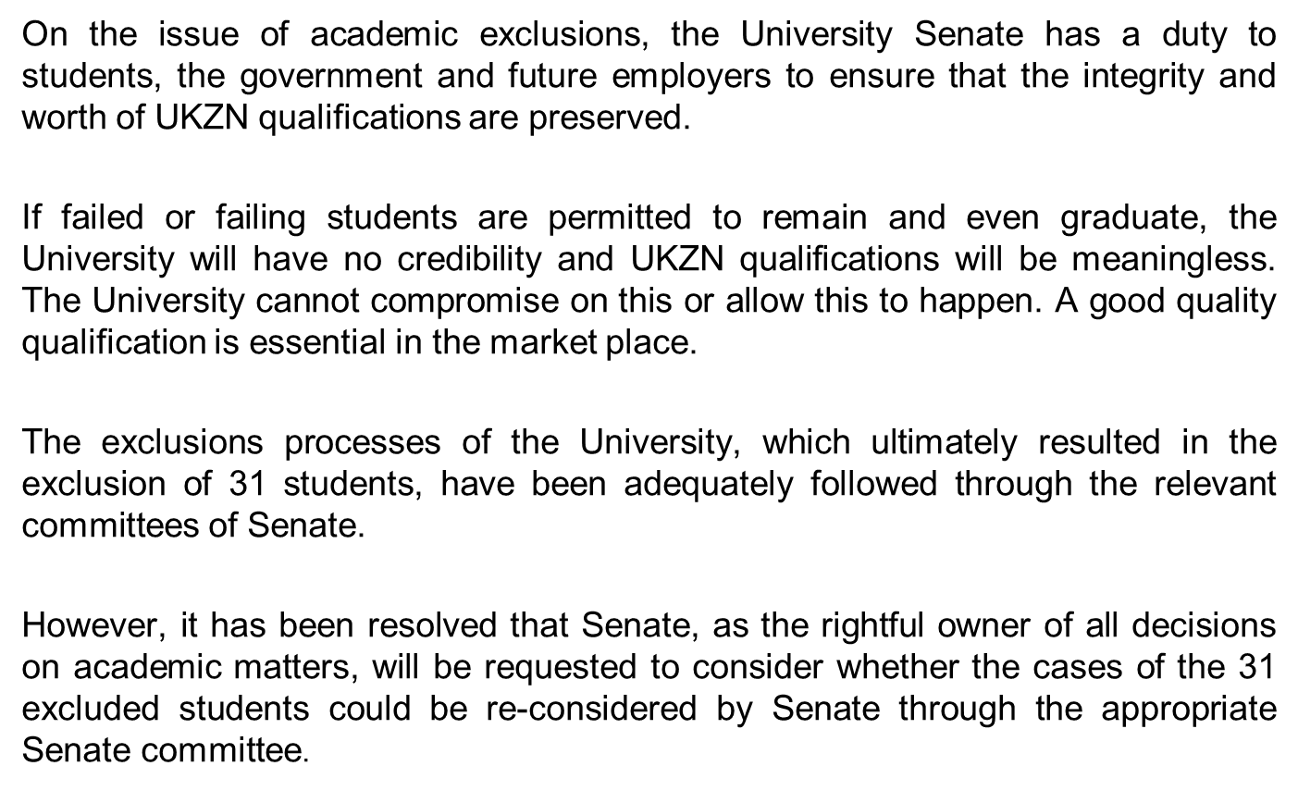
Academic exclusions – summary University response

Slide 14
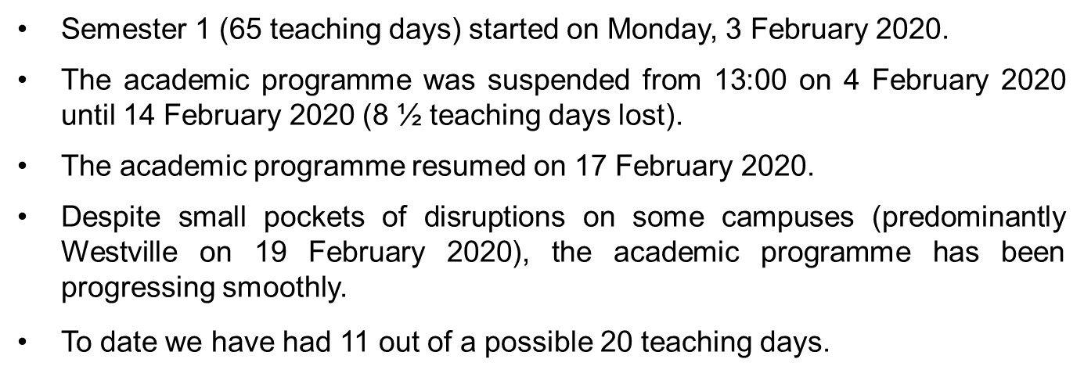
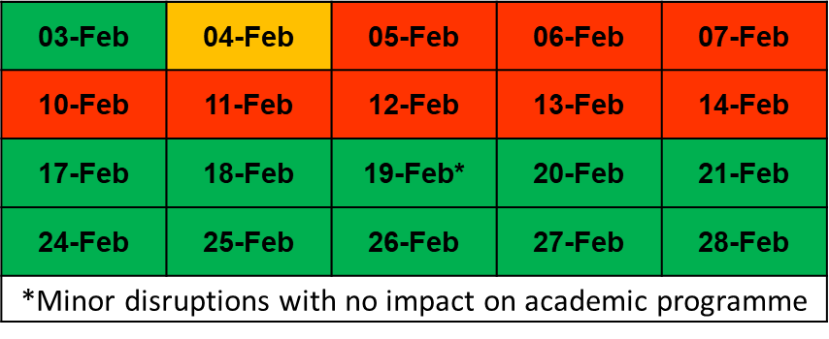
Teaching and Learning

Slide 15
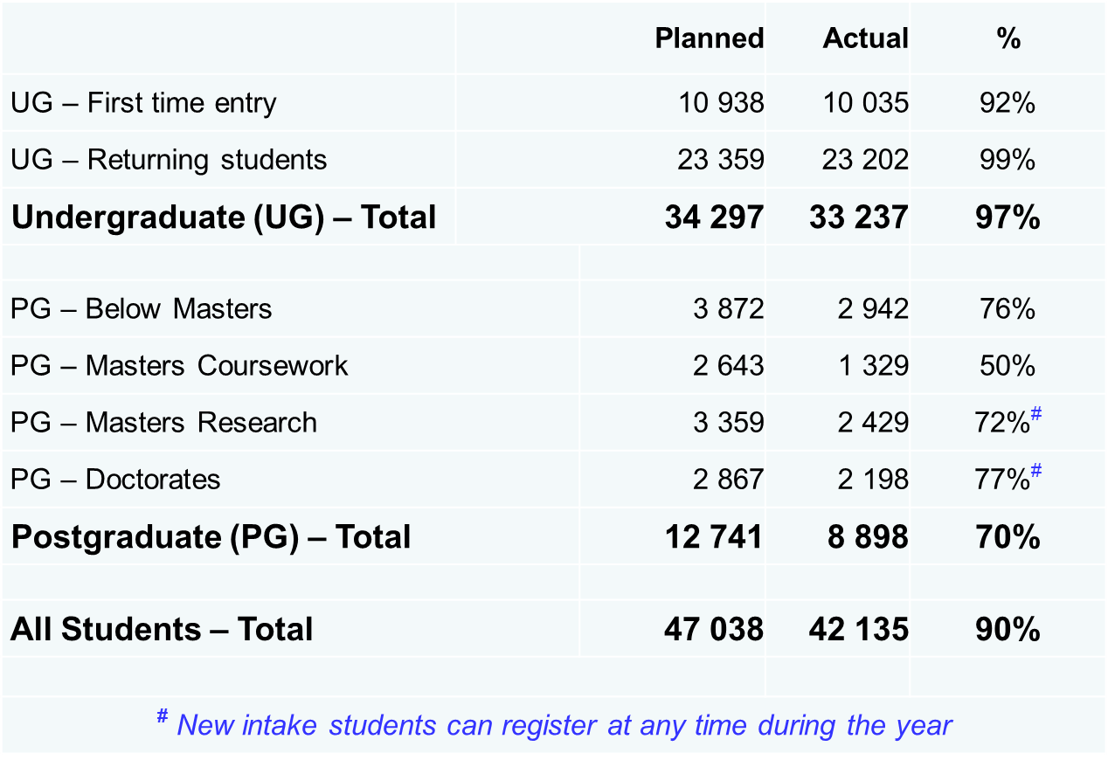
Registration and enrollments as at 1 March 2020

Slide 17
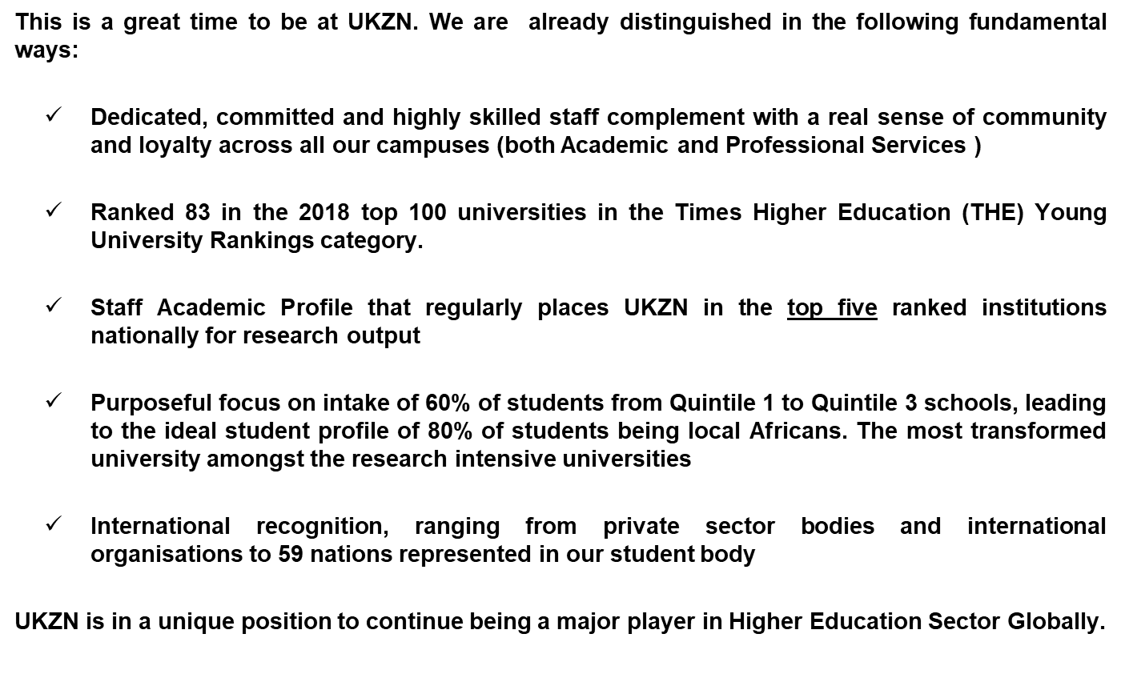
UKZN: Poised to make a HUGE Contribution

Slide 18
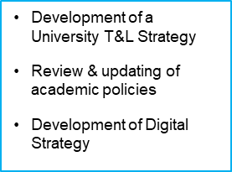
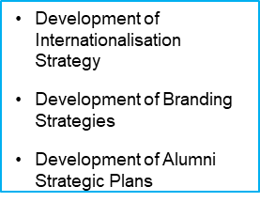
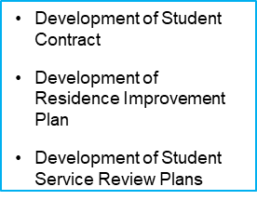
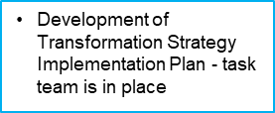
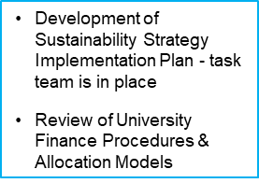
Implementation of the Strategy
Aspiration
Action
Teaching & Learning
Research
Internationalisation
Student Contract
Transformation
Sustainability
People

