Slide 1

Contents
Department of Science and Innovation Brief on Energy Security
26 February 2020
Chapter 01
Chapter 01
Chapter 01
Chapter 01
Chapter 01
Chapter 01
Chapter 01

Slide 2
Energy Landscape in South Africa
International Energy Agency, DMRE Energy Balances
2

Slide 3
What is Energy Security?
The International Energy Agency defines energy security as the uninterrupted availability of energy sources at an affordable price.
  Short term – Energy security focuses on the ability of the energy system to react promptly to sudden changes in the supply-demand balance
  Long term – Energy security mainly deals with timely investments to supply energy in line with economic development and environmental needs.
  DSI portfolio focuses on mainly energy security for South Africa in the long term.
3

Slide 4
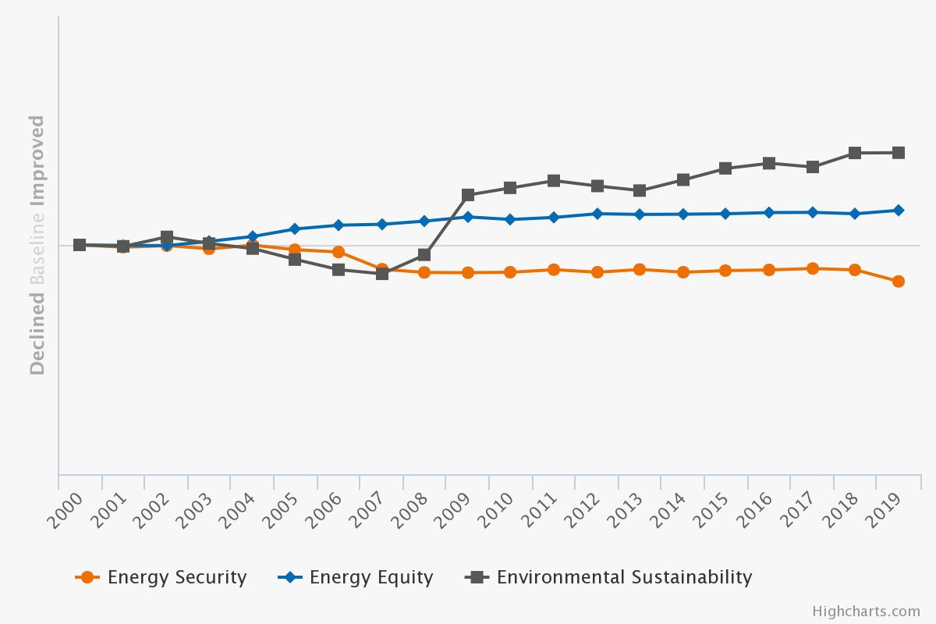
Energy Landscape in South Africa
World Energy Council, 2019 Energy Trilemma Analysis Report
4

Slide 5
Energy Equity - Informal Dwellings
Source: General Household Survey, 2018 Statistics South Africa

Slide 6
Energy Equity - Informal Dwellings
Source: General Household Survey, 2018 Statistics South Africa

Slide 7
Energy Equity - Informal Dwellings
Source: General Household Survey, 2018 Statistics South Africa

Slide 8
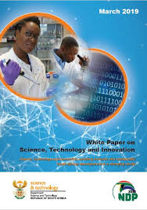
White Paper on Science Technology and Innovation
Fully-fledged Department of Science and Innovation (DSI) with the mandate of a:
  Responsive, coordinated and efficient National System of Innovation
  Human capital development for science
  Increased knowledge generation
  Using knowledge for economic and inclusive development
  Innovation for a capable state
March 2019 New White Paper on Science,
Technology and Innovation

Slide 9
New Department of Science and Innovation mandate
Emerging Science & Technology
Mature Science & Technology
Routine Science & Technology
Department of Science and Innovation
(DSI)
DSI
&
Lead
Departments
Lead
departments
New mandate of the new Department of Science and Innovation: Addition of the innovation function.
Decadal Plan to give expression for the stronger systemic coordination role assigned to the DSI by the White Paper.
9

Slide 10
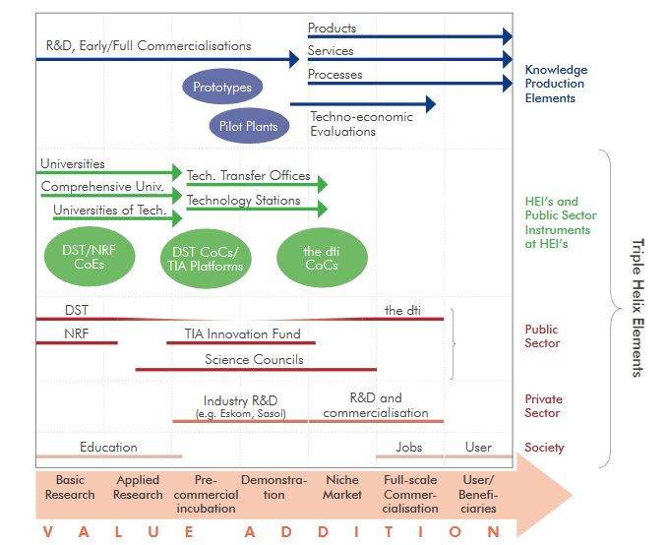
National System of Innovation
DSI/NRF CoEs
DSI &DMRE
CoCs
The dtic
CoCs
DSI
DMRE
The dtic
Sovereign Innovation Fund
10

Slide 11
Funding for Energy Grand Challenge Implementation
Source: DST&DSI Annual Performance Reports 2008 - 2019
11

Slide 12
Transforming the profile of the researcher – Energy Grand Challenge Implementation
Source: DST&DSI Annual Performance Reports 2008 - 2019
12

Slide 13
Knowledge Outputs from 2008 - 2019 – Energy Grand Challenge Implementation
Source: DST&DSI Annual Performance Reports 2008 - 2019
13

Slide 14
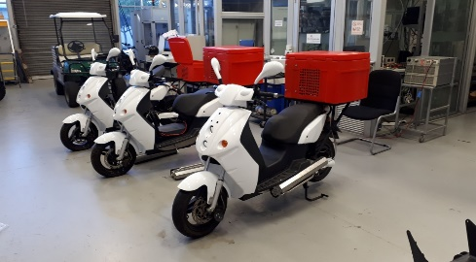
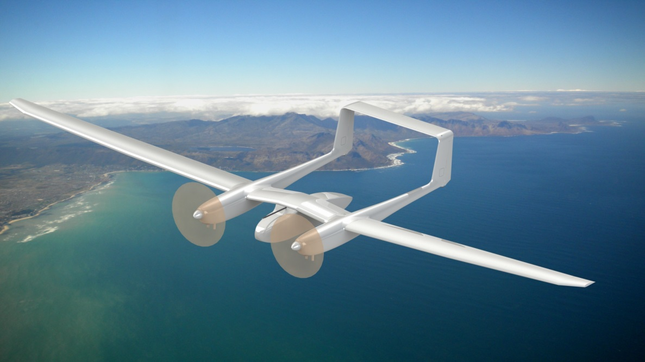
Revistalising the role of SOEs in innovation
Eskom
South African Post Office
Transnet/Denel
The Biomass Action Plan Electricity in South Africa (BAPESA) is a process involving Eskom and other stakeholders that used the Bioenergy Atlas to inform the decision to locate a biomass fired power plant in Nelspruit.
Hydrogen Fuel Cell scooters
Bioenergy Atlas
Limited range of electric scooters impacting on productivity
Fuel cells used to extend the driving range from 70 km to 200km per charge
Pilot to support implementation of Green Transport Strategy
Piloting of hydrogen fuel cell UAV in support of Transnet and Denel to assist with surveillance of the railway line and trains that take high grade coal from Ermelo to Richards Bay. in support Transnet and Denel to assist with surveillance o to Richards Bay
Hydrogen Fuel Cell Unmanned Aerial Vehicles (UAV)

Slide 15
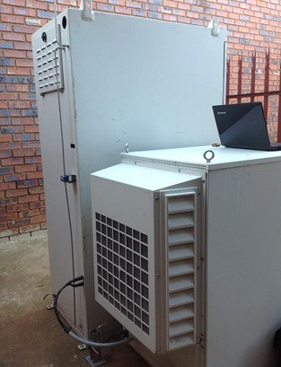
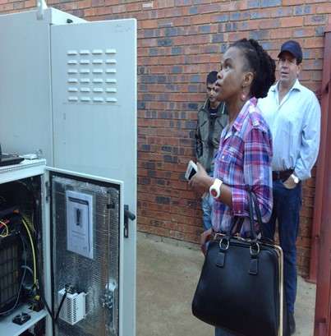
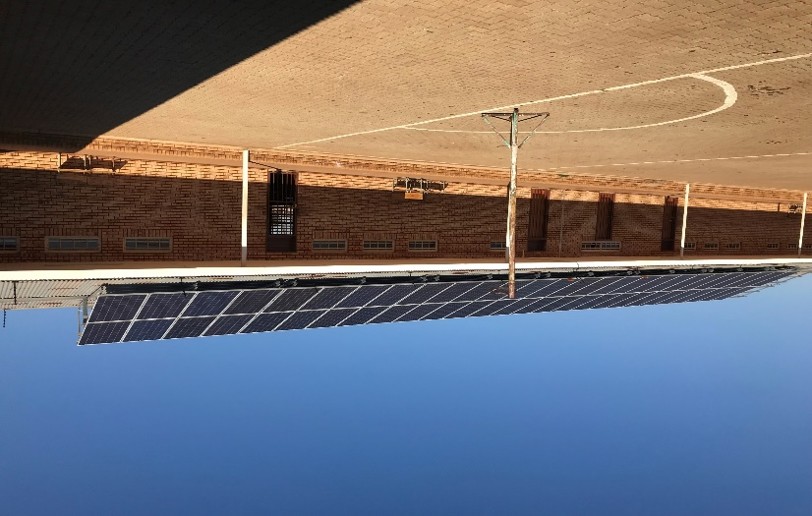
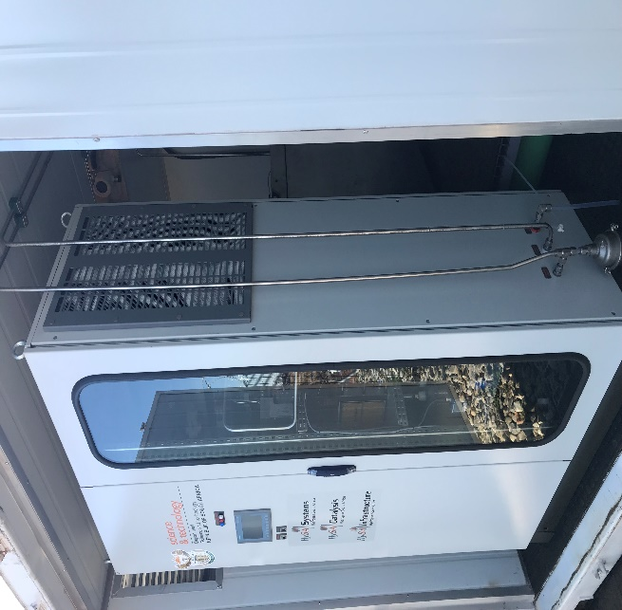
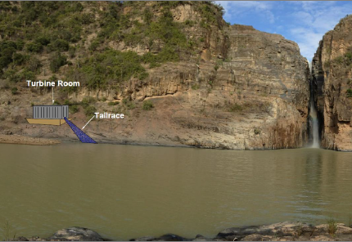
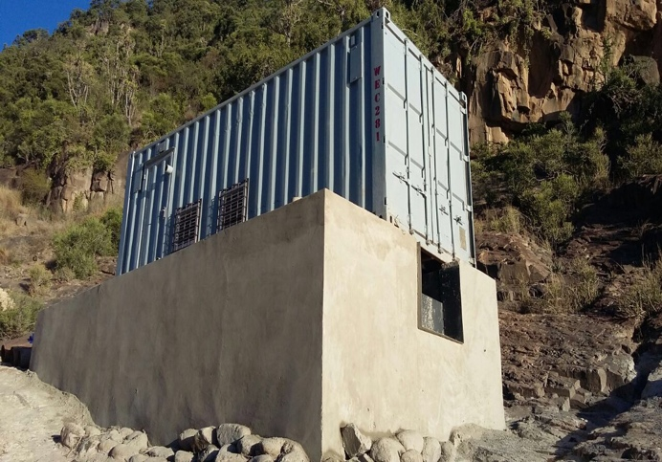
Strengthening government’s role as an enabler for innovation
Gauteng, Randburg
North West, Ventersdorp
Eastern Cape, KwaMadiba
Fuel cell provides back up power to vaccine fridges during rolling blackouts
Clinic serves 2000 patients a month
Other regional clinics store vaccines at the Randburg clinic
Fuel cell used for primary power for ICT equipment, lighting and electrical appliances
Improved quality of education as the school is able to afford the electricity bill
54 households without electricity were provided with power from hydro turbine
Opportunity to connect the electrical supply to pump water for the irrigation of crops and develop Thina Falls as a tourist attraction
Urban Clinic
Rural Secondary School
Rural community

Slide 16
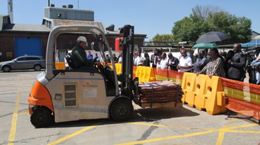
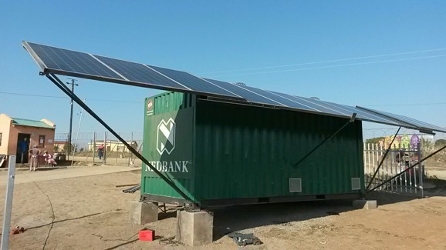
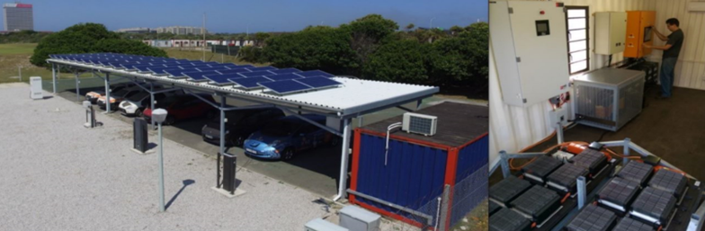
Targeted technology development and deployment to support firms
Impala Platinum
Nedbank
Volkswagen, BMW, Nissan
Fuel cell powered forklift
Hydrogen refueling infrastructure
Increase in productivity due to reduced refueling time
Improved air quality
SolarTurtle deployed to service the under served communities by mitigating Eskom and Telkom disrupted services.
Solar powered bank and wifi connectivity
Battery testing for safety and compliance
Battery integration into vehicle for testing and validation
Vehicle to grid testing
Fuel cells in material handling equipment
Improved access to e-commerce
uYillo Electric Vehicle Testing Facility

Slide 17
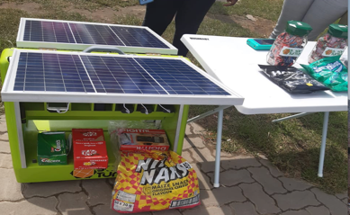
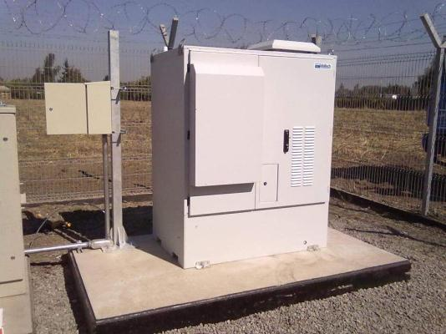
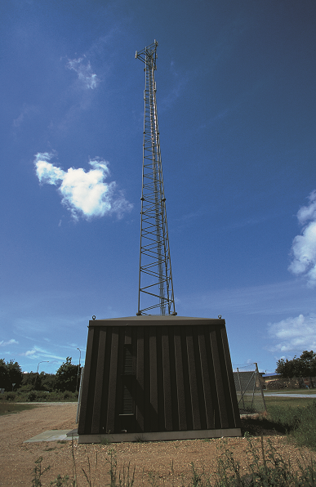
Energy Security in Support of 4IR (Communication)
MTN
South African Mini Industry Development (SAMID)
Ndwedwe local municipality
Fuel cells provide primary or backup power for telecoms base stations
Mitigation against battery and diesel theft
Allow for off grid deployment.
MoU signed between SolarTurtle and SAMID to support informal traders to pilot BabyTurtle (solar charging and wifi hotspots)
Fuel cells deployed to provide immediate access to communication
Fuel cells for powering telecommunications infrastructure
Baby Turtle deployed to support modernization the informal economy
In support of rural electrification also to speed up access to communication (cell phone charging, radio, television, lighting)

Slide 18
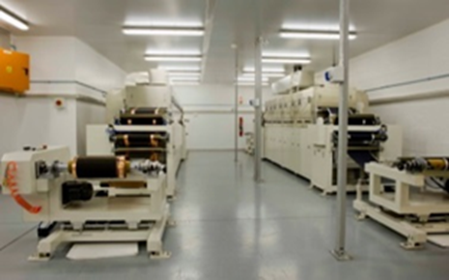
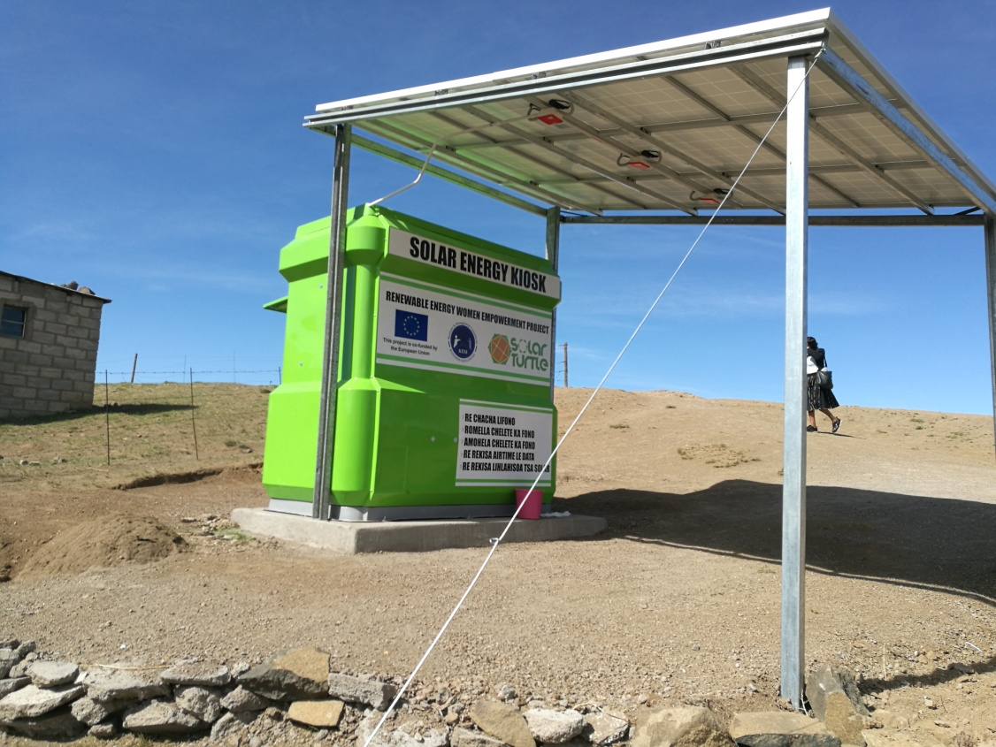
Energy Security – International Partnerships
South Africa - Germany
EU-SADC
South Africa - Japan
LoCoNiFe Battery Project was established to develop low – cost – battery consisting of a Fe anode an Ni cathode
Partnership between DSI, UWC, ESKOM, German Government, Fraunhofer, two SMMEs (Connect'd Energy and Volterion)
Ten (10) solar energy kiosks to support women and youth entrepreneurs in Lesotho
Example of South African innovation deployed in the SADC region
Science & Technology Research Partnership for Sustainable Development (SATREPS) project. Project using waste water from wastewater treatment facility to cultivate microalgae to then produce biofuels. Partnerships: eTheKwini Metropolitan Municipality, Agricultural Research Council, Durban University of Technology , Nagoya University, Tokyo University of Agriculture & Technology
Low Cost Nickel Iron (LoCoNiFe) Battery
Solar Power
Waste to Energy

Slide 19
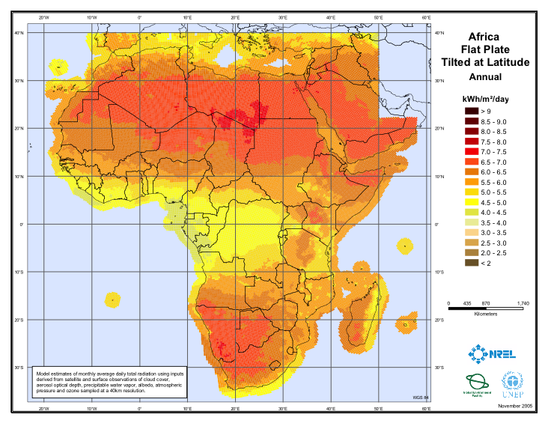
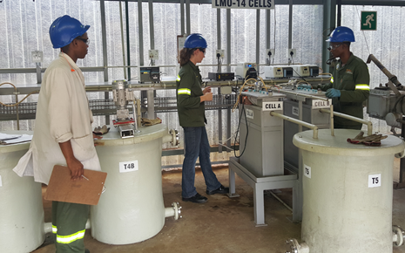
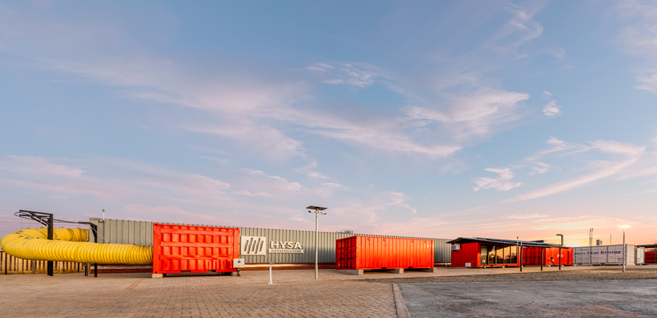
Energy Security – Research Infrastructure
Solar Research Facility
Manganese Precursor Battery Facility
Clean Mining Facility
Improving balance of payments (possibly reduce import of crude oil & natural gas), security of supply (indigenous source of hydrogen) and opportunities for export of hydrogen produced from solar.
Manganese beneficiation for lithium ion battery materials
Development of lithium manganese oxide & lithium nickel manganese cobalt precursors
Export of value added precursor materials.
Facility used to test the use of fuel cells and safe use of hydrogen underground
Hydrogen fuel cells have the potential to displace diesel powered equipment and improve health & working conditions for underground miners.
National Research Facility
University of Limpopo
North West University

Slide 20
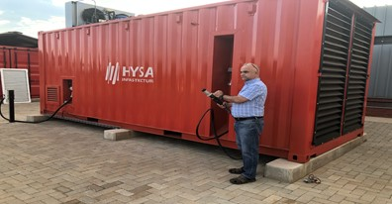
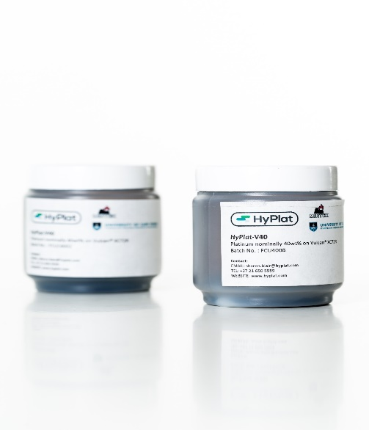
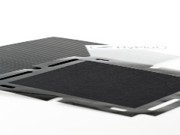
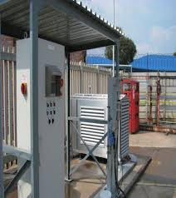
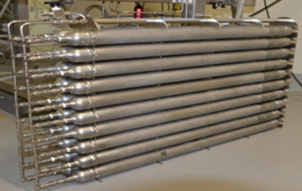
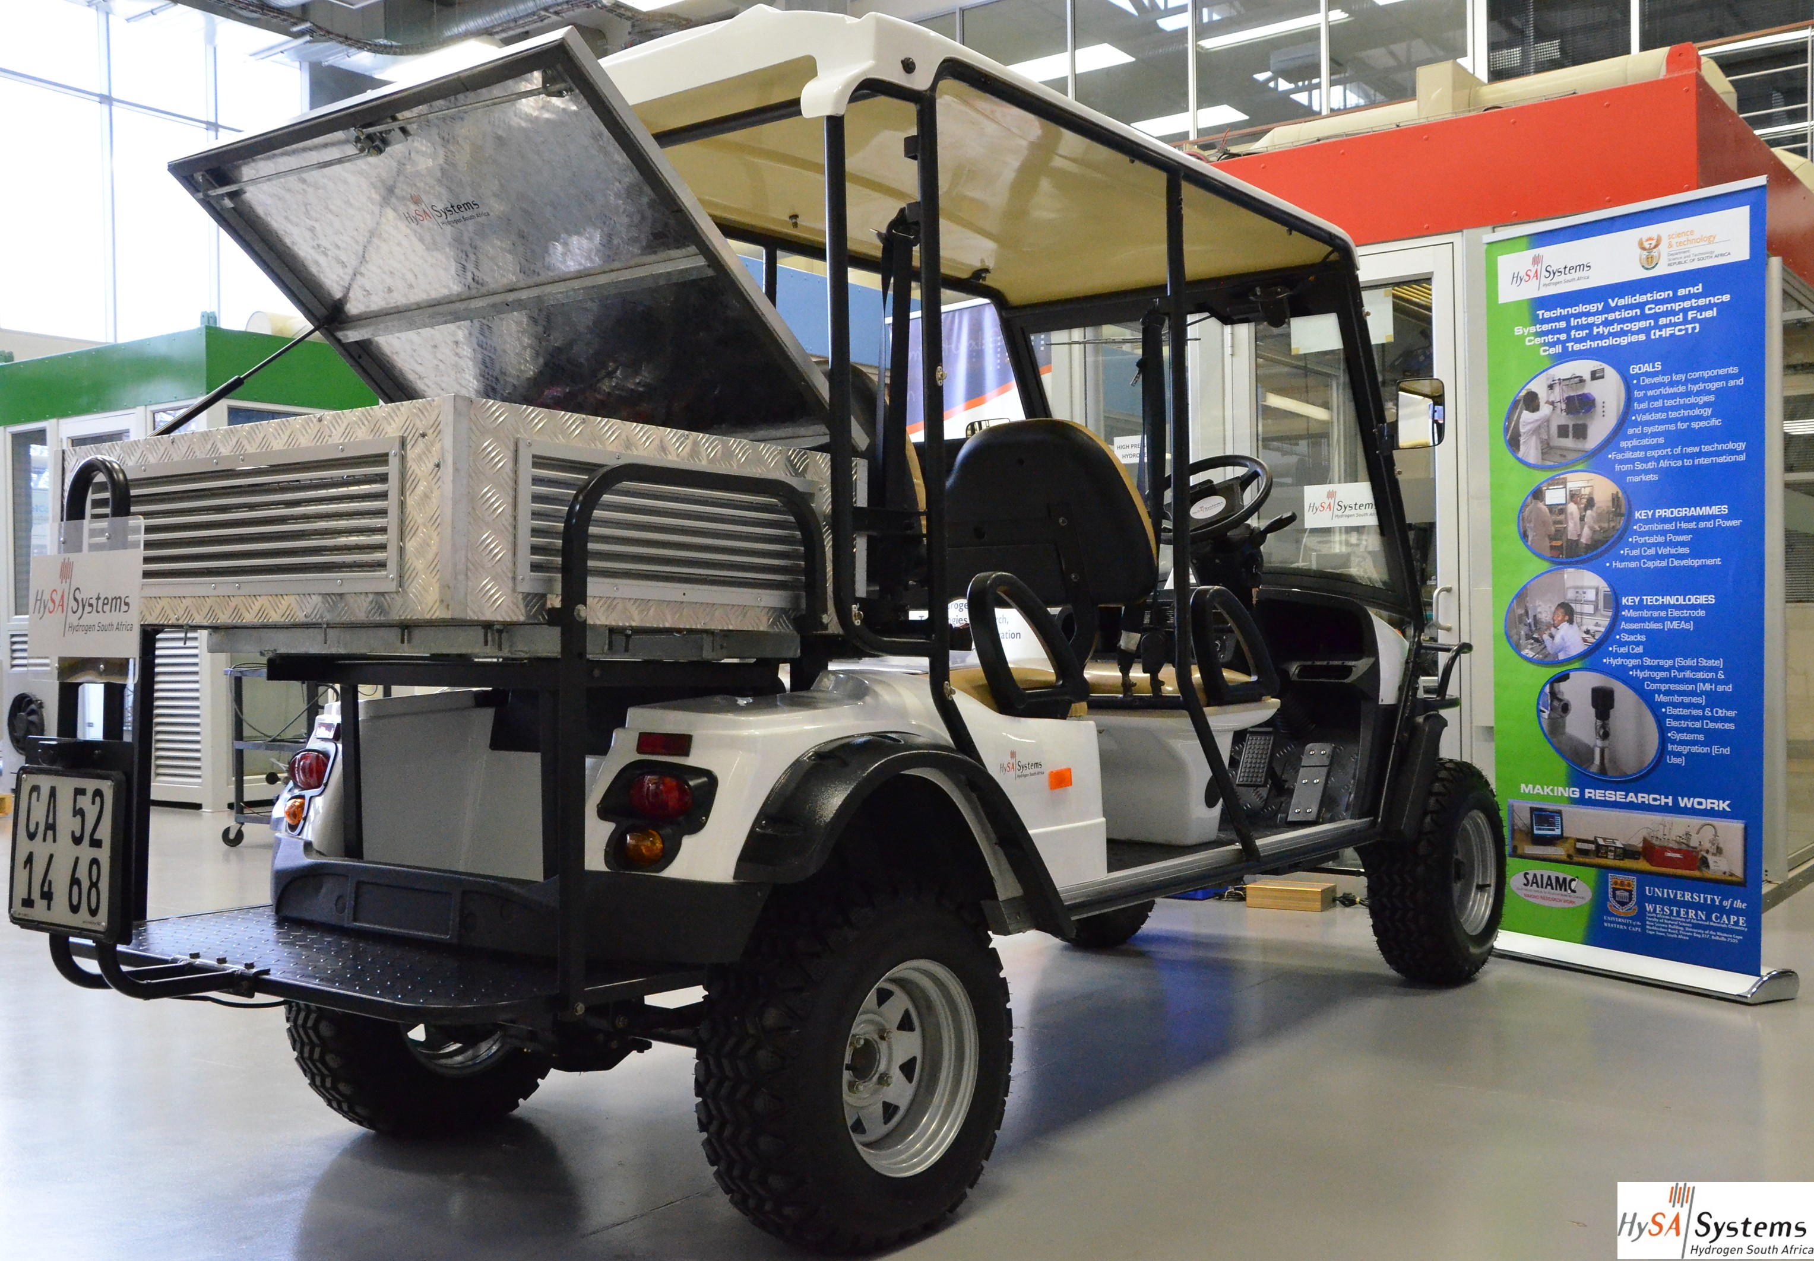
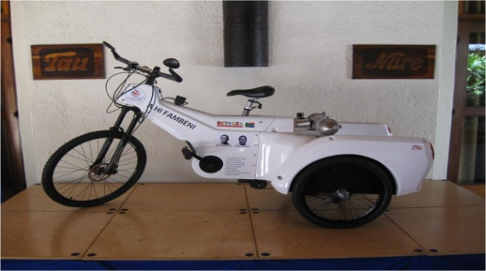
Hydrogen South Africa Implementation at a Glance
2019 Review of Second Five -Year Phase and start of the third Phase
2018 HySA developed fuel cell unit launched to power a rural school
2018 Commercial sales of catalysts and membrane electrode assemblies
2017 Competitive funding introduced to encourage private sector participation
2016 Independent Review of the HySA Technology Portfolio
2015 Development of prototypes for targeted niche applications; golf carts, forklifts
2014 Review of the First Five Years of HySA Programme & streamlining RDI scope
2013 Appointment of the HySA Advisory Board, comprising local and international experts
2009 Establishment of the HySA Centres of Competence and commencement of RDI activities
2008 Formal launch of the Hydrogen South Africa Strategy by the Minister of Science and Technology
2007 Cabinet approves the National Hydrogen South Africa (HySA) RDI Strategy

Slide 21
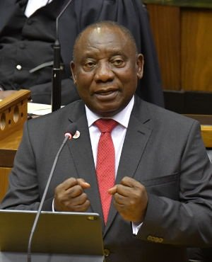
Hydrogen Economy Government Commitment
  President Rampaphosa reaffirmed his commitment to the Hydrogen Economy
“We must increase the contribution of renewable and clean energy to our national energy mix and explore the potential of the hydrogen economy”.
President Cyril Ramaphosa, State of the Nation Address (SONA), 20 June 2019
  Other Critical Policy Documents:
  Green Transport Strategy 2018
  National Energy Efficiency Strategy – post 2015
  Household Electrification Strategy
  Public Works Green Building Strategy
  The President signed into law the Carbon Tax Act No 15 of 2019, which came into effect on 1 June 2019: https://www.gov.za › publication-2019-carbon-tax-act-26-may-2019
  The Integrated Resource Plan 2019 was released on 18 October 2019
Notes:
Our primary strategic document is the NDP – Vision 2030. This sets the framework for how we can transition towards a knowledge driven low-carbon economy. The New Growth Path identified the Green economy as one of 10 jobs drivers, coupled with the Green Economy Accord, between Government, Business and Labour put in place the foundation for the transition as envisaged in the NDP. The new White Paper on Science, Technology and Innovation emphasizes the role that STI can play in stimulating Economic growth. Minerals beneficiation and a Circular Economy are key pillars of the NDP.

Slide 22
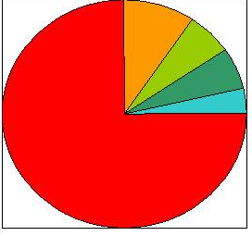

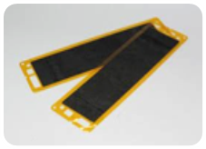
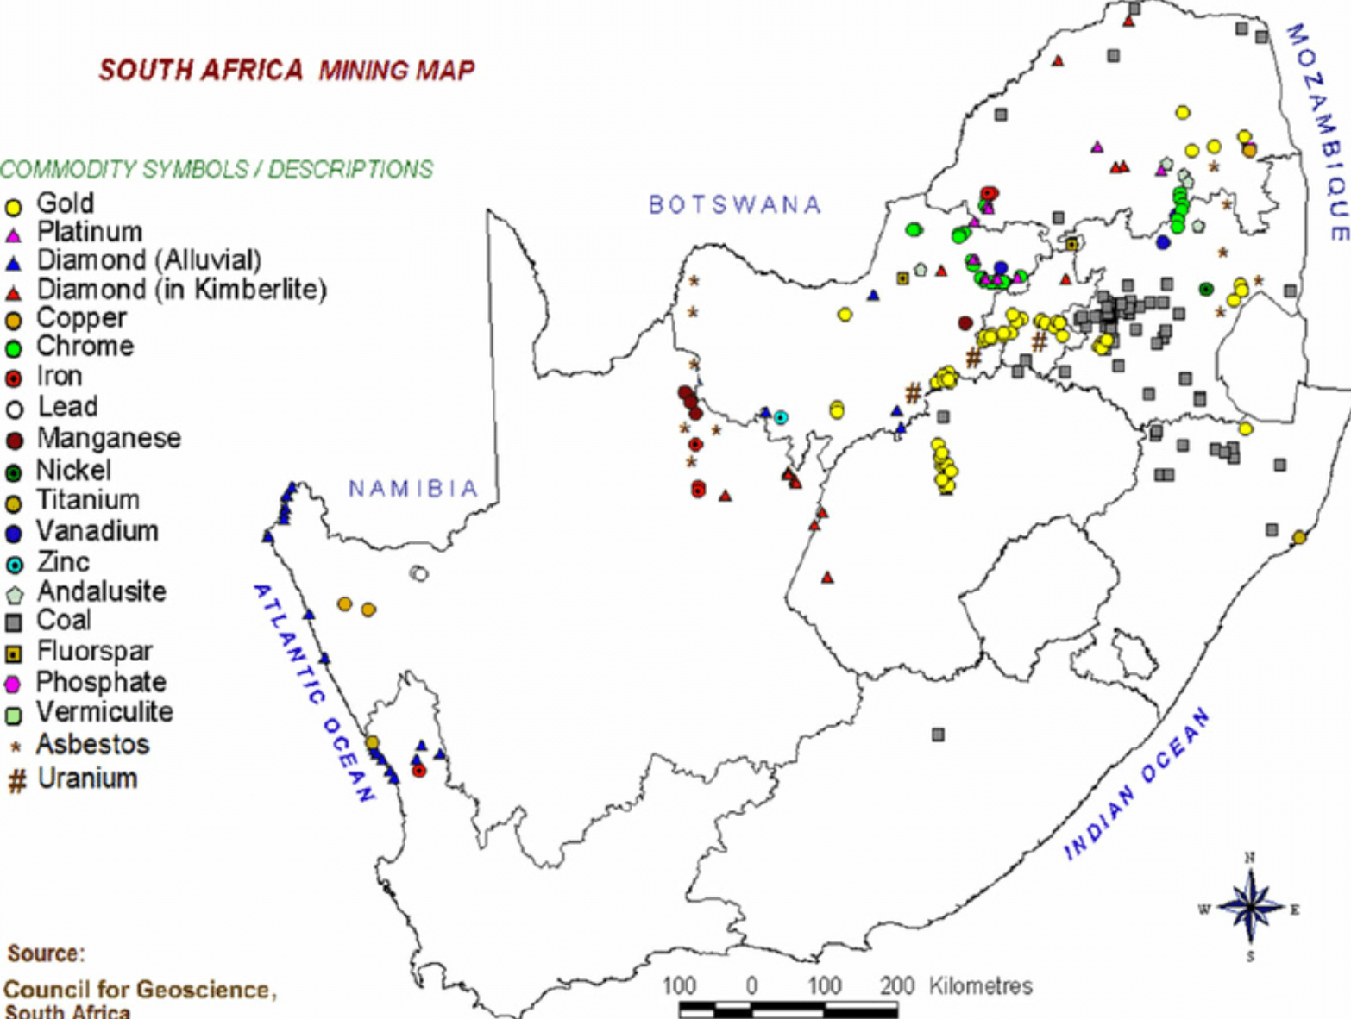
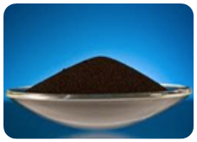
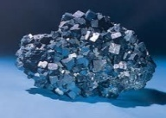
Hydrogen South Africa Value Proposition
World Platinum Reserves
$ 14 400/ounce
Zimbabwe
Finland
Russia
North America
South Africa
STACK
$ 9 500/ounce
BENEFICIATION VALUE CHAIN
MEA
$ 2 170/ounce
Export $958/ounce
CATALYST
South Africa possesses 75% of global Pt reserves
Pt
Notes:
Our primary strategic document is the NDP – Vision 2030. This sets the framework for how we can transition towards a knowledge driven low-carbon economy. The New Growth Path identified the Green economy as one of 10 jobs drivers, coupled with the Green Economy Accord, between Government, Business and Labour put in place the foundation for the transition as envisaged in the NDP. The new White Paper on Science, Technology and Innovation emphasizes the role that STI can play in stimulating Economic growth. Minerals beneficiation and a Circular Economy are key pillars of the NDP.

Slide 23

Hydrogen South Africa Strategic Objectives
Technology catch-up
South African Extension
South African Innovation
2008 - 2013
2013 - 2018
2018 - 2023
  Key Personnel is hired
  Initial markets are identified
  First pre-commercial technologies developed
  Research Infrastructure is set up
  Establish critical supply chain capability
  Deliver first products to market
  Demonstrate capabilities in pilot markets
  Compete successfully on world market
  Capture 25% of Catalyst Demand in Hydrogen and Fuel Cells
  Contribute to international innovation
COMMERCIAL
ACADEMIC & RESEARCH
Notes:
Our primary strategic document is the NDP – Vision 2030. This sets the framework for how we can transition towards a knowledge driven low-carbon economy. The New Growth Path identified the Green economy as one of 10 jobs drivers, coupled with the Green Economy Accord, between Government, Business and Labour put in place the foundation for the transition as envisaged in the NDP. The new White Paper on Science, Technology and Innovation emphasizes the role that STI can play in stimulating Economic growth. Minerals beneficiation and a Circular Economy are key pillars of the NDP.

Slide 24





Hydrogen South Africa Centres of Competence
NWU / CSIR
UCT / Mintek
UWC
Renewable hydrogen storage and infrastructure
Fuel cell and electrolyser subcomponents: catalysts and MEAs
Systems integration and technology validation
Notes:
Our primary strategic document is the NDP – Vision 2030. This sets the framework for how we can transition towards a knowledge driven low-carbon economy. The New Growth Path identified the Green economy as one of 10 jobs drivers, coupled with the Green Economy Accord, between Government, Business and Labour put in place the foundation for the transition as envisaged in the NDP. The new White Paper on Science, Technology and Innovation emphasizes the role that STI can play in stimulating Economic growth. Minerals beneficiation and a Circular Economy are key pillars of the NDP.

Slide 25
South Africa Platinum Valley

Slide 26
South Africa Platinum Valley- OR Tambo Airport

Slide 27
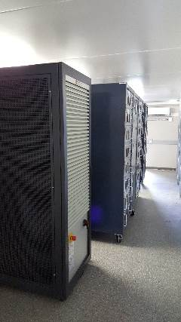

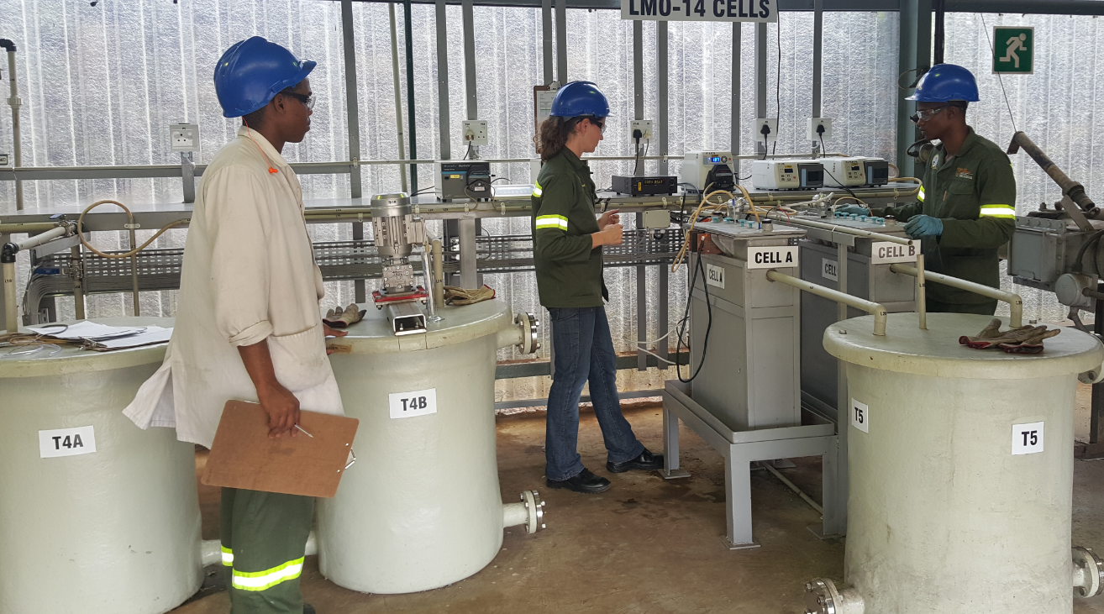
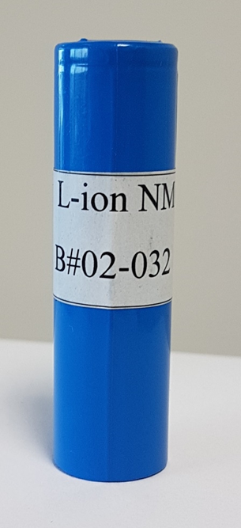
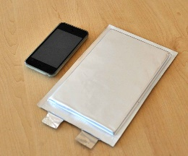
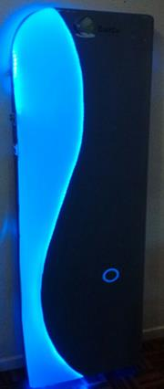

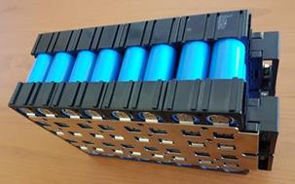
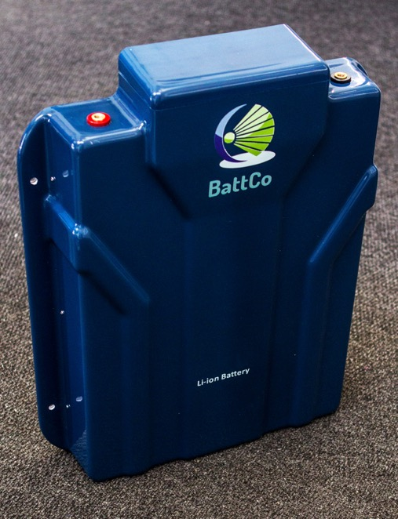
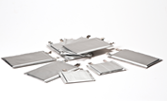
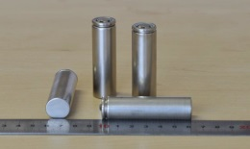
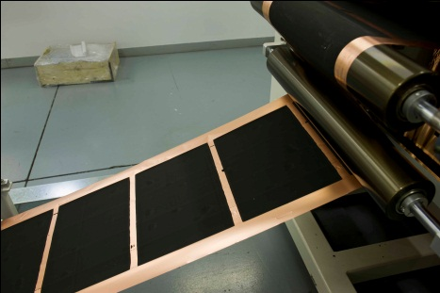
Energy Storage RDI Programme at a Glance
2019 Discussions on formal collaboration with ANL formalised
2019 Development of the Energy Storage RDI roadmap initiated
2018 IDC conducts feasibility studies on precursor manufacturing in SA
2017 Minister Pandor launches the LMO and NMC precursor pilot facility
2016 Energy Storage RDI is expanded to include electrolyte development and NMC precursor material
2015 DST acquires the IP and LMO precursor development pilot facility from EMD
2015 Second international battery conference held in KwaMaritane with ANL team
2015 Lithium Ion battery Programme is incorporated into the Energy Storage RDI
2013 Lithium Ion cell manufacturing pilot facility at University of the Western Cape
2012 First International Battery Conference held at the Kruger National Park
2011 Start of the Lithium Ion Battery Key Programme as part of the HySA Programme.

Slide 28
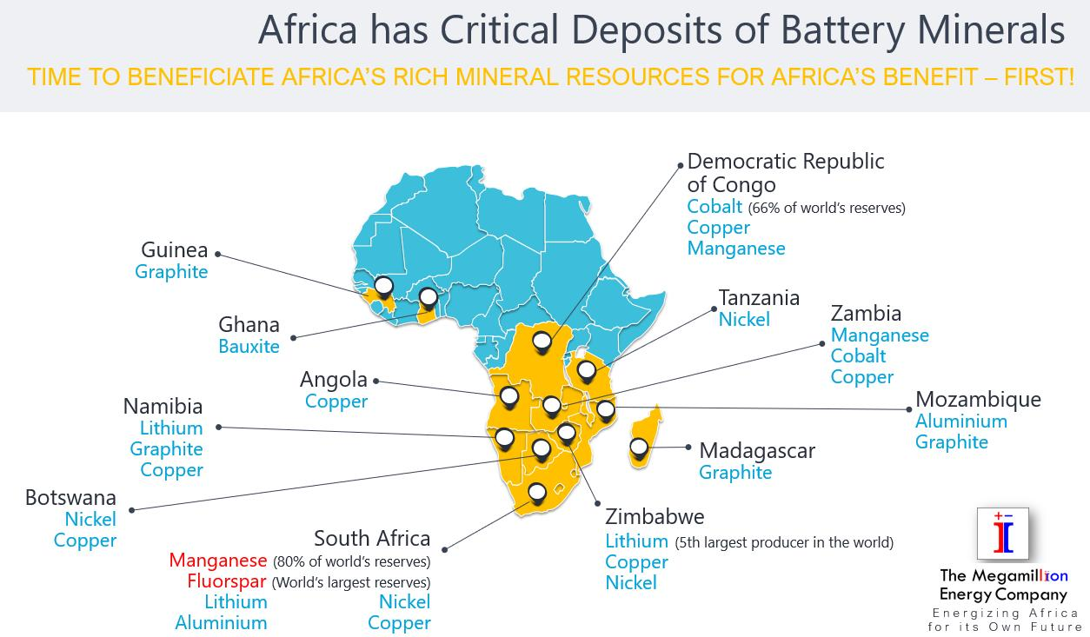
Africa’s Clean Oil
Notes:
Needs Assessment conducted for DSI by GreenCape. It identified 7 key questions that if completed are expected to provide a sufficient knowledge base for the development of evidence-based policies, plans and interventions to embed the CE in South Africa and mitigate risks associated with global CE shifts

Slide 29
Potential LIB Precursor Material Value Chains in the SADC region
Upstream
Downstream
Raw Material Source
Input material
Value added
Precursor Materials
System (Cells,
Modules BMS)
Cobalt
DRC
Cobalt
Sulphate
Nickel Manganese Cobalt
Li-ion Battery
production based on outcome of detailed techno-economic study
Local
Lithium
(Zim, Namibia)
Lithium
Nickel
Sulphate
Lithium Manganese Nickel Oxide
Primary market:
Global
Li-ion
Battery Production
Nickel
SA (Thakadu), Zim, Botswana
Export
SA Manganese (Assoman, Kalakadi)
Manganese Ore
Lithium Manganese Oxide
DRC- Democratic Republic of Congo
SA – South Africa
Zim - Zimbabwe

Slide 30
South Africa is well-endowed with mineral resources
South Africa’s Mineral Reserves, World Ranking, 2009 Production & Nominal Life (assuming no further reserves) at 2009 Extraction Rates
Mineral |  | RESERVES |  |  | PRODUCTION 2009 |  |  | LIFE
 |  | Mass | %World | Rank | Mass | %World | Rank | Years
Alumino-silicates | Mt | 51 | * | * | 0.265 | 60.2 | 1 | 192
Antimony | kt | 350 | 16.7 | 3 | 3 | 1.6 | 3 | 117
Chromium Ore | Mt | 5500 | 72.4 | 1 | 6.762 | * | 1 | 813
Coal | Mt | 30408 | 7.4 | 6 | 250.6 | 3.6 | 7 | 121
Copper | Mt | 13 | 2.4 | 6 | 0.089 | * | * | 146
Fluorspar | Mt | 80 | 17 | 2 | 0.18 | 3.5 | 5 | 444
Gold | t | 6000 | 12.7 | 1 | 197 | 7.8 | 5 | 30
Iron Ore | Mt | 1500 | 0.8 | 13 | 55.4 | 3.5 | 6 | 27
Iron Ore - incl. BC | Mt | 25000 | ~10 | * | 55.4 | 3.5 | 6 | 451
Lead | kt | 3000 | 2.1 | 6 | 49 | 1.2 | 10 | 61
Manganese Ore | Mt | 4000 | 80 | 1 | 4.576 | 17.1 | 2 | 874
Nickel | Mt | 3.7 | 5.2 | 8 | 0.0346 | 2.4 | 12 | 107
PGMs | t | 70000 | 87.7 | 1 | 271 | 58.7 | 1 | 258
Phosphate Rock | Mt | 2500 | 5.3 | 4 | 2.237 | 1.4 | 11 | 1118
Titanium Minerals | Mt | 71 | 9.8 | 2 | 1.1 | 19.2 | 2 | 65
Titanium- incl. BC | Mt | 400 | 65 | 1 | 1.1 | 19.2 | 2 | 364
Uranium | kt | 435 | 8 | 4 | 0.623 | 1.3 | 10 | 698
Vanadium | kt | 12000 | 32 | 2 | 11.6 | 25.4 | 1 | 1034
Vermiculite | Mt | 80 | 40 | 2 | 0.1943 | 35 | 1 | 412
Zinc | Mt | 15 | 3.3 | 8 | 0.029 | 0.2 | 25 | 517
Zirconium | Mt | 14 | 25 | 2 | 0.395 | 32 | 2 | 35
Source: SAMI 2009/2010, DMR 2010; and Wilson & Anhaeusser 1998: “The Mineral Resources of South Africa”, CGS Pretoria (for BC- Bushveld Complex)
Notes:
Check Ti & P figures

Slide 31
Energy Storage Value Proposition
ES RDI Strategy
Develop high quality precursor materials for lithium ion batteries based on SA manganese resources
Develop local skills to beneficiate manganese for the energy storage and electric vehicle markets
Promote equity and inclusion in the economic benefits of South Africa’s resources
$10 000/tonne
NMC
622 - several
352 - ANL
271- BASF
BENEFICIATION VALUE CHAIN
$2000/tonne
LMO
South Africa possesses significant amounts of high grade Mn reserves
Export $100/tonne
Mn ore
31

Slide 32
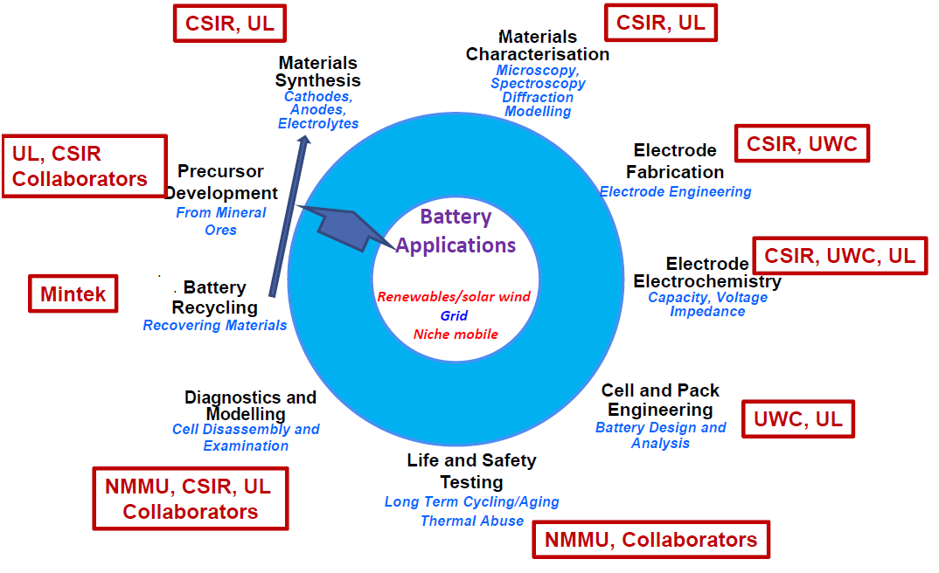
Energy Storage Consortium Members
UL, Necsa, CSIR
NMU, CSIR, UL
NMU, Collaborators
32

Slide 33
Lithium Ion Battery Development: Focus areas
Focus Area & Institution | Objective
Development of Manganese based precursor materials (University of Limpopo) | Development of cost effective and globally competitive manganese precursors for the energy storage and electric vehicle market. Main materials: Lithium manganese oxide (LMO) Nickel manganese cobalt (NMC) in various chemistries
Materials modelling (University of Limpopo) | Use of large scale simulations to predict vital properties of electrode materials and their interactions
Electrode materials (CSIR) | High performance precursor materials for the cathode and anode for Li-ion batteries
Advanced batteries (University of the Witwatersrand) | Development of advanced battery chemistries as well as solid electrolytes
Nuclear Energy Corporation of South Africa (NECSA) | Fluorination of precursor materials & development of liquid electrolytes
Cell & Module production (University of the Western Cape) | Use locally developed materials to make Li-ion battery cells and modules for mobility and stationary energy storage markets
Battery Testing (Nelson Mandela University) | Testing of Li-ion battery cells and modules for mobility and stationary energy storage markets with a focus on safety and compliance
Mintek | Investigation of battery recycling to recover valuable mineral components, study on availability of key battery minerals in the SADC

Slide 34
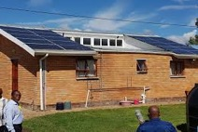
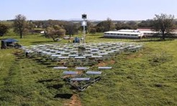
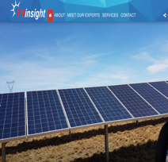


RE Hub and Spokes Programme Implementation at a Glance
2019 Solar powered water desalinating unit deployed
PV Insight spin out company
2017 PV Insight spin out company established
2016 Renewable Energy Development Zones (GeoSun assessment)
2015 Helio 100 demo facility (solar thermal plant)
2014 Tech 4 RED Cofimvaba solar energy (SolarTurtle prototype)
2014 Adventure Power and SWET supported by the Wind spoke
2012 GeoSun spin out company (solar resource mapping for IPPs)
2011 SARETEC feasibility assessment
2009 Renewable Energy Training for learners (schools)
2009 Solar resource mapping for EXXARO
2008 Solar Water Heating training (Austrian Development Agency)
2008 Renewable Energy Spokes established (Solar PV, Wind & Solar thermal)
2006 Government establish the Renewable Energy (RE) Hub at the University of Stellenbosch

Slide 35

Renewable Power in South Africa
Source: Renewable Energy IPP Office
35

Slide 36
Renewable Power in South Africa
36
Source: Renewable Energy IPP Office

Slide 37
Renewable Energy Hub and Spokes Programme
Hub: The institution that is responsible for project management (coordination, reporting and management of approved funds), performance research, investigate new areas and provide technical consultancy services. The broad focus done at both hub and spokes level includes knowledge generation, human capital development, market transformation and technology develop and deployment.
Spokes:
Solar Thermal (Stellenbosch University and University of Pretoria): Bulk power generation using CSP with a focus on developing thermal systems, ranging from components to plants and including hardware and software. The focus is on solar thermal analysis, cooling system – dry and hybrid, thermal storage, high temp phase change materials and high temperature applications.
Solar Photovoltaic (Nelson Mandela University and University of Fort Hare): Reduce the cost and improve efficiency of photovoltaic (PV) by investigating alternative materials. The focus is on characterization, concentrated PV and late generation PV.
Wind (Stellenbosch University and University of Cape Town): Focus on low wind speed regimes technologies, investigates alternative materials in turbine technology, and develop performance monitoring diagnostic tools.
37

Slide 38
Renewable Energy Hub and Spokes Programme
38

Slide 39
Renewable Energy Hub and Spokes Programme
Policy and Strategic Planning
Systems Integration
Solar thermal
Solar PV
Local Manufacturing
Impact Assessment
Techno- Economic
Assessment
Geo-Spatial Assessment
Distributed Generation
Solar Resource Assessment
Systems Modelling
System analysis (plant level)
Optical
Thermal
Cooling
Electrical
Storage
Materials / Cells
Module & system performance
Electronics
Storage
Value Chain Assessment
Test facilities
Localization
Demo/Pilot
Applications
39

Slide 40

Renewable Energy Hub and Spokes Programme – Solar Resource Mapping
About 30 measuring stations operational and operated by SAWS & Universities
DST funded 13 stations through SAWS in support of national capability development.
40

Slide 41
Renewable Energy Hub and Spokes Programme – Helio 100
Water- Energy Nexus
Water desalination project in the Western Cape commenced in 2018 in order to use high temperature solar desalinate seawater.
Helio 100 was co-funded by the Technology Innovation Agency.
41

Slide 42




Renewable Energy Hub and Spokes Programme – Photo Voltaic intellectual Properaty Pty Ltd
PTIP HISTORY
Established Research Laboratories
Commissioned Production Line TechnoPark
(7200cm²)
Filed International Patents
Transfered R&D Labs to TechnoPark
Singulus Partnership
Constructed Pilot Facilty at UJ
Incorporated PTiP
1993
2010
2012
2007
2013
2005
2004
2003
2002
1995
Fabricated > 10% Devices (1cm²)
Fabricated > 10% Modules (1500cm²) and 16% Devices
International License Awarded to Bosch for local manufacturing in Germany
IDC Shareholding
TIA Funding
42

Slide 43
Renewable Energy Hub and Spokes Programme – Solar Turtle
43

Slide 44
Renewable Energy Hub and Spokes Programme –
PV insight
44

Slide 45
Renewable Energy Hub and Spokes Programme –
Geosun
45

Slide 46


Carbon Capture Storage and Use Programme Implementation at a Glance
2020 Coal CO2 to X Flagship Programme established
2019 DSI joins the National Coordination Committee for Air Pollution in Low-
Income Settlements
2018 Strategy for Addressing Air Pollution in Dense Low-Income Settlements
approved by Cabinet
2015 Coalgae tested by Sasol and Eskom
2012 Coalgae testing facility established at Nelson Mandela University
2008 Biofuels Technology Demonstration Programme established to develop biofuels (non-food crops)
2007 Government approved the Biofuels Industrial Strategy

Slide 47
Advanced Biofuels Programme
Bio-fuels Technology Demonstration Programme
  Funding support for development and demonstration of late generation bio-fuels (non food crops) with an emphasis on coal fines
Focal Area | Objective
Coalgae | Eliminate blending infrastructure - combining of coal discards with algae to form bio-blended fuel sources (currently @ 15% algae).
Bio-crude oil | Produce crude oil from renewable sources - through pyrolysis producing bio-crude oil from algae at laboratory scale.
Coalgae gasification | Leveraging existing refineries – use of cleaner coal in the existing coal/gas to liquid process
47

Slide 48
Coalgae Facility Established
Photo bioreactors – growing micro algae
Coalgae product – mix of coal fines with algae
Department of Environmental Affairs and Forestry
48

Slide 49
Reduction in Carbon Emissions
49

Slide 50
Compliance Limits for Local Pollutants
50

Slide 51
Coal CO2-X Flagship Programme

Slide 52

Coal CO2-X Flagship Programme

Slide 53
















CoalCO2-X: System Level Integration
Deliverables for R80M @ 3 Years
SRL/TRL/IRL/MRL=6
On-Site Demo
SRL/TRL/IRL/MRL=2→6
On-Site Demo
SRL/TRL/IRL/MRL=2→4
Lab Demo
Sponsor
BBBEE SME
Endorsement
Letters of Intent
CO₂ & SOx Conversion
Sulphuric Acid Production
ABC Fertiliser Production
PM, Hg, NOx Capturing
Advanced Fertiliser Granule
Export to 48 Countries
Green Hydrogen
Green Ammonia
Triple
Helix
Pending Letter of Intent
Chemistry 1.0 = Coal Chemistry
Chemistry 2.0 = Petrochemistry
Chemistry 3.0 = Globalisation & Specialisation
Chemistry 4.0 = Digitization, Circular Economy & Waste Gas Conversion

Slide 54
Purpose of the Coal CO2-X Flagship Programme
The key advantages of CoalCO₂-X program to convert coal CO₂ into multiple commodity streams would include:
• Demonstrating the technical viability for multi-pollutant emission abatement of local pollutants such as particulate matter (PM), sulphur oxides (SOx), nitrogen oxides (NOx) as well as the global pollutant CO₂
•Building upon the capabilities developed under Hydrogen South Africa to produce solar from hydrogen demonstrate the technical viability of decentralized Green Ammonia production with a zero CO₂ footprint using renewable energy
• Demonstrating the paradigm shift that a “dirty” coal-fired power plant could actually form the basis of a future modern CO₂ free chemical factory that generates revenue beyond electricity production
• Demonstrating the technical and commercial viability to produce renewable electrolytic hydrogen at scale in combination with ammonia production
• Demonstrating South Africa’s ability to adapt to the Chemistry 4.0 paradigm shift.

Slide 55
Dankie
Enkosi
Ha khensa
Re a leboga
Ro livhuwa
Siyabonga
Siyathokoza
Thank you

