Slide 1
South Africa Works because of Public Works
Briefing to the Portfolio Committee on Public Works and Infrastructure
Process Towards the Development of the Public Works Bill
26 February 2020

Slide 2
OUTLINE
Context
Background
Key Issues and Findings
Key Highlights
Proposed Way forward
Conclusion

Slide 3
Context
In June 2019, at the start of the Sixth Administration, the President of South Africa reconfigured government and added infrastructure to the Department of Public Works and Infrastructure (DPWI).
The impetus for the development of the Public Works Bill has arisen from:
The added responsibility of infrastructure conferred to DPWI;
The previous exercises on policy review conducted, especially in relation to the 1997 and 1999 White Papers; and
The need to align to the Infrastructure Development Act of 2014 to the functional practicalities facing the Department.

Slide 4
BACKGROUND
The policy framework for the Department of Public Works is encapsulated in 2 White Papers–
Public Works towards the 21st Century (1997); and
Creating an Enabling Environment for Reconstruction Growth and Development in the Construction Industry (1999).
DPWI produced a diagnostic report and the Comprehensive Policy Review Report of the 2 (two) White Papers to identify gaps and challenges encountered during the implementation of them and provided recommendations in addressing the same.

Slide 5
KEY ISSUES AND FINDINGS
The following are the key issues and findings at the core of the review of the White Papers leading to the development of the Public Works Bill:
The Department’s functions have evolved over the past 4 decades, that is since 1967.
The Public Works function is provided for as a concurrent function across three spheres of Government in terms of Schedule 4 ) read together with Schedule 5) of the Constitution.
Notwithstanding the Constitutional provisions for discharge of public services in general and the public works in particular, the Department relies on its own various pieces of Legislation and Cabinet instructions.
The Department is nonetheless charged with the administration (fully or partly) of the 32 different Acts of Parliament, some dating back to Union.

Slide 6
KEY ISSUES AND FINDINGS Cont…
The following are the key issues and findings at the core of the review of the White Papers leading to the development of the Public Works Bill:
There are many nuances, some of them very significant, around the oversight role of the public works function of government;
Policy-environment gap: much has changed, in the social, political, and economic landscapes, nationally and internationally
Weak mechanisms for regulation of the Construction industry.

Slide 7
KEY ISSUES AND FINDINGS Cont…
Functions of the Department
GIAMA, 2007: Provision and Management of immovable assets for requirement by national government departments to discharge their service delivery mandates.
Principal agent for construction projects for Organs of State through the IDT Trust
(Enabler role)
Participation in the Regulation of the Construction Industry through CIDB
(Enabler role)
Regulation of the Built Environment Professions through CBE and the 6 Built Environment Professions
(Enabler role)
Standardise non-accredited construction methods and materials through Agrement South Africa
Implementation and coordination of expanded public works programme (Contribution to socio- economic imperatives)
Facilitation and Coordination of Social and Economic Infrastructure Development through the Infrastructure and Development Act, 2014

Slide 8
KEY HIGHLIGHTS
The key highlights of the Review Report includes the following policy objectives as a basis for the development of the Public Works Bill:
Clarify the mandate of the Department:
enable focus on core business and responsibilities of DPWI; and
ensure alignment of DPWI Entities.
Clarify the concurrent nature of public works function as reflected in schedule 4, part A of the Constitution, 1996.
Determine how to better regulate and deepen transformation within the Built Environment.
Address changes in the social, political, economic and environmental landscapes, as they relate to the Department.
Strengthen the interests between those who plan/design, construct infrastructure and those who subsequently occupy, use or manage it in the context of infrastructure delivery to the user departments.

Slide 9
PROGRESS TO DATE
Identification of Policy Issues & Priorities (as per 1997 and 1999 Public Works White Papers)
Identification of Policy Issues & Priorities (Current and other development)
Gap Analysis (in terms of implementation/ practice and new paradigms)
Diagnostic Report
Comprehensive Public Works Policy Review Report

Slide 10
LEGISLATIVE DEVELOPMENT PROCESS (*All target dates refer to end of the month)
KEY ACTIVITIES | OUTCOME | TIME FRAME
Draft Policy Position Document (PPD) towards approval by Minister | Draft Policy Position Document | Jan – April 2020
Consult Stakeholders | Inputs from Stakeholders | May-June 2020
Consolidate Stakeholder inputs | Revised Policy Position | July 2020
Finalise Policy Position Document | Policy Position document | August 2020

Slide 11
LEGISLATIVE DEVELOPMENT PROCESS Cont…
KEY ACTIVITIES | OUTCOME | TIME FRAME
Draft Initial Socio Economic Impact Assessment (SEIAS)- Concurrently with PPD | Initial SEIAS developed. | February-April 2020
Submit draft Initial SEIAS to DPME | Draft 1: Initial SEIAS submitted to DPME. | April 2020
Incorporate DPME inputs to Initial SEIAS | Draft 2: Revised Initial SEIAS submitted to DPME | May 2020
Consult Stakeholders and Final SEIAS developed and submitted to DPME | Final SEIAS submitted to DPME. | August 2020
Incorporate DPME inputs and Stakeholders’ Comments to Final SEIAS | Revised Final SEIAS submitted to DPME for certification | October 2020

Slide 12
LEGISLATIVE DEVELOPMENT PROCESS Cont…
KEY ACTIVITIES | OUTCOME | TIME FRAME
Submit Policy Position Document & approved SEIAS for Ministers approval | Submission routed to Minister | November 2020
Present Policy document to relevant ESIEID for DG & Ministers’ cluster for consideration to submit to Cabinet. | Develop presentation to Clusters. | January 2021
Appoint Legal drafters | Legal drafters appointed | February 2021
Develop Draft DPWI Bill & Memorandum of Objects. | DPWI Bill & Memorandum of Objects developed. | March 2021

Slide 13
LEGISLATIVE DEVELOPMENT PROCESS Cont…
KEY ACTIVITIES | OUTCOME | TIME FRAME
Submit Draft DPWI Bill & Memorandum of Objects to EXCO & Minister for approval to proceed | EXCO & Minister endorsement | March 2021
Submit Draft DPWI Bill & Memorandum of Objects to Office of the Chief State Law Advisor (OCSLA) for comment & legal opinion. | OCSLA Opinion and comment. | May 2021
Submit revised DPWI Bill & Memorandum of Objects to Minister for approval to submit to Cabinet for approval to gazette for public comment. | Approval by Minister. | May 2021

Slide 14
LEGISLATIVE DEVELOPMENT PROCESS Cont…
KEY ACTIVITIES | OUTCOME | TIME FRAME
Submit revised Draft DPWI Bill & Memorandum of Objects to DG Cluster/ Cabinet Committee for approval to table in Parliament | Approval to table in Parliament by DG Cluster/ Cabinet Committee | July 2021
Gazette DPWI Bill & Memorandum of Objects for public comment | Revised DPWI Bill | July 2021 (21 days as per prescripts)
Consult stakeholders on Draft DPWI Bill. | Consolidated and revised Bill (if necessary) | August 2021

Slide 15
LEGISLATIVE DEVELOPMENT PROCESS Cont…
KEY ACTIVITIES | OUTCOME | TIME FRAME
Consult NEDLAC on Draft Bill | Incorporate inputs | August 2021 (minimum of 3 months as per NEDLAC guidelines)
Submit revised draft DPWI Bill & Memorandum of Objects to OCSLA for final certification | Final Certification by OCSLA | October 2021
Submit revised DPWI Bill & Memorandum of Objects to Minister for approval to table in Parliament | Approved submission by Minister | November 2021

Slide 16
LEGISLATIVE DEVELOPMENT PROCESS
KEY ACTIVITIES | OUTCOME | TIME FRAME
Table DPWI Bill & Memorandum of Objects in Parliament. | Parliamentary process. | TBD by Parliamentary processes
Participate in Parliamentary processes. | Portfolio Committee/ Select Committee/ ETC meetings and responding to questions | TBD by Parliamentary processes

Slide 17
Conclusion
It is recommended that the Portfolio Committee on Public Works and Infrastructure notes:
The Implementation plan towards developing the Draft DPWI Bill; and
That in order for the DPWI to deliver this project, the Department is currently sourcing the required capacity.

Slide 18
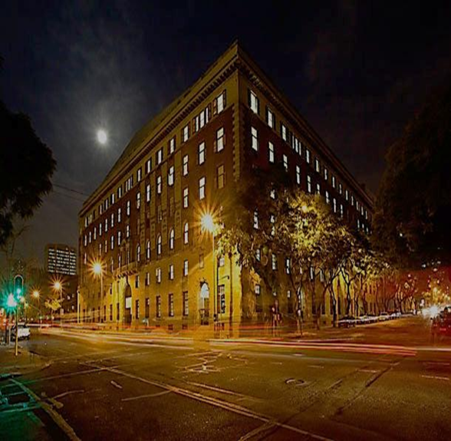
THANK YOU
Department of Public Works & Infrastructure
Head Office: Public Works & Infrastructure CGO Building Cnr. Bosman and Madiba Streets Pretoria Central
Private Bag X65 Pretoria, 0001
Website: http://www.publicworks.gov.za

