Slide 1
OVG 2019/20 QUARTER 2 PERFORMANCE REPORT PRESENTATION TO THE PORTFOLIO COMMITTEE ON AGRICULTURE, LAND REFORM AND RURAL DEVELOPMENT 25 FEBRUARY 2020

Slide 2
TABLE OF CONTENTS
Audit improvement 3-4
Financial performance 5
Financial performance – executive summary 6
Legend 7
2019/20 independently verified performance as at quarter 3 8
Backlog as at quarter 3 9-10
2019/20 independently verified performance as at quarter 3 11-12
Programme performance Q1-Q3 2019/20 13-14
2019/20 indicators not due as at quarter 3 15
Programme performance Q1-Q3 2019/20 16
Challenges 17
Solutions 18

Slide 3
AUDIT IMPROVEMENT

Slide 4
AUDIT IMPROVEMENT
The OVG had 13 audit findings during the 2018/19 statutory audit all of which relate to other administrative matters. The 2 unresolved findings will be resolved before 31 March 2020.
The OVG tabled the first APP for the 2018/19 financial year and had their first audit on performance information in the 2018/19 financial year.

Slide 5
FINANCIAL PERFORMANCE
R’000 | Annual Transfer Fund Allocation | Allocation Received | Balance available | %
Balance Brought Forward 2018/19 |  | 127 065
2018/19 Surplus surrendered to NT |  | (123 100)
Transfer Allocation from Department 2019/20 | 142 127 | 142 127 | 0 | 100%
Total | 142 127 | 146 092
R’000 | Annual Budget | Cumulative Spending | Balance available | % spent
Compensation of Employee | 75 680 | 10 305 | 65 375 | 14%
Goods and Services | 66 447 | 15 377 | 76 802 | 23%
Total operational expenditure | 142 127 | 25 682 | 116 445 | 18%
Total Surplus/ (Deficit) from Operating Activities |  | 120 410

Slide 6
FINANCIAL PERFORMANCE – EXECUTIVE SUMMARY
Cash and cash equivalent as at the 31 March 2019 is R127 million.
The amount of R123,1 million for OVG was surrendered into the National Revenue Fund
Department transferred grant amount of R142,1 million to Office of the Valuer-General during the third quarter for funding their priorities.
Spending as at 31 December 2019 amounted to R25.7 million, representing 18% of the total annual budget of R142.1,9 million.
Compensation of Employees spending amounted to R10,3 million representing 14% of the allocated budget of R75,7 million.
Good and Service spending amounted to R15.4 million representing 23% of the allocated budget of R66,4 million.
Balance available as at 31 December 2019 amount to R120,4 million.

Slide 7
LEGEND
PERFORMANCE:
 | ACHIEVED
 | NOT ACHIEVED
 | N/A

Slide 8
2019/20 INDEPENDENTLY VERIFIED PERFORMANCE AS AT QUARTER 3
INDICATORS | ANNUAL TARGET | ACHIEVED AS AT QUARTER 3 | VARIANCE | REASON | ACTUAL VALUATIONS COMPLETED
100% completion of valuations submitted by Restitution within the specified times | 100% | 37% | NA | The OVG has capacity challenges. | 74
Number of completed backlog valuations | 995 | 465 | 530 | The OVG has capacity challenges. | 465
Average number of days taken to issue a valuation certificate for valid valuation reports | 50 | 125 | 75 | The OVG has capacity challenges. | 91
Parked valuations (Only to be reported at year-end) |  |  |  |  | 112
TOTAL |  |  |  |  | 742

Slide 9
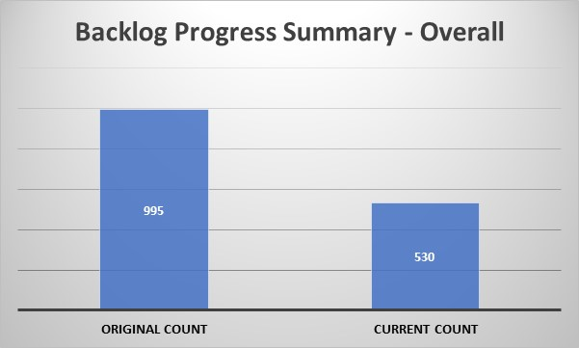
BACKLOG PROGRESS AS AT QUARTER 3

Slide 10
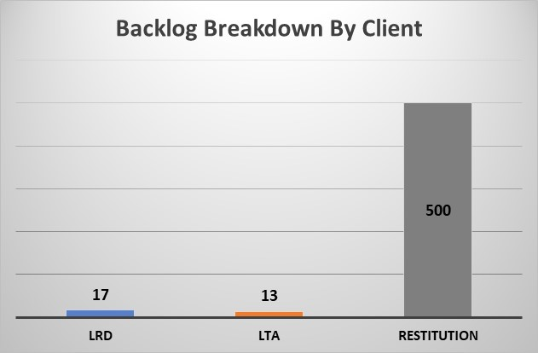
BACKLOG PROGRESS AS AT QUARTER 3

Slide 11
2019/20 INDEPENDENTLY VERIFIED PERFORMANCE AS AT QUARTER 3
INDICATORS | ANNUAL TARGET | ACHIEVED AS AT QUARTER 3 | VARIANCE | COMMENT
Strategic objective: Criteria, procedures and guidelines determined in accordance with plan
Implementation of the approved valuation criteria, procedures and guidelines | 100% Implementation of the approved valuation criteria, procedures and guidelines | Implementation plan approved by Valuer-General | - | Implementation in progress and will be reported at year-end

Slide 12
2019/20 INDEPENDENTLY VERIFIED PERFORMANCE AS AT QUARTER 3
INDICATORS | ANNUAL TARGET | ACHIEVED AS AT QUARTER 3 | VARIANCE | REASON
Strategic objective: Grow the business from non-land-reform valuations
Number of potential target clients surveyed | 11 | 3 | 8 | Surveys were sent out however the response was not as anticipated. The OVG has increased the pool of potential clients to be sent the surveys to ensure the annual target is achieved. The annual target is in sight to be reached
Strategic Objective: Produce high quality valuations
Number of independent valuation review and quality assurance committee meetings held | 12 | 8 | 4 | The process to appoint the VRAC was initiated in the previous financial year. The members were appointed in the second quarter and the committee began with their mandate.
Percentage of valuations reviewed by the quality review committee | 5,00% | 0% | -5% | Samples were selected per quarter and the reviews were done. The committee is in the process of improving its reports and finalizing such. This performance of on this indicator will only be counted once such reports have been signed off. The annual target on this indicator is in sight to be achieved,
Strategic objective: Establish operational and governance processes
development of a property data management tool | Implement property data tool in accordance with project plan approved by VG – 50% implementation | Project plan approved by Valuer-General | - | Implementation in progress and will be reported at year-end

Slide 13
PROGRAMME PERFORMANCE Q1-Q3 2019/20
Goal | Performance Indicator | Q1 Targets 19/20 | Q1 achievement | Q2 Targets 19/20 | Q2 achievement | Q3 Targets 19/20 | Q3 achievement | Annual target | Shortfall to achieve Annual target
1. Support and reform | 100% completion of valuations submitted by restitution within the specified times. | 100% | 0% | 100% | 20% | 100% | 49% | 100% | -
 | Number of completed backlog valuations | 331 | 175 | 332 | 0 *(209) | 332 | 81 | 995 | 739 *(530)
 | Average number of days taken to issue a valuation certificate for valid valuation reports (LRD and LTA) | 50 days | 29 | 50 days | 66 | 50 days | 125 | 50 days | -
2. Develop criteria, procedures and guidelines | Implementation of the approved valuation criteria, procedures and guidelines | - | - | Implementation of plan approved by the Valuer-General | OVG approved implementation plan | - | - | ***100% implementation of approved valuation criteria, procedures and guidelines. | -

Slide 14
PROGRAMME PERFORMANCE Q1-Q3 2019/20
Goal | Performance Indicator | Q1 Targets 19/20 | Q1 achievement | Q2 Targets 19/20 | Q2 achievement | Q3 Targets 19/20 | Q3 achievement | Annual target | Shortfall to achieve Annual target
3. Organisational Sustainability | Number of potential target clients surveyed | 0 | - | 3 | 3 | 4 | 0 | 11 | 8
 | Revenue from other non-land reform valuations as a percentage of annual fixed operating costs | n/a | - | n/a | - | n/a | - | ***0.25% | -
 | Number of independent valuation review and quality assurance committee meetings held | 0 | - | 4 | 3 | 4 | 5 | 12 | 4
 | Percentage of valuations reviewed by the quality review committee | n/a | - | 6.7% | 0 | 6.6% | 0 | 5% | -

Slide 15
2019/20 INDICATORS NOT DUE AS AT QUARTER 3
INDICATORS | ANNUAL TARGET | COMMENTS
Strategic objective: Achieve Operational sustainability
Filling of vacancies and retention thereof in terms of the approved structure | 80% | The Minister approved 21 critical positions and management is initiating recruitment processes.
Number of people attending the designated land reform valuation training courses | 12 | The OVG continues to track monthly and will report once achieved
Strategic objective: Grow the business from non-land-reform valuations
Revenue from other non-land reform valuations as a percentage of annual fixed operating costs | 0,25% | The office is yet to complete a Section 12(1)(B) valuation The OVG continues to track monthly and will report once achieved

Slide 16
PROGRAMME PERFORMANCE Q1-Q3 2019/20
Goal | Performance Indicator | Q1 Targets 19/20 | Q1 achievement | Q2 Targets 19/20 | Q2 achievement | Q3 Targets 19/20 | Q3 achievement | Annual target | Shortfall to achieve Annual target
3. Organisational Sustainability | Development of property data management tool | - | - | Project plan approved by OVG | OVG approved project plan | - | - | ****Implement a property data management tool in accordance with project plan approved by the VG – 50% implementation | -
 | Filling of professional vacancies and retention thereof in terms of the approved structure | n/a | - | n/a | - | n/a | - | ****80% | -
 | Number of people attending the designated land reform valuation training courses | n/a | - | n/a | - | n/a | - | *****12 | -

Slide 17
CHALLENGES
Capacity is still a challenge
Critical positions not yet filled

Slide 18
SOLUTIONS
Minister has concurred to the OVG organogram in February 2020
Recruitment drive has begun to more than double the current capacity
(warm bodies) of the OVG
Project Management Office established since December 2020 to improve efficiencies at the OVG
Oversight strengthened through the Ministry
Systems procured and being implemented to improved efficiencies in the OVG
Ministerial Advisory Panel (MAP) on the Property Valuation Act appointed by the Minister and 4 meetings held so far.
Project plan produced for the work of the MAP
Stakeholder mapping done by the MAP
Workstreams finalized to carry out the work of the MAP

Slide 19
RE YA LEBOHA

