Slide 1
2019/20
DEPARTMENT OF DEFENCE
Presentation to the PCD&MV
26 February 2020

Slide 2
Aim
Information brief to the
Portfolio Committee of Defence and Military Veterans
on the
(1) DOD Q3 Performance Report
(2) Status on BRRR
(3) Status on Audit Action Plans

Slide 3
Presentation Structure
Legislative Requirements
Part 1: DOD Q3 Performance Report as on 31 Dec 2019
Analysis of DOD Performance Indicators
Q3 Strategic Overview
DOD Selected Performance Indicators
Q3 Performance Status
Q3 Financial Performance Information

Slide 4
Presentation Structure
Part 2: Status on Budgetary Review and Recommendation Report (BRRR) as on 31 Dec 2019
Part 3: Status on Audit Action Plans as on 31 Dec 2019

Slide 5
Legislative Requirements
In terms of Section 38(1)(a)(i) and (ii) of the PFMA, 1999 as amended, the “Accounting Officer for a department must ensure that the department has and maintains effective, efficient and transparent systems of financial and risk management and internal control; and a system of internal audit under the control and direction of an audit committee”.
The Treasury Regulations, section 5.3.1 states that, the Accounting Officer of an institution must establish procedures for quarterly reporting to the Executive Authority to facilitate effective performance monitoring, evaluation and corrective action.

Slide 6
Legislative Requirements
The Revised Framework for Strategic Plans and Annual Performance Plans, states that “reporting is a vital component of the monitoring process and must be undertaken with the intent to use the findings to inform management and oversight decision making. Reporting entails tracking progress against a plan and it improves accountability for delivering on the priorities of government, and provides focus on the use of allocated budgets by institutions. It also provides an opportunity for institutions to indicate measures that will be taken to ensure that implementation of plans remains on track.”

Slide 7
Legislative Requirements
“Quarterly Performance Reports (QPRs) provide progress on the implementation of an institutions’ Annual Performance Plan on a quarterly basis, with particular reference to monitoring performance against outputs.”
DPME in the Presidency’s “Guidelines for the Preparation of Quarterly Performance Reports” dated May 2019 indicates that preliminary information must be submitted within 30 days after the end of each quarter and actual information must be submitted with preliminary data of the next quarter.

Slide 8
Part 1: DOD Q3 Performance Report

Slide 9
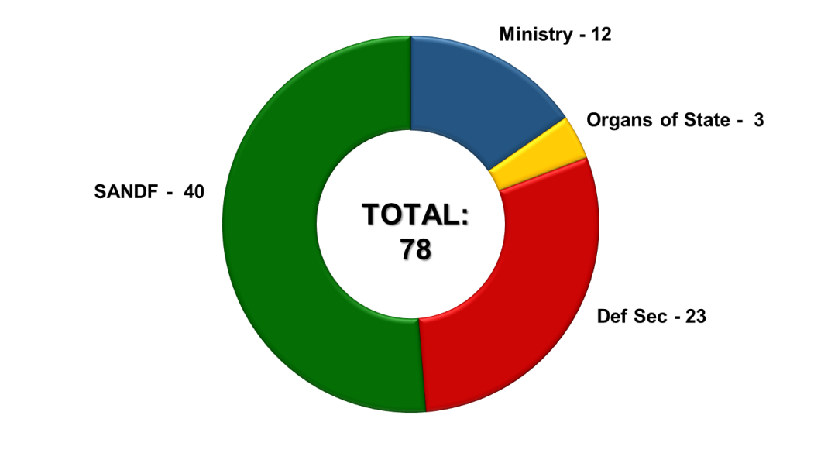
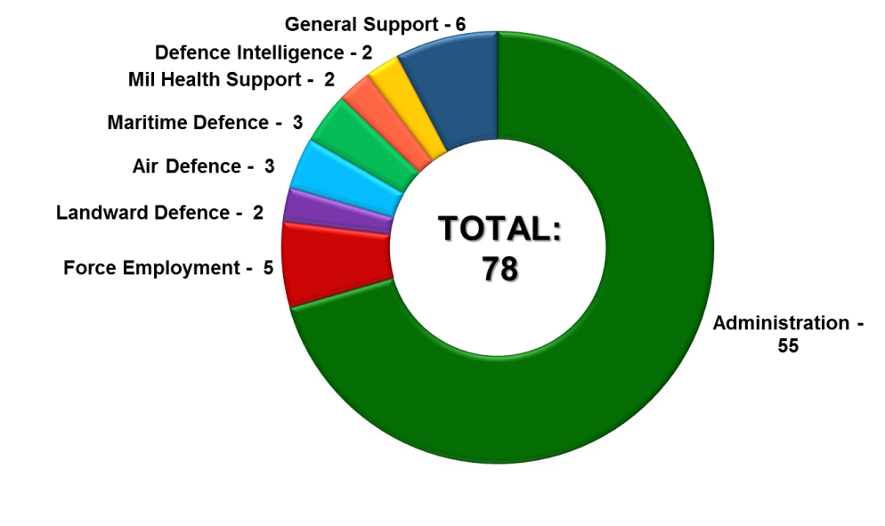
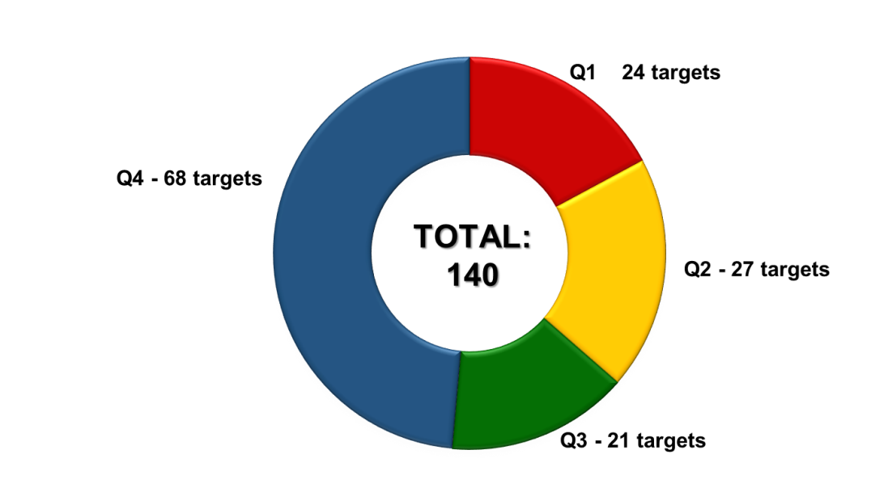
Analysis of DOD Performance Indicators
The DOD reports against 78 Performance Indicators (PInds) in the FY2019/20.

Slide 10
Analysis of DOD Targets per Main Programme
Programme | Q1 | Q2 | Q3 | Q4 | Total
Administration | 15 | 16 | 11 | 47 | 89
Force Employment | - | - | - | 5 | 5
Landward Defence | 1 | 1 | 2 | 2 | 6
Air Defence | 1 | 2 | 1 | 2 | 6
Maritime Defence | 1 | 2 | 1 | 2 | 6
Military Health Support | 2 | 2 | 2 | 2 | 8
Defence Intelligence | 2 | 2 | 2 | 2 | 8
General Support | 2 | 2 | 2 | 6 | 12
TOTAL | 24 | 27 | 21 | 68 | 140

Slide 11
Q3 Strategic Overview

Slide 12
SA Defence Review 2015 Implementation Status
The implementation of the Defence Review 2015 remains totally dependent on an improved funding trajectory to the DOD. The following two processes are pertinent.
Defence Sustainability Strategy
A strategic approach and policy framework for sustainability was developed to assist the DOD in coping with the expected funding deficits over the next two MTSF periods as was indicated in the 2019/20 MTEF Allocation Letter. The conceptual approach to the Defence Sustainability Strategy was constantly assessed and adjusted, in case it should be necessary to develop a “fall-back” position in terms of the “Revised Plan to Arrest the Defence Decline”.

Slide 13
SA Defence Review 2015 Implementation Status
Revised Plan to Arrest the Defence Decline
The DOD, including the use of specialised capabilities within ARMSCOR DDSI, has continued to contribute to the development of the “Revised Plan to Arrest the Defence Decline”.
A Special PDSC was convened on 13 Nov 2019 to discuss the NT Letter concerning the 2020/21 MTEF Defence Allocation. It was decided that the Secretary for Defence will work with the DG in the Presidency to convene a high-level meeting to discuss the future size and shape of the Defence.
A high-level presentation, based on the 15 Jan 2019 briefing to the President, will be developed for the meeting.

Slide 14
Corporate Human Resource Status
Correspondence received from the Minister of Finance dated 25 Oct 2019, referred to the 19 Oct 2019 Magoebaskloof meeting with the CSANDF. During the meeting it was indicated that Government’s Wage Bill remains unsustainable and re-emphasised that a Rejuvenation Plan are to be submitted and presented to NT.
The final Letter of Allocation from NT dated 08 Nov 2019 emphasised the urgent requirement of a high-level meeting between the President, the Ministers of Finance, Public Service and Administration and Department of Defence and Military Veterans.

Slide 15
Corporate Human Resource Status
The DOD requires an average HR strength of 77 000. In order to assure a more sustainable defence capability, an average HR strength of 75 500 will however be maintained.
The DOD reduced its strength from 78 632 on 31 Mar 2014 to 72 768 on 31 Dec 2019, constituting a reduction in strength of 5 864 over this period.
The planned average strength of the DOD for the FY2019/20 is reduced from 74 901 to 74 104 at a cost of Rb31.89, resulting in a shortfall of R2.7 billion.

Slide 16
Corporate Governance and Accountability
Financial Management
The DOD endeavoured to ensure compliance with the PFMA and NT Instruction Note 34 requirement to pay suppliers within 30 days of receipt of legitimate invoices.
During Q3, the DOD paid a total of 95 406 legitimate invoices out of 114 593 invoices received, which is 83.3% legitimate invoices paid within a period of 30 days.
The DOD is aware of its obligation to pay 100% of legitimate invoices within 30 days. Legacy DOD Information Systems is the main contributing factor hampering payment of invoices within 30 days.

Slide 17
Corporate Governance and Accountability
Defence Diplomacy
The DOD was able to ensure the 100% validity of the enabling bilateral international agreements mandating the conducting of bilateral and multilateral engagements with Europe and America (ie USA, Brazil, Italy and Canada), Africa (ie Chad, Zimbabwe, Kenya, Togo, Ghana and Egypt), as well as Asia and the Middle East (ie Thailand).
The DOD participated in multilateral engagements in the UN, AU and the SADC initiatives in support of the role of the MOD&MV. During Q3, the DOD supported the MOD&MV during the Double Troika, FIB Troop contributing countries in the DRC, which was hosted in Dar Es Salaam over the period 12 to 13 Nov 2019.

Slide 18
Corporate Governance and Accountability
Armaments Acquisition And Technology Development
During the NDIC meeting of Nov 2019, the NDIC Task Team on Denel was instructed to compile a comprehensive Report on the Causes, Remedies and Recommendations on the liquidity and operational challenges of Denel.
The NDIC Task Team on Denel presented the Report to the Deputy MOD&MV as well as NT during the period under review.

Slide 19
Command of Forces
In terms of Support to the People, in support of Outcome 3, “All people in South Africa are and feel safe” the SANDF deployed 15 sub-units to execute Op CORONA (Border Safeguarding) in Limpopo, Mpumalanga, KwaZulu-Natal, Free State, Eastern Cape, Northern Cape and North-West Provinces.
An Op CORONA maritime patrol along the East Coast was executed in the Durban, Richards Bay, Sodwana Bay, Kosi Bay areas, up to the RSA/Mozambique border over the period 11 to 28 Nov 2019.

Slide 20
Q3 Operational Successes
Force Employment Performance Status for FY2019/20
Operational Successes | Q1 | Q2 | Q3 | Q4 | YTD
Weapons Recovered | 8 | 16 | 11 | - | 35
Illegal Foreigners Apprehended | 2 629 | 1 291 | 2 093 | - | 6 013
Criminals Arrested | 162 | 192 | 149 | - | 503
Stolen Vehicles Recovered | 48 | 50 | 41 | - | 139
Dagga Confiscated | 3 477 kg | 2 175kg | 2 018kg | - | 7 670kg
Live-stock Recovered | 818 | 1 069 | 1 941 | - | 3 828
Contraband Goods Confiscated | R8.6 million | R16 million | R12 million | - | R36.6 million
Precious Metals Confiscated | 929 kg | - | - | - | 929 kg

Slide 21
Command of Forces
In support to Government Departments (Op PROSPER), the SANDF operational concept for Safety and Security Support is to employ multi-rolled military capabilities on request. The SANDF received and responded to the following requests to conduct operations in support of other Departments:
The SANDF continued assisting the North-West Provincial Government in the Department of Water and Sanitation by providing infrastructure support in order to maintain essential services in the Ditsobotla Local Municipality area.
The SANDF rendered Safety and Security Support against Gang Violence to the SAPS in the Cape Flats since 12 Jul 2019.
The SAAF assisted the SAPS in the recovery of a body of a hiker in the Wolkeberg, Limpopo on 28 Oct 2019.

Slide 22
Command of Forces
In terms of Disaster Aid and Relief (Op CHARIOT), the SA Air Force assisted in:
Air-lifting a jogger that fell from a cliff near Sudwala Caves in Mpumalanga on 12 Oct 2019.
Air-lifting a tourist that fell from Table Mountain on 04 Dec 2019.
Air-lifting a hiker that fell from ‘the chain ladders’ at the Drakensberg Amphitheatre on 08 Dec 2019.
Air-lifting missions in Centurion and Mamelodi which were affected by heavy rains and flooding between 09 to 10 Dec 2019.
In terms of search and rescue (Op ARABELLA) , The SANDF were not requested to provide assistance during the time under review.

Slide 23
Command of Forces
In terms of Regional Security, in support of Outcome 11, “Creating a better South Africa and contributing to a better and safer Africa in a better World”, the SANDF continued to:
Provide Force Structure Elements to the United Nations PSO in the DRC (Op MISTRAL).
Provide counter-piracy operations support to the Mozambican Defence Force as part of Op COPPER. A visual air reconnaissance patrol in the Mozambique Channel were conducted prior to the operation being cancelled for Q3.
Provide disaster relief response and humanitarian aid support (Op UKUWELA) to the Government of Zimbabwe from 19 July to 15 Dec 2019.

Slide 24
DOD Selected
(included in the ENE) Performance Indicators

Slide 25
Selected Performance Indicator Summary
Performance Indicator | Target | Q1 | Q2 | Q3 | Progress
Total number of Defence Attaché Offices | 44 | 44 | 44 | 44 | 100%
Number of Military Skills Development Members in the System per year | 3 510 | 3 374 | 3 295 | 3 226 | 91%
Number of reserve force mandays | 2 693 048 | 655 104 | 691 782 | 700 957 | 76%
Percentage compliance with the Southern African Development Community Standby Force Pledge | 100% | 100% | 100% | 100% | 100%
Percentage compliance with number of ordered commitments (external operations) | 100% | 100% | 100% | 100% | 100%

Slide 26
Selected Performance Indicator Summary
Performance Indicator | Target | Q1 | Q2 |  | Progress
Percentage compliance with number of ordered commitments (internal operations) | 100% | 100% | 100% | 100% | 100%
Number of joint, interdepartmental, interagency and multinational military exercises conducted per year | 1 | - | - | 1 | 100%
Number of landward sub-units deployed on border safeguarding per year | 15 | 15 | 15 | 15 | 100%
Number of hours flown per year | 17 200 | 4 369.60 | 4 573.20 | 3 891.80 | 75%
Number of hours at sea per year | 10 000 | 1 336.84 | 2 690.93 | 1 332.14 | 54%
Note:
The SANDF successfully participated in a combat-readiness exercise during Q3.
Exercise MOSI was a Joint, Multi-National Maritime exercise between the Chinese, Russian and South African Naval Forces with the primary aim to maintain and to promote navigation and sea economic activities between the countries. The Exercise was conducted on the Western Coast of South Africa between Cape Columbine and the Cape of Good Hope over the period 21 to 30 Nov 2019.

Slide 27
DOD Number of Hours Flown per Year
Flying Hours Year-On-Year Analysis
Flying Hour Type | FY2017/18 |  | FY2018/19 |  | FY2019/20
 | Target | Actual | Target | Actual | Planned | YTD
Force Employment | 4 000 | 3 629.20 (90.7%) | 4 000 | 2 441.60 (61%) | 4 000 | 2 156.30 (54%)
VVIP | 1 000 | 496.30 (49.6%) | 1 000 | 545.70 (54.6%) | 1 000 | 737.30 (74%)
Force Preparation | – | – | 20 000 | 14 882.90 (74.4%) | 12 200 | 9 941.00 (81%)
TOTAL | 5 000 | 4 125.50 (82.5%) | 25 000 | 17 870.20 (71.5%) | 17 200 | 12 834.60 (75%)

Slide 28
DOD Number of Hours at Sea per Year
Sea Hours Year-On-Year Analysis
Sea Hour Type | FY2017/18 |  | FY2018/19 |  | FY2019/20
 | Target | Actual | Target | Actual | Planned | YTD
Force Employment | 12 000 | 3 470.26 (28.9%) | 12 000 | 4 545.00 (37.9%) | 10 000 | 2 467.00 (25%)
Force Preparation |  | 2 576.42 (21.5%) |  | 3 159.13 (26.3%) |  | 2 892.91 (29%)
TOTAL | 12 000 | 6 046.68 (50.4%) | 12 000 | 7 704.13 (64.2%) | 10 000 | 5 359.91 (54%)

Slide 29
Q3 Performance Status

Slide 30
Performance Status on Targets per Quarter
 | Q1 | Q2 | Q3 | Q4 | YTD Status
Achieved | 16 (66.7%) | 18 (66.7%) | 16 (76%) | - | 69%
Not Achieved | 8 (33.3%) | 9 (33.3%) | 5 (24%) | - | 31%
TOTAL | 24 | 27 | 21 | 68 | 140

Slide 31
Q3 Financial Performance Information

Slide 32
Summary of State of Expenditure: 31 Dec 2019
DOD Planned Expenditure: 71.7%
 | R’000
Budget Allocation | 50 888 132
Less: Expenditure | 36 837 613
Total Amount Available | 14 050 519
% Expenditure (Paid) | 72.4%

Slide 33
Summary of State of Expenditure: 31 Dec 2019
Programme | 2019/20 ENE | Available Funds | Approved Drawing | Approved Drawing | Actual Expenditure | Actual Expenditure | Variance | Variance
 | R'000 | R'000 | R'000 | % | R'000 | % | R'000 | %
a | b | c | d | e=(d/c) | f | g=(f/c) | h=(d-f) | i=(h/d)
Administration | 6 187 144 | 6 177 144 | 4 595 288 | 74.4% | 4 314 336 | 69.8% | 280 952 | 6.1%
Force Employment | 3 620 718 | 3 620 718 | 2 536 259 | 70.0% | 2 411 092 | 66.6% | 125 167 | 4.9%
Landward Defence | 16 464 299 | 16 432 002 | 12 162 577 | 74.0% | 12 743 817 | 77.6% | -581 240 | -4.8%
Air Defence | 6 977 747 | 6 943 775 | 4 842 142 | 69.7% | 4 941 951 | 71.2% | -99 809 | -2.1%
Maritime Defence | 4 517 878 | 4 838 487 | 3 249 785 | 67.2% | 3 092 191 | 63.9% | 157 594 | 4.8%
Military Health Support | 5 375 266 | 5 358 966 | 3 950 102 | 73.7% | 3 869 515 | 72.2% | 80 587 | 2.0%
Defence Intelligence | 1 020 469 | 1 020 469 | 747 809 | 73.3% | 732 477 | 71.8% | 15 332 | 2.1%
General Support | 6 349 471 | 6 496 571 | 4 380 595 | 67.4% | 4 732 234 | 72.8% | -351 639 | -8.0%
Total | 50 512 992 | 50 888 132 | 36 464 557 | 71.7% | 36 837 613 | 72.4% | -373 056 | -1.0%

Slide 34
Comments on of State of Expenditure per
Programme: 31 Dec 2019
Contributing factors to negative or positive balances of more than 8% of actual drawings per economic classification are as follows:
General Support. Over expenditure of R351.639 million was mainly due to:
The CoE ceiling set by the NT not supporting the current strength of the Department.
Payments made regarding the refurbishment of 1 Military Hospital managed by the National Department of Public Works & Infrastructure as well as the Defence Works Formation being higher than the original cash flow plan submitted.
Payment of Microsoft Office and Mainframe software license fees.

Slide 35
Comments on of State of Expenditure per
Programme: 31 Dec 2019
Contributing factors to negative or positive balances of more than 8% of actual drawings per economic classification are as follows:
General Support. Over expenditure of R351.639 million was mainly due to:
The procurement of network management software effective to develop, configure and integrate various platforms for the management, monitoring and control of the network elements for the entire National Telecommunication Backbone Infrastructure network.
The payment of completed modules for the implementation of the Allied Codification Publication 1 (ACODP-1) NATO Compliant Codification System.

Slide 36
Summary of State of Expenditure
per Economic Classification: 31 Dec 2019
Economic Classification | 2019/20 ENE | Available Funds | Approved Drawing | Approved Drawing | Actual Expenditure | Actual Expenditure | Variance | Variance
 | R'000 | R'000 | R'000 | % | R'000 | % | R'000 | %
a | b | c | d | e=(d/c) | f | g=(f/c) | h=(d-f) | i=(h/d)
Compensation of Employees | 29 193 710 | 29 193 710 | 21 897 121 | 75.0% | 23 516 492 | 80.6% | -1 619 371 | -7.4%
Goods and Services | 12 934 153 | 12 932 578 | 8 879 946 | 68.7% | 7 263 315 | 56.2% | 1 616 631 | 18.2%
Total Transfers and Subsidies | 7 622 351 | 7 997 491 | 5 325 820 | 66.6% | 5 327 379 | 66.6% | -1 559 | 0.0%
Payments for Capital Assets | 762 778 | 762 778 | 361 670 | 47.4% | 727 096 | 95.3% | -365 426 | -101.0%
Payments for Financial Assets | 0 | 0 | 0 | 0.0% | 3 331 | 100.0% | -3 331 | 100.0%
Total Expenditure | 50 512 992 | 50 886 557 | 36 464 557 | 71.7% | 36 837 613 | 72.4% | -373 056 | -1.0%

Slide 37
Comments on of State of Expenditure per
Economic Classification: 31 Dec 2019
Contributing factors to negative or positive balances of more than 8% of actual drawings per economic classification are as follows:
Goods and Services. Under expenditure of R1.617 billion was mainly due to:
The contingency budget provided for the envisaged shortfall on Compensation of Employees. R1.223 billion was inherently encapsulated within the cash flow projections made for Goods and Services, which was based on historical expenditure percentage trends.
The ‘switch over’ from the primary data centre to the secondary data centre of the Department resulted in the non-functioning of the interface link between the DOD Financial Management System (FMS) and the ARMSCOR system. This situation negatively affected payments reported as the FMS was not updated with all the relevant payment transactions done by ARMSCOR (±R107.295 million).
Invoices for Municipality Services were not processed timely for payment during December 2019.

Slide 38
Comments on of State of Expenditure per
Economic Classification: 31 Dec 2019
Contributing factors to negative or positive balances of more than 8% of actual drawings per economic classification are as follows:
Payments for Capital Assets. The over expenditure of R365.426 million was as a result of:
Payment of completed modules for the implementation of the Allied Codification Publication 1 (ACODP-1) NATO Compliant Codification System. The NATO Compliant Codification system ensures that the Department is compliant to the rules and regulations of the Allied Codification Publication and would replace the current codification system which are being used by the National Codification Bureau of South Africa.
Higher than planned expenditure regarding the upgrading and rehabilitation of buildings, i.e. the building of living in quarters at Lords Ground KZN and 1 Military Hospital.

Slide 39
Comments on of State of Expenditure per
Economic Classification: 31 Dec 2019
Contributing factors to negative or positive balances of more than 8% of actual drawings per economic classification are as follows:
Payments for Capital Assets (continued). The over expenditure of R365.426 million was also as a result of:
Payment of Microsoft Office and Mainframe license fees.
The procurement of network management software effective to develop, configure and integrate various platforms for the management, monitoring and control of the network elements for the entire National Telecommunication Backbone Infrastructure Network.

Slide 40
Comments on of State of Expenditure per
Economic Classification: 31 Dec 2019
Contributing factors to negative or positive balances of more than 8% of actual drawings per economic classification are as follows:
Payment for Financial Assets.
The over expenditure of R3.331 million was mainly due to transactions that create or increase outstanding debtors’ amounts as well as foreign exchange losses, thefts and other losses, etc.
It should be noted that the Department does not make provision during the budget allocation for unforeseen expenditure such as foreign exchange losses, thefts and other losses, etc.
Funds are reserved to clear these transactions at financial year-end.

Slide 41
Part 2: Status on BRRR
(as on 31 Dec 2019)

Slide 42
Status on BRRR (1)
PCD&MV Recommendation
The Committee requires a written report from the DOD with regards to the future of the Special Defence Account (SDA), including the possible phasing out of the Account. The report should further indicate how the Compensation of Employees allocation will be met once the SDA has been depleted and how it will be ensured that future defence materiel needs are addressed. The Report should further indicate whether current projects (notably Projects Biro, Hotel and Hoefyster) are under threat given limited funding in the SDA. The written report should be submitted to the Committee no later than 1 February 2020.
Target Date | 01 February 2020
Progress
The status quo remains regarding the SDA. CoE. The DOD/SANDF has appreciated the rejuvenation of the SANDF workforce with the intent to change the HR profile and not the reduction of personnel to fit within the CoE allocation. Engagement continue between NT, DPSA and the DOD. The DOD will continue to engage NT and DPSA in order to discuss challenges with regards to CoE allocations versus the DOD CoE ceiling.

Slide 43
Status on BRRR (1) Cont…
PCD&MV Recommendation
The Committee requires a written report from the DOD with regards to the future of the Special Defence Account (SDA), including the possible phasing out of the Account. The report should further indicate how the Compensation of Employees allocation will be met once the SDA has been depleted and how it will be ensured that future defence materiel needs are addressed. The Report should further indicate whether current projects (notably Projects Biro, Hotel and Hoefyster) are under threat given limited funding in the SDA. The written report should be submitted to the Committee no later than 1 February 2020.
Target Date | 01 February 2020
Progress
The DOD will ensure that no unauthorised expenditure is incurred on the Vote due to the shortfall on the CoE allocation for FY2019/20. The DOD will reprioritise expenditure on less essential commodities / activities on the operating budget by means of cash-flow management towards the end of the financial year. Status of Projects. Projects BIRO (Acquisition of a Multi Mission Inshore Patrol Capability), HOTEL (Acquisition of a Hydrographic Survey Capability) and HOEFYSTER (Acquisition of a New Generation Infantry Combat Vehicle) are currently under threat due to the limited funding allocated in the in-year SDA and 2020 Medium-Term Expenditure Framework (MTEF) SDA.

Slide 44
Status on BRRR (1) Cont…
PCD&MV Recommendation
The Committee requires a written report from the DOD with regards to the future of the Special Defence Account (SDA), including the possible phasing out of the Account. The report should further indicate how the Compensation of Employees allocation will be met once the SDA has been depleted and how it will be ensured that future defence materiel needs are addressed. The Report should further indicate whether current projects (notably Projects Biro, Hotel and Hoefyster) are under threat given limited funding in the SDA. The written report should be submitted to the Committee no later than 1 February 2020.
Target Date | 01 February 2020
Progress
These three Projects have contractual obligations which the DOD cannot honour: • BIRO – Contractual obligations until FY2024/25. • HOEFYSTER – Contractual obligations until FY2022/23. • HOTEL - Contractual obligations until FY2021/22. Contractual obligations for these three Projects amounts to RB13.7 (FY2019/20 – FY2024/25) whilst the current allocation only amounts to RB2.8. Therefore, there is a shortfall of RB10.9 over the various contractual years.

Slide 45
Status on BRRR (2)
PCD&MV Recommendation
The DOD should, as part of its quarterly performance reports to Parliament, include an update on the number of investigations underway related to irregular expenditure and fruitless and wasteful expenditure. This should include information on the number of cases referred to the Military Police and/or the SAPS, the number of cases under investigation and the outcome of such investigations. This information is essential to ensure improved Consequence Management in the Department of Defence.
Target Date | Quarterly, according to DOD QPR Timelines
Progress
The AO instituted controls as detailed in the Audit Action Plan to reduce the incurrence of Irregular Expenditure and Fruitless and Wasteful Expenditure, by providing checks and balances within the procurement environments at unit level to ensure policies, procedures and legislation is adhered to in the awarding of contracts. With regard to prior period’s Irregular Expenditure incurred, which are of a significant value, the AO tasked the Inspector-General and Internal Audit Division, together with a forensic company (as identified by NT) to work in a co-sourced relationship to investigate root causes of the procurement related irregular expenditure incurred.

Slide 46
Status on BRRR (2) Cont…
PCD&MV Recommendation
The DOD should, as part of its quarterly performance reports to Parliament, include an update on the number of investigations underway related to irregular expenditure and fruitless and wasteful expenditure. This should include information on the number of cases referred to the Military Police and/or the SAPS, the number of cases under investigation and the outcome of such investigations. This information is essential to ensure improved Consequence Management in the Department of Defence.
Target Date | Quarterly, according to DOD QPR Timelines
Progress
This is currently a work in progress. Board of Inquiries (BOI) were instituted within the Department to deal with the incurrence of Irregular Expenditure and Fruitless and Wasteful Expenditure by the various Services and Divisions. The recommendations by the BOIs are forwarded to the Legal Services Division and Military Police Division, respectively, for sanctions and consequence management.

Slide 47
Status on BRRR (3)
PCD&MV Recommendation
The DOD should prioritise its Internal Audit Division’s capacity through the filling of vacant posts. The DOD should provide the Committee with quarterly updates on the status of the Internal Audit capacity.
Target Date | Quarterly, according to DOD QPR Timelines
Progress
The funded HR posts for Internal Audit Division is 69. Of these 69 funded posts, 43 posts were filled on 31 Dec 2019, resulting in a vacancy rate of 26 (37%). Financial authority for the staffing of 19 posts has been granted to date.

Slide 48
Status on BRRR (4)
PCD&MV Recommendation
The Committee urges ARMSCOR, the DOD and the AG to finalise a plan to correctly capture tangible assets in order to avoid future misstatements and subsequent adverse findings by the AG. The DOD should report to the Committee on progress in this regard on a quarterly basis.
Target Date | Quarterly, according to DOD QPR Timelines
Progress
The DOD and ARMSCOR agreed on a process to disclose Tangible Assets, as prescribed in the Modified Cash Standard (MCS); which is to disclose WIP in Q2 and Q4 of FY2019/20 and the Tangible Assets only in Q4. This is due to the complexity around the delivery and recognition of asset as per MCS, versus the contractual obligations between the DOD, ARMSCOR and suppliers. In order to address the issue of the misstatement, the DOD and ARMSCOR agreed on a debrief process which will be held during Apr / May of each year to reconfirm what has been capitalised by the DOD versus what ARMSCOR provided. The agreement with AGSA is that a session be held, prior to the actual audit, where the process to derive the capitalised amounts is explained.

Slide 49
Status on BRRR (5)
PCD&MV Recommendation
Although the situation around reimbursements from the United Nations for SANDF troop and equipment contributions has improved, the Committee noted ongoing concerns related to these reimbursements. This relates largely to the unserviceability of the Prime Mission Equipment in the mission areas. The latest information from the Minister of Defence indicated that reimbursements to the value of R54.667 million was forfeited. The Committee therefore strongly recommends that the DOD institute further measures to improve on the reimbursement levels from the UN. Quarterly updates on UN reimbursement levels should be provided to the Committee.
Target Date | Quarterly, according to DOD QPR Timelines
Progress
Serviceability of Prime Mission Equipment increased from 70% in FY2018/19 to 86% during Q3 of FY2019/20. This can however change rapidly depending on the intensity of operations being conducted and the supply and support from Services. As at 31 Dec 2019, the DOD was reimbursed by the UN for MoUs to the amount of RM240,062 and for the LOA to the amount of RM352,042.

Slide 50
Status on BRRR (6)
PCD&MV Recommendation
The DOD should provide quarterly updates on the attainment of sea hours and flying hours by the SA Navy and SA Air Force, respectively. Furthermore, spending on key military functions such as the Maritime Combat Capability and Air Combat Capability must be reported to ensure that healthy spending patterns are maintained. The Department should also report on all virements and shifts in terms of these capabilities on a quarterly basis to prevent a situation where these movements take place at the end of the financial year, signalling poor planning.
Target Date | Quarterly, according to DOD QPR Timelines
Progress
Attainment of Hours at Sea. During Q3 the SA Navy achieved 1 332.14 hours at sea, comprising of 667.14 hours for Force Preparation and 665 hours for Force Employment. The total amount of hours at sea achieved to date during FY2019/20 is 5 359.91 hours, comprising of 2 892.91 hours for Force Preparation and 2 467 hours for Force Employment. Maritime Combat Capability Expenditure. As at the end of Q3, operating expenditure amounted to R74 400 889,00 and capital expenditure (SDA-related) to R449 122 438,00. Virements and Shifts: None.

Slide 51
Status on BRRR (6) Cont…
PCD&MV Recommendation
The DOD should provide quarterly updates on the attainment of sea hours and flying hours by the SA Navy and SA Air Force, respectively. Furthermore, spending on key military functions such as the Maritime Combat Capability and Air Combat Capability must be reported to ensure that healthy spending patterns are maintained. The Department should also report on all virements and shifts in terms of these capabilities on a quarterly basis to prevent a situation where these movements take place at the end of the financial year, signalling poor planning.
Target Date | Quarterly, according to DOD QPR Timelines
Progress
Attainment of Flying Hours. The SA Air Force achieved 3 891.8 flying hours, comprising of 2 993.9 hours for Force Preparation and 617.10 hours for Force Employment and 280.80 hours for VVIP flights during Q3. The total amount of hours flown to date during FY2019/20 is 12 834.60 hours, comprising 9 941.0 hours for Force Preparation and 2 156.30 hours for Force Employment and 737.30 hours for VVIP flights. Air Defence Combat Capability Expenditure. As at the end of Q3, operating expenditure amounted to R231 835 433,00 and capital expenditure (SDA-related) to R131 038 343,00. Virements and Shifts: None.

Slide 52
Status on BRRR (7)
PCD&MV Recommendation
The DOD to take urgent steps to ensure the midlife upgrades for SA Navy frigates and submarines are carried out according to schedule. Feedback should be provided to the Committee before the end of the 2019/20 financial year.
Target Date | 31 March 2020
Progress
Project SYNE (Frigate Midlife Upgrade) and Project NAPOLEON (Submarine Midlife Upgrade) were registered as capital acquisition projects by the SA Navy. However, due to the limited funding allocated to the SDA, there is not sufficient funding for the DOD to continue with the midlife upgrades of these two Projects.

Slide 53
Status on BRRR (8)
PCD&MV Recommendation
The Committee observed the need for South Africa to maintain a modern military force capable of executing its constitutional mandate. Given the current financial constraints, the Committee recommends that the DOD focuses expenditure on key deliverables that would contribute to the requirements of a modern military force. The Committee will monitor quarterly expenditure to ensure alignment with this objective.
Target Date | Quarterly, according to DOD QPR Timelines
Progress
The acquisition of “Required Operational Capabilities”, as identified by Services for a modern military force, are executed through the SCAMP. It is challenging to focus on key deliverables, which will contribute to a modern military force, through the SCAMP since the available SDA allocation is insufficient to honour current contractual obligations. The DOD can thus not enter into new contracts to modernise the current capital equipment within the Services.

Slide 54
Part 3: Status on Audit Action Plans
(as on 31 Dec 2019)

Slide 55
Status on Audit Action Plans
In the FY2018/19, the DOD received a qualified audit opinion on the basis of the following audited areas:
Movable Tangible Capital Assets (Work-in-Progress).
Movable Tangible Capital Assets (Inventory).
Intangible Capital Assets (Software Licenses).
Goods and Services and Investments (Sensitive Projects).
Commitments.
Irregular Expenditure.

Slide 56
Status on Audit Action Plans
In order to ensure improved controls during FY2019/20 audit cycle, the following actions have been undertaken by the Department:
Implementation of the Accounting Officer’s Instruction on the submission and monitoring of action plans relating to AGSA audit findings.
Continued liaison with NT and political oversight bodies regarding an improved Defence budget allocation.

Slide 57
Movable Tangible Capital Assets (Work-in-Progress)
The DOD and NT reached an agreement on how the WIP will be disclosed in order to achieve fair presentation in the Annual Financial Statements.
NT will adjust the Financial Statements’ templates accordingly.

Slide 58
Movable Tangible Capital Assets (Inventory)
NT Guidelines for disclosure in the Financial Statements of all government departments on capital assets have been updated to give all departments discretion on the extent of the components to be included in asset registers.
The DOD is in process of updating the Asset Management Policy in this regard after which the Asset Register will be updated according.

Slide 59
Intangible Capital Assets (Software Licenses)
Intangible Asset registers have been updated with software and licenses to ensure that these registers are complete.
Supporting documentation is now readily available for audit purposes to verify the existence at [1] the correct locations and to [2] confirm installations and [3] recording on asset registers.

Slide 60
Goods and Services and Investments (Sensitive Projects)
The Department will continue to be qualified on Sensitive Activities due to adherence to the stipulations of the Defence Special Account Act.
Any possible amendments to this Act will affect the PFMA and the ARMSCOR Act.

Slide 61
Commitments
The Department was qualified on Commitments due to the opening balance being understated during the FY2018/19 audit cycle; this has since been corrected.

Slide 62
Irregular Expenditure
In terms of irregular expenditure incurred, pertaining to Supply Chain Management (SCM), SCM practitioners are being trained to ensure that there are consistencies in the disqualification of suppliers who do not meet the minimum criteria and the awarding of contracts are done in terms of policy and legislation.
Regular meetings are held with Officers Commanding of procurement units to share best practices and to improve on procurement practices. An oversight committee within the Department has been established to monitor DOD procurement entities across the country where findings occurred and intensifying the effective functioning of Bid Committees and Bid Evaluation Committees.

Slide 63
Thank you…

