Slide 1

Briefing by the National Registrar of Tourist Guides on compliance with legislation and the programmes for Tourist Guides.
Portfolio Committee on Tourism
25 February 2020

Slide 2
Contents
Introduction
Legislative Overview
- Definitions and Categories
- Functions of the Registrars of Tourist Guides
- Provisions of the Act
Statistical Overview
Skills Development Initiatives
Awareness Initiatives
Status of Provincial Registrars

Slide 3
Introduction
Tourist guides play a major role in the tourism industry. Through their vast abilities, they can transform a typical tour into a unique and memorable holiday experience. As the tourism industry is a service orientated industry with customer satisfaction at its core, the human element and the intermediary role that tourist guides play is crucial.
Tourist Guides act as ambassadors of the country, they are the first to meet and welcome tourists and they are often the last ones to bid farewell to them when they leave the country.
Nowadays, a tourist guide is seen as an important medium for conveying important environmental messages; enhancing destination image and implementing the goals of responsible tourism. As most customers only view their surroundings from a leisure perspective - guides have the ability to present and interpret information which gives more effect to the way customers perceive an attraction and understand local culture and heritage.
Thus, tourist guiding is a very critical component of the tourism value chain.

Slide 4
Legislative Overview
Tourism Act, 2014 (effective as of 16 June 2014) - defines the scope of guiding and provides a framework for the conduct and governance of the tourist guiding profession.
Regulations, 1994 and 2001 (currently in effect) - sets out the procedures for the registration of tourist guides, the drafting of the code of conduct and ethics and includes endorsements and suspension procedures, fines to be levied for non-compliance and procedures for appeals.

Slide 5
Definition and Categories
“A tourist guide means any person registered as such under section 50 and who for reward accompanies any person who travels within or visits any place within the Republic and who furnishes such person with information or comments’’
Tourist guides are classified into various categories, types and levels. These are determined by the qualification that guides obtain and the areas in which they are deemed competent to operate. The categories include site, provincial and/or national guides with a further breakdown as culture, nature and/or adventure guides.
Training programmes must be registered by the South African Qualifications Authority (SAQA). Most accredited programmes are offered through CATHSSETA-accredited training providers.

Slide 6
Functions of Registrars of Tourist Guides
National Registrar (appointed by Minister as per section 48) – maintain a central database; prepare code of conduct and ethics; hear and determine appeals; monitor trends and conduct research; publish and disseminate info on guides; facilitate growth and development; improve and maintain standards and liaise with various stakeholders on issues of guiding.
Provincial Registrar (appointed by the relevant MEC as per section 49) – keep a register of tourist guides; publish and disseminate info about registered tourist guides; promote and develop the sector; deal with complaints; exercise disciplinary powers; lay charges in the case of contraventions.

Slide 7
Provisions of the Act
Section/Provision | Information
Section 50 - Procedures related to the registration of tourist guides | Process and requirements for registration eg. completed form, R240 reg. fee, proof of competence, first aid, work visa (non-SA citizens) etc.
Section 51 - Competence | Competencies registered by SAQA
Section 52 – Code of Conduct and Ethics | Related to the conduct and behaviour of guides. All guides must adhere to this.
Section 53 - Reporting of Contraventions | Complaints reported to Provincial Registrars. If complaints disclose an offence, lay charges with SAPS. Complaints regarding misconduct must be handled in terms of the disciplinary processes set out on the Act.
Section 54 - Disqualifications | Provincial Registrars can disqualify in relation to section 50 (3)
Section 55 – Disciplinary measures | Contravening code of conduct, any provision of the Act and conditions for which a guide has been registered. Impose warning, fine not exceeding R10 000 or withdrawal.

Slide 8
Provisions of the Act (2)
Section/Provision | Information
Section 56 – Appeals and Reviews | Should a person feel aggrieved by a decision of Provincial Registrar, such person can lodge an appeal with the National Registrar
Section 57 - Prohibitions | No person who is not registered may guide No person who has become disqualified can guide No person, company or close corporation may employ as a tourist guide, a person who is not registered or whose registration has been suspended or withdrawn.
Section 58 – Disputes | Disagreements between the National and Provincial Registrars to be dealt with in accordance with this section.
Section 59 – Offences and Penalties | Any company of close corporation that contravenes section 57 (3) is guilty of an offence and liable on conviction to a fine not exceeding R100 000

Slide 9
Statistical Overview
In South Africa, there are more than 13 000 registered tourist guides. Over the last five (5) years, the numbers of registered tourist guides grew from 11 367 in the 2014/15 financial year to 13 279 by the end of the 2018/19 financial year.
The demographical breakdown at the end of 2018/19 was as follows: white tourist guides represented 65% of the total number of guides registered whilst black guides represented 35%. The percentage representation of female guides has also been consistent over the years, with females representing only 32% of the total number of guides registered whilst males represent 68%.
Western Cape, Gauteng and Mpumalanga together constitute 75% of all registered tourist guides in the country.
Challenges in terms of achieving transformation in the tourist guiding sector includes lack of employment and market access opportunities; work which is often seasonal in nature acts as deterrent; profession driven by passion and not financial gain which poses a challenge in terms of sustaining a career as a guide.
The Department endeavors, through its programmes, to ensure opportunities are created for black tourist guides to enter the guiding profession and ensure issues of sustainability form an integral component of all departmental initiatives involving tourist guides.

Slide 10
Statistical Overview (2)

Slide 11
Statistical Overview (3)
PROVINCE | AFRICAN |  | COLOURED |  | INDIAN |  | WHITE |  | TOTAL
 | Male | Female | Male | Female | Male | Female | Male | Female | Male | Female
1. Gauteng | 614 | 287 | 14 | 6 | 12 | 7 | 1370 | 1197 | 2010 | 1497
2. Limpopo | 244 | 47 | 0 | 0 | 2 | 0 | 572 | 169 | 818 | 216
3. North West | 83 | 4 | 1 | 0 | 0 | 0 | 125 | 25 | 209 | 29
4. Mpumalanga | 787 | 116 | 7 | 0 | 5 | 1 | 1152 | 302 | 1951 | 419
5. Northern Cape | 25 | 23 | 36 | 33 | 0 | 1 | 91 | 60 | 152 | 117
6. Free State | 26 | 22 | 0 | 0 | 0 | 0 | 23 | 10 | 49 | 32
7. Eastern Cape | 218 | 103 | 60 | 19 | 0 | 1 | 454 | 181 | 732 | 304
8. KwaZulu- Natal | 204 | 67 | 1 | 2 | 3 | 3 | 261 | 89 | 469 | 161
9. Western Cape | 372 | 109 | 766 | 291 | 34 | 17 | 1528 | 997 | 2700 | 1414
Sub Total | 2573 | 778 | 885 | 351 | 56 | 30 | 5576 | 3030 | 9090 | 4189
Grand Total | 3351 |  | 1236 |  | 86 |  | 8606 |  | 13279
4673 Blacks |  |  |  |  |  |  | 8606 Whites

Slide 12
Skills development initiatives
Type | Progress to date
New entrants | Approximately 110 tourist guides from previously disadvantaged backgrounds were given opportunities to enter the guiding sector, through a range of training programmes. Example: 20 guides were selected to undergo adventure guide training for the hiking trail between Pt Edward and Pt St. Johns. Guides were recruited from communities such as Nquza Hills, Mbizana, Coffee Bay and Port St Johns. They were operating as guides and did not have the financial means to undergo formal training. Individuals from Limpopo, Northern Cape, North West, KwaZulu-Natal have benefited from these initiatives.
Up-skilling | A total of 120 tourist guides have been up-skilled since the inception of the up-skilling 3 years ago. Guides were up-skilled in a variety of areas across 6 World Heritage Sites. The programme continued at iSimangaliso Wetland Park where approximately 25 tourist guides benefitted from an Enterprise Development programme resulting in better opportunities including concessions in the Park.

Slide 13
Skills development initiatives (2)
Type | Progress to date
 | Currently, the Department is implementing Mandarin Language Training for 20 existing tourist guides that were selected from Western Cape, Eastern Cape and Gauteng. With over 13 000 registered tourist guides in South Africa, only 228 tourist guides are able to speak Mandarin, most of whom are Chinese nationals. Hence, the main objective of the training programme is to provide opportunities for local tourist guides to be trained in the command of the Mandarin language to better serve the potential influx of Chinese tourists to South Africa. The project will be implemented in 3 phases and will ultimately result in tourist guides becoming conversant in Mandarin in all provinces. The Department will roll out this and other foreign language programmes over the next 5 years.
Narrative development | There are many inconsistencies in the manner that information is provided to visitors and tourists. The development of content or narratives for key tourism attractions is a pilot initiative that the Department will be pursuing which seeks to address some of these challenges. The pilot will be implemented in the Khomani San Cultural Landscape which is located in the Kgalagadi Transfronteir Park.

Slide 14
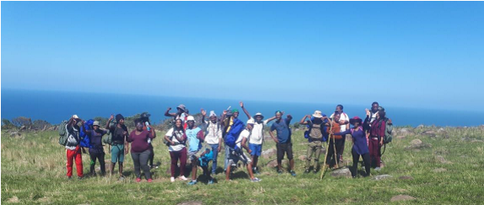
Photo: Adventure Guide Learners in the Eastern Cape

Slide 15
Awareness programmes
Over the years, the Department has been implementing a series of awareness programmes ranging from the development of awareness materials and newsletters, illegal guiding awareness inspections at various identified illegal guiding hotspots, the adjudication of tourist guides as part of the Lilizela Tourism Awards and the celebration of International Tourist Guide Day (ITGD).
Such programmes seek to create awareness about the use and availability of registered tourist guides as well as the consequence of utilising unregistered/illegal guides.
Programmes such as the Lilizela Tourism Awards and ITGD recognises tourist guides for the excellent work and for their important role in tourism.

Slide 16
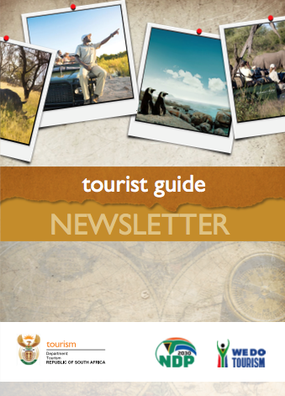
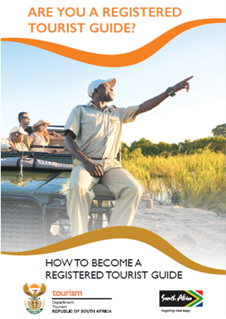
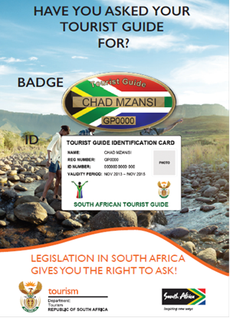
Awareness programmes (2)

Slide 17
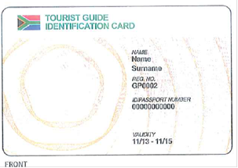
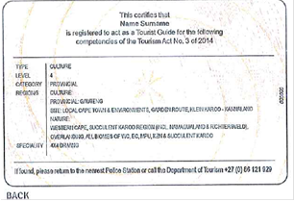
Awareness programmes (3)
Image: Identification card with security features
Photo: Members of law enforcement agencies and the tourist guiding team conducting inspections at Hluhluwe-Imfolozi Game Reserve

Slide 18
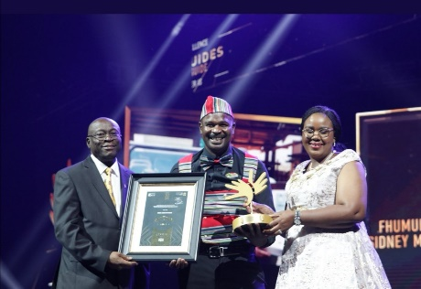


Awareness programmes (4)
Lilizela Tourism Awards – Tourist Guiding Adjudication managed by the Department.
Participation in the category has declined from 205 entries which were recorded in 2014 to just under 140 in 2019.
The Department, in collaboration with the Provincial Registrars are looking at the possibility of introducing incentives for the tourist guiding category as it is believed that it would improve the overall participation in this category and revitalise the entry process for tourist guides.
A proposal will be submitted in this regard for further consideration and approval.
Looking at opportunities to link winners with existing trade, marketing and other tourism incentive platforms.
Sidney Mikosi– 2019 Best Nature Guide (LP)
Bulelani Futshane– 2019 Best Nature Guide (WC)
Kwandiwe Waxa- 2019 Best Adventure Guide (EC)

Slide 19
Status of Provincial Registrars
Province | Appointment by MEC | Gazetting | Level of Appointment | Department or Entity
Eastern Cape |  |  | Officer | Entity
Free State |  |  | Assistant Director | Department
Gauteng |  |  | SMS | Department
KwaZulu-Natal |  |  | Deputy Director | Department
Limpopo |  |  | SMS (Director) | Department
Mpumalanga |  |  | SMS (Director) | Entity
Northern Cape |  |  | Assistant Manager | Department
North West |  |  | Director | Department
Western Cape |  |  | Deputy Director | Department

Slide 20
Thank you

