Slide 1
PRESENTATION TO THE PPC
Celebrating 20 years of honouring our Heroes and Heroines

Slide 2
PRESENTATION OUTLINE
Introduction
Background
Institutional arrangements
Programmes
Policy and Strategic Development
Performance
Labour matters
State of the site
Financial matters
Achievements
Challenges
Way forward – Strategic Focus Areas

Slide 3
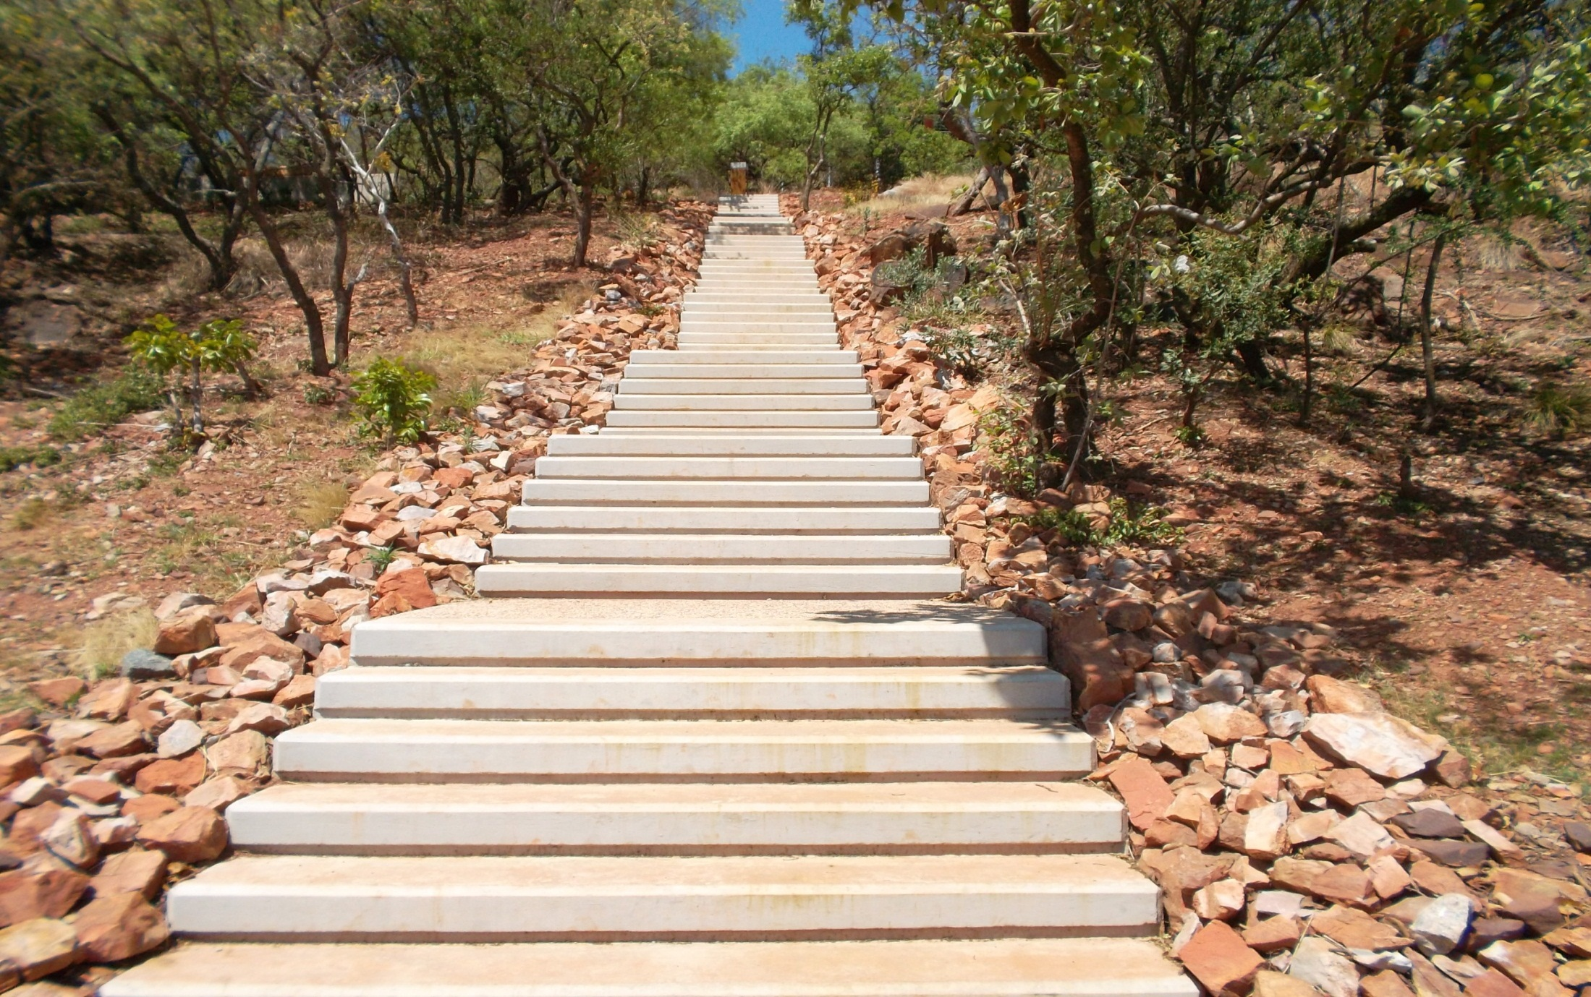
THE GENESIS- THE BEGINING
‘Taking Freedom Park to the People’

Slide 4
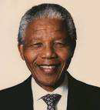
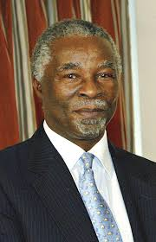
GENESIS
“ …the day should not be far off, when we shall have a people’s shrine, a Freedom Park, where we shall honour with all the dignity they deserve, those who endured pain so we should experience the joy of freedom.” - (Patron-in-Chief of Freedom Park, Former President Nelson Mandela - 1999)
“Freedom Park will be a place of hope in which will be embedded the rich history of our country and all humanity. It will represent both a transformed landscape and historical memory intertwined. It will be a place which will hold our memories in incubation, allowing them to nurture a future free of bitterness, free of hatred, free of stereotypes, free of racism, and free of the destructive fury of war.” - (Former President Thabo Mbeki - 2007)

Slide 5
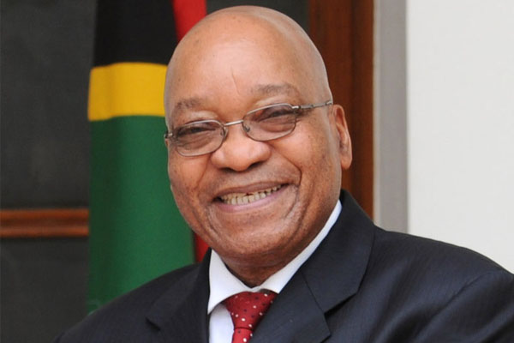
GENESIS
“..we solemnly remember that our freedom was not free. It came at a high price …There is no better place to commemorate this day than here at Freedom Park, which stands as a monument to human dignity, democracy and national reconciliation.” - (President Zuma - 2011)

Slide 6
THE PILLARS
History
Heritage(liberation)
Spirituality
Culture
Foregrounded in Indigenous Knowledge Systems

Slide 7
BACKGROUND
The Park is a 52 hectare site that was established as a Trust whose mandate was to honour those who died for freedom and humanity, and to foster reconciliation, social cohesion and nation building in the country.
The project was officially launched on 1 June 2000, and the Freedom Park Trust was established in 2001 to develop the heritage project.
In 2009, the Freedom Park Trust was declared a Cultural Institution in terms of the Cultural Institutions Act, 119 of 1998 effective from 01 April 2009.

Slide 8
BACKGROUND CONTINUED
From 2001 to 2013 Freedom Park was a construction site divided into three phases, meaning that there was less programmatic implementation.
It is worth noting that historically and over time, the operational grant received by Freedom Park has only grown marginally, and therefore, fell short of addressing inflation, increase in the staff complement and other operational requirements such as maintenance and salary increases as demanded by the market.
During the construction phase(2001-2013), Freedom Park depended on the request for the utilisation of surpluses accrued from the Capital budget in order to alleviate budget pressures.

Slide 9
MANDATE
Freedom Park is a statutory agency of the Department of Arts and Culture (DAC)
It comprises a memorial and monument that will narrate a story spanning a period of 3.6 billion years through the following seven epochs:
Earth
Ancestors
Peopling
Resistance & Colonisation
Industrialisation & Urbanisation
Nationalism & Struggle
Nation Building & Continent Building
The Park comprises a Garden of Remembrance - to acknowledge men, women and children who contributed to the freedom of the country

Slide 10
FREEDOM PARK’S VISION AND MISSION
VISION
To be a leading national and international icon of humanity and freedom
MISSION
To provide a pioneering and empowering heritage destination in order to mobilise for reconciliation, social cohesion and nation building in our country; to reflect upon our past, improving our present and building our future as a united nation; and to contribute continentally and internationally to the formation of better human understanding among nations and peoples.

Slide 11
CORE VALUES
Tolerance of diversity
Inclusivity
Trust
Transparency
Accountability

Slide 12
THE CORE BUSINESS
Creation of a national memorial and museum
Narrate the story of South Africa’s 3.6 billion years’ history and heritage
Acknowledge those that laid down their lives for freedom and humanity
Contribute to Social Cohesion, Reconciliation, Nation and continent building
Manage Freedom Park as a Cultural Institution

Slide 13
STRATEGIC OBJECTIVES
Contribute to social cohesion by positioning Freedom Park as a symbol of national identity
Establish mechanisms to promote, protect and preserve indigenous knowledge systems
Creating a conducive environment in order to attract, engage and retain effective knowledgeable talent, as measured by industry standards
Manage Freedom Park as a financially sustainable and customer focused cultural institution
Mobilise institutions through active partnerships and continental and international institutions to emancipate the African voice

Slide 14
OPERATIONAL PHASE
The last phase of Freedom Park, //hapo museum was launched on the 22 April 2013 and the institution then geared itself for full operationalisation.
This implies that more professional staff had to be appointed, a process which began in 2011- 2013
The staff complement grew from 49 to 107(currently 91)
The completion of construction also meant that the capital budget was almost depleted and therefore, the interest revenue was no longer there to buffer the shortfall
On the other hand, this also meant the beginning of the implementation of specific programmes(the APP achievement grew from about 45% to 87% in the last five years)

Slide 15
ELEMENTS OF THE PARK

Slide 16
ISIVIVANE: 16 DECEMBER 2004
This element is designed as the resting place for the spirits of those who fell in the struggle for humanity and freedom.
Visitors to this space are expected to observe the practices and protocols associated with spirituality. From a visitor experience point of view, Isivivane provides the opportunity of pilgrimage and contemplation as well as respecting traditions and practices of diverse belief systems
Isivivane has been constructed on tenets rooted in practices from the continent. There is a practice that when our people passed a village, they would, at times, not go into the village, but rather indicate that they had passed the place. The traveler would pick a stone, breath or spit on it and add it on the heap–this practice of Paying Homage to the hospitality of a place, symbolises the individuals’ interconnectedness with the landscape as well as with the people in the surrounding area.

Slide 17
ISIVIVANE CONTINUED….
To imbue Isivivane with a sense of spirituality religious leaders from various faiths performed a number of sacred ceremonies and rituals that lay to rest the spirits of our fallen heroes and heroines. Paying homage to ancestors in all societies was always preceded by personal cleansing and purification. In order to symbolically represent that act the center of the Lesaka is constantly covered in mist.
Isivivane is therefore:
A place where all South Africans can have communion with their ancestors
A place for purifying past pains and where individual pain is transformed in to a national shared pain
A home for cleansing and healing and performance for rituals that contributes to social cohesion, reconciliation, nation and continent building.

Slide 18
ISIVIVANE

Slide 19
Isivivane-Symbolic final resting place.
“ Freedom Park is dedicated to heroes and heroines in the country and the rest of the world who sacrificed in many ways and surrendered their lives so that we could be free”.

Slide 20
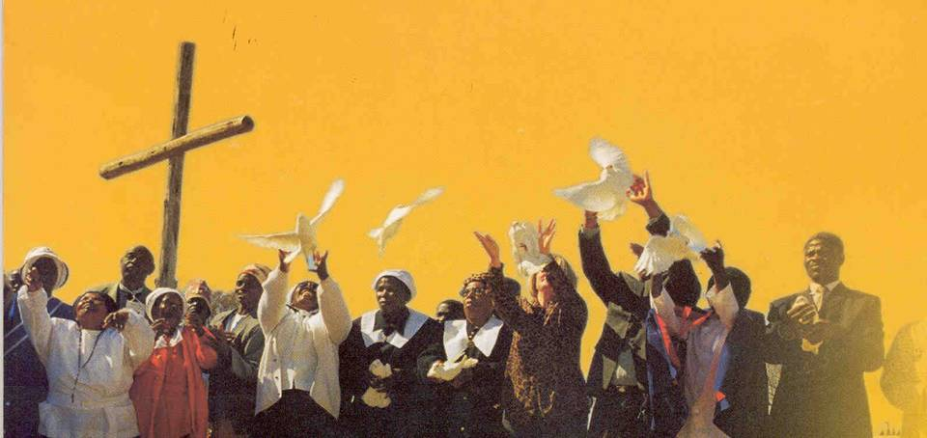
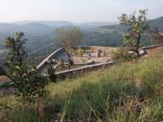
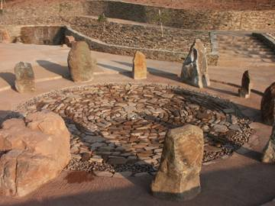
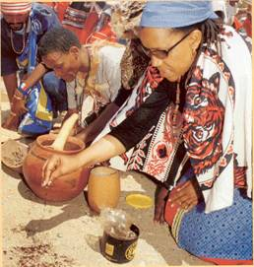
Triumph of the human spirit

Slide 21
…stands as a testimony to the conflicts that shaped the South Africa we live in today
S'KHUMBUTO: 16 DECEMBER 2007
…it commemorates those who laid down their lives for humanity and freedom

Slide 22
THE ELEMENTS OF S’KHUMBUTO
The Wall of Names is inscribed with the names of people who fell during the eight conflict events; - Pre-Colonial wars, Genocide, Slavery, Wars of Resistance, South African War, First and Second World Wars as well as the Liberation Struggle;
An Eternal Flame - honours the unknown heroes and heroines who contributed to the struggle for humanity and freedom;
The Gallery of Leaders - aims to portray nominated leaders that have been identified through a consultative process and showcased as exemplary role models worthy of being emulated; (to date 42 names have been approved)
The Sanctuary is a reflective space where visitors can ponder and contemplate, pray and intercede
The Amphitheatre with seating for up to 2 000 visitors is a public gathering space;
The Reeds symbolises the rebirth of the South African nation

Slide 23
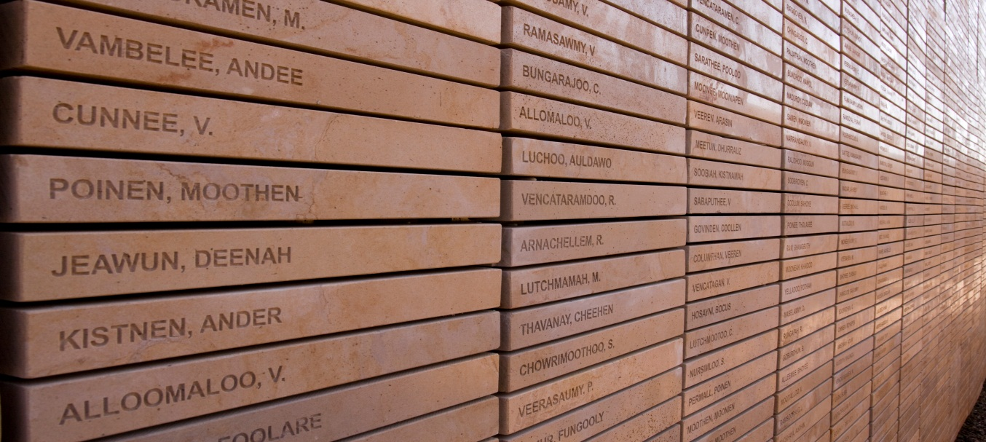
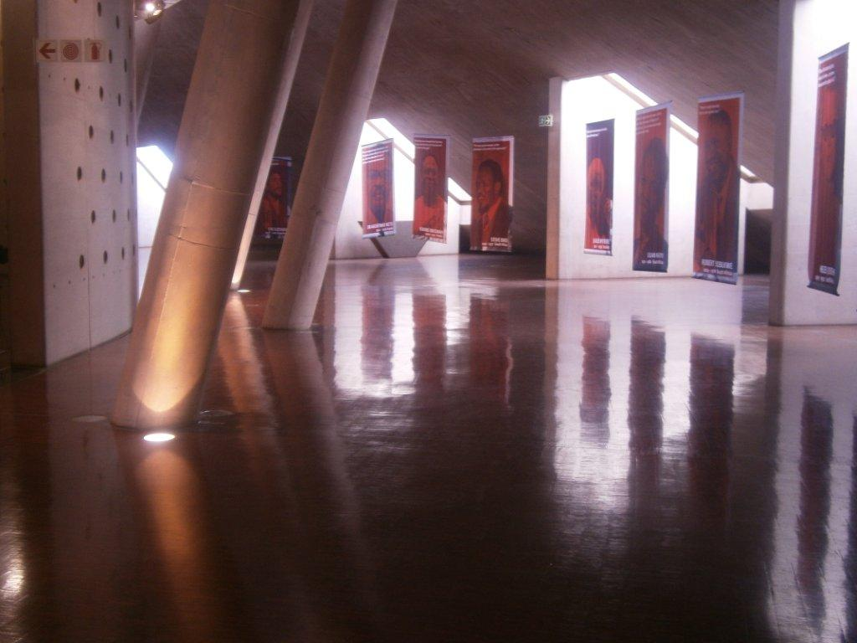
MEMORIALISATION & COMMEMORATION

Slide 24
THE REEDS

Slide 25
MOSHATE IS THE HOSPITALITY SUITE
… used for diplomatic and high-level discussions
… based on the design of the homes of Dikgosi within South Africa

Slide 26
UITSPAN PLEK
… where visitors can relax after a tour
… breath-taking views of the city and luscious lawns make this the ideal picnic spot for the family

Slide 27
THE DREAM -//hapo
Freedom Park offers //hapo - a breathtaking heritage experience that navigate visitors on a unique journey dating back 3,6 billion years and systematically traverse the seven eras or epochs from an African perspective commencing with epoch Earth, Ancestors, Peopling, Resistance and Colonization, Industrialization and Urbanization, Nationalisms and Struggle and consolidating all these epochs with the last but not least - Nation and Continent Building

Slide 28
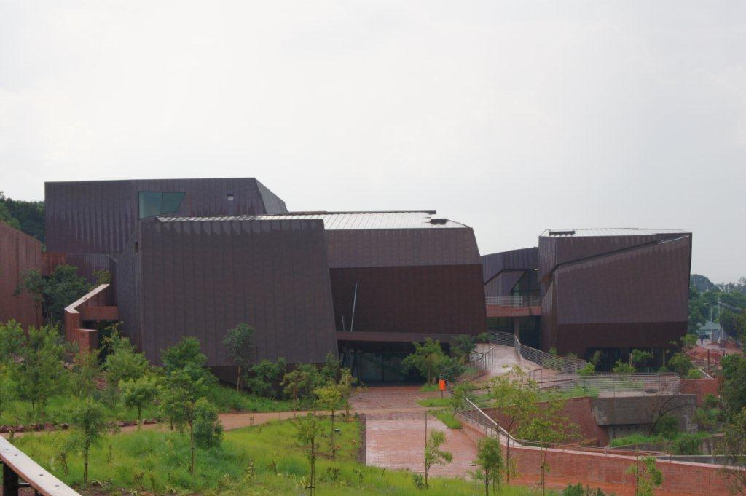

Slide 29
INSTITUTIONAL ARRANGEMENTS
Council consists of 8 members (3 Members are women)
Committees
- Core Business : Dr Raphalalani
- Audit and Risk : Ms Mohamed
- Finance and Fundraising : Mr Mpanza
- Ethics and Legal : Ms Jabosigo
- HR & Remuneration : Kgosi Mabalane
The staff compliment is 91

Slide 30
DEPARTMENTS
Currently the organisation comprise the following departments:
Office of the CEO- Ms. Jane Mufamadi
The Heritage and Knowledge Department – Mr. Tlou Makhura
Public Participation- Ms. Modjadji Makoela
Park Operations – Ms Modjadji Makoela(Acting)
Human Resources- Ms. Sharon Kekana
Finance- Ms Hulisani Ramugadi
Corporate Governance- Ms. Masesi Koto

Slide 31
OTHER COMMITTEES
Names Verification Committee (independent committee that approves the names)
Interfaith Committee(volunteers)
Western Cape Committee(volunteers)

Slide 32
THE CHALLENGES
In 2014/15 and 2015/16 , Freedom Park’s budget was cut by R20 million.
Furthermore, historically Freedom Park’s budget was approved on a cash basis despite the institutions accounting for its total cost of conducting business (i.e. making provision for depreciation/non-cash items).
The effects of depreciation on the financial performance of the institution would result in a net deficit for the foreseeable future (in 2016/2017 Treasury estimated this deficit to be R42million and 2017/18 at R15million, this year we are at R2mil).
Therefore, depreciation charge poses a significant risk to the liquidity of the Institution as it constitutes almost a quarter of the subsidy received thus cannot be accommodated through reprioritization
It is also worth noting that with the operationalization of the site, the baseline allocation was not adjusted accordingly from the construction phase to operational phase

Slide 33
HUMAN RESOURCES
In order to optimise delivery, Freedom Park embarked on a process to realign the organisational structure

Slide 34
WHY REALIGNMENT?
Organisational structure is a tool to facilitate the achievement of the institution’s objective
Since structure is derived from the organisation’s strategy, it follows that it must be “fit for purpose”
The current organisational structure is bloated, irrational, inefficient and costly
Serious mistakes were made during expansion and redeployment in preparation for planned operationalisation in 2009
Posts with one job description created on different levels on the organogram has become a source of much confusion and resentment
Span of control problematic in many cases- too wide
Line functions not clearly defined, e.g. Education, outreach, tour guides, Front line and ticketing
Some posts e.g. archiving and Resource center not based on structural requirements but ill conceived redeployment
Silos, fiefdoms
Therefore, need to streamline and coordinate in order to create coherence, effectiveness and efficiency.

Slide 35
INVESTIGATION BY COUNCIL
Union Task Team addressed a letter to Council on 06 June 2019 requesting for a meeting with Council to address ‘mismanagement of Freedom Park’
The Union (NEHAWU) was not active at the time
Council met with the Task Team on 21 June 2019
The Union Task Team raised areas of concern and Council requested that they also submit a formal submission, which was addressed to Council
Concerns raised by the Union Task Team were around Human Resources, State of the organisation, Financial Management and Cross-cutting issues

Slide 36
INVESTIGATION BY COUNCIL
Union Task Team addressed a letter to Council on 06 June 2019 requesting for a meeting with Council to address ‘mismanagement of Freedom Park’
The Union (NEHAWU) was not active at the time
Council met with the Task Team on 21 June 2019
The Union Task Team raised areas of concern and Council requested that they also submit a formal submission, which was addressed to Council
Concerns raised by the Union Task Team were around Human Resources, State of the organisation, Financial Management and Cross-cutting issues

Slide 37
INVESTIGATION BY COUNCIL (cont)
Council delegated the investigation to the Chairpersons Committee
The Investigation was finalized on 17 August 2019
Council met with NEHAWU on 30 August 2019 to provide outcome regarding the Investigation
NEHAWU was not satisfied with the outcome of the investigation
Council resolved to appoint an independent service provider through supply chain process to conduct the investigation on behalf of Council
Morare Thobejane Incorporated Attorneys were appointed on 07 October 2019

Slide 38
INVESTIGATION BY COUNCIL (cont)
NEHAWU resolved not to participate in the Investigation despite several correspondence by Council urging the Union to participate
The lawyers has since finalized the Investigation
Council considered the Draft Investigation Report on 22 January 2020
The Final Investigation Report will be shared with the Minister of Sports, Arts and Culture and all the employees of Freedom Park

Slide 39
CHALLENGES RE THE INVESTIGATION
NEHAWU resolved not to participate in the Investigation and therefore declined to be interviewed by the lawyers regarding the allegations even though the allegations emanated from the Union Task Team at the time
Some of the allegations could therefore not be investigated due to lack of information or evidence
Only Management and some of the affected staff members were interviewed by the lawyers
Some of the staff members implicated are also members of the Union
Some of the affected staff members needed more clarification and or evidence from the Union

Slide 40
ALLEGATIONS FROM THE UNION SUBMISSION
A total of 58 allegations were made by the Union
There were no adverse findings issued by the investigating lawyers
Key Findings
The lawyers found that some of the allegations:-
Could not be investigated due to non-participation by the Union Members
Were due to lack of understanding of policy and processes
Were not substantiated
Were false

Slide 41
RECOMMENDATIONS FROM THE INVESTIGATION REPORT
The Union was hijacked to advance interest of certain Union Members (eg Chairperson of Union)
The Union is using the realignment process to fight Management
The realignment process should be concluded with specific timeframes
International trips are not understood by employees
The SAPS case (R500 000 payment) has been outstanding for too long – it should be escalated to another law enforcement agency
Relationship between Management and Union has broken down – Team building exercises recommended
Individual performance should be recognized through Service Awards Policy since the payment of bonuses has been abolished

Slide 42
DISCIPLINARY REPORT 2018
Rank of employee | Reason for action | Outcome | Sanction
Education Manager | Failure to adhere to Performance and Management policy | Guilty | 1st Written warning ( 3 months)
Chief Curator | Failure to adhere to Performance and Management policy | Guilty | 1st Written warning ( 3 months)
Facilities Manager | Failure to adhere to Performance and Management policy | Guilty | 1st Written warning ( 3 months)

Slide 43
DISCIPLINARY REPORT 2018 (cont.)
Rank of employee | Reason for action | Outcome | Sanction
Events Coordinator | Failure to adhere to Performance and Management policy | Guilty | 1st Written warning( 3 months)
HOD Parks Operations | Failure to adhere to Performance and Management policy | Guilty | 1st Written warning( 3 months)
HOD: Heritage and Knowledge | Failure to adhere to Performance and Management policy | Guilty | 1st Written warning( 3 months)

Slide 44
DISCIPLINARY REPORT 2019
Rank of employee | Reason for action | Outcome | Sanction
Financial manager | Gross negligence manipulated financial report& dereliction of duties | Mutual separation Agreement | None
HOD Heritage & Knowledge | Dereliction of duties | Guilty | Final written warning (12 months)
Office Assistant | Absence without leave | Guilty | 1st Written warning ( 3 months)

Slide 45
DISCIPLINARY REPORT 2019 (cont.)
Rank of employee | Reason for action | Outcome | Sanction
Audio Visual Producer | Failure to adhere to Leave policy | Guilty | 1st Written warning ( 3 months)
HOD Heritage & Knowledge | Dereliction of duties | Guilty | Final written warning (12 months)
Education Officer | Misappropriation of Freedom Park funds | Guilty | Dismissal

Slide 46
DISCIPLINARY REPORT 2020
Rank of employee | Reason for action | Outcome | Sanction
Unit Head : Protocol and Security | Breach of Communication and Security Policy | Employee on suspension | Pending

Slide 47
STATE OF SITE
Facilities management and Security:
Freedom Park conducted condition assessment in May-June 2019
DSAC also conducted a high level condition assessment for all entities in October 2019
Freedom Park developed a 10-year preventative maintenance plan, approved by Council in July 2019.
The User Asset Management Plan was also submitted to DSAC
Council approved that Freedom Park employ a technical person on infrastructure and facilities management
Council also approved that Freedom Park appoint a Facilities Management Company.
Of the 31 audit findings in security unit as of December 2017, 30 have been addressed and 1 is in progress and would be resolved by the 31st March 2020.

Slide 48
CONTRACT MANAGEMENT
Recently awarded contracts
Contract | Duration | Cost | Saving from previous contract
Landscaping tender awarded to Leafy Space | Three years- commenced 1 September 2019-30 August 2021 | R9 299 015 35 personnel | R2 601 245 From R11 900 260 43 personnel
Security tender awarded to Titanium Security | Three years-commenced 1 Dec 2019-30 Nov 2021 | R12 755 026 26 personnel | R11 044 352 From R23 799 378 35 personnel
Repairs and maintenance of CCTV | Two years- commenced 1 Sep 2019-31 Aug 2021 | R989 402 | R0
Hygiene | 12 months | R159 238 (12 months) | R440 000.88 (24 months)

Slide 49
CHALLENGES RELATED TO PARK OPERATIONS
Maintenance of the Park facilities is challenging due to budgetary constraints
The buildings are shifting due to settlement movement, and being on the hill certain cracks are beginning to show
Most of the infrastructure, especially IT, is imported, tailor-made and difficult to replace once broken. However, most of it is being replaced by local brands
Recommend- Transfer the maintenance services of the property to the Department of Public Works and Infrastructure.
Lack of internal capacity

Slide 50
SALVOKOP COMMUNITY STRIKE
On 3 December 2019, the community of Salvokop started protests at the circle leading to Freedom Park’s main entrance.
A meeting with Ward Councillors took place to understand the sudden outrage as we had always had a cordial relationship with the community.
Their concerns were to force Freedom Park to dictate to the newly appointed security company to hire Security Officers who previously worked for the recently expired security company contract.
The Ward Councillor was requested to submit their concerns in writing and the names of those Security Officers.

Slide 51
SALVOKOP COMMUNITY STRIKE
On the 9th of December they submitted a list of 53 people
Freedom Park’s records show that the previous security company employed only 7 of the Security Officers residing in Salvokop out of the compliment of 35 officers.
Freedom Park responded through a letter disputing the allegation, and also stating all employees employed by Freedom Park:
10 permanent (this constitute about 10% of FP personnel)
11 staff contract through Freedom Park’s service providers, and 7 whose contracts expired with the Security Company
10 temporary staff and
Marshals (average of 15 per event)

Slide 52
SALVOKOP COMMUNITY STRIKE
Upon receipt of the letter, the community staged another protest at the circle next to the main entrance on the 12th December 2019
This time they were prohibiting Freedom Park staff members and visitors to pass through the circle
Freedom Park responded by calling the police to disperse the protestors,
Freedom Park Management engaged community leaders and a
a Task Team to resolve the matter was formed.

Slide 53
SALVOKOP COMMUNITY STRIKE
The meeting was held on 13 December 2019 where it was agreed that they would profile the people on the list and send their CVs through to the newly appointed security service provider
The service provider indicated that should he require more people he will give the community members first preference
Whilst the process was underway to profile the list provided by community of Salvokop, they staged yet another protest, this time at the Freedom Park entrance on 18 December 2019 prohibiting staff to leave premises. They demanded that all of them should be absorbed. Assistance was sought from SAPS
Freedom Park had no choice but to seek a court interdict.
The court granted an interim interdict on 20 December 2019. The final hearing is set for 03 March 2020.
The community continues to gather and picket at the circle on selected days and blocked the roads

Slide 54
5 Year Allocation
Year | 2016/17 | 2017/18 | 2018/19 | 2019/20 | 2020/21
 | 000’ | 000’ | 000’ | 000’ | 000’
Transfers Received | 102,812 | 106,600 | 97,275 | 95,678 | 99,700
Interest income | 4,527 | 3,135 | 4,182 | 2,500 | 2,000
Sale of Assets | 876 | - | - | - | -
Admission fees | 1,072 | 1,106.00 | 1,313 | 1,392 | 1,475
Venue Hire | 1,419 | 914.00 | 820 | 869 | 921
Tender/Other income | 429 | 3,079.00 | 150 | 159 | 169
Total income | 111,135 | 114,834 | 103,740 | 100,598 | 104,265

Slide 55
Reduction on subsidy
 | 2018/19 | 2019/20 | 2020/21 | 2021/22 | 2022/23
2018/19 Allocation | 86,227 | 91,056 | 96,064
2019/20 allocation |  | 91,056 | 96,064 | 101,347
2020/21 prelim allocation |  |  | 93,659 | 98,810
Reduction |  |  | 2,405 | 2,537
 | 2018/19 | 2019/20 | 2020/21 | 2021/22 | 2022/23
Reduction 2019/20 |  | -2,280 | -2,405 | -2,537
Reduction 2020/21 |  |  | -1,649 | -1,511 | -1,568
 |  | -2,280 | -4,054 | -4,048 | -1,568

Slide 56
5 Year Allocation
Year | 2016/17 | 2017/18 | 2018/19 | 2019/20 | 2020/21
 | 000’ | 000’ | 000’ | 000’ | 000’
Transfers Received | 102,812 | 106,600 | 97,275 | 95,678 | 99,700
Interest income | 4,527 | 3,135 | 4,182 | 2,500 | 2,000
Sale of Assets | 876 | - | - | - | -
Admission fees | 1,072 | 1,106.00 | 1,313 | 1,392 | 1,475
Venue Hire | 1,419 | 914.00 | 820 | 869 | 921
Tender/Other income | 429 | 3,079.00 | 150 | 159 | 169
Total income | 111,135 | 114,834 | 103,740 | 100,598 | 104,265

Slide 57
Budget per Department
 | 2016/17 | 2017/18 | 2018/19 | 2019/20 | 2020/21 | 2021/22 | 2022/23
 | Audited Outcome | Audited Outcome | Audited Outcome | Approved budget | Revised budget estimate | Revised budget estimate | Planning Budget Estimate
Rand thousand
Objective/Activity
Administration | 90,058 | 89,772 | 86,625 | 62,694 | 65,478 | 68,751 | 72,052
Business Development | 17,422 | 21,725 | 19,543 | 21,907 | 23,008 | 24,083 | 25,239
Public Engagement | 13,769 | 14,818 | 14,521 | 15,883 | 16,678 | 17,513 | 18,353
Total | 121,249 | 126,315 | 120,689 | 100,484 | 105,164 | 110,347 | 115,644

Slide 58
Expenditure by classification
 | 2016/17 | 2017/18 | 2018/19 | 2019/20 | 2020/21 | 2021/22 | 2022/23
 | Audited Outcome | Audited Outcome | Audited Outcome | Approved budget | Revised budget estimate | Revised budget estimate | Planning Budget Estimate
Compensation of employees | 58,568 | 60,223 | 61,446 | 64,518 | 67,393 | 70,762 | 74,159
Goods and services | 41,070 | 41,692 | 35,741 | 35,966 | 37,771 | 39,585 | 41,485
 | 99,638 | 101,915 | 97,187 | 100,484 | 105,164 | 110,347 | 115,644

Slide 59
Audit Outcome
Annual Financial Statements
Performance Information
2018/19 | 2017/18 | 2016/17 | 2015/16
Unqualified | Qualified | Unqualified | Unqualified
2018/19 | 2017/18 | 2016/17 | 2015/16
No material findings | Material Findings | Material Findings | No material findings

Slide 60
Asset management
Officials are required to take all reasonable measures to ensure that Freedom Park assets in their custody are safeguarded
Failure to prove the existence of this asset may results in fruitless and wasteful expenditure which must recovered from yourself in terms of Treasury Regulation 12.7

Slide 61
Asset management
Asset Classifications | Book value at 30/11/2018 | Depreciation | NBV (31/03/2019)
Artwork | 208,982.30 | 0.00 | 208,982.30
Computer Equipment | 2,217,873.96 | 1,438,306.14 | 779,567.82
Furniture And Fittings | 6,825,774.23 | 2,167,233.22 | 4,658,541.01
Office Equipment | 9,663,132.56 | 5,527,220.03 | 4,135,912.52
Vehicles | 922,540.00 | 893,781.24 | 28,758.76
Grand Total | 19,838,303.05 | 10,026,540.64 | 9,811,762.41

Slide 62
OUR KEY ACHIEVEMENTS
To date, more than 150 000 names have been collected and verified and of these 139 895 have been inscribed on the wall of names.
Number of names verified, validated and approved in the Gallery of leaders: 42, that is, national, continental and international.
The opening of ‘Reconciliation Road’ between Freedom Park and Voortrekker Monument
Publication of the book entitled “Freedom Park: A place of Emancipation and Meaning”
Declaration of FP as a Grade 1 national heritage site by SAHRA
Launching the Veterans Voice radio
Positive media coverage for the past four years

Slide 63
AWARDS
In 2016 FP was ranked amongst the top ten architecturally outstanding museums in the world by Visi magazine
FP was rated the best heritage site in Pretoria in 2017 and 2018 respectively by Pretoria News readers
South African Institute of Architects - Award of Merit in 2014
South African Institute of Architects - Award for Excellence- 2014
PIA Award for Architecture 2011
This project received an ILASA Award of Excellence in landscaping
Leader in Gender empowerment in South Africa in 2020-most gender empowered.

Slide 64
CHALLENGES
Challenges | Interventions | Progress
Financial constraints | Requested additional funding from DSAC Additional revenue source | Awaiting the responses Fundraising programmes planned for the years
Ownership of the Park | Written letters to Ministers DSAC and DPWI requesting land to be donated | Awaiting responses from DPWI
Structure | Realignment process Cost Containment Measures
Labour matters | Realignment process | Realignment process put in abeyance pending finalization of the investigation
Community issues | Urgent Interdict applied | Date of hearing 03/03/20

