Slide 1
PRESENTATION TO THE
PORTFOLIO COMMITTEE ON TRANSPORT ON THE
APPOINTMENT OF THE ADMINISTRATOR FOR THE
PASSENGER RAIL AGENCY OF SOUTH AFRICA (PRASA)
25 FEBRUARY 2020

Slide 2
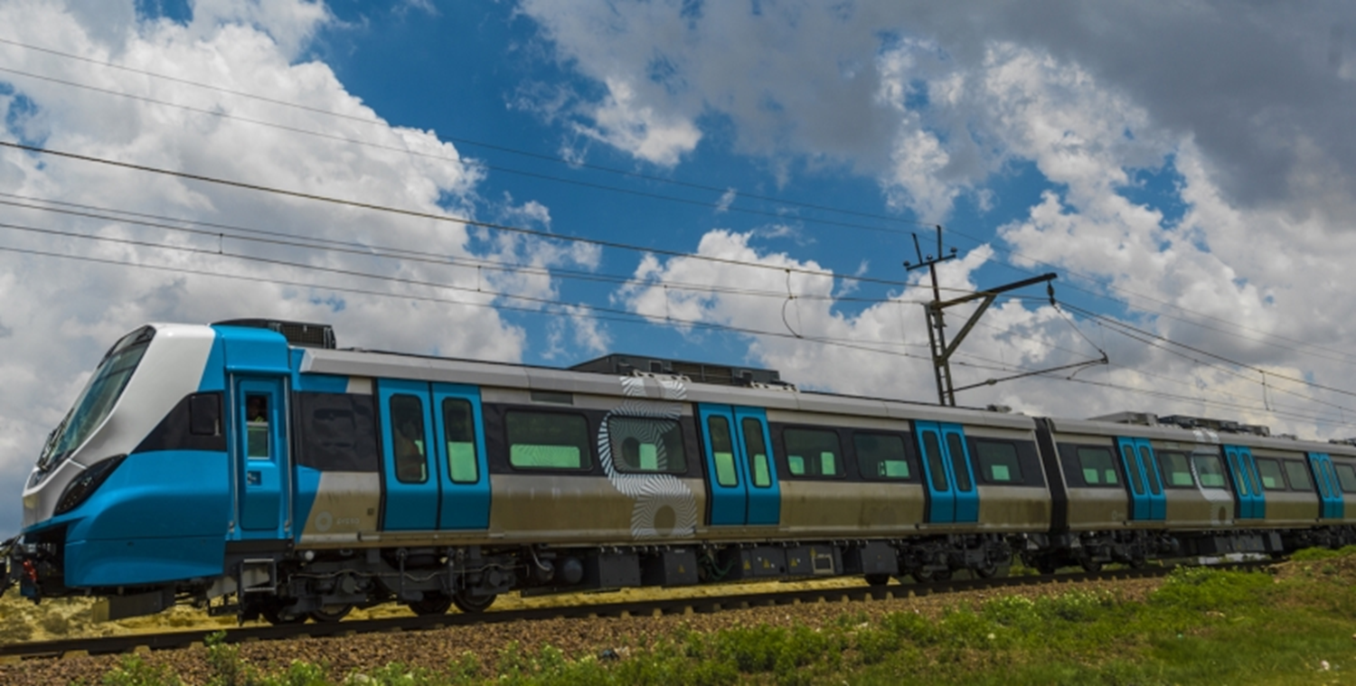
PART 1:
Operational Challenges

Slide 3
CHALLENGES POOR METRORAIL OPERATIONAL PERFORMANCE
This has primarily been driven by Metrorail’s operational performance…..
Metrorail’s On-time and Cancellation Performance
Metrorail’s reliability has declined substantially
Metrorail’s Passenger Fatalities and Weighted Injuries
Metrorail’s safety record has also been poor
The RSR has also not accepted Metrorail’s Safety Management Plan
3

Slide 4
DECLINING PERFORMANCE IN OTHER AREAS AS WELL
Other customer facing business units have also performed poorly
MLPS
PAX numbers in 18/19 equaled 387,530 compared to 3.8 million in 2008/09.
Decline mainly due to locomotive reliability and availability.
PAX numbers are down from 3.15 million in 2012/13 to 1.9 million in 17/18.
Fleet availability in 17/18 fell to a low of 90 buses out of 570.
On timing servicing of the buses in 17/18 was only 38%.
AUTOPAX
A positive is that rental revenues are up from R220 million in 2010/11 to R583 million in 2016/17.
However, the 18/19 results show that 43% of the Cres’ billings (i.e. revenue) have not been paid after 180 days.
Other returns from property investments have been curtailed by shareholder issues between Intersite and PRASA Group.
Property (CRES & Intersite)
4

Slide 5
UNTENABLE FINANCIAL POSITION
PRASA’s financial position has become increasingly untenable
Changes in PRASA’s Current Ratio
Its ability to pay its short term liabilities has been low
Improvement driven by excess cash from unspent capital subsidy
Cash generated¹ from PRASA’s Operations (R Billion)
It is increasingly dependent on BOTH its operational and capital subsidy for cash injections to stay afloat
Total cash used in operations since 2018/09 = R18 billion²
5

Slide 6
FALLING PAYING PASSENGER NUMBERS
This has led to a fall in customer satisfaction and paid passenger numbers
Customer Satisfaction Scores from Annual Surveys (%)
Metrorail Paid Passenger Numbers (millions)
6

Slide 7
EMPLOYEE COSTS CROWDING OUT OTHER EXPENDITURE
Further, expenditure on employee costs is crowding out expenditure on critical operational aspects such as maintenance and security
Changes in PRASA Cost Structure (2008/09 – 2017/18)
(Share of Total OPEX (%))
Drop in Maintenance and Security’s share
Increase in Employee Costs share
Increase in Employee cists’s share,. Drop in Maintenance and Security’s share
7

Slide 8
LEADERSHIP INSTABILITY
1. Leadership instability and poor organisational culture
Long term plans do not self-execute and require sustained and consistent leadership to succeed
Multiple ministers, boards, and GCEOs
Negative impacts of changes include
New leaders reject past plans
Creation of uncertainty and skepticism
Slowing of decisions making
Hindering of trust and relationship building with internal and external stakeholders (e.g., RSR)
Hinders building of organizational culture, values, and norms
8

Slide 9
STAFFING AND SKILLS
2. Staffing and skills
Some units are understaffed or incorrectly staffed. Others are overstaffed or under utilized
Skill shortage in rolling stock, perway, electrical, and signaling
No direct links between operating model, organizational structure and staffing decisions
Many appointments didn’t follow due process
Staff numbers, especially at Head Office have ballooned
9

Slide 10
WEAK SUPPORT FUNCTIONS
3. Weaknesses with support functions
Absence of guiding policies and processes
SCM processes are not working, negatively impacting on maintenance and capital expenditure
Poor Human Resource Management underpins staffing and skills issues
AG findings point to weaknesses in financial management processes and systems
Debt collection at PRASA is poor and starves the business of cash
Debtor days has grown from 22 days in 2012/13 to 225 days in 2017/18
10

Slide 11
CORRUPTION
4. Corruption
Past and current investigations
Public Protector’s report
Locomotive purchase
Implication of past leadership
Alleged collusion between suppliers and staff
Cumulative irregular expenditure at the 2017/18 exceeded R24.2 billion
11

Slide 12
REQUEST
We request the Portfolio Committee to note the presentation and support the Honourable Minister in his endeavour to address the challenges facing the entity.

Slide 13
Thank you!
Expect something different and refreshing from PRASA!

