Slide 1

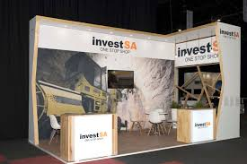
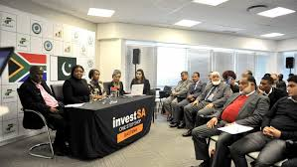

EASE OF DOING BUSINESS &
ONE STOP SHOP IMPLEMENTATION
18 FEBRUARY 2020

Slide 2

TABLE OF CONTENTS
# | Topic
1 | Investment Services
2 | Ease of Doing Business
2 | One Stop Shop Implementation
3 | Discussion & Questions

Slide 3

INVESTMENT SERVICES
Investment South Africa’s provides the following services to
investors:
Investment Information Aftercare Services
Economic Environment
Regulatory Environment
Legal Environment & Compliance
Industrial Development & Financial Support
Investment Guides
Advice on recruitment, talent & skills
Advice on lifestyle amenities e.g location of housing, schools etc.
Policy Advocacy
Investor Surveys
Business Forums and Investment Roundtables
Retention & Expansion Services
Investment Facilitation
Inter-governmental coordination and facilitation
Licencing, company registrations and work permits
Municipal facilitation
Incentives facilitation
Location analysis and facilitation
Critical infrastructure and utilities
Broad Based Black Economic Empowerment (BBBEE) Facilitation
Mediation and Arbitration
Introduction to financial institutions and funding opportunities
Priority sectors, designation and localisation
Site visits and Business to Business Programs
Partnerships with Stakeholders
Company verifications
Enterprise and supplier development
Introduction to raw materials suppliers
Advice and customs clearing
Investment promotion and international investment missions
Facilitation by the dti representatives abroad
3

Slide 4
SECTOR FOCUS
Green Industries
Renewable energy
Services Industries
Oil & gas
Resource Based Industries
Mining
Manufacturing
Advanced Manufacturing
Ship building
Ship repairs
Business process outsourcing
Films
Explorations
Agro-processing
Aquaculture
Agriculture
Mineral beneficiation
Ocean / blue economy
Automotive
Leather & footwear
Clothing & textiles
Rail
Metals fabrication
Yellow goods
Heavy vehicles
Cosmetics
FMCG
Plastics
Electronics
White goods
Aerospace
Pharma
Chemicals
Biochemical
Defence industries
Energy efficiency
Water
The waste economy
Green transport
Sustainable Development Goals

Slide 5
INVESTMENT RELATIONSHIP
Investor
National IPA
Foreign Trade Ministry
Consulting & Legal Firms
SEZ/Industrial Parks
Sectoral Institutes
Sectoral Ministries
State IPIs
Foreign Affairs Ministry
Chambers & Associations
Vision & Strategy
Linkages & Spillovers
Attraction
Sub-national IPA
Regional Development Agencies
Chambers & Associations
Consulting & Legal Firms
Sectoral Offices
SEZ/Industrial districts
Other IPIs
Challenges
Autonomy
Incoherent Messaging
Getting all partners to collaborate
Retention & Expansion
Entry & Establishment

Slide 6
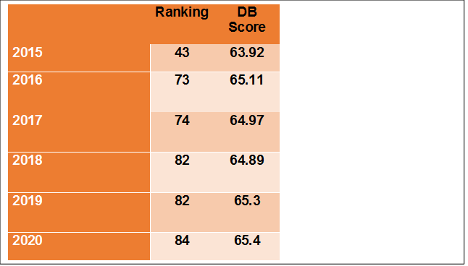
EASE OF DOING BUSINESS
INTRODUCTION
To improve South Africa’s investment climate and ease of doing business to position 50, as per the President’s State of the Nation Address within the next 2 years by 2021.
Improve South Africa’s rankings, SA currently ranked 84. In 2006 SA was ranked in the top 30.
Improve government business processes and turnaround times through automation so government can ultimately move to becoming e-government in keeping pace with global trends & practices over the next 5 years.

Slide 7

EASE OF DOING BUSINESS
PROBLEM STATEMENT
President Cyril Ramaphosa, in his 2018 SONA, committed to move South Africa to 50th position on the World Bank Doing Business Survey over the course of the next 3 years, which requires government wide collaboration.
Of concern is that over the last 10 years South Africa has declined 50 places. South Africa is currently ranked 84.
Improving South Africa’s Doing Business performance is key to strengthening the country’s investment performance, as annual DB results are used to position and market investment attractiveness to potential investors. Notably, DB results are also used by international credit rating agencies to benchmark the strength of a country’s investment and business regulatory reforms and overall investment climate.

Slide 8
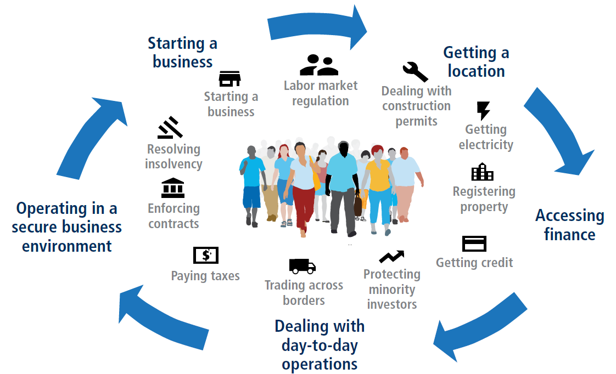
EASE OF DOING BUSINESS
The 11 areas of business regulation measured by Doing Business affect firms throughout their life cycle

Slide 9

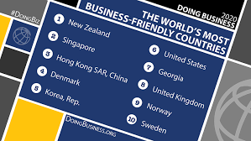
EASE OF DOING BUSINESS
HOW ARE THE RANKINGS DETERMINED
Economies are ranked on their ease of doing business, from 1–190. A high ease of doing business ranking means the regulatory environment is more conducive to the starting and operation of a local firm. The rankings are determined by sorting the aggregate scores on 10 topics, each consisting of several indicators, giving equal weight to each topic. The rankings for the 190 economies are benchmarked to May 2019.
Rankings are determined based on results of a survey undertaken by respondents per indicator.
Doing Business Score vs Rankings
Rankings are determined relative to what other countries have implemented reforms
Doing Business score previously known as Distance to Frontier (DTF) more accurate and stable.

Slide 10
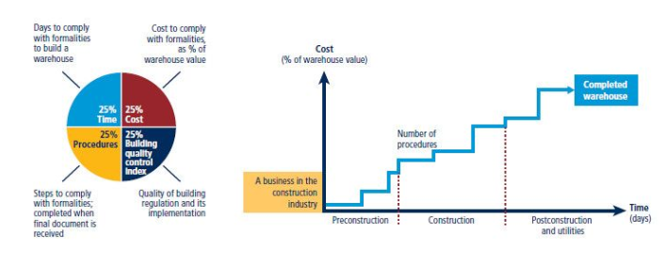
EASE OF DOING BUSINESS
WHAT DOES DOING BUSINESS MEASURE?

Slide 11
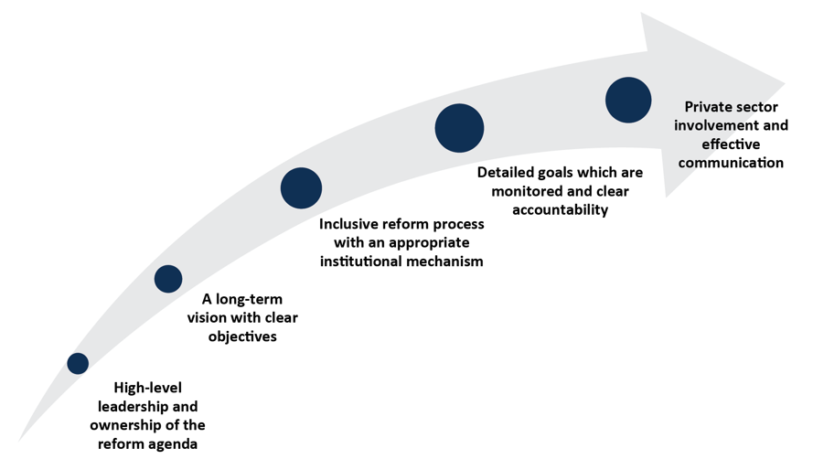
EASE OF DOING BUSINESS
COMMON FEATURES OF SUCCESSFUL REFORMERS

Slide 12
EASE OF DOING BUSINESS
South Africa is among the top performing economies in Sub-Saharan Africa but is losing ground against Mauritius, Rwanda and Kenya both in terms of ranking and DTF.

Slide 13
EASE OF DOING BUSINESS
SA’s RANKINGS ON EASE OF DOING BUSINESS INDICATORS
Ranking is volatile but Distance to Frontier is a more objective indication of SA’s performance
Indicator(s) | 2017 |  | 2018 |  | 2019 |  | 2020
 | DB Ranking (1-190) | DTF (0-100) | DB Ranking | DTF | DB Ranking | DTF | DB Ranking | DTF
Overall | 74 | 67 | 82 | 66.7 | 82 | 65.3 | 84 | 65.4
1. Starting a Business | 131 | 80.47 | 136 | 79.97 | 134 | 81.22 | 139 | 81.2
2. Paying Taxes | 51 | 81.09 | 46 | 80.02 | 46 | 81.13 | 54 | 81.2
3. Registering Property | 105 | 59.03 | 107 | 58.43 | 106 | 59.32 | 108 | 59.5
4. Trading Across Borders | 139 | 58.01 | 147 | 58.01 | 143 | 59.64 | 145 | 59.6
5. Dealing with Construction Permits | 99 | 68.21 | 94 | 67.53 | 96 | 68.25 | 98 | 68.3
6. Resolving Insolvency | 50 | 57.94 | 55 | 57.59 | 66 | 54.49 | 68 | 54.6
7. Getting Electricity | 111 | 60 | 112 | 63.21 | 109 | 68.79 | 114 | 68.8
8. Protecting Minority Investors | 22 | 70 | 24 | 70 | 23 | 73.33 | 13 | 80
9. Getting Credit | 62 | 65.2 | 68 | 60 | 73 | 60 | 80 | 60
10. Enforcing Contracts | 113 | 54.1 | 115 | 54.1 | 115 | 54.1 | 102 | 56.9

Slide 14
EASE OF DOING BUSINESS
TECHNICAL WORKING GROUPS (TWGs)
Indicator | Actions required | Responsible entities
Starting a Business | The CIPC launched the Biz Portal which integrates the registration processes of the CIPC, UIF, and Compensation Fund. The Biz Portal reduces the time and number of procedures in starting a business. | Dti/CIPC √ Dept of Labour √ Pilot Roll Out in Nov 2019
Registering a Property | EDRS Bill signed 27 September 2019. DG DRDLR to mandate the Chief Registrar Deeds and Surveyor General to accelerate implementation of process optimisation and e-lodgement in current FY. | Dept of Rural Development & Land Reform/ Office of the Chief Registrar Deeds. X To plan for e-lodgement City of Joburg X To launch e-rates clearance Conveyancers X
Paying Taxes | Reduce time taken to get a VAT refund. Ongoing training of SARS staff to improve customer experience. Ongoing improvement of SARS website and communication. | SARS √
Trading Across Borders | Requires participation from Department of Home Affairs, Agriculture, SARS, SAPS, SABS, NRCS, Transnet. To create single border management structure and undertake joint inspections. Transnet to improve Durban Port logistics and extend rail links between JHB and Durban. | SARS √ Transnet X Transnet to improve Durban Port logistics and extend rail links between JHB and Durban.
Dealing with construction permits | Amendment of the National Building Regulations Establish national standard for obtaining a construction permit. Move to national online permitting system for obtaining a construction permit. | Dti X City of Joburg X CoJ to procure local service provider. Amend National building regulations

Slide 15
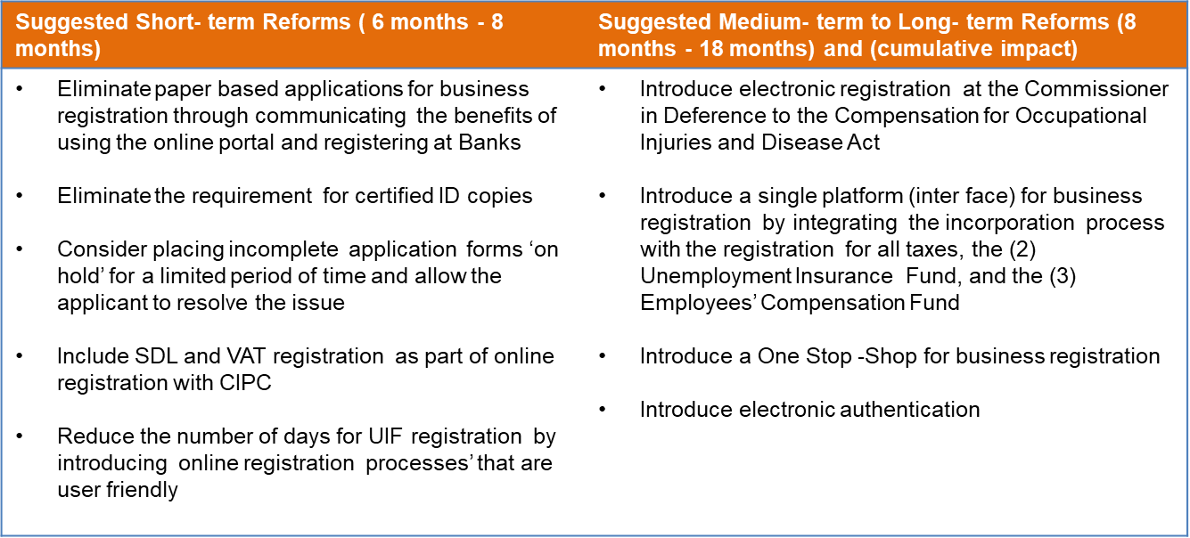
EASE OF DOING BUSINESS
IMPLEMENTATION PLAN – STARTING A BUSINESS
South Africa ranks 139th out of 190 economies on the Starting a business indicator. It takes 7 steps, 40 days and costs 0.2% of income per capita, and there is no paid-in min capital requirement
STARTING A BUSINESS
Current rank 139- future rank 9
Implementing the above-mentioned short-term recommendations would drop South Africa’s procedure count from 7 to 4, reduce days from 40 to 26, placing it in 68th place on the index. Implementing the medium and long term recommendations, would further reduce the procedures to 3, ranking to 9th position globally on this indicator.

Slide 16
EASE OF DOING BUSINESS
IMPLEMENTATION – STARTING A BUSINESS
South Africa ranks 139th out of 190 economies on the Starting a business indicator. It takes 7 steps, 40 days and costs 0.2% of income per capita, and there is no paid-in min capital requirement
Indicator | Status | Message target | Impact
Starting a Business | Achieved | Paper -based applications have been eliminated for business registration | Fast, efficient process
 | Achieved | Incomplete application forms are placed “on hold” for a limited time. | Incomplete entries dealt with efficiently
 | Achieved | UIF and Compensation fund have introduced online registration. Registration within a day. | Time reduced to start a business
 | Achieved | 99% of applications submitted online to CIPC | Fast, efficient process
 | Achieved | Obtain UIF and CF registration numbers | Reduces the amount of time spent verifying identity
 | Achieved | CIPC authenticates online application with the Department of Home Affairs. | Reduces the amount of time spent verifying identity and no uploading of documents
 | Achieved Test Launch in Oct | Biz Portal virtual one stop shop for business registration | A domestic company can register a business in 1 day, reducing the number of steps and time
 | Achieved Test Launch in Oct | Company registration, domain name and tax registration, BBBEE certificate done in real time through an online platform | Streamlined approach to register a business in 1 day, reducing the number of steps and time
 | Future | The Biz Portal allows for the verification of status of existing companies with partner regulators | Register a company in 1 day
 | Achieved | Paper -based applications have been eliminated for business registration | Fast, efficient process
 | Achieved | Incomplete application forms are placed “on hold” for a limited time. | Incomplete entries dealt with efficiently

Slide 17
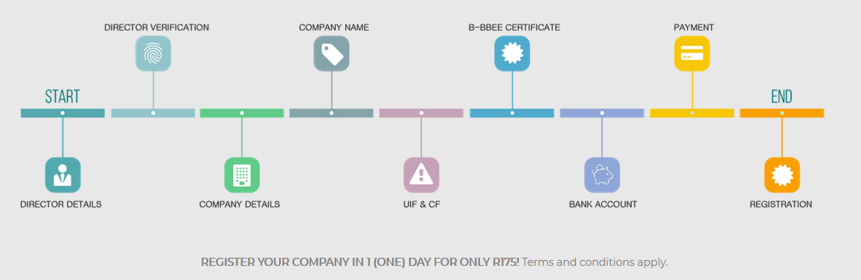
BIZ PORTAL
The Biz Portal, is a pilot-phase, single integrated company registration platform. This will allow entrepreneurs to:
Register a company
Obtain a tax registration number
Register a domain name
Obtain a B-BBEE Certificate
Register with the Compensation Fund
Register for UIF
Open a business bank account.
The Biz Portal soft launch took place in November 2019, and has since reduced the business registration time to less than one day.
Registration Process Flow
17

Slide 18
EASE OF DOING BUSINESS
STARTING A BUSINESS – Biz Portal makes headway for entrepreneurs registering a business
What’s working
What’s next
The Biz Portal was launched in 2019 Q4, with great take-up.
  This endeavour will see SA climbing through the ranks of Doing Business.
  This innovation was made possible with CIPC, UIF, CF, SARS, and the Banks.
The Private Sector Professionals have yet to verify the old process versus the new process.
We have a potential of meeting the Top 50 ranking!

Slide 19
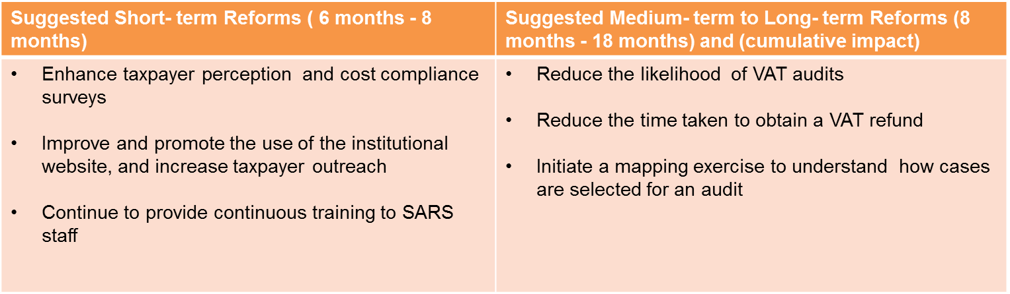
EASE OF DOING BUSINESS
IMPLEMENTATION PLAN – PAYING TAXES
South Africa ranks 54th globally out of 190 economies on the ease of Paying Taxes indicator. It takes 7 payments and 210 hours to comply with tax requirements in South Africa. The total tax rate is 29.2% of profit, while the country’s score on the post-filing index is 60.8 out of 100 points.
PAYING TAXES
Current rank 54- future rank 25
Should SA implement the reforms its ranking would improve from 54 to 25 assuming other countries do not reform.

Slide 20
EASE OF DOING BUSINESS
ACHIEVEMENTS – PAYING TAXES
South Africa ranks 54th globally out of 190 economies on the ease of Paying Taxes indicator. It takes 7 payments and 210 hours to comply with tax requirements in South Africa. The total tax rate is 29.2% of profit, while the country’s score on the post-filing index is 60.8 out of 100 points.
Indicator | Status | Message target | Impact
Paying Taxes | Achieved | Improved customer service | Improved awareness of turnaround times from SARS
 | Achieved | Service charter published- when | Published standards for what the public can expect in terms of customer service
 | Achieved | Updated website
 | Ongoing | Reduce time taken to obtain a VAT refund- | Bringing value to SME's
 | Ongoing | Reduction of VAT audits
 | Ongoing | Continuous training provided to SARS staff through SARS learning academy | To improve SARS staff response to customer needs
 | Ongoing | Simplification of Income Tax Act | To reorganise and logically sequence Income Tax Act for easy comprehension
 | Ongoing | Focus groups on financial literacy | To promote understanding of Income Tax Act to SME's

Slide 21
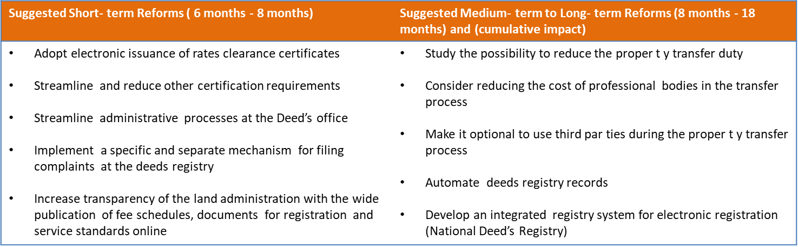
EASE OF DOING BUSINESS
IMPLEMENTATION PLAN – REGISTERING A PROPERTY
South Africa ranks 108th out of 190 economies globally on the Registering Property indicator. It takes 7 steps, 23 days and costs 8.0% of property value to transfer a property in Johannesburg. On the quality of the land administration index, South Africa scores 15.5 out of possible 30 points.
REGISTERING A PROPERTY
Current rank 108- future rank 44
Should South Africa implement all of the above short-term recommendations, its procedure count on this indicator would drop to 4, days to 16, and its score on the quality index could increase by 1 point, placing the country in 74th position globally. Should South Africa implement all of the above mentioned medium and long term recommendations, its days would drop to 15, index could increase by 6.5 points and its ranking would increase to 44th position globally.

Slide 22
EASE OF DOING BUSINESS
ACHIEVEMENTS – REGISTERING A PROPERTY
South Africa ranks 108th out of 190 economies globally on the Registering Property indicator. It takes 7 steps, 23 days and costs 8.0% of property value to transfer a property in Johannesburg. On the quality of the land administration index, South Africa scores 15.5 out of possible 30 points.
Indicator | Status | Message target | Impact
Registering a property | Achieved | Service charter developed | Reduce time taken to register a property
 | Achieved | Increased transparency and availability of information fee schedules, documents for registration and services. | Newly developed website provides relevant information to SA Citizens when registering property
 | Achieved | COJ e-rates clearance IT solution completed at launch phase | Reduces cost and time for the issuance of a Rates Clearance Certificate
 | Future | SA to develop an integrated registry system for electronic registration | Reduces number of steps, cost and time taken for registering property in SA

Slide 23
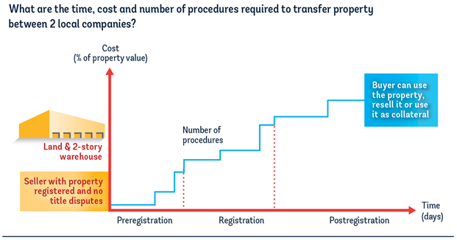
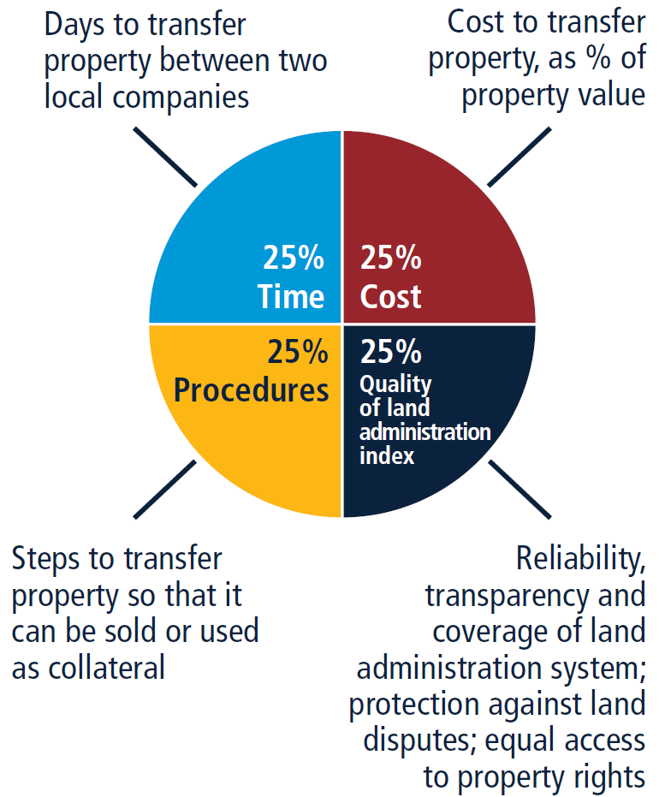
EASE OF DOING BUSINESS
WHAT DOES REGISTERING A PROPERTY MEASURE?
  The indicator measures the transfer of a commercial warehouse between two domestic limited liability companies
How is the indicator constructed?
Four sub-indicators

Slide 24
EASE OF DOING BUSINESS
Rates E-Clearance – City of Johannesburg
Key Performance Area
Target
Who
How
Benefit
1. e-Clearances
Lufuno Mashau
Pilot to 20 Conveyancers
Launch eClearance formally
Customer delight
Reduction of Turnaround times
Reduce traffic at Thuso House
11 to 7 days
What must CoJ Leadership do immediately?
Provide Deeds Office with access – verification link. Ticket resolution within 3 days through dedicated team from revenue.
A separate ‘Helpdesk’ email address will be created for support to the Conveyancers .
Pilot with 20 Conveyancers..
Launch e-Clearance to Conveyancers..
Measure daily..

Slide 25
EASE OF DOING BUSINESS
Registering Property – Department of Rural Development AND LAND REFORM
Key Performance Area
Target
Who
How
Benefit
1. e-DRS
Launch Phase I
DG
Sign-off on Financials
Phase I will replace the Mainframe system only
What must the Deeds Office do?
Obtain sign-off on the Financials to go ahead with the e-DRS. Director General.

Slide 26
EASE OF DOING BUSINESS
REGISTERING A PROPERTY
The Chief Registrar of Deeds launched a Deeds Website thereby improving the quality of information to the citizens of South Africa
What’s working
What’s next
The Deeds website makes a major contribution to the South African by providing them with useful information when buying and selling property.
  Useful property transfer information.
  Infographics on documents required and the process
  Costs involved
Whilst the Deed Website is providing useful quality information, the e-DRS has to be implemented. Steps have to be taken to mobilise this.

Slide 27
EASE OF DOING BUSINESS
REGISTERING A PROPERTY
CoJ are producing results on Rates e-Clearance Certificates since November 2019
What’s working
What’s next
CoJ launched the Rates eClearances in 2019 Q4, after experiencing security breaches in the CoJ network
  Since November 2019, 5772 e-Clearance Certificates were issued with 98% within 24 hours
  Ticket resolution within 3 days through a dedicated team
A launch to ~500 Conveyancers will be held on 11 February 2020.
Verification link to CoJ Deeds Office has to be provided
A separate ‘Helpdesk’ email to be created to support the Conveyancers.
Increase uptake of the system which is currently low.

Slide 28
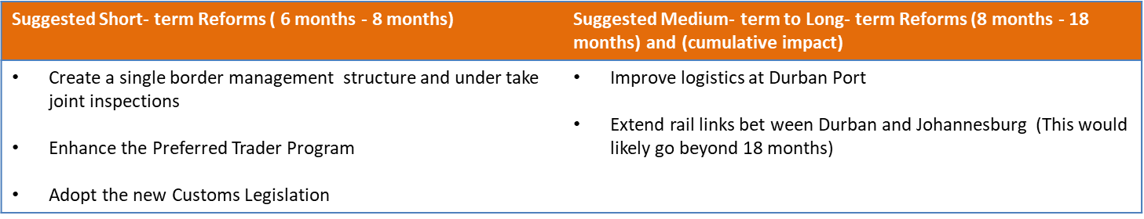
EASE OF DOING BUSINESS
IMPLEMENTATION PLAN – TRADING ACROSS BORDERS
South Africa ranks 145th out of 190 economies globally on the Trading Across Borders indicator. For export, it takes 68 hours and costs $55 for documentary compliance and 92 hours and $1257 for border compliance. For import, it takes 36 hours and costs $73 for documentary compliance and 87 hours and $676 for border compliance.
TRADING ACROSS BORDERS
Current rank 145- future rank 88
Should South Africa implement the short-term recommendations, the time under border compliance could drop from 92 to 70 hours in export procedures and from 144 to 100 hours in import procedures. Time measured under documentary compliance could be reduced from 68 to 50 hours in export procedures, and from 36 to 30 hours in import procedures. The country’s ranking would go up form 145 position to 121st globally. Should the country implement all of the medium and long-term recommendations, the time measured under border compliance could reduce from 100 to 50 hours in export procedures, and from 144 to 80 hours in import procedures. Time measured under documentary compliance could be reduced from 68 to 36 hours in export procedures, and from 36 to 18 hours in import procedures. The country ’s ranking on this indicator would have gone up from 145 position to 88th globally.

Slide 29
EASE OF DOING BUSINESS
ACHIEVEMENTS – TRADING ACROSS BORDERS
South Africa ranks 145th out of 190 economies globally on the Trading Across Borders indicator. For export, it takes 68 hours and costs $55 for documentary compliance and 92 hours and $1257 for border compliance. For import, it takes 36 hours and costs $73 for documentary compliance and 87 hours and $676 for border compliance.
Indicator | Status | Message target | Impact
Trading Across Borders | Achieved | Transnet port services fully automated | Reduces time, cost and procedures to import/export a vehicle
 | Ongoing | Expanded Preferred Traders Programme | Risk based approach involving pre-screening of accredited enterprises to fast track customs clearance
 | Future | Improved logistics at Durban port- logistics plan for Transnet | Reduces time, cost and procedures to import/export a vehicle
 | Future | Extended rail links between Johannesburg and Durban | Reduces time, cost and procedures to import/export a vehicle
 | Achieved | Cut off time reduced from 72 hours to 24 hours for pre-loading stacking vehicles to be at the port | Reduces time to import/export a vehicle
 | Achieved | Queuing times measured from inside the port gate to the stack and not from outside the gate point of entry at port to discharge of goods | Reduces time to import/export a vehicle. Reduce time for offloading.
 | Achieved | Transnet port services fully automated- what is the turnaround time. Which port services? | Reduces time, cost and procedures to import/export a vehicle

Slide 30
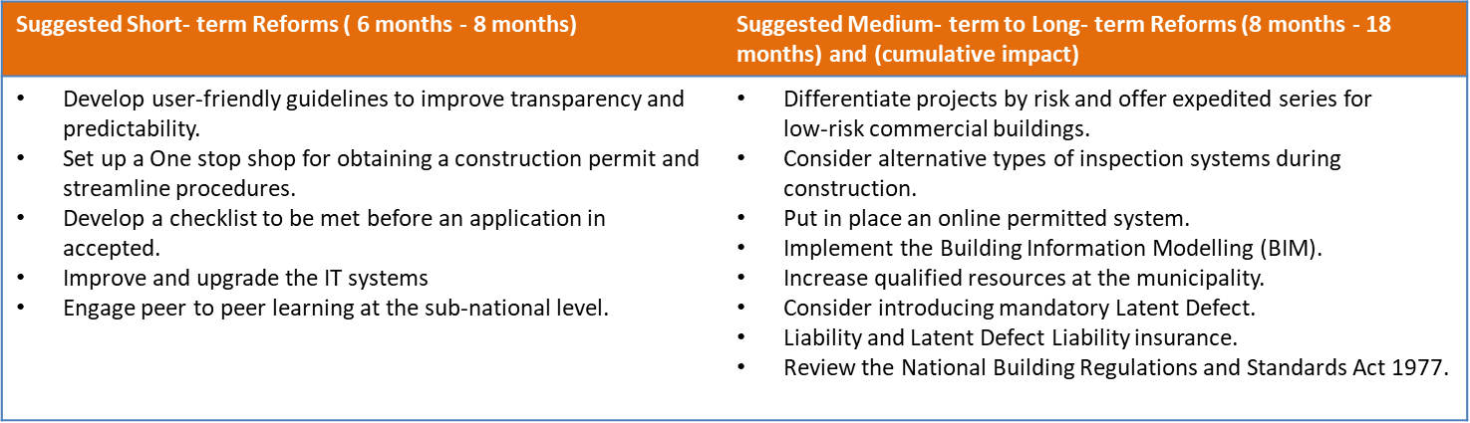
EASE OF DOING BUSINESS
IMPLEMENTATION PLAN – CONSTRUCTION PERMITS
South Africa ranks 98th out of 190 economies in the world on the ease of Dealing with Construction Permits indicator. It takes 20 steps, 155 days and costs 1.9% of warehouse value to build a warehouse. On the building control index, South Africa scores 12 out possible 15 points.
Dealing with Construction Permits
Current rank 98- future rank 7
Implementing the above-mentioned short term and medium term recommendations would further drop procedure count to 14, days to 76, and increase building quality control index to 14 points, placing it 7th globally on this indicator.

Slide 31
EASE OF DOING BUSINESS
ACHIEVEMENTS – CONSTRUCTION PERMITS
South Africa ranks 98th out of 190 economies in the world on the ease of Dealing with Construction Permits indicator. It takes 20 steps, 155 days and costs 1.9% of warehouse value to build a warehouse. On the building control index, South Africa scores 12 out possible 15 points.
Indicator | Status | Message target | Impact
Dealing with construction permits | Future | Development of a national standardised process for building plan submissions, conducting inspections and issuance of occupancy certificates. | Reduces the number of procedures, time taken and cost to obtain a construction permit
 | Future | Development of a streamlined online permitting system for CoJ | Secure, fast and measurable process institutionalised into a system.
 | Future | Seminars on SANS 10400 for selected Municipalities and Architects by the NRCS | To provide know how on standards for compliance when building
 | Future | Continuous professional development for Architects | Improve the quality of submissions by architects and reduce time to process applications
 | Current | COJ isolating warehouse applications to process within 14 days for Site Development Plans and 14 days for Building Plans | Time reduced for warehouse applications
 | Achieved | Temporary One Stop Shop achieved.
 | Current | COJ to process ALL building within 30 days and site development plans within 28 days | Time reduce for building and site development plans

Slide 32
EASE OF DOING BUSINESS
High-level Plan for CoJ – Construction Permits Jan to Jun 2020
Key Performance Area
Target
Who
How
Benefit
Ensure full implementation of Temporary OSS (TOSS)
Ensure full commitment to new turn around times for SDP and BP
Reduction of 4 steps and time
Thuli
Gcina
MOEs
SOPS to be approved and enforced
Communication internal and external
Full commitment from MOEs presence at Metrolink
Customer delight
Faster development
Job creation
SDP from 53 to 28 days
BP from 60 to 30 days
3. Commercial Property SDP
4. Commercial Property BP
Thuli
EM to Appoint tactical team
Set targets
Communicate
Measure daily
Revenue: Bill for water faster
Customer delight
10 to 15 days
5 to 10 days
Gcina
5. Final Water Connection
5 days
JHB Water
Measure
What must CoJ Leadership do immediately?
Appoint Local IT Service Provider..
Appoint Dedicated Tactical Team from existing capacity.
Communicate to Management and to External Stakeholders. Measure daily by Dedicated Tactical Team. Amolemo Mathoagae. CM, MMC and EM report weekly on a Monday
Jhb Water needs to reduce the turnaround times for Final Water connection.

Slide 33
EASE OF DOING BUSINESS
CONSTRUCTION PERMITS
CoJ are producing results on Rates eClearance Certificates since November 2019
What’s working
What’s next
CoJ launched that Rates eClearances in 2019 Q4, after experiencing security breaches in the CoJ network
  Since November 2019, 5772 eClearance Certificates were issued with 98% within 24 hours
  Ticket resolution within 3 days through a dedicated team
A launch to ~500 Conveyancers will be held on 11 February 2020.
Verification link to CoJ Deeds Office has to be provided
A separate ‘Helpdesk’ email to be created to support the Conveyancers.
Increase uptake of the system which is currently low.

Slide 34
EASE OF DOING BUSINESS
DEALING WITH CONSTRUCTION PERMITS
CoJ has implemented reforms that are beginning to reap benefits
What’s working
What’s next
CoJ Land Use Management department has taken steps to become more customer centric.
  Single touchpoint without the need to obtain comments from the MoEs reducing procedures by 4 steps.
  91% of SDPs were approved within 28 days (previously 53 days)
Achieving stretch
  SDPs will be approved within 10 to 15 days with the introduction of a dedicated task team, for Commercial Property.
Building Plans
  Approvals/Refusals for Commercial Property will be done within 5 to 10 days with a reorganisation of the teams in Building Control.
Digitisation – implementation of Construction Permitting Management System
Provision of training of NBR, Regulations and SANS10400 to the Officials

Slide 35
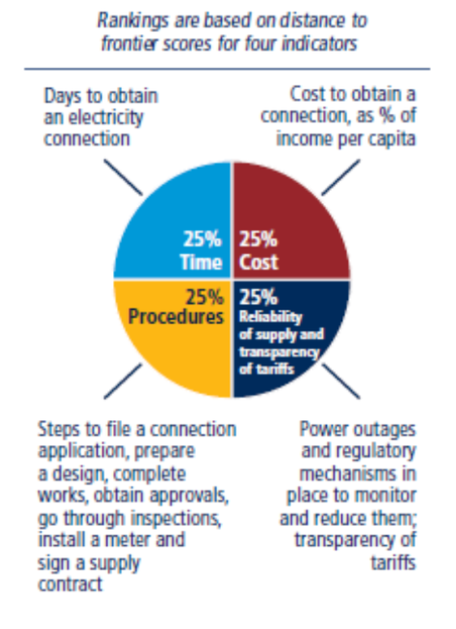
EASE OF DOING BUSINESS
REPORT – GETTING ELECTRICITY
“How easy is it for a new medium – size commercial customer to get a connection to the electricity network?”
What does the Getting Electricity indicator measure?
Number of procedures, time and cost needed by an enterprise to get a new electricity connection.
The reliability of supply provided by the company to its consumers.

Slide 36
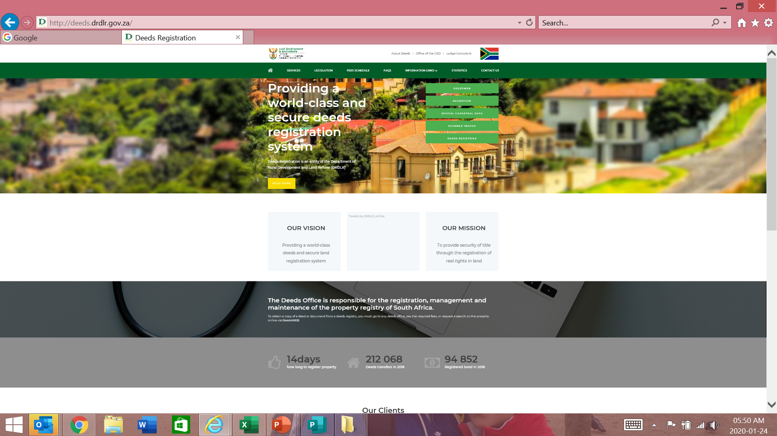
EASE OF DOING BUSINESS
Pillars of Success
Biz Portal
e-DRS
Building Plans
eClearances

Slide 37
EASE OF DOING BUSINESS
STAKEHOLDERS CONSULTED
STAKEHOLDERS | STAKEHOLDERS
Presidency, Economic Advisor, Investment & Infrastructure Office | E & Y
National Treasury | City of Johannesburg
SARS | eThekwini
Department of Agriculture, Land Reform and Rural Development (DALRRD) | City of Cape Town
The Office of the Chief Registrar Deeds | University of Johannesburg
Transnet | University of South Africa
South African Freight Forwarders Association | Presentations made to BUSA, BBC, BLSA
PwC | PPGI
SAICA | SACAP
ECSA | SAIT

Slide 38
EASE OF DOING BUSINESS
RECOMMENDATIONS
Indicator | Actions required
Starting a Business | The CIPC launched the Biz Portal which integrates the registration processes of the CIPC, UIF, and Compensation Fund. The Biz Portal reduces the time and number of procedures in starting a business. Need to ensure that the UIF and Compensation Fund links are active.
Registering a Property | EDRS Bill signed 27 September 2019. DG DRDLR to mandate the Chief Registrar Deeds and Surveyor General to accelerate implementation of process optimisation and e-lodgement in current FY.
Paying Taxes | Reduce time taken to get a VAT refund. Ongoing training of SARS staff to improve customer experience. Ongoing improvement of SARS website and communication.
Trading Across Borders | Requires participation from Department of Home Affairs, Agriculture, SARS, SAPS, SABS, NRCS, Transnet. To create single border management structure and undertake joint inspections. Transnet to improve Durban Port logistics and extend rail links between JHB and Durban.
Dealing with construction permits | Amendment of the National Building Regulations Establish national standard for obtaining a construction permit. Move to national online permitting system for obtaining a construction permit. SABS to make accessible SANS 10400 required for municipalities to conduct inspections.

Slide 39
THE ONE STOP SHOP CONCEPT
Serve and accessible entry point for investors in need of regulatory compliance with laws and / or regulations at a national level;
Change regulator decision process (registration, licencing, permitting, land allocation or property registration) by increasing transparency, clarify regulations and improve the quality and timeframe of service;
Perform pre-and post investment screening for appropriate investors and investments into South Africa on a project by project basis;
Assist in various incentives (tax, land, training, special economic zones, etc.);
Participate in the regulatory reform / roadmap process of South Africa;
Facilitate the approval of services (market data, costs, incentives, project approval, visits, local partners, etc.) to investors; and
Facilitate the approval of regulatory services (permits, approvals, import equipment & raw materials, central bank profit repatriation, work permits, etc.) to the investor.

Slide 40
KEY GOVERNMENT PARTNERS
The list of strategic national government departments -
Trade and Industry
Cooperative Governance and Traditional Affairs
Environmental Affairs & Forestry & Fisheries
Finance
Health
Home Affairs
Employment and Labour
Mineral Resources and Energy
Public Enterprises
Agriculture, Rural Development and Land Reform
Science and Technology
Human Settlements, Water and Sanitation
Small Business Development
All Agencies / SOEs impacting on investment facilitation

Slide 41
IMPLEMENTATION APPROACH
Inter-governmental relations framework:
ONE STOP SHOP
INVESTSA DTI
PIPA
PROVINCIAL
DEPT
SEZ
METROS & DISTRICTS
NATIONAL & PROVINCIAL PARTNERS
Minister of Trade & Industry wrote to all Premiers in July 2016 i.r.o the implementation and readiness of the provinces.
Responses received from the Gauteng, Western Cape and KwaZulu-Natal provinces for first phase of implementation which led to establishment of OSS in those provinces. Work is underway to roll out to the other provinces.
MECs for Economic Development delegated their Provincial Investment Promotion Agencies to work with InvestSA to establish the OSSs.
Strong emphasis on compliance to legislative requirements.

Slide 42
IMPLEMENTATION PHASES
First briefing in provinces
Project Planning
Stakeholder Engagement
Site Identification and Space Planning
Launch Planning
Operations
Implementation of Governance Model
The Provincial Investment Promotion Agency (IPA) takes responsibility for the implementation.
the dti and PIPA signs a Memorandum of Agreement for 3 years.
The PIPA must ensure that all provincial stakeholders are invited to participate.
the dti provides project management support.
The overall period from first consultation session in provinces before the launch can take up
to 12 months.

Slide 43
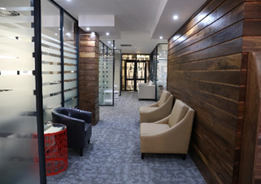



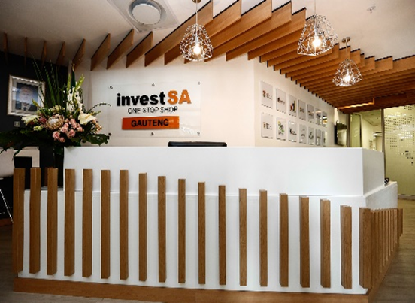
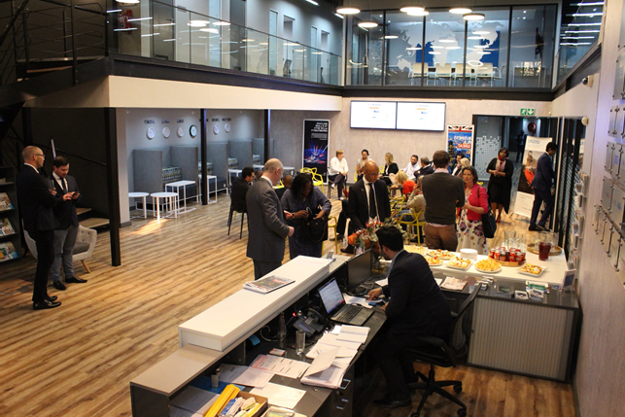

LAUNCH OF THE OSS FACILITIES
Effectively facilitating investment
National Government / Agencies / SOEs / Provincial Partners

Slide 44

STAKEHOLDER ENGAGEMENT - EC
Ensuring inclusivity and OSS sustainability
Consultations started – ORT; Alfred Nzo, Sarah Baartman & Nelson Mandela.
Proposals for satellite offices.
Management of satellite offices.
Meeting schedule.
DTI function and responsibility
Guide on process of operational control & integration.
Establishment of satellite offices at the SEZ / IDZ in accordance with
legislation.

Slide 45
GOVERNANCE
the dti
PIPAs
MoA outlines:
Roles & responsibilities
Operational management
Funding
Reporting
M&E
STEERCOM
PROVINCIAL PMO & SECRETARIAT
FACILITIES
FINANCE & SCM
STAKEHOLDER MANAGEMENT
ICT & CRM
MARKETING & COMMUNICATIONS
High Level Strategic Structure

Slide 46
WORKSTREAMS
ONE STOP SHOP PROVINCIAL OPERATIONAL STRUCTURE
Facilities
Draft specifications for location
Oversee refurbishment & operations
Finance & SCM
Unblocking of administrative / procedural delays
Manage expenditure
Stakeholder Management
ID all provincial stakeholder groups
Draft a continuous stakeholder engagement plan
ICT
Marketing & Communications
ID project manager
Budget allocation
Manage appointment of professional services / contracting
Facilitate MoU with stakeholders
Monitor & report
ID ICT requirements
Incorporate ICT infrastructure requirements in space planning
Ensure effective functioning of ICT
Monitor & report
Manage development of website
Manage CRM system
Draft Marketing & Communications Plan
Mobilise Provincial Marketing & Comms Practitioners
Implement Marketing & Comms activities
Monitor & report
Monitor & report
Monitor & report
ESTABLISHED AT CONCEPTUALISATION PHASE FOR DURATION OF THE ONE STOP SHOP

Slide 47
CORPORATE IDENTITY
  InvestSA developed a Corporate Identity (CI) Manual that outlines the broad branding principles that will be applied across all provinces.
  Enhances standardised brand across all provinces.
  Provinces can expand the CI Manual where applicable.

Slide 48
MARKETING & COMMS
  InvestSA developed a Marketing and Communications Plan example for customisation at provincial level.
  This was developed in collaboration with Brand South Africa and GCIS.
Advertising
Social Media
Promotional Work

Slide 49
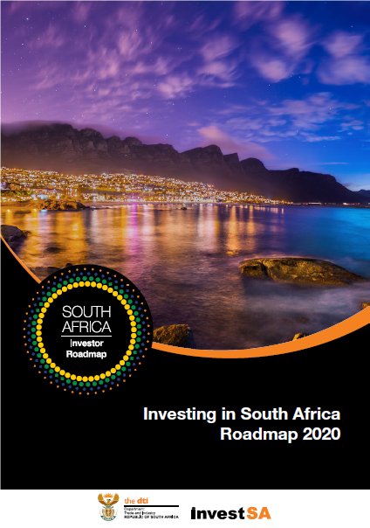



Investsa publications
InvestSA produced a number of publications in collaboration with the Industrial Development Division that will now expand its marketing collateral significantly.
Digital copies will be disseminated to all stakeholders i.e. PIPAs, Provincial Economic Development Departments; DIRCO; Metros; Industry Associations; Chambers and Embassies.
The publications are also available on the InvestSA website: www.InvestSA.gov.za

Slide 50








Investsa publications

Slide 51





Investsa publications
ACCELERATING ECONOMIC GROWTH BY BUILDING PARTNERSHIPS

Slide 52
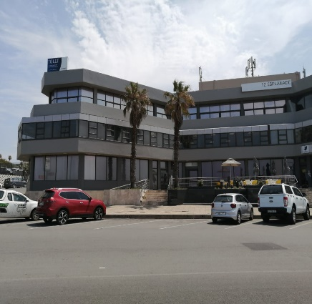
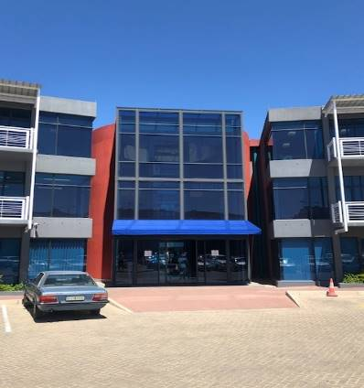
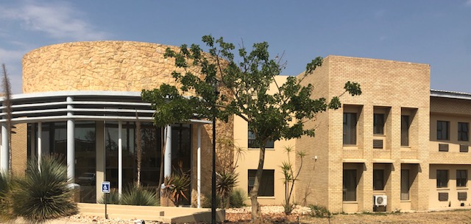
NEW ONE STOP SHOPS IN 2019/20
Providing a smooth landing for investors
Stakeholder consultation on the expansion of the InvestSA One Stop Shops in the Limpopo; Eastern Cape and Northern Cape Provinces continued during the reporting period.
All supply chain management processes and refurbishment for the above sites started for completion in Q4.
The table below illustrates the progress in brief:
# | Province | Summary Progress
1 | Eastern Cape | Refurbishment finalised Supply chain management process underway for AV equipment & furniture Occupation of site early January Projected launch readiness, March 2020 Project Governance implementation
2 | Northern Cape | Site identification finalised Stakeholder Engagement Plan finalised Stakeholder consultations ongoing Project Governance implementation in process Marketing & Communications Plan finalised Projected launch date February-March 2020
4 | Limpopo | Site location identified Supply chain management process for AV equipment, furniture & refurbishment in process Stakeholder consultations conducted Governance Structure discussed and agreed on Initial costing for refurbishment conducted Project Governance implementation Projected launch date is March 2020
Eastern Cape OSS site
Northern Cape OSS site
Limpopo OSS site
National Government / Agencies / SOEs / Provincial Partners

Slide 53
INTER-DEPARTMENTAL COLLABORATION
ENSURING A SMOOTH LANDING FOR INVESTORS
InvestSA and other Government Departments have established various structures to ensure rapid resolution of any VISA and other impediments for investors.
This includes the establishment of the:
  Inter-Departmental and Join Project Meeting; and
  Deputy Director General Meeting.
Joint Project Meeting (operational)
*DTI
*DHA
*DE&L
*DIRCO
DDG Meeting (strategic)
*DTI
*DHA
*DE&L
*DIRCO
Other relevant Departments / Agencies invited depending of the nature of the investment project

Slide 54
THE UNBLOCKING PROCESS
Effective coordination of unblocking across Invest SA One Stop Shops
InvestSA deals with administrative regulatory issues for unblocking specifically for the private sector.
Unblocking can happen at any stage of the investment cycle.
Process – National - InvestSA project manager request; national government mobilised (recordal of information).
Inter-governmental task teams (DTI, DHA, DE&L etc.).
Provincial – OSS operational committees.
Investment Lead Management System to be introduced in February 2020 that will incorporate national (training to be conducted from end January 2020).
The process is running effectively.

Slide 55
TYPES OF UNBLOCKING
Effective coordination of unblocking across Invest SA One Stop Shops
Municipal facilitation
Immigration
Environmental Impact Assessments – timeline etc.
Labour
Incentives
Energy
Licences
Permits
Standards (imports)
Tax
CIPC related but specifically registering foreign companies
Relocation of burial sites

Slide 56
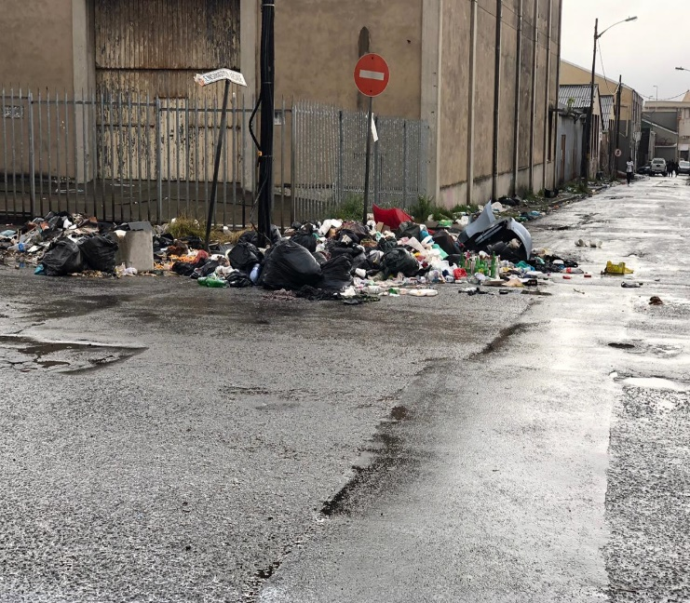
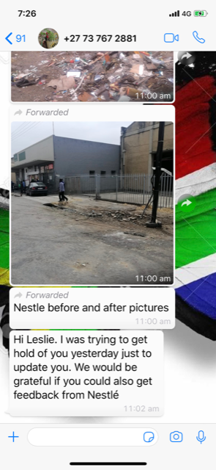
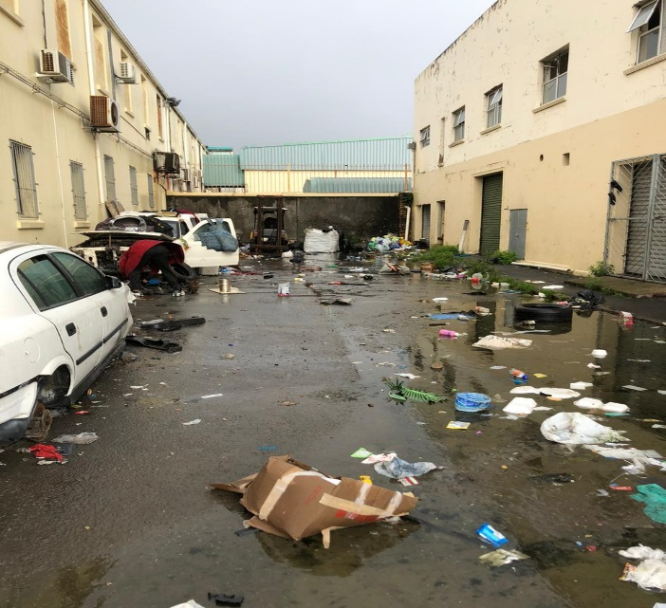
TYPES OF UNBLOCKING
Effective coordination of unblocking across Invest SA One Stop Shops
Nestle intervention with BCM – December 2019

Slide 57



