Slide 1
THIRD QUARTER PRELIMINARY PERFORMANCE INFORMATION (01 OCTOBER-31 DECEMBER 2019)
GCIS Presentation

Slide 2
Presentation outline
1. Introduction
2. Overview of the Organisational Environment
2.1 Establishment
2.2 Vacancy Per Occupational Category
2.3 Employment Equity Status
2.4 Progress on Employment Equity Per Quarter
3. Summary of Organisational Performance
4. Summary of Achievements
5. Delayed Targets
6. Programme Performance Information
7. GCIS 2019/20 Total Budget And Overview
8. Budget vs Expenditure – 30 December 2019

Slide 3
1. INTRODUCTION
Communication & Content Management
The legal requirement related to the production of quarterly performance reports is reflected in the Treasury Regulations. Section 5.3.1, which states that the Accounting Officer of an institution must establish procedures for quarterly reporting to the Executive Authority to facilitate effective performance monitoring, evaluation and corrective action.
Quarterly performance reports function as an ‘early warning system’ to alert departments to areas of weak performance, potential problems and where corrective action is required. This in-year monitoring report also serves as an oversight tool to the Department of Planning, Monitoring and Evaluation (DPME) and National Treasury (NT) and, as a management tool for departments.
The 2019/20 Third Quarter Preliminary Performance Report provides unaudited achievements against the targets set in the 2019/20 Annual Performance Plan.
The reported preliminary performance information will be verified by Internal Audit for validity and accuracy during the fourth quarter of 2019/20 financial year.

Slide 4
2. OVERVIEW OF THE ORGANISATIONAL ENVIRONMENT
The department complied with the legislative requirements of National Treasury, DPSA and DPME by submitting the following documents:
The second quarter 2019/20 performance report was submitted to National Treasury, DPME and Executive Authority according to prescribed legislation according to prescribed legislation
The second quarter 2019/20 interim financial reporting was compiled and submitted to National Treasury on 31 October 2019.
Appointment of the Chief Director: Communication Service Agency was approved by the Minister. The Chief Director assumed duty in January 2020.

Slide 5
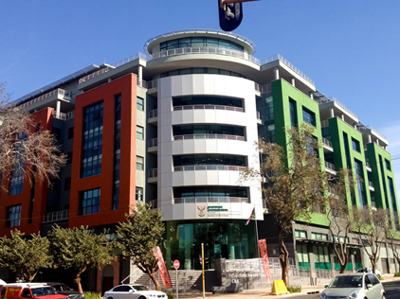
2.1 STAFF ESTABLISHMENT
ORGANISATION
ADDITIONAL POSTS
APPROVED
POSTS:
468
61
FILLED POSTS:
416
% OF FILLED POSTS:
88.89%
APPROVED: 53
FILLED : 47
VACANT POSTS
52
VACANCY RATE
11.11%

Slide 6
2.2 STAFF ESTABLISHMENT PER OCCUPATIONAL CLASSIFICATION
PERMANENT POSTS
Occupational categories | Number of posts | Filled posts | Number of vacant posts | Vacancy rate
Top Management (Salary level 15-16) | 4 | 1 | 3 | 75%
Senior management (Salary 13-14) | 49 | 46 | 3 | 6.12%
Professionally qualified and experienced specialists and mid-management (Salary level 9-12) | 222 | 198 | 24 | 10.81%
Skilled technical and academically qualified workers (Salary level 6-8) | 158 | 139 | 19 | 12.02%
Semi-skilled and discretionary decision making (Salary level 3-5) | 35 | 32 | 3 | 8.57%
Total | 468 | 416 | 52 | 11.11%

Slide 7
2.3 EMPLOYMENT EQUITY STATUS
GENDER
DISABILITY
RACE
AFRICAN:
Target: 75%
Current: 85.10 % (+10.10%)
FEMALE:
Target: 50%
Current 58% (+8%)
Target: 2%
Current: 3.37%
(+1.37)
COLOURED:
Target: 9%
Current: 6.49 % (-2.51%)
MALE:
Target: 50%
Current: 42% (-8%)
INDIAN:
Target : 5%
Current: 2.88% (-2.12%)
WOMEN AT SMS LEVEL :
Target : 50%
Current: 53%
WHITE:
Target: 11%
Current: 5.53 % (5.47%)

Slide 8
2.4 PROGRESS ON EMPLOYMENT EQUITY PER QUARTER

Slide 10
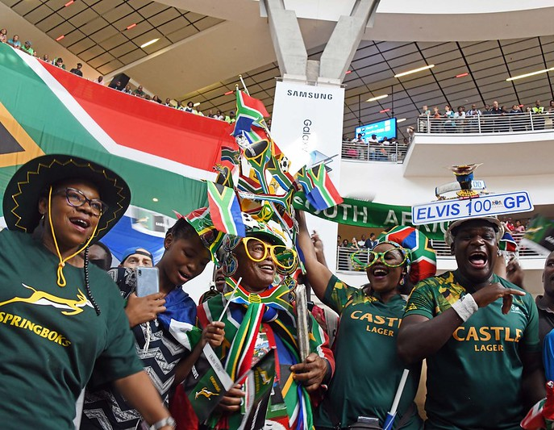
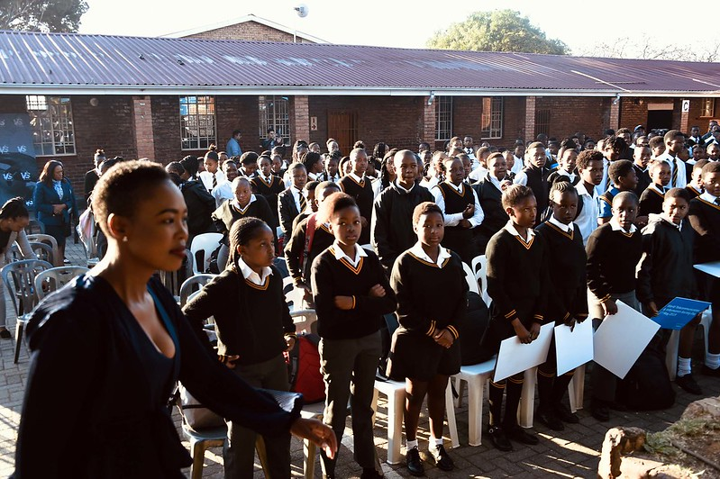
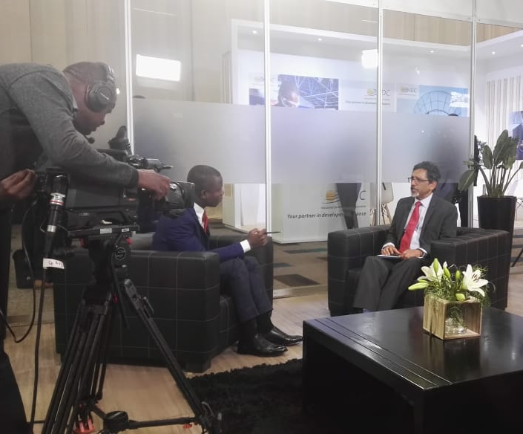
Highpoints Q3: Thuma Mina – more efficient way of working
Taking Post Cabinet decisions to citizens
Uniting the nation behind Springboks – GCIS & DSAC lead a national roadshow
District Development Model launches
406 stakeholder liaison visits
146 graphic designs

Slide 11
4. DELAYED TARGETS
Performance Indicator | Target October- December | Preliminary Output October- December | Deviation | Reason for Deviation | Corrective Action
Number of radio products and services provided | 60 radio products and services provided | 47 radio products and services provided . | Target underachieved by -13 | Fewer radio services were requested than anticipated when setting the target Attribute this to overall budget cuts | The radio unit explore other platforms that do not necessarily require huge budgets.
Number of requests for media briefings received from government departments conducted per year | 25 requests for media briefings received from government departments conducted per year | 16 requests for media briefings received from government departments conducted per year | Target underachieved by 9 | Few requests for media briefings were received . Other departments utilise their venues | GCIS will continue to allocate media briefings to our facilities as they attracted wider coverage
Number of government communicators trained | 25 government communicators trained | 9 government communicators were trained | Target underachieved by -16 | This Quarter coincides with Public Servants studying and less trainings were requested. | While the annual target has already been exceeded based on previous demand there are likely to be significantly more training requests in Quarter 4

Slide 12
4. DELAYED TARGETS ….continued
Performance Indicator | Target October- December | Preliminary Output October- December |  | Deviation | Reason for Deviation | Corrective Action
Number of marketing events for Thusong programme held | 62 marketing events for Thusong programme held | 59 marketing events for Thusong programme were held | Target underachieved by -3 |  | Underachievement was experienced due to vacancies in provinces | All vacancies are in the process of being filled and Thusong Marketing will be up scaled in the coming quarter

Slide 13
5. PROGRAMME PERFORMANCE INFORMATION
Programme 1
Administration
Purpose
Provide strategic leadership, management and support services to the department

Slide 14
PROGRAMME 1: ADMINISTRATION
Sub-programme: Strategic Management
Performance Indicator | Target October - December | Preliminary Output October - December | Deviation | Reason for Deviation | Corrective Action
APP tabled in Parliament within prescribed regulations | Second draft 2020-2023 APP submitted to National Treasury and the DPME as a legislative requirement | Second draft is no longer required as per Revised Framework for Strategic Plan and Annual Performance Plans | 0% | None | None
Number of approved quarterly performance reports submitted to National Treasury, Department of Planning, Monitoring and Evaluation (DPME), and Executive Authority, according to prescribed legislation | Second quarter 2019/20 performance report submitted to National Treasury, DPME and Executive Authority according to prescribed legislation | The Second quarter 2019/20 performance report was submitted to National Treasury, DPME and Executive Authority according to prescribed legislation according to prescribed legislation | 0% | None | None
Annual Report tabled in Parliament within National Treasury guidelines and legislative time frames | No Target | No Target | None | None | None

Slide 15
Sub-programme: Strategic Management
Performance Indicator | Target October- December | Preliminary Output October- December | Deviation | Reason for Deviation | Corrective Action
Number of progress reports on the implementation of the risk-mitigation plans produced | Second quarter 2019/20 progress report on implementation of risk-mitigation reports were produced | First quarter 2019/20 progress report on implementation of the enterprise risk management framework was produced | 0% | None | None

Slide 16
PROGRAMME 1 CONTINUED…..
Sub-programme: Human Resources
Performance Indicator | Target October- December | Preliminary Output October– December | Deviation | Reason for Deviation | Corrective Action
MTEF Human Resource Plan (HRP) implemented | No target | No target | None | None | None
Sub-programme: Information Management and Technology
Number of reports on IM&T governance implemented | One report on the availability of IT Infrastructure presented to the IM&T SC | The 2019-20 second quarter report on IT Infrastructure Availability was presented to the IM&T Steering Committee on 23 October 2019 | None | None | None
 | One report on IM systems development presented to the IM&T SC | 2019/20 second quarter report on IM systems development was presented to the IM&T Steering Committee on 23 October 2019 | None | None | None

Slide 17
PROGRAMME 1 CONTINUED…….
Sub-programme: Finance, Supply Chain Management and Auxiliary Services
Performance Indicator | Target October– December | Preliminary Output October – December | Deviation | Reason for Deviation | Corrective Action
Annual financial statements issued within legislated prescripts | Second quarter 2019/20 interim financial reporting compiled and submitted to National Treasury | The second quarter 2019/20 interim financial reporting was compiled and submitted to National Treasury on 31 October 2019. | None | None | None
Sub-programme: Internal Audit
Risk-based Internal Audit Plan and operational plan updated and implemented | No target | No target | None | None | None
Number of progress reports on assurance audits produced | One progress report on performance, compliance, financial audit conducted | The progress report on performance, compliance, financial audits conducted was developed. | None | None | None

Slide 18
6. PROGRAMME PERFORMANCE INFORMATION
Programme 2
Content Processing and Dissemination
Purpose
Provide strategic leadership in government communication to ensure coherence, coordination, consistency, quality, impact and responsiveness of government communication

Slide 20
Programme 2: Content Processing and Dissemination
Products and Platforms
Performance Indicator | Target October – December | Preliminary Output October – December | Deviation | Reason for Deviation | Corrective Action
Number of copies of Vuk’uzenzele Newspaper produced | 4250000 copies of Vuk’uzenzele newspaper produced | 4 250 000 copies of Vuk’uzenzele newspaper were produced | None | None | None
Number of editions of PSM magazine published annually | Three editions of PSM magazine published | Three editions of the PSM magazine were published. | None | None | None
An online edition of SAYB and Pocket Guide to South Africa published annually | 2018/19 SAYB and Official Guide to South Africa published | 2018/19 SAYB and Official Guide to South Africa published | None | None | None
Percentage of language services requests completed | 100% language services requests completed | 100% (339) language services requests completed | None | None | None
News updates on key government programmes and activities | Daily news updates on key government programmes and activities (excluding some public holidays, weekends and holiday periods. | Daily news were updated on key government programmes and activities: 1. Stories published over quarter: 593 | None | None | None

Slide 21
PROGRAMME 2: CONTENT PROCESSING AND DISSEMINATION. CONTINUED…
Products and Platforms
Performance Indicator | Target October - December | Preliminary Output October – December | Deviation | Reason for Deviation | Corrective Action
Updated content on the www.gov.za website as per items received (excluding public holidays, weekends and holiday periods) | Daily content updates to the www.gov.za website as per items received (excluding public holidays, weekends and holiday periods) | Daily content updates to the www.gov.za website as per items received | None | Website updated on some public holidays and weekends in order to have a current website | None
Updated social media accounts as per content received (excluding public holidays, weekends and holiday periods) | Daily updates on GCIS social media accounts implemented (excluding public holidays, weekends and holiday periods) | Daily updates on GCIS social media accounts were implemented (excluding public holidays, weekends and holiday periods) | None | Updates took place on weekends and public holidays so that social media accounts are current | None

Slide 22
PROGRAMME 2 CONTINUED…
Sub-programme: Policy and Research
Performance Indicator | Target October– December | Preliminary Output October– December | Deviation | Reason for Deviation | Corrective Action
Number of cluster reports on perceptions of government priorities produced | Five cluster reports on perception of government priorities produced | Five cluster reports on perception of government priorities produced | None | None | None
Number of reports on government communication monitoring and evaluation (GCME) produced | No target | No target | None | None | None
Percentage of requested key messages produced. (excluding weekends, public holidays and holiday periods) | Produce 100% of key messages requested. (excluding weekends, public holidays and holiday periods) | 100% (47) key messages requests were produced | None | None | None
Percentage of opinion pieces produced (excluding weekends, public holidays and holiday periods) | Produce 100% of opinion pieces requested (excluding weekends, public holidays and holiday periods) | 100% (18) opinion pieces requests were produced. | None | None | None

Slide 23
PROGRAMME 2 CONTINUED…
Sub-programme: Communication Service Agency
Performance Indicator | Target October- December | Preliminary Output October– December | Deviation | Reason for Deviation | Corrective Action
Percentage of approved media buying campaigns implemented | 40% of approved media-buying campaigns implemented | 50% of approved media-buying campaigns were implemented | Target overachieved by +10% | More requests were received than anticipated. | None
Number of photographic services provided per year | 100 photographic services provided | 126 photographic services were | Target overachieved by 26 | More request for photographic services were received than anticipated when setting the target | None
Number of video services provided per year | 150 video services provided | 188 video services were provided | Target overachieved by 38 | More requests for video coverage were received than anticipated when setting the target | None
Number of radio products and services provided per year | 60 radio products and services provided | 47 radio products and services were provided | Target overachieved by -13 | Fewer radio services were requested than anticipated when setting the target. Reduced departmental budgets | The radio unit will explore other packages that require less budget

Slide 24
PROGRAMME 2 CONTINUED…
Sub-programme: Communication Service Agency
Performance Indicator | Target October– December | Preliminary Output October– December | Deviation | Reason for Deviation | Corrective Action
Number of graphic designs completed per year | 80 graphic designs completed | 146 graphic designs were completed | Target overachieved by +66 | More requests for graphic design were received than anticipated. | None
Percentage of approved marketing services activities implemented | 100% of approved marketing services requests implemented | 100% (21) of approved marketing services request were implemented. | None | None | None
Number of GCIS print products distributed | Six GCIS print products distributed | 9 GCIS print products were distributed | Target underachieved by +3 | Both September 2019 editions were distributed in October 2019 due to the transition to a new printing service provider. The GCIS 2018-19 annual report was also distributed. | None

Slide 25
7. PROGRAMME PERFORMANCE INFORMATION
Programme 3
Intergovernmental Coordination and Stakeholder Management
Purpose
Implement development communication through mediated and unmediated communication channels and foster sound stakeholder relations and partnerships

Slide 26
ICSM – A CONTEXTUAL ANALYSIS
Quarter 3 saw solid progress however:
Overachievements must be contextualised:
Development Communication activations (face-to-face interactions) remain very poplar and demand for various themed outreaches e.g. such as GBV and 2019 Ruby World Cup activities in this Q3, continue to grown on GCIS Provinces and Districts.
However, current resources mean these activities e.g. Taxi Rank or Mall Activations; Community Marches etc, reach fewer people and therefore do not have as much impact as they could. The most important resource in delivering these remains the District Based Communicators of the GCIS and their partners.
They would be far more impactful and reach more people if backed-up by paid for social media and community radio work; tens of thousands could thus be reached as opposed to between 300 and 2000 people per event currently. (Free such mediums are used but these have limits.).
Community and stakeholder engagements will always increase when activities are to be arranged – the major emphasis on GBV meant many more local engagements and discussions with stakeholders were needed to deliver these activities.
Underachievements have been outlined on slide 11 above, however:
Many government media briefings happen and GCIS prefers these to be at the GCIS. More work is needed to get all government briefings through Tshedimosetso House, Hatfield and the Imbizo Centre, Parliament.
Training of government communicators is currently on demand and the indicator was set based on the historical baseline.

Slide 27
PROGRAMME 3: INTERGOVERNMENTAL COORDINATION AND STAKEHOLDER MANAGEMENT
Sub-programme: Media Engagement
Performance Indicator | Target October– December | Preliminary Output October– December | Deviation | Reason for Deviation | Corrective Action
Number of engagements between government officials and senior journalists on the government PoA held | Three engagements between government officials and senior journalists on the government PoA held | Three engagements were held between government officials and senior journalists. | None | None | None
Number on post-Cabinet media briefings and/or statements issued after ordinary Cabinet meeting | Four post-Cabinet media briefings and/or statements issued after ordinary Cabinet meeting per quarter | Four post-Cabinet media briefings and/or statements were issued after ordinary Cabinet meeting. | None | None | None

Slide 28
PROGRAMME 3: INTERGOVERNMENTAL COORDINATION AND STAKEHOLDER MANAGEMENT
Sub-programme: Media Engagement
Performance Indicator | Target October – December | Preliminary Output October – December | Deviation | Reason for Deviation | Corrective Action
Number of requests for media briefings received from government departments conducted per year | 25 media briefings conducted | 16 requests for media briefings received from government departments conducted per year | Target underachieved by -9 | Few requests for media briefings were received . Other departments use their own venues | GCIS will always try to get media briefings to be done in our facilities as they tend to have wider coverage
Number of biweekly Rapid Response reports produced (excluding December and January) | Six bi-weekly Rapid Response reports produced (excluding December and January) | Six bi-weekly Rapid Response reports were produced | None | None | None

Slide 29
PROGRAMME 3: INTERGOVERNMENTAL COORDINATION AND STAKEHOLDER MANAGEMENT CONTINUED….
Sub-programme: Cluster Communication
Performance Indicator | Target October– December | Preliminary Output October– December | Deviation | Reason for Deviation | Corrective Action
Number of Cluster Communication Plans (CCP) developed | No target | No target | None | None | None
Number of reports on the implementation of Cluster Communication Plans | 10 reports developed on the implementation of the 2019/20 CCPs | 10 reports were developed on the implementation of the 2019/20 CCPs. | None | None | None
Number of engagements with HoCs held | One engagement with HoCs held | One engagements with HoCs was held | None | None | None

Slide 30
PROGRAMME 3: INTERGOVERNMENTAL COORDINATION AND STAKEHOLDER MANAGEMENT CONTINUED….
Sub-programme: Cluster Communication
Performance Indicator | Target October– December | Preliminary Output October– December | Deviation | Reason for Deviation | Corrective Action
Number of Internal Communicators’ Forum (ICF) held | Two ICFs held | Two ICFs were held | None | None | None
Number of government communicators trained per year | 25 government communicators trained | 9 government communicators trained | Target underachieve- 16 | This Quarter coincides with Public Servants studying and less trainings were requested. | While the annual target has already been exceeded based on previous demand there are likely to be significantly more training requests in Quarter 4

Slide 31
PROGRAMME 3: INTERGOVERNMENTAL COORDINATION AND STAKEHOLDER MANAGEMENT CONTINUED….
Sub-programme: Provincial and Local Liaison
Performance Indicator | Target October– December | Preliminary Output October– December | Deviation | Reason for Deviation | Corrective Action
Number of reports on support to the functioning of government communication system produced (provincial and local level) | One report on support to the functioning of government communication system produced (provincial and local level) | One report on the support to the functioning government communication system was produced. | None | None | None
Number of development communication activations aligned to the GCP | 228 development communication activations aligned to the GCP were conducted | 426 development communication activations aligned to the GCP were conducted | Target overachieved by 198 | Overachievement on the target was due provided on SA Rugby World Cup, Gender Based Violence, and Launch of District Model | None
Number of marketing events for Thusong programme held | 62 marketing events for Thusong programme held | 59 marketing events for Thusong programme were held | Target underachieved by -3 | Underachievement was experienced due to vacancies in provinces | All vacancies are in the process of being filled and Thusong Marketing will be up scaled in the coming quarter

Slide 32
PROGRAMME 3: INTERGOVERNMENTAL COORDINATION AND STAKEHOLDER MANAGEMENT CONTINUED….
Sub-programme: Provincial and Local Liaison
Performance Indicator | Target October– December | Preliminary Output October- December | Deviation | Reason for Deviation | Corrective Action
Number of community and stakeholder liaison visits undertaken | 399 community and stakeholder liaison visits undertaken | 405 community and stakeholder liaison visits undertaken | Target overachieved by +6 | Overachievement was due to the support provided for Rugby World Cup. | None
Number of reports on Izimbizo events held | One report on Izimbizo events held per quarter | One report on 15 izimbizo events held was produced. | None | None | None
Number of electronic My District Today newsletters published. | 10 electronic My District Today newsletters published | 10 electronic My District Today newsletters were published | None | None | None

Slide 33
8. GCIS 2019/20 TOTAL BUDGET AND OVERVIEW
BUDGET 2019/20 R 441 683 000 – 100%
Less: Compensation of Employees (COE) - (R273 302 000) – 62%
Less: Contractual/Commitments/Capital - (R131 206 000) – 30%
Balance: Operational Costs - R 37 175 000 – 8%
2

Slide 34
9. Budget vs Expenditure – 2nd and 3rd Quarters 2019/20
PROGRAMME | TOTAL BUDGET | 2ND QUARTER ENDED 30 SEPTEMBER 2019 |  | 3RD QUARTER ENDED 31 DECEMBER 2019
 |  | ACTUAL EXPENDITURE | % SPENT | ACTUAL EXPENDITURE | % SPENT
 | R'000 | R'000 |  | R'000
PROGRAMME 1: ADMINISTRATION | 163 823 | 85 663 | 52.3% | 125 943 | 76,9%
PROGRAMME 2: CONTENT PROCESSING AND DISSEMINATION | 152 890 | 71 137 | 46.5% | 110 332 | 72,2%
PROGRAMME 3: INTERGOVERNMENTAL COORDINATION AND STAKEHOLDER MANAGEMENT | 124 970 | 57 896 | 46,3% | 89 896 | 71,9%
TOTAL | 441 683 | 214 696 | 48.6% | 326 171 | 73,8%
Benchmark: 50% at 30 September 2019; 75% at 31 December 2019

Slide 35
9. Budget vs Expenditure – 2nd and 3rd Quarters 2019/20
ECONOMIC CLASSIFICATION | TOTAL BUDGET | 2ND QUARTER ENDED 30 SEPTEMBER 2019 |  | 3RD QUARTER ENDED 31 DECEMBER 2019
 |  | ACTUAL EXPENDITURE | % SPENT | ACTUAL EXPENDITURE | % SPENT
 | R'000 | R'000 |  | R'000
COMPENSATION OF EMPLOYEES (CoE) | 273 302 | 125 069 | 45,8% | 193 418 | 70,8%
TRANSFERS AND SUBSIDIES * | 64 | 115 | 179% | 265 | 414%
OPERATIONAL: - GOODS AND SERVICES (G&S) - CAPITAL ASSETS ** | 168 317 166 141 2 176 | 89 512 83 362 6 150 | 53.2% 50,2% 282% | 132 488 125 369 7 119 | 78.7% 75,5% 327%
TOTAL | 441 683 | 214 696 | 48.6% | 326 171 | 73.8%
* Funds shifted from CoE; awaited promulgation of 2019 AENE ** Funds shifted from G&S; awaited promulgation of 2019 AENE Benchmark: 50% at 30 September 2019; 75% at 31 December 2019

Slide 36
Thank you
- End -

