Slide 1
SECOND QUARTER ACTUAL PERFORMANCE INFORMATION (01 July-30 September 2019)
GCIS Presentation

Slide 2
Presentation outline
1. Introduction
2. Overview of the Organisational Environment
2.1 Establishment
2.2 Vacancy Per Occupational Category
2.3 Employment Equity Status
2.4 Progress on Employment Equity Per Quarter
3. Summary of Organisational Performance
4. Summary of Achievements
5. Delayed Targets
6. Programme Performance Information
7. GCIS 2019/20 Total Budget And Overview
8. Budget vs Expenditure – 30 September 2019

Slide 3
1. INTRODUCTION
Communication & Content Management
The legal requirement related to the production of quarterly performance reports is reflected in the Treasury Regulations. Section 5.3.1, which states that the Accounting Officer of an institution must establish procedures for quarterly reporting to the Executive Authority to facilitate effective performance monitoring, evaluation and corrective action.
Quarterly performance reports function as an ‘early warning system’ to alert departments to areas of weak performance, potential problems and where corrective action is required. This in-year monitoring report also serves as an oversight tool to the Department of Planning, Monitoring and Evaluation (DPME) and National Treasury (NT) and, as a management tool for departments.
The 2019/20 Second Quarter Preliminary Performance Report provides unaudited achievements against the targets set in the 2019/20 Annual Performance Plan.
The reported preliminary performance information will be verified by Internal Audit for validity and accuracy during the third quarter of 2019/20 financial year.

Slide 4
2. OVERVIEW OF THE ORGANISATIONAL ENVIRONMENT
The department complied with the legislative requirements of National Treasury, DPSA and DPME by submitting the following documents:
The 2018/19 Annual Report was tabled in Parliament within National Treasury guidelines and legislated time frame, on 27 September 2019.
The first quarter 2019/20 performance report was submitted to National Treasury, DPME and Executive Authority according to prescribed legislation.
The first quarter 2019/20 interim financial reporting was compiled and submitted to National Treasury on 31 July 2019
Recommendations to appoint a Chief Director: Communication Service Agency were routed for Minister’s approval. The Director: Information Technology assumed duty on 1 October 2019. The Director: Digital Media assumed duty on 1 November 2019

Slide 5
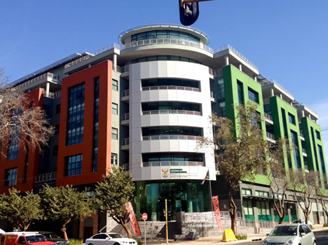
2.1 STAFF ESTABLISHMENT
ORGANISATION
ADDITIONAL POSTS
APPROVED
POSTS:
468
40
FILLED POSTS:
421
% OF FILLED POSTS:
90%
APPROVED: 53
FILLED : 48
VACANT POSTS
47
VACANCY RATE
10.04%

Slide 6
2.2 STAFF ESTABLISHMENT PER OCCUPATIONAL CLASSIFICATION
PERMANENT POSTS
Occupational categories | Number of posts | Filled posts | Number of vacant posts | Vacancy rate
Top Management (Salary level 15-16) | 4 | 1 | 3 | 75%
Senior management (Salary 13-14) | 49 | 47 | 2 | 4.08%
Professionally qualified and experienced specialists and mid-management (Salary level 9-12) | 222 | 199 | 23 | 10.36%
Skilled technical and academically qualified workers (Salary level 6-8) | 158 | 142 | 16 | 10.12%
Semi-skilled and discretionary decision making (Salary level 3-5) | 35 | 32 | 3 | 8.57%
Total | 468 | 421 | 47 | 10.04%

Slide 7
2.3 EMPLOYMENT EQUITY STATUS
GENDER
DISABILITY
RACE
AFRICAN:
Target: 75%
Current: 85.27 % (+10.27%)
FEMALE:
Target: 50%
Current 58% (+8%)
Target: 2%
Current: 3%
(+1)
COLOURED:
Target: 9%
Current: 6.41 % (-2.59%)
MALE:
Target: 50%
Current: 42% (-8%)
INDIAN:
Target : 5%
Current: 2.85% (-2.15%)
WOMEN AT SMS LEVEL :
Target : 50%
Current: 52%
WHITE:
Target: 11%
Current: 5.46 % (5.54%)

Slide 8
2.4 PROGRESS ON EMPLOYMENT EQUITY PER QUARTER

Slide 10
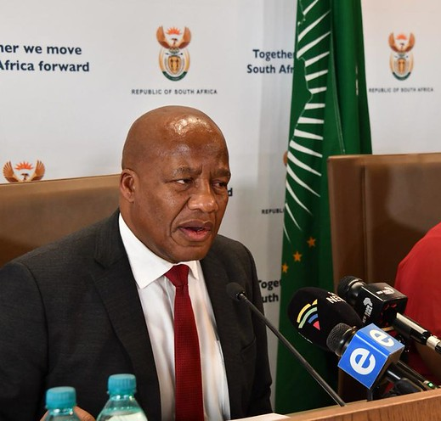
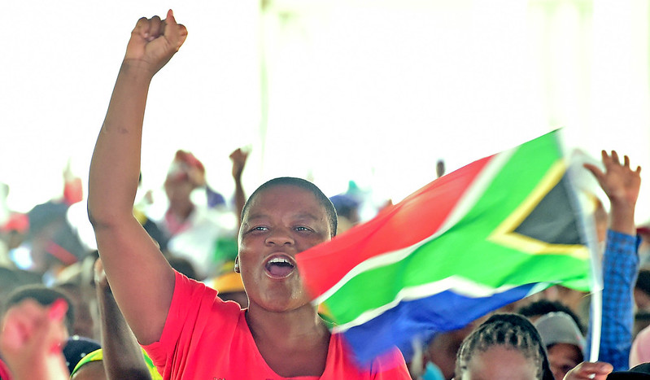
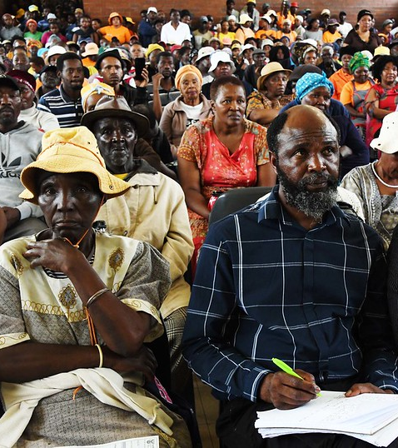
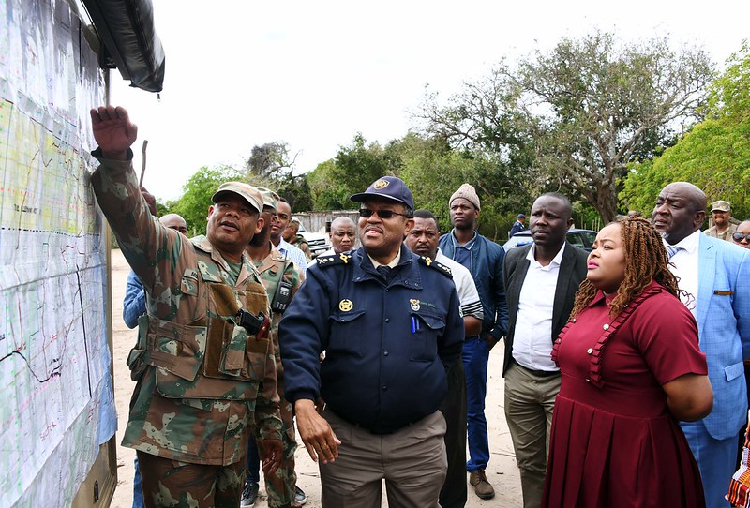
Highpoints Q2: Thuma Mina Operations Room – a more efficient way of working
1 895 (100%) compliant invoices paid in 30 days
461 development communication activations; 25% were on gender-based violence
214 communicators trained
GCIS Investment Conference studio

Slide 11
5. DELAYED TARGETS
Performance Indicator | Target Jul - Sept | Preliminary Output Jul - Sept | Deviation | Reason for Deviation | Corrective Action
Programme 1: Administration
First draft 2020-2023 APP submitted to National Treasury and the DPME as a | First draft 2020-2023 APP submitted to National Treasury and the DPME as a | The first draft APP is due to be submitted to DPME on 31 October 2019 | First draft APP was not submitted due to changes in the target date by the DPME | The revised Framework for Strategic and Annual Performance Plans require departments to submit the Draft 2020-2023 APP by 31 October 2019 | GCIS submitted the Strat Plan and APP on the 15 November 2019 after DPME acceded to the request.
Programme 2: Content Processing and Dissemination
Number of copies of Vuk’uzenzele newspaper | 5.1 million copies of Vuk’uzenzele newspaper produced | 4 050 000 copies of Vuk’uzenzele newspaper | Target underachieved by 1050 000 | The September one and two editions of Vuk’uzenzele could not be printed on time as a result of the transition from the old service provider to a new service provider | Both September editions were printed and distributed in October.
Number of GCIS print products distributed | Six GCIS print products distributed | 4 GCIS print products were distributed | Target underachieved by 2 | September 2019 editions were not distributed as a result of the transition from the old printing service provider to a new service provider | Both September 2019 editions were distributed in October 2019 in order to meet the target for the year.

Slide 12
5. DELAYED TARGETS ….continued
Performance Indicator | Target Jul - Sept | Preliminary Output Jul - Sept |  | Deviation | Reason for Deviation | Corrective Action
Programme 3: Intergovernmental Coordination and Stakeholder Engagement
Number of Internal Communicators’ Forum (ICF) held | Three ICFs held | Two ICFs were held | Target underachieved by 1 |  | The third ICF dedicated to NHI could not be held, it had to be moved to another date due to unavailability of presenters from Department of Health (DOH). | The special NHI ICF took place on 18 October 2019.

Slide 13
6. PROGRAMME PERFORMANCE INFORMATION
Programme 1
Administration
Purpose
Provide strategic leadership, management and support services to the department

Slide 14
PROGRAMME 1: ADMINISTRATION
Sub-programme: Strategic Management
Performance Indicator | Target July - September | Preliminary Output July - September | Deviation | Reason for Deviation | Corrective Action
APP tabled in Parliament within prescribed regulations | First draft 2020-2023 APP submitted to National Treasury and the DPME as a legislative requirement | The first draft APP is due to be submitted to DPME on 31 October 2019 | First draft APP was not submitted due to changes in the target date by the DPME | The revised Framework for Strategic and Annual Performance Plans require departments to submit the Draft 2020-2023 APP by 31 October 2019 | GCIS submitted the Strat Plan and APP on 15 November 2019 after DPME acceded to the request.
Number of approved quarterly performance reports submitted to National Treasury, Department of Planning, Monitoring and Evaluation (DPME), and Executive Authority, according to prescribed legislation | First quarter 2019/20 performance report submitted to National Treasury, DPME and Executive Authority according to prescribed | The first quarter 2019/20 performance report was submitted to National Treasury, DPME and Executive Authority according to prescribed legislation | None | None | None
Annual Report tabled in Parliament within National Treasury guidelines and legislative time frames | 2018/19 Annual Report tabled in Parliament within National Treasury guidelines and legislated time | 2018/19 Annual Report was tabled in Parliament within National Treasury guidelines and legislated time frame, on 27 September 2019. | None | None | None

Slide 15
Sub-programme: Strategic Management
Performance Indicator | Target July - Sept | Preliminary Output July - Sept | Deviation | Reason for Deviation | Corrective Action
Number of progress reports on the implementation of the risk-mitigation plans produced | First quarter 2019/20 progress report on implementation of the | First quarter 2019/20 progress report on implementation of the enterprise risk management framework was produced | None | None | None

Slide 16
PROGRAMME 1 CONTINUED…..
Sub-programme: Human Resources
Performance Indicator | Target July- Sept | Preliminary Output July – Sept | Deviation | Reason for Deviation | Corrective Action
MTEF Human Resource Plan (HRP) implemented | No target | No target | None | None | None
Sub-programme: Information Management and Technology
Number of reports on IM&T governance implemented | One report on the availability of IT Infrastructure presented to the IM&T SC | The 2019-20 first quarter report on IT Infrastructure Availability was presented to the IM&T Steering Committee on 19 July 2019 | None | None | None
 | One report on IM systems development presented to the IM&T SC | 2019/20 first quarter report on IM systems development was presented to the IM&T Steering Committee on 19 July 2019 | None | None | None

Slide 17
PROGRAMME 1 CONTINUED…….
Sub-programme: Finance, Supply Chain Management and Auxiliary Services
Performance Indicator | Target July – Sept | Preliminary Output July – Sept | Deviation | Reason for Deviation | Corrective Action
Annual financial statements issued within legislated prescripts | First quarter 2019/20 interim financial reporting compiled and submitted to National Treasury | The first quarter 2019/20 interim financial reporting was compiled and submitted to National Treasury on 31 July 2019. | None | None | None
Sub-programme: Internal Audit
Risk-based Internal Audit Plan and operational plan updated and implemented | No target | No target | None | None | None
Number of progress reports on assurance audits produced | One progress report on performance, compliance, financial audit conducted | The progress report on performance, compliance, financial audits conducted was developed. | None | None | None

Slide 18
5. PROGRAMME PERFORMANCE INFORMATION
Programme 2
Content Processing and Dissemination
Purpose
Provide strategic leadership in government communication to ensure coherence, coordination, consistency, quality, impact and responsiveness of government communication

Slide 19
Programme 2: Content Processing and Dissemination
Products and Platforms
Performance Indicator | Target July – Sept | Preliminary Output July – Sept | Deviation | Reason for Deviation | Corrective Action
Number of copies of Vuk’uzenzele newspaper | 5.1 million copies of Vuk’uzenzele newspaper produced | 4 050 000 copies of Vuk’uzenzele newspaper | Target underachieved by 1050 000 | The September one and two editions of Vuk’uzenzele could not be printed on time as a result of the transition from the old service provider to a new service provider | Both September editions were printed and distributed in October.
Number of editions of PSM magazine published annually | Three editions of PSM magazine published | Three editions of the PSM magazine were published. | None | None | None
An online edition of SAYB and Pocket Guide to South Africa published annually | Chapters of the 2018/19 SAYB and Official Guide to South Africa updated and | Chapters of the 2018/19 SAYB and Official Guide to South Africa edited and proofread | None | None | None
Percentage of language services requests completed | 100% language services requests completed | 100% (485) language services requests completed | None | None | None
News updates on key government programmes and activities | Daily news updates on key government programmes and activities (excluding some public holidays, weekends and holiday | Daily news were updated on key government programmes and activities: 1. Stories published over quarter: 733 | None | None | None

Slide 20
PROGRAMME 2: CONTENT PROCESSING AND DISSEMINATION. CONTINUED…
Products and Platforms
Performance Indicator | Target July - Sept | Preliminary Output July – Sept | Deviation | Reason for Deviation | Corrective Action
Updated content on the www.gov.za website as per items received (excluding public holidays, weekends and holiday periods) | Daily content updates to the www.gov.za website as per items received (excluding public holidays, weekend and holiday periods) | Daily content updates to the www.gov.za website as per items received (excluding public holidays, weekend and holiday periods) | None | Website updated on some public holidays and weekends in order to have a current website | None
Updated social media accounts as per content received (excluding public holidays, weekends and holiday periods) | Daily updates on GCIS social media accounts implemented | Daily updates on GCIS social media accounts were implemented (excluding public holidays, weekends and holiday periods) | None | Updates took place on weekends and public holidays so that social media accounts are current | None

Slide 21
PROGRAMME 2 CONTINUED…
Sub-programme: Policy and Research
Performance Indicator | Target July – Sept | Preliminary Output July – Sept | Deviation | Reason for Deviation | Corrective Action
Number of cluster reports on perceptions of government priorities produced | No | No | None | None | None
Number of reports on government communication monitoring and evaluation (GCME) produced | One report on government communication monitoring and evaluation produced | One report on government communication monitoring and evaluation produced | None | None | None
Percentage of requested key messages produced. (excluding weekends, public holidays and holiday periods) | Produce 100% of key messages requested. (excluding weekends, public holidays and holiday periods) | 100% (37) key messages requests were produced. | None | None | None
Percentage of opinion pieces produced (excluding weekends, public holidays and holiday periods) | Produce 100% of opinion pieces requested (excluding weekends, public holidays and holiday periods) | 100% (28) opinion pieces were produced. | None | None | None

Slide 22
PROGRAMME 2 CONTINUED…
Sub-programme: Communication Service Agency
Performance Indicator | Target July - Sept | Preliminary Output July – Sept | Deviation | Reason for Deviation | Corrective Action
Percentage of approved media buying campaigns implemented | 40% of approved media-buying campaigns implemented | 51% of approved media-buying campaigns were implemented | Target overachieved by 11% | More requests were received than anticipated. | None
Number of photographic services provided | 100 photographic services provided | 125 photographic services were provided | Target overachieved by 25 | More request for photographic services were received than anticipated when setting the target. | None
Number of video services provided | 150 video services provided | 198 video services were provided | Target overachieved by 48 | More requests for video coverage were received than anticipated when setting the target | None
Number of radio products and services provided | 60 radio products and services provided | 71 radio products and services were provided | Target overachieved by 11 | More Requests for radio products were received than anticipated when setting the target. | None

Slide 23
PROGRAMME 2 CONTINUED…
Sub-programme: Communication Service Agency
Performance Indicator | Target July – Sept | Preliminary Output July – Sept | Deviation | Reason for Deviation | Corrective Action
Number of graphic designs completed | 110 graphic designs completed | 187 graphic designs were completed | Target overachieved by 77 | More requests for graphic design were received than anticipated. | None
Percentage of approved marketing services activities implemented | 100% of approved marketing services requests implemented | 100% (22) of approved marketing services request were implemented. | None | None | None
Number of GCIS print products distributed | Six GCIS print products distributed | 4 GCIS print products were distributed | Target underachieved by 2 | September 2019 editions were not distributed as a result of the transition from the old printing service provider to a new service provider | Both September 2019 editions were distributed in October 2019 in order to meet the target for the year.

Slide 24
5. PROGRAMME PERFORMANCE INFORMATION
Programme 3
Intergovernmental Coordination and Stakeholder Management
Purpose
Implement development communication through mediated and unmediated communication channels and foster sound stakeholder relations and partnerships

Slide 25
PROGRAMME 3: INTERGOVERNMENTAL COORDINATION AND STAKEHOLDER MANAGEMENT
Sub-programme: Media Engagement
Performance Indicator | Target July – Sept | Preliminary Output July – Sept | Deviation | Reason for Deviation | Corrective Action
Number of engagements between government officials and senior journalists on the government PoA and policy issues held | Six engagements between government officials and senior journalists on the government PoA held | Eight engagements were held between government officials and senior journalists. | Target overachieved by 2 | Additional engagements were required for projects from other departments | None
Number on post-Cabinet media briefings and/or statements issued after ordinary Cabinet meeting | Five post-Cabinet media briefings and/or statements issued after ordinary Cabinet meeting per quarter | Six post Cabinet statement was issued. | Target overachieved by 1 | The environment necessitated that an additional post cabinet briefing be held in the quarter | None

Slide 26
PROGRAMME 3: INTERGOVERNMENTAL COORDINATION AND STAKEHOLDER MANAGEMENT
Sub-programme: Media Engagement
Performance Indicator | Target July – Sept | Preliminary Output July – Sept | Deviation | Reason for Deviation | Corrective Action
Number of biweekly Rapid Response reports produced | Seven bi-weekly Rapid Response reports produced (excluding December and January) | Seven bi-weekly Rapid Response reports were produced | None | None | None
Number of requests for media briefings received from government departments conducted per year | 25 media briefings conducted | 37 requests for media briefings received from government departments conducted per year | Target overachieved by 12 | Additional media briefings occurred due to budget votes taking place later than scheduled due to election period | None

Slide 27
PROGRAMME 3: INTERGOVERNMENTAL COORDINATION AND STAKEHOLDER MANAGEMENT CONTINUED….
Sub-programme: Cluster Communication
Performance Indicator | Target July – Sept | Preliminary Output July – Sept | Deviation | Reason for Deviation | Corrective Action
Number of Cluster Communication Plans (CCP) developed | No target | No target | None | None | None
Number of reports on the implementation of Cluster Communication Plans | 15 reports developed on the implementation of the 2019/20 CCPs | 15 reports were developed on the implementation of the 2019/20 CCPs. | None | None | None
Number of engagements with HoCs held | One engagement with HoCs held | One engagements with HoCs was held | None | None | None

Slide 28
PROGRAMME 3: INTERGOVERNMENTAL COORDINATION AND STAKEHOLDER MANAGEMENT CONTINUED….
Sub-programme: Cluster Communication
Performance Indicator | Target July – Sept | Preliminary Output July – Sept | Deviation | Reason for Deviation | Corrective Action
Number of Internal Communicators’ Forum (ICF) held | Three ICFs held | Two ICFs were held | Target underachieved by 1 | The third ICF dedicated to NHI could not be held, it had to be moved to another date due to unavailability of presenters from Department of Health (DOH). | The special NHI ICF took place on 18 October 2019.
Number of government communicators trained per year | 25 government communicators trained | 214 government communicators trained | Target overachieved by 189 | More requests for training from different government institutions were received. The department attended to all requests hence the large number that was trained. | None

Slide 29
PROGRAMME 3: INTERGOVERNMENTAL COORDINATION AND STAKEHOLDER MANAGEMENT CONTINUED….
Sub-programme: Provincial and Local Liaison
Performance Indicator | Target July – Sept | Preliminary Output July – Sept | Deviation | Reason for Deviation | Corrective Action
Number of reports on support to the functioning of government communication system produced (provincial and local level) | One report on support to the functioning of government communication system produced (provincial and local level) | One report on the support to the functioning government communication system was produced. | None | None | None
Number of development communication activations aligned to the GCP | 342 development communication activations aligned to the GCP | 461 development communication activations aligned to the GCP were conducted | Target overachieved by 119 | Overachievement on the target was due to the high focus on Gender Based Violence, Job Opportunities and launch of the Presidential District Model | None
Number of marketing events for Thusong programme held | 61 marketing events for Thusong programme held | 116 marketing events for Thusong programme were held | Target overachieved by 55 | Overachievement was due to a focus on the Thusong Annual Week | None

Slide 30
PROGRAMME 3: INTERGOVERNMENTAL COORDINATION AND STAKEHOLDER MANAGEMENT CONTINUED….
Sub-programme: Provincial and Local Liaison
Performance Indicator | Target July – Sept | Preliminary Output July - Sept | Deviation | Reason for Deviation | Corrective Action
Number of community and stakeholder liaison visits undertaken | 513 community and stakeholder liaison visits undertaken | 547 community and stakeholder liaison visits undertaken | Target overachieved by 34 | Overachievement was due to the Thusong Annual Week and the launch of the Presidential District Model | None
Number of reports on Izimbizo events held | One report on Izimbizo events held per quarter | One report on 24 izimbizo events held was produced. | None | None | None
Number of electronic My District Today newsletters published | 13 electronic My District Today newsletters published | 13 electronic My District Today newsletters were published | None | None | None

Slide 31
7. GCIS 2019/20 TOTAL BUDGET AND OVERVIEW
(30 September 2019)
BUDGET 2019/20 R 441 683 000 – 100%
Less: Compensation of Employees (COE) (R272 702 000) – 62%
Less: Contractual/Commitments/Capital (R136 265 000) – 31%
Balance: Operational Costs R 32 716 000 – 7%
2

Slide 32
8. Budget vs Expenditure – 30 September 2019
PROGRAMME | TOTAL BUDGET | ACTUAL EXPENDITURE | % SPENT
 | R'000 | R'000
PROGRAMME 1: ADMINISTRATION | 164 623 | 85 663 | 52.0%
PROGRAMME 2: CONTENT PROCESSING AND DISSEMINATION | 152 090 | 71 137 | 46.8%
PROGRAMME 3: INTERGOVERNMENTAL COORDINATION AND STAKEHOLDER MANAGEMENT | 124 970 | 57 896 | 46.3%
TOTAL | 441 683 | 214 696 | 48.6%
Benchmark: 50%

Slide 33
8. Budget vs Expenditure – 30 September 2019
ECONOMIC CLASSIFICATION | TOTAL BUDGET | ACTUAL EXPENDITURE | % SPENT
 | R'000 | R'000
COMPENSATION OF EMPLOYEES | 272 702 | 125 069 | 45.9%
TRANSFERS AND SUBSIDIES | 664 | 115 | 17.3%
OPERATIONAL: - GOODS AND SERVICES - CAPITAL ASSETS | 168 317 161 082 7 235 | 89 512 83 362 6 150 | 53.2% 51.8% 85.0%
TOTAL | 441 683 | 214 696 | 48.6%
Benchmark: 50%

Slide 34
Thank you
- End -

