Slide 1
DATA MINING AND DASH BOARDING ON
SCM PERFORMANCE INFORMATION
PROVINCIAL TREASURY
Committee Room 1
Mrs N Ebrahim
Date: 19 February 2020

Slide 2
Problem Statement
Systems
Data analysis is in many areas currently a labour intensive process;
Requires intervention for service that puts data in a format that requires further work around, cleansing and analysis (Kitso used);
Data interfaces from different financial and non-financial sources are not always possible, is not done or requires further manual or labour intensive processes;
Data integrity is problematic; and
Kitso information is only from BAS and does not reconcile with LOGIS, Persal, IPS and WCSD information
Procurement
Lack of ability to depict Preferential Procurement focus from a socio-economic perspective
Have oversight and surveillance over critical SCM high risk compliance issues that pose governance risks
To enable the move from a basic compliance agenda to a performance one by producing procurement information in a format that supports and improves management decision-making

Slide 3
Spend Analysis and Visualisation
Response Plan
Initial Need (2013-14)
Improve logistics management activities;
To strengthen relationships with suppliers and customers;
Seamlessly integrate supply and demand activities across provincial departments;
To monitor departmental spend within allocated budgets;
Improve procurement planning; and
Identify strategic commodities.
Evolving Need ( Post 2015)
Promote better procurement planning;
Improve visibility in spend and the achievement of efficiencies in expenditure management;
Improve decision making;
Achieve value for money in procurement
Data analytics and visualisation tool to facilitate the analysis and extracting of data;
Position commodities based on strategic drivers and develop commodity strategies for identified functional areas or per requests from departments; and
Establish and report on supplier positioning strategies.

Slide 4
DATA ANALYSIS AND VISUALISATION
DATA GATHERING/EXTRACTION. Gathering or extraction of data from the WCG databases or legacy systems and or other sources, the integration, structuring and mapping of the data from various data sources.
DATA VALIDATION AND CLEANSING: The service should provide for the identification of errors in data through validation rules, exception reporting or similarly appropriate mechanisms. Anomalies or gaps in data must be able to be detected and corrected.
DATA INTEGRATION OR ENRICHMENT: The ability to augment the WCG spend data with supplier performance data, risk management, compliance information or other identified sources in order to enhance the business intelligence analysis or value added analysis of the data.
DATA CLASSIFICATION: The categorisation of data in terms of commodity classification system
DATA MANAGEMENT SERVICE: Monthly update of data
DATA ANALYSIS TOOL (LICENSING): Microsoft Power BI used to build the platform for data mining

Slide 5
Self-service Business Intelligence tools
What is a Self-service Business Intelligence (BI) tool?
Self-service business intelligence(BI) tools are data analytic tools that enables business users (analyst, managers, practitioners etc.) to access and analyse business data without the IT’s involvement.
The self-service approach lets end users create reports that help them understand and analyse data.
It also allows users to present data visually within the tool in a meaningful way.
FAST ANALYTICS | Connect and visualize data in minutes
EASE OF USE | Anyone can analyse data with intuitive drag & drop
BIG DATA, ANY DATA | From spreadsheets to databases to SQL servers, explore any data
SMART DASHBOARDS | Combine multiple views of data for richer insight

Slide 6
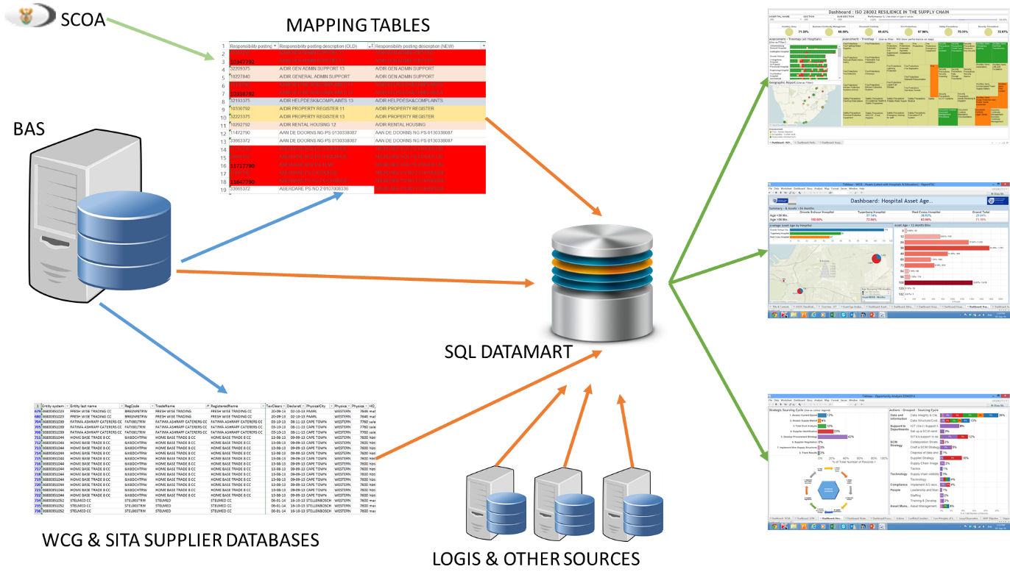
Data Mining & Dash Boarding

Slide 7
Examples of Dash-boarding for Procurement Performance
B-BBEE/ PPPFR Supplier Analysis
Payments to suppliers per designated categories
Spend Analysis per region
Spend Analysis per SCOA item
Potential Irregular Expenditure;
  Conflict of Interests and payments made iro such conflicts
  Deviations from Competitive Bidding (limited bids and Expansions)
IPS – e-procurement for quotations
  Events
  Commodity analysis
  Supplier participation rate

Slide 8
SNAPSHOTS OF DASHBOARDS Example 1
IPS Events Analysis

Slide 9
Example 2
Competitive Bidding vs Limited Bidding

Slide 10
Example 3
Supplier per regional Analysis

Slide 11
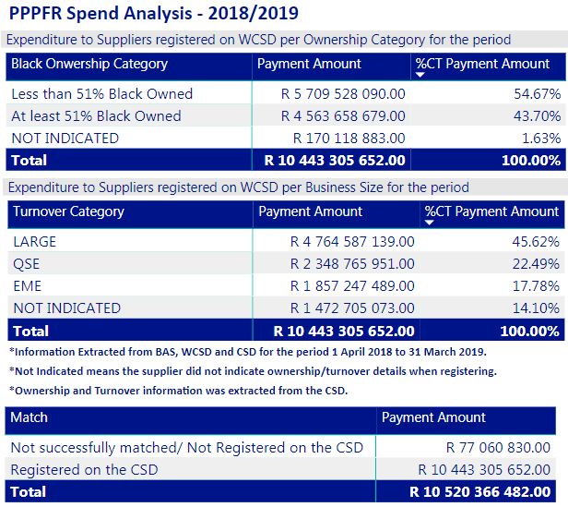
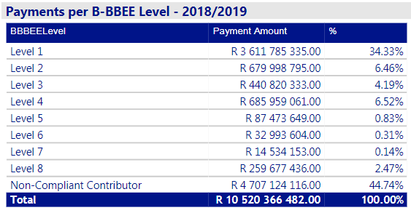
Example 4
2018/19

Slide 12
Example 5
PPPFR demographics

Slide 13
Example 6
Spend Analysis per Region

