Slide 1
DEPARTMENT OF EMPLOYMENT AND LABOUR
ORIENTATION PRESENTATION TO PORTFOLIO COMMITTEE ON LABOUR
27 JANUARY 2020

Slide 2
Contents
Organizational structure
Branch allocations
PES programmes
PES mandate
PES achievements
PES challenges
Current DEL employment interventions
Other external employment interventions

Slide 3
1. PES ORGANOGRAM:TOP STRUCTURE

Slide 4
2. Budget allocations
Programme purpose: Provide assistance to companies & workers to adjust to changing labour market conditions.
Total PES staff compliment is 556 (488 across 126 Labour Centres & 9 provinces & 68 at Head office).
Total budget allocation is R611.198 million for the 2019/20
SUBPROGRAMMES
 | 2019/20 Baseline
 | "000
Management and Support Services | 51,962
Employer Services | 124, 735
Work Seeker Services | 184,436
Designated Group Special Services | 21, 525
Supported Employment Enterprises | 155, 733
Productivity South Africa | 54, 610
Unemployment Insurance Fund | 1
Compensation Fund | 16, 877
Training of Staff | 1, 319
Total | 611,198
Economic Classification
Current Payments | 367,956
Compensation of Employees | 327,729
Goods and Services | 40,227
Transfers and Subsidies | 241,986
Payment for capital assets | 1,256
Total | 611,198

Slide 5
3. Purpose
Provide assistance to companies and workers to adjust to changing labour market.

Slide 6
3.1. PES Programmes
Chief Directorate (CD) Employer Services: register work opportunities, placing of work-seekers, regulates Private Employment Agencies & Temporary Employment Agencies, Labour Migration Management & Secretariat to Employment Services Board
CD Work-Seeker Services: register work-seekers on Employment Services system South Africa (ESSA), provides counselling to work-seekers, placement of work-seekers in opportunities, provides subsidies to designated PWD organizations
Management & Support Services: provides Branch PES Human Resources, financial support, branch planning, monitoring & evaluation support functions & transfers to Entities
Supported Employment Enterprises: provides employment opportunities to Persons with Mental Disabilities
Productivity SA: promotes productivity in work places, turnaround solutions & workplace competitiveness
Compensation Fund (CF) Transfers: provides for transfers to CF for compensation of public servants occupational injuries & diseases
Unemployment Insurance Fund Transfers: provides for transfers to UIF for unemployment insurance claims by public servants

Slide 7
4. PES mandate
PES derives its mandate from:
Employment Services Act 4 of 2014,
applicable provisions that remain in the Skills Development Act 14 of 1998 &
applicable provisions of the Immigration Act 2002
applicable provisions of other Labour legislation e.g. UI Act, COIDA
PES services are also aligned to the following ILO Conventions:
C2 Unemployment Convention, 1919;
C22 Employment Policy Convention, 1964;
C88 Employment Service Convention, 1948;
C168 Employment Promotion and Protection against Unemployment Convention, 1988;
C150 Labour Administration Convention, 1978;
C181 Private Employment Agencies Convention, 1997;
C159 Vocational Rehabilitation and Employment (disabled persons) Convention, 1983;
C142 Human Resources Development Convention, 1975;
C97 Migration for Employment Convention (revised), 1949

Slide 8
5. PES Achievements
During the MTF Period 2014/15 to 31st March 2019
Registered 3.698 868 million work seekers, counselled 1 087 120; registered 503 918 opportunities and placed 109 122.
During the First Three Quarters of 2019/20 PES: Achieved and exceeded all its APP targets
Out of the 9 work plan targets; all were achieved.

Slide 9
The Departments programme to create employment opportunities to assist with the eradication of high unemployment, for the period April 2019-October 2019 is as follows:
Number of workseekers enrolled with the Department = 537,890
Number of work opportunities canvassed from potential employers= 100,114
Number or placements into job opportunities= 35,894
Number of unemployed workseekers assisted to prepare them for the labour market, by the departments counsellors = 157,787

Slide 10
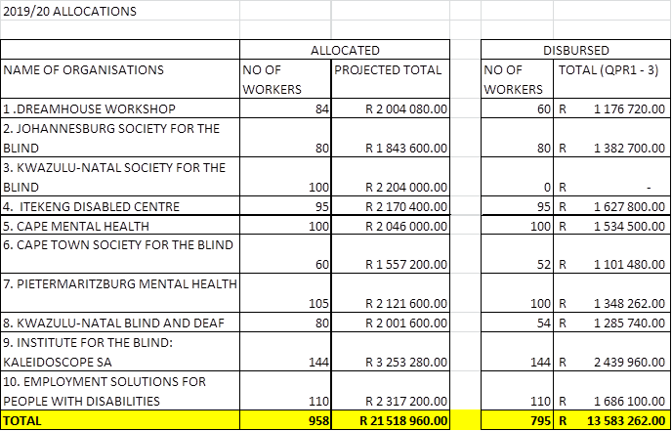
Subsidies to Designated Organisations
NB: No disbursements to KZN society for the Blind pending their compliance with Funding requirements

Slide 11
6. PES Challenges
Insufficient number of registered work seekers placed in employment.
Insufficient coordination, complementarity, M&E and reporting on employment creation levels and interventions across the country.
Duplication & competition of employment initiatives across government
Insufficient resources and capacity within the Branch:

Slide 12
7. Employment interventions that are in line with other international best practices
1. Employment policy: Already secured agreement with the ILO for assistance
2. Labour Migration policy: scheduled to be completed by end of March 2020
3. Employment Schemes provided for under Section 7 and 12 of the ES Act currently being implemented or discussion under the ES Board.
3.1. Supported Employment Enterprises: Increasing the number, production, market & employment capacity: 13 companies already exist and employ more than 1020 PWD and 159 support staff.
3.2. Subsidies to Designated NPOs and emerging industries: Scaling up subsidies & employment levels of People With Disabilities; the aged and other Social development benefitting categories
3.3. SA / EU employability programme: Implement youth employment centre pilot in 6 labour centres to offer integrated services for youth.
3.4. Review and realignment of PES / UIF / CF Labour Activation Programmes: to scale up the numbers and employment opportunities.
3.5. Productivity SA/CCMA: Scale up productivity & competitiveness, Turn around solutions, work place change, training lay-off job retention schemes.

Slide 13
8. Employment interventions cont..
4. Other Major government Employment Initiatives: Secure agreements, establish relations, coordination, directives and or M&E and reporting regarding:
4.1. Skills development ; skills levies and Employer Tax Initiative,
4.2. EPWP and other related programmes
4.3. Youth employment Initiatives (Including 5by5)
4.4. Jobs Fund
4.5. Job Summit
4.6. New Investments ventures
4.7. PIC and other related Funds Investments
6. Quarterly Labour Survey: Establish collaboration to measure overall changes in employment levels across the country.
7. Cooperatives; SMEs; Self Employment: collaboration with relevant departments and sectors w.r.t. determination of employment levels and other related matters.
8. G 20 Employment loss prevention and 4IR Intervention and mitigation strategies

Slide 14
Thank You…

