Slide 1

Presentation to the Portfolio Committee on Tourism:
Co-ordination across Tourism Stakeholders
4 February 2020

Slide 2
Purpose
To provide parliament with the context of the environment and interrelationships of factors within the tourism value chain.
To present to parliament the department’s approach to integrated management of stakeholder relations.

Slide 3
The Case for Tourism
Tourism is one of the best performing economic sectors.
Has the potential to increase jobs, foreign exchange earnings & balance of payments, provision of economic opportunity for youth, stimulates economic activity in rural areas, support development of SMME’s.
Supports the NDP’s economic policy proposal for a more diversified economy.
Has multiple linkages with other sectors of the economy and generate significant multiplier effects.

Slide 4
The Case for Tourism Cont. . .
Tourism is a complex sector, composed of a very diverse series of industries and activities.
It involves not only primary tourism businesses such as hotels, visitor attractions and tourism transport, but a wide range of facilities and services within the economy.
Tourism is thus affected by, and has a bearing on, other factors and economic sectors that must also be competitive.
Tourism is often perceived as being the exclusive domain of the ministry responsible for tourism - Yet, the very elements of tourism competitiveness are the responsibility of several different government departments, authorities, agencies, private sector and communities interests.

Slide 5
Policy and Legislative Mandate
Tourism is a concurrent function for all three spheres of Government. At a National level, the Department of Tourism came into existence in 2009.
Overall legislative and policy direction for the Department of Tourism is provided for in the Tourism Act, 2014 (Act No 3 of 2014), the National Development Plan (NDP) and the National Tourism Sector Strategy (NTSS - 2017)
The Department’s mandate is to grow tourism to and within South Africa such that:
Its contribution to the Gross Domestic Product (GDP) and the economy is increased.
Its contribution to job creation in South Africa is increased.
Economic participation in the sector is inclusive.
Enjoyment of tourism is shared by all South Africans.
Quality tourism products and services are promoted.
The practice of responsible tourism is promoted.

Slide 6
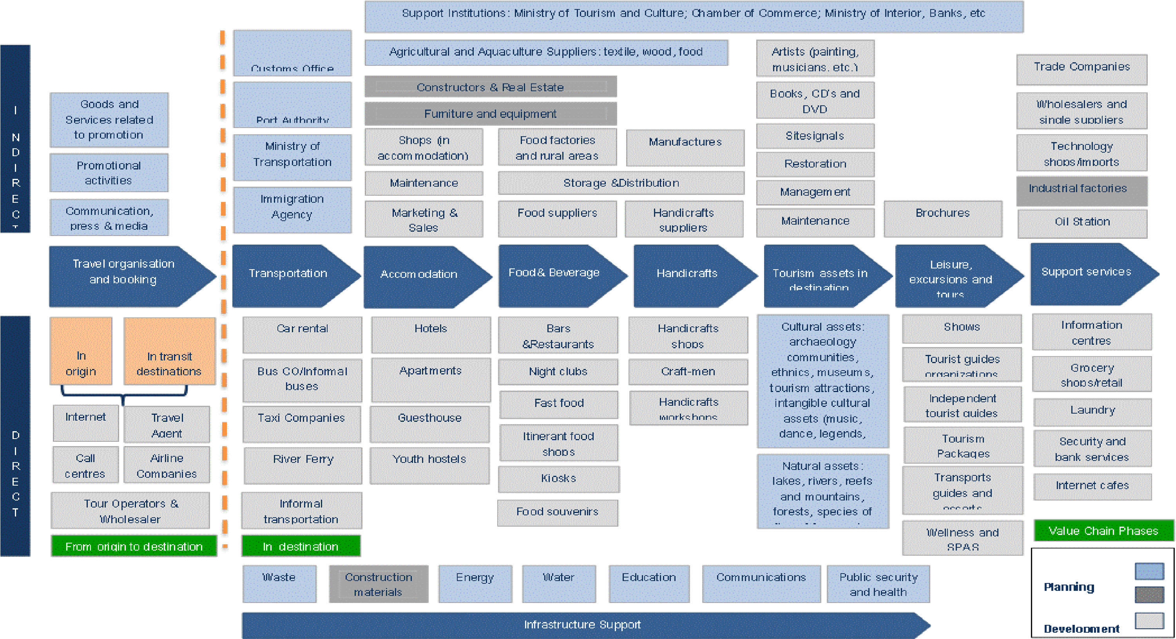
The tourism value chain

Slide 7
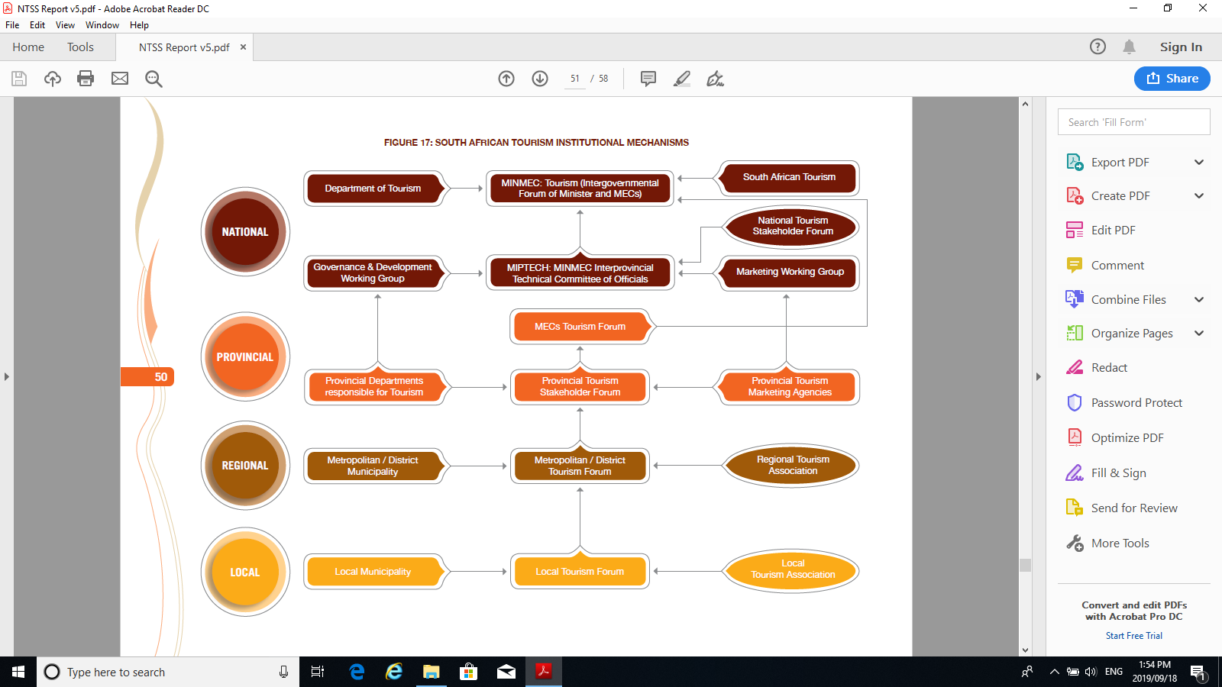
Institutional Mechanisms

Slide 8
INSTITUTIONAL MECHANISMS Cont…..
National Tourism Safety Forum
Divi Commissioner Visible Policing
Department of Tourism
SAPS Ports of Entry
Nia/SSA & DHA
TBCSA / Industry Associations / ACSA
NAT Joints
(Deputy National Comma)
INFORMATION GATHERING AND FACT FINDING
Holding Statement
Local Environmental Assessment (Protests)
SAPS OB Recording
Product Owner / Operator Information
Community
National Comms Task Team
Provincial Tourism Safety Forum
Department. Of Home Affairs
Provincial Tourism Agencies and Dept.
NIA(SSA)
Tourism Associations
DepProv Commissioner Visible Policing
Provincial Joints
(Provincial Commissioner)
Provincial Comms Task Team
Heads of Communications, Media Liaison Officers, Industry Spokespersons
District Safety Forum
Deputy District Commissioner Tourism Associations
Chief / Dep Chief Metro Police
Depts. of Home Affairs
(2) Arts and culture
Community Police Forum
Tourism Safety Police Officer
District Joints
(District Commissioner)
District
Comms Task Team
Local Tourism Safety Forum
Tourist Monitors
Tourist Sites & Establishments
Station Head Visible Policing
Metro Police
Victim Empowerment Entities
Embassies and Consulates
Station Level
(Station Commissioner)
Designated Tourism Safety Police Officer
Local Councillor

Slide 9
Project Steering Committees (PSC) – Purpose, Composition and Responsibilities
Purpose
Ensure that there is constant monitoring of the implementation of the project.
Active participation all by all relevant stakeholders and beneficiaries advising, monitoring and overseeing the implementation of the projects funded by the Department in their areas.
Keep all stakeholders informed and constantly updated about the projects to enable them to answer questions and deal with queries about the projects from any interested and affected party.
Provide the Implementer with an opportunity to report on the progress and challenges with the project to all stakeholders.
Composition
Project Manager (Departmental Official)
Owning Entity
The Implementer and Representative/s
Representatives from provincial department/Tourism Authority and participating municipalities
Other relevant stakeholders
Responsibilities
Advise, monitor and oversee the implementation of the project
Information sharing on project related issues on project implementation progress
Identification of bottlenecks to project implementation
Identification of mechanisms and means to unblock the identified bottlenecks

Slide 10
Stakeholder Engagement – Tourism Sector Masterplan
  The Tourism Sector Masterplan is being developed as a result of tourism being prioritised within South Africa’s Industrial Policy. The following structures are created specifically to review and finalise this work:
  Executive Oversight Committee (EOC):
  This is the highest decision-making body (Committee of Principals)
  Chaired and convened by the Minister of Tourism
  Members include the Deputy Minister of Tourism, Community Representation (NEDLAC Community Trust), Labour Representatives (COSATU and FEDHUSA), Business Representatives (TBCSA and BUSA) and Representatives from the
  SA Tourism and Brand SA Boards.
  Industry Reference Group (IRG):
  Representatives from Business, Government, Labour, research, support and industry associations
  Chaired by the Director General of Tourism
  Ensures that findings and emerging recommendations are tested with the sector and value-chain on an incremental, phased basis
  In addition to the IRG, ongoing engagement with individual stakeholder groupings continues

Slide 11
Other Stakeholder Formations
Ministerial Leadership Forum and thematic Ministerial engagements with individual industry stakeholder formations.
National Tourism Stakeholder Forum and its workstreams (Marketing, Ease of Access, Visitor Experience, Destination Management and Broad-based benefits).
Indaba Ministerial Forum.
National Tourism Statistical Forum.
National Tourism Research Expert Forum.
Public Outreach or Izimbizo.
Engagements with Traditional Leaders.
Tourist Guides Registrar Forum.
Tourism Service Excellence and complaints management Forum.
Tourism Sector HRD strategy implementation Committee.
The department also works closely with sister departments and agencies across the system who have responsibility for various aspects of the tourism value chain (e.g. Transport, Home Affairs, Basic Education etc.)

Slide 12
Structures/Programmes to Capacitate District and Local Government Officials
The learning networks focus on building capacity of tourism officials on tourism planning, tourism research and information management, collection of data, guidelines for establishment of tourism structures, and institutionalise destination planning tools.
Objectives of the Local Government Tourism Peer Learning Networks (LGTPLN) are to:
  strengthen and enhance technical capacity of local government tourism/LED practitioners;
  identify and propose areas of government intervention, norms and standards, and guidelines;
  create a platform where tourism/LED practitioners from various municipalities share experiences, best practices, case studies, tourism development models or approaches
  ensure alignment of municipal tourism plans with provincial and national tourism plans; and
  provision of technical support to municipalities.
These quarterly convened learning networks are structured to be basic, interactive, and advance a practical/participatory learning approach.
Outcomes:
  identified gaps addressed, destination interventions improve planning expertise of tourism practitioners and municipalities, build understanding of the significance of tourism by officials, thereby ensuring that tourism is prioritised and adequately resourced.

Slide 13
  Thank You

