Slide 1

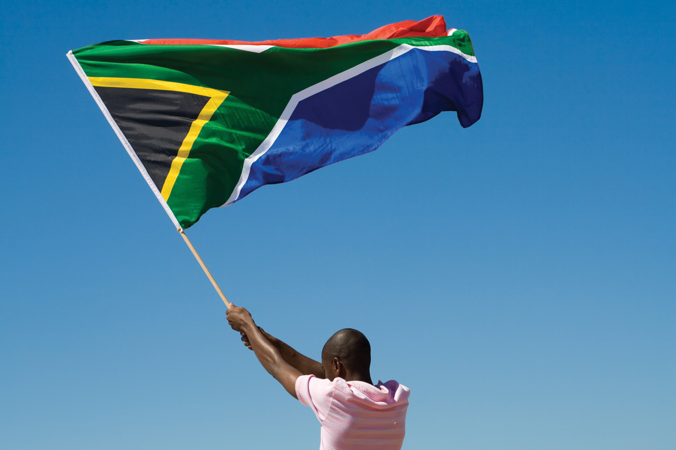
BRIEFING TO THE PORTFOLIO COMMITTEE OF HOME AFFAIRS
on the Follow-up Performance Audit of the immigration processes of illegal immigrants
at the Department of Home Affairs
4 February 2020

Slide 2


MISSION
The Auditor-General of South Africa has a constitutional mandate and, as the supreme audit institution (SAI) of South Africa, exists to strengthen our country’s democracy by enabling oversight, accountability and governance in the public sector through auditing, thereby building public confidence
VISION
To be recognised by all our stakeholders as a relevant supreme audit institution (SAI) that enhances public sector accountability

Slide 3
Content
Background
Key findings
2.1 Border management and port control
2.2 Transportation
2.3 Holding facility
2.4 Asylum regime
2.5 Information systems
2.6 Intragovernmental and other coordination
3. Responses from the relevant role players
4. Conclusion

Slide 4
Background
The first audit was done in 2000 and identified a significant number of findings. During the follow up audit in 2007, there was an improvement on a number of issues. In the 2018 follow up, a major regression was identified on most areas previously reported on.
Follow up performance audit of the immigration process of illegal immigrants
Performance audit of the migration process
Follow up performance audit of the immigration process
2000
2007
2018
Evaluate the progress made by the department since 2007, focussing on whether the findings / situation still existed

Slide 5

Border management and port control
Integrated border management and control are key to the effective management of immigration.
No single national policy on integrated border management in SA.
The border management authority was established in 2013, however the BMA Bill has not been passed.
  This ultimately contributed to a large volume of people entering the country illegally, or not exiting the country in time as required by visa or permit requirements.

Slide 6

Border management and port control
Outstanding fines owed by airline companies increased
R4,2 million to almost R17 million between the 2000 and 2007 audits.
In 2018:
the system had deteriorated, and
the value of the outstanding fines was not available.
The number of persons declared undesirable due to overstaying increased
The Immigration Act was amended and, in 2016-17, this amendment scrapped fines to individuals overstaying their visa requirements. This was replaced by declaring a person undesirable. Departmental officials at OR Tambo International Airport indicated that the change from the fine payment system to the five-year undesirable status did not deter travellers from overstaying their visas.

Slide 7

Transportation
No approved policy, directives, procedures or guidelines on transporting illegal immigrants.
  The road transport was arranged via the three quotation system as the contracts lapsed, which delayed the transportation of individuals by up to nine weeks.
  This impacted on
    the detention periods,
    overcrowding of detention facilities while the holding facility was below threshold, and
    increased the number of illegal immigrants released back into the country.

Slide 8

Transportation
  Illegal immigrants were released after 120 days with an order to leave.
The department did not know how many orders to leave were issued,
No system in place to record orders issued (some manual registers), and
No monitoring or verification that foreigners left the country.

Slide 9

Holding facility
The contract with the service provider of the holding facility provided for a minimum threshold (the department had to pay an amount equal to the threshold, irrespective of the actual number of detainees).
The threshold was only exceeded once in 29 months. This increased the effective average daily cost per person by 454% compared to the actual cost.
5 000 max capacity

Slide 10
Holding facility
The pricing annexure of the contract could not be provided by the department for audit purposes.
Detainees were released due to their detention period exceeding 120 days.

Slide 11

Asylum regime
Backlogs in registering new asylum seekers up to 7 months and in some instances 19 months (cannot quantify backlog).
Backlog in processing asylum seekers at independent bodies.
  If no new cases were received, it would take
68 years to finalise the backlog at RAB, and
Just over 1 year to finalise the backlog at SCRA.
Refugee Appeals Board
Standing Committee for Refugee Affairs

Slide 12
Asylum regime
The department did not know how many of the 946 314 inactive section 22 applicants (as at 31 December 2017) were still in the country
  the various systems such as the National Immigration Information System, Movement Control System and National Population register were not integrated.

Slide 13
Information systems
Information systems were unreliable, not integrated or in instances not updated in time, resulting in outdated information as well as ineffective monitoring.
Best available information was used throughout the audit, and is used in the report to illustrate the problem or principle.
  Movement data on the movement control system mainframe was last updated on 15 January 2017 because the server at the department crashed and movements could not be extracted from the enhanced movement control system, to be uploaded to the mainframe.
  Penalty case system was dysfunctional and the department used MS Excel to manage conveyors. The outstanding amount of penalties and fines to conveyors could not be provided
  The department did not have an accounting system for fines and maintained a register of fines issued on a spreadsheet, and
  In the absence of an accounting system to manage the fines, the department was unable to send monthly statements to the conveyors, and did not perform reconciliations over the years.

Slide 14
Information systems
  No central recording systems to
    register new asylum seekers,
    record detainees at detention facilities, or
    record orders to leave. The case management system was implemented early in 2018 to address detainees and orders to leave, but is not fully used.
  Department did not have its own information system at the holding facility and had to rely on information captured by the service provider, which included noticeable errors. Furthermore it only retained data for three months after the release of a detainee. Hardcopy documents were filed.
  National immigration information system for asylum seekers was not updated timely and a number of cases were never captured on the system when it replaced the previous refugee system in 2008.
  It was also not integrated with other systems for example Movement Control System or National Population Register.

Slide 15
Intragovernmental and other coordination
The department did not always know when immigrants were released by the Department of Correctional Services, to effectively plan and coordinate their deportation.
No coordination process in place with Department of Justice, who was responsible for judicial reviews of asylum seekers and dealing with asylum seekers that did not proceed further with their hearing.
Only a few MoUs were in place to negotiate recovery of deportation costs from other countries.
There was only one MoU in place with a conveyor on the cooperation in combatting the irregular movement of persons.

Slide 16
Responses from the relevant role players
The outcomes of the performance audit were shared with
* management of the department,
* the executive authority, and
* the relevant independent bodies.
The acting director-general of the department’s comments were received on 18 March 2019.
This report was discussed with the
* previous minister of Home Affairs on 2 April 2019,
he instructed the department to compile an audit action plan,
* current minister of Home Affairs on 30 September 2019, and
* Chairperson of the Portfolio Committee on Home Affairs on 3 October 2019

Slide 17





Conclusion
An increase in individuals that transgressed their visa and other requirements and remained in the country beyond their allotted time frames
A decrease in the number of detained and deported illegal immigrants to their respective countries of origin
The abuse of the system for seeking asylum as backlogs in registering and finalising asylum applications increased

Slide 18
Our social media platforms

