Slide 1
BRIEFING TO THE PORTFOLIO COMMITTEE ON AGRICULTURE, LAND REFORM AND RURAL DEVELOPMENT
ANIMALS PROTECTION AMENDMENT BILL
16 MAY 2023

Slide 2
PURPOSE
The Department of Agriculture, Land Reform and Rural Development’s (DALRRD) response to the Animals Protection Amendment Bill.
DALRRD to respond to the inputs made during the PC meetings of 21 February 2023 and 24 February 2023.
02

Slide 3
RESPONSE TO THE DELIBERATIONS AND QUESTIONS RAISED AT THE MEETING OF 21 FEBRUARY 2023
Animal Protection Index (API) –
South Africa has been awarded a score of “E” on a scale of A to G.
Response:
This scoring is done by the World Animal Protection Organisation, which has its own standards in which it evaluates animal welfare; however, these standards have not been adopted or referenced by recognized international standards generating bodies such as the World Organisation for Animal Health (WOAH/OIE).
03

Slide 4
RESPONSE TO THE DELIBERATIONS AND QUESTIONS RAISED
Problems with the API scoring:
Inaccurate statements made by the organization in its assessment of the country.
DALRRD was not provided with an opportunity to provide clarification and evidence where necessary.
Possible influence by some persons/ organisations to influence the evaluation of the country.
The index penalizes the country because the definition of “animal sentience” is not explicit, even though the Animals Protection Act covers aspects of animal sentience in the contents.
04

Slide 5
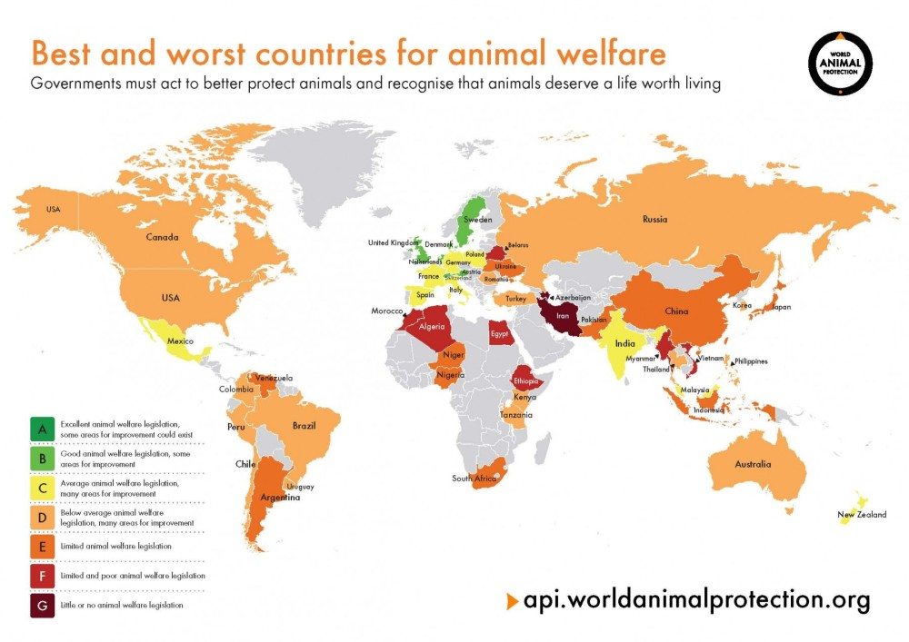
RESPONSE TO THE DELIBERATIONS AND QUESTIONS RAISED AT THE MEETING OF THE 21ST FEBRUARY 2023
Problems with the API scoring:
Inaccurate statements made by the organization in its assessment of the country.
The DALRRD was not provided with an opportunity to provide clarification and evidence where necessary.
Possible influence by some persons/organisations to influence the evaluation of the country.
The index indicates that the legislation must explicitly define “animal sentience”, even though the Animals Protection Act covers aspects that would be defined under “animal sentience”. This is even recognized in the index. It can be argued that if the content of the legislation covers all the aspects necessary to enhance animal welfare, there may not be a need to define every term.
05

Slide 6
RESPONSE TO DELIBERATIONS AND QUESTIONS RAISED
Vegan cosmetics vs cruelty-free cosmetics
Labelling of cosmetics as vegan is limited to products that do not contain animal products; however, this does not necessarily mean they were not tested on animals.
Some cosmetics companies use the term “cruelty-free” cosmetics to denote that the product has not been tested on animals, however, this could also be misleading in some instances where their definition is that the “product at hand” was not tested on animals, but it is possible that ingredients were tested on animals in the past.
06

Slide 7
RESPONSE TO THE DELIBERATIONS AND QUESTIONS RAISED
Ms Dudley requested inputs on the then Animals Protection Amendment Bill from the department in 2017 and there was no response:
Response:
The department was notified that it would be called to make a presentation to the Committee on the Bill, and no invitation to the department followed.
The department was ready to present to the Committee on the Bill.
07

Slide 8
RESPONSE TO THE DELIBERATIONS AND QUESTIONS RAISED AT THE MEETING OF 21 FEBRUARY 2023
The process of vaccinating animals against heartwater is cruel:
Response:
Vaccination of animals against heartwater is a simple procedure of injecting the vaccine into the bloodstream of an animal and thereafter giving the animal a dose of antibiotics.
This procedure is not different to any treatment of animals against other diseases.
Adverse reactions can occur with any medication administered to animals and this should not be considered to be the norm.
08

Slide 9
RESPONSE TO THE DELIBERATIONS AND QUESTIONS RAISED AT THE MEETING OF 21 FEBRUARY 2023
Milk from South Africa cannot be exported to the Netherlands because there is something that needs to be added to the milk and South Africa is not complying:
Response:
There is no requirement to add any substance to milk in order to export it to the Netherlands.
The challenge with the exportation of milk and other animal products to the EU is related to animal diseases control, usage of growth promoters and residue control programmes. This is not related to animal welfare at all.
09

Slide 10
CONSIDERATIONS REGARDING THE BILL
The cosmetics industry in South Africa directly employs around 60 000 people. This does not include employment at retail.
The industry contributes 0.1% to the GDP.
There is currently no technology and expertise in South Africa for alternative methods of testing of cosmetics.
In the absence of technology and expertise, a ban will result in South African companies having to test cosmetics outside of South Africa, at an additional cost and may not be competitive when compared to multinational companies.
10

Slide 11
CONSIDERATIONS REGARDING THE BILL
The amendment may not achieve its intended purpose if it does not cover imported products as well. A ban limited to testing in South Africa may disadvantage local businesses whereas allowing multinationals to import similar products into the country without any restrictions on animal testing.
DALRRD has no evidence of international trade protocols being linked to the testing of cosmetics on animal; while there is a move internationally to include animal welfare aspects in export certification, this is limited to the animals and products thereof that are being certified for.
11

Slide 12
CONSIDERATIONS REGARDING THE BILL
The European Union has placed a ban on the marketing and testing of cosmetics on animals, however, Member States can apply for a derogation to the ban in exceptional circumstances. These circumstances are:
the ingredient is in wide use and cannot be replaced by another ingredient having the same function;
there is evidence of human health problems. In such cases, animal testing is justified and supported by a detailed research protocol.
12

Slide 13
CONSIDERATIONS REGARDING THE BILL
Alternative methods of testing cosmetics include the following:
In vitro testing;
Human volunteers;
Computer modelling;
Human tissues sourced from hospitals after surgery;
Reduction in the number of animals used in testing, e.g., The OECD in vivo tests: the Fixed-Dose Procedure Test, the Acute Toxic Class Method Test, and the Up-and-Down Procedure.
These tests are performed in a sequence, in which the outcome of the previous step/dosage defines the next dose to be tested; this allows for a significant reduction in the number of animals utilized for each test, to a minimum of five animals per test (Silva RJ, 2022).
13

Slide 14
CONSIDERATIONS REGARDING THE BILL
The Organisation for Economic Co-operation and Development (OECD), whose members include at least 15 EU countries, Australia, New Zealand, and the USA, have adopted the following statement:
"The welfare of laboratory animals is important; it will continue to be an important factor influencing the work in the OECD Chemicals Programme. The progress in OECD on the harmonisation of chemicals control, in particular the agreement on Mutual Acceptance of Data (MAD), by reducing duplicative testing, will do much to reduce the number of animals used in testing. Such testing cannot be eliminated at present, but every effort should be made to discover, develop and validate alternative testing systems".
14

Slide 15
CONSIDERATIONS REGARDING THE BILL
Additional advisory from OECD:
A complete ban on the use of animals to test cosmetics leaves very few options available for the registration of these products particularly when considering that the products must be safe when used on humans. The alternative is to consider and strengthen legal requirements for cosmetic safety and encourage the manufacturers to consider alternative methods for testing of cosmetics.
The manufacturers of cosmetics should utilize whatever appropriate methods (including animal testing) that are available. It is however prudent to indicate that the welfare of the animals must be taken into consideration. Guidelines on the use of animals must however be developed to ensure that as few as possible animals are used for testing to get scientifically justifiable results.
15

Slide 16
CONSIDERATIONS REGARDING THE BILL
Additional advisory from OECD:
Before approval is given to use whole animals (mostly laboratory animals) for testing of cosmetics, there should be evidence that consideration to other alternative methods has taken place. These methods may include and are not limited to nanotechnology, trace contaminants and safety assessments.
16

Slide 17
DALRRD COMMENTS ON THE BILL
Definition of Cosmetics - means any article, preparation or substance, except a medicine as defined in the Medicines and Related Substances Act, 1965 (Act No. 101 of 1965), intended to be rubbed, poured, sprinkled, injected or sprayed on or otherwise applied to the human body, including the epidermis, hair, teeth, mucous membranes of the oral cavity, lips and external genital organs, for purposes of cleansing, perfuming, correcting body odours, conditioning, beautifying, protecting, promoting attractiveness or improving or altering the appearance, and includes any part or ingredient of any such article, preparation or substance;’’
The definition includes products that are meant to improve the quality of life of the user (personal care and wellbeing) and should not be considered as beautifying products, such as:
Protecting the skin and protection of health,
Improving feminine hygiene, and
Correcting unpleasant body odour.
17

Slide 18
DALRRD COMMENTS ON THE BILL
(b) sub-section (1)(nA), the testing on an animal of an ingredient that may be included in a cosmetic, shall not constitute an offence where that testing is for a purpose unrelated to the use of that ingredient in a cosmetic.’’.
There is a possibility of bypassing this provision by applying to test an ingredient as a medicine; however, with a hidden intention of using the outcomes thereof to determine the usage of such a product as a cosmetic.
18

Slide 19
RECOMMENDATIONS
1) The Committee is advised to consider alternative approaches to the ban on testing as follows: the adoption of the 3R- principle on the usage of animals in experiments. The 3 Rs are:
Replacement,
Reduction, and
Refinement.
19

Slide 20
The Principles of Humane Experimental Technique – Updated by NC3Rs
 | Basic | Updated
Replacement | Avoiding or replacing the use of animals in areas where they otherwise would have been used. | Accelerating the development and use of predictive and robust models and tools, based on the latest science and technologies, to address important scientific questions without the use of animals.
Reduction | Minimising the number of animals used consistent with scientific aims. | Appropriately designed and analysed animal experiments that are robust and reproducible, and truly add to the knowledge base.
Refinement | Minimising the pain, suffering, distress or lasting harm that research animals might experience | Advancing research in animal welfare by exploiting the latest in vivo technologies and by improving understanding of the impact of welfare on scientific outcomes.

Slide 21
RECOMMENDATIONS
The amendment or development of legislation as follows:
First option
To amend the Animals Protection Act by the inclusion of the following clauses:
Any person intending to test an ingredient on an animal for use as a cosmetic, must apply to the Minister for permission to conduct such testing.
The Minister must subject such an application to an independent panel of experts in animal ethics which shall include at least one veterinarian with expertise in animal welfare.
The applicant must provide reasons as to why alternative methods of testing are not desirable.
21

Slide 22
RECOMMENDATIONS
Second option
To develop regulations under the Animals Protection Act to address the testing of cosmetics on animals.
Section 10 of APA provides as follows:
The Minister may make regulations relating to-
…
any other reasonable requirements which may be necessary to prevent cruelty to or suffering of any animal;
…
generally such matters as are required for the better carrying out of the objects and purposes of this Act.
22

Slide 23
THANK YOU

