Slide 1
AUDIT ACTION PLAN BASED ON THE 2020/21 AGSA REPORTS
Presentation by DMV on the audit action plan, 21 February 2022

Slide 2
PRESENTATION OUTLINE
Purpose
Audit outcomes and internal control environment
Conclusion

Slide 3
Purpose
The purpose of the presentation is to apprise the Portfolio Committee with high level results of matters raised in the AGSA Reports

Slide 4
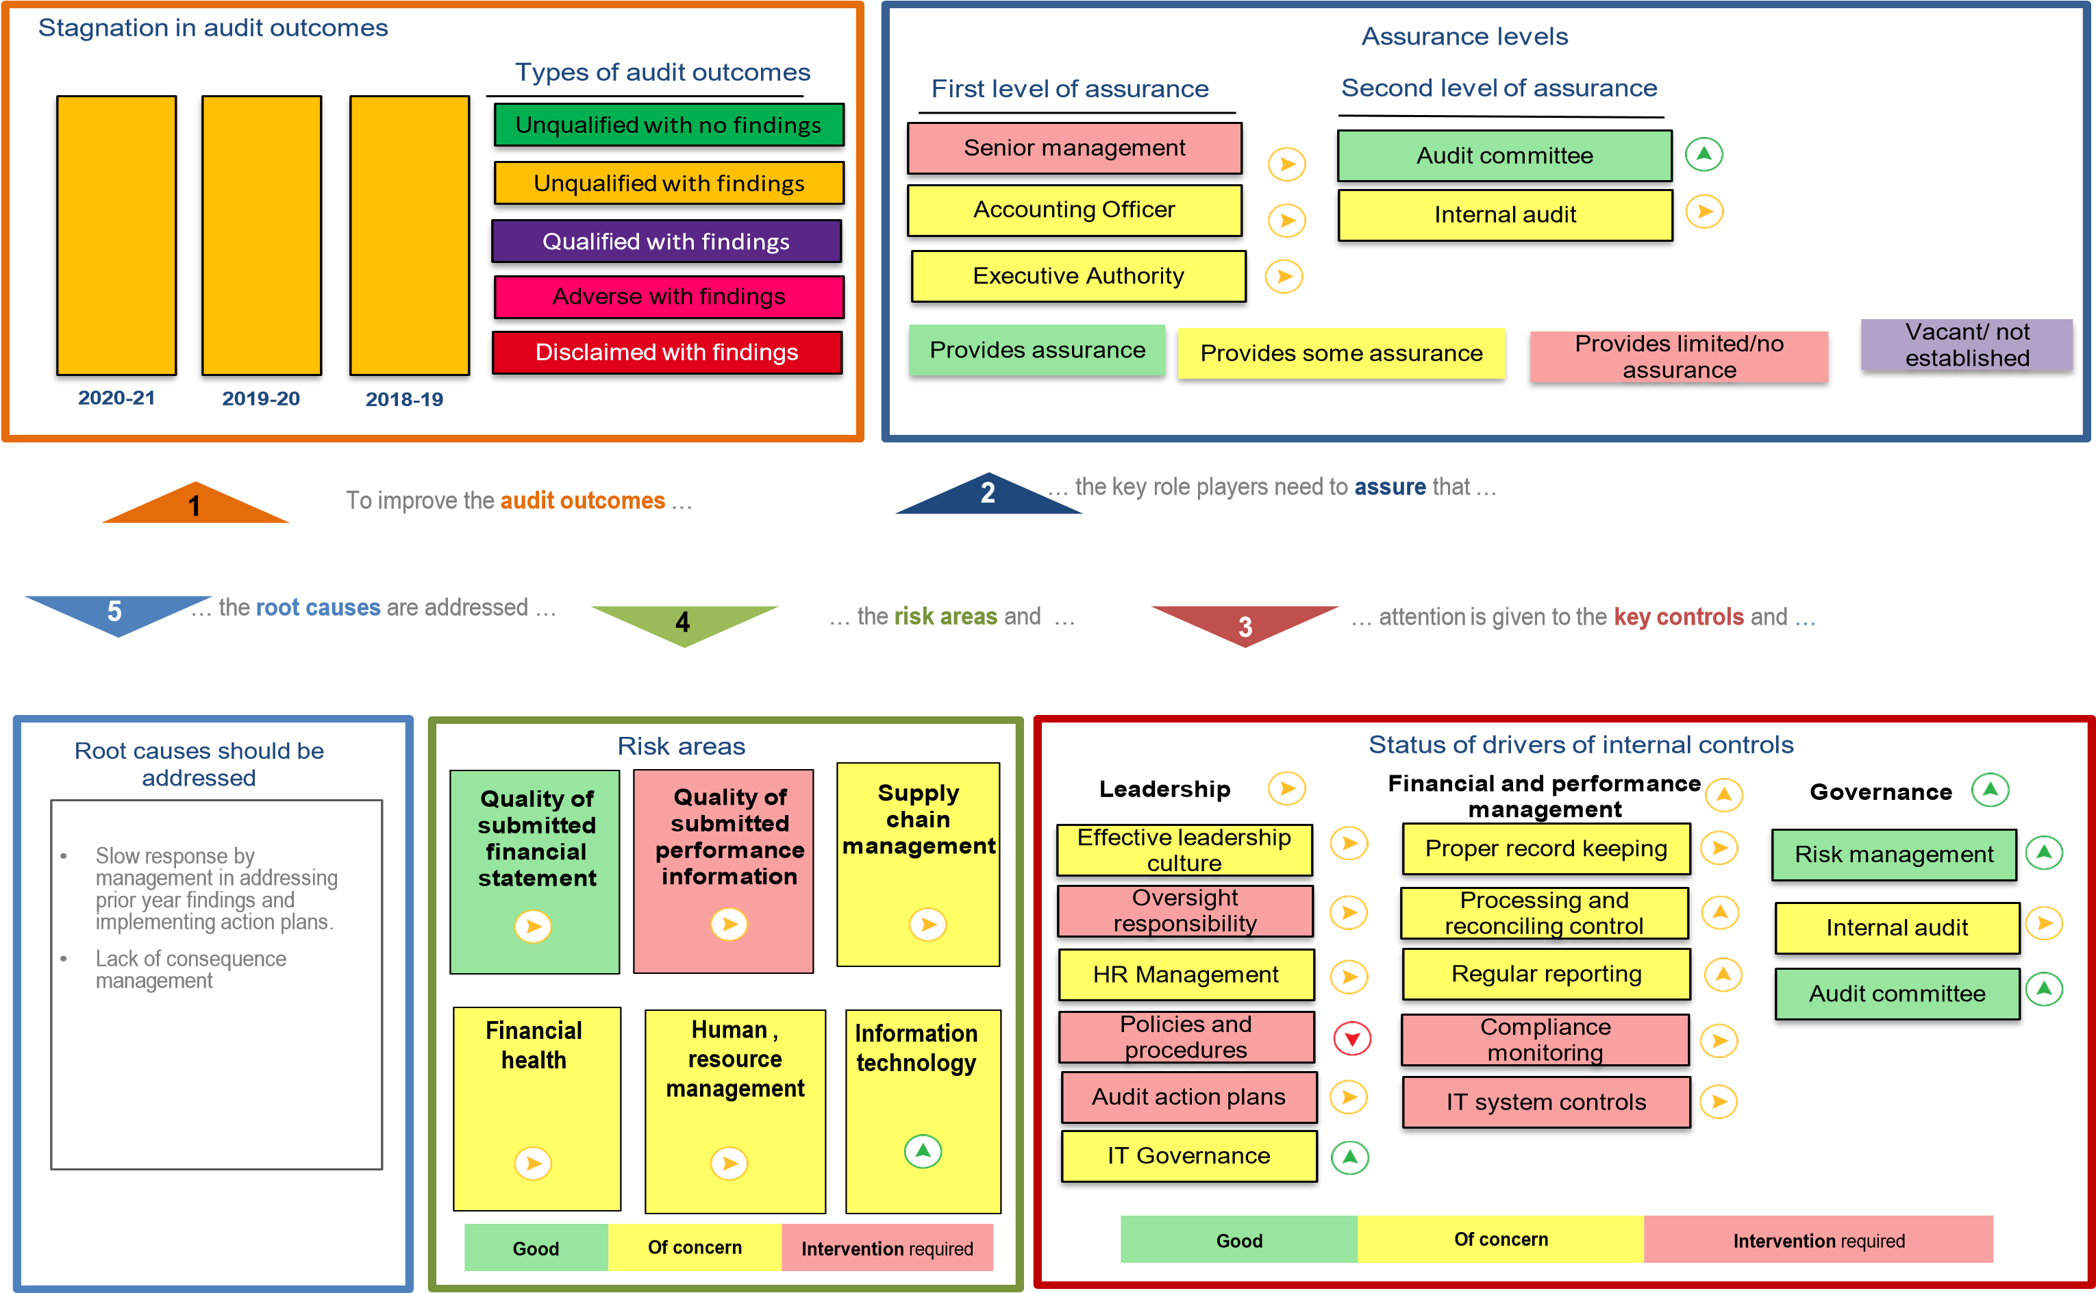
Audit outcomes and internal control environment

Slide 5
AG audit outcomes
Description | 2018-19 | 2019-20 | 2020-21
Audit findings raised | 46 | 60 | 73
New audit findings | 7 | 26 | 37
Management dissagreements | 8 | 10 | 9
Matters affecting the audit report | 17 | 6 | 9
No management responses | 0 | 0 | 0
Recurring audit findings | 39 | 33 | 25
Matter of emphasis
The department is the defendant in contract cancellation lawsuits amounting to R 189 159 000.00. The ultimate outcome of these matters cannot presently be determined and no provision for any liability that may result has been made in the financial statements.

Slide 6
Matters relating to the audit report
Finance related
Effective steps were not taken to prevent fruitless and wasteful expenditure amounting to R1 332 000, as disclosed in note 24 to the financial statements. The majority of the fruitless and wasteful expenditure was caused by payments for interest for delayed settlements.
Some payments were not made within 30 days or an agreed period after receipt of an invoice, as required by treasury regulation 8.2.3.
Bid documentation for procurement of commodities designated for local content and production, did not stipulated the minimum threshold for local production and content as required by the 2017 Procurement Regulation 8(2)
Investigations into irregular and fruitless and wasteful expenditure not completed and lack of consequence management
Other investigations not completed and lack of consequence management

Slide 7
Matters relating to the audit report
Specific focus areas – finance related
The department had a reduction in the accrual amount for the new year from R159 330 000 to R146 762 000 but the amount of long outstanding accruals represents a majority of the amount with an increase in the number of days outstanding this could have been due to COVID and persons not being available in office.
A considerable increase in the number of days for creditor payment period was noted which could result in the department being liable for possible interest on late payments. It was confirmed that this was mainly due to a to shortage of personnel as a result of Covid-19 lockdown regulations; other internal delays, and a lack of a proper tracking system.
R1 827 000 (100%) of irregular expenditure incurred in the current financial year was as a result of the contravention of SCM legislation. 5.6% of this irregular expenditure was identified during the audit process and not detected by the department’s monitoring processes. The root cause was mainly due to old contracts that were entered into without following proper procurement processes, irregular expenditure will continue to be incurred until these contracts come to an end.

Slide 8
Matters relating to the audit report
Specific focus areas – finance related
Awards to persons in the service of the state and their close family members – 1 instance amounting to R20 000 was identified where official did not declare interest.
One quotation to the value of R235 193.40 was awarded to a bidder who did not score the highest points in the bid evaluations, and there was no justification for the deviation.
Local content and production (designated sectors) - specifications for two awards with a total value of R104 394.80 did not stipulate the minimum threshold for local production and content.
Ongoing investigations - a total of 62 investigations were ongoing at year-end into allegations relating to financial misconduct, fraud and/or improper conduct in SCM. Some of these investigations have been ongoing for a period exceeding 12 months.
In addition to the above, a total of 64 investigations were completed during the current year. For 64 completed investigations, appropriate action (sanctions) were not taken as per the findings/recommendations from the investigations.

Slide 9
Matters relating to the audit report
Programmes | Opinion 2018-19 | Opinion 2019-20 | Opinion 2020-21
Programme 2: SES | Qualified | Qualified | Qualified
Performance Information related
PPI 201: Number of Military Veterans who are verified and captured on the National Military Veterans Database - the achievement of 2489 was reported against a target of 5325 in the annual performance report. However, the supporting evidence provided materially differed from the reported achievement.
PPI 203: Number of Military Veterans approved and provided with compensation benefit - Insufficient appropriate audit evidence for the achievement of 25 reported against target 100 in the annual performance report, due to the lack of accurate and complete records. I was unable to confirm the reported achievement by alternative means. Consequently, I was unable to determine whether any adjustments were required to the reported achievement.
PPI 206: Number of bursaries provided to Military Veterans and their dependants per year - the achievement of 2779 was reported against a target of 3500 in the annual performance report. However, some supporting evidence provided materially differed from the reported achievement, while in other instances there was insufficient appropriate audit evidence. This was due to insufficient evidence and applicants who were reported in the incorrect financial year.

Slide 10
Q3 progress against the action plan
Management Response Actions | FINANCE | CORPORATE SERVICES | ODG | SES | ESM | IA & RM | TOTAL | %
Implemented | 21 | 9 | 0 | 7 | 0 | 0 | 37 | 54
In -progress | 13 | 9 | 1 | 6 | 1 | 2 | 32 | 46
Not implemented |  |  |  |  |  |  |  | 0
TOTAL | 34 | 18 | 1 | 13 | 1 | 2 | 69 | 100

Slide 11
AG audit outcomes & action plans
Areas of improvement
LOGIS implementation to assist in management of assets and procurement process.
Introduce electronic benefits management system which should interface with all 11 benefits in the Act.
Introduce electronic performance management system
Develop and implement effective invoice tracking policy and system
Perform investigations of unwanted expenditure and finalize on time
Introduce monthly reporting for performance information to allow adequate time to rectify errors and omissions.
Monthly monitoring of audit action plans

Slide 12
Conclusion
Thank you

