Slide 1
Municipal Electricity debt: Presentation to the Select Committee on Appropriations
02 May 2017
For an Equitable Sharing of National Revenue

Slide 2
Structure of Presentation
Background
Aggregate Municipal Debt
Creditors as Share of Total Debt Owed by Municipalities
Total Debt Overview
Top 20 Defaulting Municipalities
Municipal Debt by Province
Small Power Users Debt
Recent Developments
What Municipalities are Owed by Organs of State
What Municipalities are Owed by Provincial and National Departments
Recommendations

Slide 3
Background
The Electricity Regulation Act, 2006 (Act No. 4 of 2006) gives the National Energy Regulator of South Africa (NERSA) a mandate to regulate the supply of electricity through the provision and approval of tariffs.
From the tariffs given by NERSA, Eskom sells electricity to municipalities in bulk which in turn the municipalities resell to their respective clients (households).
According to Eskom, 42% of the company’s revenue is derived from municipalities, suggesting that the defaulting municipalities are adversely affecting the power utility’s financial health.
As of February 2017 Eskom was owed R10billion (i.e. overdue debt only).
The top 10 defaulting municipalities owe about R6.2 billion, whilst the top 20 defaulting municipalities are overdue by about R7.4 billion.

Slide 4
Aggregate Municipal Debt, 2011/12 – 2015/16
The diagram depicts a five year over-view of three municipal creditors and the total amounts owed to them by municipalities year on year, from 2011/12 to 2015/16.
Municipal debt to Eskom shows a serious increase in the amount from 2014/15 to 2015/16.
Debt for bulk water has had a moderate increase over the past 5 years, whereas debt to SARS on PAYE deductions shows a steady decline over the years.

Slide 5
Creditors as share of total debt owed by Municipalities, 2011/12 – 2015/16
The table illustrates the contribution of each creditor to the total creditors owed by municipalities,
In 2011/12 the highest debt by municipalities was for trade creditors (39%) followed by Eskom (28%).
In 2015/16 Eskom debt was the highest (35%) followed by Trade creditors (27%).

Slide 6
Total Overdue Eskom Debt Trend Dec 2012 – Feb 2017
Increasing trend broken by Promotion of Administrative Justice Act (PAJA), whereby eight municipalities had their electricity supply interrupted

Slide 7
Top 20 Defaulting Municipalities
65% still same in Dec 2014 and Feb 2017

Slide 8
Total Outstanding Debt by Province, November 2014 vs Feb 2017
February 2017

Slide 9
Small Power Users Debt per Province, end Jan 2017
Soweto has the largest outstanding debt, at 91% of total outstanding debt of small power users.

Slide 10
Recent Developments

Slide 11
Recent Developments
Following the process of the Promotion of Administrative Justice Act (PAJA), eight municipalities have had their electricity interrupted since 16 Jan. 2017, in North West, Northern Cape and Mpumalanga:
- North West
- Naledi
- Kgetleng River
- Lekwa-Teemane
- Ventersdorp
- Northern Cape
- Renosterberg
- Ubuntu
- Mpumalanga
- eMalahleni
- Msukaligwa

Slide 12
Recent Developments
Eskom has proposals on the table to resolve the Eskom debt quandary: (Partly in response to concerns raised by SALGA)
Eskom reducing the interest rates charged on overdue balances from prime plus 5% to prime plus 2%,
The reduction of municipal tariff options from 11 to 3,
Eskom changing the payment period on municipal bulk accounts from 15 to 30 days to give municipalities more time for payment, and
Eskom changing its payment allocation policy to allocate payments to capital first and then interest.
The Commission notes these proposals and if implemented, will lead to some improvements

Slide 13
What are municipalities Owed?
Of concern to the Commission is also that even some national and provincial government departments are not complying with the 30 day payment rule, (i.e. Section 38(1) of the PFMA (and Treasury regulations 8.2.3 (2001) and Treasury Instruction note No. 34). For example (Next 2 slides)

Slide 14
What Municipalities are Owed by Organs of State, 2015/16
What are Municipalities Owed

Slide 15
What Municipalities are Owed by National Departments

Slide 16
What Municipalities are Owed by Provincial Departments

Slide 17
Commission’s Recommendations

Slide 18
Commission’s Recommendations
1. Need to Improve efficiencies in the System
Avoidable electricity losses should minimized (e.g. graphs below on electricity losses)
Prepaid metering is one option that can be considered, albeit it requires careful balancing its side effects against the benefits
The rollout of prepaid metering is progressing slowly in metros while in the rest of local government sector, the rollout is insignificant

Slide 22
Commission’s Recommendations
2. A proper diagnostics of the root cause of non-payment be done and if it is due to bad management, appropriate consequences should be rendered especially the perennial defaulters
Stricter measures should be imposed on individuals within municipalities that are responsible for continued flouting of MFMA rules.
3. Municipalities must produce balanced budgets and in addition the electricity and water undertakings must be ring fenced.
4. That IGFR forums dedicate sufficient time to find lasting solutions to the debt problems within the Local government sector.
5. Prepaid metering (use of mart technologies) is one option that can be considered, albeit it requires carefully balancing its side effects against the benefits.

Slide 23
Thank You.
Financial and Fiscal Commission
Montrose Place (2nd Floor), Bekker Street,
Waterfall Park, Vorna Valley, Midrand,
Private Bag X69, Halfway House 1685
www.ffc.co.za
Tel: +27 11 207 2300
Fax: +27 86 589 1038

Slide 24
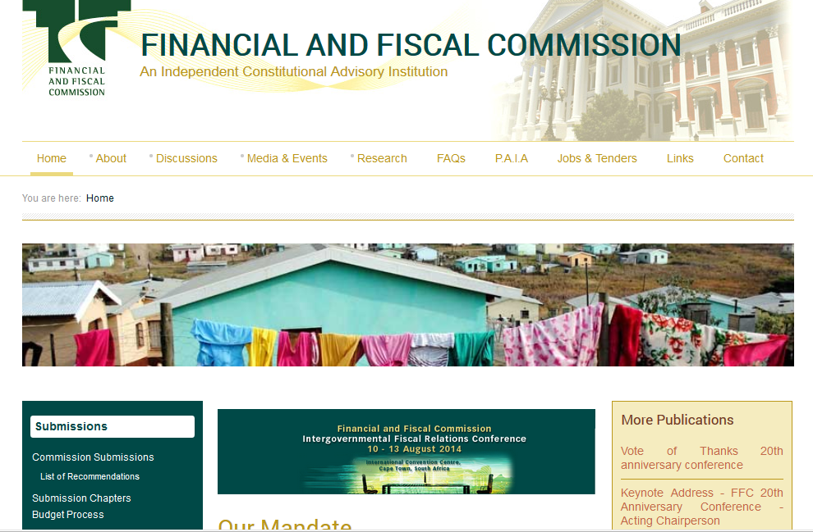
FFC’s Website: www.ffc.co.za
FFC MTBPS Training for SCoA_September 2014
Introduction to the Financial and Fiscal Commission 2014

