Slide 1
PORTFOLIO COMMITTEE - COOPERATIVE GOVERNANCE AND TRADITIONAL AFFAIRS
ACTING MUNICIPAL MANAGER: CWA NIEUWOUDT 04 DECEMBER 2019

Slide 2
STATE OF THE MUNICIPALITY
ACTING MUNICIPAL MANAGER: CWA NIEUWOUDT 04 DECEMBER 2019

Slide 3
DEMOGRAPHIC PROFILE
Population data:
Population: 188 843.
Number of households: 66 525.
Average household size: 2.8 persons per household.
Male population 48.8% and Females 51.2% .
(Source: Community Survey 2016 and Quantec, 2017).

Slide 4
DEMOGRAPHIC PROFILE ….cont…
Migration Trends:
Negative migration rate since 2011 – net loss of 23 000 people.
This is attributed to the declining mining economy.
(source: Quantec 2017)

Slide 5
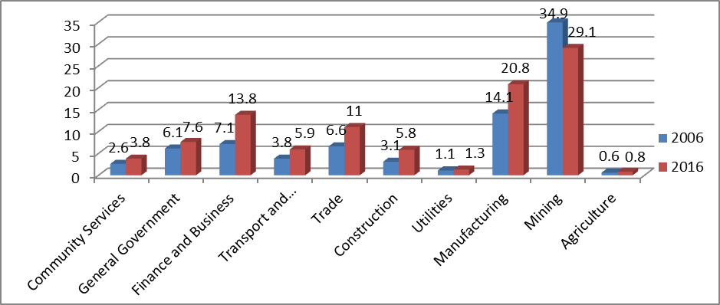
DEMOGRAPHIC PROFILE ….cont…
Economic Performance:
The figure below shows the gross domestic product (GDP) contribution per sector in the MCLM.
Although mining has shown a declining trend relative to its share in 2006, the mining sector remains the largest contributor to the municipality’s GDP.
Conversely, all the other sectors have been growing, with the greatest increases reported in the manufacturing sector and finance and business division.
(Source: Quantec 2017)

Slide 6
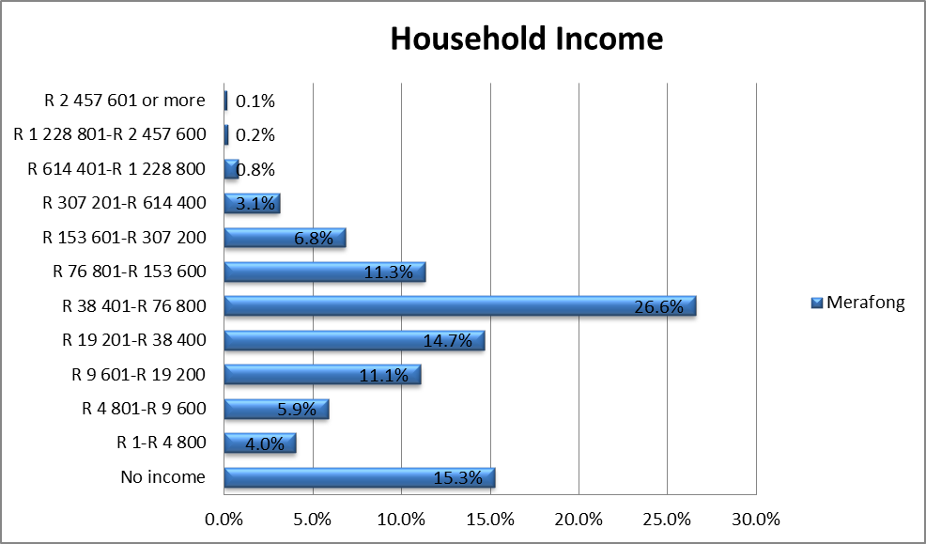
DEMOGRAPHIC PROFILE ….cont…
Household Income:
Majority households income: R19 201 to R76 800 per annum, similar to Gauteng Province and WRDM.
Average households income R6 750 per month, which is lower than the district’s household average income (R8 690) and almost 50% lower than Gauteng’s average household income.
(Source: Quantec 2017)

Slide 7
FINANCIAL POSITION
ACTING MUNICIPAL MANAGER: CWA NIEUWOUDT 04 DECEMBER 2019

Slide 8
Consolidated Overview of the 2019/20 BUDGET MTREF
R thousand | Adjustment Budget 2018/19 (Million) | Budget Year 2019/20 (Million) | Budget Year 2020/21(Million) | Budget Year 2021/22(Million)
Total Operating Revenue | 1,266,174 | 1,674,748 | 1,776,603 | 1,888,613
Total Operating Expenditure | 1,551,056 | 1,635,900 | 1,736,839 | 1,828,340
Surplus / (Deficit) for the Year | -284,882 | 38,848 | 39,764 | 60,273
Total Capital Expenditure | 304,103 | 163,290 | 164,604 | 176,020

Slide 9
IMPACT OF MINES VALUATION DISPUTE ON REVENUE
 | 2012/13 | 2013/14 | 2014/15 | 2015/16 | 2016/17 | 2017/18 | 2018/19
Collection Rate | 83.79% | 83.24% | 76.04% | 69.49% Property rates outcome | 71.59% Property rates outcome | 68.06% Property rates outcome | 64.20% Property rates outcome

Slide 10
FINANCIAL POSITION- CHALLENGES
Reason 1: Mine valuation outcome
Negative outcome of mine valuation – revenue loss R144m p/a since 2015.
Outstanding mine valuation appeals – SV6
Appointment of Valuation Appeal Board (VAB)–October 2019
Appeal Board induction completed in October 2019
Appeal hearings should resume soon.
Finalisation of objections for the mines supplementary valuation appeal will contribute to stabilized revenue base
The following table indicates the best and worst case scenarios of the possible outcome of the VAB – green line reflects very realistic anticipated outcome.

Slide 11
IMPACT OF SUPPLEMENTARY VALUATION 6
TOTAL PROPERTY VALUE | ANNUAL PROPERTY RATES TARIFF | ANNUAL PROPERTY RATES INCOME | 1 AUG 2015 – 30 JUN 2019 (46 months)
R7 billion | R0,03641 | R255 million | R978 million
R6 billion | R0,03641 | R218 million | R836 million
R5 billion | R0,03641 | R182 million | R698 million
R4 billion | R0,03641 | R146 million | R560 million
R3 billion | R0,03641 | R109 million | R418 million
R2 billion | R0,03641 | R73 million | R280 million
R1 billion | R0,03641 | R36 million | R138 million

Slide 12
IMPACT OF SUPPLEMENTARY VALUATION 6
Mines have already agreed on an interim rates payment whilst the VAB process is unfolding.
Mines have offered to pay a interim amount of R36 198 234,00 p/a or R3 016 519,00 pm with effect from 1 July 2019
The cumulative amount billed for period 1 July 2019 – 31 December 2019 - R18 099 114
This amount excludes 50% payment to be held in Trust until final outcome of the VAB.

Slide 13
FINANCIAL POSITION-CHALLENGES
Reason 2: Payment levels
Resistance from communities to pay for municipal services.
Persistent culture of non-payment.
The average payment level for 2018/19 financial is 64.20% against a budgeted payment level of 70%.
Quarter 1 (2019/20) 59,65% - The payment figure was adversely affected by an unlawful strike in September 2019 where the payment figure was 49,52%

Slide 14
PAYMENT LEVELS PER AREA 2018/19

Slide 15
FINANCIAL POSITION - CHALLENGES
Credit control – status quo
Disconnection in Carletonville, Fochville and Welverdiend continuing.
Disconnection in township areas not successful due to intimidation by communities.
Ward based consultation process finalised in August 2019
Despite intensive consultation, Council employees and credit control service provider were prohibited to execute their duties.
Law enforcement agencies had to escort personnel to safety
Panel of debt collectors mandated to enforce the full scope of debt collection, including attachment of property
Targeted internal debt collection done on high owing accounts
 | July 2019 | Aug 2019 | Sept 2019
Disconnections | 550 | 393 | 705

Slide 16
FINANCIAL POSITION -CHALLENGES
Reason 3: Water loss
Average water losses for the 2018/19 financial year is 47.16%. – R68,3m
As at the end of the first quarter(Q1) of 2019/20 financial year is 32.23%. - R12M
Implementation of the water loss strategy has yielded positive results in the reduction of water losses in Q1.

Slide 17
DISTRIBUTION LOSS - WATER

Slide 18
FINANCIAL POSITION - CHALLENGES
Main causes of water losses
Decommissioning of four reservoirs and bulk supply lines as a result of sinkhole occurrences.
Direct supply from Rand Water bulk supply leads to fluctuating pressure.
Instability in the water supply and fluctuating pressure resulting in pipe bursts and leakages.
Overflowing reservoirs due to insufficient levelling devices
Aged infrastructure, vandalism of infrastructure and the “Zama Zama’s” illegal activities.

Slide 19
WATER LOSSES STRATEGY
CRITICAL PATH TO ADDRESS WATER LOSSES
Overflowing Reservoirs
Working Pressure in Residential Areas
Address Small Water Leakages
Replace Bulk Water meters
Replace Internal Water Meters
Normal Maintenance

Slide 20
PROGRESS TO DATE ON THE WATER LOSS PLAN
Projects implemented according to water services plan:
Khutsong Reservoir replacement project – completion December 2020
The replacement of the Adatta bulk pipeline – completion date December 2020
The new pipeline to the Elijah Barayi Housing project and Welverdiend – completion October 2019
Network upgrades including replacement of PRVs – completion March 2020 - Additional MIG allocation gazetted for R2.7m
New reservoir and related bulk infrastructure in Fochville - completion January 2020
War on leaks (Rand Water Foundation) – R6.5m

Slide 21
COST CONTAINMENT
Cost containment measures were implemented with effect from 2014/15 financial year. The expenditure has reduced from R40.5m to R10m in the 2018/19 financial year. The focus was mainly on attendance and conference, entertainment, travel and conferences, outsources grass cutting services and security services.

Slide 22
COST CONTAINMENT
COST CUTTING MEASURES (R)
 | 2013/14 | 2014/15 | 2015/16 | 2016/17 | 2017/18 | 2018/19
Attendance and conference | 359 701 | 184 045 | 6 315 | 5 660 | 0 | 0
Entertainment | 688 210 | 345 071 | 155 913 | 14 406 | 2 406 | 7 725
Travel and conferences | 1 776 114 | 892 212 | 120 183 | 171 489 | 65 016 | 5 000
Grass cutting contracted services | 12 450 269 | 11 424 840 | 5 757 944 | 0 | 0 | 0
Security Services | 25 307 704 | 23 677 941 | 14 084 243 | 12 548 593 | 10 096 853 | 9 989 775
 | R 40 581 998 | R36 524 109 | R20 124 598 | R12 740 148 | R10 164 275 | R10 002 500

Slide 23
FINANCIAL POSITION
Reason 4: Electricity loss
Average electricity loss for the 2018/19 financial year is 44.01%. – R118,9m
This has increased to an average of 50.44% in the first quarter of the 2019/20 financial year. R51.8M
Main reason for the increase in technical and non-technical losses are as follows:

Slide 24
UNITS PURCHASED VS SOLD 2018/19

Slide 25
ELECTRICITY LOSSES TECHNICAL MAIN CAUSES
Overloading of bulk capacity
Overloading of network capacity
Overloading of transformers
Insufficient preventative maintenance

Slide 26
PROPOSED SOLUTIONS TECHNICAL LOSSES
URGENT NETWORK STABILISATION NEEDS
Fochville |  | R40 000 000 | Upgrade substation 2 x 20 MVA
Khtsong South |  | R6,500,000 | Upgrade Substation Capacity from 10MVA to 20MVA
Blybank |  | R490 000 | Installation of 1.3km line from Blybank Substation to DP 2
Khtsong South |  | R1,250,000 | Installation of2.2km line from Mall Substation to Khutsong sSouth West Substation
Khtsong South |  | R325,000 | Replacement of 2 x Transformers (200kVa to 315 kVa at Khtusong South
Wedela |  | R325,000 | Replacement of 2 x Transformers (200kVa to 315 kVa) at Ext 3
Khutsong South |  | R275,000 | Repalcement of Breakers in Khutsong South Main substation
Wedela |  | R165,000 | Install 300m cable betwee Nu3 and Ext 2
Carletonville |  | R1220 000 | Repair of 20MVA transformer at Reinecke Substation
Khutsong South |  | R185,000 | Install 1 x T3OF Switch at Khutsong South West Sub

Slide 27
ELECTRICITY LOSSES NON-TECHNICAL MAIN CAUSES
By-passing of prepaid meters
Non-registering meters
Illegal connections
Vandalism of breakers in main sub-stations resulting in blown fuses
Cable theft
Illegal connections
Illegal buildings and back rooms – exceeds design capacity

Slide 28
TAMPERED METERS PER AREA

Slide 29
PROGRESS TO DATE – NON TECHNICAL LOSSES
Continuous meter audits and verification
Continuous data verification
Rolling Load shedding
Criminal cases for tampering opened
Investigation of staff and some businesses for collusion in tampering

Slide 30
PROVINCIAL SUPPORT
On 02 May 2016 the MEC for Local Government placed Merafong City LM under Section 154 (1) of the Constitution , requiring the National and Provincial government to assist the municipality in developing capacity such that it is able to fulfil its local government objects as per Section 152 of the Constitution. A section 154 Implementation Plan was also approved focusing on the following 4 pillars:
Increase revenue collection;
Reduction of electricity and water losses;
Cost containment;
Indigent management.

Slide 31
INVESTMENT IN VBS
ACTING MUNICIPAL MANAGER: CWA NIEUWOUDT 04 DECEMBER 2019

Slide 32
INVESTMENT IN VBS
Amount invested: R50 000 000
Initial period: 90 Days from 23 June 2017
Reinvestment: 60 days from 13 September 2017
Interest withdrawal 31 January 2018: R2 858 368
Instruction for withdrawal of investment: 06 March 2018
VBS confirmed that the system automatically reinvested the funds and the funds will mature 31 March 2019.
The amount invested in VBS was for capital projects that were not yet completed as at 30 June 2017 and the funds were not required in the short term based on project cash flow requirements.
Funds are ring-fenced for capital projects and this did not impact on the operational budget are therefore no impact on daily operations.

Slide 33
RECOVERY OF INVESTMENT AND TREATMENT OF SHORTFALL
Liquidation claim submitted and accepted at the second creditors meeting held on the 8th November 2019.
Summons for civil recovery instituted against Mr. R Mohaudi in accordance with the legal advice based on the forensic report.
RECONCILIATION OF GRANT FUNDING VS RING FENCED INVESTMENT
Unspent grant funds 31/10/2019 | R(118 208 761)
FNB Investment 31/10/2019 | R103 539 111
VBS Mutual Bank | R50 000 000
VBS Mutual Bank impaired | R(50 000 000)
Shortfall | (R14 669 650)

Slide 34
CONSEQUENCE MANAGEMENT
28 March 2018 – Council resolved to request Gauteng MEC Finance to initiate forensic investigation.
17 May 2018 – GPT mandated Deloitte to investigate the investments.
01 March 2019 – Deloitte presented the forensic report to Council.
Council resolved to obtain a legal opinion on the implementation of the recommendations of the report;
25 April 2019 – Legal opinion was presented to Council with the following recommendations:
Disciplinary procedures to be instituted against Mr. Wienekus and Ms. Chauke;
Provide copies of the report to the employer of Ms. Ngwenya and Mr. Mohaudi as they were both no longer employed by Merafong City Local Municipality;
Criminal proceedings to be instituted against Mr. Mohaudi;
Legal opinion on civil recovery;
18 June 2019 – Disciplinary hearing of Ms. Chauke;
19 June 2019 – Disciplinary hearing of Mr. Wienekus;

Slide 35
CONSEQUENCE MANAGEMENT
Criminal charges are being investigated by Directorate for Priority Crime Investigation (case number DPCI Head Office Enquiry 6/01/19);
Outcome of disciplinary inquiry presented to Council on the 12 August 2019, matter deferred and finalised on the meeting held on the 29 October 2019 (item 88/2019);
Sanction imposed by disciplinary inquiry of a final written warning was implemented by Council.

Slide 36
THANK YOU!

