Slide 1
USAASA and USAF
Presentation
Portfolio Committee on Telecommunications and Postal Services
“Universal Access and Service to ICT for All”

Slide 2

USAASA/ USAF OVERVIEW
The White Paper provides that USAASA, established in terms of the ECA, 2005 will be dissolved and be replaced by a new Digital Development Fund (DDF) responsible for providing universal service and access support.
The DDF will be subject to the provisions of the PFMA
The DDF will provide support for both infrastructure and targeted demand stimulation projects
The rationalisation process is underway hence the critical vacancies at USAASA have not been filled.

Slide 3
2019/20 USAASA

Slide 4
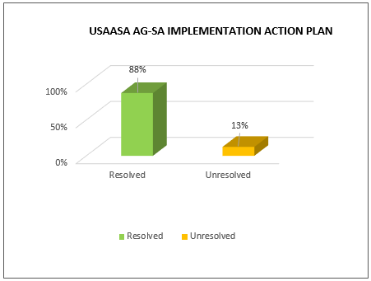
USAASA AG-SA IMPLEMENTATION PLAN

Slide 5
USAASA AG-SA IMPLEMENTATION PLAN (Cont…)
Audit Finding | Progress
Asset management policy outdated. Miss-alignment between accounting policy and asset management policy | Asset Management Policy has been revised

Slide 6
USAASA
FINANCIAL STATEMENTS
QUARTER 2 (2019/20 FY)

Slide 7
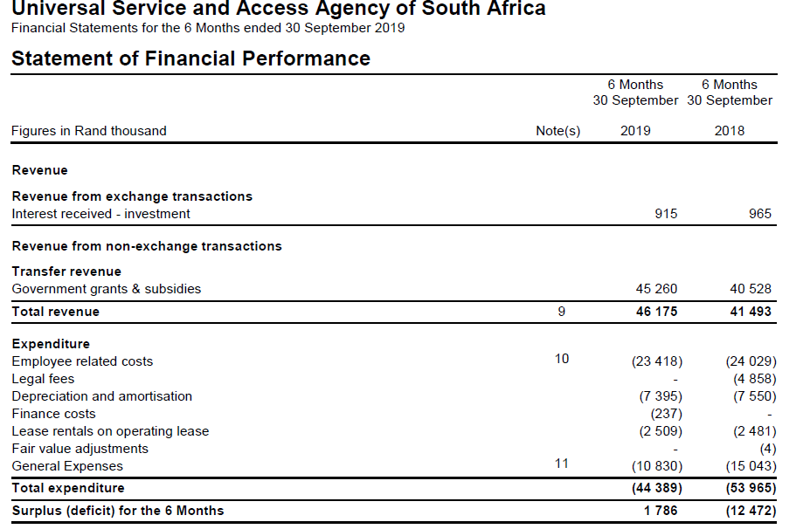
Quarter 2 Financial Statements 2018/19
USAASA’s financial performance for quarter two improved, compared to the prior year for the same period. There was a deficit of R12.5 million reported in the prior year compared to the surplus of R1.7 million in the current period. The revenue increased by 11%, from R41 million to R46 million. Expenses in the current period reduced by 21.57%. The main contributors towards the reduction of expenses were employee costs by R611k, legal cost by R4.9 million, consulting fees by R4.5 million and license fees by R573k.

Slide 8
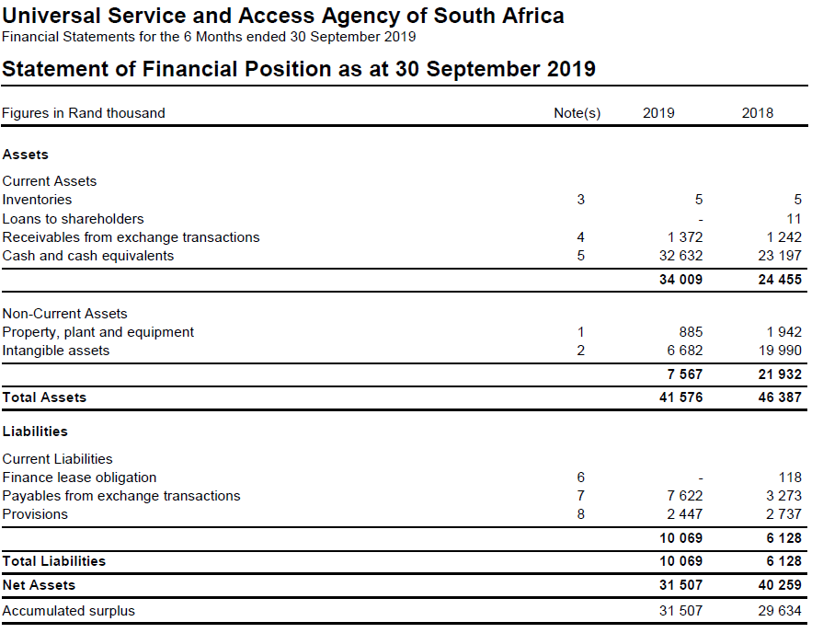
Quarter 2 Financial Statements 2018/19
The financial position deteriorated, resulting in the net assets of R31.5 million compared to R40.3 million in the prior year. The contributor is the aging of non-current asset, especially intangible asset. USAASA’s intangible assets has a net book value of R6.7 million compared to R20 million in the prior year.

Slide 9
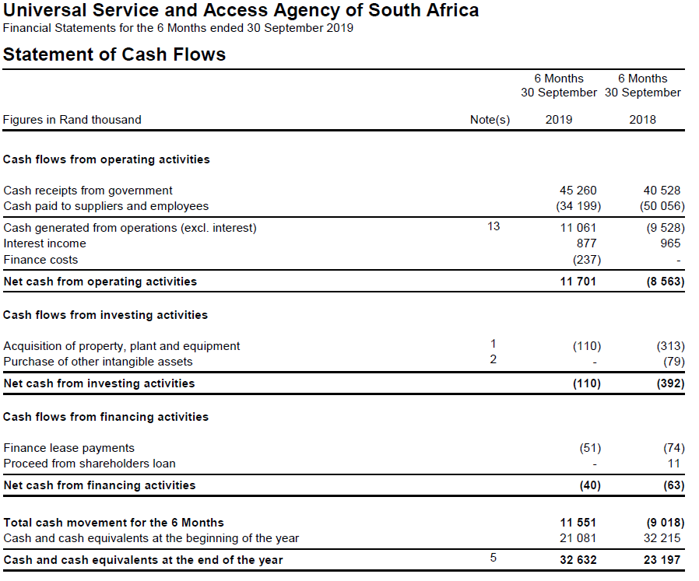
Quarter 2 Financial Statements 2018/19
Cash has improved from R23.2 million in prior year to R32.6 million in the current year. This can be attributed to lower spending.

Slide 10
IRREGULAR / FRUITLESS AND WASTEFUL EXPENDITURE SUMMARY
Cumulative irregular expenditure for Quarter one and two amounted to R 757 751.19
Cumulative Fruitless and Wasteful for Quarter one and two amounted to R 236 691.51
Internal Audit unit has been assigned the responsibility for investigating Irregular/ Fruitless and Wasteful expenditure and provide reports thereof

Slide 11
2019/20 USAF

Slide 12

USAF AG-SA IMPLEMENTATION PLAN

Slide 13
USAF AG-SA IMPLEMENTATION PLAN
Audit Finding | Progress
Misstatement of opening balance of inventory | Increase Capacity and specifically manage the implementation of the Broadcast Digital Migration program Process of inventory recovery from Installers who did not return. Audit Steering Committee providing oversight on the progress made against findings.
AFS inventory balance not agreeing to inventory list
Inventory not returned by installers included in the closing balance
Differences noted between inventory counted and inventory as per SAPO SAP system
Duplicate serial numbers in issued and redeemed inventory

Slide 14
USAF
FINANCIAL STATEMENTS
QUARTER 2 (2019/20 FY)

Slide 15
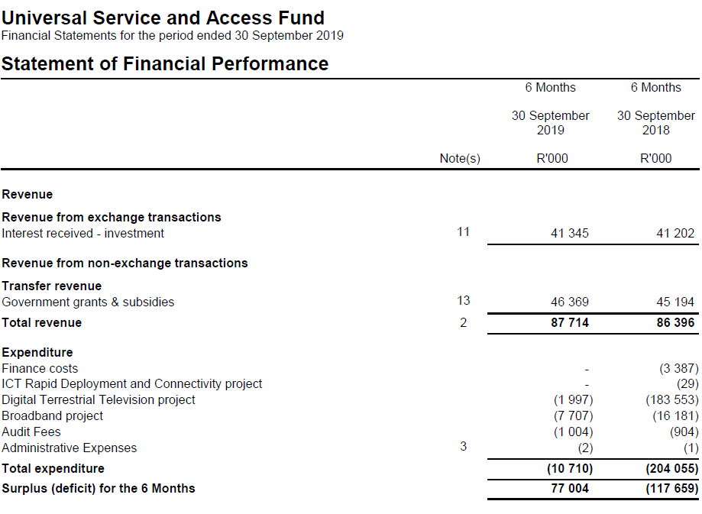
Quarter 2 Financial Statements 2019/20
USAF’s financial performance for quarter two improved, compared to the prior year for the same period. There was a deficit of R117.7 million reported in the prior year compared to the surplus of R77 million in the current period. The revenue increased by a small margin of 1.5%, from R86.4 million to R87.7 million. Expenses in the current period reduced due to less projects rolled out. The main contributors towards the reduction of expenses are the BDM project by R181.56 million due to inventory which is not installed and Broadband projects by R8.5 million as there is no new project rolled out.

Slide 16
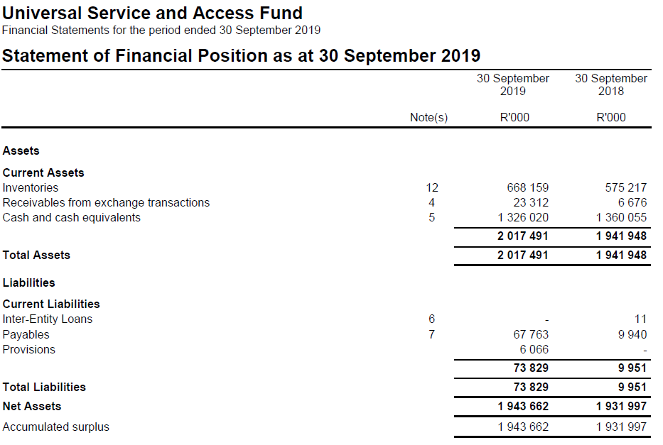
Quarter 2 Financial Statements 2019/20
The financial position also improved, resulting in the net assets of R1.944 billion compared to R1.932 billion in the prior year. The main contributor is the increase in the inventory on hand by R92.9 million.

Slide 17
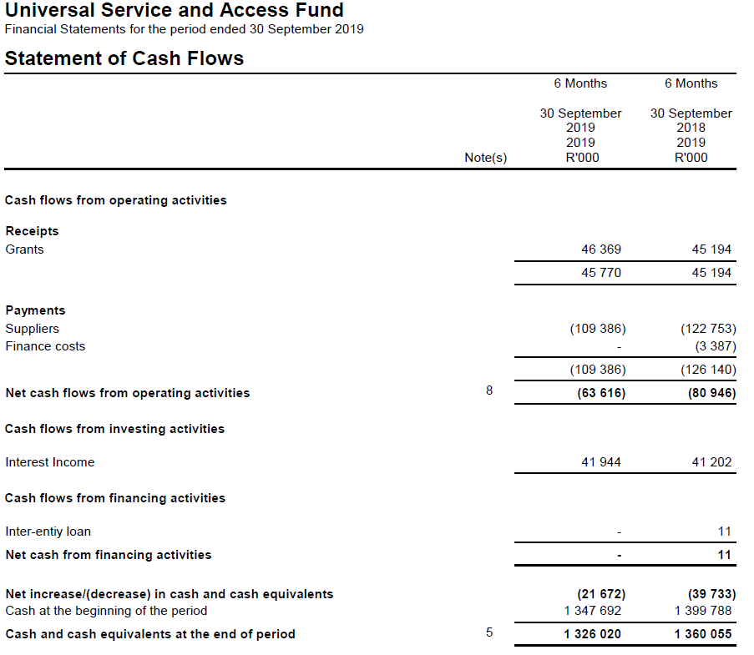
Quarter 2 Financial Statements 2019/20
Cash has decreased from R1.36 billion in prior year to R1.33 billion in the current year. This can be attributed to payments done to BDM inventory manufactures in the current year. Manufacturers that were paid in the current year did not deliver inventory in the prior year, some due to disputes in contracts.

Slide 18
IRREGULAR EXPENDITURE SUMMARY
Cumulative irregular expenditure for Quarter one and two amounted to R 83 030.70
Internal Audit unit has been assigned the responsibility for investigating Irregular/ Fruitless and Wasteful expenditure and provide reports thereof

Slide 19
PROJECT MANAGEMENT
BROADCAST DIGITAL MIGRATION

Slide 20
BDM PROJECT MANAGEMENT OFFICE
BDM Model: The Ministry of Communications and Digital Technologies is finalising the new BDM model for Cabinet approval.
  USAASA has halted the BDM implementation, including related procurement services.
Increase Capacity and specifically manage the implementation of the Broadcast Digital Migration program
Accelerate the installation of the remaining 1 million set-top boxes
  Accelerate the completion of installations in the Free State, NC and NW (516 to be installed by year end)
Jointly with the DOC and other stakeholders, communicate the program to beneficiaries, educate and provide consumer awareness to affected households.
Jointly undertake registration drives
Improve the management of suppliers (SAPO, STB manufacturers, etc)

Slide 21
BDM PROJECT PROGRESS UPDATE
Government committed to subsidise at least 5 million indigent households.
Statistics South Africa 2016 data depicts estimated eligible households of 4.7 million.
In 2015 USAASA procured 1.5 million consignment of decoders, aerials and satellite dishes.
  Of the total commitment to date:
    1 207 990 decoders have been delivered;
    1 million aerials delivered;
    405 073 satellite dishes delivered;
    Therefore, there is 290 000 decoders to be supplied by end of the financial year.
  Of the delivered devices;
    549 344 decoders issued
    511 368 eligible households have been installed
      Therefore there is 37 976 decoder kits not installed
    Approximately 1 million decoder kits still to be installed
In January 2019, installations contracts expired and decoder rollout halted.
There is approximately 650 000 decoders stored in the SAPO warehouses incurring R5.1 million storage per month

Slide 22
BDM PROJECT PROGRESS UPDATE (2)
Depletion of decoder stock at SAPO warehouses.
  A new installation framework developed to consider appointing installers at district and local municipalities.
  Procurement of installers to be undertaken for the depletion of decoder consignment kept at SAPO warehouses.
Subsidising the remainder of eligible households
  Remaining estimated 3.2 million households of to be serviced by the process of the new delivery model to be finalised by Minister and approved by Cabinet.

Slide 23
REVIEW OF THE BROADBAND ROLL OUT MODEL

Slide 24

KEY FOCUS AREAS
New broadband remodel
Key to the new broadband model is the USAASA collaboration
One of the key aspects is to enable longer contracting terms to ensure sustainability
Technology focus
Infrastructure deployed should be future enabled.
To be inline with local & international standards
Look at the issue of network ownership – Contracting with Service providers
4IR benefits for rural communities
Capacity building where infrastructure is deployed
Technology deployed should be 4IR based to enable rural development.

Slide 25
BROADBAND ROLL OUT
USAASA to propose three option for Broadband roll out for approval by the department by the end of November 2019.
Proposal to include project plans for Broadband roll out in OR Tambo, Waterberg and eThekwini district municipalities.
Propose recommendations that will resolve sustainability challenges encountered in the previous projects.

Slide 26

THANK YOU

