Slide 1
THE PORTFOLIO COMMITTEE ON TRADE AND INDUSTRY
COMPANIES TRIBUNAL
2018/2019 Annual Report &
1st & 2nd Quarter Performance Report 2019/20
27 November 2019
1

Slide 2
DELEGATION
Dr. Mohamed Alli Chicktay
  (Chairperson: Companies Tribunal)
072 400 5072
Ms ‘Maletlatsa Monica Ledingwane
(Chief Operating Officer)
073 766 8866
Ms Irene Mathatho
(Chief Financial Officer)
083 781 4291
2

Slide 3
TABLE OF CONTENTS
Background and mandate of the Companies Tribunal (Tribunal)
Companies Tribunal Organogram
Benefits of the Tribunal’s services
Annual Performance Plan 2018/19 Outputs
Contribution to the National Development Plan
Key highlights 2018/19 Annual Report
Total and nature of cases handled
Turnaround time in adjudication of cases
Human Resources
Challenges
Budget spent per programme 2018/19
Revenue collection 2018/19
Expenditure 2018/19
Historical Financial performance
Progress on issues raised by the Auditor General
1st & 2nd Quarter Performance Report 2019/20
3

Slide 4
1. BACKGROUND AND MANDATE
Establishment:
  Companies Tribunal (CT) was established in under section 193 of the Companies Act, 2008;
  Started operating in September of 2011.
Mandate in terms of Section 195:
  Adjudication;
  dispute resolution through ADR and Perform;
  any other function assigned by Act or in Schedule 4.
Independence: Subject to constitution and law.
Vision: world class adjudicatory and dispute resolution organisation that contributes to promotion of fair and ethical business practices.
Composition: Chairperson and 12 Members (Acting Judges, 2 Law Professors, 2 Advocates, Attorneys, Accredited Mediators).
Staff Compliment: 12 staff members.
4

Slide 5
2. CT ORGANOGRAM AS AT 3O SEPT 2019
Chairperson of the CT (Dr Chictay)
14 x Part-Time Tribunal Members
3 x REMCO Member
5 x Arc & Risk Committee
IT Steering Committee
Chief Operations Officer (MM Ledingwane)
Executive Support
(C Galloway)
Chief Financial Officer (I Mathatho)
Senior Manager: Operations (Vacant)
Senior Manager: Corporate Services (Vacant)
Manager: Finance
(S Mahlabane)
Manager: Legal (Vacant)
Manager: Registry
(S Magwasha)
Manager: Communications & Marketing (S Khoza)
Manager ICT(K Sebokoane)
Manager: Human Resources (S Ramaphoko)
Finance Officer
(R Ligege)
SCM Practitioner (Vacant)
Aphane – against
Researcher (Vacant)
Legal Advisor
(D Mokaba)
Case Management Officer (vacant)
Records Practitioner (Vacant)
Communications & Marketing Officer
(D Mthalane)
IT Support Technician (Vacant) R Gafane – against
Snr Admin Assistant
(M Zibi)
Receptionist (Ms Mashile)
Filled Funded Positions - 13
Vacant & Funded Positions - 1
Vacant & Unfunded Positions - 7
Not actual positions
5

Slide 6
3. BENEFITS OF THE TRIBUNAL’S SERVICES
Cost effective compared to litigation- Offered at no cost & no need for legal representation.
Informal and flexible able to respond to emerging challenges and provide innovative solutions.
Preserve business relationship that are critical to sustain business operations- not acrimonious.
Parties control the outcome of the case and thus limit financial risk and the risk of uncertain outcomes associated with litigation.
Manage reputational risks – confidential.
Mutually beneficial settlement agreement – not imposed.
Settlement can be made an order of court- save time and cost.
6

Slide 7
4. ANNUAL PERFORMANCE PLAN 2018/19 OUTPUTS
1. Programme 1: Adjudication
1.1 Achieving set target of issuing of decisions
1.2 Achieving set targets in the finalization of disputes
2. Programme 2: Administration
2.1 Case Management System (CMS)
2.2 Research
2.3 Staff Retention
2.4 Advocacy Services
2.5 Sound Financial Management
7

Slide 8
5. CONTRIBUTION TO THE NATIONAL
DEVELOPMENT PLAN
NDP Requirements | Strategic outcome oriented Goals | Companies Tribunal Achievements
Reduce cost of regulatory compliance | Adjudicate and make orders in relation to any application | 93% issued within 30 days from date of allocation 100% of decisions issued within 40 days from date of hearing and
 | Resolution of disputes in terms of Alternative Dispute Resolution (ADR) | All (100%) ADR cases were finalized within the planned 25 days (Target=100%)
Broaden participation- more inclusive economic growth | Ensure operational effectiveness and efficiency of the Tribunal | 76% of procurement from level 1, 2 and 3 contributors 100% of suppliers paid within 30 days (91% paid within 15%)
A capable and developmental state: institutional capability | Ensure operational effectiveness and efficiency of the Tribunal | CT received a clean audit report
8

Slide 9
6. KEY HIGHLIGHTS 2018/19 ANNUAL REPORT
On Programme 1 Adjudication:
  Targets: Exceeded all three targets for adjudication and arbitration of cases:
    93% of unopposed cases were finalized within the planned 30 days (Target=90%);
    All (100%) opposed cases were finalized within the planned 40 days (Target=90%);
    All (100%) ADR cases were finalized within the planned 25 days (Target=100%).
  Legal Representation: 95% lodged without legal representation.
  Social and Ethics Committee (SEC):There was a 14% increase in the number of applications for exemption from appointing SEC.
9
Notes:
Age analysis, how many cases were carried forward and the reasons for the carry forward

Slide 10
KEY HIGHLIGHTS 2018/19 ANNUAL REPORT (continued)
On Programme 2 Administration:
  Targets: All but one targets were achieved (case management system, partially);
  Adjudication Guidelines developed;
  Advocacy: Successful seminar on Alternative Disputes Resolution (ADR) in partnership with Mandela Institute -
    Approximately 150 attendees (academics and practitioners in the legal field);
  Organizational Review completed: Compliment reduction-28 to 21 posts.12 filled;
  Specialist Committee on Company Law: Gave input to enhance CT mandate.
10

Slide 11
KEY HIGHLIGHTS 2019/20 ANNUAL REPORT (continued)
Financial Management:
  No irregular expenditure incurred;
  All issues raised by the Auditor General addressed;
  Achieved clean audit report for the fourth consecutive year.
100% Suppliers paid 30 days (91% within 15 days).
100% compliance with Cost Containment National Treasury Instruction.
Strategic risks identified and properly managed.
Various monitoring tools such as Risk register and Internal Control Drivers DashBoard show improvement in performance.
11
Notes:
Age analysis, how many cases were carried forward and the reasons for the carry forward

Slide 12
7. TOTAL AND NATURE OF CASES HANDLED
Comparison of cases handled in five-year period: 2014/15-2018/19 FY
Nature of cases | 2014/2015 | 2015/16 | 2016/17 | 2017/18 | 2018/19
Access to records | 1 | 1 | 0 | 0 | 0
Change to the financial year end | 6 | 0 | 0 | 0 | 0
Company restoration | 0 | 0 | 0 | 0 | 0
Review of compliance notice | 2 | 5 | 9 | 8 | 2
Directors’ dispute | 10 | 13 | 27 | 30 | 35
Extension of time to prepare annual financial statements | 5 | 3 | 3 | 0 | 0
Extension of time to convene AGM | 9 | 14 | 14 | 9 | 4
Holding of an AGM | 2 | 3 | 0 | 1 | 1
Name disputes | 233 | 273 | 180 | 178 | 168
Outstanding information | 1 | 0 | 0 | 0 | 0
Review of CIPC decision | 2 | 2 | 6 | 2 | 6
SEC (S 72) (5) | 36 | 57 | 29 | 24 | 28
S 2(3) exemption | 0 | 0 | 1 | 0 | 0
S 6(2) exemption | 4 | 1 | 2 | 2 | 0
Substituted service | 4 | 5 | 1 | 0 | 0
Variation of Order | 1 | 0 | 0 | 0 | 0
Total | 316 | 377 | 272 | 254 | 244
‘Handled cases’ refers to new cases received in the financial year under review and carried over cases from previous financial year.
12

Slide 13
8. TURNAROUND TIME IN ADJUDICATION OF CASES
13

Slide 14
9. HUMAN RESOURCES
Employment and vacancies
Programme | Number of employees 2017/18 | Approved and funded posts 2018/19 |  | Number of employees 2018/19 | Approved and funded vacancies 2018/19 | Percentage of vacancies
Administration | 13 |  | 15 | 12 | 3 | 20%
Level | Number of employees 2017/18 | Approved and funded posts 2018/19 | Number of employees 2018/9 | Approved and funded vacancies 2018/19 | Percentage of funded vacancies
Top management | 1 | 1 | - | 1 | 100%
Senior management | 3 | 3 | 2 | 1 | 33%
Professional qualified | 7 | 8 | 8 | - | -
Skilled | 2 | 3 | 2 | 1 | 33%
Total | 13 | 15 | 12 | 3 | 20%
14

Slide 15
10. CHALLENGES
Funding/Budgetary Constraints
Declining number of cases
Limited Mandate challenges
Facilities
External dependencies
15

Slide 16
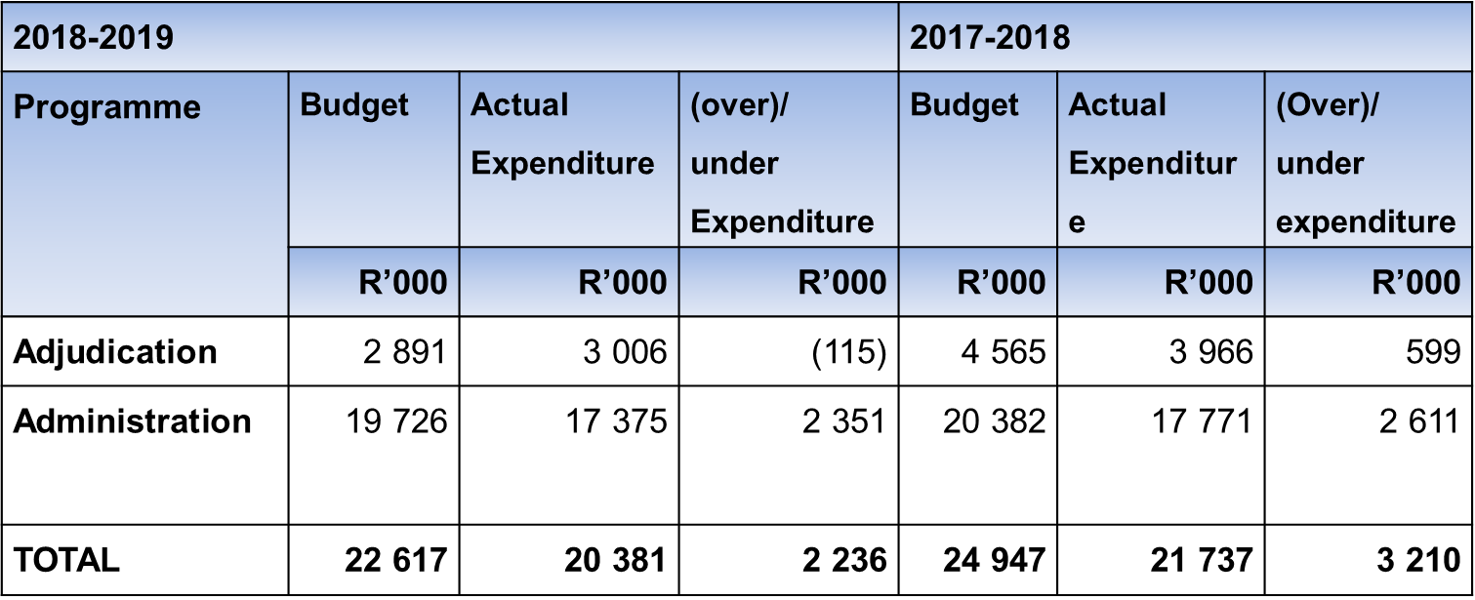
11. BUDGET SPENT PER PROGRAMME 2018/19
16

Slide 17
12. REVENUE COLLECTION 2018/19
2018-2019 |  |  |  | 2017-2018
Source of Revenue | Budget | Actual Expenditure | (over)/ under Expenditure | Budget | Actual Expenditure | (Over)/ under expenditure
Government grant | 16 740 | 16 740 | - | 15 822 | 15 822 | -
 | R’000 | R’000 | R’000 | R’000 | R’000 | R’000
Interest received | 890 | 814 | 76 | 1 043 | 1 196 | (153)
Other income | 4 987 | 1 537 | 3 450 | 8 082 | 1 456 | 6 626
TOTAL | 22 617 | 19 091 | 3 526 | 24 947 | 18 474 | 6 473
17

Slide 18
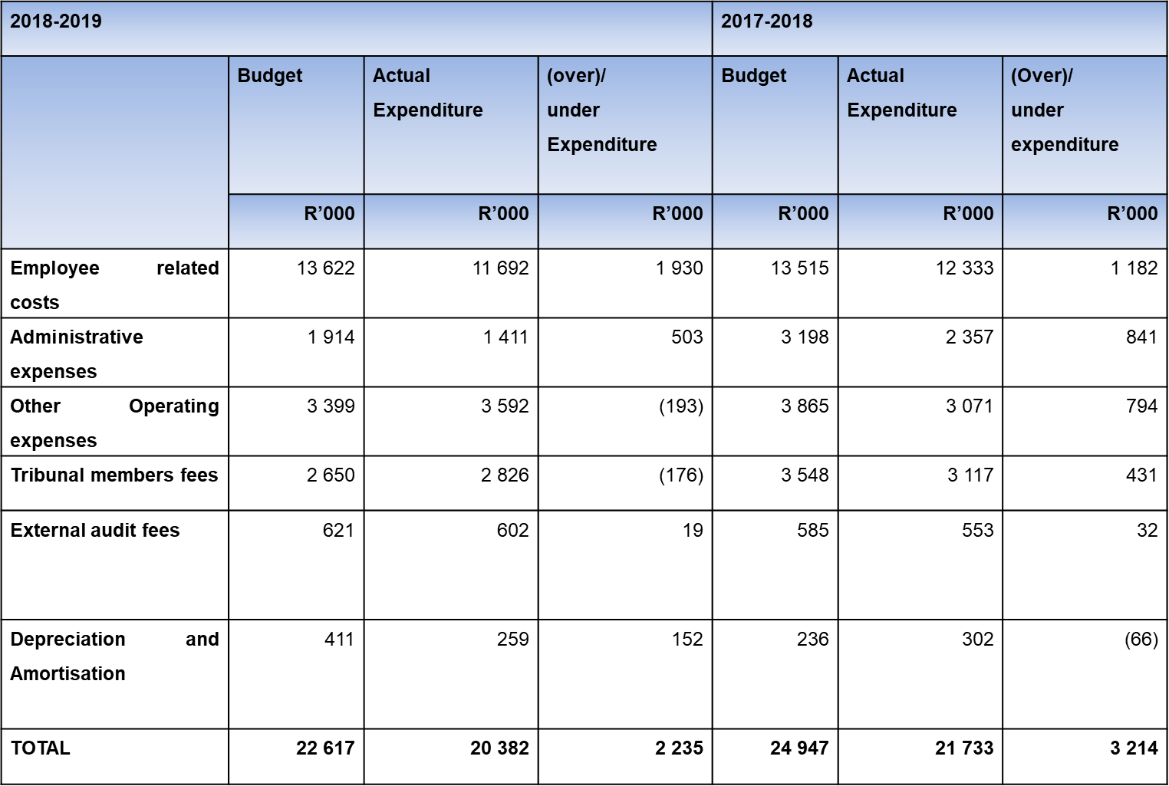
13. EXPENDITURE: 2018/19
18

Slide 19
14. HISTORICAL FINANCIAL PERFORMANCE
19

Slide 20
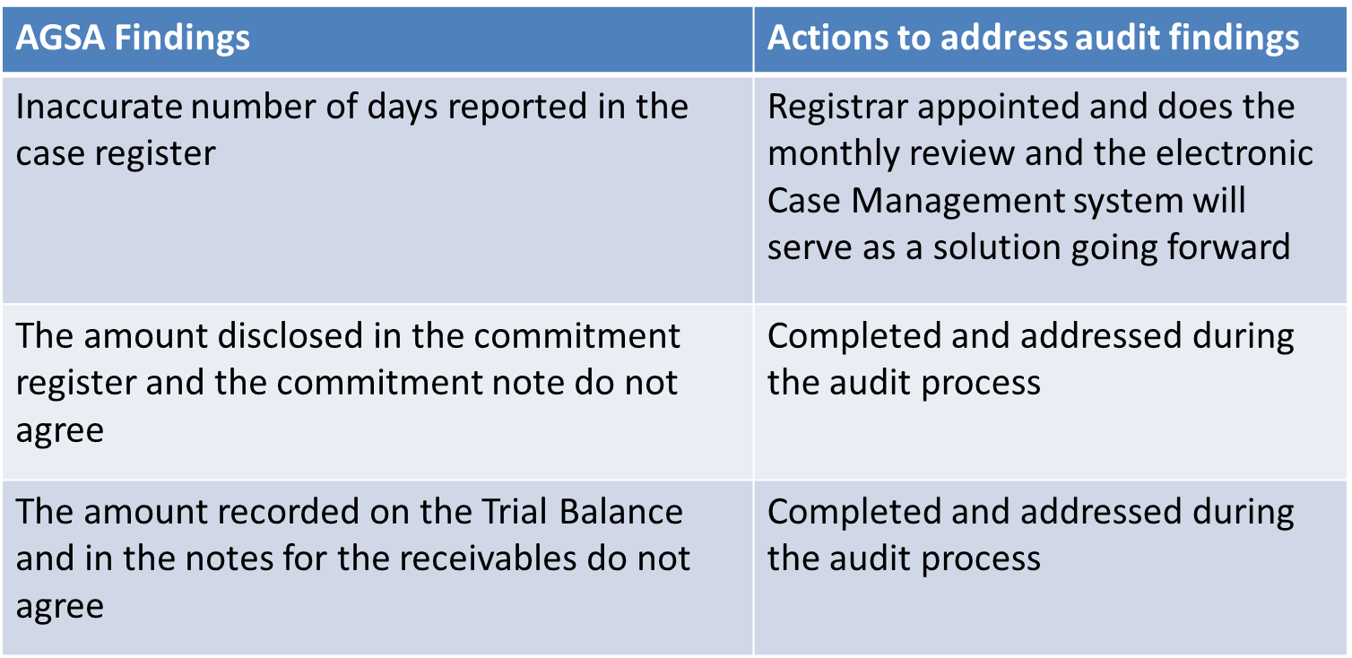
15. PROGRESS ON ISSUES RAISED BY THE
AUDITOR GENERAL
20

Slide 21
COMPANIES TRIBUNAL
1st & 2nd Quarter Performance Report 2019/20
21

Slide 22

MANAGEMENT OF CASES
Quarter 1 and 2
PROGRESS STATUS | ADJUDICATION (QTR 1) | ADJUDICATION (QTR 2) | ADR (QTR 1) | ADR (QTR 2)
Total number of cases | 91 | 117 | 17 | 20
New cases received | 60 | 53 | 14 | 9
Total cases finalised | 29 (decided) | 39 (decided) | 5 | 5
Active files | 39 | 38 | 11 | 11
22

Slide 23
EDUCATION AND AWARENESS INITIATIVES
  Published the Tribunal’s Quarterly Bulletin Volume I 2019
  Participated in a consultative fact-finding workshop on Alternative Dispute Resolution (ADR) framework for small enterprises coordinated by the Department of Small Business Development (DSBD) in the following provinces: KwaZulu-Natal, Limpopo, Free State and Western Cape
  Reached out in King Cetshwayo (eShowe) and a meeting was held in Bloemfontein with the Free State Bar Council
  Published article on social media (LinkedIn) and the website, highlighting the launch of the Case Management System on 01st August 2019
23

Slide 24
FINANCIAL MANAGEMENT
CATEGORY | QTR 1 | QTR 2
Budget spent | 23% | 51%
Irregular, fruitless and wasteful expenditure | None | Fruitless and wasteful expenditure of R437
Payment of suppliers | 100% within 30 days 85% within 15 days | 100% within 30 days 94% within 15 days
24

Slide 25

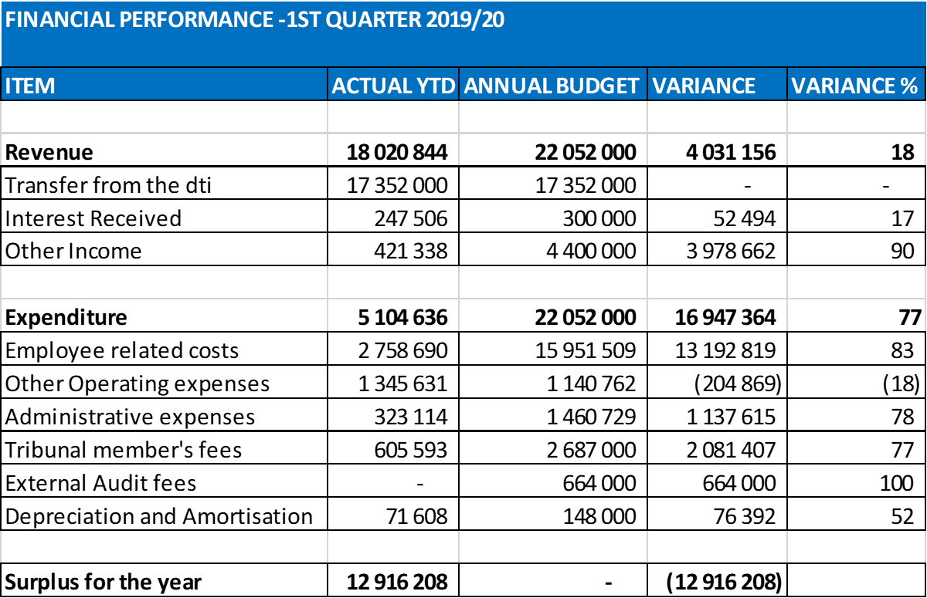
QTR 1 FINANCIAL PERFORMANCE
25

Slide 26
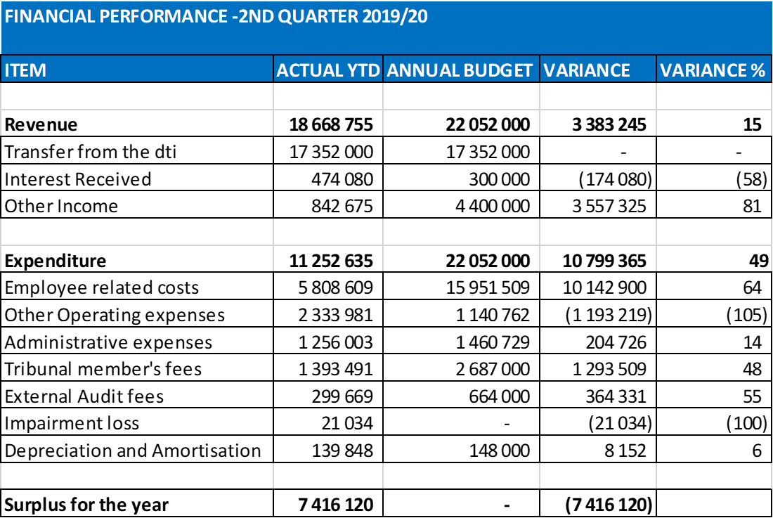
QTR 2 FINANCIAL PERFORMANCE
26

Slide 27
RESOURCES
HUMAN RESOURCES
Approved establishment | QTR 1 | QTR 2
Funded posts | 14 | 14
Filled | 10 | 13
Vacant | 4 | 1
27

Slide 28

Thank you!
28

