Slide 1
portfolio committee briefing
2018/2019 annual report, 2019/2020 1ST & 2ND quarter reports
ADV. RORY VOLLER
COMMISSIONER
27 NOVEMBER 2019

Slide 2
Purpose of Presentation
To brief the Portfolio Committee on the Companies and Intellectual Property Commission (CIPC):
  2018/2019 Annual Report, 2019/2020,
  2019/2020 First Quarter Performance Report, and
  2019/2020 Second Quarter Performance Report.
Notes:
Data is the new oil of the 4th industrial resolution
If we make AI the rule, we will be out of the equation
Bot cannot understand a human’s emotion as a human can

Slide 3
Outline of the presentation
1. PART 1: 2018/2019 Annual report
2. PART 2: 2019/2020 First quarter report
3. PART 3: 2019/2020 Second quarter report
4. PART 4: Key challenges
5. PART 5: CIPC Vision 2030

Slide 4
part 1: 2018/2019 annual report

Slide 5
Outline of part 1: 2018/2019 annual report
Key highlights
Programme performance
Non-financial performance information
Financial Performance Information

Slide 6
2018/19 cipc annual report Highlights
Clean audit opinion from the Auditor General of South Africa – with no material misstatements
The introduction of an electronic financial reporting language, eXtensible Business Reporting Language (XBRL) (7513 filings as at 31 March 2019, 15296 as at September 2019)
Company registration – average 1 day
Substantive Search and Examination (SSE) of patent applications in South Africa - Appointment and training of interns: substantive patent examination
“Respect for IP growing from the tip of Africa” conference in November 2018.
CIPC Introduced Mobile App technology
First Phases of IT Infrastructure migrations
Notes:
Data is the new oil of the 4th industrial resolution
If we make AI the rule, we will be out of the equation
Bot cannot understand a human’s emotion as a human can

Slide 7
Programme performance
Programme 1: Service Delivery and Access
Programme 2: Innovation and Creativity
Programme 3: Business Regulation and Reputation
Notes:
Data is the new oil of the 4th industrial resolution
If we make AI the rule, we will be out of the equation
Bot cannot understand a human’s emotion as a human can

Slide 8
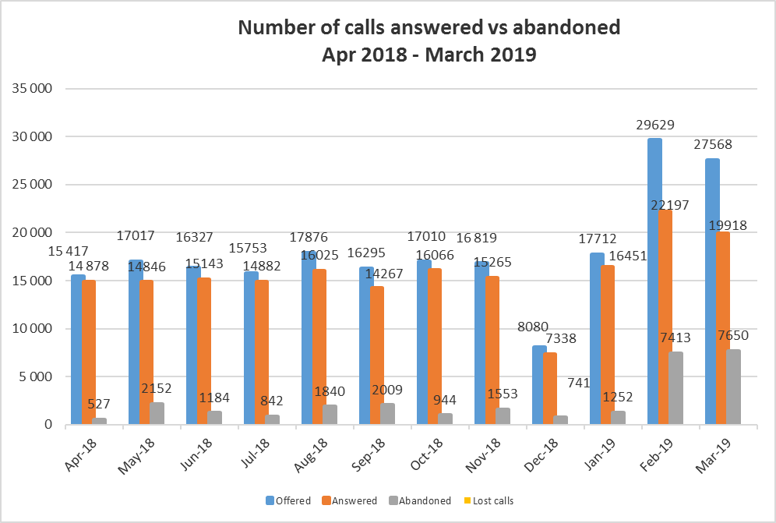
Programme 1: Service Delivery and Access
Call centre
The number of calls received spiked in the last two months of the year. The detailed reasons for the increase in calls are as follows:
Additional services offered on e-service relating to the introduction of mandatory filing of Annual Financial Statements (AFS) or Financial Accountability Supplement (FAS) when filing Annual Returns; Changes made on B-BBEE certificates; Real time verification of Identification Numbers via Department of Home Affairs (DHA) on e-services; and Compliance status.
Application errors, resulting in very high volumes of incoming calls.
Introduction new, user-friendly Interactive Voice Recording (IVR) messages. This has ensured that customers could reach the call centre quicker, and has, in turn, led to an increase of calls.
The high influx of calls resulted in customers waiting longer to be assisted, and led to customers dropping calls, and a high volume of repeat calls.

Slide 9
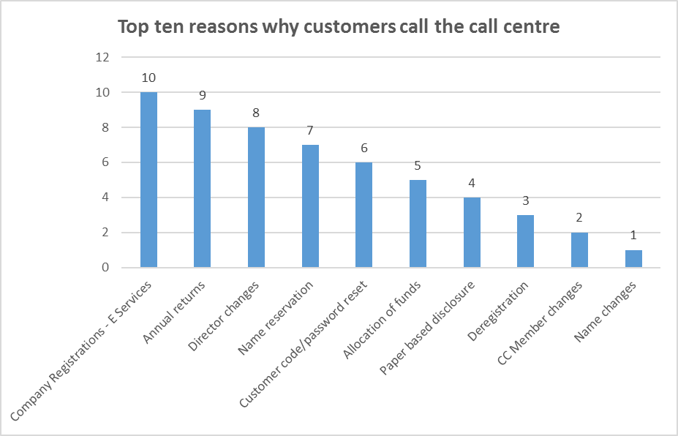
Programme 1: Service Delivery and Access
Call centre
Most of the calls received relate to the top 5 reasons:
  E-services,
  Annual returns,
  Director Changes,
  Name reservations and
  Customer codes/password resets..
Notes:
Data is the new oil of the 4th industrial resolution
If we make AI the rule, we will be out of the equation
Bot cannot understand a human’s emotion as a human can

Slide 10
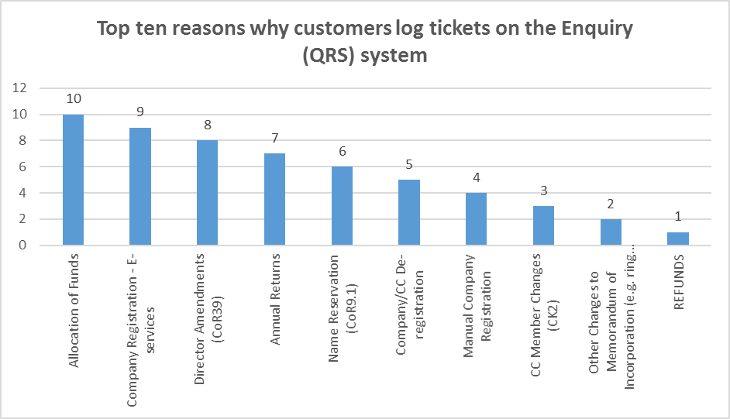
Programme 1: Service Delivery and Access
Query Resolution System (QRS)
The top reasons for customers logging tickets with CIPC included
  allocation of funds,
  company registration,
  director amendments, and
  annual returns.
Notes:
Data is the new oil of the 4th industrial resolution
If we make AI the rule, we will be out of the equation
Bot cannot understand a human’s emotion as a human can

Slide 11
Programme 1: Service Delivery and Access
Social media queries
System downtime due to migrations has been the topical issue for customer queries in the 2018/19 financial year
Other queries being about
  clarity on company registration and annual returns processes,
  status of customers’ application for company registration and name reservation,
  complaints about delayed response to queries lodged through the query resolution system,
  lack of clarity in the reasons for rejection of customers’ applications, and
  non-response on applications for registration of cooperatives.

Slide 12
Programme 2: Innovation and Creativity
Patents
There was a spike in local patent applications
Provisional patent applications increased slightly
Notes:
Data is the new oil of the 4th industrial resolution
If we make AI the rule, we will be out of the equation
Bot cannot understand a human’s emotion as a human can

Slide 13
Programme 2: Innovation and Creativity
Designs
The design filings have remained steady as compared to patents
Notes:
Data is the new oil of the 4th industrial resolution
If we make AI the rule, we will be out of the equation
Bot cannot understand a human’s emotion as a human can

Slide 14
Programme 2: Innovation and Creativity
Collecting societies
CIPC approved the Independent Music Performance Rights Association (IMPRA) Distribution plan for 2018 and SAMPRA Distribution Plan for 2017 to ensure that beneficiaries such as performing artists continue to reap benefits accruing from their Intellectual Property (copyright works/performances). IMPRA reported that at least 38% of the distribution is done.
Notes:
Data is the new oil of the 4th industrial resolution
If we make AI the rule, we will be out of the equation
Bot cannot understand a human’s emotion as a human can

Slide 15
Programme 2: Innovation and Creativity
Copyright Amendment Bill
CIPC has been a key participant of the Parliamentary process to amend both Copyright Act, 1978 and the Performers Protection Act, 1967.
The two Bills are now voted for by the two houses of Parliament and will be submitted to Presidency for signing into law.

Slide 17
Programme 3: Business Regulation and Reputation
Business Rescue
217 proceedings were declared a nullity;
721 proceedings were terminated by way of filing a Notice of Termination (CoR125.2);
548 proceedings were substantially implemented by way of filing a Notice of Substantial Implementation (CoR125.3);
392 proceedings ended up directly in liquidation;
22 proceedings the court set aside the business rescue proceedings; and
1263 proceedings are still in business rescue.
Notes:
Data is the new oil of the 4th industrial resolution
If we make AI the rule, we will be out of the equation
Bot cannot understand a human’s emotion as a human can

Slide 18
Programme 3: Business Regulation and Reputation
Co-operatives
New co-operatives registration 12 270 down from 12 748 in 2017/2018.
This may be linked to the general low growth rate in the economy
The other contributing factor may be the issues related to the perceived delay in the funding of cooperatives
Notes:
Data is the new oil of the 4th industrial resolution
If we make AI the rule, we will be out of the equation
Bot cannot understand a human’s emotion as a human can

Slide 19
Programme 3: Business Regulation and Reputation
Trade marks
Generally the filling of trade marks applications continued for the year under review and,
residents continue to file better numbers
Notes:
Data is the new oil of the 4th industrial resolution
If we make AI the rule, we will be out of the equation
Bot cannot understand a human’s emotion as a human can

Slide 20
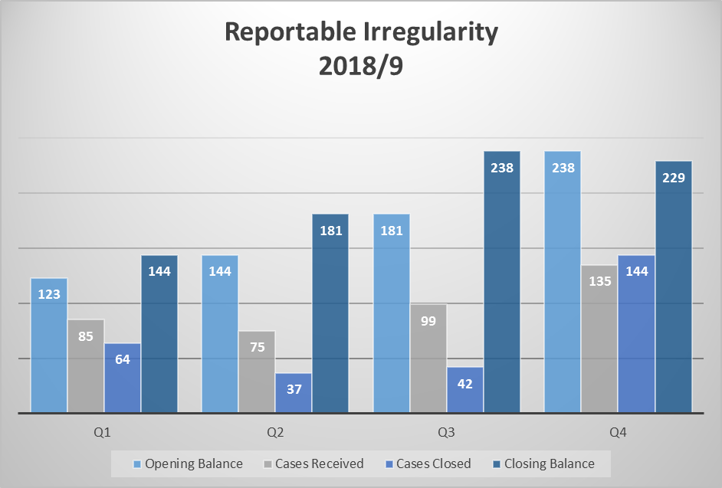
Programme 3: Business Regulation and Reputation
Reportable irregularities
Some of the entities include:
Mitsubishi Hitachi Power Systems Africa (Proprietary) Limited – AFSs not prepared within 6 Months Of Financial Year End;
Hisense SA Manufacturing (Proprietary) Limited – AFSs not prepared within 6 months of Financial Year End; SABC – Proactive Investigation Into Solvency;
Eskom Holdings SOC Limited – Undeclared Conflict Of Interest and Irregular Payments;
Ayo Technology Solutions Ltd – AFSs not prepared within 6 months of Financial Year End;
Bombela Concession Company; As a result of the State Capture revelations African Global Operations (Proprietary) Limited – Material Misstaments for 2017 Financial Year;
Bosasa Youth Development Centres (Proprietary) Limited - Provisional liquidation pending an appeal.

Slide 21
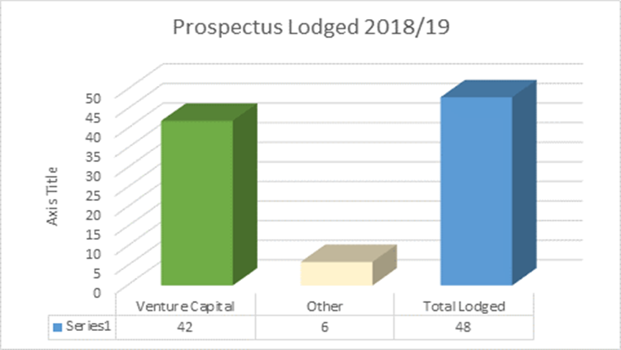
Programme 3: Business Regulation and Reputation
Prospectuses
A total of 48 Prospectuses were lodged during the 2018/19 financial year
Of which 42 of them are based on Section 12J of the Income Tax Act.
A legal provision introduced as an incentive to enable (SMMEs) small business to diminish the capital procurement deficiency they are faced with.

Slide 22
Programme 1:Performance information
Output | Performance Measure or Indicator | 2018/19 Annual Target | Actual Achievement | Deviation from planned target to actual achievement | Comments on deviations
GOAL 1: Reduce administrative compliance burden for companies and IP owners
Strategic Objective 1.1 24/7 access to all CIPC products and services.
Increased % in the website performance for e-services 24/7 | % website performance for e-Services 24/7 | 93% | 95% | 2% | The ICT infrastructure is continuously monitored to ensure that the website works optimally
Increase in the number of provinces where SSTs were installed and are operational | The number of provinces where SSTs were installed and are operational | 8 (1 Province added) | 9 | 1 | EC SST became operational in Q3 due to effective collaboration among relevant units involved in the project
Increase in the % of CIPC services with an option to file electronically compared to services which may only be filed manually | % of CIPC services with an option to file electronically compared to services which may only be filed manually | 26% (1% increase) | 26% | 0% | No deviation
Strategic Objective 1.3 Intelligent, innovative, high performance organisational environment.
Increase or maintain the score of the customer stakeholder value index | A score from 1 to 10 of the customer and stakeholder value index, a higher score indicating satisfaction with the CIPC | 7 | 7.4 | 0.4 | Customers rated CIPC at 7.8 and stakeholders rated CIPC at 6.9, which makes an average of 7.4

Slide 23
Programme 2:Performance information
Output | Performance Measure or Indicator | 2018/19 Annual Target | Actual Achievement | Deviation from planned target to actual achievement | Comments on deviations
GOAL 2: A reputable Business Regulation and IP Protection environment in South Africa.
Strategic Objective 2.1: Increased knowledge and awareness on Company and IP Laws.
Increased knowledge and awareness on IP | Number of education and awareness events on IP conducted by CIPC | 30 | 56 | 26 | The stakeholders responded in numbers on the IP interventions
Strategic Objective 2.2: Improved compliance with Company and IP Laws.
Increased knowledge and awareness of creativity and IP enforcement | Number of education and awareness events on IP enforcement initiatives conducted by CIPC | 6 | 9 | 3 | Special requests were received that had future collaboration benefits.

Slide 24
Programme 3: Business Regulation and Reputation: performance information
Output | Performance Measure or Indicator | 2018/19 Annual Target | Actual Achievement | Deviation from planned target to actual achievement | Comments on deviations
GOAL 2: A reputable Business Regulation and IP Protection environment in South Africa.
Strategic Objective 2.1: Increased knowledge and awareness on Company and IP Laws.
Increased knowledge and awareness on IP | Number of education and awareness events on IP conducted by CIPC | 30 | 56 | 26 | The stakeholders responded in numbers on the IP interventions
Strategic Objective 2.2: Improved compliance with Company and IP Laws.
Increased knowledge and awareness of creativity and IP enforcement | Number of education and awareness events on IP enforcement initiatives conducted by CIPC | 6 | 9 | 3 | Special requests were received that had future collaboration benefits.

Slide 25
2018/2019 annual report
FINANCIAL INFORMATION

Slide 26
REPORT OF THE AUDITOR-GENERAL – 2018/19
Mar-19 | Mar-18 | Mar-17 | Movement
Overall audit opinion
Clean audit | Clean audit | Clean audit | <->
Annual financial statements
Unqualified | Unqualified | Unqualified | <->
Compliance with laws and regulations
No material findings | No material findings | No material findings | <->
Predetermined objectives (Performance Information)
Unqualified | Unqualified | Unqualified | <->

Slide 27
ANNUAL FINANCIAL STATEMENTS – 2018/19
Financial Position
Description | Mar-19 | Mar-18 | Mar-17 | Variance (2019 v 2018)
 | R'000 | R'000 | R'000 | R'000 | %
Assets
Non-current assets | 74 615 | 68 094 | 55 391 | 6 521 | 10%
Current assets | 769 505 | 675 636 | 1 560 211 | 93 869 | 14%
Total Assets | 844 120 | 743 730 | 1 615 602 | 100 390 | 13%
Total Liabilities | 422 912 | 158 704 | 360 097 | 264 208 | 166%
Net assets | 421 208 | 585 026 | 1 255 505 | (163 818) | -28%

Slide 28
ANNUAL FINANCIAL STATEMENTS – 2018/19
Financial Performance
Description | Mar-19 | Mar-18 | Mar-17 | Variance (2019 v 2018)
 | R'000 | R'000 | R'000 | R'000 | %
Total income | 566 891 | 597 051 | 595 999 | (30 160) | -5%
Total expenditure | (485 309) | (477 378) | (411 420) | 7 931 | 2%
Surplus for the year | 81 582 | 119 673 | 184 579 | (38 091) | -32%

Slide 29
OPERATIONAL PERFORMANCE vs BUDGET 2018/19
Description | Total annual budget | Actual | Budget variance | % Variance
 | R'000 | R'000 | R'000 | %
Income
Revenue | 502 959 | 508 371 | 5 412 | 1%
Other* | 2 918 | 7 834 | 4 916 | 168%
Interest | 47 897 | 50 686 | 2 789 | 6%
Total Income | 553 774 | 566 891 | 13 117 | 2%
Expenditure
Employee costs | 319 898 | 325 425 | (5 527) | -2%
Operating expenditure ** | 171 035 | 101 031 | 70 004 | 41%
Administrative expenditure *** | 42 775 | 38 552 | 4 223 | 10%
Depreciation | 20 066 | 20 301 | (235) | -1%
Expenditure | 553 774 | 485 309 | 68 465 | 12%
Surplus for the period | - | 81 582 | 81 582

Slide 30
REVENUE TREND
MARCH 2017 TO MARCH 2019
R’000

Slide 31
OPERATIONAL EXPENDITURE TREND
MARCH 2017 TO MARCH 2019
R’000
Description | 2018/19 | 2017/18 | 2016/17 | Trend % (2017-2019)
Employee costs | 325 425 | 323 574 | 253 103 | 29%
Operating expenditure | 101 031 | 98 770 | 109 644 | -8%
Administrative expenditure | 38 552 | 38 039 | 38 184 | 1%
Depreciation & Impairment losses | 20 301 | 16 713 | 10 647 | 91%
Total Expenditure | 485 309 | 477 276 | 411 578 | 18%

Slide 32
2019/2020 first quarter report

Slide 33
Outline of part 2: 2019/2020 quarter 1 report
Key highlights
Programme performance
Non-financial performance information
Financial Performance Information

Slide 34
Quarter 1: key highlights
Development of Bizportal – Presidential initiative
The launch of CIPC Broadcast, an online streaming radio service
The office accommodation project has been approved by their Real Estate Management Division and a “Procurement Instruction” issued to the Pretoria Regional Office for processing.
The IP BRICS activities under the period of chairmanship of the CIPC (28 March 2018 to 16 April 2019) successfully concluded with the hosting of the 11th BRICS HIPO Meeting, held in Stellenbosch on 14-16 April 2019.
There was a sudden increase in the submission of financial accountability statements (FAS) during the first quarter when filing annual returns, of 49% compared to the previous quarter in the filing of the FAS. This was mainly due to the Hardstop functionality in XBRL that was implemented during the month of March 2019.
Notes:
Note 1: During Quarter 3, a survey will be undertaken to confirm why public companies are not filing annual returns on time. It is also a consideration that the filing rate could improve during the remainder of the financial year since public companies becoming due during quarter 1, may still file during quarter 2, 3 or 4.
Note 2: Investigation steps will be implemented to take additional punitive steps (in addition to penalties) towards public companies who contravene Section 33 which will include compliance notices

Slide 35
Q1: Programme performance
Programme 1: Service Delivery and Access
Programme 2: Innovation and Creativity
Programme 3: Business Regulation and Reputation
Notes:
Note 1: During Quarter 3, a survey will be undertaken to confirm why public companies are not filing annual returns on time. It is also a consideration that the filing rate could improve during the remainder of the financial year since public companies becoming due during quarter 1, may still file during quarter 2, 3 or 4.
Note 2: Investigation steps will be implemented to take additional punitive steps (in addition to penalties) towards public companies who contravene Section 33 which will include compliance notices

Slide 36
Q1: Programme performance: programme 1: service delivery and access
K2 Business Process Management (BPM) project - the development of the automated co-operatives registration application near completion,
The Future View Enterprise Architecture project was completed,
A tender for Organisational Design was advertised with the closing date of 23 July 2019.

Slide 37
Q1: Programme performance: programme 2: innovation and creativity
The European Patent Office (EPO) examiners conducted an on-site training from 1 to 12 April 2019, with the CIPC patent searchers on advanced searching techniques and understanding the patentability criteria. The EPO also engaged in a study visit to the CIPC offices, to review of CIPC’s formality requirements for the establishment of SSE.
The World Intellectual Property Organization (WIPO) conducted a mission to South Africa from 23 to 26 April 2019 to install further applications of the IPAS system on the CIPC infrastructure and to work with our ICT team on developing the framework for linking IPAS to CIPC’s billing system. WIPO also conducted training for CIPC officials on the use of IPAS.
Internship Program on Substantive Search and Examination Program has commenced with the recruitment process.
Notes:
Note 1: During Quarter 3, a survey will be undertaken to confirm why public companies are not filing annual returns on time. It is also a consideration that the filing rate could improve during the remainder of the financial year since public companies becoming due during quarter 1, may still file during quarter 2, 3 or 4.
Note 2: Investigation steps will be implemented to take additional punitive steps (in addition to penalties) towards public companies who contravene Section 33 which will include compliance notices

Slide 38
Q1: Programme performance: programme 3: business regulation and reputation
A total of 98 666 new companies were registered at the average of 2 working days,
A total of 2 890 new co-operative registrations were registered at an average of 2 working days,
A total of 10 925 annual financial statements was received via XBRL and the numbers are steadily increasing. So far the XBRL system is functioning as expected with few a few glitches encountered,
75400 entities were identified as having failed to submit their Annual Returns within 30 business days after their registration anniversary date,
92 621 entities were identified before the implementation of Hardstop Functionality, have submitted Annual Returns but have not submitted their Annual financial statements/ or Financial Accountability Supplements,
The closing balance of reportable irregularities was 242, the reason of entities reporting RI’s concerning technical insolvency is usually related to start-up capital provision by owners/shareholders, tough economic conditions (taking time for companies to break-even) and accounting principles applied upon valuation of assets,
All the prospectuses that were lodged in the previous quarter were registered, at the current stage we have eight outstanding and we are expecting to receive the final draft at a later stage,
1263 companies are in business rescue.

Slide 39
Q1: Programme performance: programme 3: business regulation and reputation
High profile companies under investigation

Slide 40
Quarter 1 (2019/20)
Performance Information Summary
1. 78% (9) of the targets were met.
2. The following targets were not met:
% of Public Companies (entities with an active business status) that have filed annual returns by the end reporting period.
% of Public Companies (entities with an active business status) that have filed audited financial statements on time by the end reporting period.
Notes:
Note 1: During Quarter 3, a survey will be undertaken to confirm why public companies are not filing annual returns on time. It is also a consideration that the filing rate could improve during the remainder of the financial year since public companies becoming due during quarter 1, may still file during quarter 2, 3 or 4.
Note 2: Investigation steps will be implemented to take additional punitive steps (in addition to penalties) towards public companies who contravene Section 33 which will include compliance notices

Slide 41
Q1: performance information: programme 1
Output | Performance Measure or Indicator | 2019/20 Annual Target | 1st Quarter milestones | Actual Achievement | Reason for Variance | Corrective Action
GOAL 1: Reduced administrative compliance burden for companies and IP owners.
Strategic Objective 1.1 24/7 access to all CIPC products and services.
Increased in the % of website performance for e-services 24/7 | % website performance for e-services 24/7 | 93% | 93% | 96% | The overachievement is due improved ICT infrastructure. | N/A
Increase in the % of CIPC services with an option to file electronically compared to manually filed services | % of CIPC services with an option to file electronically compared to manually filed services | 27% (1% increase) | 26% | 26% | N/A | N/A

Slide 42
Q1: performance information: programme 2
Output | Performance Measure or Indicator | 2019/20 Annual Target | 1st Quarter milestones | Actual Achievement | Reason for Variance | Corrective Action
GOAL 2: A reputable Business Regulation and IP Protection environment in South Africa.
Strategic Objective 2.1: Increased knowledge and awareness on Company and IP Laws.
Increased level of awareness of Company Act and other related legislation. | Number of education and awareness events conducted by the CIPC on the Companies Act and related legislation | 3 | 0 | 17 | The overachievement is due to influx of requests by the dti Minister and other stakeholders which CIPC honoured. | N/A
Increased knowledge and awareness on IP | Number of education and awareness events on IP conducted by CIPC | 30 | 8 | 27 | The overachievement is due positive responses by the various stakeholders, including the creative sector and the public. Increased partnership also resulted in more events held. | N/A
Strategic Objective 2.2 Improved compliance with the Company and IP Laws
Increased knowledge and awareness on IP enforcement | Number of education and awareness events on IP enforcement conducted by CIPC | 6 | 2 | 3 | The overachievement is due positive responses by the various stakeholders. | N/A

Slide 43
Q1: performance information: programme 3
Output | Performance Measure or Indicator | 2019/20 Annual Target | 1st Quarter milestones | Actual Achievement | Reason for Variance | Corrective Action
Strategic Objective 1.2 Timely delivery of all CIPC products and services.
Reduction in the average number of days to register a company from the date of receipt of a complete application | The average number of days to register a company from the date of receipt of a complete application. | 2 | 2 | 2 | N/A | N/A
Reduction in the average number of days to register a co-operative from the date of receipt of a complete application. | The average of the number of days to register a co-operative from the date of receipt of a complete application. | 3 | 3 | 2 | The overachievement is due to unprecedented ICT system stability during the period under review. | N/A
Strategic Objective 1.3 Intelligent, innovative, high performance organisational environment.
GOAL 2: A reputable Business Regulation and IP Protection environment in South Africa.
Strategic Objective 2.1: Increased knowledge and awareness on Company and IP Laws.
Increased level of awareness of Company Act and other related legislation. | Number of education and awareness events conducted by the CIPC on the Companies Act and related legislation | 3 | 0 | 17 | The overachievement is due to influx of requests by the dti Minister and other stakeholders which CIPC honoured. | N/A
Strategic Objective 2.2 Improved compliance with the Company and IP Laws
Increased % of Public Companies (entities with an “active business” status) that have filed annual returns by the reporting period | % of Public Companies (entities with an active business status) that have filed annual returns by the end reporting period. | 75% | 50% | 49% | Of the 484 public companies expected to file annual returns, 206 public companies filed (49%). | As customers adapts to the filing of Audited Financial Statements, the compliance rate should improve.
Increased % of Public Companies (entities with an “active business” status) that have filed audited financial statements on time by the end of the reporting period | % of Public Companies (entities with an active business status) that have filed audited financial statements on time by the end reporting period. | 60% | 60% | 53% | Of the 421 public companies expected to file AFS in the first quarter, 223 public companies filed (53%). | It is anticipated that should the Hard-Stop Functionality experience system clichés (as will all technology era), follow ups on the non-filing of AFS will be investigated accordingly. Pro-active enforcement will also be put in place.

Slide 44
2019/2020 first quarter
FINANCIAL INFORMATION

Slide 45
OVERVIEW OF THE ANNUAL BUDGET
2019/20
R’000

Slide 46
OPERATIONAL PERFORMANCE FOR QUARTER 1
APRIL’19 – JUNE’19
OPERATIONAL PERFORMANCE
Description | Total Annual Budget | Pro-rated Budget (April - Jun '19) | Actual (April - Jun '19) | Variance (June ‘19) |  | Variance (June '18) | Forecast (March ‘20)
 | R'000 | R'000 | R'000 | R'000 | % | % | R'000
Income
Revenue | 548 546 | 137 137 | 135 578 | (1559) | (1%) | 3% | 546 987
Other | 685 | 171 | 131 | (41) | (24%) | (98%) | 644
Interest | 47 242 | 11 811 | 12 149 | 339 | 3% | (3%) | 47 581
Total Income | 596 473 | 149 118 | 147 857 | (1 261) | (1%) | 2% | 595 212
Expenditure
Employee costs | 358 758 | 89 690 | 77 778 | 11 912 | 13% | 8% | 346 847
Operating and administrative expenditure | 216 092 | 54 022 | 29 219 | 24 803 | 46% | 45% | 191 288
Depreciation | 21 623 | 5 406 | 6 024 | (618) | (11%) | 0% | 22 241
Expenditure | 596 473 | 149 118 | 113 021 | 36 098 | 24% | 22% | 560 375
Surplus for the period | - | - | 34 837 | 34 837 | - |  | 34 837

Slide 47
REVENUE ANALYSIS
JUNE 2018 vs. JUNE 2019
(R’000)

Slide 48
ANNUAL EXPENDITURE BUDGET vs
ACTUAL QUARTER ONE EXPENDITURE
APRIL 2019 - JUNE 2019

Slide 49
OPERATIONAL EXPENDITURE ANALYSIS
JUNE 2019 vs. JUNE 2018
(R’000)

Slide 50
CAPITAL EXPENDITURE ANALYSIS
APRIL – JUNE 2019

Slide 51
CAPITAL EXPENDITURE ANALYSIS
APRIL – JUNE 2019

Slide 52
2019/2020 second quarter report

Slide 53
Outline of part 2: 2019/2020 quarter 2 report
Key highlights
Programme performance
Non-financial performance information
Financial Performance Information

Slide 54
Quarter 2 (2019/20) highlights
The tender for the Organisational Design project evaluated.
30 Interns recommended for appointment in the Patent Substantive Search and Examination, after a lengthy recruitment process due to the volume of applications received.
The CIPC Executive Committee (ExCo) approved the Proof of Concept (PoC) for the Industrial Property Automation System (IPAS) to full implementation.

Slide 55
Q2 programme performance 1: service delivery and access
109 310 companies were registered at average of 1 day.
A total of 3 211 co-operative new applications were registered during Q2. 99% (3172) of these applications were registered within two working days. Only 1% (39) were registered outside the turnaround time.
9781 tickets were logged on the query resolution system (QRS). The trend of top reasons why customers is the allocation of funds, company registration, name reservations and director amendments
Over 800 000 impressions recorded on social media
The K2 Business Process Management (BPM) project, advanced considerably well with the development of the new name search solution onto the K2 platform, thereby replacing the legacy Verity system. The solution was planned for release with the automated co-operatives registration and customer registration applications.

Slide 56
Q2 programme performance 2: innovation and creativity
The Screening Committee of the Investor Assistance Programme (IAP) met on 8 July and 28 August 2019 respectively to review applications received from inventors and SMMEs. In total, 38 applications were reviewed, but only 3 applications met the criteria for further support.
The IP for Kids Media Week was hosted from 14 – 17 August 2019. About 180 learners from three prominent high schools in Soweto, Gauteng were taken through various workshops on the value of IP and how to be a citizen journalist.

Slide 57
Q2 programme performance 3: business regulation and reputation
109 310 new companies were registered at an average of 1 day,
3 211 new co-operatives were registered registered at an average of 2 days,
9812 new trade marks applications were processed,
There were 292 reportable irregularities,
Compliance notice was issued for the following:
  AFRICAN GLOBAL HOLDINGS (PTY) LTD
  KGWERANO FINANCIAL SERVICES (PTY) LTD
As at the end of September 2019, 15 351 annual financial statements was received via XBRL and the numbers are steadily increasing. So far the XBRL system is functioning as expected with few glitches encountered,
75 400 entities were identified as having failed to submit their Annual Returns within 30 Business days after their registration anniversary date,
92 621 entities were identified before the implementation of the ‘Hard-Stop Functionality’, have submitted Annual Returns but have not submitted their Annual financial statements/ or Financial Accountability Supplements.

Slide 58
Quarter 2 (2019/20)
Performance Information Summary
1. 78% (9) of the targets were met.
2. The following targets were not met:
% of Public Companies (entities with an active business status) that have filed annual returns by the end reporting period.
  Reason:
% of Public Companies (entities with an active business status) that have filed audited financial statements on time by the end reporting period.
    Reason:
Notes:
Note 1: During Quarter 3, a survey will be undertaken to confirm why public companies are not filing annual returns on time. It is also a consideration that the filing rate could improve during the remainder of the financial year since public companies becoming due during quarter 1, may still file during quarter 2, 3 or 4.
Note 2: Investigation steps will be implemented to take additional punitive steps (in addition to penalties) towards public companies who contravene Section 33 which will include compliance notices

Slide 59
Q2 performance information: programme 1
Output | Performance Measure or Indicator | 2019/20 Annual Target | 2nd Quarter milestones | Actual Achievement | Reason for Variance | Corrective Action
GOAL 1: Reduced administrative compliance burden for companies and IP owners.
Strategic Objective 1.1 24/7 access to all CIPC products and services.
Increased % in the website performance for e-services 24/7 | % website performance for e-services 24/7 | 93% | 93% | 95% | Improved Infrastructure | N/A
Increase in the % of CIPC services with an option to file electronically compared to manually filed services | % of CIPC services with an option to file electronically compared to manually filed services | 27% (1% increase) | 26% | 26% | N/A | N/A
Strategic Objective 1.3 Intelligent, innovative, high performance organisational environment.
Increase the score of the customer stakeholder value index | A score between 1 - 10 of the customer and stakeholder value index, a higher score indicating satisfaction with the CIPC | 7 | Not to be measured

Slide 60
Q2 performance information: programme 2
Output | Performance Measure or Indicator | 2019/20 Annual Target | 2nd Quarter milestones | Actual Achievement | Reason for Variance | Corrective Action
GOAL 1: Reduced administrative compliance burden for companies and IP owners.
Strategic Objective 1.2 Timely delivery of all CIPC products and services.
Reduction in the average number of days to register a company from the date of receipt of a complete application | The average number of days to register a company from the date of receipt of a complete application. | 2 | 2 | 1 | Experienced outlook and ICT challenges during quarter 2, however team put extra effort to ensure that application processed within target once systems were back up. | None Required.
Reduction in the average number of days to register a co-operative from the date of receipt of a complete application. | The average of the number of days to register a co-operative from the date of receipt of a complete application. | 3 | 3 | 2 | There was no system challenges experienced during Q2, hence 99% applications were registered within 2 working days. | None
GOAL 2: A reputable Business Regulation and IP Protection environment in South Africa.
Strategic Objective 2.1: Increased knowledge and awareness on Company and IP Laws.
Increased level of awareness of Company Act and other related legislation. | Number of education and awareness events conducted by the CIPC on the Companies Act and related legislation | 3 | 1 | 1 | An event was arranged and conducted in Rustenburg on 7 August 2019. | N/A

Slide 61
Q2 performance information: programme 3
Output | Performance Measure or Indicator | 2019/20 Annual Target | 2nd Quarter milestones | Actual Achievement | Reason for Variance | Corrective Action
Strategic Objective 1.2 Timely delivery of all CIPC products and services.
Reduction in the average number of days to register a company from the date of receipt of a complete application | The average number of days to register a company from the date of receipt of a complete application. | 2 | 2 | 1 | Experienced outlook and ICT challenges during quarter 2, however team put extra effort to ensure that application processed within target once systems were back up. | None Required.
Reduction in the average number of days to register a co-operative from the date of receipt of a complete application. | The average of the number of days to register a co-operative from the date of receipt of a complete application. | 3 | 3 | 2 | There was no system challenges experienced during Q2, hence 99% applications were registered within 2 working days. | None
GOAL 2: A reputable Business Regulation and IP Protection environment in South Africa.
Strategic Objective 2.1: Increased knowledge and awareness on Company and IP Laws.
Increased level of awareness of Company Act and other related legislation. | Number of education and awareness events conducted by the CIPC on the Companies Act and related legislation | 3 | 1 | 1 | An event was arranged and conducted in Rustenburg on 7 August 2019. | N/A
Strategic Objective 2.2 Improved compliance with the Company and IP Laws
Increased % of Public Companies (entities with an “active business” status) that have filed annual returns by the reporting period | % of Public Companies (entities with an active business status) that have filed annual returns by the end reporting period. | 75% | 60% | 57% | During 2018-2019 comparative period, a 7% decrease (or 31 less public companies) was noted for "in time" filings for public companies in comparison to 2017-2018. For the current period, a decrease of 21% has been noted. It is suspected that the mandatory filing of Audited Financial Statements may have contributed to the low filing rate. | During Quarter 3, a survey will be undertaken to confirm why public companies are not filing annual returns on time. It is also a consideration that the filing rate could improve during the remainder of the financial year since public companies becoming due during quarter 1, may still file during quarter 2, 3 or 4.
Increased % of Public Companies (entities with an “active business” status) that have filed audited financial statements on time by the end of the reporting period | % of Public Companies (entities with an active business status) that have filed audited financial statements on time by the end reporting period. | 60% | 60% | 39% | Investigation steps will be implemented to take additional punitive steps (in addition to penalties) towards public companies who contravene Section 33 which will include compliance notices | Investigations to be initiated and compliance notices issued against contravening entities.
Notes:
Note 1: During Quarter 3, a survey will be undertaken to confirm why public companies are not filing annual returns on time. It is also a consideration that the filing rate could improve during the remainder of the financial year since public companies becoming due during quarter 1, may still file during quarter 2, 3 or 4.
Note 2: Investigation steps will be implemented to take additional punitive steps (in addition to penalties) towards public companies who contravene Section 33 which will include compliance notices

Slide 62
2019/2020 SECOND quarter
FINANCIAL INFORMATION

Slide 63
OVERVIEW OF THE ANNUAL BUDGET
2019/20
R’000

Slide 64
OPERATIONAL PERFORMANCE FOR QUARTER 2
APRIL’19 – SEPTEMBER’19
OPERATIONAL PERFORMANCE
Description | Total Annual Budget | Pro-rated Budget (Apr - Sep '19) | Actual (Apr - Sep '19) | Variance (Sep ‘19) |  | Variance (Sep '18) | Forecast (March ‘20)
 | R'000 | R'000 | R'000 | R'000 | % | % | R'000
Income
Revenue | 548 546 | 274 273 | 282 927 | 8 654 | 3% | 1% | 557 200
Other | 685 | 343 | 476 | 133 | 39% | (71%) | 819
Interest | 47 242 | 23 621 | 21 884 | (1 737) | (7%) | 0% | 45 505
Total Income | 596 473 | 298 237 | 305 287 | 7 050 | 2% | 1% | 603 524
Expenditure
Employee costs | 358 758 | 179 379 | 176 893 | 2 486 | 1% | (3%) | 356 272
Operating and administrative expenditure | 216 092 | 108 046 | 60 246 | 47 800 | 44% | 45% | 168 292
Depreciation | 21 623 | 10 812 | 11 955 | (1 143) | (11%) | (6%) | 22 767
Expenditure | 596 473 | 298 237 | 249 094 | 49 143 | 16% | 16% | 547 331
Surplus for the period | - | - | 56 193 | 56 193 |  |  | 56 193

Slide 65
REVENUE ANALYSIS
SEPTEMBER 2019 vs. SEPTEMBER 2018
(R’000)

Slide 66
ANNUAL EXPENDITURE BUDGET vs
ACTUAL QUARTER TWO EXPENDITURE
APRIL 2019 - SEPTEMBER 2019

Slide 67
OPERATIONAL EXPENDITURE ANALYSIS
SEPTEMBER 2019 vs. SEPTEMBER 2018

Slide 68
CAPITAL EXPENDITURE ANALYSIS
APRIL – SEPTEMBER 2019

Slide 69
part 2: key challenges

Slide 70
Key challenges: the effects of modernisation (automation)
The staff uncertainty - their roles are changing
Organisational design process to realign strategy & functions has resumed and extensive engagement sessions with all staff, organised labour and the executive management is in progress.
Effects of migration to upgrade systems from legacy systems proved challenging with power failures also affecting systems

Slide 71
Key challenges: MIGRATION TO A PATENT SYSTEM
CIPC is migrating the patent system to a system (IPAS) provided by WIPO to member organisations,
The CIPC is working with WIPO to address this issue.

Slide 72
Key challenges: manual ip processes
The processes in trademarks, patents and design registration sections remains largely manual.
However, automation is underway.

Slide 73
Key challenges: low uptake of independent review
There has been low uptake of the use of Independent Review as a form of assurance,
There are low levels of reporting by recognised Independent Review professionals/ practitioners,
All Accounting and Auditing Professional Bodies throughout the country were visited to explore ways to address these challenges,
Webinar events will be organised to meet targeted audiences and address this challenge.

Slide 74
Conclusion
Thank you

