Slide 1
PRESENTATION TO THE PORTOFOLIO COMMITTEE ON ALEXKOR SOC LIMTED INTEGRATED REPORT FOR THE YEAR ENDED 31 MARCH 2019
Date: 27 November 2019

Slide 2
1. Key Focal Areas FY2018/19 2. Business Model 3. Strategy 4. 2018/19 overview 5. Annual Financial Statements
Notes:
1.1.1st slide – master slide

Slide 3
Key Focal Areas FY2018/19
Notes:
1.1.1st slide – master slide

Slide 4
Key Focal Areas FY2018/19
Disclaimer opinion
Matters raised by auditors:
Reckless trading
Going Concern
No irregular expenditure in the 2018/19 financial year
PSJV is technically insolvent
Alexkor has short and long term liquidity challenges
Reportable irregularity in respect of reckless trading
Governance and compliance challenges
DoS outstanding matters
Loss for the year
Notes:
Excluding about 40 Alexkor FTEs

Slide 5
Business Model
Notes:
1.1.1st slide – master slide

Slide 6
Overview of Joint Venture
Alexkor SOC LTD
Richtersveld Mining Community
51%
49%
Pooling & Sharing Joint Venture (PSJV)
Unincorporated joint venture
Governed by the Deed of Settlement and Unanimous Resolution
Managed by an executive team comprising of eight individuals led by a Chief Executive Officer
Executive team oversight provided by the PSJV board

Slide 7
Business Model
The core business of Alexkor is the mining of diamonds on land, along rivers, on beaches and in the sea along the north west coast of South Africa.
Alexkor applies extensive mining expertise and innovation to maximise value creation at our existing mining operations and to explore new mining opportunities
Alexkor focuses on unlocking shareholder value while delivering sustainable socio-economic upliftment for the Richtersveld community
Alexkor only shares in profits or losses that may arise in the joint venture operations but has no outright control of the joint venture.
Alexkor and the Pool and Sharing Joint Venture (PSJV) are two distinct and separate entities but operate interdependently
The main business of the PSJV is the economic exploitation of diamonds from the pooled marine and land mining rights in the Alexander Bay area.
The current mining operations comprise low-scale land operations and shallow and deep-water marine mining that are currently performed by mining contractors appointed by the PSJV.
Notes:
Excluding about 40 Alexkor FTEs

Slide 8
Strategy
Notes:
1.1.1st slide – master slide

Slide 9
Strategy
During November 2018, a company strategy session was conducted. The primary outcomes that were identified are:
Increase carat production both in Land and Marine
Explore alternative Diamond marketing strategy
Diamond beneficiation as a business unit
Notes:
Excluding about 40 Alexkor FTEs

Slide 10
2019 overview
Notes:
1.1.1st slide – master slide

Slide 11
PSJV - 2019 overview
FY2018/19 has been the most challenging year for the PSJV operations, with the year ending with retrenchment consultations with the affected employees.
Revenue increased marginally from R409 million to R412 million
Loss for the year amounted to R64 million
Carat production increased significantly from 41 941 to 67 724
R26m was further spend on land exploration for the year
R4 million was spent on CSI, Social and Labour Plan (SLP) and education for the financial year

Slide 12
Alexkor Corporate Office - 2019 overview
There was no irregular expenditure in the current financial year
Phase 1A of the Legacy rehabilitation being the demolition of old buildings was successfully completed.
Litigation matter with Nabera mining was resolved
Ms H Matseke resigned as a chairperson of the Board during October 2018, Mr T Matona was then appointed as the chairperson.
The year ended with Alexkor not being a going concern.

Slide 13
Annual Financial Statements for the year ended 31 March 2019
Notes:
1.1.1st slide – master slide

Slide 14
Contents
Alexkor SOC - Predetermined Objectives
PSJV - Key Performance Indicators
Auditor’s Opinion
Annual Financial Statements
Other Financial matters
Future Outlook

Slide 15
Alexkor - Predetermined Objectives
Overview of performance against objectives in the year under review:
Achieved 65% Operational cash buffer of R39m against a target of R60m
Rental Income collected was 70% of target
Establishment of Alexcoal was declined by DPE
Feasibility study on diamond beneficiation was put on hold
Phase 1A of the Rehab project (Demolition of old buildings) was successfully completed before year end
Black Owned and Black Women Owned procurement targets were achieved

Slide 16
PSJV – Predetermined Objectives
PSJV’s predetermined objectives were negatively impacted by financial constraints
Total production of 48 127 carats against a target of 57 000 carats (excludes deep marine concessions)
Targeted EBITDA margin was not achieved
Exploration was suspended due to financial constraints
Safety: There were no fatalities in the current financial year
Targets for Artisan and Technical trainees was achieved
Training and CSI spend was curbed due to limited financial resources
Procurement targets were negatively impacted by cost-saving initiatives and cash constraints

Slide 17
Auditor’s Opinion
AFS for both Alexkor SOC and PSJV have been prepared on a going concern basis
The auditors issued a disclaimer of opinion based on the going concern uncertainty and reckless trading at both Alexkor and PSJV
The following matters were highlighted in the audit report:
Business rescue – Alexkor did not receive a response from the Shareholder regarding correspondence informing the Minister and seeking approval to file for business rescue due to company’s financial distress as required by s129(7) of the Companies Act. The same has been reported as a reportable irregularity to the IRBA for reckless trading.
Loan to the PSJV amounting to R189 million was impaired as the loan was assessed as irrecoverable
Presentation of the comparative figures was changed from disclosing the group and the company to only showing the group consolidated figures
The Predetermined Objectives did not meet the SMART criteria
Certain Predetermined Objectives were not achieved as a result of the financial constraints

Slide 18
Consolidated Statement of Comprehensive Income : Revenue 2019 Revenue marginally increased due to production from IMDSA.

Slide 19
Consolidated Statement of Comprehensive Income : Net Finance Income The Net finance income is significantly lower in the current year, in FY2018 Alexkor released historic earned interest on restricted funds for operational use after fulfilling the conditions attached to it.

Slide 20
Consolidated Statement of Comprehensive Income : Cost of sales Cost of sales increase is driven by the increase in production

Slide 21
Consolidated Statement of Comprehensive Income : Profit/(Loss) for the year Alexkor reported a loss of R 149 million, due to the impairment of intercompany loan.

Slide 22
Consolidated Statement of Financial Position : Cash and Cash Equivalents Cash has reduced due to additional contribution to the Rehabilitation Trust Fund

Slide 23
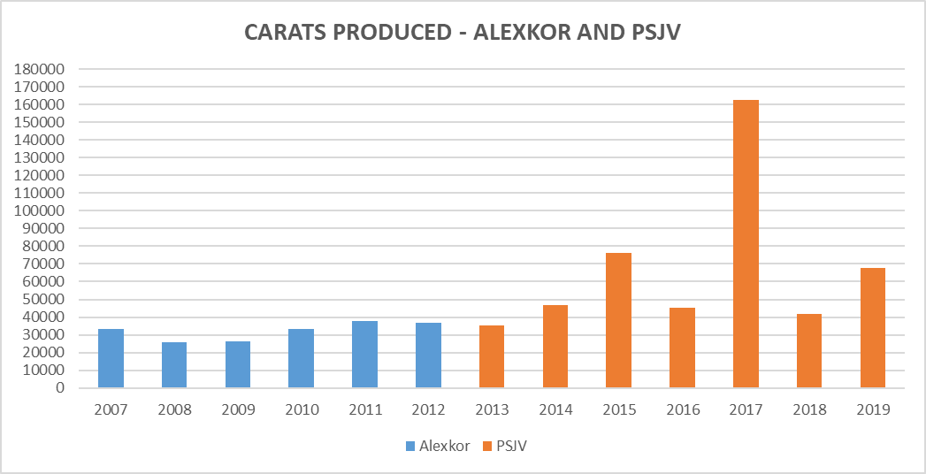
Carat production
From 2007 – 2012 Alexkor SOC produced 193 355 carats.
From 2013 – 2018 the PSJV has produced 407 941 carats. In 2017 IMDSA produced 112 288 carats
67 724 carats were produced in 2019 (2018: 41 941)

Slide 24
Revenue
From 2007 – 2012 Alexkor SOC generated diamond income of R932.5 million.
From 2013 – 2018 the PSJV generated diamond income of R2.4 billion.
2019 revenue amounted to R412 million

Slide 25
Fruitless and Wasteful Expenditure at 31 March 2019
 | 2019 | 2018
Opening Balance | 5 481 | 3 465 721
Current Year | 644 | 5 481
Written off | -5 481 | -3 465 721
Recovered | -644 | -
Closing Balance | - | 5 481
The fruitless and wasteful expense relates to interest incurred as a result of late payment to suppliers. Steps were taken to recover the money from the staff. There were no other fruitless and wasteful expenditure during the year.

Slide 26
Fruitless & wasteful expenditure 2017/18 financial year
Supplier Name | Description | Nature of irregular | Amount
Eskom | Interest paid on Eskom invoice as a result of late submission by PSJV staff | Payment made late | R 5 481

Slide 27
Fruitless & wasteful expenditure 2018/19 financial year
Supplier Name | Description | Nature of irregular | Amount
Telkom | Interest paid on Telkom invoice as a result of late payment | Payment made late | R 644

Slide 28
Irregular Expenditure at 31 March 2019
 | 2019 | 2018
Opening Balance | 26 018 876 | 14 436 064
Current Year | - | 10 368 409
Condoned | - | (2 435 094)
Closing Balance | 26 018 876 | 26 018 876
There was no irregular expenditure in FY2018/19.
Opening balance of the irregular expenditure consists mainly of the following:
Increase in scope of work of R6.9m in terms of National Treasury instruction note 3, but the percentage used was related to construction contracts and not goods and services (dispute on interpretation)
In 2017 the Minister condoned the lease rental for the period, however the amount that was ratified was only for the FY2016/17 expenditure and not for the remaining contract value(R2.6m rental).
Legal services procured of R2m based on single source which should have been approved by National Treasury
Company secretary services procured in 2016, prior to the of National Treasury instruction note 3 becoming effective, however auditors classified cost as irregular as procured through single source basis (R1m).

Slide 29
Annual Financial Statements Government Funded Obligations
 | Opening balance at beginning of the year | Interest earned on investment of funds | Closing balance at the end of the year
Township establishment | 3 932 639 | 334 793 | 4 267 432
Costs related to Deed of Settlement | 6 742 777 | 572 458 | 7 315 235
Total government funded obligations | 10 675 416 | 907 251 | 11 582 667

Slide 30
Other Financial Matters at 31 March 2019
Borrowings
The Company currently does not have any borrowings.
Dividends
No dividends were declared (2018: Nil)

Slide 31
Future outlook
Lack of adequate working capital
Execute the remaining Deed of Settlement Obligations : Handover of residential properties and Alexander Bay Township
Increase the confidence level of the current geological information
Going Concern (Liquidity and Solvency – L/Term and S/Term)
Review of mining contracts
Review of the operating model for Alexkor and the PSJV

Slide 32
Thank you

