Slide 1
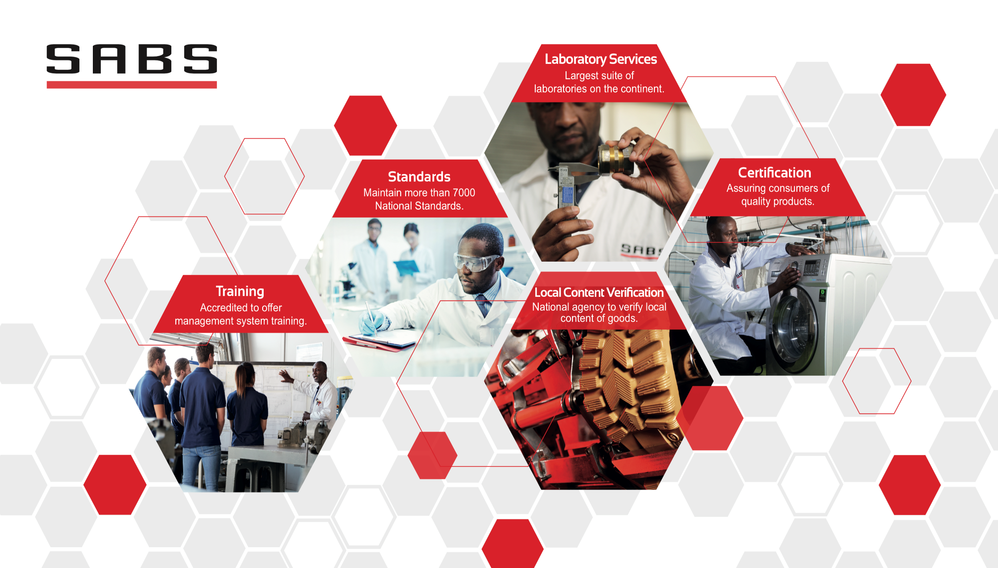
Update on the SABS Turnaround Plan Presentation to the Portfolio Committee on Trade and Industry
26 November 2019

Slide 2

TABLE OF CONTENT
Delegation details
Brief overview of the SABS
  Legislative mandate and SQAM Institutions
  SABS service offering and funding model
  Understanding the competitive landscape
SABS turnaround plan
  Key events which shaped the SABS
  Reflecting on the financial challenge
  Approach taken, key achievement and planned initiatives
  Update on progress made on findings from external auditors and forensic investigations

Slide 3
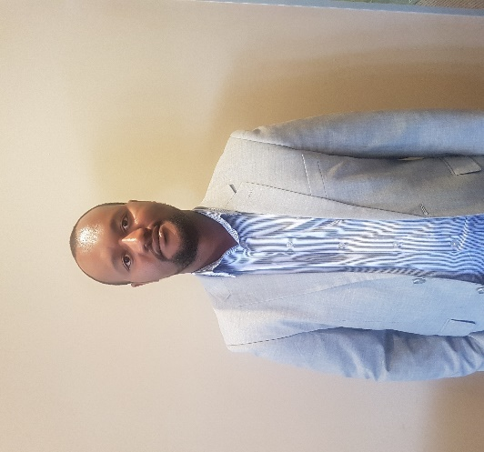
DELEGATION’s DETAILS
Mr Garth Strachan
Acting Chief Executive Officer
Office number: +27 12 428 6002
E-mail: Garth.Strachan@sabs.co.za
Ms Tina Maharaj
Chief Financial Officer
Office number: +27 12 428 6457
E-mail: Tina.Maharaj@sabs.co.za
Ms Amanda Gcabashe
Executive: Certification
Office number: +27 12 428 6779
E-mail: Amanda.Gcabasche@sabs.co.za
Mr Joseph Leotlela
Group Manager Legal Services and Acting Company Secretary
Office number: +27 12 428 6242
E-mail: Joseph.Leotlela@sabs.co.za

Slide 4
BRIEF OVERVIEW OF THE SABS

Slide 5





LEGISLATIVE FRAMEWORK AND SQAM INSTITUTIONS
The SABS was established by the Standards Act, 1945 (Act 24 of 1945)
The SABS exists as a public entity under the Standards Act, 2008 (Act 8 of 2008)
[Executive Authority]
Development Finance and Small Business Development Institutions
Regulatory Institutions
Standardisation, Quality Assurance, Accreditation and Metrology Institutions
[Accounting Authority]
Standardisation
To develop, promote and maintain South African National Standards (SANS)
To promote quality with respect to commodities, products and services for the domestic and export markets
Providing conformity assessment services – certification, laboratory testing and local content verification
Regulation
Administers regulation to ensure compliance and protect human health and safety
Accreditation
Provides formal recognition to carry out specific tasks
Metrology
Underpins testing and calibration through measurement, accuracy and measurement traceability
ROLE OF THE SABS IS DISTINCT FROM OTHER SQAM INSTITUTIONS, ESPECIALLY NRCS. NRCS ADMINISTERS REGULATIONS FOR COMPULSORY SPECIFICATIONS, WHEREAS SABS DEVELOPS VOLUNTARY STANDARDS WHICH MAY BE REFERENCED IN REGULATIONS

Slide 6
SABS SERVICE OFFERING
SABS provides services across the standards development and services value chain, supporting 35 economic sectors and sub-sectors
SABS is the apex national standardisation institute responsible for the development of SANS | SABS provides conformity assessment services in a commercially competitive market
Facilitating the end-to-end standards development process | Training on standards | Technical support in standardisation services | System certification SABS Mark scheme – Product certification Conducts local content verification Consignment inspections | Testing of products in line with international protocols for laboratories such as ISO/IEC Proficiency schemes
Key sectors supported (across value chain)
Accessibility Acoustics Adhesive and packaging Agrochemicals Automotive Building and construction Chemicals | Chromatography Civil engineering Clothing and protective wear Electro-technical Electronic appliances Energy efficiency Engineering | Environment (EMS) Explosion prevention Fibre and polymers Food and beverages ICT Industrial chemistry Lighting technology | Mechanical and fluids Medical and health Mining and minerals Paints and sealants Petrochemical Pharmaceutical Radiation protection | Rotating machinery Rubber and plastics Safety and security Solar water heating Textiles and leather Timber Transportation
Standards development
Certification
Testing
Training
Advisory

Slide 7
SABS FUNDING MODEL
Funding sources
SABS business funded
Annual grant from the Fiscus
Standards development and promotion activities
Operations and support services of the SABS
Maintenance and investment in infrastructure especially testing laboratories
Revenue generated in a commercial market
Conformity assessment services including certification, testing, training and local content verification
Source: Latest published SABS annual financial statement

Slide 8
UNDERSTANDING THE COMPETITIVE LANDSCAPE
SABS operates in a highly competitive environment
Conformity assessment services globally is big business
SABS faces strong competition from foreign and local companies targeting niche industries and market segments
27
SANAS accredited certification bodies in RSA
Company | Quick facts | Presence in RSA?
SGS Group | +97 000 employees +2 600 offices and laboratories | Yes
BSI Group | Operational in 193 countries 117 years in operations 4 784 employees | Yes
Bureau Veritas | 75 428 employees Operational in 140 countries | Yes
TUV Rheinland | Established in 1872 20 450 employees | Yes
Intertek | +3 000 auditors +1 000 laboratories +44 000 employees | Yes
Source: Latest published company annual reports
EMA: Europe, Middle-East and Africa
SABS revenue, excludes grant from the dti and other income

Slide 9
SABS TURNAROUND PLAN

Slide 10
KEY EVENTS WHICH SHAPED THE SABS
Pre-1999
Followed a technology / product based structure
SABS established in 1945
Sector focus e.g. Chemicals
  Standards
  Regulatory
  Mark scheme
  System certification
  Testing
  Mark scheme/permit- evergreen (no renewal)
1999-2001
Ring-fenced standards development and regulatory duties. Commercial business - move towards profit focus and cost-cutting
Three separate “businesses” created
  Standards
  Regulatory
  SABS Holding Company with five subsidiaries
  Product certification (SABS Mark) transferred from Testing to Certification
  Mark scheme – changed to 3 year validity, leading to expiry of permits not renewed
2005
SABS Commercial restructured towards sector/industry view with system certification, Mark Scheme and testing services allocated to each sector cluster
  All subsidiary companies collapsed into one entity (SABS Commercial SOC)
  Loss of critical technical skills
  Project Hannibal initiated to improve SABS productivity, review processes and systems. Embedding the principles throughout SABS was a challenge
2012-2017
Significant events
Central bargaining unit – increased benefit – Additional R65 million per annum unfunded cost to company
SANAS suspension of certification accreditation – reputational damage
Discontinued partial testing and requirement to only test to SANS standards – loss of customers
Cancelled permits/certificates led to loss of annual fees of approximately R19 million in FY2017, R61 million in FY2018 and R57 million in FY2019
2010
Certification and testing activities split into two separately managed business divisions
Management structure changed from sector/industry to product focus i.e. certification and testing divisions (created silo’s)
2008
SABS Act amended and regulatory duties removed from SABS
NRCS established and all regulatory responsibilities and income (levy) removed from SABS
  Loss of skills especially from the labs, (test officer and inspectors) to join NRCS.
  NRCS determined that SABS Mark not adequate proof of compliance and not exempted from levy. As Mark is voluntary, customers elected to discontinue Mark and comply to regulatory requirements – significant loss of revenue
  Part of lost levy historically used for testing equipment investment.
SABS not repurposed.
2018
SABS placed under administration and co-administrators appointed

Slide 11
REFLECTING ON THE FINANCIAL CHALLENGE
Broadly two challenges
  Generating insufficient revenue from conformity assessment services to cover operational expenditure:
    Employee expenditure account for ~70% of administrative and operating expenditure
    Increased benefits awarded to central bargaining unit employees (additional R65 million per annum) without corresponding increase in competitiveness and output
    National footprint and costly infrastructure
    SABS provides a broad range of “public good” services in a competitive market
  Unless significant additional revenue is generated and cost cutting achieved, cash resources will be depleted by ~March 2021
Financial impact of increase in central bargaining unit benefits, suspension of SANAS accreditation, discontinued partial testing and requirement to only test to SANS standards, loss of customers
Net losses
Forecast
Total income includes revenue from services, government grant, other income and net finance income
Forecast numbers for FY2021 to FY2023 currently in draft

Slide 12
NEED FOR A TURNAROUND ….
The need for turnaround plan driven by …
SABS placed under administration in July 2018
Diagnostic process – highlighted….
Turnaround plan developed with ongoing refinement
Shareholder/SABS – unsustainable adversarial policy and mandate creep
Stakeholder and client relations deterioration and sub-optimal resolution of complaints and queries
Customer specific requirement testing, declining capacity/capability in testing infrastructure
  Ineffective or sub-optimal business processes – permit expiry, loss of accreditation, standards development
Human capital and policies:
  Loss of critical skills, long-standing mission critical vacancies
  Arbitrary shifting of functions and personnel deployment
  Sub-optimal suite of policies
  Pervasive bottlenecks – e.g. procurement
  Degraded Performance Management
Maintenance and facilities :
  Serious shortcomings and lack of capex investment in plant and equipment.
Finances;
  Disclaimer audit opinion
  Precipitous fall in revenue in certification and laboratory services
Increase in customer and industry complaints
Short-term “Stabilise SABS”
Substantial governance and operational performance concerns
Medium-term “Fix the business”
Weak financial position and significant sustainability concerns
Longer-term “Chart a new course”

Slide 13
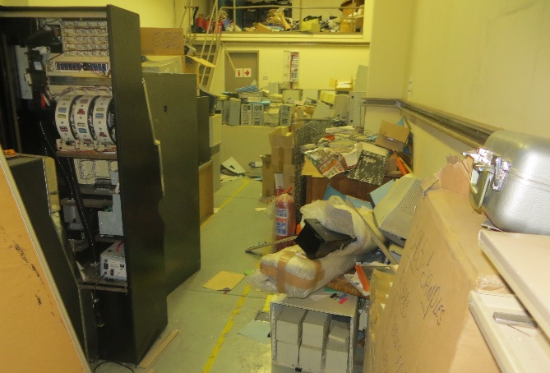
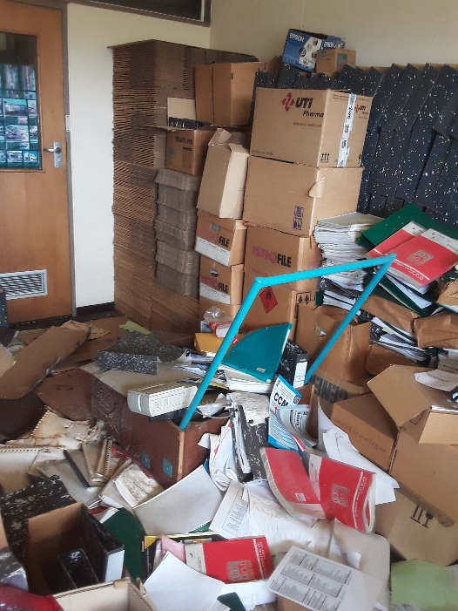
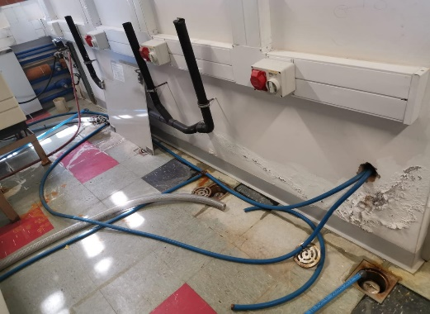
STATE OF DISREPAIR OF SABS INFRASTRUCTURE
Main plant room and general housekeeping weak

Slide 14
THREE-PRONGED APPROACH TO THE TURNAROUND PLAN
Phase 3: “Chart a new course”
Incoming Board and CEO (in consultation with the Executive Authority) to determine the longer-term structural, strategic and systemic issues involving the future direction of SABS including its business model and company structure; its high cost, cumbersome and outmoded national infrastructure and employee profile and the mix of ‘public good’ and commercially viable services. The Acting CEO’s term will end at the end of January 2020. A smooth transition is required to build on the work completed in the past year
Current phase
Phase 2: “Fix the business”
“Integrated Operational Excellence” focus
Need to rectify various basic business processes before determining a long-term strategic course
More iterative process involving general and senior managers across the organisation
Facilitation support from an external specialist turnaround consultant with the requisite technical skills
Phase 1: “Stabilise SABS”
Co-administrators appointed July 2018
High-level top-down approach
Minister approved plan in January 2019
Various successes achieved
Recognised despite some achievements there would be no “silver bullet” for an institution in significant distress

Slide 15
“STABILISE SABS” – KEY ACHIEVEMENTS (1)
Financial
Cost containment measures implemented
  R53.5 million saving in total operating expenditure (FY2019: R847.8 million versus R901.3 million in FY2018):
    Review of all expenditure contracts
    Implemented a new cost allocation model
    New pricing model developed for implementation.
    All vacancies reviewed and only critical positions filled. Since December 2018, total headcount, including permanent and contract workers, reduced from 908 to 879 at the end of October 2019.
    Total number of Executives have reduced from 8 to 5 in the past year due to natural attrition. A review of the Executive management team structure is currently underway
    No performance bonuses paid for FY2019
    Executive’s salary increases limited to 2.8% for FY2020.
    Proposal for the implementation of a long-term incentive plan was not approved
  Funding
  Secured additional funding from the dti to support capital expenditure over the short-term. Additional short-term funding is required for operational expenditure.
  Procurement
  Interventions to overcome significant bottlenecks, improving turnaround times from ~60 days to between 50 and 55 days in the past view months, and cost savings
  Roll-out of ICT strategy
  Cancellation of R300 million digitisation plan in favour of cost effective integrated model

Slide 16
“STABILISE SABS” – KEY ACHIEVEMENTS (2)
Operational
  Certification
  Maintained SANAS and RvA accreditation
  Reduction in expired permits following interventions to secure management, systems and oversight improvements
  Local content verification (LCV)
  SABS has established a local content verification capacity. To date 63 verifications has been completed out of a portfolio of 84 projects within the furniture, textiles, valves, transformers, steel structures, locomotive and vessels industries. Activities were funded from the grant allocated by the dti.
  SABS has been granted a further R12 million per annum over the MTEF by the dti for LCV. A more comprehensive funding model for LCV has not yet been finalised by government.
  LCV under the Mining Charter process has been delayed owing to uncertainty related to legal processes currently underway.
  SABS is working on a methodology and plan involving the use of a digital platform for item identification, standards and LCV in the mining value chain. This will be a pilot with enormous potential benefits for local content and supplier development in the public and private sectors with spill over potential for other industrial sectors.’
  Laboratory services
  Roll-out of sequenced investment in laboratory services. Lack of technical capacity for tender specifications a significant hindrance.
  Sequential reinstatement of “customer specific requirement” / “partial” testing

Slide 17
“STABILISE SABS” – KEY ACHIEVEMENTS (3)
Operational (continued)
Facilities
  Critical maintenance completed on plant room and related infrastructure.
  Human capital
  Review of the full suite of SABS policies; occupational health, safety and environmental management plans as well as training, learning and development plans
  Put in place a new organisational structure
  Stakeholder engagement
  Ongoing improvement in customer, government and stakeholder engagement
  Internal audit
  Restructuring and resourcing of the Internal Audit department is nearing completion
  Various forensic investigations have been completed (see later in presentation for more feedback)

Slide 18
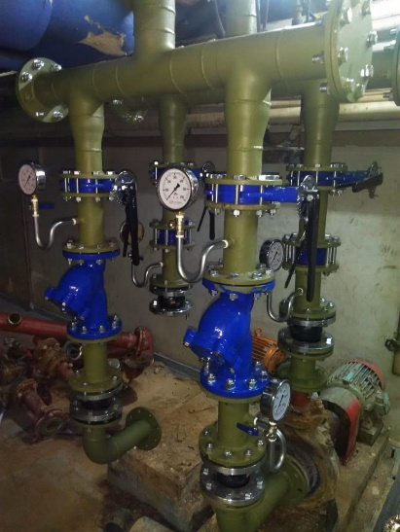
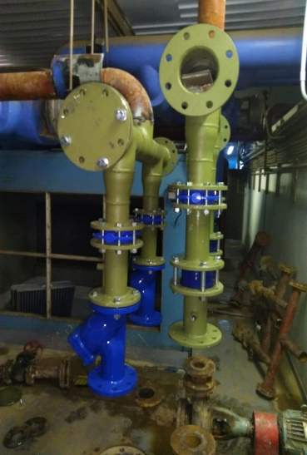
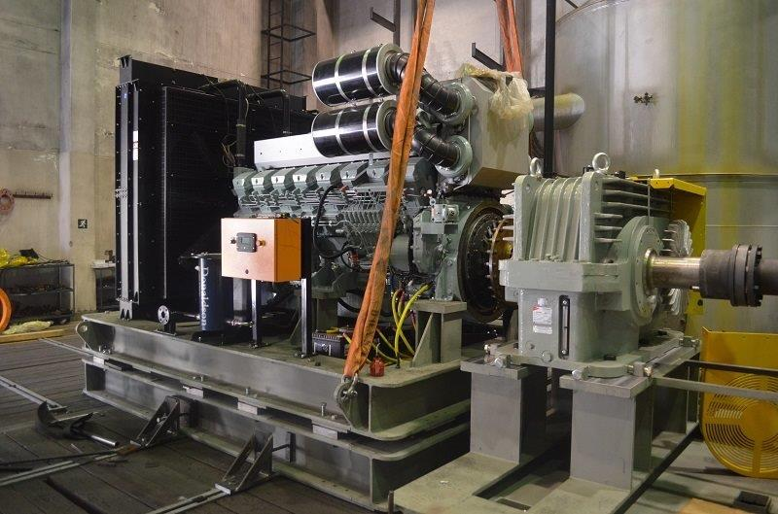
EXAMPLES OF RECENT UPGRADES TO INFRASTRUCTURE
Upgrade of sub-plant in C-block
Upgrade of the testing capability for centrifugal pump

Slide 19
PROGRESS ON FINDINGS BY EXTERNAL AUDITORS
Significant work is underway to ensure that the SABS moves from a qualified audit in 2018/19 to an unqualified audit in 2019/20
Technical accounting matters
  Assets – componentisation and useful lives of old assets (land; buildings and investment property) (Group and separate financial statements) – technical experts appointed to assist in componentising the assets of the SABS and reassessing the useful lives
  Completeness of revenue within the Laboratory services division (Group financial statements) – system enhancements to ensure that a report is generated showing all samples received (completeness). Review of all reports underway to ensure there are no gaps in the report
  Split between the current revenue and income received in advance for subscription fees (Group and separate financial statements) – manual review of all subscription contracts and update of dates on the system to ensure correct calculation of revenue vs income received in advance
  Expected credit losses relating to loans to group companies (separate financial statements) – options for settlement of intercompany loan underway
Irregular expenditure – Lack of an appropriate system to identifying all irregular expenditure (Group and separate financial statements) – review of all policies/registers/transactions for 2019 completed. 2018 in progress.
Compliance with legislation
  Some goods, works or services were not procured through a procurement process which is fair, equitable, transparent and competitive – policy reviews to be completed by 30 November 2019
All other findings – 60% completed. All outstanding matters to be addressed by 31 January 2020.

Slide 20
FORENSIC INVESTIGATIONS
Loss of IATF Accreditation
  A forensic investigation was undertaken into the deficiencies which led to loss of the (International Automotive Task Force) IATF accreditation by the SABS. The investigation raised a number of organisational inadequacies which contributed to the loss of the IATF accreditation. These include: poor succession planning and resourcing; lack of the required technical skills; inadequate reporting of interventions, remedial actions and oversight by the then Executive and governance deficiencies. Remedial steps are being taken to address the weaknesses identified.
Irregular appointments
  A forensic investigation into allegations by anonymous whistle blowers concerning irregularities in the appointment to various positions in the SABS spanning a period between February 2015 and
  30 November 2018 undertaken. This raised a number of deficiencies in the recruitment and appointment processes to various positions. A process has been initiated to obtain further legal advice as to the possible recourse and obligations of the SABS based on the report findings and take disciplinary action against employees still in the employment of the SABS.
  Eskom Coal Testing
  A forensic investigation was undertaken into allegations of irregularities by the SABS with respect to coal testing for the Tegeta Coal Mine. The investigation uncovered deficiencies in operating procedures and compliance thereto which have led to amendments in operating activities and an increased focus in the internal audit of compliance to operating procedures. The report was sent to the dti and Eskom.

Slide 21
KEY PLANS TO “FIX THE BUSINESS” (1)
Phase 2 of the ‘bottom- up’ turnaround plan, involving all of senior management to secure deeper ‘back-to-basics’ and ‘integrated operational excellence’ across the SABS business.
Objective: Improve resource utilisation, secure basic operational efficiencies and on-time delivery.
Planning, scheduling and workflow optimisation
  Review of planning and scheduling systems to assist in integrated planning and master data quality
    Certification division
      Establish a centralised planning and monitoring function. Ensure that delivery times are monitored and delays appropriately addressed
      Implement a technology-based audit management system to assist auditors in the execution of the various audits
    Laboratory services
      Review of laboratory processes, including sample management, densification of laboratories and testing workflow. Pilot four labs: cement, detergents, footwear, materials and installations at NETFA
      Review, and where appropriate, standardise and integrate the laboratory management systems
      Asset management and housekeeping
        Complete asset management system implementation to integrate laboratories, finance and procurement
        Complete asset verification
        Conduct general housekeeping – clearing of old equipment and clutter in the laboratories and adjoining workspaces.

Slide 22
KEY PLANS TO “FIX THE BUSINESS” (2)
  Client management, sales and marketing
  Establish a centralized, integrated sales and operations forum
  Develop capability to assess ongoing customer needs and requirements
  Adopt a new marketing and sales plan and structure
  Operationalise the product development portfolio
  Develop, in conjunction with the operating businesses, client engagement plans for the top 50 best opportunities for additional sales to be followed by other business opportunities
  Enhance and simplify the customer journey, focusing on a improving the customer engagement model across the organisation
  Finance and facilities
  Further cost-containment measures
  Develop a cost management framework, providing a split between direct and indirect expenditure
  Complete grant allocation modelling project
  Develop strategies and plans to secure further funding for the SABS
  Upgrade of the main plant room and adjacent infrastructure
  IT systems
  Review core IT systems, concentrating on Labware/LIMS and Certification solutions and enterprise resource planning (ERP) and hardware to establish critical timeline for upgrade or replacement

Slide 23
KEY PLANS TO “FIX THE BUSINESS” (3)
  Q-Block assessment
  Decision to construct new laboratories (Q-block), operating independently from the main plant room, was taken in 2008. Construction commenced in 2010 and partial occupancy occurred in 2011.
  Full occupancy was not achieved mainly due to the inability of the heating, ventilation and air conditioning system to provide stable environmental conditions to all laboratories. The root cause being inadequate contracted design specifications.
  Funding to the value of R300 million was provided by the dti of which R205 million has been spent.
  SABS is currently finalising the appointment of a multi-disciplinary engineering (MDE) firm, to advise the SABS on extent of the problem, proposed solutions and additional infrastructure requirements as well as potential cost to achieve full occupancy. A draft report is anticipated early in the new year.
  A technically informed decision on the best course of action will then be taken
Human capital
  Complete skills and culture audit. Develop talent acquisition plans to fill gaps
  Review consequence management framework
  Investigate incentives or disincentives measures linked to the turnaround plan
  Consider a fit-for-purpose organisational structure which is less “top-heavy” and prioritises the commercial business requirements
  Standards
  Prioritise standards and revenue opportunities linked to the masterplans to be developed as part of government’s industrial development plans
Initiatives are supported by a detailed project plan, allocated project owner and delivery timeframes. All project plans are available on a shared IT portal and monitored on an on-going basis

Slide 24
FINAL REFLECTIONS ON TURNAROUND PLAN
  At the core of Phase 2 of the Turnaround plan: secure an integrated operational and execution management plan for SABS, with strong monitoring and oversight. The plan is based on getting all the basic ‘nuts and bolts’ operations back to acceptable levels. These plans will be supported by robust sales and marketing initiatives.
  The challenges at SABS are deep-seated and multi-layered. The turnaround plan will take time to yield optimal outcomes to return the institution to a competitive, professional services company which is able to compete in the certification and testing market, develop standards which are aligned with and support the industrial effort and provide a cost effective and competitive services in local content verification and training.
  The financial sustainability and the cash position of the SABS remains the most critical challenge over the next two years.

Slide 25
THANK YOU

