Slide 1
Transformation of the financial sector Presentation to the SCOF Unathi Kamlana Head: Policy, Statistics and Industry Support Department
26 November 2019

Slide 2
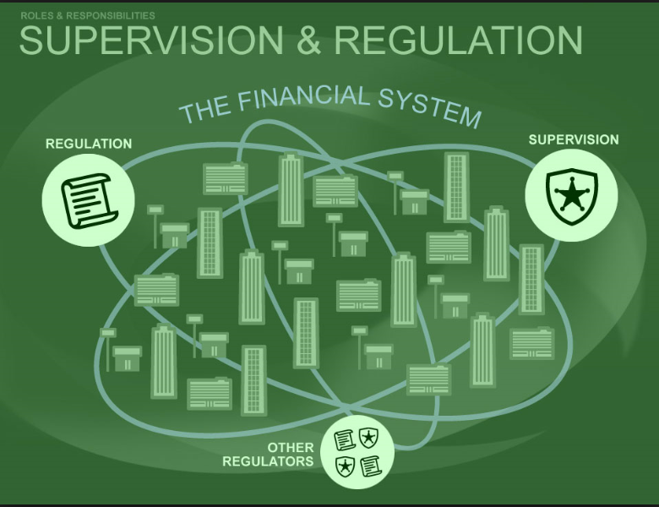
Overview of presentation
Overview of the mandate and objective of the PA
Overview of the PA Structure and Governance
Regulatory and supervisory strategy
The transformation agenda and the PA
Entities supervised by the PA
Update on the relevant sectors
Listing requirements for banks and insurers
What is the role of the prudential regulator in transformation
The Financial Sector Regulation Act, 2017
Transformation requirements of the Insurance Act
What is the model of transformation envisaged?
Understanding the role
Way forward

Slide 3
Overview of the PA: Mandate and Objectives
MANDATE
To promote and enhance the safety and soundness of financial institutions (such as banks and insurers) and Market Infrastructures (such as central counterparties, central securities depositories, clearing houses, trade repositories and exchanges).
Responsible for protecting financial customers against the risk of those institutions failing to meet their obligations.
The PA also assists the SARB in maintaining financial stability.
Commercial Banks
Mutual Banks
Co-operative Banks
Co-operative Financial Institutions
Life-insurers
Non-life insurers
Exchanges
Central Counterparties
Trade Repositories
Clearing Houses
Central Securities Depository
OBJECTIVES
Safety and soundness
Safety and Soundness
Protect
Assist SARB
Promote and enhance the safety and soundness of financial institutions that provide financial products and securities services
Promote and enhance the safety and soundness of market infrastructures
Protect financial customers against the risk that those financial institutions may fail to meet their obligations
Assist in maintaining financial stability
Financial Institutions
Market Infrastructures
Financial customers
Financial Stability
a
b
c
d

Slide 4
Overview of the PA: Structure and Governance
Lesetja Kganyago
Governor & Chairperson of the Prudential Committee
Kuben Naidoo
Deputy Governor and CEO of the Prudential Authority
Fundi Tshazibana
Deputy Governor
Markets and International
Rashad Cassim
Deputy Governor
Financial Stability
Suzette Vogelsang
Head: Banking, Insurance, Market Infrastructure and CFI Supervision
Denzel Bostander
Head: Financial Conglomerate Supervision
Faizel Jeena
Head: Risk Support
Unathi Kamlana
Head: Policy, Statistics and Industry Support
Prudential Committee
Prudential Authority Management

Slide 5
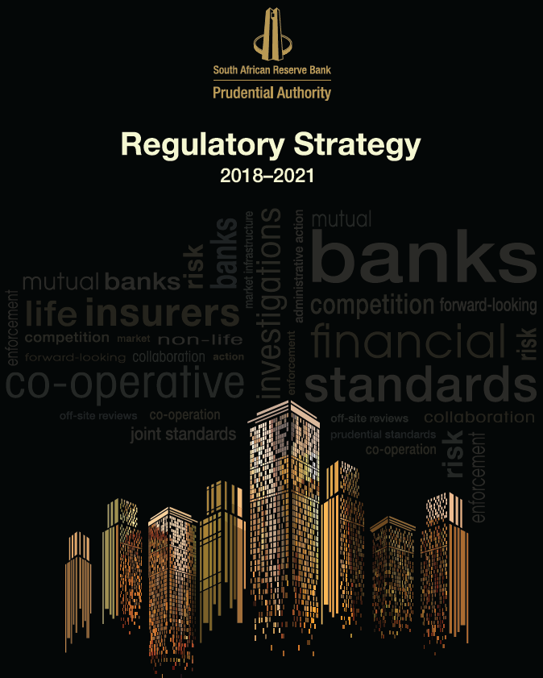
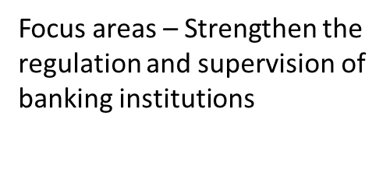
Regulatory strategy and supervisory framework
The PA’s Regulatory Strategy 2018-2021, was adopted by the Prudential Committee and published on the SARB’s website on 28 September 2018.
The Regulatory Strategy deals with the PA’s approach to regulation and supervision, the areas of immediate focus as well as areas of additional priorities
Immediate Focus areas
1 – Strengthen the regulation and supervision of banking institutions
2 – Implement prudential regulation and supervision of financial conglomerates
3 – Prudentially regulate MIs
4 – Prudentially regulate and supervise insurers
5- Establish a framework for significant owners
6 – Conclude MoUs with the SARB and regulators
Approach to Regulation
give effect to the consultation requirements as stipulated in the FSR Act and ensure compliance with internationally agreed standards
Approach to Supervision
risk-based and proportional, forward-looking, outcomes-focused and integrated, underpinned by appropriate supervisory tools
Supervisory frameworks
Banks, insurers and MIs
To be developed – financial conglomerates, significant owners
Additional priorities
Supporting transformation
Supporting sustainable competition in the provisions of financial services and
supporting financial inclusion as well as development in financial technology (fintech)

Slide 6
Entities supervised by the Prudential Authority
Entities per sector | No. of entities
Banking sector | 34
Registered banks | 19
Local branches of foreign banks | 15
Mutual bank sector | 4
Co-operative sector | 26
Co-operative banks | 4
Co-operative financial institutions | 22
Life insurance sector | 73
Primary insurers | 66
Cell captive entities | 7
Non-life insurance sector | 86
Primary insurers | 73
Cell captive entities | 5
Captive insurers | 8
Reinsurers | 11
Life reinsurers | 3
Non-life reinsurers | 3
Composite reinsurers | 5
Total | 234
Notes:
Financial institutions registered in 2018/2019
Banks – Representative offices Effective date
Metbank Limited 29 November 2018
Barclays Bank Plc 29 November 2018
Macquarie Bank Limited 30 November 2018
Bank Julius Baer & Co 8 March 2019
Insurers Effective Date
Swiss Re Life and Health Africa Limited 26 April 2018
Mutual Banks Effective Date
Bank Zero Mutual Bank 17 August 2018
Co-operative Banks Effective Date
Webbers Employees Savings and Credit Co-operative Bank 29 November 2018

Slide 7
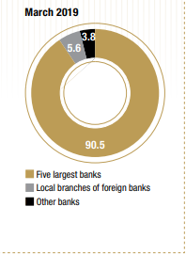
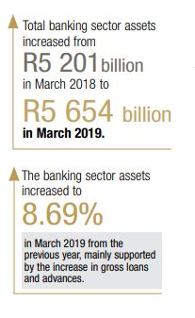
Banks
5 largest banks hold 90.5% of the total banking sector assets
Designation of Systemically Important Banks (D-SIBs)
Quantitative methodology ranks the systemic relevance of banks in relation to each other.
Use of supervisory judge- ment and discretion – to assess the level of significance
Higher capital requirements for D-SIBS and intensified supervisory oversight
Levels the playing field – comparing with smaller players
Enhances competition
by
Notes:
The South African banking sector is dominated by five large banks, which collectively held 90.5% of the total
banking sector assets as at 31 March 2019 (31 March 2018: 90.2%). Local branches of international banks
accounted for 5.6% of banking sector assets at the end of March 2019 (March 2018: 5.9%), while other
banks represented 3.8% at the end of March 2019 (March 2018: 3.9%). Note: Banking sector data includes one institution, Ithala SOC Limited, conducting banking business in terms of an exemption from the provisions of the Banks Act.
DSIBs - It may be impossible to completely eliminate perceptions that some institutions are too-big-to-fail as there will always be pressure on the government and regulators to prevent the disorderly failure of financial institutions. However, strengthening frameworks for capital, liquidity, financial market infrastructure and resolution will go a long way to lessen the perceptions, moral hazard and crippling effects on taxpayers.
D-SIBs and the D-SII methodology (that is currently work in progress), is the ranking of institutions in relation to each other in terms of systemic relevance. Quantitative methodology is used to rank the systemic relevance of banks in South Africa in this regard. It is considered impossible to rank banks’ systemic relevance in relation to each other based on qualitative methodology. The crucial aspect of the methodology is what is done with the ranking (or information that is sourced from the rankings) that could make a difference in reducing the impact or probability of a large institution failing.
What is done next with the information - would be based on supervisory judgement and discretion. There are no absolutes in determining systemic important – there are multiple ways of measuring the level of significance and therefore the importance of supervisory judgement and discretion cannot be overstated.
However it must be understood that it is impossible to add capital to the extent that the remaining systemic risk is zero, the failure of smaller institutions that did not make the cut in terms of systemic relevance would still have an impact on the economy. The higher capital requirements on systemic banks could have the result of reducing their competitiveness with smaller players.

Slide 8
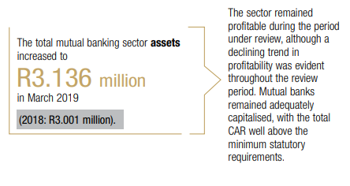
Member-based deposit taking institutions
Mutual Banks
Co-operative banks and CFIs
Work being done on updating co-operative banks rules and development of prudential standards for CFIs
Identifying the challenges being
experienced under the current mutual banks framework, as well as the best approach to make supervision more relevant to the current ownership structures of mutual banks.
Notes:
This sector comprises co-operative banks and CFIs. While co-operative banks have always been regulated by the SARB, through the erstwhile BSD, the PA now regulates both areas, having taken over the regulatory oversight of CFIs from the CBDA. While a number of CFIs meet the new minimum requirement for registration as a co-operative bank (i.e. having at least 200 members and R1 million in deposits), they fall short in terms of financial acumen, skills, as well as prudential and/or operational requirements. Other CFIs are small and, in most cases, newly registered.

Slide 9
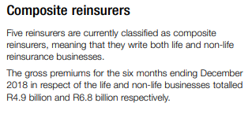
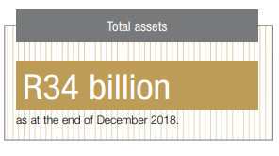
Insurers – Life, non-life and reinsurers
Notes:
Life insurers The net premium income (after deducting premiums for reinsurance) for primary life insurers (those that do not conduct business solely as reinsurers), cell captives and reinsurers was standing at R281 million for the six months ending December 2018. Benefit payments for the same period totalled R225 million. Insurance companies make a significant portion of their income from investment revenues (both realised and unrealised). The 2018 calendar year saw particular challenges, which included slow economic growth, poor investment returns, and volatility in the exchange rate. The total assets in respect of the primary life insurers, cell captives and reinsurance industry stood at R3 011 billion as at the end of December 2018. The majority of these assets was invested in investment funds and equities.
The gross premiums of primary insurers (those that do not conduct business solely as reinsurers), cell captives, captives and reinsurers in the non-life insurance industry were R75 million for the six months ending December 2018. The underwriting results (where the underwriting profit is expressed as a percentage of net earned premiums) stood at 10% for the primary insurers, cell captives, captives and reinsurers in the non-life insurance industry as at the end of December 2018. The non-life insurance industry did not experience any catastrophic events during 2018. The six-monthly operating profits, which included investment income, stood at R7.3 billion as at the end of December 2018, and were also affected by subdued investor sentiments.

Slide 10
Financial market infrastructures
The PA is responsible for the
prudential supervision of market
infrastructures.
This category includes
exchanges, central securities
depositories, clearing houses, central counterparties (CCPs), and trade
repositories.
The reporting templates for market
infrastructures’ data submissions
were published in January 2019, with
the first set of data submissions to
the PA being due by April 2019.
The PA will report on market
infrastructures’ data in its 2019/20
Annual Report.

Slide 11
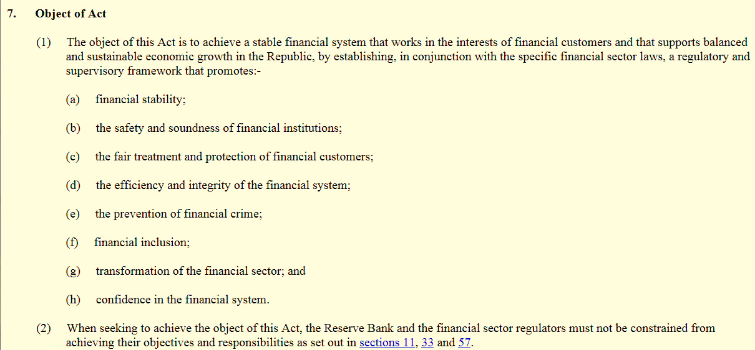
Financial Sector Regulation Act, 2017
Promulgated on 22 August 2017
Gave effect to the Twin Peaks Model
Established the PA and the FSCA on 1 April 2018
Formalised the financial stability mandate of the SARB

Slide 12
What is the role of the prudential regulator in transformation?
Prudential regulators have a direct role to play:
Entrants into the sector – Licensing
Development of a financial institution - Promote and enhance safety Financial sector data - Supervision
Products offered to consumers - Supervision
Ensuring compliance - Enforcement
Exit from the sector – Resolution
The role of the prudential regulatory in transformation can only unfold within the regulator’s legislative mandate
Licensing:
Reduce barriers for entry and promote competition – risk based approach
Licensing:
Allow for a variety of types of financial institutions – microinsurers, co-ops, CFIs, mutual banks
Licensing:
Consider transformation targets when licensing – specifically provided for with regard to insurers
Supervision: Proportional and risk based
Progressive realisation of prudential requirements - insurers
Supervision: Obtain and analyse transformation data
Supervision:
Monitor transformation targets
Supervision: Products that promote access and financial inclusion

Slide 13
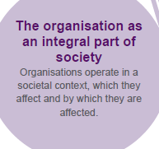
Listing requirements for banks and insurers
Stakeholder inclusivity
Corporate Citizenship
Transformation
Organisation - integral part of society
Sustainability development
Financial stability
January 2012
Board representation
King IV - composition of the board - diversity – race and gender

Slide 14
What is the model of transformation we envisage?
Licensing
Engage with NT to consider a tiered approach to banking and insurance which will reduce capital requirements for simpler business models and allow more entrants into the sector
More entrants will promote competition in the sector
Supervision
Proportional supervision – allows for growth in sector
Monitor transformation targets - catered for in the insurance sector – extend to banking and FMIs
Developmental
Allow financial institutions or fintech companies to experiment with financial technology dealing with the provision of financial products and financial services in a safe environment – allows for new methods to promote access to financial services (financial inclusion) and promote competition
Competition will promote access to financial services

Slide 15
Transformation requirements of the Insurance Act, 2017
Definition of Transformation
IA defines ‘‘transformation of the insurance sector’’ as transformation as envisaged by the FSC issued in terms of section 9(1) of the BBBEEA.
The IA provides for transformation in the objective of the Act, requirements for conversion of existing registrations and new licences variation of licencing conditions and exemptions.
Licensing
Allowing for progressive compliance with the requirements of the IA.
This can be achieved by licensing conditions and exemptions that will consider the transformation plans submitted by the applicant
Supervision
Entrenching the principle of proportional supervision
The regulatory requirements are applied in a manner which is proportional to the nature, scale and complexity of the risks inherent in the business
Dedicated prudential standards
Notes:
The Insurance Act places certain requirements on the Prudential Authority relating to the transformation of the insurance sector. Accordingly, the Prudential Authority is obliged to develop a framework setting out its proposals and processes for transformation in the insurance sector.
The Insurance Act defines ‘‘transformation of the insurance sector’’ as transformation as envisaged by the FSC issued in terms of section 9(1) of the BBBEEA. The Insurance Act provides for transformation in the objective of the Act, requirements for conversion of existing registrations and new licences (by requiring an applicant to demonstrate that it has a plan to meet its stated commitments in terms of transformation of the insurance sector, including meeting the targets envisaged by the FSC), variation of licencing conditions and exemptions.
While the PA does not play an active role in agreeing or setting of the transformation targets; it will provide support in monitoring plans and achievements of an insurer with regard to the implementation of the FSC. The FSC is and will remain the product of the interaction and negotiations between trade associations, labour, community, government and the Association of Black Securities and Investment Professionals (ABSIP).
This approach recognises the lead / central role of the PA in respect of overseeing the prudential soundness of insurers and their governing bodies. It provides clarity as to who is responsible for monitoring the implementation of the FSC in respect of insurers. The primary responsibility vests in the governing bodies of the insurers, while the PA has a secondary obligation to ensure that this indeed happens.
This approach allows for the integration of the monitoring of the implementation of the FSC into the supervisory framework for insurers. This in turn allows the PA to better monitor risks faced by insurers and the potential impact of these risks on their financial soundness.
The Insurance Act facilitates transformation by, amongst others, allowing for progressive compliance with the requirements of that Act and / or Prudential Standards made thereunder. This is achieved by licencing conditions and exemptions.
The PA may –
- impose different licencing conditions in respect of different types or kinds of insurers, and different classes and sub-classes of insurance business and impose conditions in a manner that seeks to facilitate the progressive or incremental compliance with the Act by a specific insurer to promote developmental, financial inclusion and transformation objectives; and
- exempt any insurer from, or in respect of, a provision of the Act for a period and on conditions determined by the Prudential Authority if practicalities impede the strict application of a specific provision of the Act, if a strict application of a specific provision of the Act is not proportional to the nature, scale and complexity of the business of an insurer or for developmental, financial inclusion and transformation objectives necessary to facilitate the progressive or incremental compliance of the Act by a specific insurer, including meeting the targets envisaged by the FSC.
The Insurance Act entrenches the principle of proportionality, which means that regulatory requirements are applied in a manner which is proportionate to the nature, scale and complexity of the risks inherent in the business of an insurer. An insurer’s own risk profile serves as the primary guide to assess the application of the principle. Prudential Standards may therefore be drafted in a proportionate manner. Dedicated Prudential Standards for different types of insurers may be provided for.

Slide 16
Understanding the role
Through checks and balances
Role | Checks and balances
Reducing barriers to entry – based on simple business models – strengthen tiered financial system | Do not compromise on safety and soundness of financial institutions
More entrants – increased competition | Do not compromise on financial stability and safety and soundness of financial institutions.
Proportional supervision | Forward looking, risk and outcomes based
Encourage fintech in provision of financial products and services | Promote regulatory and supervisory objectives – work being done by the IFWG

Slide 17
Way forward
Integrating regulatory and supervisory process to incorporate transformation
Strengthen the CFIs, Mutual Banks and Co-operative Banks framework to ensure proportional supervision and attainable entrance to the sector
Co-operate and collaborate with other regulators on transformation agendas
Engage with National Treasury on tiered banking

Slide 18
Discussion

