Slide 1
NRCS Turnaround Strategy – Presentation to the Portfolio Committee on Trade and Industry Edward Mamadise Chief Executive Officer 26 November 2019

Slide 2
NRCS Delegation
Mr. Edward Mamadise
Chief Executive Officer
Mr Edward Matemba
Manager Strategy and Risk
Ms Nomathemba Majola
Acting Chief Information Officer

Slide 3
Scope of Presentation
Strategic Overview of the NRCS
Strategic Goals, Mission, Vision
Legislative mandate
Regulated industries
Turnaround and Modernization Strategy
Human Resources
Audit Qualification
ICT modernisation
Progress thus far

Slide 4
NRCS Strategy, Mission and Vision
NRCS Strategic Goals
Mission & Vision
To ensure an optimally capacitated institution
To develop, maintain and administer compulsory specifications and technical regulations
To maximise compliance with all specifications and technical regulations
To inform and educate our stakeholders about the NRCS
Mission
Vision
A credible and respected regulator for the protection of the public, the economy and the environment
To develop compulsory specifications and technical regulations, and maximise compliance of regulated products and services

Slide 5
Legislative Mandate
Mandate of the NRCS is derived from the following Acts.
National Regulator for Compulsory Specifications Act
(Act No. 5 of 2008 as amended)
Legal Metrology Act
(Act No. 9 of 2014)
National Building Regulations and Building Standards Act
(Act No. 103 of 1977)
The Foodstuffs, Cosmetics and Disinfectants Act
(Act 54 of 1972)
The National Road Traffic Act, Act No. 93 of 1996 as amended

Slide 6
Industries regulated by NRCS
Industry Sector | Product regulated / Service rendered
Automotive | Vehicles, Replacements components, Manufactures Importers and Builders
Chemicals, Materials and Mechanicals | Cement, chemicals, detergents, Personal protective equipment, safety shoes, building materials, treated timber, plastic bags, solar water heaters, plumbing equipment
Electro-technical | Electrical appliances and products, Electronic appliances and products
Food and Associated | Fishery products, canned meat and processed meat additional mandate - new VC effective from 8 October 2019
Legal Metrology | Calibration of measuring instruments, weights, measures and gaming equipment
Building Regulations | Ensure uniform interpretation of National Building Regulations and Standards Act, administer review Board

Slide 7
NRCS Turnaround Strategy

Slide 8
Problem Analysis
The NRCS has received a qualified audit opinion from the Auditor-General for the past six years.
The organisation is experiencing long-turnaround times for issuance of some pre-market approvals as noted by parliament.

Slide 9
Situational Analysis
• Senior Management Turn-over
Qualified Opinion
• Fragile labour environment
• Inadequate ICT systems
• Service Delivery and poor performance culture
• Funding model
• Regulatory model –Legislation

Slide 10
Human Resources
Identified Challenges
Unpacking the challenges
Actions plan completed
Actions planned
Organisational review stage completed 5 of the 9 phases
Positions filled on Secondment bases – CIO, Financial Manager and ICT Specialist
Critical positions – advertised
12 Policies reviewed
SABS Payroll system
Electronic leave management as of 18 November 2019
Fill all vacant critical positions by 31 March 2020
Complete the remaining 4 phase of organisational review by 31/03/20
Management and Labour to explore reinstatement of Management by objectives by 31 July 2020
Finalise 6 remaining policies by 31 March 2020
Resolve implementation of CDP for support staff with labour and thedti by 30 June 2020
Conduct job grading
Review and benchmark salaries
High CEO turnover rate – 4 CEOs since establishment
Vacant Critical Positions
Vacant Management positions
Senior Management Turn-over rate
Mistrust between Labour and management
Failure to fully evaluate, assess the impact and suitability of the Competency Development Program (CDP)
Partial Implementation of the CDP
Failure to timeously review the organizational structure
Shareholder Initiatives
Salary disparities
Leave management
Fragile Labour Environment

Slide 11
Audit Qualification
Identified Challenges
Unpacking the challenges
Actions plan completed
Actions planned
Declaration rate now at 85% from 55% in 2015/16 FY
Estimation methodology – (however the Auditor General raised concerns)
Reviewed business processes – no LOA to be processed for companies that have failed to declare levies & Inspection process includes levy status verification
Implemented consequence management
Review Estimation methodology to incorporate AG findings – 24/12/19
Ensure all known companies are registered on the financial system 30 days after the inspection has been conducted
Achieve 100% declaration or by estimation 30/04/20
Prepare Quarterly financial statements starting 15/01/20
Appoint Financial Manager by 01/02/20
Completeness of revenue
Estimation methodology
Cut-off revenue
Financial Statements Compliance to Standards
Revenue Qualification
Inadequate capacity
Lack of consequence management
Poor performance management
Lack of accountability
Post Retirement benefit and Leave

Slide 12
Pre-market Approvals (LOAs)
• 100% of all Measuring Instruments Type approvals being done within 120 calendar days
99% of all gaming approvals being finalized within 30 calendar days
99,56% of the Automotive Approvals are being finalised within 120 calendar days

Slide 13
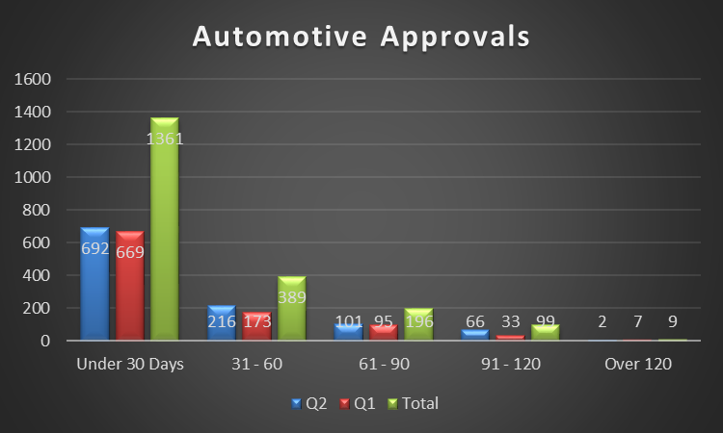
Automotive Approvals 1 April 2019 – 30 September 2019

Slide 14
Pre-market Approvals (LOAs) - CMM
• 90,38 % of all Chemicals Materials and Mechanicals (CMM) LOA applications processed within 120 days
15 (not processed) outstanding LOAs over the 120 days within the Chemicals, Materials and Mechanicals section were above 120 days. These have now been allocated
Problem: Failure to implement the 30 days cancellation policy
Action for CMM – Implemented the 30 day cancellation as of November 2019

Slide 15
Pre- Market Approvals Electro-technical
Identified
Challenges
Unpacking the challenges
Actions plan completed
Actions planned
Implemented the 30 days cancellation policy.
Six candidate inspectors were recruited and qualified in April 2019 after undergoing training and as a result, the business unit is now able to process and approve more than 1 200 applications per month.
Leave planning institutionalised
Additional Administrative capacity
Applications on hand reduced from 3146 to 2321
100% implementation of 30 day cancellation policy
Reduction of LOAs on hand to 1600 which is the equivalent of applications received per month plus carried over by end May
Additional administrative capacity to deal with the bottleneck in capturing approved applications
Adherence to the Risk Based Approach
Work planning
Overtime
Backlog applications brought forward from 2017/18 financial year
High number applications on hand
Failure to timeously process Electro-technical Approvals
Inadequate capacity
Poor planning
Non-implementation of 30 day cancellation
Poor performance management

Slide 16
Pre-market Approvals (LOAs) Electro-technical
3146 applications were carried over to the third quarter.
2321 applications on hand as at 12 November 2019
711 Unassigned < 30 days;
695 awaiting capturing and issuance of LOA
915 – Pending findings (findings communicated to the applicant)

Slide 17
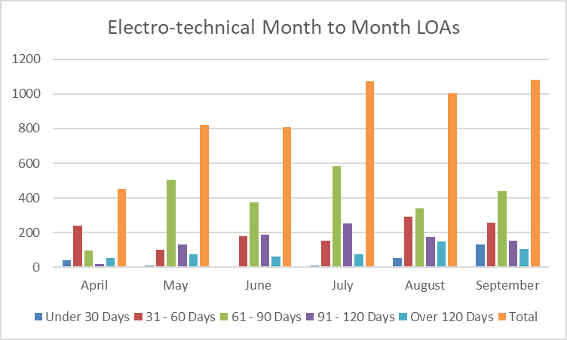
Pre-market Approvals (LOAs) Electro-technical

Slide 18
ICT Modernisation

Slide 19
Progress thus far (NRCS Modernization Holistic View)
Program
Projects/Initiatives
Actions plan completed
Actions planned
NRCS IT Infrastructure was upgraded in the FY 2018/ 19, and currently runs on a world class IT infrastructure
The VoIP project has been implemented within NRCS users can now use enterprise directory from the office phones, do conference calls, auto attendant etc.
Upgrade the network bandwidth, Estimation date of appointment is 31st of January 2020, using the existing Service Provider = Currently sourcing quotes
Finalize the network switches specification and submit to BAC for approval, open tender process, Estimation date of appointment is 31st March 2020.
IT Infrastructure refresh
Voice over IP Telephones (VoIP)
Bandwidth Upgrade (to avoid calls dropping and prepare enough space on the network Applications to be added on the Infrastructure)
Add network switches (to ensure smooth network and less glitches)
IT Infrastructure Review and Upgrade Programme

Slide 20
Progress thus far cont….
Programme Name | Justification | Projects/ Initiatives | Actions Completed | Action Plan
IT skills, capacity and competency procurement, development and deployment Programme | The Modernization Project requires fit for purpose IT structure and highly skilled IT resources to ensure successful implementation for both Regulatory systems and Administration/ Support systems | IT Resource Company/ Panel of resources procurement | Developed a plan to identify the skills gap, as fit for purpose IT skills are required to complete the Modernization | Currently Reviewing the previously developed specification to procure all required resources, pending the completion of the OD project, Estimation date of appointment is 28th February 2020 , Open tender.

Slide 21
Progress thus far cont….
Programme Name | Justification | Projects/ Initiatives | Progress/Action Plan
Application Systems Stabilization and Modernisation Programme | The current Financial System (JDE) needs to be immediately upgraded and stabilized to resolve all audit findings Implement a fit for purpose Business Support System that integrates all administration modules with seamless workflow for online approvals | JDE upgrade and stabilization Enterprise Resource Planning System Change Management Programme | Engaged the OEM (Oracle) to assist with the solution (s) to address an overly customized and inadequate JDE system, engagement process to be completed by 29th November 2019 Start a procurement process to immediately fix the JDE system using the OEM proposal, estimation date of proposal completion is date 20 January 2020 Estimation Date to fix JDE is 31 March 2020 ERP tender advertised, briefing session took place, now awaiting tender responses, tender closes on the 25th November 2019 Award ERP tender by 28 February 2020 Change Management Programme commenced on 1 November 2019, this will continue and link with the ERP award project, estimated date to complete the ERP project 30 November 2020

Slide 22
Progress thus far cont….
Programme Name | Justification | Projects/ Initiatives | Action Plan
Data Integrity, back-up, archiving and security programme | To ensure NRCS systems are well secured, avoid vulnerabilities and eliminate unauthorized access on NRCS systems | IT Security Architecture implementation (Implement a demilitarized zone DMZ for NRCS data center) and explore opportunities with strategic partners to triangulate and authenticate data | This will commence once core network and Broadband upgrade are complete, end of January 2020 Initiate collaboration discussions with SARS, CIPC and SABS to prioritize implementation opportunities. To commence January 2020

Slide 23
Progress thus far cont….
Programme Name | Justification | Projects/ Initiatives | Actions Completed | Action Plan
Review Update and Implementation of a coherent and pragmatic ICT Governance Programme | To ensure a well managed IT environment, that is flexible and a quick response to business solutions requirements | ICT policies update and Governance review | In Progress | IT Policies & Governance to be updated to address IT risk and Audit Findings. 13 December 2019
An internal and external Customer Service delivery excellence Programme to inform Regulatory Systems modernisation opportunities | To ensure that the outcomes of strategic initiatives are aligned with internal and external stakeholder expectations and the changing NRCS Business Model | 1. Further Modernization Opportunities | Modernisation of existing Regulatory Systems has commenced. Implemented SharePoint to upload customer documents Online registration of Processed Meats companies completed 4 October 2019 | Online registration of all other regulated Entities not yet registered with the NRCS - 20 December 2019 Online declaration of levies – 20 December 2019 Linkage to and re-use developed CIPC applications e.g. Website, re- structure and customer registration - dependent on appointment of Resourcing Company

Slide 24
Thank You

