Slide 1
REAL FACTS, REAL PEOPLE, REAL PROBLEMS SEEKING REAL SOLUTIONS

Slide 2
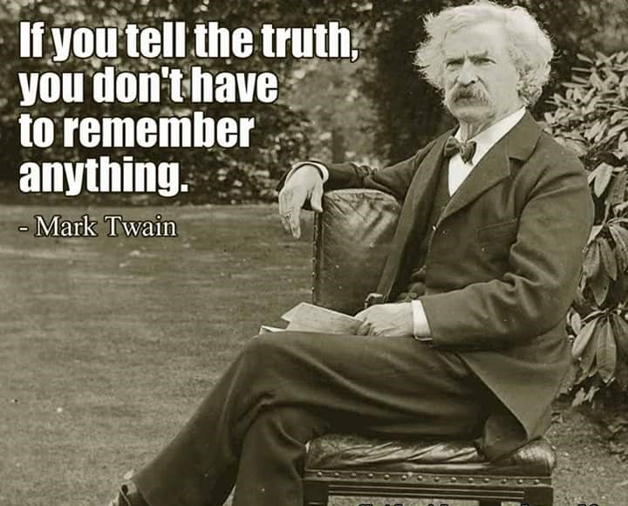

Slide 3
DESIRED OUTCOME: At the end of this presentation, we’d like the Committee to:
Accept our bona fides
Accept & understand who we are & who we represent
Understand our history, struggle & ultimate goal
Ensure that future engagements with our leaders continue to be dignified, respectful
Treat us as partners in our quest for a better life for our people
Understand & accept that a wrong has been perpetrated & perpetuated against our people
Undertake to improve engagement with our community
Engage other departments & encourage them too to constructively engage with this community

Slide 4
The world famous brazier at Farm 371 Gong Gong, our home.
It is commonly, erroneously, referred to as a “waterfall”. The previous Lutheran Church school for coloured children took its name from this natural feature and was called “Waterval Kleurlingskool”. The other school, for Africans, was called “St. Peter Claver Combined School” & was administered by the Catholic Church.
The state has never provided any educational infrastructure to this community.

Slide 5
BRIEF HISTORY
People been living on this farm as early as 1700’s
Homogenous community of Black, White, Indian & Griqua (later reclassified as coloureds). Inter marrying across racial divide was common place.
Indians & Whites removed in the 1950’s
Black people relocated to Papierstad in 1967/68
Early 1980’s government tried to remove Coloureds. Capt. AJ Jood resisted & started negotiations for the purchase of the property for Griquas (Coloureds)
1986 NP government relents & purchases farm for R 975 000.00 from Gong Gong Mining Co. Ltd. Local Government appointed custodian.
1996 land claim lodged. Farm 371 not part of claim settlement. Dikgatlong Municipality lays claim to farm & registers it in their name in 2003. Dispossesses an entire community.
NCPG structures resists all requests for assistance from the community

Slide 6
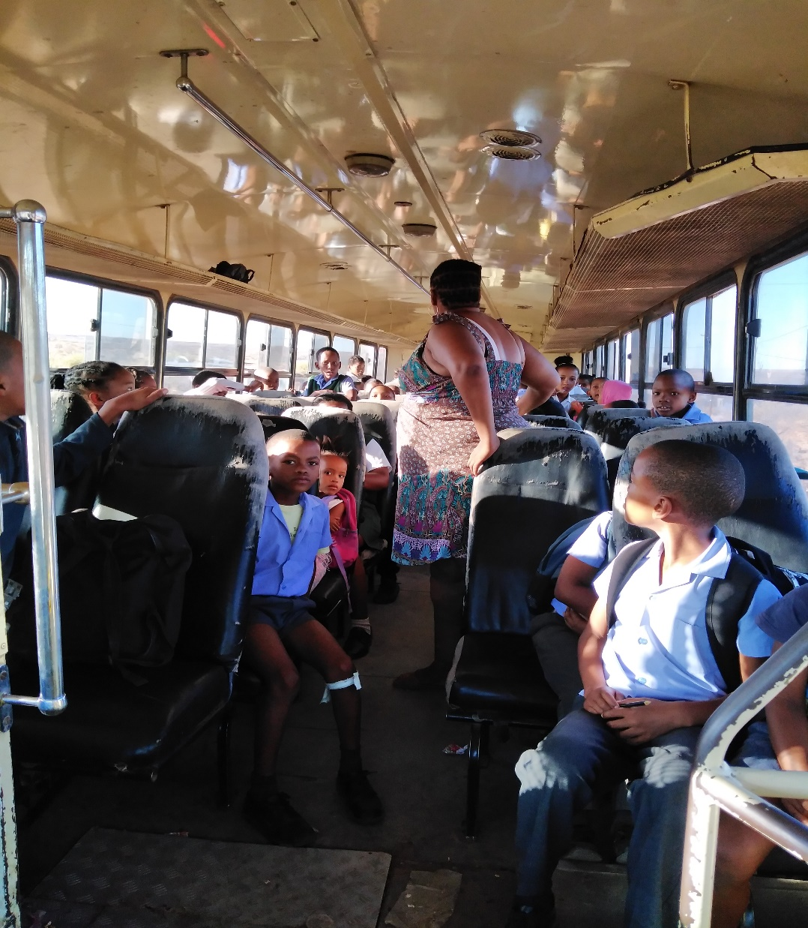

Slide 7
CURRENT SITUATION
Over 400 families live under constant harassment by an illegal CPA established by DRDLA & ably assisted by Dikgatlong Municipal officials
No potable water & sanitation
No road infrastructure
Community advocated on their own behalf and succeeded in electrifying the farm, via Eskom
No ECD facilities
No proper health facilities
No development of any nature by any state agency / organ
Constant threat of mining companies coming in without proper consultation but approved by the CPA, DMR & Dikgatlong Municipality.
No school for our children.

Slide 8
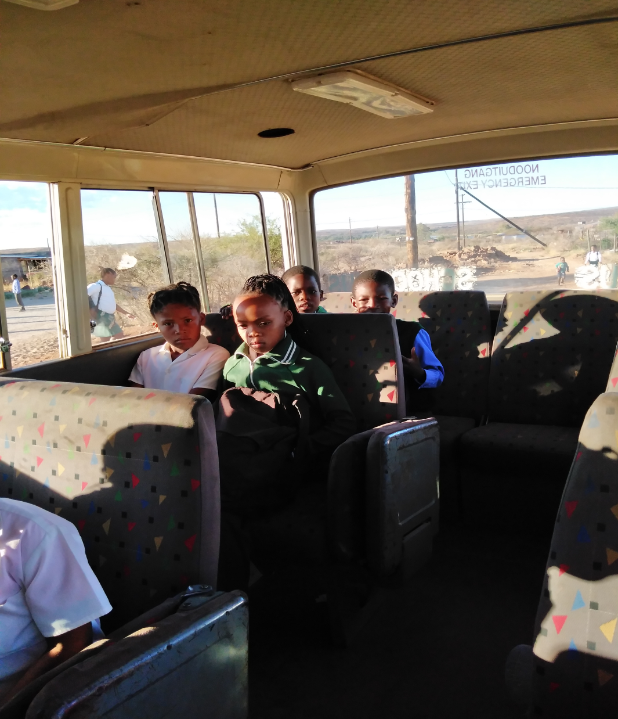

Slide 9
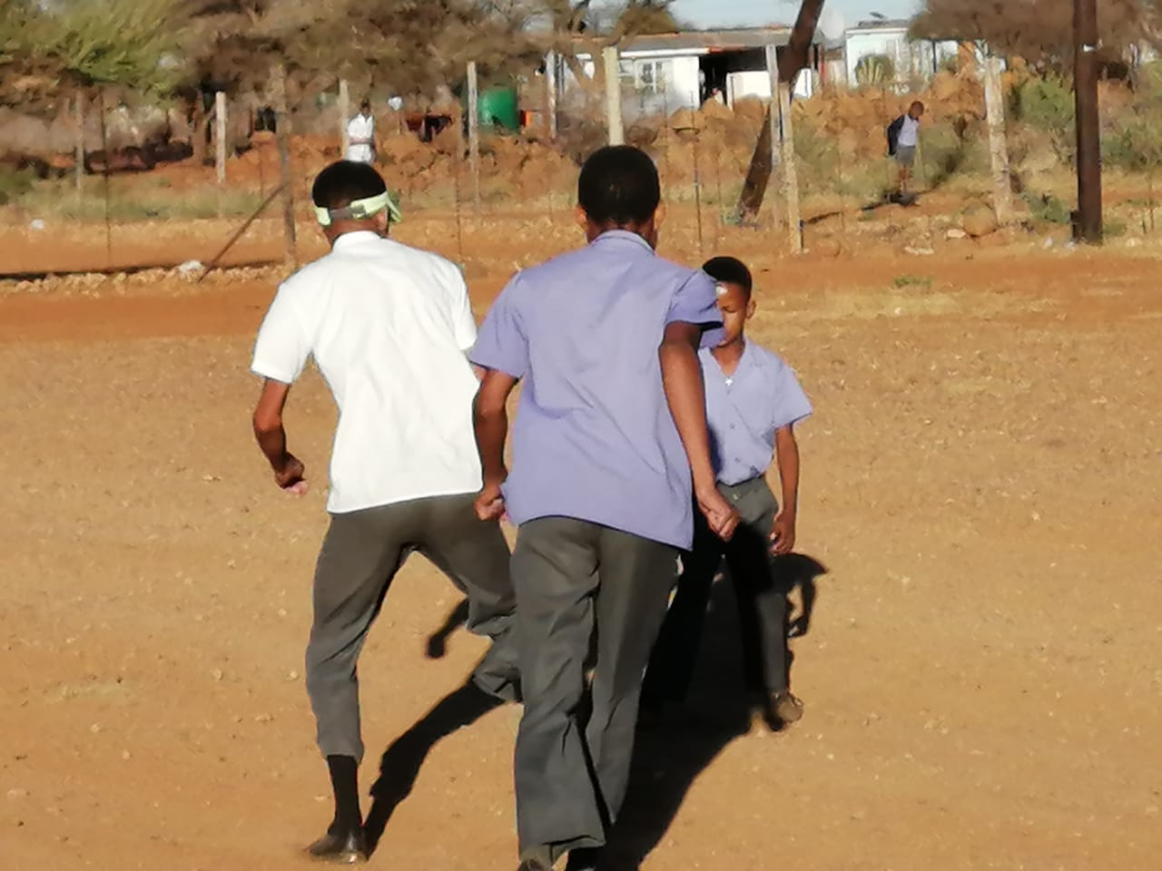
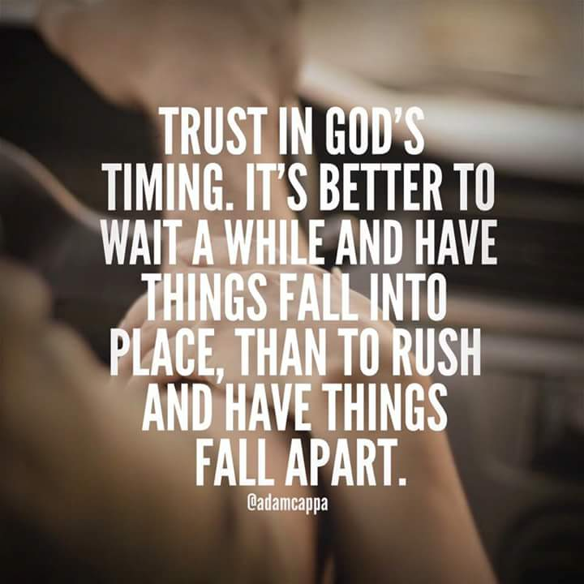

Slide 10
TALKING NUMBERS
NCDE FIGURES
We note with grave concern the stats in the letter from the NCDE. We found:
Grade R = 24
Grade 1 = 13
Grade 2 = 17
Grade 3 = 17
Grade 4 = 23
Grade 5 = 11
Grade 6 = 15
Grade 7 = 16
Grade 8 – 12 = 54
TOTAL: 190
Our children commute to five different schools in our area. The schools are:
G. N. Pressley Intermediate (Longlands)
Barkly West Primary
Barkly West Secondary
Mosalakae Primary (Mataleng)
Borosetse Secondary (Mataleng)

Slide 11
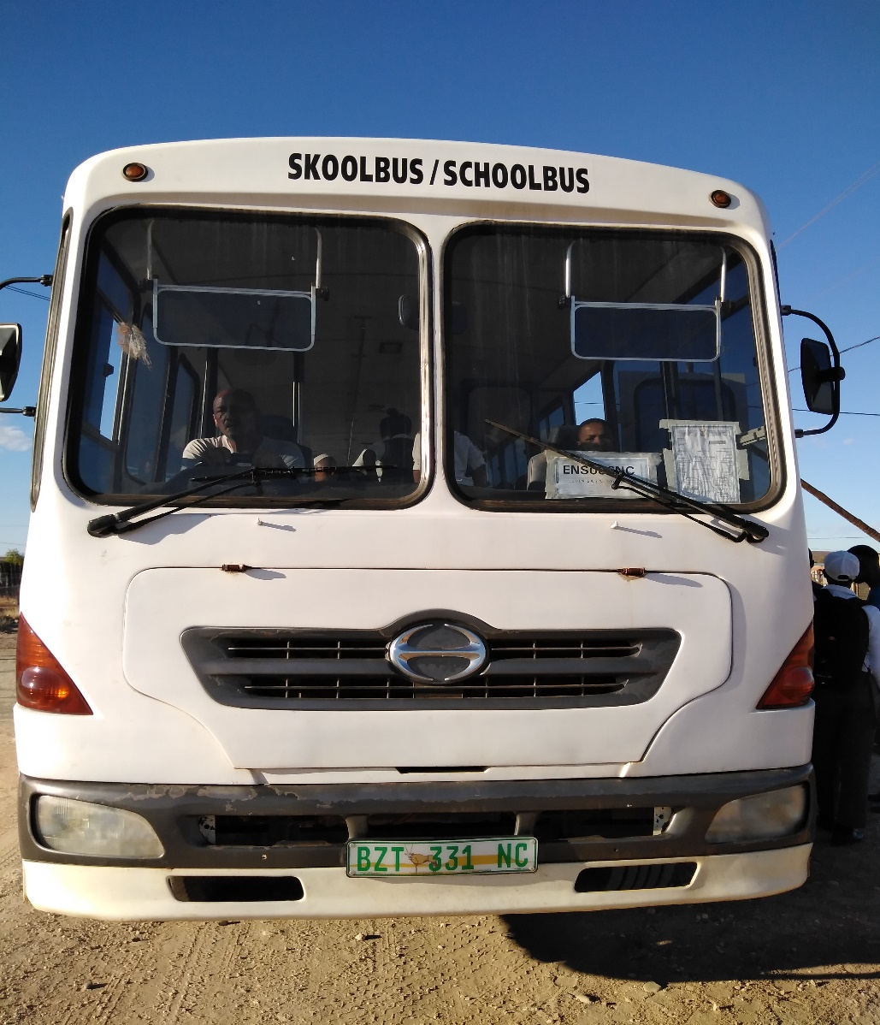

Slide 12
TALKING NUMBERS
We accept that the numbers may not be 100% correct for G. N. Pressley, Mosalakae & Borosetse.
Figures for the Barkly schools we got from the parents in a meeting on 21.11.2019
Principals were exceptionally reluctant to divulge figures. One wonders why?
Judging by these numbers & comparing them to that of schools in areas similar to Farm 371 we find:
G.N. Pressley in Moddergat, our neighbouring farm, has a school from Gr. R to Gr. 9 for 505 learners
Pniel Landgoed has a school from Gr. R – Gr. 7 for 167 learners
Why can’t we have our own school?

Slide 13
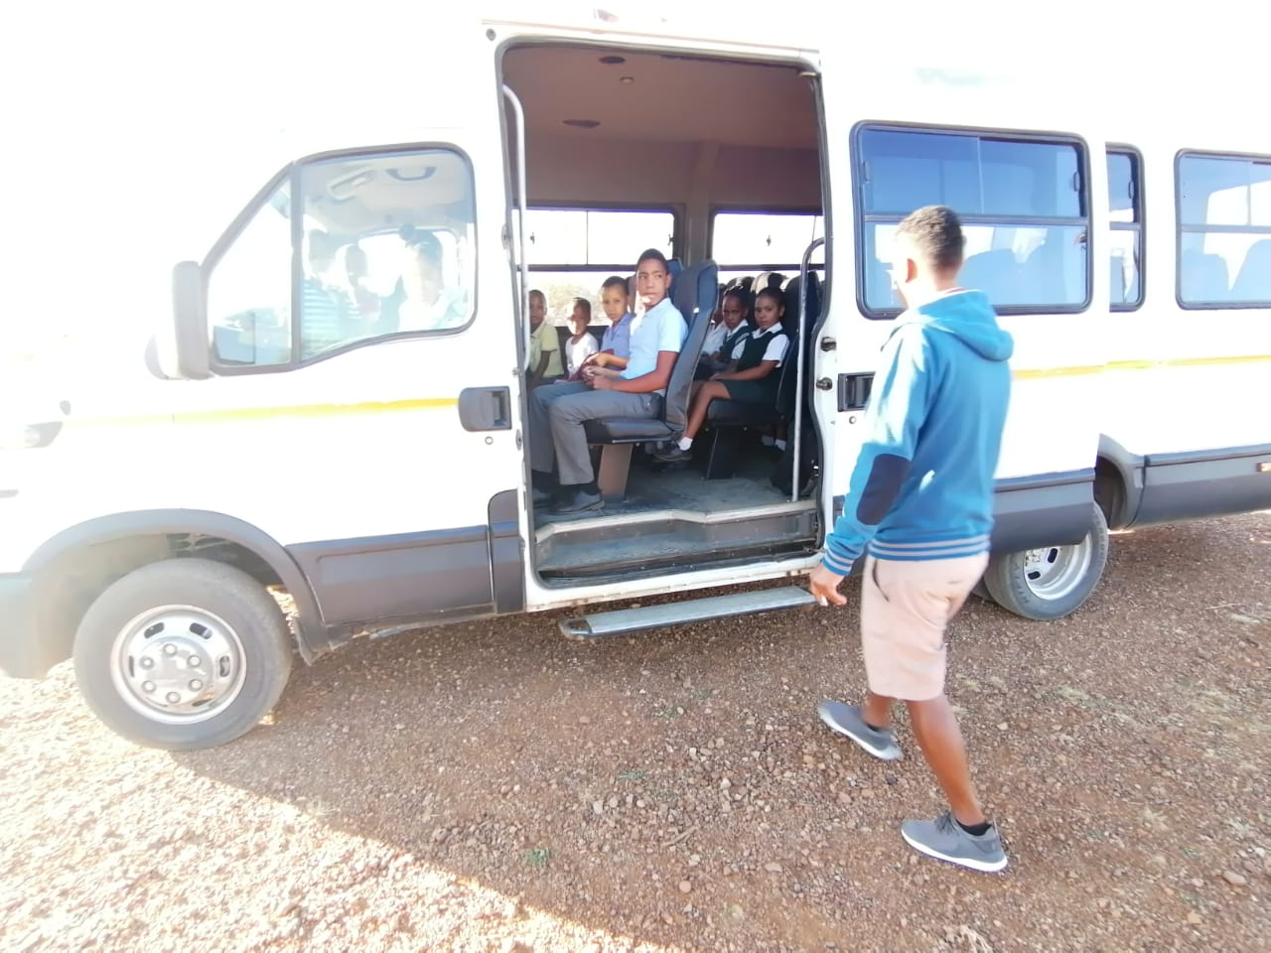

Slide 14
WE NEED OUR OWN SCHOOL TO ARREST THE FOLLOWING ILLS:
Children as young as 5 yrs old having to commute to school
During winter these “arme bloedjies” leave home at dawn
They get bullied on the busses
They constantly lose stuff between home & bus; school & bus
They are in the firing line when the older children become boisterous and even combative
Children cannot be children because they only get home in time for homework & bed
Children board the bus but never reach school
Our children are migrant learners who cannot fully participate in educational opportunities due to transport problems
Parents cannot engage actively with the school due to financial constraints
Parents often have to pay for repairs to buses
Parents cannot attend parent meetings as it is conducted at night & no transport is available

Slide 16
BENEFITS OF HAVING OUR OWN SCHOOL
We can pursue our culture
Learners will have better opportunities to develop holistically
A co-curricular programme can be developed and managed
Learner absenteeism will decrease
Children can walk to school
An after care programme can be introduced
Learners at risk can be better managed
Truant learners would be better managed by parents, teachers & community members
Parent involvement can be improved
Community will have a sense of purpose again
Community programmes can be school based
A school enrichment programme can be introduced
ABET classes can be offered to parents
Job opportunities for community

Slide 17
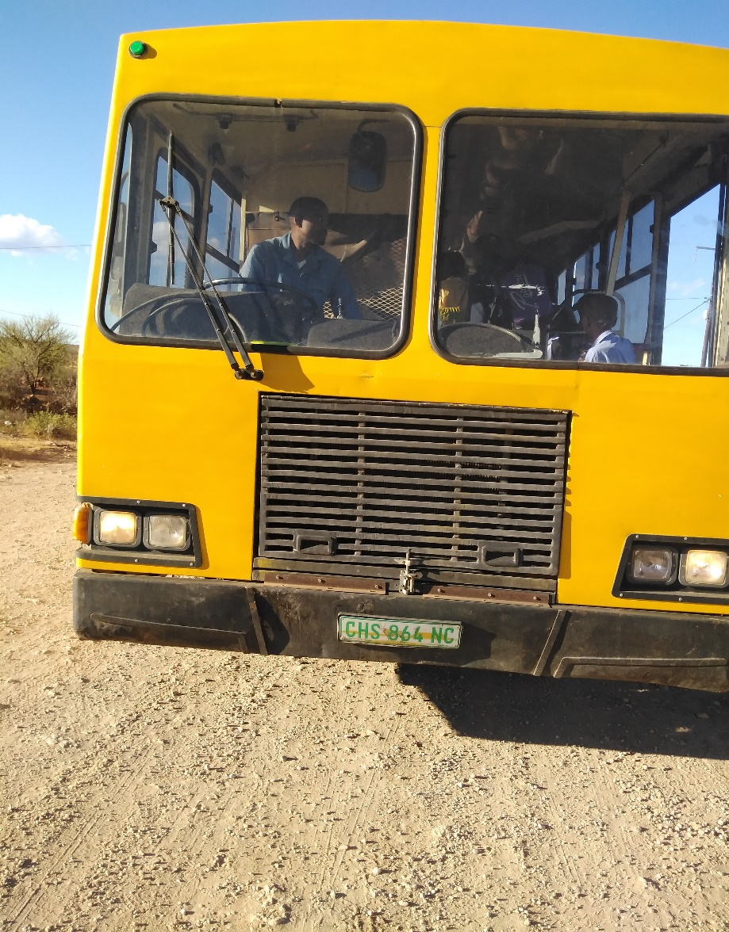

Slide 18
OPTIONS AVAILABLE TO PARTIES:
Chairperson, our community is not oblivious / ignorant about the state of the fiscus and the severe constraints under which departments have to operate.
We are however, fully aware of the authority vested in this august house, hence our appeal to you to remember the downtrodden, dispossessed, forgotten, neglected, unemployed, hungry people of Farm 371.
How does the state justify dispossessing us of our land and all the benefits it could unlock for us?
In the archives in this very building, there is documentary evidence of the ownership of our land. Dikgatlong Municipality only needs to do right by us.

Slide 19
OPTIONS 2
The state does not currently have the resources to provide us with a school. We understand & accept that.
Could the state possibly:
Ensure the speedy return of land rights & ownership to the community
Make available expertise to assist us in seeking funding to build a community school & skills development centre
Assist us with special planning on the farm
Provide training to our people to benefit from the busy R31

Slide 20
OUR COMMITMENT TO FARM 371
We have been teaching & preaching development to our people for the last six years.
We have asked them to initiate the development they wish to see on our beloved farm
Gongsters have not disappointed us. They challenged us to electrify the farm first before they spend any money. They promised to do their part soon as the electricity arrives.
The following is proof of their fulfilling that promise

Slide 21
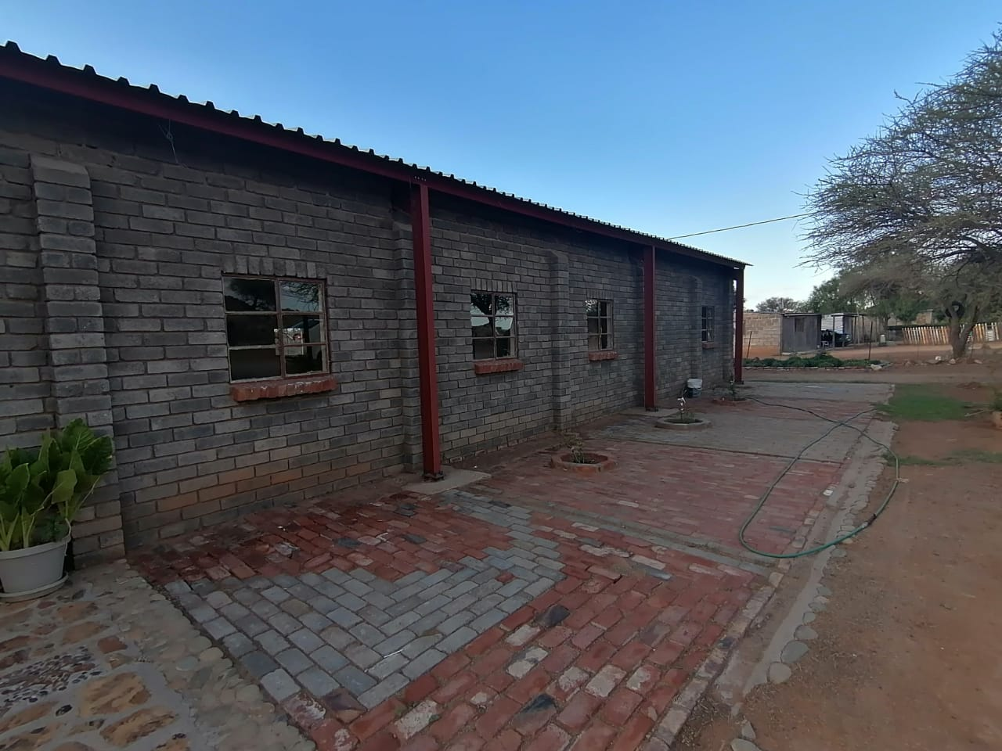
Saint Joseph Lutheran Church
On the left is the old building used for services until 2018.
The parish demonstrated a willingness to do for themselves & raised all the required funds themselves.

Slide 22
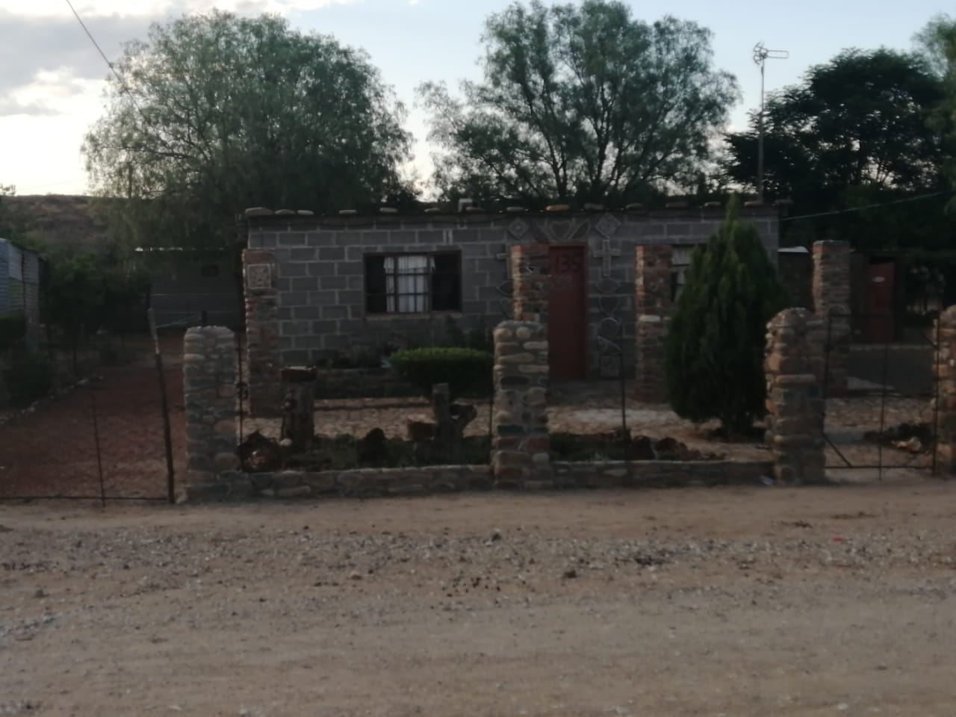
THE OLD & THE NEW
The old & the new

Slide 23
DEVELOPMENTS
St Peter Claver Catholic Church

Slide 26
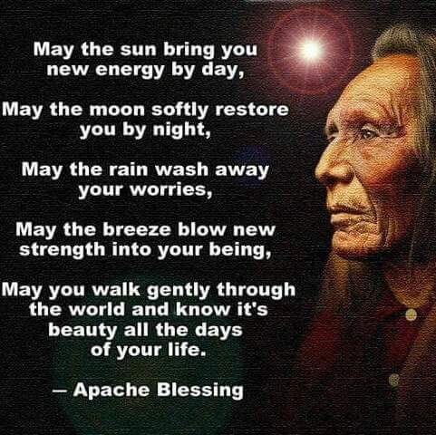
IN CONCLUSION

Slide 27
VOTE OF THANKS
NDIYABONGA / ENKOSI / VELE DANKE / MERCI / GRACIAS / GRACIE / REA LEBOHA / REA LEBOGA / SIYABONGA / AWE / BAIE DANKIE
THANK YOU EVER SOOOO MUCH

