Slide 1
loveLife Presentation to the Portfolio Committee on Sports, Arts and Culture
POWERING THE FUTURE
12 November 2019
Presented by: Dr. Linda Nkomo CA(SA), Chief Executive Officer
Mrs. Beryl Traore, Head – Programmes

Slide 2
Programme objective
The four impact areas that the programme contributes to in the long-term:
The development of holistic athletes
Provision of safe spaces for young people to engage in active recreation and hone natural talent
Use sport and recreation to foster social cohesion in the communities where we work
Reduced risk for non-communicable diseases among young people through increased physical activity.

Slide 3
loveLife’s response
Issues Affecting Youth:
inactivity, obesity, tobacco consumption, drug and alcohol abuse, hypertension, poor diet, poor access to recreation, drop in social cohesion levels
Programme Package:
Health Programme – love4Life Challenge
Life Coach Development Programme – Coach4Life
Recreation Programme – Play4Life Programme
Nation Building Programmes - Youth Camps

Slide 4
Health promotion programme – love4Life Challenge
Life Coach Development Programme – Coach4Life
Training of teachers and community coaches on the Coach4Life programme,
Social Cohesion/Nation Building Programmes
Youth Camps
Recreation Programme – Play4Life
Recreation Leagues (Provision of safe places to play)
The training enables coaches to understand young athletes holistically and therefore empowers them to better support their athletes
Exercise and physical activity
Decision making
Personal development & developing a healthy self image
Y-Centre exercise and fitness promotion activities
Non-communicable diseases
HIV and TB
Knowledge building programme that makes use of an interactive board game to test and increase knowledge around
Nutrition
Sexuality
These coaches and teachers become loveLife’s Adult Allies who are able to guide young athletes to make better choices both on and off the field
Y-Centre active recreation holiday programmes
Move4Life events
Sport events that foster social change (groundBREAKER Sport4Change events)

Slide 5
loveLife deliverables on SRSA Strategy
School Sport
National Youth Camps
Community Sport/Active Recreation:
- #iChoose2BActive Campaign
- The Big Walk
- National Recreation Day
- Indigenous Games Festival
- National Move for health Day
- Sport for Social Change and Development
Notes:
A team is not a group of people who work together it is a group of people who trust each other

Slide 6
School Sport
Output/Outcome | Increased knowledge on health and nutrition for in-school athletes Positive Behaviour Change
Activities | The love4Life Challenge – Face-to-face interaction with young people around issues though an interactive board game at Sports, Arts and Culture School Sport events at al levels Athlete tracking - to gauge young athletes participation and development in School Sport events at various levels intra-school to inter-school, to cluster level, to district level, to provincial level and ultimately to national level. loveLife Contact centre -Psychosocial Support services offered to young athletes through the loveLife Contact centre. loveLife groundBREAKERs promote the contact centre at all Sport and Recreation events where they are present. The loveLife rewards handed out after the completion of the love4Life challenge all include the loveLife contact centre details which young people are encouraged to make use of to help them navigate through life successfully. The contact centre is also promoted to the young athletes who are part of the Ministarial Bursary programme to provide them with support and guidance as they try to navigate through life and adjust being in schools that often take them away from home

Slide 7
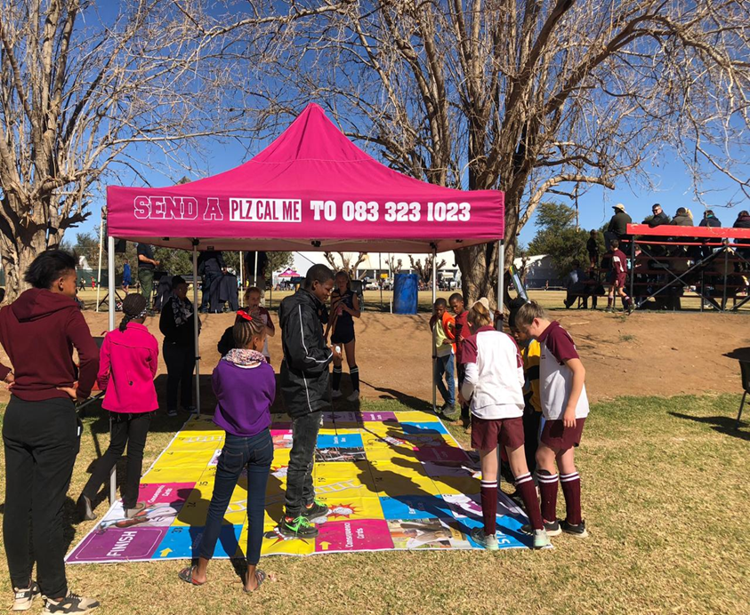

Slide 8
School Sport cont.
Output/Outcome | Increased knowledge on health and nutrition for in-school athletes Positive Behaviour Change
Activities | loveLife Social media platforms – loveLife has very active Twitter, Facebook and Instagram pages which are used to promote SRSA events and campaigns and also to spark conversation around sport and recreation, nutrition and the importance of physical activity Radio – loveLife has a fully equipped radio studio where quality adverts and PSAs can be produced. loveLife currently works with 5 SABC radio stations and 22 community radio stations. Once per quarter loveLife has a sport, recreation, nutrition or physical activity promotion discussion across radio stations. Coach4Life trainings – coaches and teachers responsible for sport in schools are trained on the coach4life programme. A programme that focusses on the holistic athlete equipping coaches with skills to assist young people do well in life beyond the sport field which will ultimately positively impact their performance on the field. MYC Activations – loveLife’s nomadic tent known as an MYC (Mobile Y-Centre) is pitched at events, this is where loveLife edutainment activities take place. Role model talks done by ex and current sport stars are done here too.

Slide 9
National Youth Camps
Output/Outcome | Increased knowledge and skills of Camp Masters and Facilitators to deliver and achieve the Camp Objectives Increased knowledge of youth on Camp Objectives
Activities | Number of Camp Masters and Facilitators Trained Number of youth participants reached

Slide 10
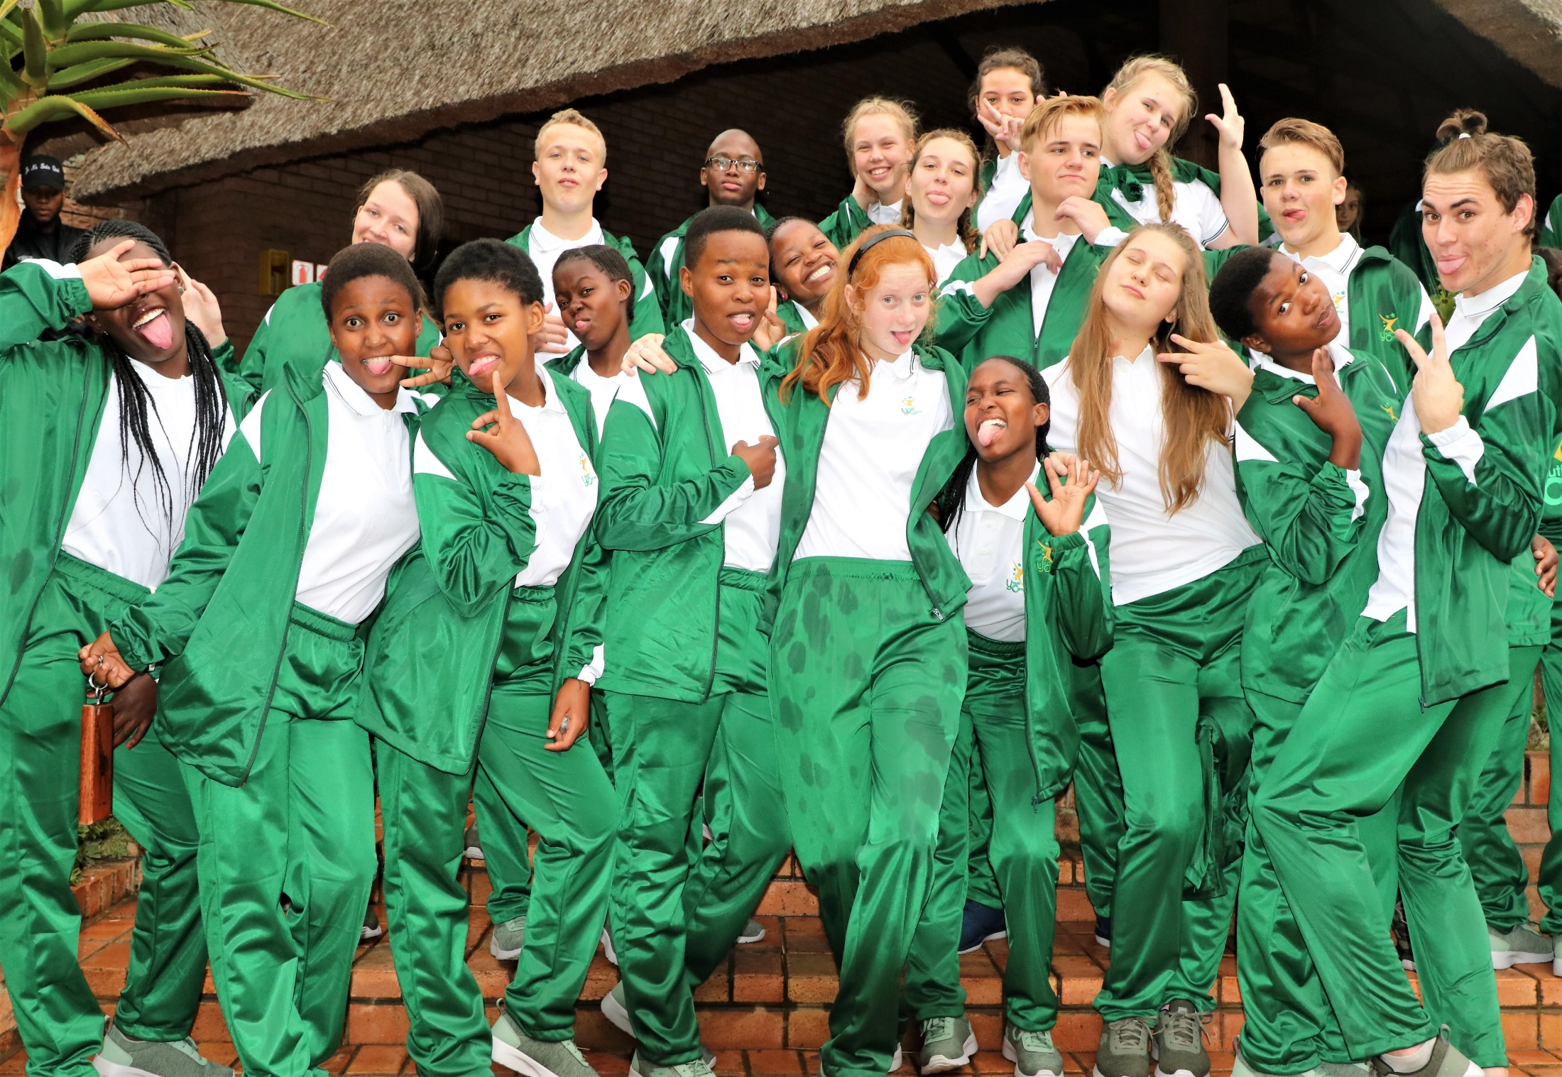

Slide 11
Community Sport/Active Recreation
Output/Outcome | Position loveLife Y-Centres as sport and recreation hubs where young people are exposed various activities to encourage physical activity as well as life-skills
Activities | Run recreational leagues at community level to increase physical activity among young people through continuous regular play Host FitDayz at Y-Centres and hubs to encourage a culture of physical activity and mass participation. To take the #iChoose2BActive message down to community level Host community level National Recreation and Big Walk events on the same day as the National and Provincial events to encourage mass participation and to take government initiatives to community level. Host edutainment activities at the National Indigenous Games Festival through an MYC activation and activities at the Kiddies Corner At National events, namely; National Recreation Day, The Big Walk and International Move for Health Day loveLife hosts activities that promote physical activities at an MYC activation and/or at the designated kiddies corner
Notes:
Recreational leagues also help groundBREAKERs identify talent and refer talented young people to clubs affiliated to the Club development with in SRSA

Slide 12
Community Sport/Active Recreation cont.
Output/Outcome | Position loveLife Y-Centres as sport and recreation hubs where young people are exposed various activities to encourage physical activity as well as life-skills
Activities | Host Sport for Social Change and Development initiatives and events to promote sport and active recreation as well as foster social cohesion within communities. This loveLife does through various ways: - run intra and inter school leagues at schools that are not part of the School Sport programme including those in rural areas that are not part of the Rural Sport Programme - groundBREAKERs run Sport4Change events at community level. These are events that use sport as a way to raise awareness and get communities to talk about difficult issues that face young people and prevent them from having healthy childhoods which include being part of a sports team or playing recreationally. Some topics inc. “Say no to Drugs”, “Get our community Gang-free”, “Not in My Name – stand up against GBV” “xeNOphobia” Host move4Life events. These events encourage physical activity to combat obesity and non-communicable diseases. groundBREAKERs bring in other stakeholders to take blood pressure, measure MBI, speak on diet and other topics related to a heathy wellbeing
Notes:
Recreational leagues also help groundBREAKERs identify talent and refer talented young people to clubs affiliated to the Club development with in SRSA

Slide 13
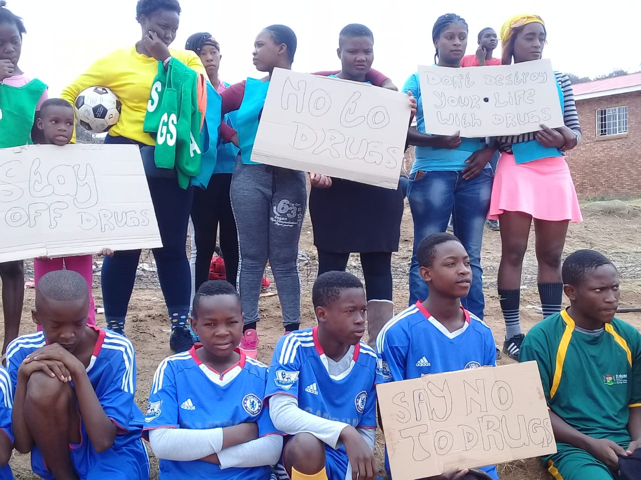
Community Sport/Active Recreation cont.
Notes:
Recreational leagues also help groundBREAKERs identify talent and refer talented young people to clubs affiliated to the Club development with in SRSA

Slide 14
Community Sport/Active Recreation cont.
Output/Outcome | Position loveLife Y-Centres as sport and recreation hubs where young people are exposed various activities to encourage physical activity as well as life-skills
Activities | Host move4Life events. These events encourage physical activity to combat obesity and non-communicable diseases. groundBREAKERs bring in other stakeholders to take blood pressure, measure MBI, speak on diet and other topics related to a heathy wellbeing. groundBREAKERs also give health talks encouraging young people to make use of health facilities and give them knowledge around the importance of taking care of ones physical and emotional wellbeing. Through these events groundBREAKERs encourage young people to make exercise a part of their daily routine and encourage them to use what they have as part of their exercise routine for example, putting sand into empty plastic bottles to be used for resistance training.
Notes:
Recreational leagues also help groundBREAKERs identify talent and refer talented young people to clubs affiliated to the Club development with in SRSA

Slide 15
Performance

Slide 16
groundBREAKERs based in rural areas
Province | Number or rural based gBs | Gender |  | Race
 |  | Male | Female
Eastern Cape | 13 | 8 | 5 | 2 Coloured, 11 Black
Free State | 5 | 3 | 2 | 5 Black
Gauteng | 7 | 4 | 3 | 1 Coloured, 6 Black
KwaZulu Natal | 42 | 18 | 24 | 42 Black
Limpopo | 11 | 5 | 6 | 11 Black
Mpumalanga | 4 | 1 | 3 | 4 Black
North West | 3 | 0 | 3 | 3 Black
Northern Cape | 1 | 0 | 1 | 1 Black
Western Cape | 9 | 4 | 5 | 4 Coloured, 5 Black
Total | 86 | 39 | 47
Notes:
A team is not a group of people who work together it is a group of people who trust each other

Slide 17
love4Life Challenge Participation
Province | Y-Centre | Total Participants per province
Eastern Cape | Buffalo City | 108 593
 | KwaNobuhle
 | Mthatha
Free State | Botshabelo | 59 078
Gauteng | Mamelodi | 132 900
 | Jozi Metro
 | Orange Farm
KwaZulu-Natal | Ethekwini Metro | 133 916
 | Mandeni
Limpopo | Lenyenye | 121 265
Mpumalanga | Acornhoek | 118 172
 | Emalahleni
North West | North West | 105 584
Northern Cape | Kimberley | 59 384
Western Cape | Langa | 124 123
 | Grand Total | 963 015

Slide 18
Athlete Tracking

Slide 19
Recreation leagues
Province | Y-Centre | Total Participants per province from a total of 3 376 leagues run
Eastern Cape | Buffalo City | 17 783
 | KwaNobuhle
 | Mthatha
Free State | Botshabelo | 11 133
Gauteng | Mamelodi | 39 488
 | Jozi Metro
 | Orange Farm
KwaZulu-Natal | Ethekwini Metro | 42 218
 | Mandeni
Limpopo | Lenyenye | 37 444
Mpumalanga | Acornhoek | 18 759
 | Emalahleni
North West | North West | 9 829
Northern Cape | Kimberley | 5 917
Western Cape | Langa | 14 553
 | Grand Total | 197 124

Slide 20
move4Life participation
Province | Y-Centre | Total Participants per province
Eastern Cape | Buffalo City | 5 385
 | KwaNobuhle
 | Mthatha
Free State | Botshabelo | 4 744
Gauteng | Mamelodi | 10 947
 | Jozi Metro
 | Orange Farm
KwaZulu-Natal | Ethekwini Metro | 9 151
 | Mandeni
Limpopo | Lenyenye | 7 719
Mpumalanga | Acornhoek | 3 157
 | Emalahleni
North West | North West | 5 821
Northern Cape | Kimberley | 2 744
Western Cape | Langa | 3 735
 | Grand Total | 52 903

Slide 21
sport4Change events
Province | Y-Centre | Total Participants per province
Eastern Cape | Buffalo City | 31
 | KwaNobuhle
 | Mthatha
Free State | Botshabelo | 16
Gauteng | Mamelodi | 46
 | Jozi Metro
 | Orange Farm
KwaZulu-Natal | Ethekwini Metro | 39
 | Mandeni
Limpopo | Lenyenye | 20
Mpumalanga | Acornhoek | 14
 | Emalahleni
North West | North West | 20
Northern Cape | Kimberley | 16
Western Cape | Langa | 23
 | Grand Total | 225

Slide 22
Coach4Life training
Coach type | Number of coaches | Total no. of coaches
School Sport coaches | 318 | 1 178 coaches
Community Coaches | 507
groundBREAKER coaches | 25

Slide 23
Future plans/discussions with the Department

Slide 24
Extended scope of work for loveLife to include programmes that speak to Arts and Culture. This could include the loveLife Media Ys programme which teaches young people to be citizen journalists capturing various activities in the community and editing the footage into a complete documentary.
Incorporate the department’s Artists in School programme objectives into the groundBREAKER programme offering so as to strengthen this initiative

Slide 25
Conclusion

Slide 26
loveLife, through it’s nation-wide footprint, assists the department to take its programmes and initiatives down to community level
The partnership allows 219 young people a year to give back to their community while at the same time gain skills that increase their employability
young lives are changed for the better every day as groundBREAKERs teach a message of the combine the importance of physical activity and nutrition for a healthy life
The partnership helps the nation takes steps towards responding to, and ultimately the success of the National Development Plan, the Sport and Recreation Plan, the UN Sustainability Goals as well as the 90-90-90 Strategy for the fight against HIV

Slide 27
Financials

Slide 28
2018 Financials
loveLife is funded mainly by the two government departments i.e. DSR and DOH
A total of R34,172,000 is recorded in the financials as being received from SRSA
The loveLife financial year is Jan-Dec while government fiscal is April-March
At least 83% of the grant amount received from DSR was spent on programmatic activities

Slide 29
Grant relocation
Grant Income reconciliation for 2017
 | Amount in ZAR | Amount in ZAR
2016/17 Contract per DSR | 38,500,000
2016 portion(25%; Q4) |  | 9,625,000
2017/18 Contract per DSR | 40,433,000
2017 portion(75%; Q1,Q2 and Q3) |  | 30,324,750
Grant Income per loveLife financials |  | 39,949,750
Grant Income reconciliation for 2018
 | Amount in ZAR | Amount in ZAR
2017/18 Contract per DSR | 40,433,000
2018 portion(25%;Q4) |  | 10,108,250
2018/19 Contract per DSR | 32,085,000
2018 portion(75%;Q1,Q2and Q3) |  | 24,063,750
Grant Income per loveLife financials |  | 34,172,000

Slide 30
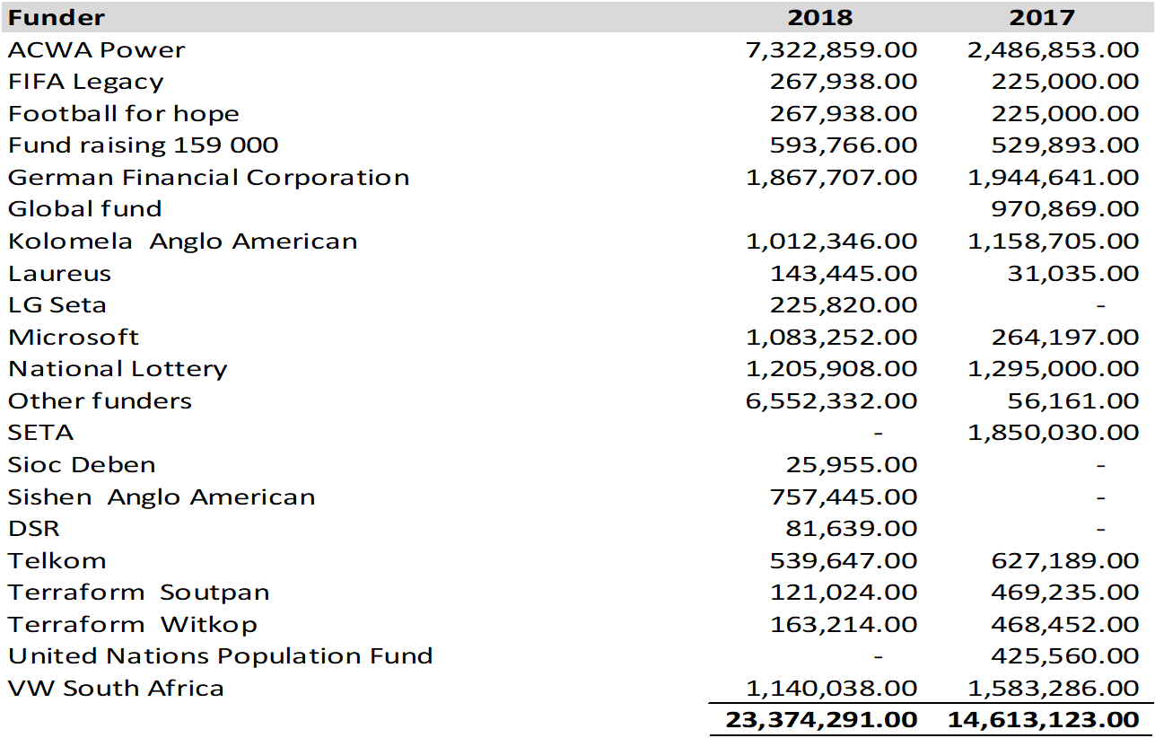
Other funders

Slide 31
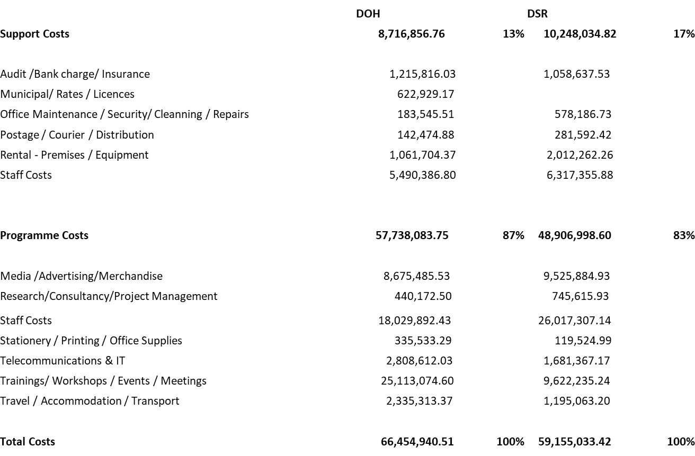
Expenditure Jan-Dec 2018

Slide 32
Thank you
Tel: +27 (0)11 523 1000, Fax: +27 (0)11 523 1001
Address: 48 Wierda rd west, Wierda valley, Sandton,
2196, PO box 45, Parklands, 2121, South Africa
talk@lovelife.org.za
Website: www.lovelife.org.za

