Slide 1
ARMSCOR’s PERSPECTIVE OF CHALLENGES IN DEFENCE INDUSTRY PCDMV

Slide 2
Challenges faced by Defence Industry
Challenging tendering process (Lack of understanding & Change in legislation)
Under Performance of Defence Industry
Reduction of Defence Budget
Under utilisation and subsequent loss of development expertise in industry.
Loss of competitive edge by industry, due to no new or modernised products to market
Decline in production capacity of industry, as a result of under utilisation.
Increasing number of no-bids
Delays in timeous contracting, as a result of repeated Requests for Bid
Delays in commitment of SANDF funds, resulting in increased risk of losing budgeted funds
Going through learning curve of manufacturing
Delays in delivery of contracted goods/services to the SANDF
Reduced cash flow per annum

Slide 3
Impact of budget reduction
A small percentage of local companies providing sovereign or strategic capabilities are facing a high risk of unsustainability in the near-term.
A noteworthy percentage of funds is exported to foreign suppliers.
The cost of (imported) maintenance increases.
The local industry order book continues to reduce.
Given the aforementioned – urgent and focused intervention is required
Confidential

Slide 4
Acquisition Budget Trend
*
Note * : Operating budget only allocated during in-year. Not allocated for 20/21 and 21/22
Confidential

Slide 5
Projects before and after budgets cuts
Confidential

Slide 6
Trend In Active Projects per annum
Note : Number of active projects per annum, includes
projects that rolled from previous years
Confidential

Slide 7
MAIN CATEGORIES OF DEFENCE INDUSTRY
R&D
Manufacturing
Maintenance &
Support
Mainly Armscor & CSIR
Mainly DENEL
Mainly DENEL & Industry

Slide 8
Denel
Denel primarily is an integrator or main contractor of subsystems sourced from the broader industry.
Challenges experienced by Denel, is having a negative ripple effect throughout industry – resulting in a large number of small but highly specialised local suppliers experiencing significant financial distress – and the demise of some.
Denel cash flow challenges resulting in –
In some instances to virtually no performance against capital projects
Loss of technical capability and capacity – resulting in diminished ability to meet future requirements of the SANDF.
Non-payment of subcontractors – placing numerous subcontractors in financial distress
Confidential

Slide 9
Delays in Contracting Industry
Armscor is experiencing increased number of failed bids by industry, resulting in repeated cycles of Request for Bid – causing delays in contracting.
No-bids are caused by :
Increased regulatory/compliance/transformation requirements - making compliance to critical criteria more complex and stringent
Non-diligence by industry in completing Bid documentation – resulting in exclusion from being evaluated
Compliance Requirements (e.g. tax compliance) is resulting in significantly higher rate of non-approval and non-placement of contracts within allocated time
Industry not meeting set Pre-Qualifying criteria (e.g. required BBBEE Levels) as required in Request for Bid documents.
All these challenges are attended by a programme of industry workshops and supplier days.
Confidential

Slide 10
Under-performance by Industry
General loss of capacity in industry as a result of reduced DOD spend
Increased focus on export contracts with stringent timescales and penalties – resulting in delays in execution of Armscor contracts
Reduction in DOD Capital Budget is resulting in no new development projects- will result in industry losing competitive edge in the international marketplace
New entrants in Defence Industry tend to underestimate the complexity of DOD requirements, resulting in :
Under estimation of cost and time to execute contracted requirements
Delays in meeting contractual timescales
Financial challenges due to reduced cashflow.
Industry attempts to maximise order book, is resulting in insufficient capacity to timeously execute contracted requirements.
Confidential

Slide 11
Defence Industry Analysis Context (1/2)
Information from Armscor database:
303 companies analysed
7 Foreign owned locally based
33 Foreign owned
21 SOE (State Owned Entities or Divisions)
242 Local
Confidential

Slide 12
Defence Industry Analysis Context (2/2)
13 –companies supplying sovereign capabilities
27 – companies supplying strategic capabilities companies
26 companies highly dependent on DOD Funding
7 supplying sovereign capabilities
7 supplying strategic capabilities
Sovereign is the ability to ensure, under full national control and without reliance on any direct foreign assistance, certain capabilities identified as vital to national security
Strategic independence means the ability of the Defence Force to perform its key functions for extended periods without reliance on direct foreign support in respect of critical capabilities
*Definitions of Sovereign and Strategic broadly used
Confidential

Slide 13
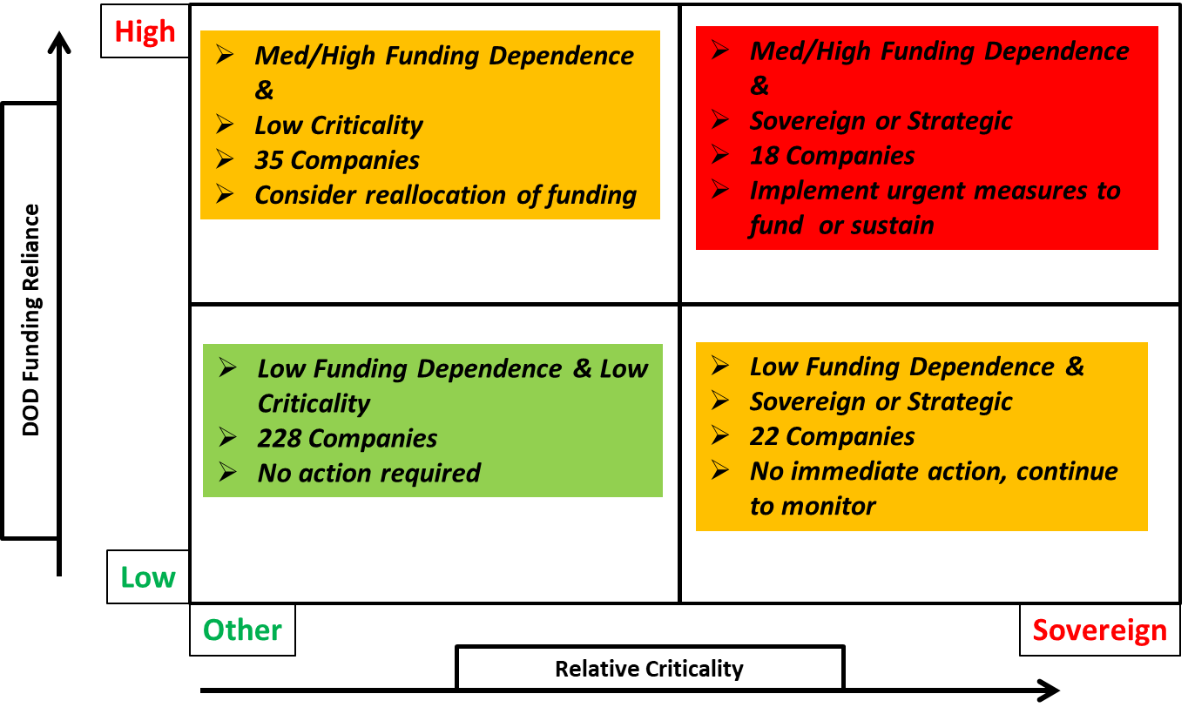
Integrated Relative Important Index
Confidential

Slide 14
Conclusion
PCDMV to take note of the severe impact of the reduction in Defence spend on defence industry. The reduction in Defence Spend is resulting in :
Loss of skills and jobs
Strategic capabilities were created at significant cost, and will not be resurrected without a massive investment
Reduction in competitive edge of local industry
Loss of critical capabilities of SANDF due to:
Obsolete and technologically aged equipment
Inability to properly maintain critical systems (aircraft, vehicles, etc)
Loss of technological competitive edge – force multiplier
Confidential

Slide 15
Conclusion …
Confidential
Optimise DoD funding across operating, capital and technology to provide short to medium term financial support
Obtain Government intervention to fund distressed companies providing sovereign or strategic capabilities
Develop Inter-departmental initiatives through NDIC e.g. alternative funding
Direct strategic initiatives:
SADI restructuring / consolidation,
Export driven focus,
Partnering with other industry players, etc.
Confidential

Slide 16
Questions ?

