Slide 1
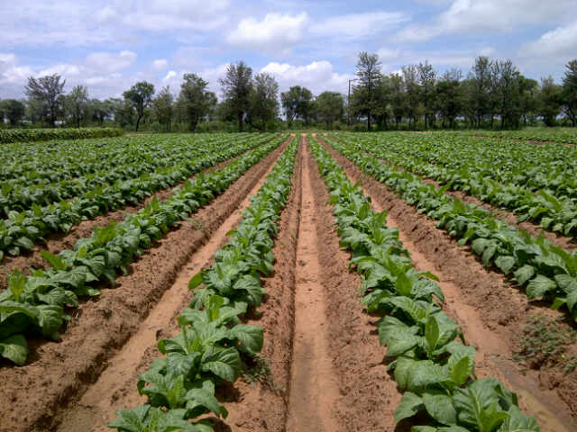
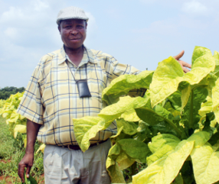
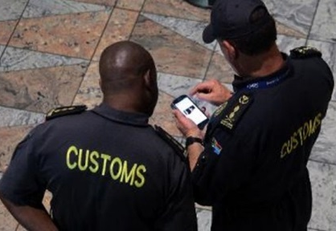
Presentation to Standing and Select Committees on Finance
Parliament, 06 November 2019

Slide 2
TISA Scope and Mandate
TISA is the industry body for the legal tobacco sector in SA; mandate extends into the South Africa Customs Union (SACU) region.
TISA represents farmers, leaf processors, leaf merchants, manufacturers, importers and exporters of all tobacco products; in the legally compliant industry. Clear distinction between legal and illegal industry.
Strategic objectives:
Regulation (secure a reasonable regulatory framework for the sector)
Illicit Trade (strategy to bring down illicit rates in cooperation with Govt)
To ensure the sustainability of tobacco sector, including farmers.
TISA believes in public/private partnerships to achieve objectives for the Govt (NDP), the sector and SA Pty Ltd, on the basis of trust, mutual respect and good relationships.

Slide 3
TISA calls for a Cigarette Excise Duty Freeze – why?
In 2018, Ipsos study found that 42% of informal market is illicit.
Total consumption in SA is between 31 and 35 billion cigarettes per year. Tax paid on only 17-19 bn cigarettes, leaves a gap of at least 12 bn cigarettes, costing the fiscus more than R11bn.
Generally accepted world-wide: Direct link between higher taxes (higher prices) and illicit trade - incentive to make money, if taxes are avoided.
Excise on cigarettes increased in SA from R4.53 in 2004 to R16.66 in 2019, 267% or average of 17.85% p.a.
A price of R35 per legal pack of cigarettes, represents R21.22 or 60% in taxes. Price of R40 means R21.87 in taxes or 54.6%.

Slide 4
TISA calls for a Cigarette Excise Duty Freeze – why?
Because of price elasticity on cigarettes, consumers could absorb higher than inflation increases every year, but it has reached a peak. Consumers reverting to cheap illicit products where no taxes are paid.
Legal industry has shrunk more than 22% in past 3 years, paying less taxes, shedding jobs, farmers producing 15% less with job losses in rural areas.
Any further increases in excise will result in even larger differential between tax paid and illicit products, with further decline in income for the state and decimation of the legal industry.
SA has the potential for total market to be supplied by illicit players, with little/no income to the fiscus, loss of a legal industry contributing to SA, and total consumption of cheap, unregulated, illicit products.
Logic arguments and the numbers tell us that excise should be lowered or kept at current levels for at least 3 years or until enforcement has caught up and all cigarettes in the market are tax paid.

Slide 5
MTBPS 2019 - Revenue Shortfall Concern
The Medium Term Budget Policy Statement (MTBPS) 2019 projects a year-on-year increase in revenue shortfall.
Shortfall for 2019/2020 tax year alone is R 52.5 billion.
Medium to long term turn-around strategies to rebuild SARS and other government institutions are applauded – but, we also need short term solutions to contain losses to the fiscus and protect legal Business.
In the context of a growing revenue shortfall, TISA would like to address responses from National Treasury/SARS on TISA comments made at the September hearings to Honourable Members of the Finance Committees.

Slide 6
Addressing National Treasury/SARS responses to TISA proposals
In September, TISA requested and motivated for an excise duty freeze on cigarettes, for a period of three years, or at least until the illicit cigarette trade is drastically reduced.
Treasury/SARS responded that excise duty increases are not responsible for the growth in illicit trade in tobacco products, but “rather due to a lack of legal enforcement and the criminal nature of the activities”.
While TISA fully supports the need for well-resourced, effective and consistent enforcement, it will take time for SARS and other law enforcement agencies to rebuild and strengthen their enforcement and prosecuting capacities. In the meantime, the bucket is leaking billions, so we can’t wait for enforcement alone.
There is no silver bullet to solve the illicit trade in tobacco products. Effective enforcement is an essential tool to address the illicit tobacco trade, but equally important is a reasonable and stable tax regime to ensure optimal revenue collection.

Slide 7
Addressing National Treasury/SARS responses to TISA proposals
Treasury/SARS noted that their current tobacco excise policy “uses the targeted incidence approach that is set at 40% of the retail selling price of the most popular brand within each product category”.
TISA would like to bring to the attention of Honourable Members, the Honourable Minister of Finance, National Treasury and SARS, that the tax incidence on cigarettes has exceeded the 40% mark. The tax incidence on the most popular price class of cigarettes is currently 43.3% which is in breach of NT’s own policy.
TISA therefore respectfully calls on the Honourable Minister of Finance to bring the excise tax rates on cigarettes back in line with the 40% targeted incidence and in line with National Treasury’s own policy, and also in line with other tobacco product categories.

Slide 8
Conclusion
TISA firmly believes that correcting the excise rate level of cigarettes together with an excise duty freeze for a period of at least three years, while enforcement capacity is being strengthened, will lead to SARS collecting more revenue in the form of taxes.
TISA remains willing to discuss these matters further with National Treasury and SARS and we remain committed to working with SARS and other law enforcement agencies in public/private partnerships to combat the illicit trade in tobacco and tobacco products.

Slide 9
Thank you.

