Slide 1

Portfolio Committee on Trade and Industry
_________________
Presentation on the NLC’s Integrated Report for
2018/19 and Second Quarter Performance Report

Slide 2
OUTLINE OF PRESENTATION
Key Highlights of the NLC
Mandate of the NLC
Strategic Overview of the NLC
Business Model
Operations Overview of the NLC
Impact on Communities
Performance 2018/19
    Performance of the Licence
    Financial Performance
Challenges and How Managed
AGSA Findings and Plan of Action

Slide 3
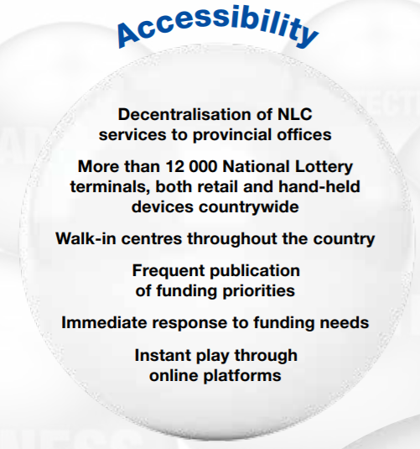
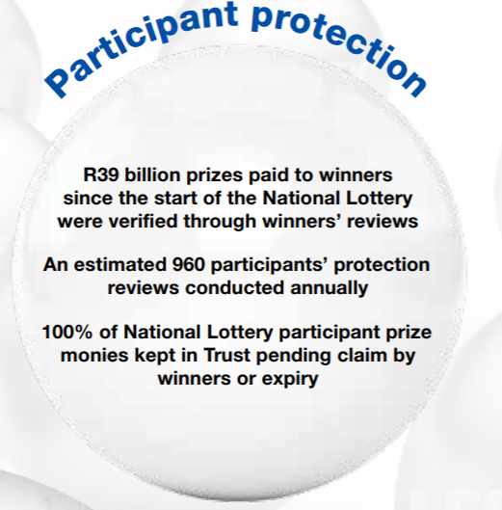
KEY HIGHLIGHTS & IMPACT ON COMMUNITIES
3

Slide 4
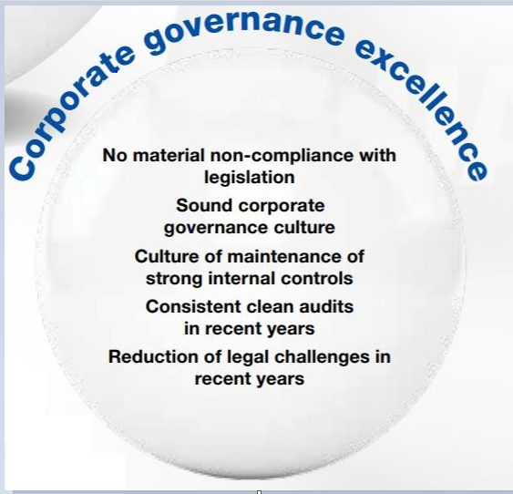
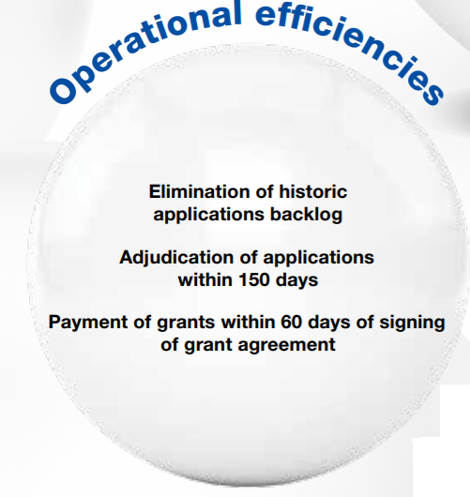
KEY HIGHLIGHTS & IMPACT ON COMMUNITIES
4

Slide 5
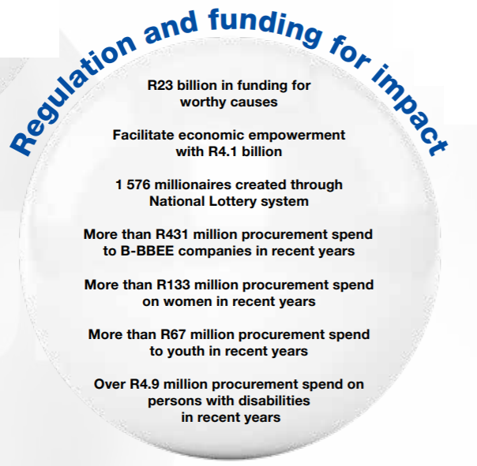
KEY HIGHLIGHTS & IMPACT ON COMMUNITIES
5

Slide 6
WHAT WE DO AND WHO WE SERVE
The NLC is the sole regulator for Lotteries and Sports Pools in South Africa. The NLC is also the largest grant funder reaching up to 3 418 beneficiaries countrywide during the period under review.
Constitutional Mandate
The NLC has the sole mandate to regulate and prohibit lotteries and sports pools and to provide for matters connected therewith.
Legislative mandate
To ensure that the National Lottery and Sports Pools are conducted with all due propriety and strictly in accordance with the Constitution, this Act, all other applicable law and the licence for the National Lottery, together with any agreement pertaining to that licence and that the interests of every participant in the National Lottery are adequately protected.
Conduct research on worthy good causes that may be funded without lodging an application prescribed in terms of the Lotteries Act, upon request by the Minister, Board or on its own initiative in consultation with the Board.
Invite applications for grants from worthy good causes in the prescribed manner.
Promote public knowledge and awareness by developing and implementing educational and informational measures to educate the public about the lotteries and provisions of the Lotteries Act, as amended, and educating the public by explaining the process, requirements and qualifications relating to the application for grants in terms of this Act.
Manage staff and its financial, administrative and clerical functions and exercise any other function as delegated or directed by the Minister or the Board.

Slide 7
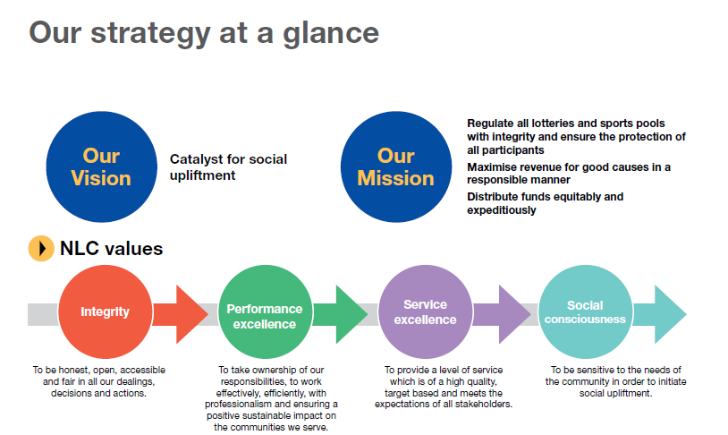
STRATEGIC OVERVIEW

Slide 8
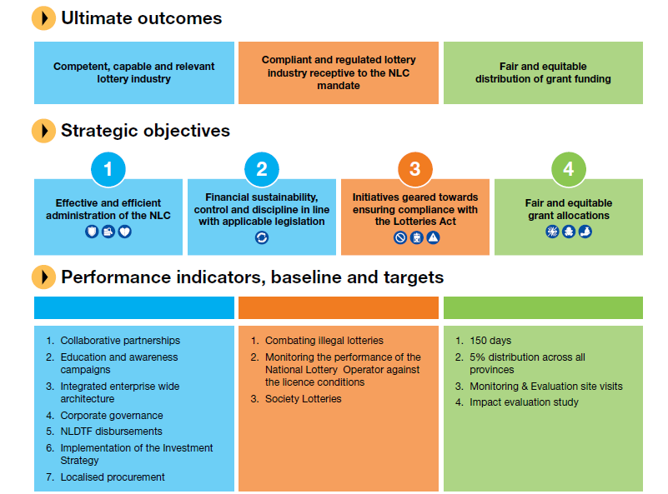
STRATEGIC OVERVIEW

Slide 9
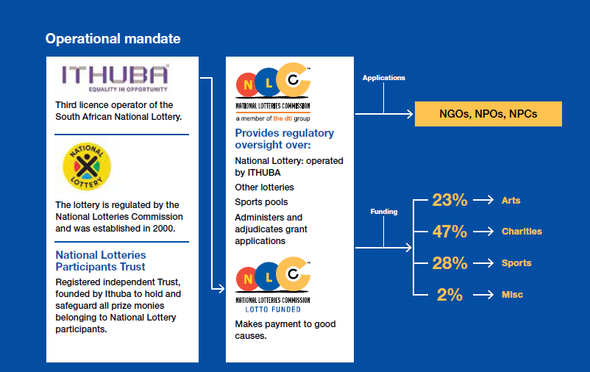
OPERATIONAL MANDATE

Slide 10
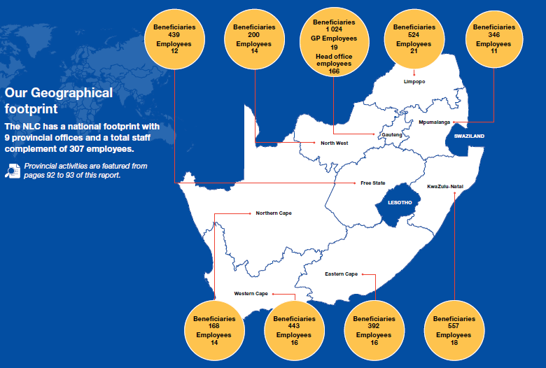
GEOGRAPHICAL FOOTPRINT

Slide 11
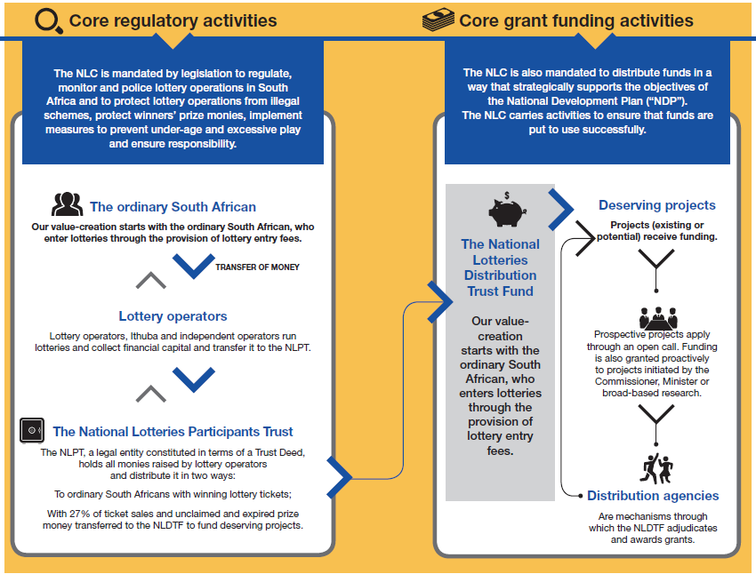
NLC BUSINESS MODEL

Slide 12
NLC BUSINESS MODEL
12

Slide 13
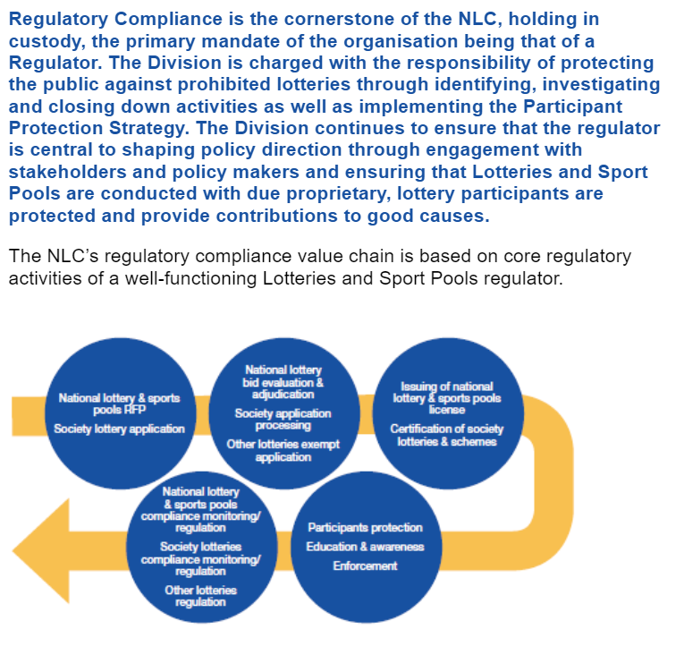
OPERATIONS OVERVIEW

Slide 14
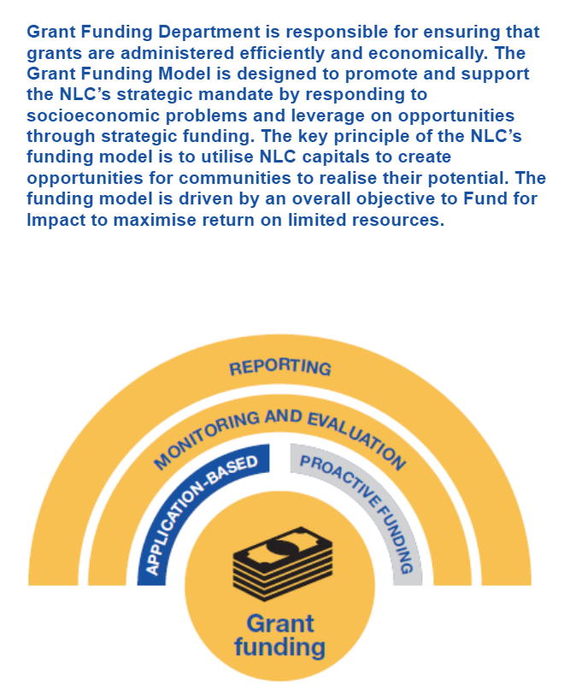
OPERATIONS OVERVIEW

Slide 15
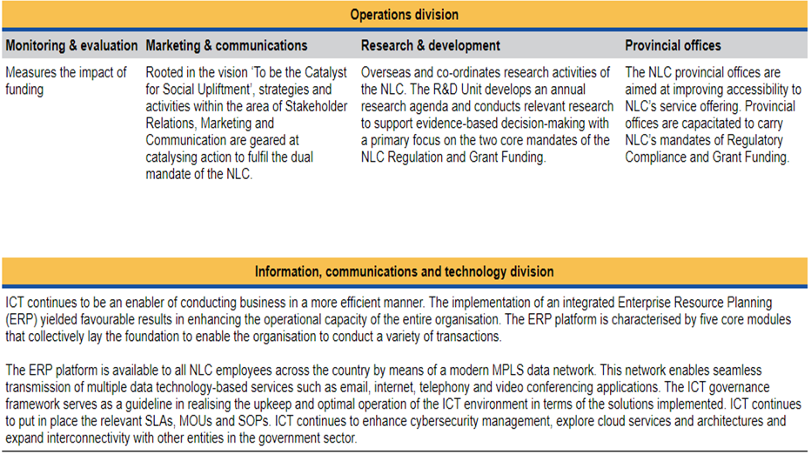
OPERATIONS OVERVIEW

Slide 16
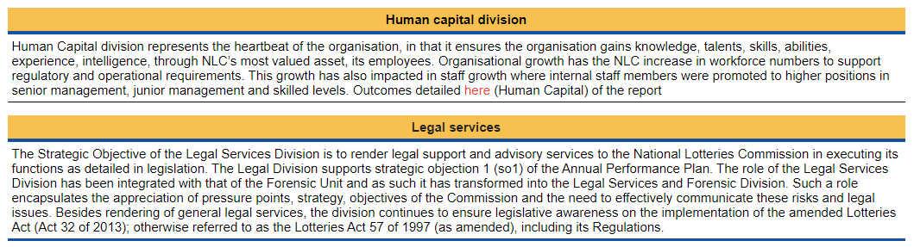
OPERATIONS OVERVIEW

Slide 17
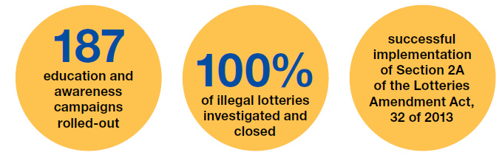
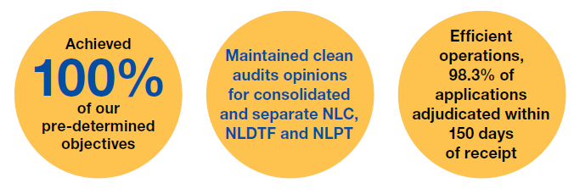
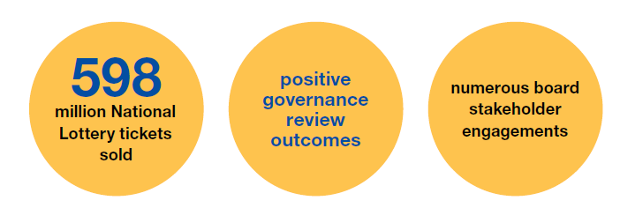
PERFORMANCE INFORMATION
The NLC achieved 100% performance against its predetermined objectives and targets for the past 5 years. No corrective actions were identified.

Slide 18
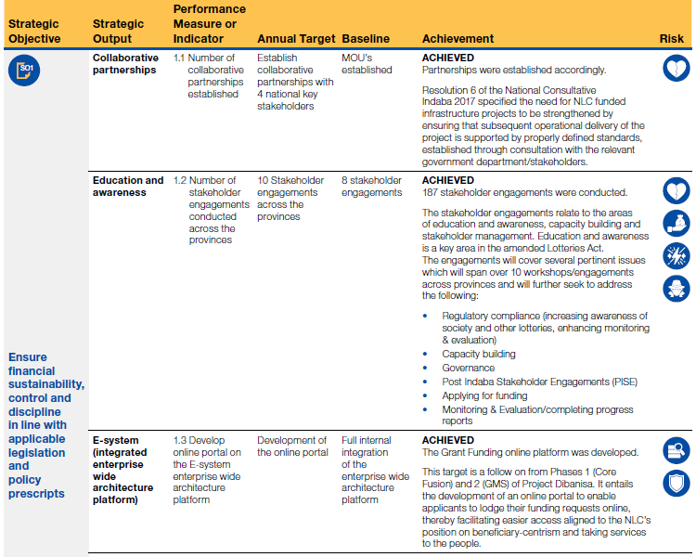
PERFORMANCE INFORMATION
18

Slide 19
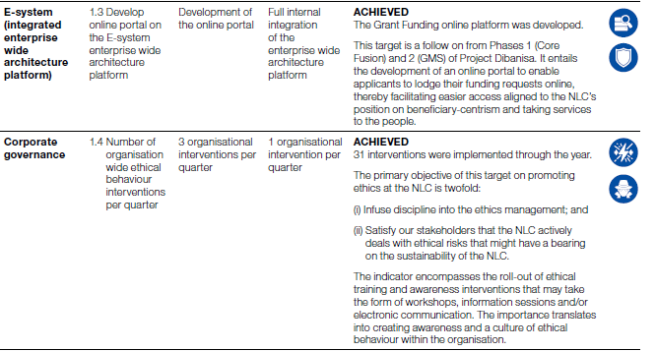
PERFORMANCE INFORMATION

Slide 20
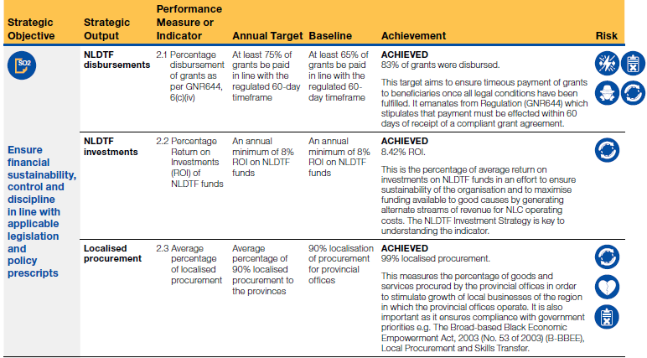
PERFORMANCE INFORMATION
20

Slide 21
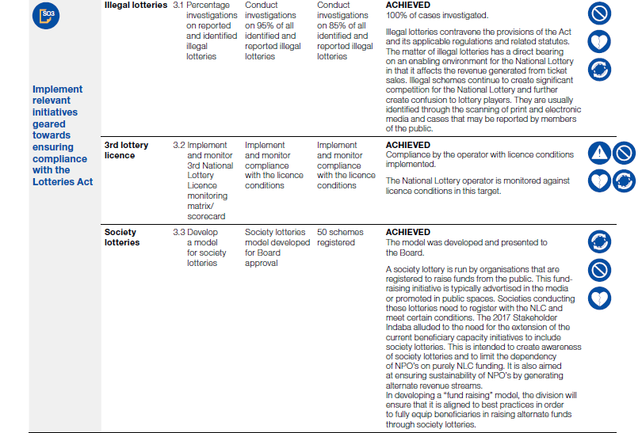
PERFORMANCE INFORMATION
21

Slide 22
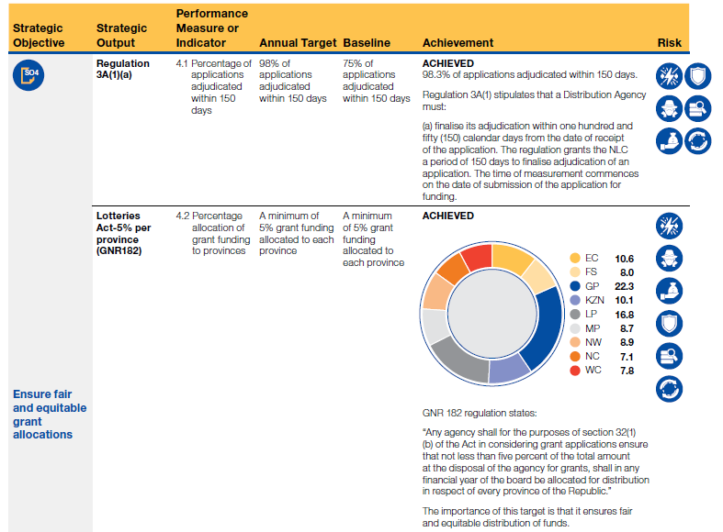
PERFORMANCE INFORMATION
22

Slide 23
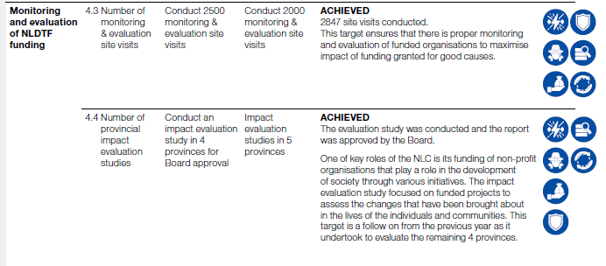
PERFORMANCE INFORMATION

Slide 24
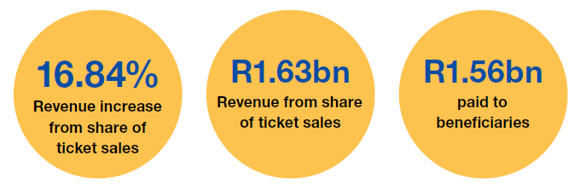
FINANCIAL INFORMATION
The NLC once again received clean audit opinions from the Auditor General for the Consolidated financial statements of the NLC and separate financial statements of the NLC, NLDTF and NLPT.

Slide 25
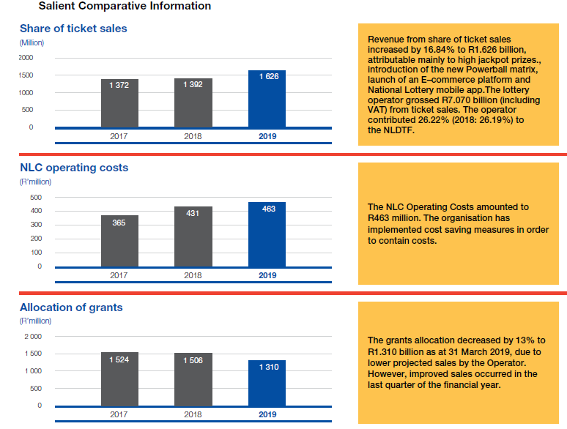
FINANCIAL INFORMATION

Slide 26
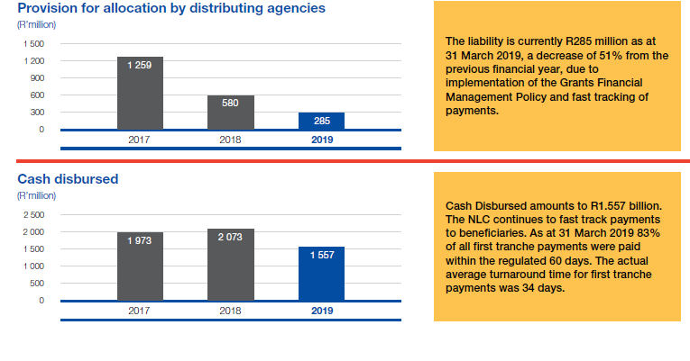
FINANCIAL INFORMATION

Slide 27
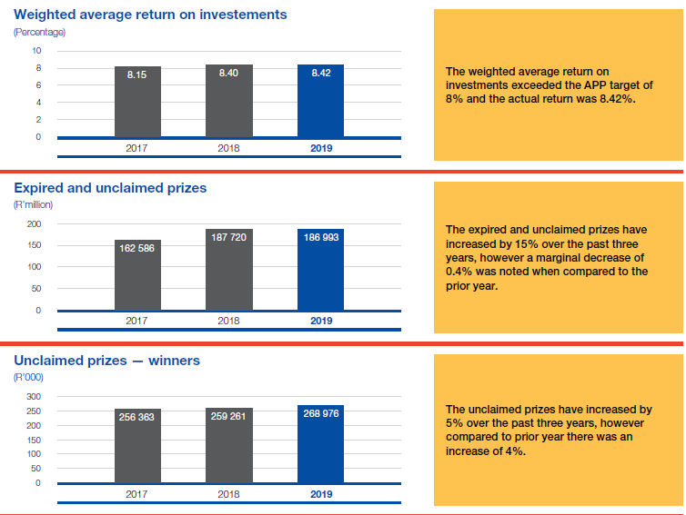
FINANCIAL INFORMATION

Slide 28
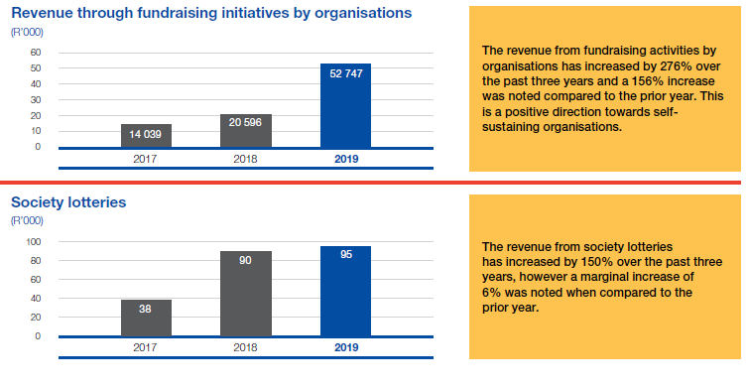
FINANCIAL INFORMATION

Slide 29
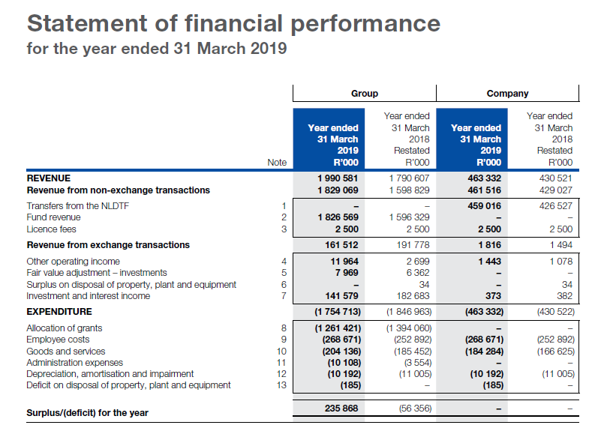
FINANCIAL INFORMATION
29

Slide 30
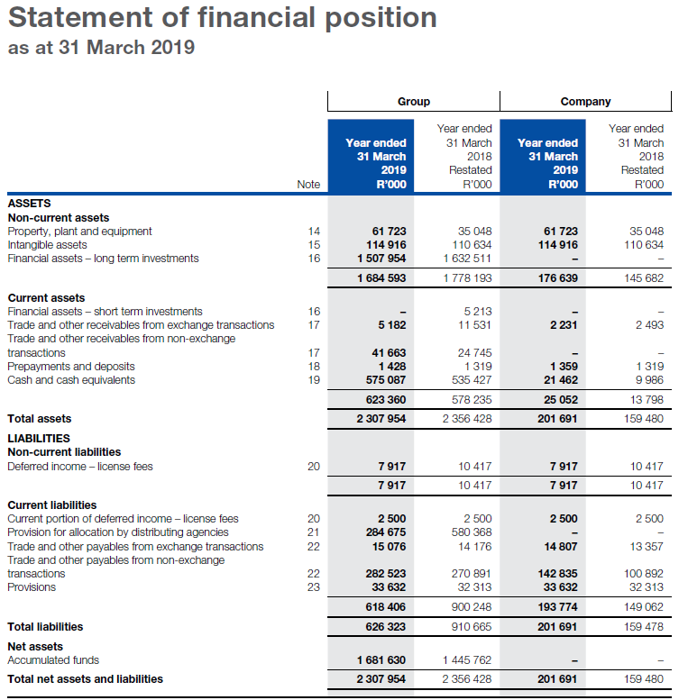
FINANCIAL INFORMATION
30

Slide 31
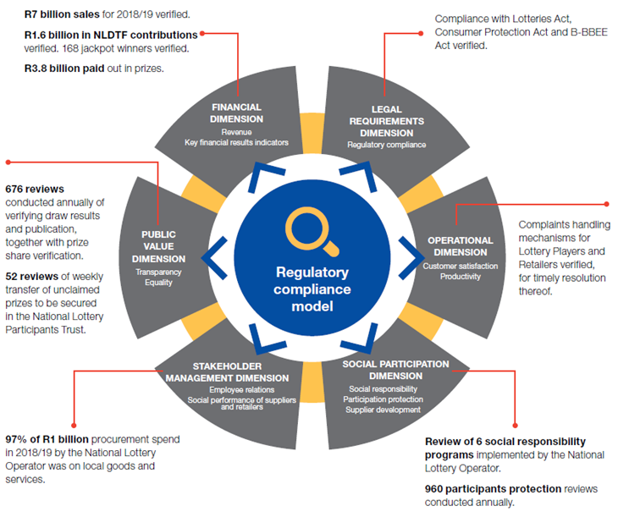
PERFORMANCE OF NATIONAL LOTTERY LICENCE
31

Slide 32
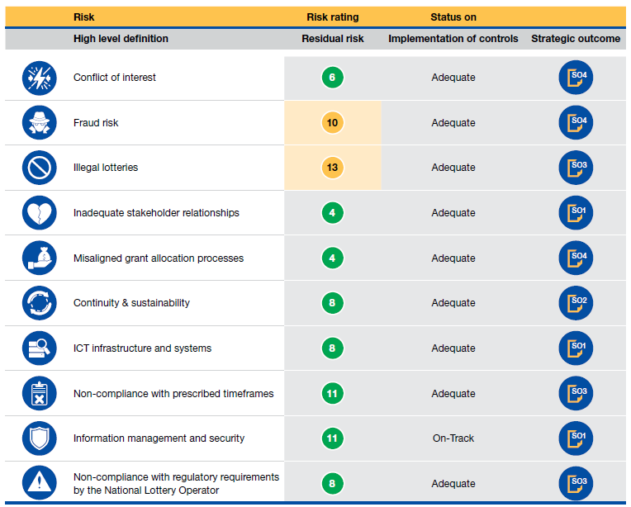
RISK MANAGEMENT

Slide 33
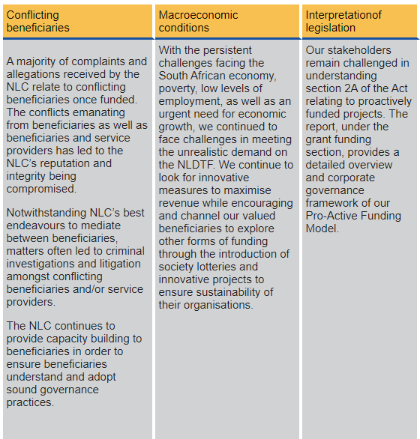
CHALLENGES

Slide 34
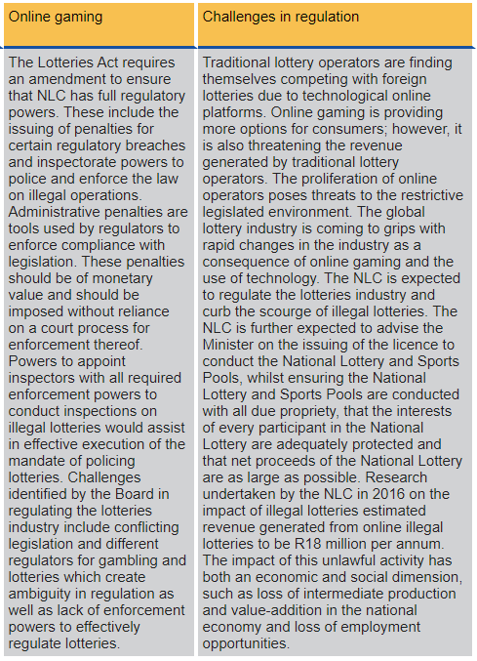
CHALLENGES

Slide 35
2018-19 AUDIT OUTCOMES
ENTITY | OUTCOME
National Lotteries Commission(NLC)- separate | Unqualified with no findings ( Clean Audit)
National Lotteries Commission (NLC) -Consolidated | Unqualified with no findings ( Clean Audit)
National Lottery Distribution Trust Fund (NLDTF) | Unqualified with no findings ( Clean Audit)
National Lotteries Participant’s Trust | Unqualified with no findings ( Clean Audit)
AGSA has noted that the overall audit outcome has remained clean as a result of having the right skills set in key management positions, a leadership that drives a culture of sound corporate governance and the maintenance of strong internal controls throughout the financial period.
No findings on the main compliance focus areas as well as audit of pre-determined objectives.
Quality of financial statements and performance was commended [there were no audit adjustments to the financial statements and the report on performance information].
35

Slide 36
2018-19 AUDIT OUTCOMES AND HIGHLIGHT
Concluded that the overall financial viability is of the NLC good.
All assurance service providers [Senior Management, Internal Audit, Audit Committee, Board, Minister]were assessed as having providing reasonable assurance (i.e. green).
36

Slide 37
HIGHLIGHTS FOR 2nd QUARTER 2019/20
NLC signed a Memorandum of Understanding (MOU) with the Department of Planning, Monitoring and Evaluation (DPME) to collaborate on inter alia, guiding funding to align with the priorities of government at planning sessions by providing updated information; coverage of NLC funded projects in government publications about service delivery and provision of information by the NLC to the DPME on funded projects to demonstrate NLC’s contribution to good causes in the country.
The NLC further identified the provincial gambling boards as a key stakeholder in addressing the growing scourge of illegal lotteries and gambling. To this end, meetings with nine (9) gambling boards (national and 8 provincial) were held to discuss amicable solutions on the matter.
In line with our responsibility to protect lottery participants and educate members of the public on lotteries, the NLC collaborated with the Gauteng, Eastern Cape, North West and Northern Cape provincial offices. A total of 7 workshops were conducted in the provinces.
37

Slide 38
PROGRESS ON MINISTERIAL PRIORITIES
IDENTIFIED AREA | PERFORMANCE MEASURE | PROGRESS TO DATE
Education and Awareness | Develop informational measures to educate the public about lotteries and provisions of the Lotteries Amendment Act No 32 of 2013 and by explaining the process, requirements and qualifications for grants | Education and awareness is been included in NLC Annual Performance Plan as a target and performance against that target is measured. Seventy-six education and awareness were held within the period under review.
Full-time Distributing Agencies | Manage the integration of full-time Distributing Agency (DA) members to improve the application process | The full time Distributing Agency (DA) function have been fully integrated into the Grant Funding value chain, furthermore the implementation of Standard Operating Procedure for the adjudication process clearly outlining the role and responsibilities of both administration and DA is monitored. The organisation is still awaiting the finalisation of the appointment of full time Sports and Recreation DA.
38

Slide 39
PROGRESS ON MINISTERIAL PRIORITIES
IDENTIFIED AREA | PERFORMANCE MEASURE | PROGRESS TO DATE
Illegal Lotteries | Monitoring and enforcement against illegal lottery operations | Regulating and policing of illegal lottery operations was conducted through investigating identified and reported illegal lotteries. 100% of identified illegal lotteries were investigated.
Proactive Funding | Proactive funding based on informed research for worthy causes that may be funded without lodging an application in terms of the Act | The revised pro-active funding policy and standard operating procedure are approved. Sixteen pro-active funding projects were approved in line with the revised policy. All pro-actively funded projects are closely monitored to ensure that the organization yields the envisaged return on investment.
Monitoring of the Operator | Monitoring of the Lotteries Operator to ensure that it complies with government priorities e.g The Broad Based Black Economic Empowerment Act, 2003 (No. 53 of 2003) (BBBEE), Local Procurement & Skills Transfer | Operator compliance against Licence requirements continued to be monitored in this Quarter through the six performance dimensions. Areas of non-compliance are communicated on a monthly basis to the Operator to ensure timeous corrective action.
Memorandum of Understanding (MOU’s) | MOU’s with other Regulatory Agencies and provincial counterparts in clamping down on illegal lotteries and gambling | MoU’s drafted for input for Free State, Western Cape, Eastern Cape, Kwa-Zulu Natal and Gauteng Gambling Boards.
39

Slide 40
LITIGATION MATTERS
CASES | STATUS
LottoStar | This is a matter initiated by the Commission enforcing provisions of the Lotteries Act No 57 of 1997 (as amended). The Company is a bookmaker and part of its business operations includes taking bets on the outcome of lottery results which is an offence in terms of the Act and the provisions of the Constitution (Schedule 4 – Act 108 of 1996). Their activities have a negative implication on the business interest of the operator as well. Case was heard on 13 December 2018. Judgement was delivered on 15 May 2019. The court decided that the Intergovernmental Relations Framework Act be fully exhausted before the matter is referred to court. Ithuba has filed an appeal. The NLC also filed an appeal on 06 June 2019. Still awaiting confirmation of court date.
40

Slide 41
SUMMARY OF INVESTIGATIONS
Cases Investigated | Total cases | Percentage
Closed Cases | 17 | 55%
Pending | 14 | 45%
Total Cases Investigated | 31 | 100%
41

Slide 42
LABOUR RELATIONS MATTERS
42

Slide 43
EMPLOYMENT WORKFORCE
NLC has a total staff complement of 277 permanent employees, with 33 fixed term employees (temporary contracts and internships). The entity has ensured equity throughout the workforce and has exceeded targets in most levels. Focus will be on ensuring equity in the senior management category which currently demonstrates a complement of 60% males and 40% females.
43

Slide 44
PEOPLE WITH DISABILITIES
The status illustrates a 4% staff complement comprising of people with disabilities.
44

Slide 45
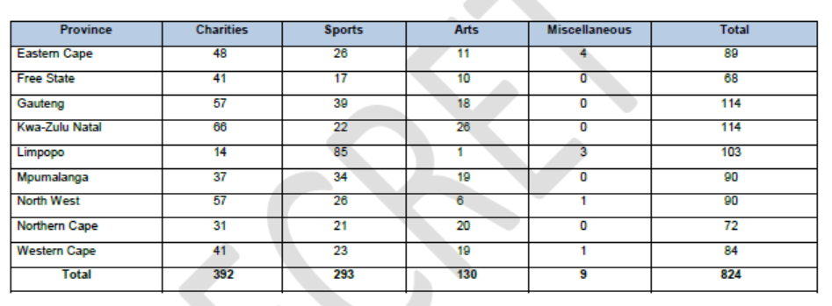
TOTAL NUMBER OF M&E VISITS
Total no of site visits conducted in the 2nd Quarter:
A total of 824 site visits were conducted during the quarter under review. The total number of site visits conducted includes both pre- adjudication and post- adjudication site-visits.
45

Slide 46
REVENUE
Revenue from share of ticket sales as at the end of quarter 2 2019 is R803.9 million (September 2018: R738.3 million) against a budget of R759.1 million. Revenue over-performed the budget by 5.86 as at 30 September 2019 as result of the rollover of the Powerball jackpot and the higher than expected daily lotto performance which boosted sales.
46

Slide 47
ALLOCATIONS PER PROVINCE
In terms of the Lotteries Act GNR 182, a minimum of 5% must be allocated to each province during the year. As at 30 September 2019, all provinces have achieved the second quarter target of 2%.
47

Slide 48
ORGANISATION PERFORMANCE
Target relates to: | Milestone for Quarter 2 | Achieved / Not Achieved
Strategic Objective 1: To Enhance Administration, Ensure Compliance with Applicable Legislation and Policy Prescripts
Position NLC as a Regulator | Implementation of the strategy | ACHIEVED The implementation was through radio campaign such as: SAFM, Kurara FM, Kaya FM; Power FM, Capricorn FM where NLC leadership was interviewed. NLC exhibited at the Gaming Regulators Africa Forum; placed adverts in Back to Basics Magazine and there were internal campaigns on 20 Years of NLC regulatory mandate.
Number of stakeholder engagements conducted per province | Conduct 12 education and awareness engagements across the provinces | ACHIEVED 76 education and awareness workshops conducted during the second quarter of 2019/20.
Integration of the E-system Enterprise Wide Architecture Platform – Online System | Development of regulatory functions on the ERP | ACHIEVED The Regulatory and Compliance handheld tool application was launched.
Governance, Organisational Compliance and Ethics | Roll out of 5 interventions | ACHIEVED The interventions were rolled out.
48

Slide 49
ORGANISATION PERFORMANCE
Target relates to: | Milestone for Quarter 2 | Achieved / Not Achieved
Strategic Objective 2: To ensure financial sustainability Control and Discipline in line with Applicable Legislation and Policy Prescripts
Percentage disbursement of grants as per GNR644, 6(c)(iv) | 60% disbursement of grants | ACHIEVED 95% disbursement of grants.
Percentage Return on Investments (ROI) of NLDTF funds | 8% Return on Investments | ACHIEVED 8.42% ROI.
Percentage of localised procurement for the provinces | 75% average procurement to the provinces | ACHIEVED 99% procurement to the provinces.
49

Slide 50
ORGANISATION PERFORMANCE
Target relates to: | Milestone for Quarter 2 | Achieved / Not Achieved
Strategic Objective 3: To Implement Relevant Initiatives Geared towards Ensuring Compliance with the Act
Percentage of investigations on reported and identified illegal lotteries | Conduct investigations on 75% of all identified and reported illegal lotteries | ACHIEVED 100% of identified and reported cases were investigated.
Implement and monitor 3rd National Lottery Licence Monitoring Matrix | Implement and Monitor Compliance with the licence conditions | ACHIEVED Implemented and monitored 3rd National Lottery Licence in line with the Monitoring Matrix/Scorecard.
Participant Protection Section 2(A)(b) | Implement program in 3 provinces | ACHIEVED 7 Participants Protection Programs were implemented in 4 provinces (Gauteng, Eastern Cape, North West and Northern Cape)
50

Slide 51
ORGANISATION PERFORMANCE
Target relates to: | Milestone for Quarter 2 | Achieved / Not Achieved
Strategic Objective 4: To Ensure Fair and Equitable Grant Allocations
Percentage of applications adjudicated within 150 days | 65% of applications adjudicated within 150 days | ACHIEVED All applications adjudicated.
Lotteries Act-5% per province (GNR182) (5% per province) | A minimum of 2% grant funding allocated to each Province | ACHIEVED EC 5,4% FS 6,0% GP 13,6% KZN 5,4% LP 7,7% MP 5,9% NW 4,6% NC 5,7% WC 4,6%
Number of impact assessments (site visits) conducted | Conduct 625 monitoring and evaluation site visits | ACHIEVED 824 visits conducted.
Provincial Infrastructure Impact Evaluation Study | Conduct Study | ACHIEVED Study Commenced.
Grant Funding Model | Submit 1st draft to Exco | ACHIEVED Report tabled at Exco
51

Slide 52
PROGRESS ON RISK REGISTER
Strategic Risk Register
The overall risk profile remains unchanged as compared to the prior quarter.
a) Residual Risk assessment: the degree of risk exposure remaining after consideration of mitigating efforts.
b) Mitigating effectiveness: Represents our current capability/effort to manage the risk’s likelihood and/or impact to within organisation’s risk appetite.
c) Risk (threat): Outlook indicates risk owner’s view about potential risk threats in the internal and/or external environment.
We have continued to monitor the strategic risks together with management and below is the NLC’s strategic risk profile.
The current strategic risk profile for the NLC is at a managed level. Control improvements are being implemented to ensure that these risks are mitigated to an acceptable level.
52

Slide 53
STRATEGIC RISK CONTINUES….
The NLC has committed to reposition as a regulator. We are in the process of reviewing the current strategic register to ensure the identification of risks and opportunities that may impact on the delivery of the repositioning mandate. We have continued to monitor the strategic risk register and the following are the top 4 strategic risks in the organisation. Control improvements that were identified by management are being implemented to ensure that these risks are mitigated to an acceptable level.
53

Slide 54
STRATEGIC RISK CONTINUES….
Top 4 Strategic Risks:
We have continued to monitor the strategic risk register and the following are the top 4 strategic risks in the organisation. Control improvements that were identified by management are being implemented to ensure that these risks are mitigated to an acceptable level.
Ref No | Risk Description | Residual Rating | Improvements
SR4 | Illegal Lotteries | 13 | Continuous monitoring by Regulatory compliance division.
SR5 | Inadequate stakeholder management | 10 | Continuous stakeholder engagement sessions were held during the quarter.
SR3 | Fraud risk | 10 | Fraud risks were monitored
SR13 | Non-compliance with regulatory requirements by National Lottery Operator. | 8 | Incidents of non-compliance by the operator were identified and reported through Regulatory Compliance Division.
54

Slide 55
2nd QUARTER ACHIEVEMENTS
Total No of Targets | Achieved | Not Achieved
15 | 15 | 0
 | 100% | %
100% Achievement of targets for the 2nd quarter of 2019/20.
55

Slide 56
Thank you

