Slide 1


FREE STATE PROVINCE PSSC
FREE STATE AGRI-PARKS PROGRESS REPORT
DATE: 29 OCTOBER 2019
Overview

Slide 2
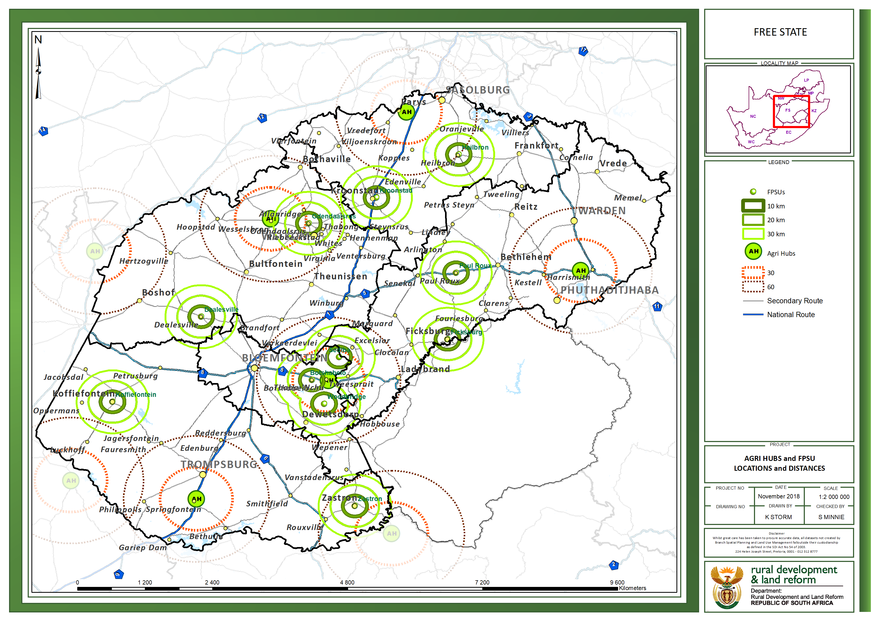

Slide 3
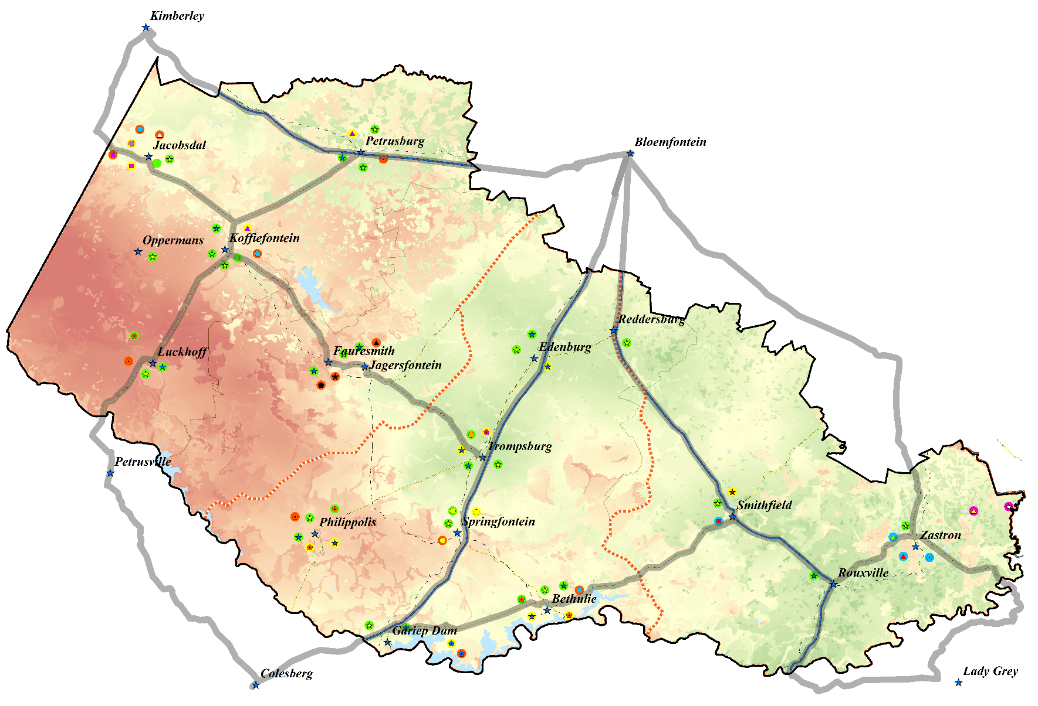
Xhariep Agri-park Progress Since SONA 2015
AgriHub Site Identification:
The Agri-hub is at Springfontein
Power of attorney - Yes
Local Municipal site approval – Yes
3 FPSUs identified at Koffiefontein, Zastron and Bethulie
Organisational Support:
District Agri-park Management Council established (16 Members)
Chairperson : Mr Lefa Tlhapuletsa - Contact 082 552 4016
DAMC Agri-parks Workshop: 26 April 2016
Enterprises Planning Support:
District wide Master Business plan is complete and signed by the District Municipality
Business cases complete, including Zastron FPSU, Koffiefontein FPSU and Bethulie FPSU.
Identified commodities: a) Venison, b) Aquaculture and c) Red Meat.
Agri-hub and FPSU Infrastructure Support:
Infrastructure Planning - EIA & Town Planning:
PMU Technical Advisory Services was appointed in February 2017 - R 2 ,97 mill .
Infrastructure Assessments – Done December 2016
Master infrastructure planning complete.
Springfontein Agri-hub EIA, complete Environmental Authorisation in Place
Township Establishment application submitted awaiting approval.
Design & Construction:
Consultants appointed to undertake the designs of Springfontein Agri-hub - R 3,3 mill.
Springfontein Agri-park fencing by DARD complete – R 8 mill.
Zastron FPSU 1.1km Fence complete – R 1.25 mill
Total Jobs created: 100

Slide 4
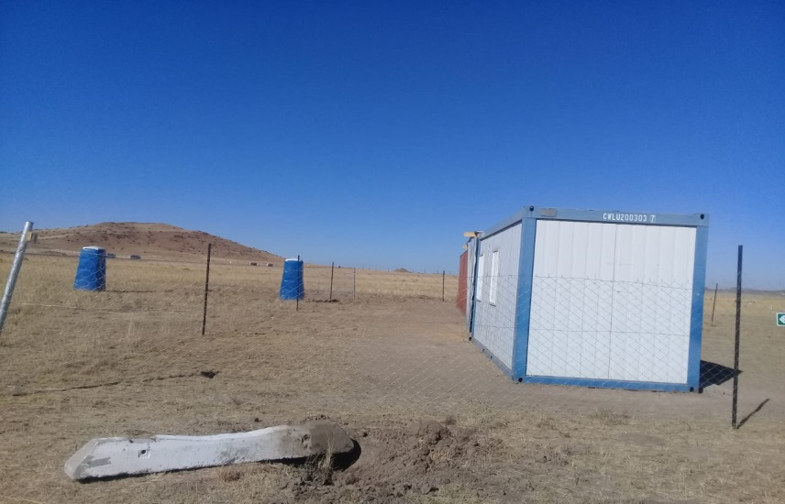
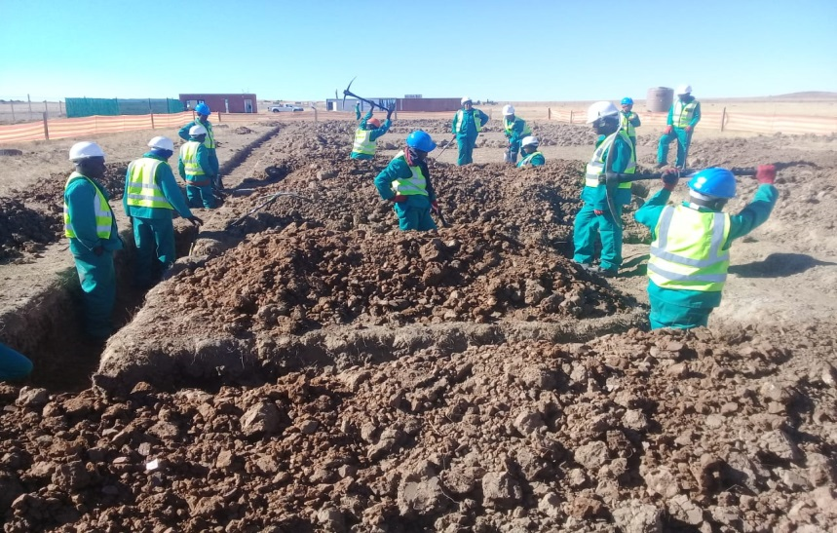
XHARIEP AGRI-PARK PROGRESS SINCE SONA 2015
Agri-hub and FPSU Infrastructure Support :
Springfontein AH Multi-purpose Warehouse & Services Designs
Designs complete
Project current under construction
Springfontein AH Multi-purpose Warehouse & Services :
Contractor appointed for the Springfontein Warehouse & Services
Contractor for Springfontein Warehouse & Services Construction appointed in April 2019.
Construction commenced end on 1st July 2019 Due to the Construction Permit Application
Construction Cost – R21Million
Progress – construction 30% complete.

Slide 5
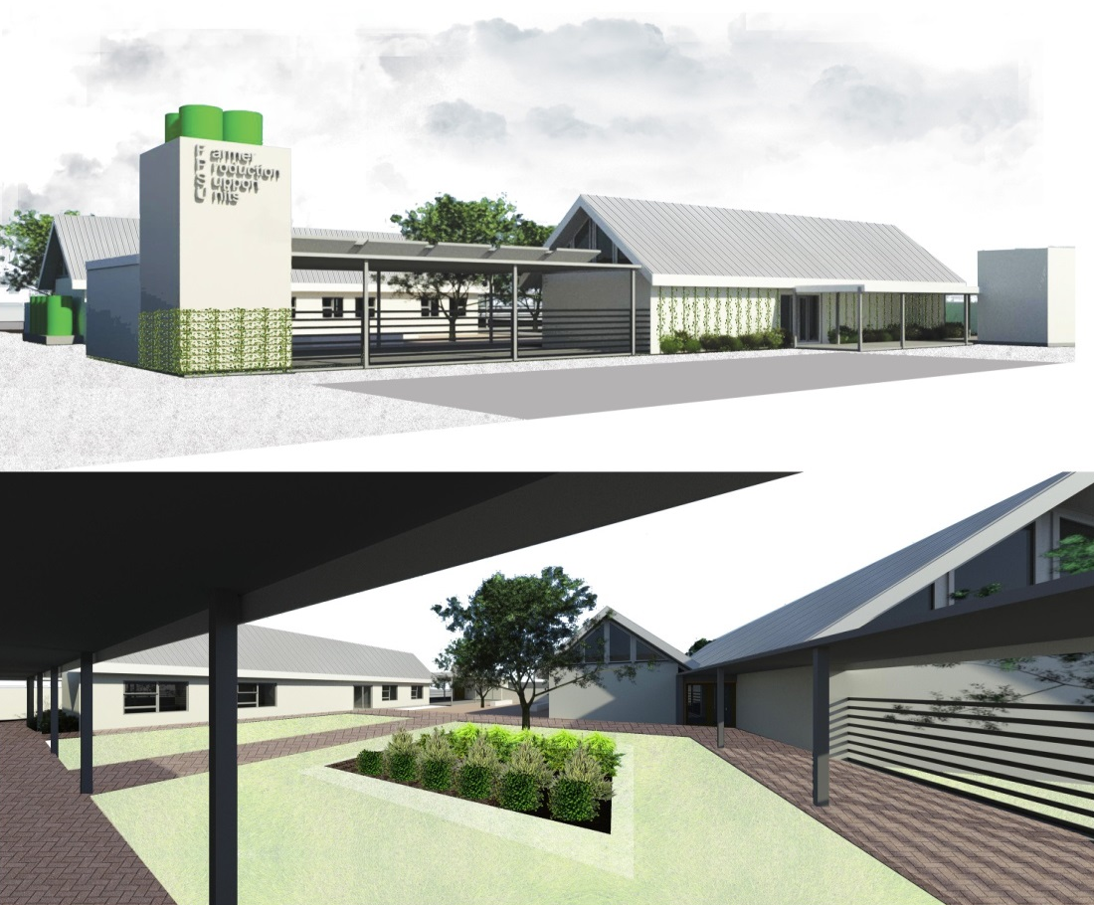
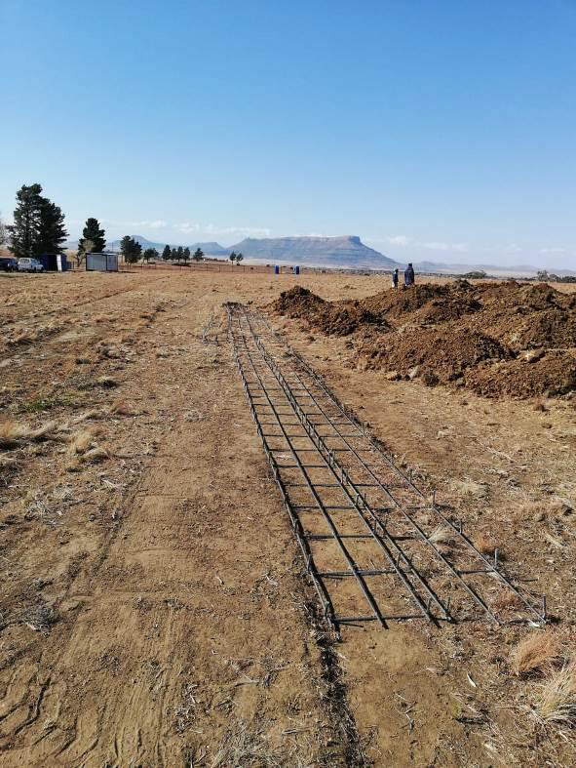
XHARIEP AGRI-PARK PROGRESS SINCE SONA 2015
Agri-hub and FPSU Infrastructure Support (Cont.):
ZASTRON FPSU:
FPSU Infrastructure Planning - EIA & Town Planning:
Environmental Authorisation Approved.
Development Application (Township Establishment or Rezoning application) awaiting approval.
Phase 1 Infrastructure – Training Centre with Offices & Mechanisation Centre.
Designs
Designs complete
Project currently under construction
Construction
Contractor appointed in April 2019.
Construction commenced end on June 2019 Due to the Construction Permit Application
Construction Cost – R23Million
Progress – construction 25% complete.

Slide 6
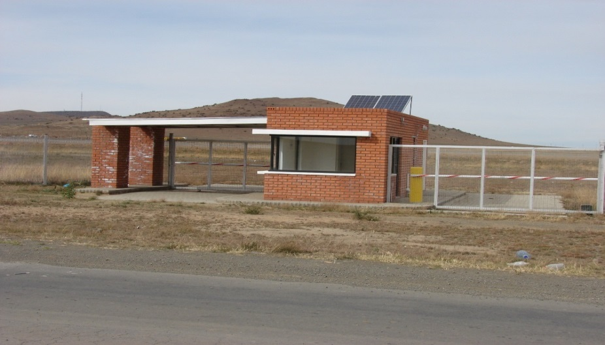
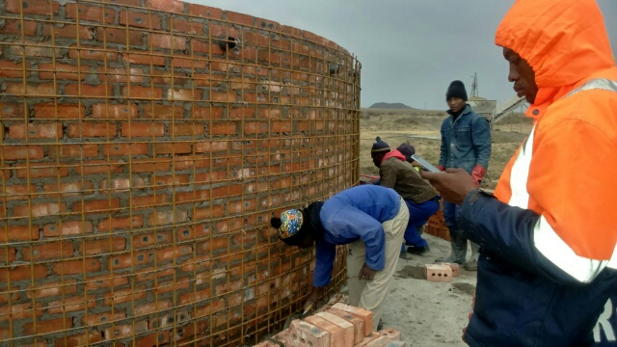
XHARIEP AGRI-PARK PROGRESS SINCE SONA 2015
Production Support:
Branch | Project Name/ Type | Amount | Beneficiaries
RID | 4 AVMP Projects | R 11 013 586.78 | 4 Communities
RECAP | 35 RECAP Projects | R 41 701 007.00 | 33 194 Hectares
 | 1 1HH1Ha Projects | R 1 088 344.00 | 6 Ha for 6 Households
Land Acquisition | 6 Land Acquisition Projects | R 36 339 473.00 | 5938 Hectares
REID | 6 Enterprise Projects | R 4 018, 692.00 | 6 Cooperatives

Slide 7
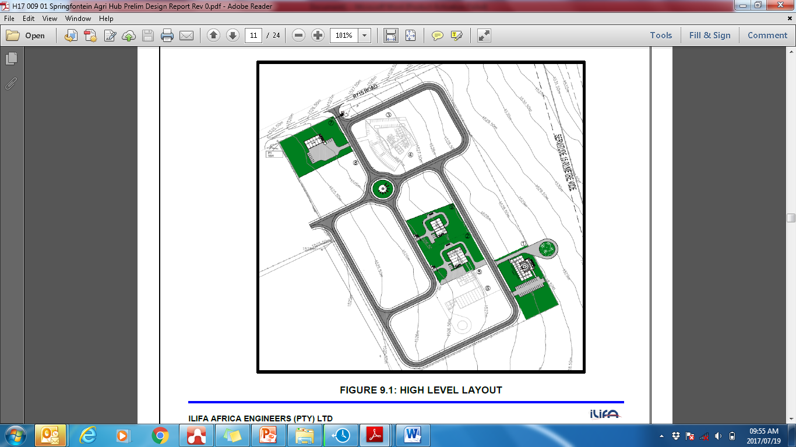
XHARIEP AGRI-PARK PLANS
Governance:
Establishment of governance structure for the management and operations of the Agri-parks (Agri-hubs and FPSUs).
Enterprises Planning Support:
Establishment of Secondary co-operatives for the operation of the Agri-hubs and FPSUs.
Agri-hub and FPSU Infrastructure Support:
Infrastructure Planning - EIA & Town Planning:
Township Establishment or Rezoning application is to be submitted awaiting approval.
Upon approval of the Development Application, the designs for the development of the full Agri-hub will commence in the subsequent Financial Years.

Slide 8
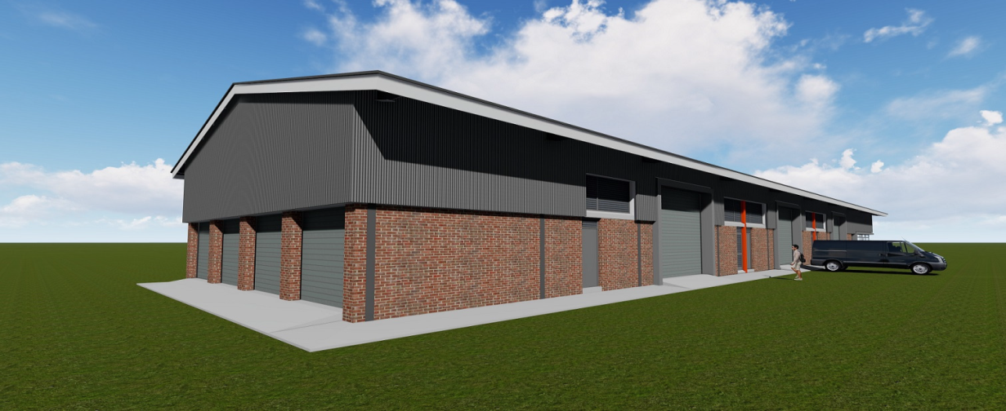
XHARIEP AGRI-PARK PLANS
Agri-hub and FPSU Infrastructure Support:
Springfontein Agri-hubs Construction: (Construction to commence in phases)
Phase 1 Infrastructure
  Multi-purpose warehouse & services, R 21 000 000.00 under construction.
Phase 2 – to commence in 2021
  Fodder Bank R 3 982 740.00
  Logistics Centre R 4 255 530.00
  Auction facility/ holding pens R 5 066 860.00
  Retail facility R 2 520 000
Admin & Tourism facility R 2 100 000
Phase 3 to Commence in 2025
Abattoir R 86 400 000
Deboning facility R 27 000 000
Offices R 2 100 000
Training Facility R 1 680 000

Slide 9
XHARIEP AGRI-PARK PLANS
Production Support: (projects in implementation)
Branch | Project Name/ Type | Amount | Beneficiaries
RID | 4 AVMP Project | R7 900 000.00 | 4 Communities
RECAP | 1 1HH1Ha Project | R 1 075 873.00 | 2,5 Ha for 1 School
Land Acquisition | 4 Land Acquisition Projects | R 20 491 495.00 | 2266 Ha
REID | 6 Enterprise Projects | R 4 018, 692.00 | 4 Cooperatives

Slide 10
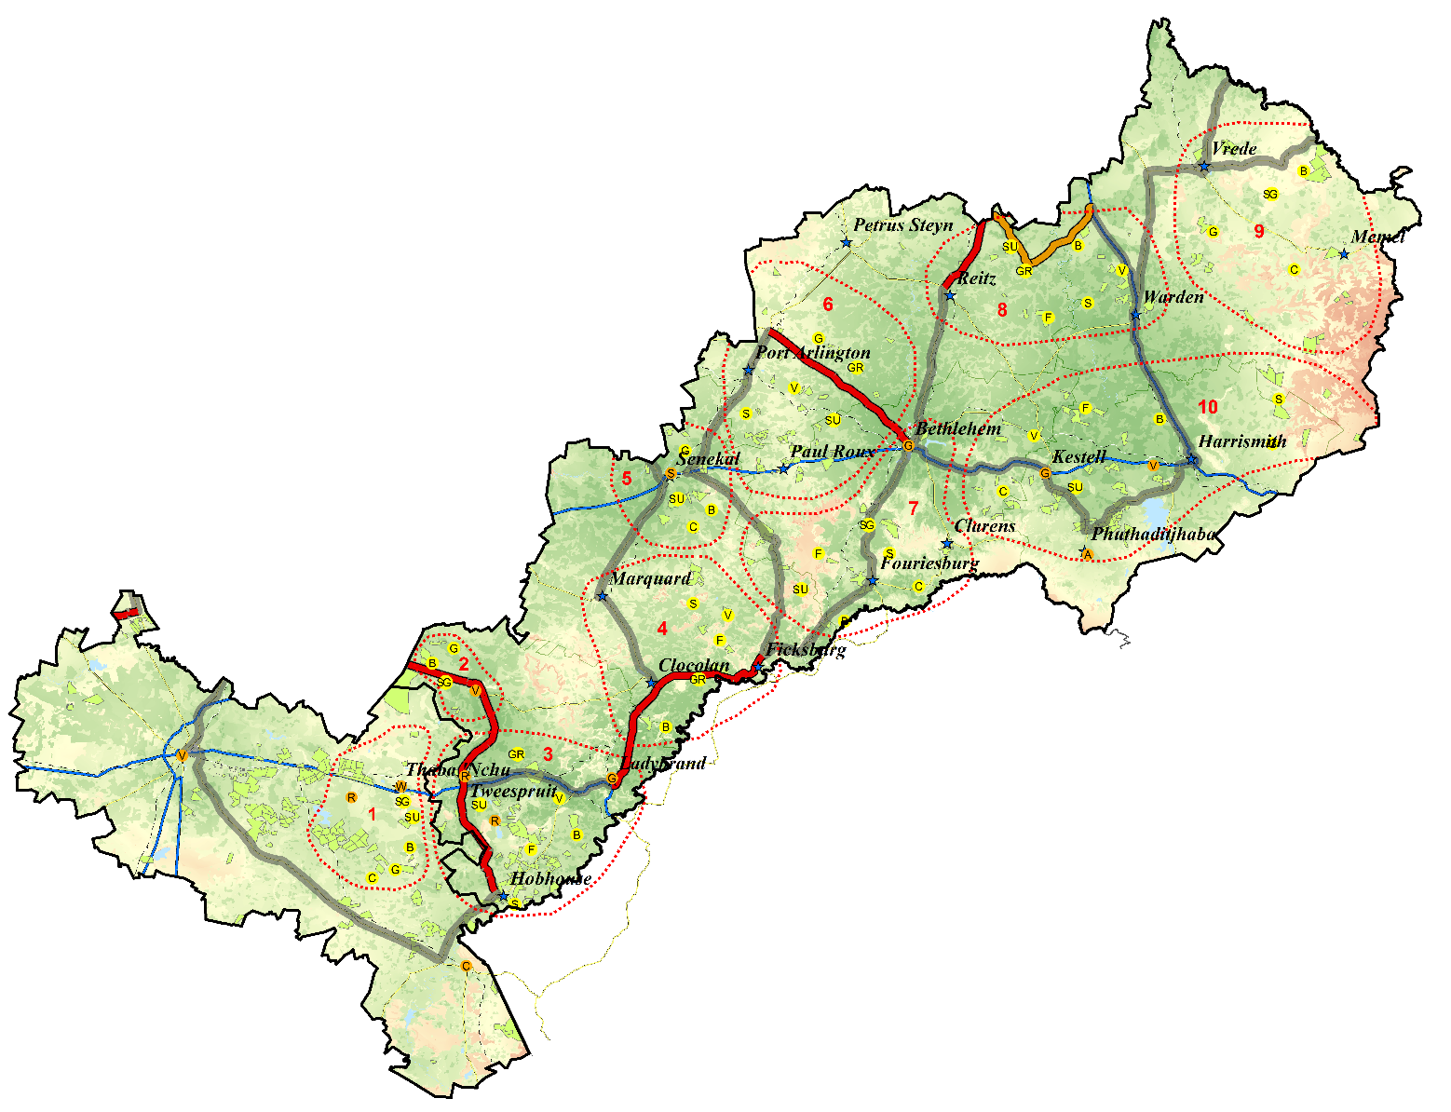
Thabo Mofutsanyane Agri-park Progress Since SONA 2015
AgriHub Site Identification:
The Agri-hub is at Tshiame
FDC Notarial Consent - Yes
Municipality site approval – Yes
2 FPSUs identification at Makholokoeng and Ficksburg
Organizational Support:
District Agri-park Management Council established (26 Members)
Chairperson: Mr Mfokazana Mbele. Contact: 078 879 3502
DAMC Workshop: 19 February 2016.
Secondary Cooperative
Enterprises Planning Support:
District wide Master Business plan is complete and signed by the District Municipality
Business cases for Makholokoeng and Ficksburg FPSUs complete.
Identified commodities:
a) Vegetables and Apples,
b) Dairy and
c) Dry Beans
Agri-hub and FPSU Infrastructure Support:
Infrastructure Planning - EIA & Town Planning:
PMU Technical Advisory Services was appointed in February 2017 - R 2 ,97 mill.
Infrastructure Assessments – Done December 2016
Development Applications and all town planning approvals complete, done by the MAP SEZ.
Environmental Impact Assessment complete, done by the MAP SEZ.
Design & Construction:
Consultants appointed to undertake the design of the Tshiame Agri-hub - R 3,89 mill.
Agri-Hub site fenced by MAP SEZ.

Slide 11
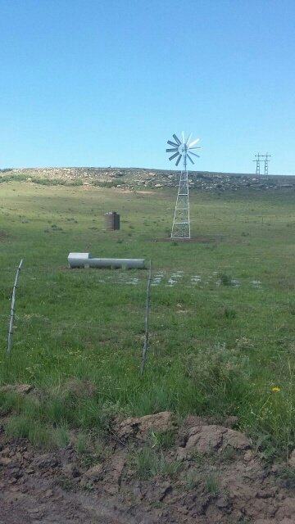
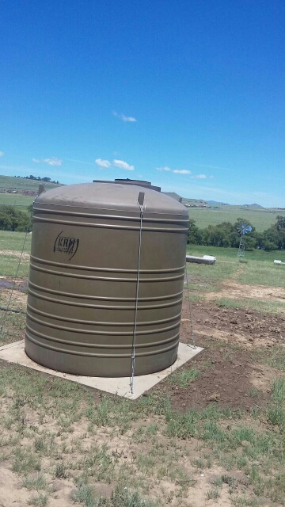
THABO MOFUTSANYANA AGRI-PARK PROGRESS SINCE SONA 2015
Production Support:
Branch | Project Name/ Type | Amount | Beneficiaries
RID | 7 AVMP Projects | R 7 516 984.79 | 7 Communities
RECAP | 11 RECAP Projects | R 19 370 061.00 | 5 732 Hectares
 | 3 1HH1Ha Projects | R 9 319 695.00 | 134 Ha for 43 Households
Land Acquisition | 2 Land Acquisition Projects | R 11 514 000.00 | 1807 Hectares
REID | 44 Farming Enterprises | R 35 779 264.76 | 44 Cooperatives

Slide 12
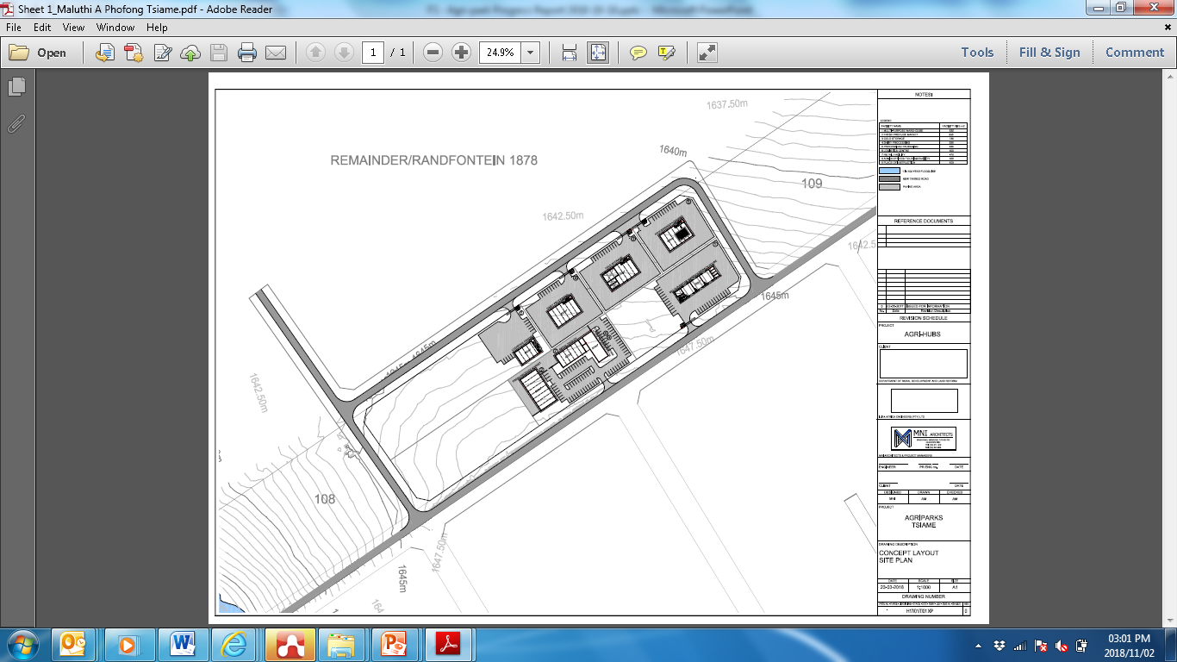
THABO MOFUTSANYANA AGRI-PARKS PLANS
Governance:
Establishment of governance structure for the management and operations of the Agri-parks (Agri-hubs and FPSUs)
DTI to fund the construction of the infrastructure including services & top structures and DRDLR will be responsible for the operation and maintenance cost of the Agri hub, including identification of Beneficiaries.
Signing of MOA between DRDLR and MAP SEZ/ DTI
Enterprises Planning Support:
Commodity Value Chain, Specific Business Planning currently underway.
Establishment of Secondary co-operatives for the operation of the Agri-hubs and FPSUs.
Agri-hub and FPSU Infrastructure Support:
Tshiame Agri-hub Designs
Bulk Services Infrastructure Designs and Specifications complete.
  Upon approval of funding by DTI the Fresh Produce Market and Agro Processing Facility designs will be completed.
  The tenders for construction will be advertised and procured through the MAP SEZ processes.

Slide 13
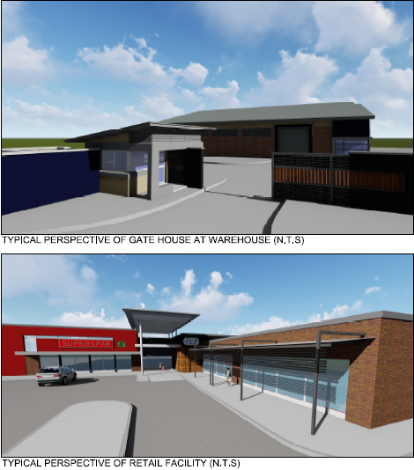
THABO MOFUTSANYANA AGRI-PARK PLANS
Agri-hub and FPSU Infrastructure Support (Cont.):
Tshiame Agri-hub Construction: (To commence in phases)
Phase 1 Infrastructure
Designs for services complete, awaiting approval of funds from DTI.
  Bulk Services, R 14 531 975.00
  Fresh Produce Market , R 12 373 425.00
  Agro-processing Facility, R 16 111 500.00
  Dairy Processing Facility, R 11 390 750.00
Phase 2-3 – to commence in 2021-2030
Multi-Purpose Warehouse R 12 512 000.00
Cold Storage R 15 092 600.00
Logistics centre R 8 397 875.00
Retail Facility R 7 870 025.00
Admin Offices/ Tourism Facility R 6 068 550.00
Place of Instruction R 3 172 275.00

Slide 14
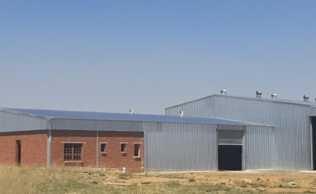
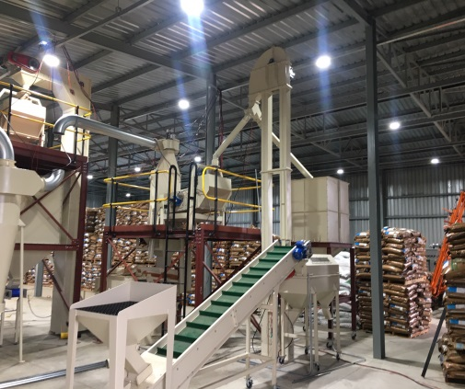
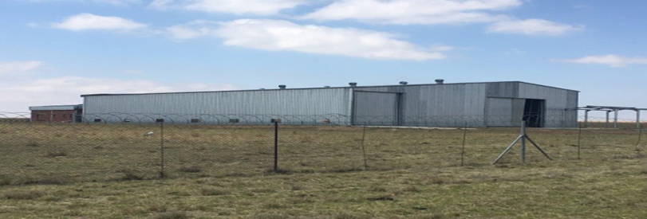
THABO MOFUTSANA AGRI-PARK PLANS
Agri-hub and FPSU Infrastructure Support (Cont.):
Makholokoeng FPSU Designs
Designs for the upgrading of the existing pack-house are complete.
Designs for the Mechanization Centre (Implement Store) are complete.
FPSU Construction
Phase1:
Upgrading of Makholokoeng FPSU Contractor appointed.
Construction Complete
Construction Cost – R7,9 Million
Phase2:
Mechanization Centre (Implement Store), construction to commence during September 2019.
Estimate Construction Cost – R4,7 Million

Slide 15
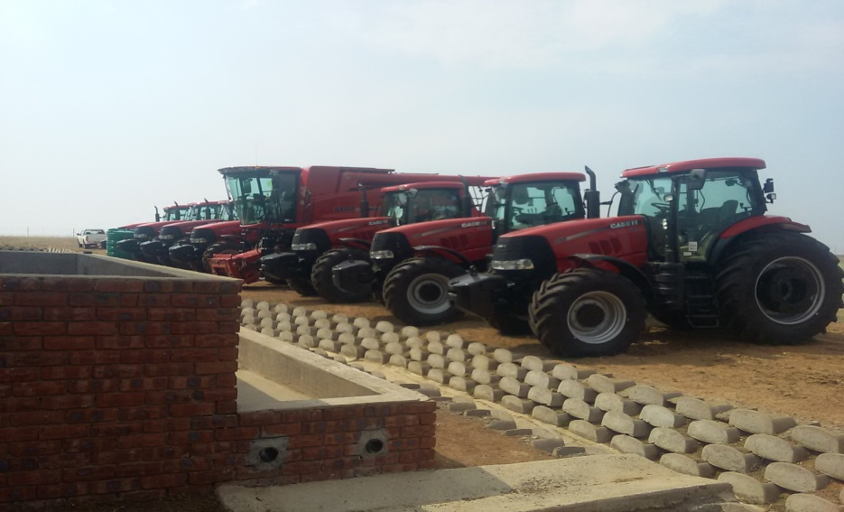
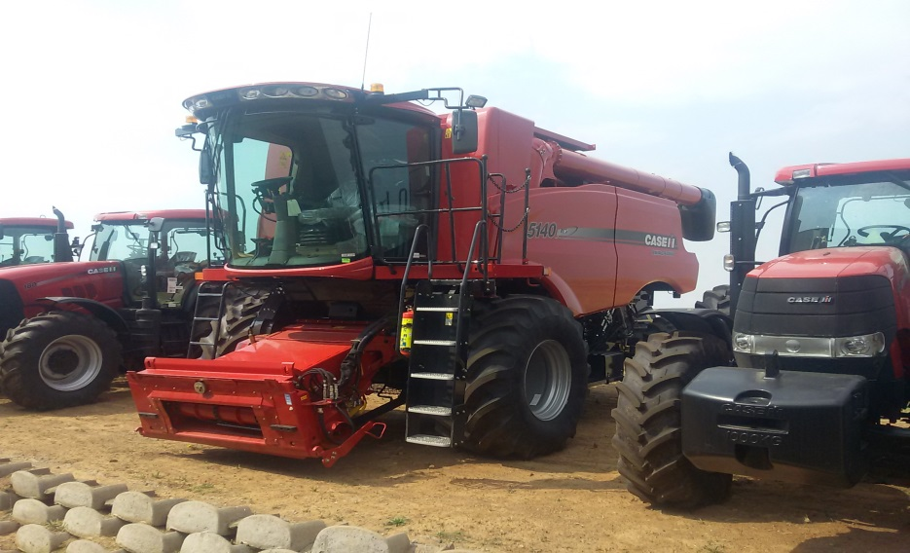
THABO MOFUTSANA AGRI-PARK PLANS
Business and Enterprises:
Makholokoeng FPSU
Secondary Cooperatives to mange the facility Established.
Machinery and Equipment Bought to date: R19 Mill
  7 x tractors
  1 x Combine Harvester
  2 x rippers
  2 x boom Sprayers
  2 x planters
  2 x disc ploughs

Slide 16
THABO MAFUTSANYANE AGRI-PARK PLANS
Production Support: (projects in implementation)
Branch | Project Name/ Type | Amount | Beneficiaries
RID | 2 AVMP Projects | R 800 000.00 | 2 Community
RECAP | 2 1HH1Ha Project | R 2 696 813.00 | 20 Ha for 2 Schools
Land Acquisition | 3 Land Acquisition Projects | R14 215 500.00 | 1322 Ha
REID | 44Farming Enterprises | R 35 779 264.76 | 44 Cooperatives

Slide 17
Mangaung Agri-park Progress Since SONA 2015
AgriHub Site Identification:
The Agri-hub is at Thaba Nchu
FDC Notarial Consent - Yes
Metro Municipality site approval – Yes
Power of Attorney – Yes
2 FPSUs identification at Sediba and Botshabelo
Organizational Support:
District Agri-park Management Council established (19 Members)
Chairperson : Mr. Beef- Contact 060 455 124
DAMC Agri-park Workshop: Done
Enterprises Planning Support:
District wide Master Business plan is complete and signed by DM
Business cases complete, including Sediba FPSU and Botshabelo FPSU.
Identified commodities::
a) Vegetables, b) Sheep Wool and c) Red Meat
Bloemfontein
Agri-hub and FPSU Infrastructure Support:
Infrastructure Planning - EIA & Town Planning:
PMU Technical Advisory Services was appointed in February 2017 - R 2 ,97 mill.
Infrastructure Assessments completed.
Master infrastructure planning completed.
Thaba Nchu Agri-hub EIA complete – Environmental Authorisation in-place.
Thaba Nchu Agri-hub Town Planning Investigations.
Design & Construction:
Consultants appointed to undertake the designs of Springfontein Agri-hub - R 3,3 mill.
Design for the Multi-purpose warehouse complete
Thaba Nchu Abattoir Upgrade – Cold Rooms (DARD) : R 6 Mill.
Thaba Nchu Abattoir Road Re-gravelling at Complete: R 1,85 Mill
Thaba Nchu Agri-hub Fencing, complete : R 1.5 Mill
Sediba FPSU Fencing = R0.78 Mill
Total Jobs created: 110

Slide 18
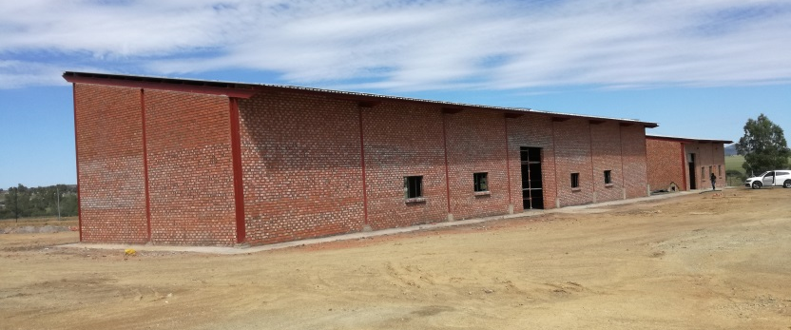
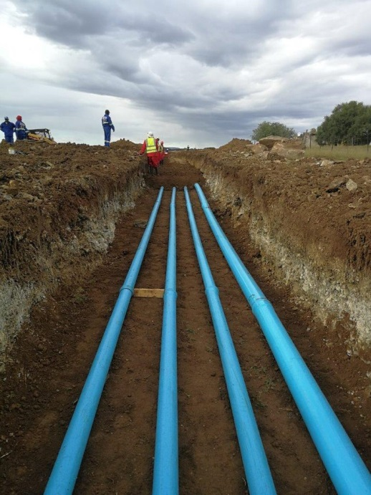
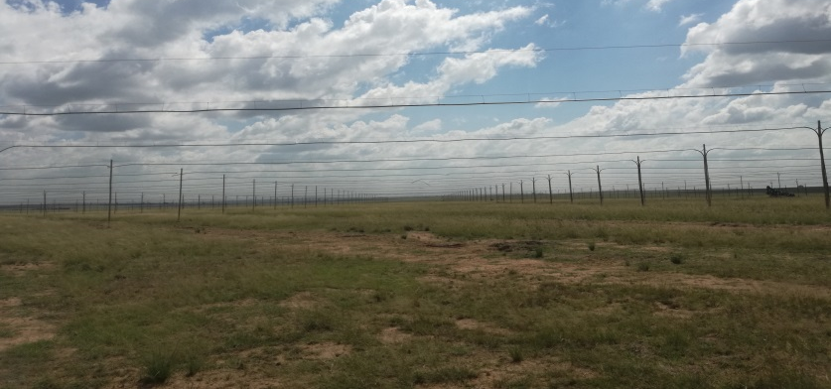
MANGAUNG AGRI-PARK PROGRESS SINCE SONA 2015
Agri-hub and FPSU Infrastructure Support (Cont.):
Sediba FPSU Designs
Designs complete, project current under construction.
Design Costs: R 896 384.20
Sediba FPSU Phase1 Construction:
Upgrading of the Scheme and construction of a Workshop, Storage Facility and Offices
Sediba FPSU Construction commenced end of March 2018
Construction Cost - R15,3 Million
Progress – construction complete.

Slide 19
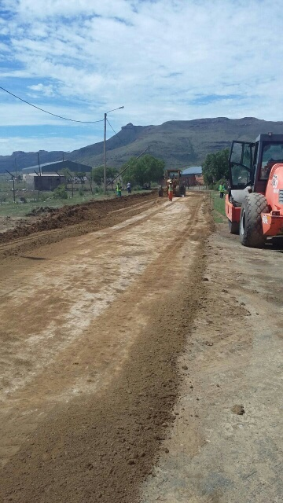
MANGAUNG AGRI-PARK PROGRESS SINCE SONA 2015
Production Support:
Branch | Project Name/ Type | Amount | Beneficiaries
RID | 4 AVMP Projects | R 7 237 883.13 | 4 Communities
RECAP | 5 RECAP Projects | R 10 435 926.00 | 2 129 Hectares
 | 13 1HH1Ha Projects | R 24 675 858.00 | 637 Ha for 611 Households
Land Acquisition | 8 Land Acquisition Projects | R 52 027 764.00 | 5273 Hectares
REID | 10 Enterprise Projects | R 9 260,000.00 | 10 Cooperatives

Slide 20
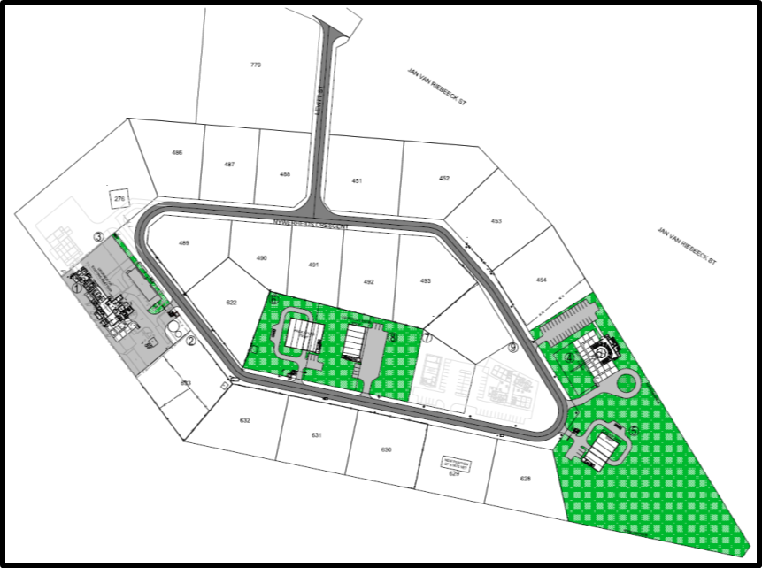
MANGAUNG AGRI-PARK PLANS
Governance:
Establishment of governance structure for the management and operations of the Agri-parks (Agri-hubs and FPSUs).
Planning Support:
Commodity Specific business plans for the Thaba Nchu Agri-hub, Sediba FPSU and Botshabelo FPSU.
Agri-hub and FPSU Infrastructure Support:
Infrastructure Planning - EIA & Town Planning:
EIA complete and Environmental Authorisation in place.
Township Establishment or Rezoning application was submitted in April 2019 upon the receipt of Environmental Authorisation, anticipated to be during Nov/Dec 2018. Approval anticipated to be submitted by October 2019.
Upon approval of the Development Application, the designs for the development of the full Agri-hub will commence in subsequent Financial Years.
Thaba Nchu Agri-hub Designs:
Designs for the Upgrading of the Abattoir & services are complete
Tender Documentation & Specifications are complete.
Tender to be re-advertised during July 2019

Slide 21
MANGAUNG AGRI-PARK PLANS
Agri-hub and FPSU Infrastructure Support (Cont.):
Thaba Nchu Agri-hub Construction: (Construction to commence in phases)
Phase 1 Infrastructure
Tender stage (Bid Specification Committee Stage), tender to be re-advertised during September 2019.
  Upgrading of the Abattoir – R 45 Million
Phase 2 – to commence in 2021
Pack house: Agro processing, packaging and storage
Logistics Centre
Admin Offices
Auction Facility
Phase 3 to Commence in 2024
Retail facility/ Industrial Shop
Admin & Tourism facility
Offices/Training Facility
Mechanization Centre
Deboning facility

Slide 22
MANGAUNG AGRI-PARK PLANS
Production Support: (projects in implementation)
Branch | Project Name/ Type | Amount | Beneficiaries
RID | 3 AVMP Project | R 700 000.00 | 3 Community
RECAP | 1 1HH1Ha Project | R 3 312 332.00 | 69 Ha for 69 Households
Land Acquisition | 5 Land Acquisition Projects | R14 376 500.00 | 894Ha
REID | 10 Enterprise Projects | R 9 260 000.00 | 10 Cooperatives

Slide 23
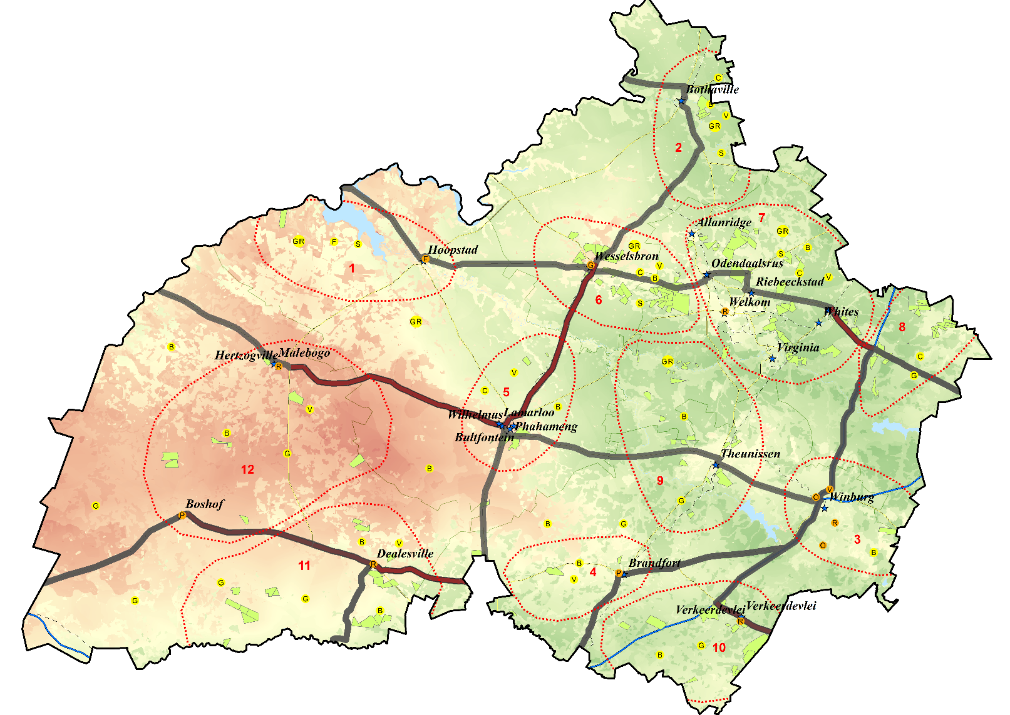
Lejweleputswa Agri-park Progress Since SONA 2015
AgriHub Site Identification:
The Agri-hub is at Wesselsbron
Local Municipal site approval – Yes
Power of Attorney – Received
2 FPSUs identified at Dealsville and Odendaalsrus
Organisational Support:
District Agri-park Management council established (19 members)
Chairperson : Mr Mandla Job - Contact 083 595 7305
DAMC Workshop: 18 February 2016
Enterprises Planning Support:
District wide Master Business plan is complete and signed by the District Municipality
Feed mill business case complete
Odendaalsrus business case complete.
Identified commodities a)Cattle (Beef) b) Grain/ Livestock feed c) Poultry (Broilers)
Agri-hub and FPSU Infrastructure Support:
Infrastructure Planning - EIA & Town Planning:
PMU Technical Advisory Services was appointed in February 2017 - R 2 ,97 mill.
Master infrastructure planning currently underway.
Wesselsbron Agri-hub Town Planning Investigations and EIA approved.
Design & Construction:
Consultants appointed to undertake the designs of Wesselsbron Agri-hub - R 3,08 mill.
Bulk Services designs complete.
Wesselsbron Agri-park Fencing complete - R2.4 Mill
Access Road Re-gravelling complete – R 0.6 Mill
Total Jobs created: 25

Slide 24
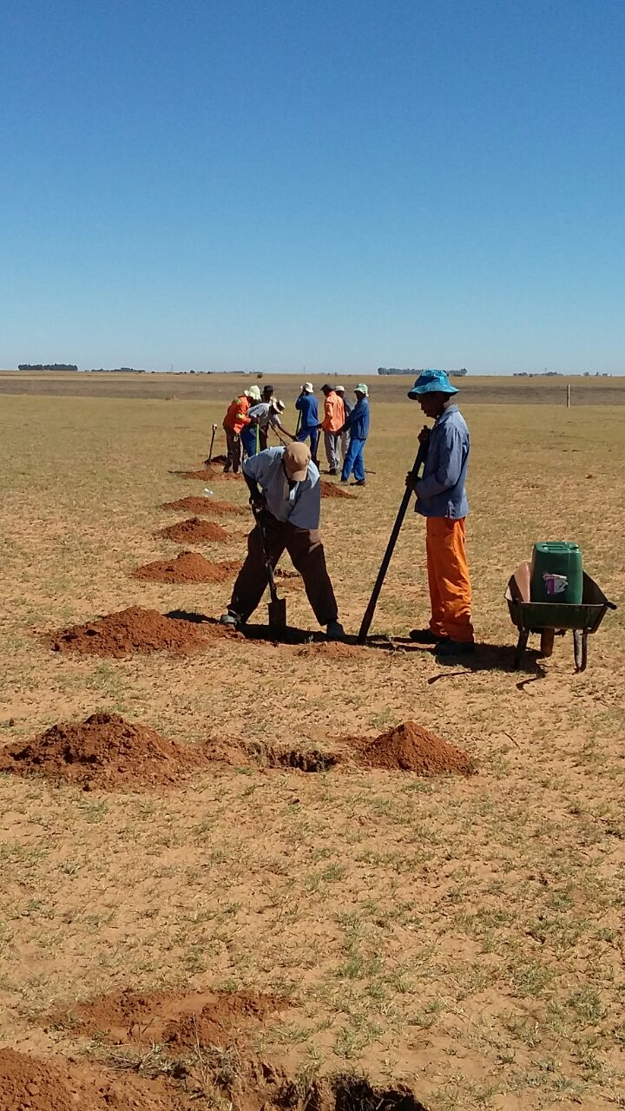
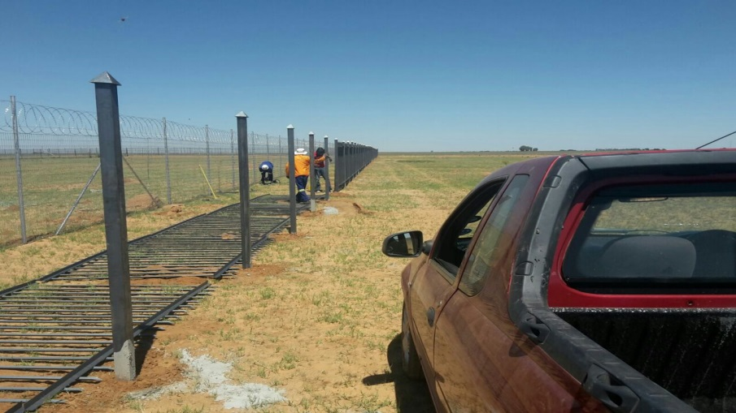
LEJWELEPUTSWA AGRI-PARK PROGRESS SINCE SONA 2015
PRODCTION SUPPORT:
Branch | Project Name/ Type | Amount | Beneficiaries
RID | 1 AVMP Project | R 1 623 829.68 | 1 Community
RECAP | 27 RECAP Projects | R 56 314 512.00 | 6 611 Ha
 | 1 1HH1Ha Projects | R 2 309 025.00 | 37 Ha for 100 Households
Land Acquisition | 12 Land Acquisition Projects | R 90 161 498.00 | 10243Ha
REID | 7 Enterprise Projects | R7 298 076 | 7 Cooperatives

Slide 25
LEJWELEPUTSWA AGRI-PARK PLANS
Production Support: (projects in implementation)
Branch | Project Name/ Type | Amount | Beneficiaries
RECAP | 1 1HH1Ha Projects | R 692 873.00 | 3 Ha for 1 School
Land Acquisition | 8 Land Acquisition Projects | R 33 497 000.00 | 4340 Ha
REID | 7 Enterprise Project | R7 298 076.00 | 7 Cooperatives

Slide 26
CHALLENGES
Challenges | Remedial Actions
Most of the identified sites for the were green-fields and therefore a lot of pre-planning work, including township establishment & EIAs had to be done prior to the actual designs and construction. | The EIA, WULA Development Applications, submitted, some approved, some currently under approval processes.
Funding – detailed designs are proving the establishment of these Agri-parks to be costly especially and therefore funding is the major constraint | More funds should be allocated for the development of the Agri-parks.
No governance structure in place for the management and the operations of the Agri-parks | Establishment of governance structure for the management of the Agri-parks
There is construction that is taking place at the PARYS Agri-hub without any consultation to the Department and without any Environmental Authorisation and By-laws | Identification of a new site.
Delays associated with signing of documents by other stakeholders and getting information. | The stakeholders including municipalities and affected sector departments to sign the documents on-time.

