Slide 1
TOWARDS A DISTRICT DEVELOPMENT MODEL Portfolio Committee 22 OCTOBER 2019

Slide 2
CONTENT
Background
Problem Statement
Main Objectives of the Model
Principles Underpinning the New District Coordination Model
Visualizing the Model
Steps Towards Implementing the Model
Resourcing Implications and Budgeting

Slide 3
INTRODUCTION
the 1994 elections manifesto envisages “a government of the people” wherein the rights “of all people to elect a government of their choice” was guaranteed and once that is done there would be a “democratic government at provincial and local levels, with the powers and resources to meet people`s needs”.
To take this forward the President indicated that things have to work differently
“For the effective implementation of our seven priorities, the structures of government will need to function with maximum coordination and cooperation as it is envisaged in our Constitution.
The truth is that lack of coordination between national and provincial governments, between departments and particularly at local government level, has not served us.
We have slid into a pattern of operating in silos.
This has led to lack of coherence in planning and implementation and has made monitoring and oversight of government’s programme difficult.
It has become a significant deterrent to investment as businesspeople have had to move from pillar to post in search of support and services in what are essentially the same sectors.
At the heart of most service delivery protests is fragmented planning on our part as well as poor communication.
As the 6th Administration we are going to do away with this fragmented approach to development.”
Therefore we are called upon to:
Ensure that we bring to life the aspirations of the people shall govern
Bring government closer to the people through the District

Slide 4
BACKGROUND
The principles of cooperative governance are pursued in Chapter 4 of the Constitution which (amongst others) calls on “all spheres and all organs of state” to “…secure the well-being of the people of the Republic; [and] provide effective, transparent, accountable and coherent government for the Republic as a whole; ….”
The Constitution also gives “developmental duties” to local government in section 152, with the overall requirement that local governments:
“a. provide democratic and accountable government for local communities;
b. ensure the provision of services to communities in a sustainable manner;
c. promote social and economic development;
d. promote a safe and healthy environment; and
e. encourage the involvement of communities and community organisations in the matters of local government.”
All developmental initiatives should therefore be seen through the local lens.

Slide 5
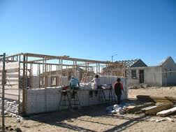
Intergovernmental Relations, IGR:
Giving Effect to Principles of Cooperative Governance
The IGR Framework Act (IGRFA) sets out the general principles and objects of intergovernmental relations: the focus is primarily on the outcomes that the system must achieve:
Coherent government
Effective provision of services
Monitoring implementation of policy and legislation; and
Realisation of national priorities.
Sec 47 of IGR Act

Slide 6
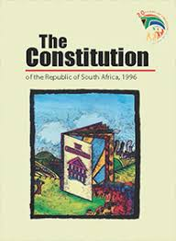
CONSTITUTIONAL OBLIGATIONS
In strengthening Cooperative Governance, the Constitution further places an obligation on National and Provincial Government to work with Local Government:
Section 154 of the Constitution:
“The national government and provincial government, by legislative and other measures, must support and strengthen the capacity of municipalities to manage their own affairs, to exercise their powers and to perform their functions.”
Local Government is the closet sphere to communities and represents all of government at local level. A functional and developmental LG is a necessary requirement for an effective Developmental State.

Slide 7
PROBLEM STATEMENT What Challenges are we Trying To Solve
Solve the Silos at a horizontal and vertical level
Narrow the distance between the people, government and the movement by strengthening the coordination role and capacities at the District and City levels as it is the penultimate sphere closer to the people after ward and local
Deliver Integrated Services whilst strengthening Monitoring and Evaluation and impact at district and local levels, as well as within the movement
Ensuring inclusive and gender mainstreamed budgets based on the needs and aspirations of our people and communities at a local level
Maximising impact and aligning resources at our disposal
Changing the face of our rural and urban landscapes by ensuring complementarity between urban and rural development, with a deliberate emphasis on Local Economic Development
Ensure sustainable development whilst accelerating initiates to promote poverty eradication, employment and equality

Slide 8
PRIMARY OUTCOMES & OBJECTIVES
Cohesive, Vibrant & Safe Communities
Taking Development to the people
Economic Transformation
Education, Skills & Health
Spatial Integration
Integrated Delivery of services
Better Quality of Life
(Poverty Eradication)
Decent Work
Capable, Ethical & Developmental State
Integrated Planning, Budgeting & Implementation
52 harmonized spaces contributing to a better Africa and world
Better Africa & Better World
MTSF Outcomes
District Model Objectives
Equity
Equality

Slide 9
Principles Underpinning the Model
Main Objectives of the Model
Existing Constitutional Framework Remains as is, whilst strengthening the regulatory framework for Cooperative Governance
Reinforce Local Government and its Proximity to Communities
Distinction Between Long-term and Medium-term Strategic Planning/Implementation Mechanisms
Build on Lessons from implementing previous similar and Existing Good Practices – Current MTSF Alignment (DPME) and Operation Sukuma Sakhe (OSS) and other emerging best practice
Reconfigure Integrated Planning Responsibilities and Institutional Arrangements
Managing rural/urban migration, as well as sustainable growth and development;
Determining and/or supporting local economic drivers;
Determining and managing spatial form, land release and land development;
Determining infrastructure investment requirements and ensure long-term infrastructure adequacy to support integrated human settlements, economic activity and provision of basic services, community and social services;
Institutionalize long term planning whilst addressing ‘burning’ short term issues

Slide 10
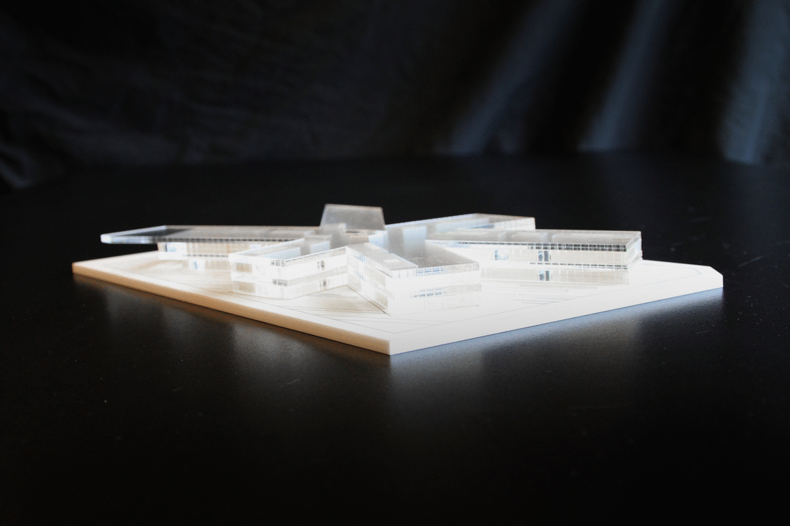
VISUALIZING THE MODEL: A New Integrated Planning Model for Cooperative Governance is Needed - District/Metro Scale
The District/Metro spaces offer the appropriate scale and arena for intergovernmental planning coordination;
District Model provides both an Institutional Approach and Territorial Approach (geographic space) Focus;
The 44 Districts plus 8 Metros as developmental spaces (IGR Impact Zones) can be the strategic alignment platforms for all three spheres of government where One Plan for each space guides and directs all strategic investments and projects for transparent accountability;
The Plan will harmonize IDPs and create interrelated, interdependent as well as ‘independent’ development hubs supported by comprehensive detailed plans;
The plan is an Inter and intra governmental and leads to society wide Social Compact; AND
The One Plan will be strategic and Long-Term in nature, with medium term strategic plans and short term operational plans all expressing the commonly agreed diagnostics, strategies and actions.
National and Provincial Departments & Municipalities
Partner and International Agreements
Community Aspirations &
Civil Society Participation
ONE PLAN
AND
CAPACITY SUPPORT
44 Districts plus 8 Metros

Slide 11
District/Metro Scale Integrated Planning Model
Spatial/Developmental Area – Development Planning
Institutional – Development Planning (NDP, NSDF, IDP, SDF, PGDS, Sector Strategies) informing Organisational/Departmental Planning (MTSF, Strategic Plans, Annual Performance Plans, Budgets, etc.)
NEC
Community / Stakeholder Involvement
District/Metro Space
(IGR Impact Zone)
National
(Presidency)
Provincial
(Premier’s Office)
District/Metro Municipality
Local Municipality 1
National Departments
Provincial Departments
LM 2
LM 3
LM 4…
Long Term Plan
(IG Protocol)
PCC
COGTA Min MEC
Sector Min MECs
PEC
REC
Branches

Slide 12
APPROACH TOWARDS ONE PLAN
Cohesive
& Sustainable Communities
National budgets and programmes spatially referenced across 44 District + 8 Metro’s spaces
Needs and Aspirations of Communities expressed in
IDP’s municipalities in
44 + 8 spaces
Provincial Governments budgets and programmes spatially referenced to District and Metro’s spaces
International, Trade & Private Sector Agreements
ONE Plan

Slide 13
DDM PILOTING PROCESS
Develop one plan that responds to needs and aspirations of communities within Districts and Metro.

Slide 14
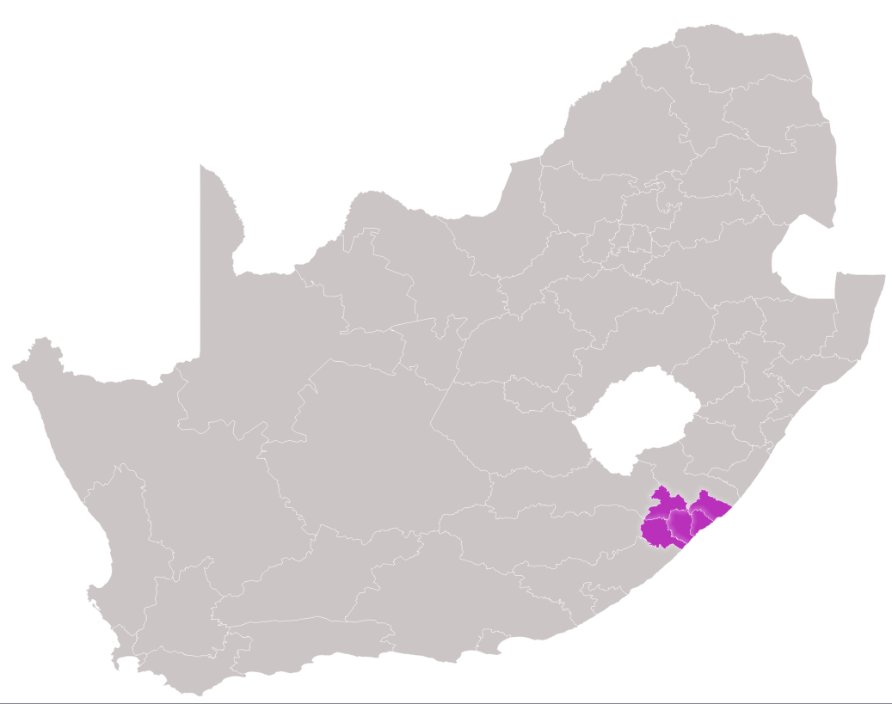
OR Tambo District Profile (2016 CS)
LESSONS FROM THE
OR TAMBO DISTRICT PROFILE

Slide 15
CURRENT POPULATION
Municipality | 2011 (Census) | 2016 (Community Survey) | 2050 Population Projection
KSD | 451713 | 490207 | 1 785 166
Mhlontlo | 188226 | 186860 | 743 868
Ingquza Hill | 278481 | 303379 | 1 100 555
Nyandeni | 290385 | 309702 | 1 147 599
Port St Johns | 156132 | 166779 | 617 032
O.R Tambo District Municipality | 1 364 943 | 1 457 384 | 5 394 220

Slide 16
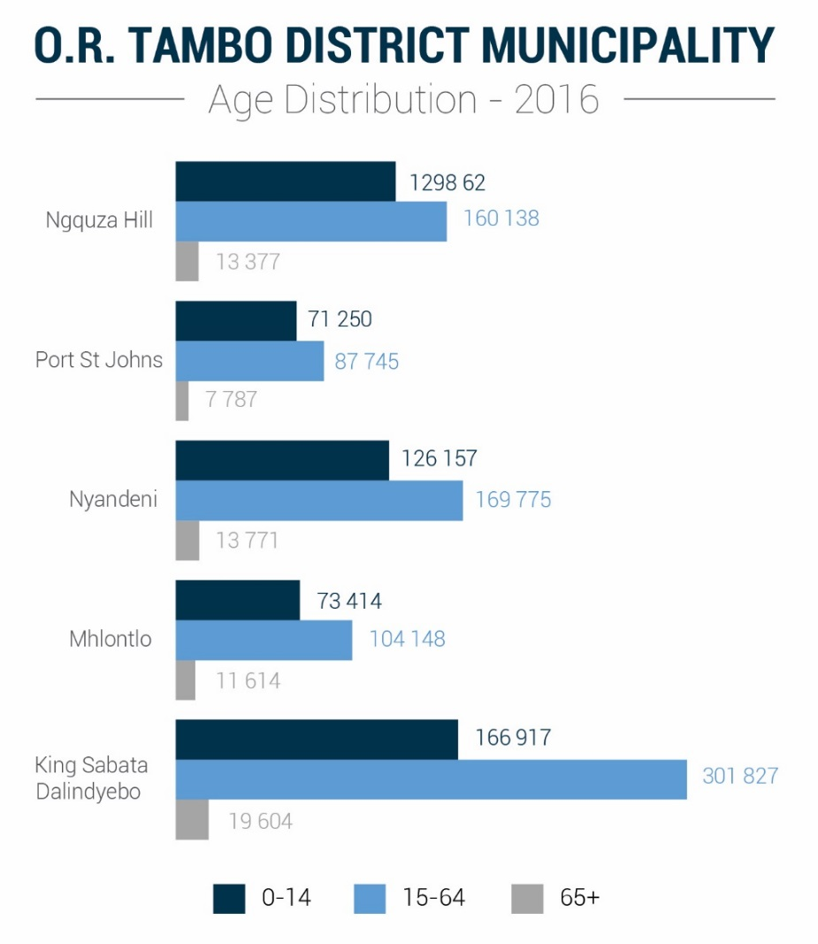
The ratio of men to women in the O.R Tambo District Municipality is 43% to 57% This is evidence of male migration to other major urban or metropolitan areas in search of work.

Slide 17
57% of Households in O.R. Tambo District Municipality were headed by a Female in 2016, the highest of all EC districts

Slide 18
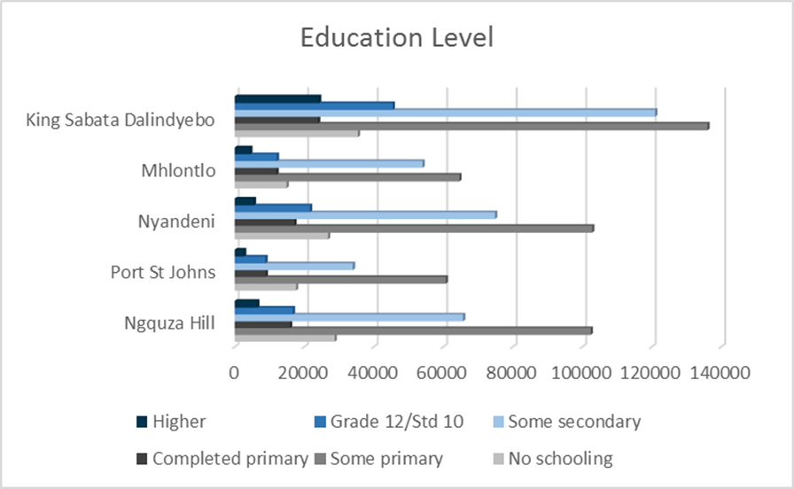

Slide 19
Heavy reliance on the public sector as a driver of or engine for the economy. The high level of government sector presence in the regional economy arises from the underdeveloped economy, which results in a small private sector presence.

Slide 20
 | 2008 | 2010 | 2012 | 2013 | 2014 | 2015 | 2016 | 2017 | 2018
Unemployment rate | 28.1% | 29.0% | 30.1% | 31.1% | 30.8% | 30.5% | 31.9% | 35.0% | 37.7%
GVA-R per capita (constant 2010 prices) | 16,981 | 16,479 | 16,594 | 16,444 | 16,338 | 16,253 | 16,159 | 16,104 | 15,727
The above means that Household incomes are low and poverty levels extremely high, which has an impact on the municipalities in the district’s abilities to collect revenue and be financially viable.

Slide 21
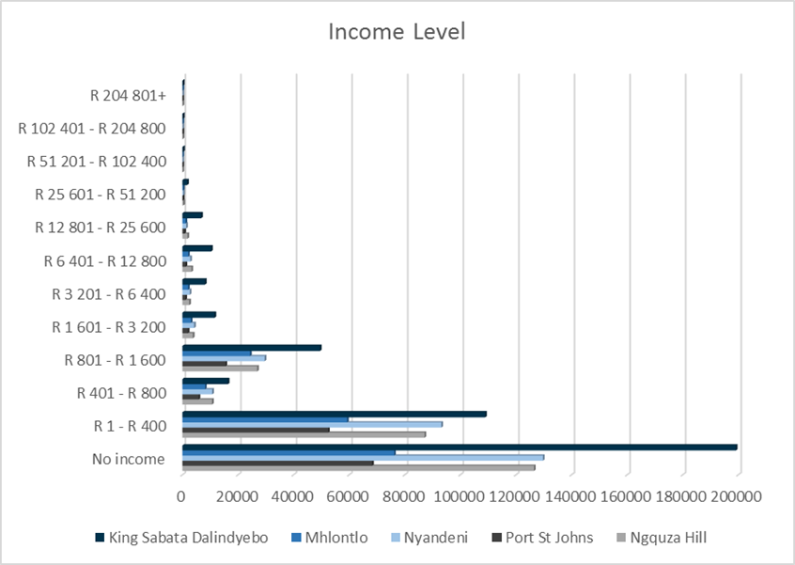

Slide 22
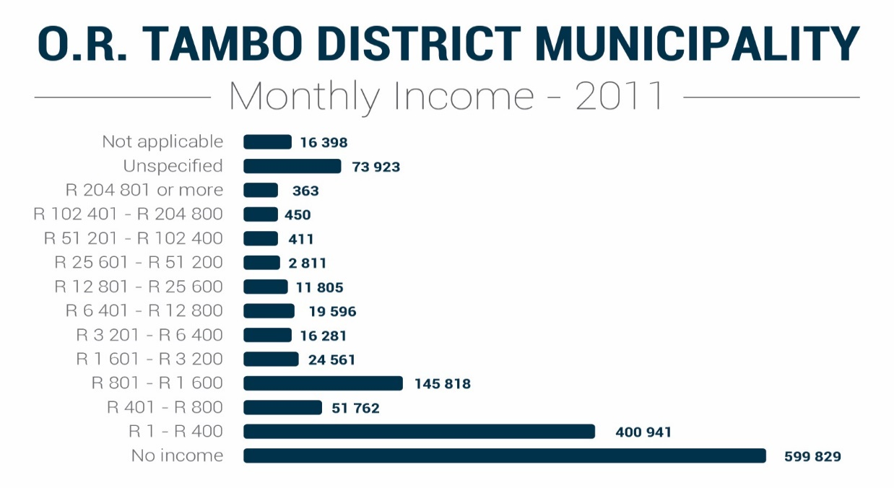
18 % of Households in O.R. Tambo District skipped a meal in the last 12 months
27 % of Households in O.R. Tambo District ran out of money to buy food

Slide 23
CONSOLIDATED BUDGET
Total budget over the MTEF
Total budget for 2019/20 financial year
TYPES OF PROJECTS | TOTAL BUDGET
Infrastructure projects | R4.4 billion
Social projects SASSA Grants EPWP CWP Food Distribution Centres Maize and Wool production | R1.8 billion
TOTAL | R6.2 billion
SPHERE | TOTAL BUDGET | NUMBER OF PROJECTS
National government | R5.2 billion | 175 projects
Provincial government | R5.4 billion | 383 projects
OR Tambo district | R648 million | 53 projects
TOTAL | R11.2 billion | 383 projects

Slide 24
ECONOMIC POTENTIAL
Despite the poor state of the District - immense potential for growth:
Under investment in Agriculture;
Cannabis/Hemp Mecca
Fertile and productive soil
Untapped tourism jewel;
Underdeveloped and under-investment in tourism
Beautiful scenery/hole in the wall/Falls/
Ocean economy;
Coastline cutting across municipal jurisdiction
beachfront, harbors

Slide 25
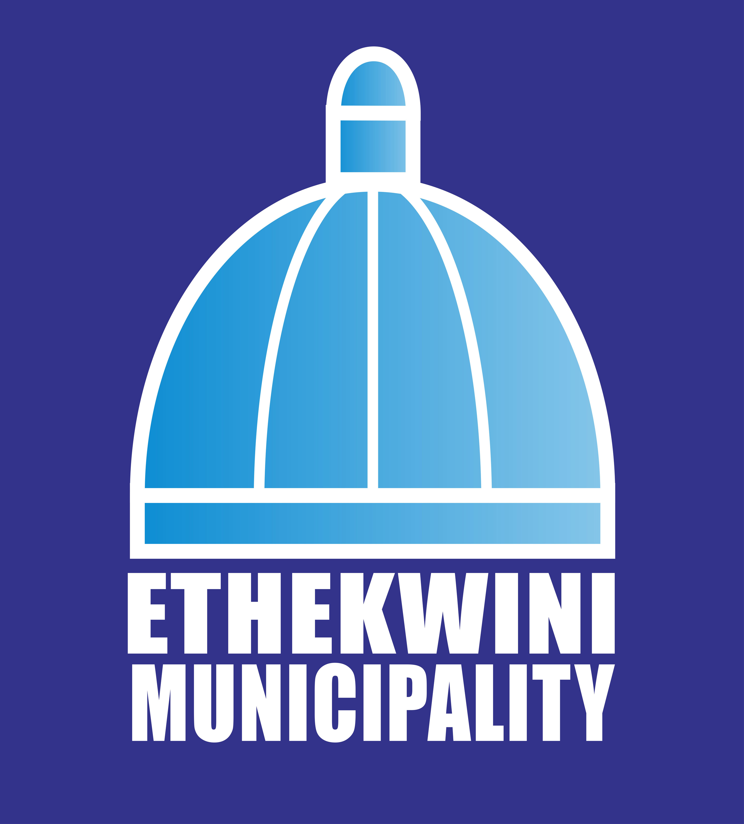
DDM PILOTING PROCESS
Develop one plan that responds to needs and aspirations of communities within Districts and Metro.

Slide 26
ETHEKWINI METRO - challenges
That the Metro has an average household size of 3.3, which is lower than the provincial average of 3.8. Close on 30% of the population is under 15 and 63% of the population is under the age of 35. Wherein 8 802 households are headed by children and young people between the ages of 15 and 19, and 42.14% of households in the metro are headed by women.
That the Metro has significant high levels of poverty, high unemployment rates, and an overall declining economy that is, in part perpetuated by apartheid spatial patterns.
That 2.1 million Citizens live below the upper bound poverty line of R 1 183 per person per month, and 17.1% of the population reported having no income in the latest STATS SA Community Survey. 8.6% of the population has no education while 5.8% have a higher education qualification.
That of the 7.9 million people living with HIV and Aids in South Africa, 2.1 million reside in KZN and 642 000 reside in the eThekwini Metro, indicating a city growth rate of 2.05% since 2008.

Slide 27
ETHEKWINI METRO - challenges
eThekwini is characterized by a diversified economy, with potential ranging from manufacturing, logistics, property and finance to tourism, leisure, sports as well as arts and culture even though the manufacturing sector has declined by about 56%.
That 60% of people who are employed earn less than R38 400 per annum in the metropolitan municipality. This challenge is compounded by the fact that the metro estimates that on average, poor communities spend between 17 and 35 percent of their disposable income on public transport due the spatial pattern in the metro and the segregation between where people live and work.
That in terms of spatial distribution, the city has replicated Apartheid planning with a spatial mismatch between areas of employment and areas of residence, with spatial concentrations occurring in the central and north regions, whereas the large labour intensive manufacturing base is in the South, for instance.
That as a consequence this spatial distribution, poorer households spend anything between 17% and 35% on transportation costs since large numbers of informal settlements are scattered across the city and in many in peripheral locations.
That some national government is investing in the areas of Agriculture, Human Settlements, Health, ICT, Infrastructure, Sanitation, Land Claims, and Environment, which require greater collaboration and coordination.

Slide 28
ETHEKWINI METRO – challenges
That the metropolitan municipality has a serious challenge with its transit camps.
With a total number of over 8000 transit camps, it is not clear that the metropolitan municipality has a coherent and comprehensive strategy that us funded to address this challenge.
While some progress has been made, the conditions in the transit camps remains a serious concern that has a potential to lead to social conflicts and strife.
That due to the topography and spatial form of the metropolitan municipality, the location of some of the informal settlements in steep slopes makes these communities vulnerable to natural disasters, such as flooding and fire.
That it is not clear that the metro has a clear comprehensive and innovative approach to dealing with its challenge on human settlement, mostly because the current approaches will not be able to cope with the current housing backlogs in the city.

Slide 29
ETHEKWINI METRO – government investment
National and provincial sector departments and the municipality engaged to understand the projects there are or will be implementing in this Metro.
Based on the information received, national sectors department’s total investment in EThekwini is R17.1 billion for the next 3-5 years.
The Department of Human Settlements, Water and Sanitation has indicated the biggest total investment of R6.1 billion human settlements, water and sanitation infrastructure.
With regards to the provincial sector departments, a total budget of R10.4 billion has been allocated for EThekwini municipality for the 2019/20 financial year.
The biggest investors are the departments of Human Settlements with a total investment of R6.1 billion followed by the Department of Transport with a total investment of R1.6 billion and the Department of Education with a total investment of R1.1 billion.
At the municipal level, the budget is allocated according to the Integrated Development Plan (IDP) goals. The municipality has a total capital budget of R7.8 billion for the 2019/20 financial with R8.0 billion and R7,6 billion allocated in the 2020/21 and 2021/20122 financial years respectively.
In total government investment in eThekwini Metropolitan Municipality is estimated to be R35.3 billion over the next 5 years.

Slide 30
ETHEKWINI METRO – catalytic projects
National and Provincial government together with Ethekwini Metro identified catalytic projects which can ignite and facilitate for joint and multi stakeholder implementation across all three spheres of governance.
These projects have a high potential for job creation and spatial transformation with the requisite domino effect for development.
These catalytic projects include:
1. Aerotropolis which encompasses the Dube Trade Port and Cornubia, Bridge City.
2. C3 Corridor encompassing the Midway Crossing; Point Waterfront Development; River Town Precinct Developments.
3. Warwick Development; Ntshongweni Mixed Use development which is strategically located at the N3; Kassier road interchange.
4 the 152-hectare Keystone Park Light Industrial Warehousing and Logistics Precinct; Automotive Supply Park.
5. Ocean Economy Programme.
6. Radical Agrarian Socio-Economic Transformation (RASET).
7. Bulk Buying Programme.
8. Agro ecology programme which integrates community gardens, is planned for all the regions of the city.

Slide 31
ETHEKWINI METRO – towards ONE PLAN
The ONE PLAN will include these catalytic projects in joint and responsive actions facilitated by the three spheres of government as a response to the developmental challenges in the area.
In the context of this ONE PLAN, the city, together with other spheres of government and the private sector will also seek to address urgent quick wins, such as:
• Providing services and a qualitative future to the 8 802 child headed households in the city and ensuring qualifying grant recipients receive their grants (on time and in humane conditions).
Resettling, into permanent housing, the 8 000 odd households who are still in ‘transit camps’.

Slide 32
ETHEKWINI METRO - towards ONE PLAN
Improving the performance of the tourism sector, through (amongst others), returning to be the preferred destination for domestic tourists, providing a safer and vibrant environment (particularly in the inner city) and unlocking the city’s hosting potential for meetings, conferences, and events.
Develop and implement an aggressive programme to tackle the 17% of people who reported that they do not have income in the metropolitan municipality;
Develop and implement a vigorous youth for work programme, which has a skills enhancement element to reinvigorate the young people who have given up on seeking work opportunities; and
Review and redirect government programmes where necessary to ensure that these programmes respond to the developmental challenges of the municipality.

Slide 33
ONE PLAN
One Plan
Demographic and District Profile
Integrated Services Provisioning
Infrastructure Engineering
Spatial Restructuring
Economic Positioning
Governance and Financial Management
The fundamental purpose of long-term planning is to envisage a desired future and clearly Illustrate how this future can become a reality.
1 Year Operational Plan
5 – 10 Year Implementation Plan
25 Year Plan
Monitoring, Evaluation and Reporting Systems

Slide 34
One Plan
Demographic and District Profile
Multi-dimensional Poverty Index
Social Capital Index
Health Index
Inequality
Service Delivery Index
Stakeholder Analysis
Hunger
Skills audit in the district
Land use and Audit of the district
Global, Regional and other Multilateral Linkages
NDP targets
RISDP Targets
Agenda 2063 targets
SDGs
Economic Positioning
Economic Development Opportunities Mapping
Competitive edge is created that enables domestic and foreign investment attraction and job creation. The economic positioning informs the spatial restructuring that is required
Unemployment/Employment
Local Economic Development (LED) supported by cooperatives, township and rural economies
Economic anchors in the areas

Slide 35
One Plan
Spatial Restructuring
Harmonization of Spatial Development Plans at the District and provincial levels, for national support
Spatial restructuring informs infrastructure investment in terms of quantum and as well as location and layout of infrastructure networks.
At least 1 SDZ in each District and/or City
Governance and Management
Coordination, accountability and management structures at national, provincial, district, local and ward level
Championship
Technical support capacity with cooperative, civil society and spheres reach
leadership and management, in particular with regards to planning, budgeting, financial and performance management takes place in an effective, efficient, accountable and transparent manner. It also includes spatial governance, that is, the process by which the spatial transformation goals are achieved through assessing and directing land development and undertaking land use management and land release of municipal/public land.
Monitoring and evaluation starting at a ward level coordinated at the district
Transformed and efficient spatial development pattern and form in order to support a competitive local economy and integrated sustainable human settlements.

Slide 36
One Plan
Infrastructure Engineering
the process by which infrastructure planning and investment especially bulk infrastructure, roads, transport, water sanitation, electricity, energy, solid waste
Alternative forms of labour intensive infrastructure projects such as the paving of access, ring and local roads
integrated human settlements in a sustainable way over the long-term.
Integrated Services Provisioning
Deliver integrated human settlement, municipal and community services in partnership with communities so as to transform spatial patterns and development for planned integrated sustainable human settlements with an integrated infrastructure network.
Holistic household level service delivery in the context of a social wage and improved jobs and livelihoods

Slide 37
PROGRESS
Received overwhelming support from Cabinet, President Coordinating Council, MINMEC, and SALGA –August 2019;
Launched pilot in OR Tambo District Municipality September with the support of Kings and Traditional Leaders in the Eastern Cape; and
COGTA to continue working on the institutionalization of the District Model for implementation.

Slide 38
Pilot Implementation phase to be immediately implemented
Comprehensive profiling exercise
Consolidate all government programmes, projects and budgets
Spatial budgeting and referencing
Gap analysis and economic opportunities mapping
Development of an all government plan
Presidential and Cabinet Clusters led Government Izimbizo
Implementation of district model and the Plan
Develop one plan that responds to needs and aspirations of communities within Districts and Metro.

Slide 39
STEPS TOWARDS IMPLEMENTING THE MODEL
Consultation with political leadership;
Development of profile of the District;
National and Provincial spatial mapping of budget and programmes (possibly to ward level)
Analysis of District and LM IDPS and SDBIP’s;
Identification of opportunities for alignment and integration towards one plan;
Development of profiles for all District and Metro’s and coordinate all government initiatives by November 2019 to produce a Harmonized One Plan
All of Government Imbizo led by the President [Starting with OR Tambo (Lusikisiki)17 September
Consultative Forum between Ministers as well as District and Local Mayors
Consultation with traditional leaders and key stakeholders
DG, MM, and stakeholder planning workshop (sectors with projects (44+8 Workshop)
Alignment of national and provincial investment with municipality plans
Expert team supports
Localized compacts/protocols and sector agreements
One plan and framework
Utilise existing IGR structures for coordination, PCC, MinMec, District IGR forums;
Address the Structural and Systemic challenges in LG.

Slide 40
Steps Towards Implementation: Enablers
Political Management of the process especially at local level to avoid political ‘interests’
Dedicated unit of experts - Producing and Monitoring the One Plan
Expert advise and analysis
Technical team with national and district presence
Programme management (District)
Policy Analysis and Development Planning (National)
M&E expertise and data capturers and analysists
Sector experts (LED, Economists, Spatial, Infrastructure, Various services (social, health, water, environment etc.
Realistic indicators
Live/Real time and integrated information system
One Communication Strategy for government in relation to work the done in the 44 + 8 spaces
Review budgeting and resource allocation across the three spheres;
Consolidation of Grants to avoid silo mentality with a better focus on anticipated outcomes
Needs and aspiration as well as gender based budgeting
Accountability for coordination responsibilities linked to the signed off multi sphere protocols
Strengthening of provincial COGTA
Transformed and capacitated MISA
Private sector, cooperatives and civil society partnerships
Resource Mobilization to support unit and plans
Mobilise retired professionals into MISA to support the project

Slide 41
Resourcing Implications and Budgeting
The model should deliver:
Disciplined execution of the Stabilization Plan supported by District/Metro based Imbizo programme is
The reinforcement and/or establishment of Integrated Planning Modalities
Development of District profiles and process towards the One Plan
Mobilize expertise centrally and at District/Metros to support the stabilization and development phase
Develop a detailed Execution plan for the medium term to give effect to the priorities over the medium term
Tactical management of current Councilors transitional arrangements post LG elections
Resourcing
Engagements with the Presidency and National Treasury to reprioritize current budgets within the Department and across government to facilitate the development of New District Model
Source funding and technical expertise from DBSA and work with other development partners, including government entities, DFIs and private sector to secure placement of multi-disciplinary teams, whilst sustainable mechanisms are put in place to build the capacity of the Department/Provinces and Districts/municipalities.
Draw a detailed budget to underpin the medium - term Plan
.

Slide 42
IMMEDIATE IMPLEMENTATION TASKS
PHASE ONE (OR TAMBO, WATERBERG AND ETHEKWINI)
ACTIVITIES:
Profiles of the three pilots developed;
National and Provincial departments budgets and programmes spatially referenced to the three pilots sites;
Analysis of the National and Provincial Department budgets/investments and projects/plans, including analysis of the IDP’s of the District and locals and Metro’s;
Development of the One Plan that reflect a single joint up plans of all of government, including investments plans of SOE’s and Private Sector;
Comprehensive Communication Strategy and Plans;
Deadline 06 and 30 September 2019

Slide 43
IMMEDIATE IMPLEMENTATION TASKS
PHASE 2 (All remaining 44 DM + 8 Metro’s)
ACTIVITIES:
Profiles of all the 44 District + 8 Metro’s developed;
National and Provincial departments budgets and programmes spatially referenced to the remaining District and Metro’s;
Analysis of the National and Provincial Department investments and plans, including analysis of the IDP’s of the District and locals and Metro’s
Development of the One Plan that reflect a single joint up plans of all of government, including investments plans of SOE’s and Private Sector;
Implementation of the Communications Strategy and Plans;
Deadline November 2019

