Slide 1
BRIEFING ON THE 2018/19 ANNUAL REPORT AND AUDITED FINANCIAL STATEMENTS TO THE PORTFOLIO COMMITTEE ON DEFENCE AND MILITARY VETERANS
Lt Gen J Mbuli (Chairman) & Mr CT Gilfellan (CEO) Cape Town, Wednesday, 16 October 2019

Slide 2
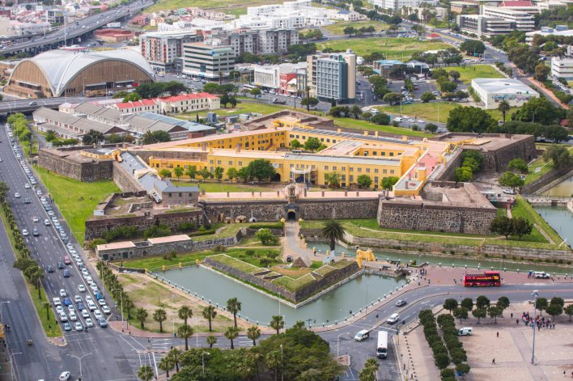

Slide 3
General introduction
1. Castle Control Board (CBB) Mandate from Castle Management Act (1993) and other relevant Legislation
2. Four (4) strategic objectives:
Good Corporate Governance and Administration
Develop the museum and interpretative heritage components
Develop and promote the Castle as a heritage tourism destination
Ensure broad, public accessibility
3. Alignment with national policy and strategic imperatives
4. The CCB manages the Castle on an enterprise-risk basis/partnerships
5. A regular, diligent process of risk assessment, risk register and mitigation i.e. going concern, revenue, safety & security, human resource management

Slide 4
BRIEF: Expected outcomes
Performance against targets set
Programmes and areas that require additional funding
Impact of any reprioritisation on the operations and management of the Department and SANDF
Areas of underperformance and measures to address these
Measures in place to address audit queries

Slide 5
2018/19 PERFORMANCE: EXECUTIVE SUMMARY
Performance Item | Score
Unqualified Audit Opinion
Increase in revenue by R35 476
Reduction in Expenditure resulting in savings of R1 734 039
Reduction in wage bill resulting in savings of R892 190
Loss of 3 managers and 2 junior staffers – disruption
Missed only 2 out of 18 of our performance targets
Maintained unprecedented media coverage reaching 365M people
Going concern risk remains…unless

Slide 6
Castle Job stats: 2018/19
Type of Employment | Totals
Full-time (CCB, Restaurant, Het Bakhuys, SANDF) | 26
Part-time contracts and paid internships | 35
Casual, temporary job opportunities inked to commercial events | 980
Non-Castle Jobs (Recruitment, Reserves) | 7
TOTAL | 1048

Slide 7
SUMMARY OF ACTUAL PERFORMANCE AGAINST (2018/19 APP TARGETS, AR PP. 20 - 24)
PERFORMANCE AREA | NUMBER OF KPI’S | UNDER/OVER | MITIGATION
Administration and Good Corporate Governance (3.1) | 4 | All 4 targets met | None
Preservation, interpretation and showcasing of the Castle’s History (3.2) | 4 | One (1) out of 4 targets not fully met; rest significantly above target | Fixed in Q1 of 2019/20
Maximizing Tourism potential (3.3) | 6 | One (1) out of 6 not met (tourism revenue but overall target the highest in history) but all others significantly above targets | Revenue optimization plan is showing significant returns
Increase public access and perception (3.4) | 4 | All 4 targets met | None

Slide 8
SUMMARY OF FINANCIAL PERFORMANCE (2018/19 BUDGET, AFS PP. 52 - 118)
Programme/activity/ objective | 2017/2018 |  |  | 2018/2019
 | Budget | Budget | Actual Expenditure | Budget | Actual Expenditure | (Over)/Under Expenditure
 | R’000 | R’000 | R’000 | R’000 | R’000 | R’000
Administration through corporate governance | 7 683 | 7 565 | 118 | 7 061 | 6 534 | 527
Preservation and protection of military and cultural heritage | 528 | 570 | (42) | 525 | 230 | 295
Maximising the Castle’s tourism potential | 63 | 39 | 24 | 60 | 3 | 57
Increased public profile and positive perception of the Castle | 264 | 279 | (15) | 204 | 294 | (90)
TOTAL | 8 538 | 8 453 | 85 | 7 850 | 7 061 | 789

Slide 9
SUMMARY OF FINANCIAL PERFORMANCE (2018/19 REVENUE, AFS PP. 86 - 89)
 | 2017/2018 |  |  | 2018/2019
Sources of Revenue | Estimate | Actual Amount Collected | (Over)/ Under Collection | Estimate | Actual Amount Collected | (Over)/Under Collection
 | R’000 | R’000 | R’000 | R’000 | R’000 | R’000
Sales | 4 500 | 4 124 | 376 | 5 000 | 4 383 | 617
Rental Income | 3 465 | 1 132 | 2 333 | 2 220 | 1 322 | 898
Other Income | 324 | 450 | (126) | 575 | 3 343 | (2 768)
Interest Income | 249 | 117 | 132 | 55 | 14 | 41
Total | 8 538 | 5 823 | 2 715 | 7 850 | 9 062 | (1 212)

Slide 10
HUMAN RESOURCES: the heartbeat of the castle (Pp. 40 – 44)
Since the CCB is a services/hospitality organization, it relies heavily on people to execute its mandate (this currently means a high staff: operations ratio);
Although the CCB only had 13 full-time posts, interns and short-term contracts (35) pushes this number up to 48 (figures exclude SANDF and other entities on site);
The salary bill for FY 2018/19 was R4 901m;
The latter is a product of (1) no direct state funding and (2) an elaborate mandate (see CM Act);
However, if one should consider the R4.5 maintenance funding from the DOD/LOG DIV as part of our budget, the ratio decreases dramatically and personnel expenses drops to 48% of total budget! This is where we should and must go.
For FY 2018/19, we have (through freezing of posts, reduction in internships, delaying of C.o.L increases and incentives) reduced our salary bill by a further R892 190!
We challenge other government entities and departments to follow our example…we need your support!

Slide 11
Previous brrR (2018) queries
PCDMV BRRR ISSUE | MITIGATION PROGRESS REPORT
One Castle, one Controlling Body | In hand-over report to EA for new EA
SANDF Guards | Vast improvement: Colonel Feni
Decreasing Surplus | Wrote to EA for bridging subsidy of between R850k – R1.2 million for the low tourism season months of April - August

Slide 12
Previous brrR (2018) queries
PCDMV BRRR ISSUE | MITIGATION PROGRESS REPORT
Strategic Risks | The Board has a Risk Register/Action Plan to deal with organizational Risks. These are thoroughly dealt with at Management, Internal Audit, Audit & Risk Committee and Board levels.
Performance Bonuses | All but a few employees has signed performance agreements. The Committee should note that no performance incentives has been paid for the FY2017/18 and 2018/19 and the Board has not approved any payments.

Slide 13
IN CONCLUSION: 1. The Board want to build and maintain good relations with this esteemed Committee; 2. In advance thank you for your unwavering support; and 3. Note that with minimal state-funded and other support, the CCB can significantly increase its’ social, economic and employment impact in the heritage sector. 4. If time permits, we want to show you some visual manifestations of the CCB’s hard work. THANK YOU!

Slide 14
Good Corporate Governance…

Slide 15
Lifestyle Events at the Castle…

Slide 16
Conferences & Expo’s at the Castle…

Slide 17
Conservation Management at the Castle…

Slide 18
Heritage Programmes at the Castle…

Slide 19
Tourism Programmes at the Castle…

Slide 20
Thank You…
Calvyn T Gilfellan
ceo@castleofgoodhope.co.za
+27823346098

