Slide 1
ANNUAL REPORT 2018/2019
PRESENTATION BY .ZA DOMAIN NAME AUTHORITY

Slide 2
CORPORATE GOVERNANCE
ZADNA’S BOARD MEETING HELD DURING THE FINANCIAL YEAR:
ZADNA Board held 7 meetings
4 ordinary, 2 special & 1 Policy Workshop
BOARD COMMITTEES MEETINGS DURING THE FINANCIAL YEAR:
ZADNA’S Board Committees also met at least quarterly during the year
Farco: 4 meetings
Hrremco: 4 meetings
Techcom: 4 meetings

Slide 3
PERFORMANCE AGAINST
ANNUAL PERFORMANCE PLAN 2018/2019
There was a total of 120 targets for the year, and ZADNA achieved 118 (98%) of the targets
There were 2 targets (2%) that were not achieved - these are deferred to 2019/2020

Slide 4
POLICY AND REGULATION
ZADNA’S PRIORITIES IN THE POLICY AND REGULATION WORK AREA FOCUSED ON THE REVIEW OF THE .ZA GENERAL POLICY
ZADNA’s priorities in the Policy and Regulation work area focused on the review of the .ZA General Policy and the draft SLR Policy. The review of the .za SLD General Policy focused on issues relating to direct registration. ZADNA achieved its targets in these areas.
ALTERNATIVE DISPUTE RESOLUTION DECISIONS PUBLISHED ON TIME:
ZADNA also succeeded in its work of publishing ADR decisions within stipulated timelines. There were 33 ADR disputes resolved during the year.

Slide 5
.ZA AWARENESS
ZADNA surpassed its awareness targets, ZADNA achieved 29 awareness events against the target of 20. The targets of 20 for media coverage was also surpassed when ZADNA achieved 27.

Slide 6
.ZA GROWTH
1 The .ZA namespace grew lesser during 2018/2019 with 37 257 new registrations than in 2017/18 where 46 711 new registrations were achieved. There were 1 222 372 registrations by 31 March 2019 compared to 1 170 472 the year before.

Slide 7
INTERNET GOVERNANCE &
TECHNICAL OPERATIONS
INTERNET GOVERNANCE
ZADNA co-hosted the 2018 ZAIGF with the Department of Digital Technologies and Communications from 16- 17 October 2018 in the Eastern Cape, East London.
IT OPERATIONS
ZADNA’s IT infrastructure used to manage .ZA SLDs functioned without any interruptions during the year. There are 5 nameservers in total, 3 of which are Anycast servers and 2 are Unicast.

Slide 8
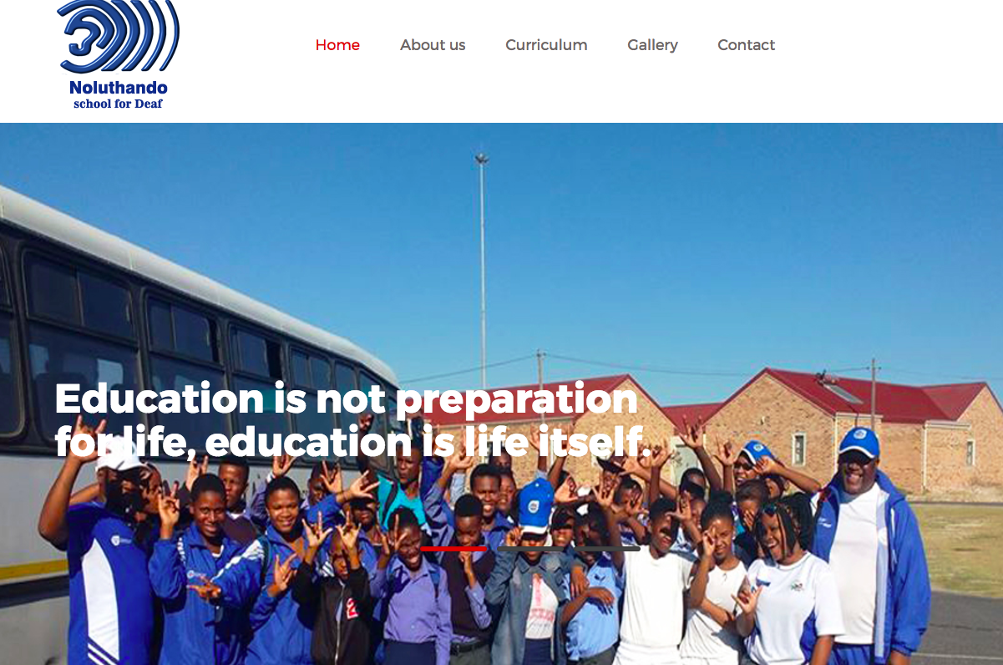
COMMUNITY ENGAGEMENT ( School Online Project)
135 .ZA school websites published.

Slide 9
FINANCIAL PERFORMANCE
The 2017/2018 Financials had to be restated to take into consideration the effect of the ZACR Settlement Agreement. The revenue was initially recorded at R7 per domain during the arbitration process. ZADNA and ZACR entered into a settlement agreement which resulted in the additional R5 (R12-R7) being recovered with effect from June 2016 hence there is a surplus for 2017/2018 and 2018/2019

Slide 10
FINANCES
The 2016/2017 and 2017/2018 Financials had to be restated to take into consideration the effect of the ZACR Settlement Agreement. This resulted in a significant increase in Accounts Receivable because of the amount outstanding from ZACR.

Slide 11
NDO LIVHUWA, NDAA.
**END**

