Slide 1
USAASA and USAF
Annual Report Presentation
Portfolio Committee on Telecommunications and Postal Services
“Universal Access and Service to ICT for All”

Slide 2


STRATEGIC OVERVIEW
Mission:
To facilitate the rollout of adequate Information and Communication Technology (ICT) infrastructure to enable universal access to under-serviced areas in South Africa.
To facilitate ICT service to under-serviced areas and thereby contributing to the reduction of poverty and unemployment in South Africa.
To promote and pursue the goal of Universal Access and Services and contribute to the sharing and preservation of information in order to build South Africa’s sustainable knowledge society.
Values:
Batho Pele – We believe in providing excellent, efficient and effective service to all customers and stakeholders.
Integrity – We uphold high standards of trust; condemn bribery and corruption; and uphold honesty and respect in all interactions with stakeholders.
Accountability – We foster employee ownership and responsibility in ensuring quality service.
Innovation – We support employee creativity in delivering all our services.
Transparency – We encourage openness in all our activities.
Teamwork – We strive to create a harmonious work environment, where all employees and contributors are respected.
Vision:
“Universal Access and Service to ICT for All”

Slide 3
2018/19 USAASA

Slide 4
SIGNIFICANT HIGHLIGHTS
For the first time, no material findings on the Audit of Predetermined Objectives (AOPO)
Achieved an unqualified audit opinion for the past four years, with emphasis of matters.
Reduction in the number of findings raised by the AG-SA as compared to the previous financial year
Adoption and embedding of effective governance principles i.e. meaningful recognition and contribution by assurance providers that led to the commissioning of two Forensic audits on Broadband and SAP ERP system
Collaboration with ICASA on the audit of Broadband and Connectivity

Slide 5
SIGNIFICANT LOWLIGHTS
50% achievement against the planned targets in the 2018/19 APP
Challenges with the SAP ERP system, including SAP ERP support and maintenance
Leadership instability, thus affecting continuity of business
Procurement processes/ contract management unresponsive (slow to respond) to business requirements (lack of appointments of service providers and irregular expenditure)

Slide 6
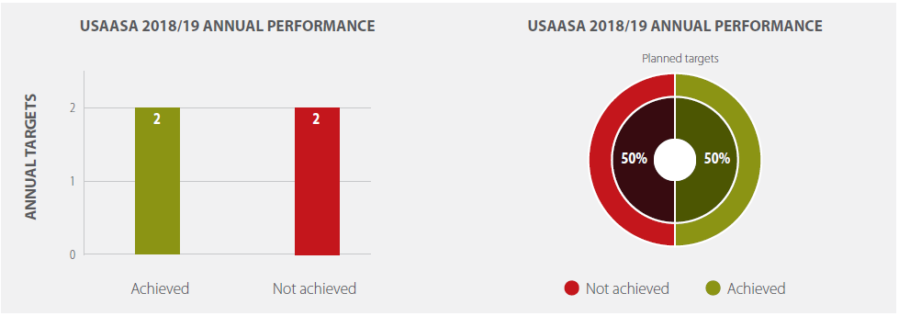
AUDITED ANNUAL PERFORMANCE OVERVIEW
SUMMARY OF USAASA ANNUAL PERFORMANCE
The below graphs depict the Agency’s achieved annual targets against the planned targets in the 2018/19 approved APP. Two of the four planned targets were achieved, a 50% achievement.

Slide 7
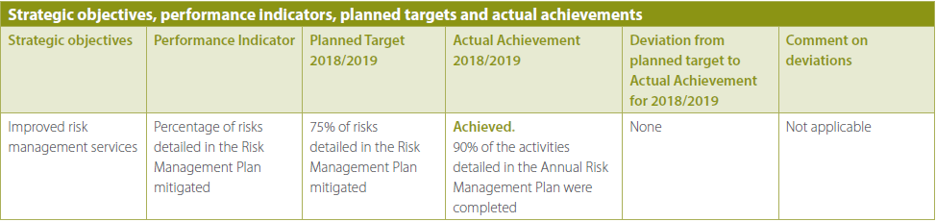
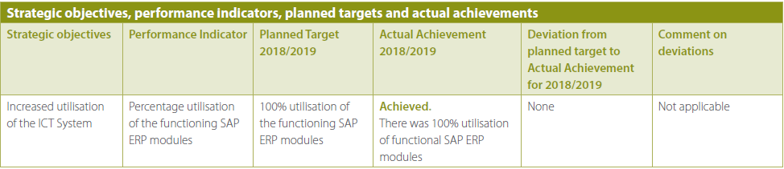
PERFORMANCE INFORMATION

Slide 8
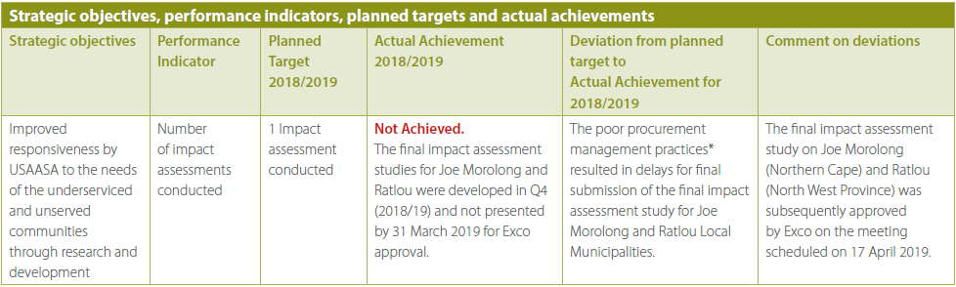
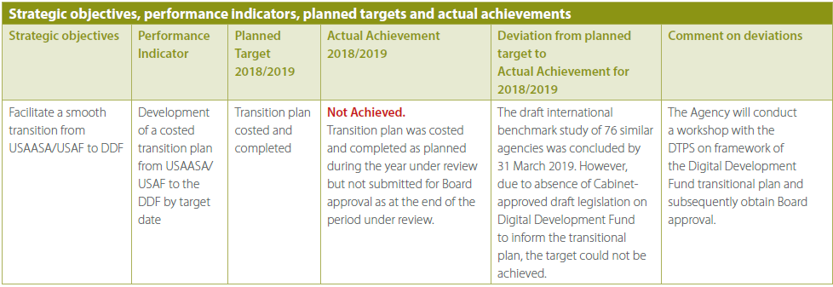
PERFORMANCE INFORMATION

Slide 9
USAASA
AUDITED FINANCIAL STATEMENTS
2018/19 FY

Slide 10
Audited USAASA Annual Financial Statements 2018/19
Universal Service and Access Agency of South Africa
Audited Annual Financial Statements for the year ended 31 March 2019
Statement of Financial Performance |  | 2019 | 2018
 |  | R’000 | R’000
Government grants & subsidies |  | 80 074 | 75 684
Interest received - investment Other income |  | 1 707 | 4 399
Recoveries |  | 125 | 20
Total revenue |  | 81 906 | 80 103
Expenditure
Employee related costs |  | - 47 781 | - 44 306
Legal fees |  | - 9 948 | - 19 717
Depreciation and amortisation |  | - 14 619 | - 16 200
Finance costs |  | - 18
Lease rentals on operating lease |  | - 5 006 | - 4 570
BDM Warehouse and Logistics |  | - | - 56 790
Loss on disposal of assets and liabilities |  | - 11 | -
Fair value adjustments |  | - 4 | - 18
General Expenses |  | - 27 684 | - 22 739
Total expenditure |  | - 105 071 | - 164 340
(Deficit) surplus for the year |  | - 23 165 | - 84 237

Slide 11
Audited USAASA Annual Financial Statements 2018/19
Universal Service and Access Agency of South Africa
Audited Annual Financial Statements for the year ended 31 March 2019
Statement of Financial Position as at 31 March 2019 |  | 2019 | 2018
 |  | R’000 | R’000
Non-Current Assets
Property, plant and equipment |  | 1 516 | 2 527
Intangible assets |  | 13 336 | 26 562
 |  | 14 852 | 29 089
Current Assets
Inventories |  | 5 | 5
Loans and receivables |  | 936 | 2 552
Cash and cash equivalents |  | 21 081 | 32 215
 |  | 22 022 | 34 772
Total Assets |  | 36 874 | 63 861
Liabilities
Non-Current Liabilities
Finance lease obligation |  | - | 51
Current Liabilities
Finance lease obligation |  | 51 | 141
Trade and other payables |  | 4 740 | 8 472
Provisions |  | 2 447 | 2 398
 |  | 7 238 | 11 011
Total Liabilities |  | 7 238 | 11 062
Net Assets |  | 29 636 | 52 799
Accumulated surplus |  | 29 636 | 52 799
The comparative figures have been adjusted accordingly to reflect correction of prior period errors.

Slide 12
Audited USAASA Annual Financial Statements 2018/19
Universal Service and Access Agency of South Africa
Audited Annual Financial Statements for the year ended 31 March 2019
Statement of Changes in Net Assets | Accumulated Surplus R’000 | Total net Assets R’000
Balance at 01 April 2017 as restated* | 137 037 | 137 037
Changes in net assets
Surplus for the year | - 84 160 | - 84 160
Total Changes | - 84 160 | - 84 160
Opening balance as previously reported | 52 877 | 52 877
Adjustments | - 78 | - 78
Balance at 01 April 2018 as restated* | 52 799 | 52 799
Changes in net assets
Deficit for the year | - 23 165 | - 23 165
Total changes | - 23 165 | - 23 165
Balance at 31 March 2019 | 29 634 | 29 634

Slide 13
Audited USAASA Annual Financial Statements 2018/19
Universal Service and Access Agency of South Africa
Audited Annual Financial Statements for the year ended 31 March 2019
Statement of Cash Flows |  | 2019 | 2018
 |  | R’000 | R’000
Cash receipts from government |  | 80 074 | 75 684
Cash paid to suppliers and employees |  | - 92 549 | - 152 104
Cash generated from operations (excl. interest) |  | - 12 475 | - 76 420
Interest income |  | 1 768 | 4 399
Finance costs |  | - 18 | -
Other income |  | 125 | -
Net cash from operating activities |  | - 10 600 | - 72 021
Cash flows from investing activities |  |  | -
Acquisition of property, plant and equipment |  | -313 | - 284
Proceeds from disposal of property, plant and equipment |  | -1 | -
Purchase of other intangible assets |  | -79
Net cash from investing activities |  | -393 | - 284
Cash flow from financing activities Finance lease payments |  | -141 | - 23
Net cash from financing activities |  | -141 | - 23
Total cash movement for the year |  | -11 134 | - 72 328
Cash and cash equivalents at the beginning of the year |  | 32 215 | 104 543
Cash and cash equivalents at the end of the year |  | 21 081 | 32 215

Slide 14
Audited USAASA Annual Financial Statements 2018/19
Statement of Comparison of Budget and Actual Amounts | Approved Budget R’000 | Adjustments R’000 | Final budget R’000 | Actual amounts on comparable basis R’000 | Difference between final budget and actual R’000 | Reference
Statement of financial Perfomance Revenue Revenue from exchange transactions Recoveries Interest received – investment | - - | - - | - - | 125 1 707 | 125 1 707 | Recoveries from former employee(s) Interest earned from short-term call account
Total revenue from exchange transactions | - | - | - | 1 832 | 1 832
Revenue from non-exchange transactions Transfer revenue Transfers & subsidies received | 80 074 | 22 740 | 102 814 | 102 814 | - | Transfer received from DTPS including 22.740mil retained surplus from 2017/18 financial year.
Total revenue | 80 074 | 22 740 | 102 814 | 104 646 | 1 832
Expenditure Employee related costs Legal fees Depreciation and amortisation Lease rentals on operating lease Finance costs General Expenses | (51 580) | - | (51 580) | (47 781) | 3 799 | Saving realised due to vacancies during the year.
 | (692) | (12 618) | (13 310) | (9 948) | 3 362 | R12.6m of the approved retained surplus allocated to Legal fees
 | (4,624) | - | (4,624) | (14 619) (5,006) | (14,619) 382 | Non cash flow item Savings realised due to to the reduction of regional offices rented
 | - | (18) | (18) | (18) | -
 | (23,178) | (10,104) | (33, 282) | (27,684) | 5 598 | R10.1 mi of the approved retained surplus allocated to general Expenses.
Total expenditure | (80 074) | (22 740) | (102 814) | (105 056) | (2 242)
Operating deficit Loss on disposal of assets and liabilities Fair value adjustments | - - | - - | - - | (410) (11) (4) | (410) (11) (4) | Non cash flow item Non cash flow item
Deficit before taxation | - | - | - | (425) | (425)
Actual Amount on Comparable Basis as Presented in the Budget and Actual Comparative Statement | - | - | - | (425) | (425)

Slide 15
2018/19 USAF

Slide 16

SIGNIFICANT HIGHLIGHTS
No material findings on the Audit of Predetermined Objectives (AOPO)
Reduction in the number of findings raised by the AG-SA as compared to the previous financial year
Collaboration with ICASA on the audit of Broadband and Connectivity

Slide 17
SIGNIFICANT LOWLIGHTS
Received a qualified audit opinion for two consecutive years.
Failed processes for BDM inventory management
Expiry of Installers' contract that led to stoppage of installations
Failed procurement processes for the appointment of a service provider to roll out broadband infrastructure in PSJ and Ingquza Hill local municipalities
9% achievement against the planned targets in the 2018/19 APP

Slide 18
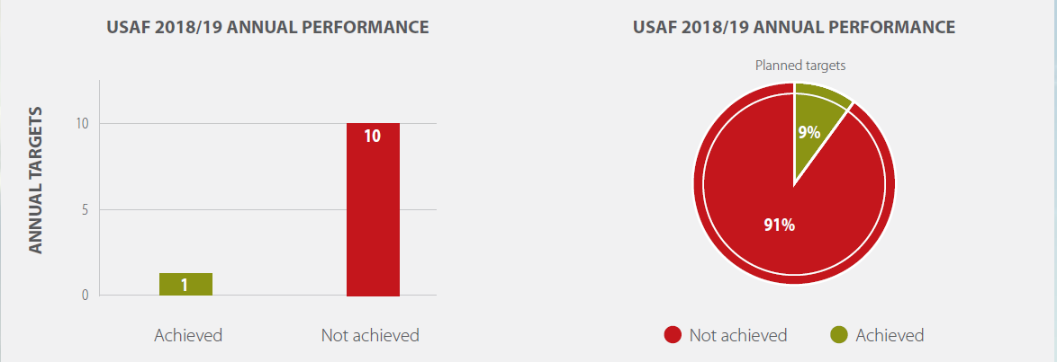
AUDITED ANNUAL PERFORMANCE OVERVIEW
SUMMARY OF USAF ANNUAL PERFORMANCE
The below graphs depict the Fund’s achieved annual targets against the planned annual targets in the 2018/19 approved APP. One of the eleven planned targets was achieved, resulting in a 9% achievement, and ten of the eleven planned targets were not achieved, resulting in 91% non-achievement.

Slide 19
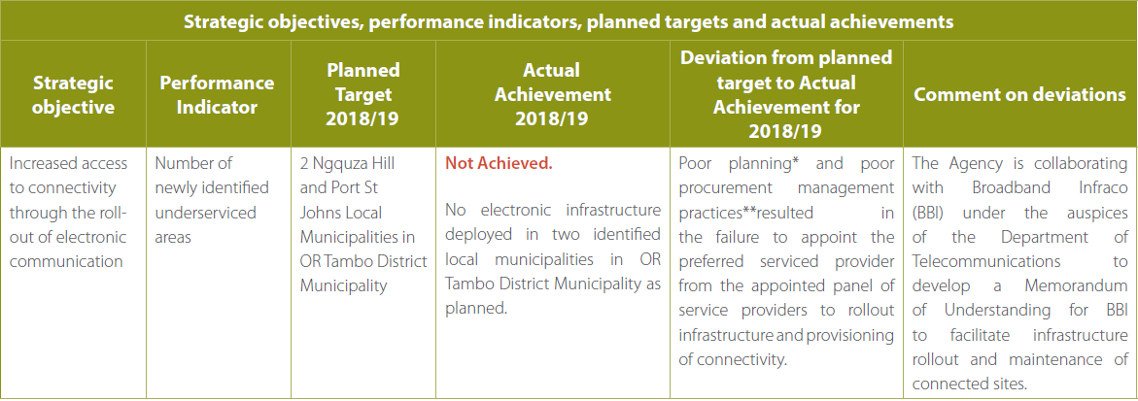
PERFORMANCE INFORMATION

Slide 20
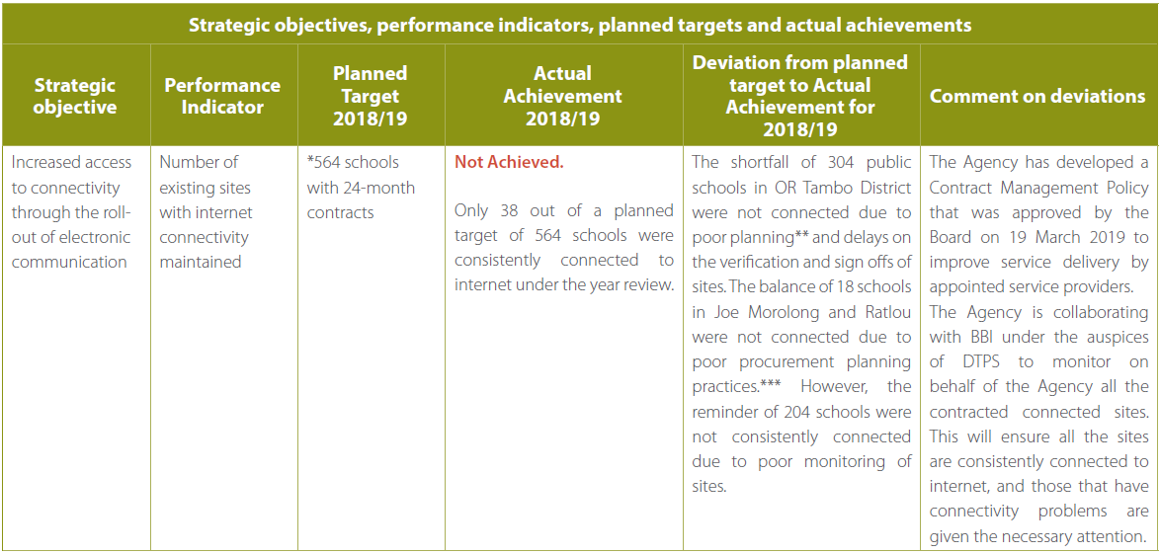
PERFORMANCE INFORMATION

Slide 21
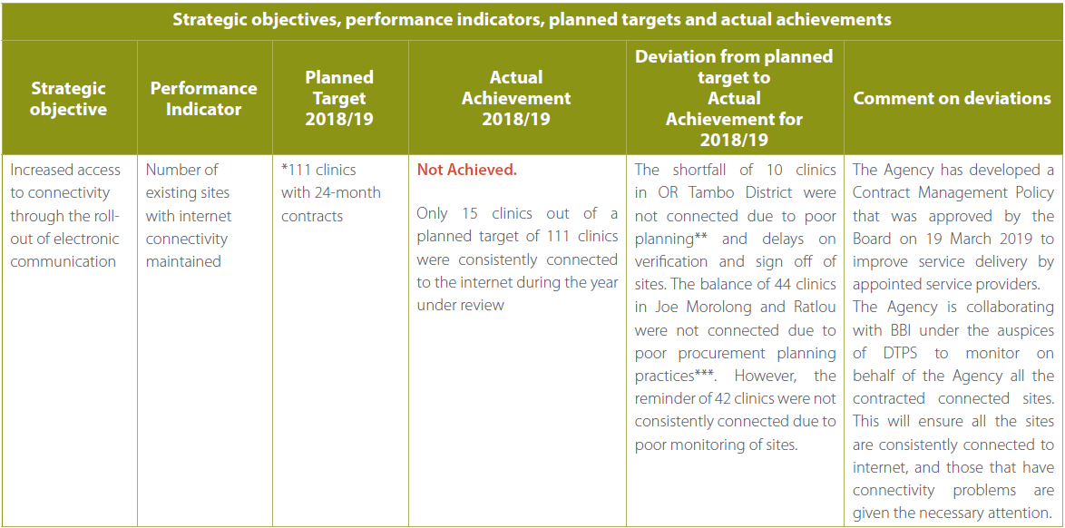
PERFORMANCE INFORMATION

Slide 22
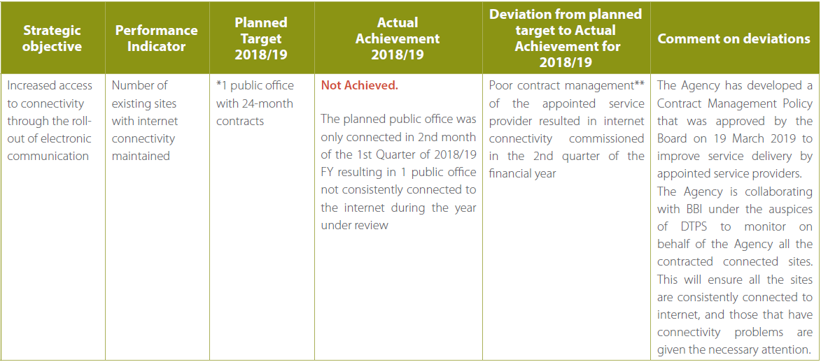
PERFORMANCE INFORMATION

Slide 23
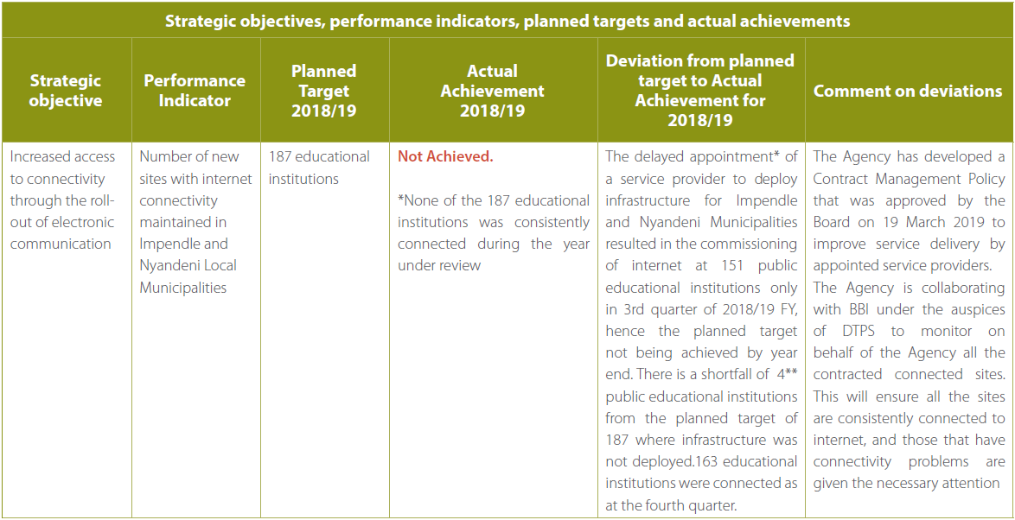
PERFORMANCE INFORMATION

Slide 24
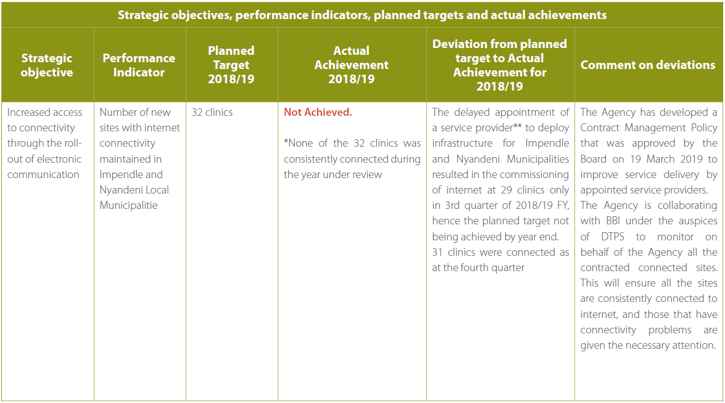
PERFORMANCE INFORMATION

Slide 25
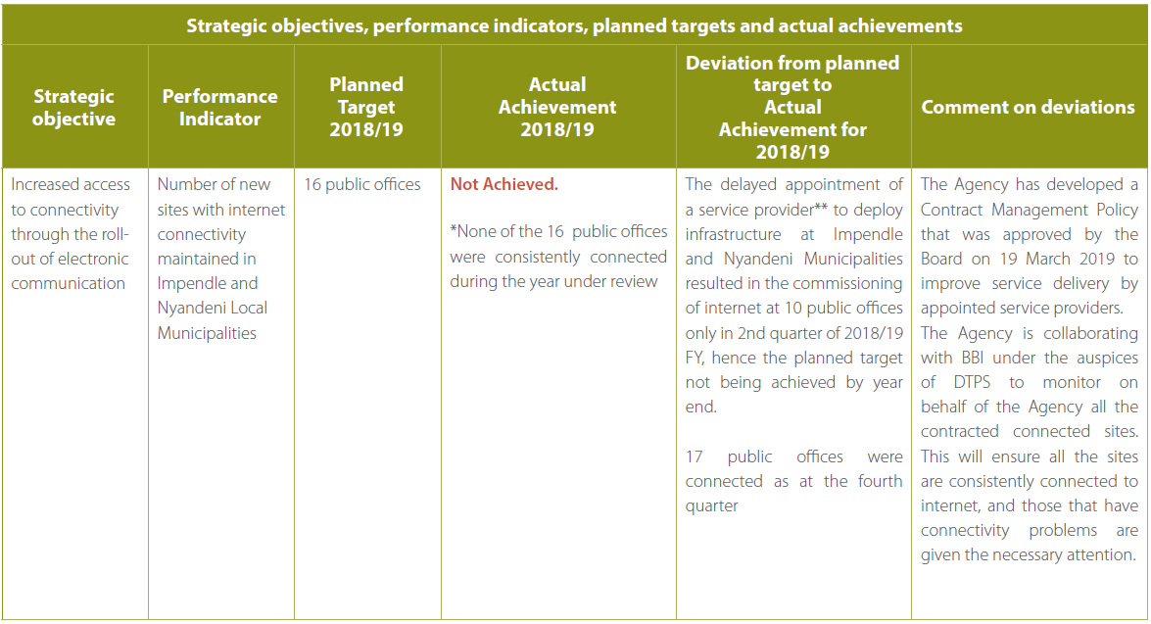
PERFORMANCE INFORMATION

Slide 26
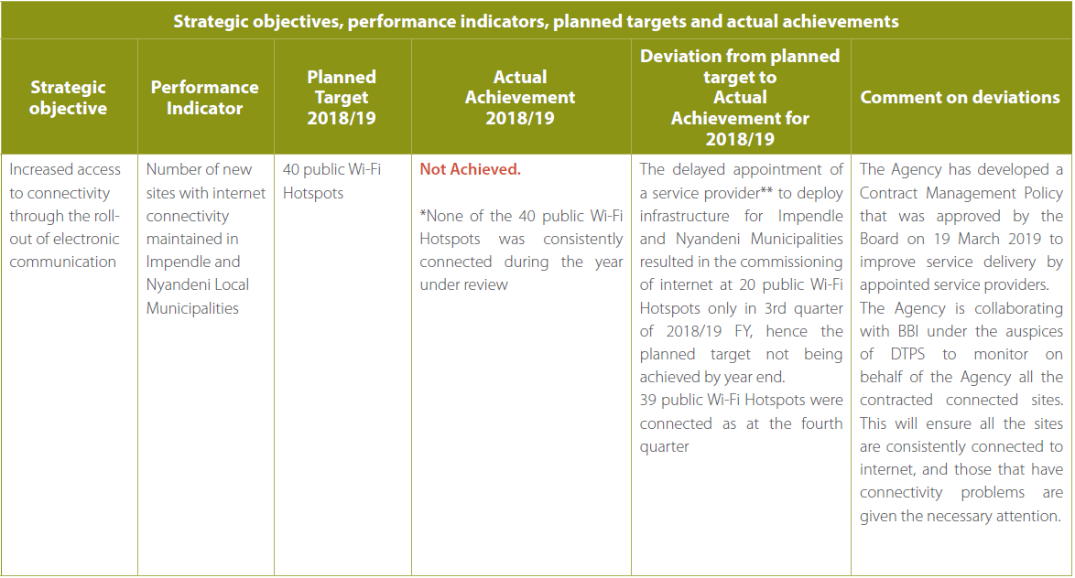
PERFORMANCE INFORMATION

Slide 27
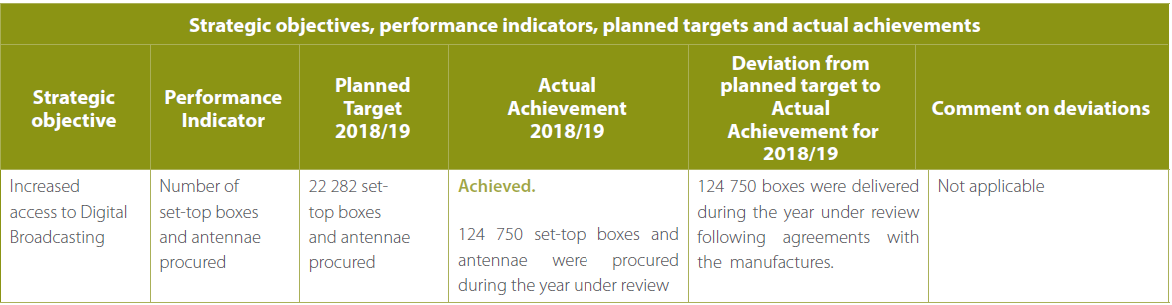
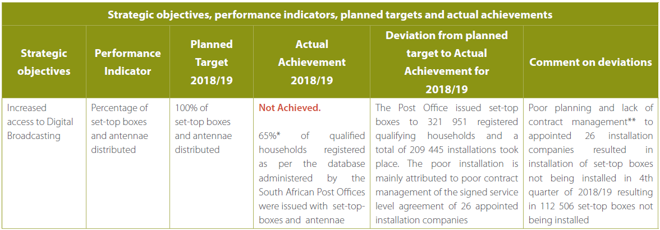
PERFORMANCE INFORMATION

Slide 28
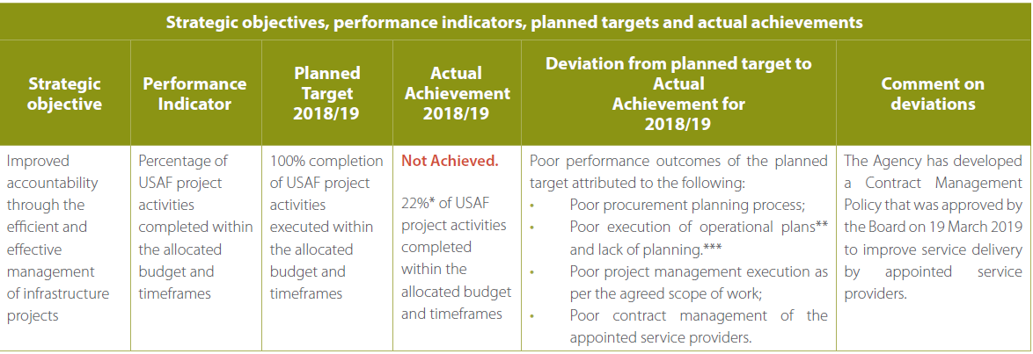
PERFORMANCE INFORMATION

Slide 29
USAF
AUDITED FINANCIAL STATEMENTS
2018/19 FY

Slide 30
Audited USAF Annual Financial Statements 2018/19
Universal Service and Access Fund Audited Annual Financial Statements for the year ended 31 March 2019 Statement of Financial Performance
 |  | 2019 R’000 | 2018 R’000
Transfers and subsidies Finance income Other income |  | 76,721 82,398 - | 133,712 105,712 -
Total revenue |  | 159,119 | 239,424
Expenditure Finance Costs ICT Rapid Deployment and connectivity projects Digital Terrestrial Television Project Broadband Project Audit Fees Administrative Expenses |  | (4,008) (537) (320,712) (32,376) (910) (2)) | - (977) (369,304) (26,994) (837) (3))
Total expenditure |  | (358,545) | (398,115)
(Deficit)Surplus for the year |  | (199,426) | (158,691)
The comparative figures have been adjusted accordingly to reflect correction of prior period errors.

Slide 31
Audited USAF Annual Financial Statements 2018/19
Universal Service and Access Fund Audited Annual Financial Statements for the year ended 31 March 2019 Statement of Financial Position
 |  |  | 2019 R’000 | 2018 R’000
Assets Current Assets Receivables from exchange transactions Inventories - DTT/ DTH Other receivables Cash and cash equivalents |  |  | 7,185 509,531 - 1,347,691 | 20,037 654,097 - 1,399,788
 |  |  | 1,864,407 | 2,073,922
Current Assets Total Assets |  |  | 1,864,407 1,864,407 | 2,073,922 2,073,922
Liabilities
Current Liabilities Payables from exchange transactions Provisions |  |  | 8,409 6,066 | 24,563 -
Total Liabilities |  |  | 14,475 | 24,563
Net Assets |  |  | 1,849,932 | 2,049,359
Accumulated surplus |  |  | 1,849,932 | 2,049,359
The comparative figures have been adjusted accordingly to reflect correction of prior period errors.

Slide 32
Audited USAF Annual Financial Statements 2018/19
Universal Service and Access Fund Audited Annual Financial Statements for the year ended 31 March 2019 Statement of Changes in Net Assets
 |  | Accumulated surplus R’000 | Total net assets R’000
Balance at 01 April 2017 Changes in net assets Deficit for the period Transfer of income surplus to National Revenue Fund |  | 2,449,851 (158, 691) (241 800) | 2,449,851 (158, 691) (241 800)
Total Changes |  | (400,491) | (400,491)
Opening balance as previously reported Adjustment of Prior year expenses |  | (2,001,247) 48,111 | (2,001,247) 48,111
Balance at 01 April 2018 Changes in net assets Deficit for the period |  | 2,049,358 (199,426) | 2,049,358 (199,426)
Total changes |  | (199,426) | (199,426)
Balance at 31 March 2019 |  | 1,849,932 | 1,849,932
The comparative figures have been adjusted accordingly to reflect correction of prior period errors.

Slide 33
Audited USAF Annual Financial Statements 2018/19
Universal Service and Access Fund Audited Annual Financial Statements for the year ended 31 March 2019 Statement of Cash Flows
 |  |  | 2019 R’000 | 2018 R’000
Cash flows from operating activities Receipts Grants |  |  | 76,721 | 133,712
Payments Suppliers Finance costs |  |  | (207,509) (4,008) | (464,851)
Net cash flows from operating activities |  |  | (134,796) | (331,139)
Cash flows from investing activities Transfer from Revenue Fund Interest Income |  |  | 82,700 | (241,800) 105,712
Cash flows from financing activities Repayment of inter-entity loan |  |  | - | -
Net cash from financing activities |  |  | - | -
Net increase/(decrease) in cash and cash equivalents Cash at the beginning of the period |  |  | (52,096) 1,399,788 | (467,227) 1,867,015
Net increase in cash and cash equivalents |  |  | 1,347,692 | 1,399,788
The comparative figures have been adjusted accordingly to reflect correction of prior period errors.

Slide 34
Audited USAF Annual Financial Statements 2018/19
Statement of Comparison of Budget and Actual Amounts
Budget on Cash Basis
Statement of Financial Performance Revenue Revenue from exchange transactions Interest received | Approved budget | Adjustments | Final Budget | Actual amounts on comparable basis | Difference between final budget and actual | Reference
 | R’000 | R’000 | R’000 | R’000 | R’000
 | - | 82 398 | 82 398 | 82 398 | - | Interest earned from short-term investment – Call account.
Revenue from non-exchange transactions Transfer revenue Government grants & subsidies | 95 661 | 205 752 | 301 413 | 301 413 | - | Initial approved budget for USAF was R96million.A budget reduction of R19million was done as an adjustment during the year. Adjustment was done on the BDM project allocation. There was also an addition of approved retention of funds amounting to R224 692million from 2017/18 financial year. .
Total revenue | 95 661 | 288 150 | 383 811 | 383 811 | -
Expenditure Finance costs ICT Rapid Deployment and connectivity projects Digital Terrestrial Television Project Broadband Project | (21,017) (37,880) (35,259) | (4.008) - (1,134,186) (201,744) | (4,008) (21,017) (1,172,066) (237,003) | (4,800) (537) (320,712) (32,376) | - 20,480 851,354 204 627 | Interest charged as a result of arbitration process Savings realised due to contracts ending during the year. Distribution of set top boxes have increased due to bulk installations. Committed funds amount to R1,1 billion from previous financial year are available to install the inventory on hand and awaiting delivery. Projects to be completed in the following financial year
Audit fees | (1,482) | - | (1,482) | (910) | (572) | Audit cost incurred during the year mainly for 2017/18 audit process
Administrative expenses | (23) | - | (23) | (2) | 21 | Bank charges during the year have decreased.
Total expenditure | (95 661) | (1 339 938) | (1 435 599) | (358 545) | 1 077 054
Surplus from operations | - | (1 051 788) | (1 051 788) | 25 266 | 1 077 054
Actual Amount on Comparable Basis as Presented in the Budget and Actual Comparative Statement | - | (1 051 788) | (1 051 788) | 25 266 | 1 077 054

Slide 35
        CORRECTIVE ACTIONS

Slide 36
SIX MONTHS TURNAROUND ACTION PLAN

Slide 37
ADDRESSING “PERFORMANCE ENEMIES”
The USAASA Board together with Management have developed a six months turnaround action plan which covers the following eight (8) areas:
Reframe the USAASA / USAF service delivery model – secure policy certainty from Shareholder
Strengthen planning and execution of core mandate – address underspending of budget
Strengthen demand planning, SCM and Contract management capability
Manage litigation exposure
Addressing non-supportive systems, policies and processes
Review of USAASA / USAF organisation design – improve capacity and capability, and improve working conditions
Addressing organisational culture and staff issues
Addressing poor perception of USAASA, and addressing unethical conduct and practices within the organisation

Slide 38
REVIEW OF THE BROADBAND ROLL OUT MODEL

Slide 39
KEY FOCUS AREAS
Collaborations
Collaborate with BBI on new Infrastructure rollout
Explore possibility of utilizing BBI NOC monitoring system
Proposal new broadband remodel
Key to the new broadband model is the USAASA/BBI collaboration
One of the key aspects is to enable longer contracting terms
Technology focus
Infrastructure deployed should be future enabled.
To be inline with local & international standards
Certain aspects dependent on National Treasury
Look at the issue of network ownership – Revisit the ECA
4IR benefits for rural communities

Slide 40
ESTABLISHMENT OF A PROJECT MANAGEMENT UNIT
BROADCAST DIGITAL MIGRATION

Slide 41
PURPOSE OF A PROJECT MANAGEMENT OFFICE
Increase Capacity and specifically manage the implementation of the Broadcast Digital Migration program
Accelerate the installation of the remaining 1 million set-top boxes
  Accelerate the completion installations in the Free State, NC and NW (516 to be installed by year end)
Jointly with the DOC and other stakeholders, communicate the program to beneficiaries, educate and provide consumer awareness to affected households.
Jointly undertake registration drives
Improve the management of suppliers (SAPO, STB manufacturers)

Slide 42

THANK YOU

