Slide 1
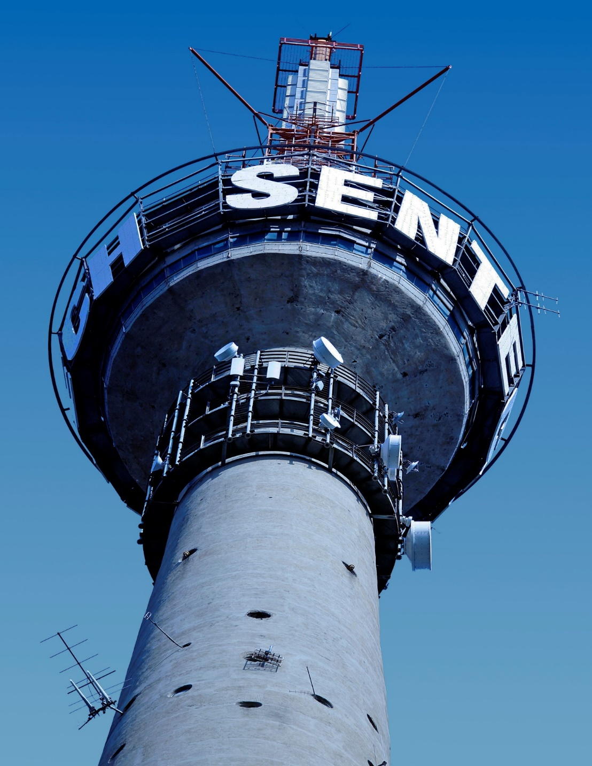
SENTECH INTEGRATED ANNUAL REPORT
For the year ended 31 March 2019
PRESENTATION TO
PORTFOLIO COMMITTEE ON COMMUNICATIONS
15 OCTOBER 2019
CAPE TOWN

Slide 2
Presentation Contents
Performance Highlights
Strategy Overview
Performance Against Corporate KPIs
Annual Financial Statement
Governance
Risks Management
Strategic Priorities for the next MTEF Period
Conclusion and Way Forward

Slide 3
Performance Highlights
Revenue grew by 4%
------------------------
R1,4 billion
EBIT grew to
----------------
R142m
Transformation spend (ESD, SD and CSI)
----------------
11.4% of NPAT
Customer satisfaction level of 65%
7th
Consecutive year of clean audit
78% of KPIs achieved
B-BBEE Level 2 Maintained

Slide 4
Strategy Overview

Slide 5
OUR STRATEGY
VISION
A global leader in digital content delivery
MISSION
Connecting customers anywhere through innovative solutions
VALUE PROPOSITION
Keeping our customers connected all the time anywhere
STRATEGIC IMPERATIVES
Build a profitable wireless broadband business
2) Pursue inorganic growth through mergers & acquisitions, strategic alliances and partnerships
3) Develop and offer innovative digital content delivery solutions
4) Pursue Pan-Africa business opportunistically
5) Drive operational excellence and high performance culture
VALUES
Integrity
Innovation
Accountability
Social Responsibility
Quality Customer Service

Slide 6
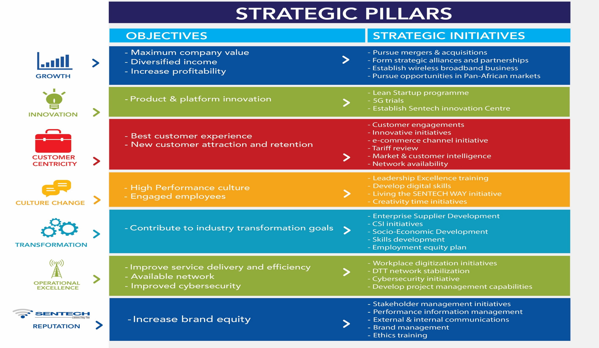

Slide 7
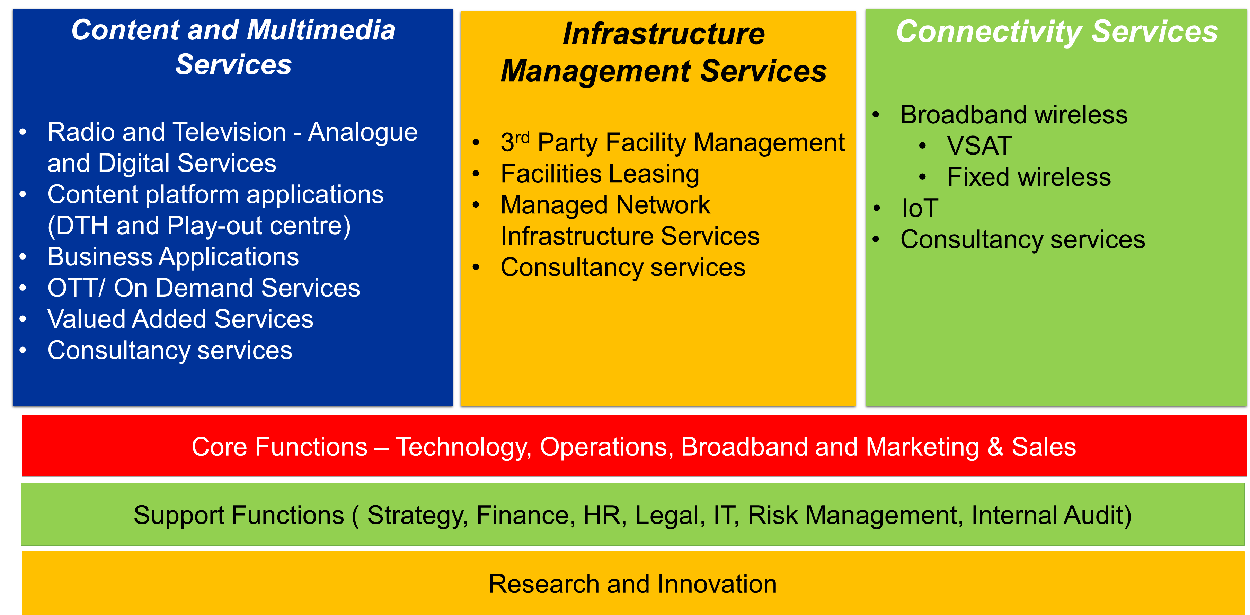
Business Model
The current business model puts more emphasis on across-the-board research, development and innovation; the products and services are focused in three categories, namely, Content and Multimedia Services, Infrastructure Management Services and Connectivity Services

Slide 8
Performance Against Objectives : Corporate KPIs

Slide 9
Performance Against Strategic Objectives
Strategic Objectives | Annual Target | Actual Performance | Status
Increase sales revenue | R1 290 million | Revenue R1 268 million | Not Achieved
Increase Earnings Before Interest and Tax (EBIT) | R125 million | Achieved EBIT of R140 million | Achieved
Contribution to socio-economic transformation | Five percent (5%) spend of allocated budget on Enterprise and Supplier Development (ESD), NPAT spend 1.5% on Socio- Economic Development and Skills Development wage expenditure (3%) | Achieved ESD spend of 6.07%; SED at 2.45% and 3.54% on Skills development wage expenditure | Achieved
Achieve Clean Audit | Clean Audit Achieved | Clean Audit Achieved | Achieved

Slide 10
Performance Against Strategic Objectives (continued..)
Strategic Objectives | Annual Target | Actual Performance | Status
Ensure network availability meets SLA requirements across all platforms | Weighted average availability based on product revenues of 99.80% | Achieved 99.85% of Weighted average network availability | Achieved
Enhanced customer orientation | Achieve 80% customer satisfaction level | Customer satisfaction level of 65% | Not Achieved
Enhance human capital development | 85% of planned training interventions on digital skills implemented | 163% of training interventions on digital skills implemented | Achieved
Enhance innovation | 2 digital products developed | 2 digital products (OTT and Fixed Wireless) developed | Achieved
Support SA Connect through delivery of Internet for All Project | 4 Broadband sites connected | 6 Broadband sites connected | Achieved

Slide 11
Financial Performance

Slide 12
Financial Summary
Description | Year ended 31 March 2019 R’000 | Year ended 31 March 2018 R’000 | Year ended 31 March 2017 R’000
Turnover | 1 399 127 | 1 349 590 | 1 232 619
Normalized EBIT (excluding shortfall in dual illumination funding) | 141 738 | 141 919 | 103 461
Dual illumination funding shortfall | 0,00 | 0,00 | (48 194)
EBIT | 141 738 | 141 919 | 33 955
EBIT margin % | 10% | 11% | 3%
Net profit | 182 726 | 152 792 | 104 153
Cash generated from operations | 74 974 | (123 047) | 92 486
Acquisition of Property Plant and equipment and Intangible Assets | (78 837) | (110 216) | (274 615)
Government grants received | 177 305 | 215 789 | 87 719
Cash balances | 1 112 407 | 916 149 | 907 357
Total Equity | 2 209 876 | 1 920 014 | 1 767 472
Return on Equity | 8% | 8% | 6%

Slide 13
Financial Analysis
EBIT
Despite marginal growth in revenue of 4% EBIT for year was almost at the same the previous financial year. Cost containment measures throughout the organization enabled the company to at least maintain overall cost increase to be in line with revenue growth.
EBITDA
EBITDA was boosted by lower depreciation during the financial year.
NET PROFIT
Net profit increased by 19% due higher interest income on overdue accounts and reduction in deferred taxation.
Notes:
REVENUE
Total revenue grew by 4% to R1,399 million when compared to the previous financial year (R1 349 million), primarily due to:
CPI related adjustment year on year of 4,8.
There were above inflation growth in connectivity business (11%) and an
increase in facility rentals (9%) due to new customers and expansion in services.
Despite the year-on-year revenue growth, there was an underperformance of R50m (4%) against the corporate plan, primarily due to:
Direct-To-Home (DTH) cancellations and tariff revisions,
slower than anticipated growth of the connectivity business, and
slower commercialisation of Digital Terrestrial Television (DTT) due to delays in ASO resulting in fewer DTT sites operating commercially as at 31 March 2019.
EBIT
Total expenditure incurred in the current year has increased by 4% overall which is below inflation, with significant contribution by employee related costs, operating expenses and other direct expenses. These are further analysed as follows:
Employee costs: Costs increased by R37m during the year because of increase in employee salaries and an increase in personnel by 24 new staff members. The increase is further explained by expenditure on relocations of employees from the Kroonstad and Meyerton sites which have been closed.
Operating expenses: Costs increased on an overall basis by 7% (R16m) due to:
Selling expenses: Expenses increased by 5% (R1m) because of increase in CSI sponsorships in the 2018/2019 year.
Administrative costs: The increase of 24% (R19m) is mainly due to stock write off at the Meyerton site (R12m), write off of new office furniture below the value of R 5000 per the Asset Management Policy (R2m) and an increase in software maintenance (R5m).
The increase in operating expenses was offset by a decrease in operating expenses of 3% (R4m). The movement was due to decrease in accommodation and meal costs R2m and sundry repairs R2m.
Direct expenses: Costs increased by 6% (R11m) when compared to the prior year, primarily due the annual and incremental NERSA approved adjustments imposed by Eskom and Municipal Councils. Direct expenses were further impacted by increased use of diesel at sites during periods of load shedding.
NET PROFIT
Despite the marginal growth in revenues, the company achieved a net profit increase of R29m from the prior year whilst the total comprehensive income increased by R137 million. This positive impact on the profitability was a result of marginal increase in finance income of R14m earned from SENTECH invested funds and interest charged on overdue accounts and a reduction in tax expense by R16m due to current year deferred tax implications and tax recovered from government grant.
Profitability was further enhanced by the decrease of 14% (R13m) in depreciation and amortisation due to assets reaching end of life as well as reduction in satellite rentals due to favourable exchange rates between the ZAR/USD plus a transponder lease that was not renewed. Other comprehensive income has increased substantially due to impact of the revaluation of Land and buildings (R139m) with the corresponding effect of deferred tax (R31m).

Slide 14
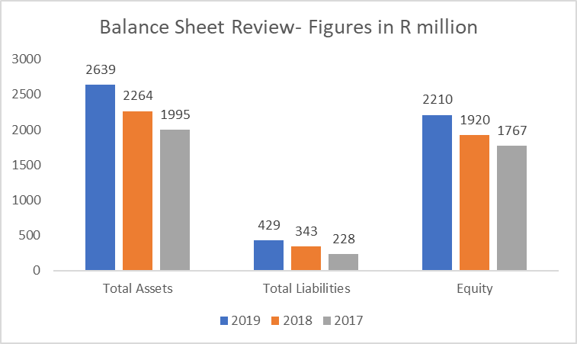
Financial Position Analysis
Total Assets increased from the previous financial due to the following:
Revaluation of Assets in line with company policy, this resulted in upward valuation of R130 million.
Improvement in cash balances due company wide cash preservation efforts and
Increase in trade receivables
Total Liabilities increased mainly due to the deferred taxation on revaluation surplus and differed income relating to government grants which will be utilized in the 2019/20 financial year.
Overall Equity was therefore boosted by the upward valuation of assets and profits made during the year.
Notes:
The company remains in a strong financial position. The net asset value of the company (total assets less total liabilities) increased by just over R290 million to R2,2 billion due to the profits made during the year and the revaluation of assets.

Slide 15
Cash flow analysis
Cashflow analysis
Cash flow from operations and overall cash balances improved during the year due to the following:
Improvement in cash payments from major customers and
Cost containment measures and optimization of capital investments.
Notes:
The cash balance in the current year has increased in the current year despite financial challenges at the SABC. Cash generated from operations increased in the current year from a negative in the last year mainly due to cost containment measures coupled with rigorous collection measures and grant funding received from the shareholder. It should also be noted that SABC serviced their debt in the year under consideration

Slide 16
Financial Outlook - MTEF Plan
Financial Outlook over the MTEF period
Description | Year ended 31 March 2020 R’000 | Year ended 31 March 2021 R’000 | Year ended 31 March 2022 R’000
Turnover | 1 264 563 | 1 273 512 | 1 339 735
EBIT | 116 117 | 88 007 | 92 583
EBIT margin % | 9,2% | 6,9% | 6,9%
Net profit | 112 282 | 77 681 | 81 720
Cash generated from operations | 233 211 | 25 984 | 54 861
Acquisition of Property Plant and equipment and Intangible Assets | (200 817) | (203 609) | (211 265)
Government grants received | 218 203 | 231 038 | 85 593
Cash balances | 1 286 907 | 1 340 320 | 1 269 509
Total Equity | 2 193 418 | 2 271 099 | 2 352 819
Return on Equity | 5% | 3% | 3%

Slide 17
Financial Outlook
Conclusion on Financial Performance
Volatile currency and slow economic growth will continue to have an impact on the performance of the company going forward.
Challenges facing community broadcasters and one of the major customers still continue, however management expects resolution of these issues in the 2020 year.
Revenue outlook has decreased in anticipation of analogue switch off.
The company will continue to streamline processes , strengthen business development, execute capital projects aimed at growing revenue , contain costs and diversify revenue.
In the medium to long term , the company will pursue opportunities in the African continent, identify possible acquisitions and grow the Managed Infrastructure Business.
Long term funding plan will be reviewed in light of the funding requirements for the growth of the business.

Slide 18
Governance and Risk Management

Slide 19
Board Structures
Board
Audit & Risk
Human Resources, Nomination & Remuneration
Social & Ethics
Investment Committee
Technology, Sales & Regulatory Coordination
SENTECH embraces governance principles and practices that are underpinned by an independent and diverse Board striving to ensure the creation of value in a manner that is sustainable for its stakeholders. The Board has ultimate accountability and responsibility for the performance and affairs of SENTECH and ensures that SENTECH adheres to high standards of ethical behavior. Governance at SENTECH entails a culture committed to sound processes and procedures, which goes beyond legal compliance and ensures sustainability long after a law and its iterations have been implemented.
In terms of the SENTECH Act, the Board shall consist of three executive directors and at least four non-executive directors, who are all appointed by the Minister. Board Committees facilitate the discharge of responsibilities and provide in-depth focus, oversight and guidance on specific areas, and report to the board through their respective chairpersons. The Company Secretary assists the Committee chairpersons with drafting the reports which they present to the Board. To this end, the Board has established four Board Committees, set out above.

Slide 20
Risk Management Review – Key risks
Risk | Risk Description | Risk Mitigations
Current and New Products | Entrance of disruptive technologies and new competing players in the market. | Regular assessment of products for market fit through benchmarking are conducted and new products are being developed.
Regulatory Environment | The impact of the SOC rationalisation process and the absence of policy direction on digital broadcasting. | SENTECH participates in the SOC rationalisation Steercom and processes. Regular engagements with the Department of communications, DTPS and ICASA on the regulatory policies that impacts on SENTECH, in particular, the Broadcasting Policy.
Ageing Infrastructure | Delayed Analogue Television network switch-off and technology obsolescence | SENTECH has deployed a national DTT network to replace analogue infrastructure. An ASO plan to spearhead the migration process has also been developed. Solution replacement plans and programmes are in place for ATV, FM, MW and VSAT. Continuous engagement of the DoC, DTPS and other key stakeholders through DTT Project Management Office to expedite commercialisation of DTT services and ASO.

Slide 21
Risk Management Review – Key risks
Risk | Risk Description | Risk Mitigations
Physical and Cyber Security | Inadequate physical security measures in remote sites, Cybercrime and deterioration of socio-economic status (crime- effect on operations). | Approved Physical Security Strategy that is linked with the Cyber Security Strategy is in place. Engagement with some communities. Sourcing of partners for implementation of the plans for National Key Points and IT security.
Financial Sustainability | Exposure to foreign exchange rates fluctuations; Increased costs of operations and delayed ASO which has an impact in dual illumination and technology obsolescence as well as credit downgrades of South Africa during the year by the rating agencies. | Forward contracts as part of standard practice on foreign currency dominated supplies to control the risk of unfavourable exchange volatility and natural hedging is aggressively pursued to apply SENTECH’s own foreign currency reserves to discharge foreign supplier commitments. Cost reduction strategies and diversification of products and services to decrease the risk of over reliance on one major customer and business expansion strategies in other areas. Engagement of the Shareholder and other stakeholders to expedite ASO.

Slide 22
Strategic Priorities for the MTEF period

Slide 23
Revenue and profitability growth
As part of our Growth Strategy, the organisation will pursue both organic and inorganic growth strategies through building a broadband business, strategic partnerships and acquisitions to realise revenue diversification.
The organisation will build a broadband business in fulfilling its mandate and has invested in several refresh technologies to enhance the performance levels of its connectivity services to service its existing and future clients.

Slide 24
Innovation and digitisation
The organisation will pursue innovative ways to meet its customers’ expectations and this entails building digital skills and capabilities.
For SENTECH to be part of the digital convergence and innovative solutions delivery, the organisation will invest in its human capital and capabilities to enable its workforce to drive innovation.

Slide 25
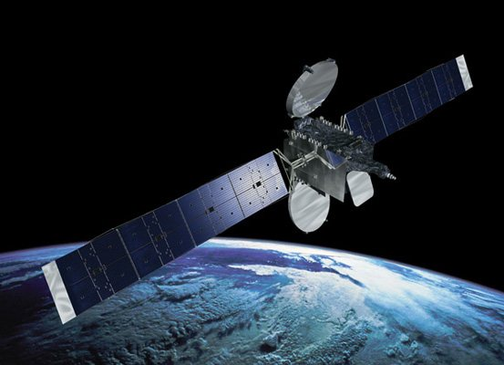
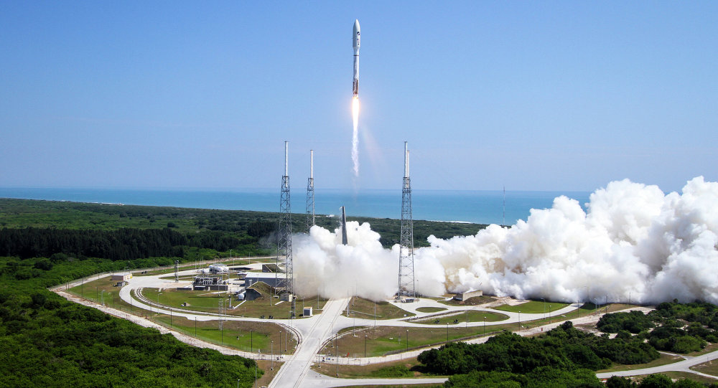
South African-Based Pan-African Satellite
The organisation is participating in the development of National Satellite Communication Strategy for a communication Pan-African Satellite as a means to address the cost of communication and to achieve the country’s broadband objectives.
The project process is underway, starting with consultation with all stakeholders in government
Once all Cabinet approvals are in place, the project will be officially launched.

Slide 26
Conclusion and Way Forward
The SENTECH strategy aims to ensure sustainability of the organization and its customers through product enhancement and introduction new products and services.
During this term we have build new capabilities and anticipate to have a significant portion of our core platforms to be fully digitized in the next term.
We plan to break new markets and create capacity and capabilities for SENTECH of the future.
Although the year was difficult, challenged by the slow economy growth factors and load shedding, we have managed to keep the organization operations sustainable for the year under review with below key Highlights.
Overall positive performance for the year , with clean audit.
Achieved 78% performance against predetermined KPIs.

Slide 27
Conclusion and Way Forward
We anticipate that the next MTEF period will be challenging, with growing competition for media resulting form the digital Convergence. We will place more focus on business sustainability through the following growth strategy initiatives
Implementation of the M&A Strategy;
Establishing the broadband business;
Growing the Facilities Leasing businesses; and
Operational efficiency and cost containment
We will also ensure good corporate governance, and develop our people to ensure successful delivery of our strategy while placing focus on the followings;
More focus on Research and Innovation;
Develop skills for 4IR by training our staff in new areas of technology
Improve stakeholder relationships.

Slide 28
Thank You!

