Slide 1
2018-2019 Annual Report
Presentation to the Portfolio Committee on Communications
Presented by: Acting Chief Executive Officer, Mr Ntutule Tshenye
Date: 15 October 2019

Slide 2
Content
Performance Information
Human Capital Management
Governance
Directors Report
Audit, Risk and Compliance Report
Social and Ethics Report
Financial Information
Audit Information

Slide 3
Performance Information: Overview
SITA prides itself that on its 20 year anniversary and 25 years into the country’s democracy, it has been the backbone of the SA government and has helped to propel the country into a positive trajectory of development.
SITA is committed to leveraging IT as a strategic resource for government, managing the IT procurement and delivery process to ensure that the government gets value for money and uses IT effectively to support the delivery of eGovernment services to all citizens.
FY2018/19 marked the second year of implementation of its new business model which intended to transform the internal operations to offer value added innovative service offerings to address the long standing customer service delivery challenges and improve the provision of government services to the citizens.
  SITA was expected to deliver services within the context of government cost containment initiatives, the impending SOC rationalisation and persistent systemic and institutional challenges.
  SITA aligned its business operations to government imperatives that enable service delivery to the citizen by focusing on key strategic priorities , namely; Electronic Government, ICT Security , Procurement and Core IT Services.

Slide 4
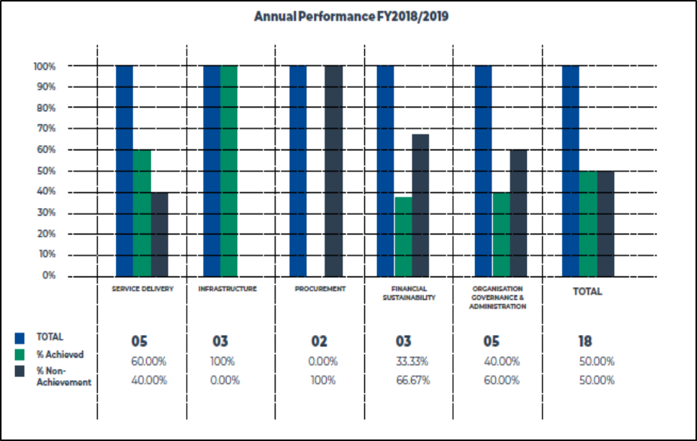
Performance Information Overview…
AG audited the predetermined objectives and there were finding raised that required a changes to the performance results
The annual performance results point to the achievement of 50% of annual targets
Challenges leading to the unsatisfactory performance in some indicators:
  Delays in the finalisation of the organisational design program leading to lack of capacity and skill to deliver on planned targets
  SLA metrics was not achieved primarily due to the power outage that took place in August 2018 that had a negative impact on some metrics
  Capacity constraints in the procurement function
  Corporate and structural changes, which in affected the ICT acquisition, spend through SMME entities.
  Significant investments made on strategic projects as part of operationalising the business model resulted in cash flow constraints .

Slide 5
Performance Information: Strategic Projects
SITA effectively supported the country’s e-Enablement and digital transformation drives aimed at transforming the public service through digital technologies.
SITA deployed 55 eServices to external clients in various provinces and 4 eServices were deployed for SITA internal use, namely; SITA Compliance Website, SITAVarsity, NDP2030 Hackathon Website and SITA Skills Audit.
Overall the benefits of the e-Services deployed have positively impacted the end-users through improved access to services, decreased operational costs, improved efficiencies and accessibility while equally SITA internal business operations have been bolstered.
SITA embarked on an infrastructure modernisation journey to re-engineer the current environment into modern state-of-the-art facilities that includes the introduction of a cloud capability.
SITA launched its new government cloud infrastructure for South Africa which is said to be one of the largest government clouds in the world in conjunction with Gijima, Huawei, and IBM.
The rollout of broadband connectivity, a very capital intensive programme, was flagged as a critical focus area by the Executive Authority, as South Africa is challenged with issues of accessibility, usability, and affordability.

Slide 6
Performance Information: Strategic Projects …
SITA supported the rollout of the programme by ensuring that 270 sites across eight (8) district municipalities were connected with Internet access at a minimum bandwidth of 10Mbps
SITA currently connects about 7 000 government entities, enabling access to internet, transversals and other shared government services with integrated Network Operations Centre (NOC) and Service Management.
This includes initiatives to maintain and improve high availability while reducing connectivity costs to government through revised competitive bidding processes and connectivity models at national and provincial levels.
SITA leads the Western Cape broadband programme, which aims to connect about 2000 sites, including schools, clinics and public libraries, with some entities extending Wi-Fi connectivity into the surrounding communities and ensures a minimum of 10 Mbps to 1Gbps connectivity speed.
Connectivity has been established in all 25 local municipalities in the Western Cape Province, covering about 570km of long distance fiber and leased capacity.

Slide 7
Performance Information: Strategic Projects…
SITA achieved ICT Security Level 3 maturity in 11 disciplines of the Information Security Forum (ISF) Maturity model.
SITA advanced the national economic transformation agenda in the ICT sector by providing a platform for the development of emerging suppliers to advance their businesses.
SITA implemented a procurement readiness programme aimed at increasing skills and potential to diversify the SITA supplier base by rollout of training to five provinces; 93 out of 147 SMME’s passed the Molex training and a total of 227 SMMEs completed the “How to tender” course.
SITA graduated off two SMME’s from Enterprise Development to Supplier Development; the same have created jobs.
SITA developed framework agreements by adopting a strategy that fosters partnerships with both the private and public sector to ensure government achieves economies of scale and that services and products are of the best quality and value for money.
The establishment of framework agreement pricing and direct model have resulted in savings of R1.3 billion

Slide 8
Programme 1: Service Delivery
The purpose of this programme is to provide a high-quality IT services to enable government to deliver efficient and convenient services to citizens through the use of ICT and to optimise the provision of SITA’s IT infrastructure services to increase availability, flexibility, scalability, predictability and security.
Strategic objective | Performance indicator | Actual achievement 2017/18 | Planned target 2018/19 | Actual Achievement 2018/19 | Deviation from planned target 2018/19 | Reasons for variance
C1: Enhance efficiency of government business processes | M4: No. of e-government services deployed | 23 e-services deployed | 50 e-services deployed | Achieved 55 e-services deployed which have deployment certificates | 5 | Additional services were developed to meet identified clients’ needs.
C2: Improve security of government data assets | M5: Level of maturity of ICT security | Attained information security maturity level 2 | Attain information security maturity Level 3 as per ISF security controls model for 11 discipline areas | Achieved SITA attained security maturity level 3 as per ISF security controls model for 11 areas. | None | No variance.

Slide 9
Programme 1: Service Delivery
The purpose of this programme is to provide a high-quality IT services to enable government to deliver efficient and convenient services to citizens through the use of ICT and to optimise the provision of SITA’s IT infrastructure services to increase availability, flexibility, scalability, predictability and security.
Strategic objective | Performance indicator | Actual achievement 2017/18 | Planned target 2018/19 | Actual achievement 2018/19 | Deviation from planned target 2018/19 | Reasons for variance
C3: Transform SITA into customer-centric organisation | M6: Customer satisfaction level | 51% | 80% customer satisfaction level | Not achieved 0% | -80% | The survey was not conducted due to cost containment measures.
 | M7: % performance against measured contracted SLA metrics | 96.56% | 98% performance against measured contracted SLA metrics | Not achieved 96.38% | -1.62% | MTTR and MTTR were missed due to power outage and backlog in August 2018. Although improvement initiatives were implemented, there was under-performance for some metrics. This being a cumulative target, the impact of Q2 and Q3 performance impacted the final YTD performance.
C4: Achieve growth in government market share | M8: % increase in government market share | 10.7% | 10% increase in government market share on designated services (increase on 2017/18 target) | Achieved 13.3% increase in government market share on designated services (increase on 2017/18 target) | 3.3% | Agency sales related to the provision and support of contracted services/SLAs transacted through framework agreements and other contracts also been included.

Slide 10
Programme 2: Infrastructure
The purpose of this programme is to optimise the provision of SITA’s IT infrastructure services in order to increase availability, flexibility, scalability, predictability and security.
Strategic objective | Performance indicator | Actual achievement 2017/18 | Planned target 2018/19 | Actual achievement 2018/19 | Deviation from planned target 2018/19 | Reasons for variance
C5: Consolidate and modernise data centres | M9: No. of government private cloud services available | 13 government private cloud services deployed | 2 government private cloud services available | Achieved 2 government private cloud services available | None | No variance.
C6: Improvement of ICT infrastructure: disaster recovery | M10: Number of clients provided with disaster recovery services | Disaster recovery services provided to 2 clients | 4 clients provided with disaster recovery services | Achieved 4 clients provided with disaster recovery services | None | No variance.
Improve broadband connectivity | M11: No. of SA connect phase 1 sites connected at bandwidths of 10Mbps | - | 257 of SA connect phase 1 sites connected and maintained at bandwidths of 10Mbps | Achieved 270 of SA connect phase 1 sites connected and maintained at bandwidth of 10Mbps | 13 | Work continued in order to meet the Minister planned target of 570 sites.

Slide 11
Programme 3: Procurement
The purpose of this programme is to address all issues relating to delayed procurement turnaround times, operational inefficiencies, removing customer pain points, cost ineffectiveness and transforming the procurement function’s ICT acquisition spending through SMME entities.
Strategic objective | Performance indicator | Actual achievement 2017/18 | Planned target 2018/19 | Actual achievement 2018/19 | Deviation from planned target 2018/19 | Reasons for variance
C7: Drive economic transformation agenda | M12: % of ICT acquisition spend through SMME entities | 14.22% | 40% of ICT acquisition spend through SMME entities | Not achieved 19.84% of ICT acquisition spending through SMME entities | -20.65% | SITA collates SMME subcontracting data from main contractors; a total value of R 370 million in indirect SMME spend was projected to close 20% variance to the 40% target. The project however, did not yield the expected results as the expected number of large entities did not subcontract to SMMEs as there was no subcontracting clause in their agreements- some big contracts within SITA were signed prior to the implementation of the Industry Transformation Preferential Procurement clauses. BBBEE certificates of unknown suppliers to the value of R76 million were collated. Due to this exercise SMMEs were identified that were previously unknown, however the spend amounts on them were too low to make a significant impact on the SMME KPI

Slide 12
Programme 3: Procurement
The purpose of this programme is to address all issues relating to delayed procurement turnaround times, operational inefficiencies, removing customer pain points, cost ineffectiveness and transforming the procurement function’s ICT acquisition spending through SMME entities.
Strategic objective | Performance indicator | Actual achievement 2017/18 | Planned target 2018/19 | Actual achievement 2018/19 | Deviation from planned target 2018/19 | Reasons for variance
P1: Improve procurement operational efficiency to enable service delivery | M13: % of tender awards completed within the targeted turnaround time | 28.94% | 85% of tender awards completed within the targeted turnaround time | Not achieved 33.9% of tender awards completed within the targeted turnaround time | -51.1% | Due to slow progress in the implementation of gCommerce and SCM capability constraints

Slide 13
Programme 4: Financial Sustainability
The purpose of this programme is to ensure an effective and efficient financial management and ensure financial growth and sustainability.
Strategic objective | Performance indicator | Actual achievement 2017/18 | Planned target 2018/19 | Actual achievement 2018/19 | Deviation from planned target 2018/19 | Reasons for variance
F1: Achieve sound financial management | M1: % EBIT | Achieved R263m | R22.3m | Not achieved -R240m | -R217.7m | This is mainly due to gross deficits yielded by some strategic projects and revenue targets not met.
 | M2: % Net Collection Rate | Achieved 94% | 80% | Achieved 83% | 3% | Due to the exclusion of disputed and uncollectable SAPS Network billing.
 | M3: % gross margin | Not achieved R1 262m | R1,296m | Not achieved R958m | -R338m | Due to gross deficits yielded by some strategic projects and revenue targets not met.

Slide 14
Programme 5: Organisation, governance and administration
The purpose of this programme is to build and maintain organisational capability to enable SITA to achieve its strategic imperatives. The programme also aims to provide leadership, strategic management, governance, risk and resource management in line with government’s accepted norms and standards.
.
Strategic objective | Performance indicator | Actual achievement 2017/18 | Planned target 2018/19 | Actual achievement 2018/19 | Deviation from planned target 2018/19 | Reasons for variance
L1: Build a healthy and high-performing organisation | M14: New organisational design implementation | - | 100% migration of employees to the new micro structure | Not Achieved 0% migration of employees to the new micro structure | -100% | Project timelines have been reviewed to allow for other dependencies like the volumetric exercise, which allows for finalisation of the structure total headcount required, Current moratorium on recruitment had a negative impact on the process.
 | M15: % of critical positions with minimum cover ratio of 1:2 | 12.5% | 50% of critical positions with minimum cover ratio of 1:1 | Not Achieved 32.8% of critical positions with minimum cover ratio of 1:1 | -17.2% | Due to resignations of candidates on this list who were never replaced. Out of the total of 152 CCS positions identified at project inception, only 73 positions had 186 potential successors identified. Out of a total of 190 assessed candidates, only 128 covering 50 CCS positions were found to be proficient to immediately occupy CCS positions. The other candidates identified require training and Current moratorium on recruitment had a negative impact on the process.

Slide 15
Programme 5: Organisation, governance and administration
The purpose of this programme is to build and maintain organisational capability to enable SITA to achieve its strategic imperatives. The programme also aims to provide leadership, strategic management, governance, risk and resource management in line with government’s accepted norms and standards.
.
Strategic objective | Performance indicator | Actual achievement 2017/18 | Planned target 2018/19 | Actual achievement 2018/19 | Deviation from planned target 2018/19 | Reasons for variance
L1: Build a healthy and high-performing organisation | M16: Employee satisfaction level | 67.25% | 70% employee satisfaction level | Not achieved 69% | -1% | Although there has been an improvement from FY2018/19 results, the following areas received low scores and initiatives are required to address this: Diversity Training and development Performance management Due to employees’ dissatisfaction/ responses to top 7 dimensions questions: Training and development Tools of trade Communication Talent management Leadership Employee wellbeing Strategic direction SCM Facilities

Slide 16
Programme 5: Organisation, governance and administration..
The purpose of this programme is to build and maintain organisational capability to enable SITA to achieve its strategic imperatives. The programme also aims to provide leadership, strategic management, governance, risk and resource management in line with government’s accepted norms and standards.
.
Strategic objective | Performance indicator | Actual achievement 2017/18 | Planned target 2018/19 | Actual achievement 2018/19 | Deviation from planned target 2018/19 | Reasons for variance
L1: Build a healthy and high-performing organisation | M17: BBBEE recognition level | - | Level 4 contributor | Achieved The external verification results indicate that SITA has attained BBBEE level 4 certification | None | No variance
 | M18: Fraud awareness and prevention rollout strategies | - | Establish fraud and corruption baseline as per industry benchmark | Achieved 100% Fraud and corruption baseline was established and approved by Social and Ethics Committee | None | No variance

Slide 17
Human Capital Management
SITA initiated a process of implementing the micro organisation redesign which intended to address the skills deficit and build appropriate competencies required to deliver on its mandate and customer expectations with minimal reliance on external service providers.
The process was initiated to design a new micro organisation structure into which employees will be migrated. This could not be concluded as planned due to impending SOC rationalisation and the moratorium on recruitment which was introduced by the new administration since these developments may jointly have a significant impact on the finalisation of the organisational structure
To ensure ongoing service delivery to its clients and meet its APP commitments, a skills augmentation process which entailed sourcing external skills to cover the capability gaps that existed within the core functions of the business
SITA implemented its succession management plan policy by identifying 203 successors who could be groomed to fill the identified core, critical and scarce skills positions.

Slide 18
Human Capital Management…
Two non-executive Board members resigned in the year under review. SITA also bid farewell to the first longest serving CEO to have completed his term of contract.
To maintain stability at a top leadership level, internal resources to act in the positions of the CEO and CFO.
The organisation has also appointed the Executive Hosting and Secure Operations; Executive Internal Audit and the Chief Digital Officer.
To better equip SITA employees to support the Agency’s future capabilities aligned to 4IR, SITA awarded 199 new bursaries to SITAzens and another 108 employees received ongoing bursary support.
281 bursaries where awarded in the ICT environment to disadvantaged youth across various provinces.
In support of the NDP 2030 vision to reduce in equality and unemployment, 152 interns were appointed and out of this number 73 have completed their internship programme and have been appointed as fixed term contractors.
A further, 61 learners were appointed and of which 38 are persons with disability. These learners will be trained towards NQF level 5 qualifications in system development and system support and will be considered for junior IT roles within the organisation.

Slide 19
Governance
The Board of Directors regard corporate governance as fundamental to the success of the business and they are fully committed to ensuring good governance is practised in order for the company to remain a viable and sustainable business.
SITA had a functional Board and subcommittees for the period under review which continues to exercise oversight, leadership and direction.
As part of its governance endeavour and oversight, SITA briefed Parliament on its legislative mandate and related activities.
SITA has seen a change in administration, resignation of 2 directors including the end of term of the CEO.
SITA has an ARC committee which monitors, compliance with legislation and ensures that appropriate systems of internal control are implemented and maintained to protect SITA’s interests and assets. The committee further reviews the activities and effectiveness of internal audit.
ARC has continued to oversee specific investigations into areas with weak internal control and areas which are prone to unethical behaviour.
Forensic investigation into a number of sole supplier contracts has continued with the assistance of IPID and the Hawks, findings of these investigations were shared with SCOPA.
ARC ensures that effective risk management processes and procedures are in place to actively manage risks that may affect SITA’s performance

Slide 20
Governance…
SITA has a S&E committee which provides direction and establishes the ethics and values pivotal to sustainable performance.
SITA has prioritised the management of fraud risk as per the PFMA and fraud-related regulations, with a zero tolerance to acts of fraud and corruption.
Fraud prevention, detection and response plans are in place and fraud and awareness campaigns have been rolled out to sensitize employees on promotion of ethical behavior within the organization.
SITA subscribes to the principles of upholding the highest standards of conduct, ethical practice and good governance has appointed a Social and Ethics Officer.
The implementation of an automated declaration of interest system proved to be effective and efficient, 97.4% of all SITA employees submitted their conflict of interest declarations which is an improvement from the previous year.
SITA’s B-BBEE compliance journey has not been satisfactory, the Agency has been found to be non-compliant for three consecutive financial years (2015/16- 2017/18). During the year under, SITA implemented initiatives which led to Agency being certified as a B-BBEE level 4 contributor.
  On the CSR front, SITA joined hands with the Free State Department of Education, to finalize the establishment of the School of Software Engineering, aimed at the introduction of schools to a new digital curriculum in the country to promote digital access through ICT skill.
  The Agency took part of in social alleviation programmes through provision of both ICT and non ICT services including supply of computer equipment to the rural village of Ndevana Village outside East London , Eastern Cape.

Slide 21
Directors Report
The directors have pleasure in presenting their report, which forms part of the audited annual financial statements of the State Information Technology Agency SOC Ltd for the year ended 31 March 2019. This report and the annual financial statements comply with the requirements of the Public Finance Management Act No 1 of 1999 (PFMA), the SITA Act No 88 of 1998 (as amended by Act 38 of 2002) and the Companies Act No 71 of 2008. The Board of Directors is the accounting authority in terms of section 49(2) (a) of the PFMA.
Nature of business: The nature of the company’s business is the provision of information technology, information systems and related services in a maintained information systems security environment to, or on behalf of, participating national government departments, provincial government departments, and local government. In this regard the company is an agent of the South African Government, in accordance with SITA Act No 88 of 1998 (as amended by Act 38 of 2002). The company derives all its revenue from ICT services and goods.
Equity Contributed: There were no changes to either the authorized or issued share capital of the company during the year ended 31 March 2019. Details of the authorized and issued share capital can be found in note 11 to the annual financial statements.

Slide 22
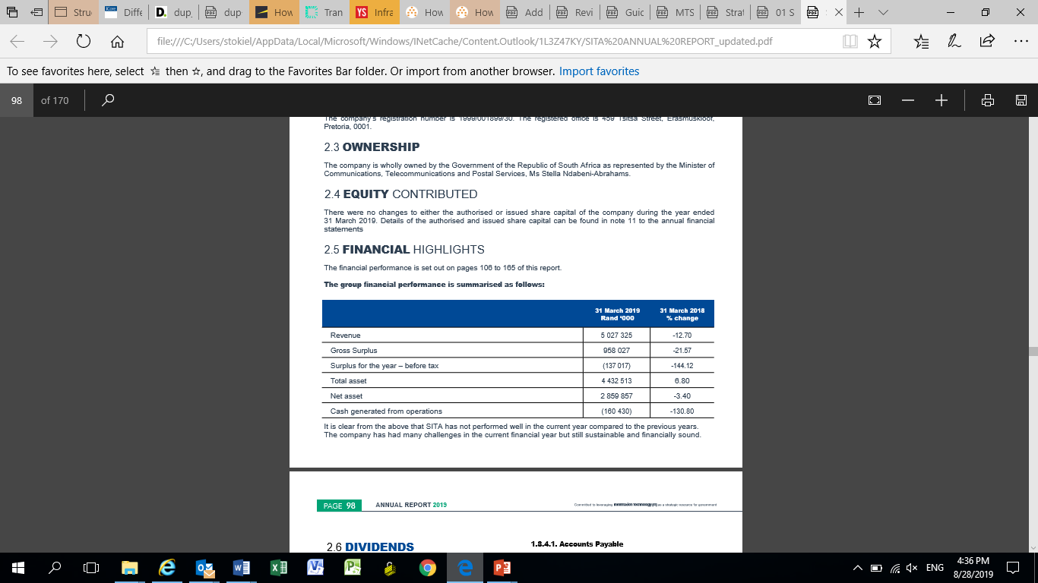
Directors Report…
Financial Highlights:The group financial performance is summarized as follows:
It is clear from the above that SITA has not performed well in the current year compared to the previous years. The company has had many challenges in the current financial year but still sustainable and financially sound.
Dividends :There were no dividends declared for the current financial year ended 31 March 2019.
Internal Controls: The Board has the ultimate responsibility for establishing a framework of internal controls. The controls are designed to provide cost effective assurance that assets are safeguarded and that liabilities and working capital are efficiently managed. The internal control environments were effectively managed by management and monitored by the internal audit department. During the year internal controls operated effectively.

Slide 23
Directors Report…
PFMA compliance: Various sections of the PFMA place responsibility on the Board to ensure that the company complies with all applicable legislations. Any non-compliance with legislation is reported on a quarterly basis to both EXCO and the Board of Directors.
Materiality and Significance Framework: A Materiality and Significance Framework has been developed for reporting losses through criminal conduct and irregular, fruitless and wasteful expenditure, as well as for significant transactions per section 54(2) of the Act, that require ministerial approval.
Material losses through criminal conduct, irregular, fruitless and wasteful expenditure: Section 55(2) b of the PFMA requires that SITA include in the annual report particulars of any material losses through criminal conduct and any irregular expenditure and fruitless and wasteful expenditure that occurred during the financial year. Refer to note 28 in the financial statements.
Accounts Payable : Management has identified accounts payable, specifically accounting for accruals as a risk having impacted on cost of sales as well during the 2018/19 financial year. Management has reinforced the internal control reviews in order to address the risk.
Public Private Partnerships :The company did not enter into Public Private Partnership during the current financial year.

Slide 24
Directors Report…
Basis of presentation: The annual financial statements have been prepared in accordance with the Standards of Generally Recognised Accounting Practices (GRAP) including any interpretations and directives issued by the International Accounting Standards Board (IASB). In terms of these standards (GRAP), in the absence of a standard or pronouncement comprising the GRAP financial reporting frameworks that specifically applies to a transaction, other event or condition, management should apply judgement and may consider the following pronouncements, in descending order, in developing an accounting policy for such a transaction, event or condition.
    Standards of GRAP that have been issued, but are not yet effective,
    International Public Sector Accounting Standards (IPSAS)
    International Financial Reporting Standards (IFRS)
Going Concern: The directors confirm that they are satisfied that the company has adequate resources to continue in business for the twelve-month period from the date of this report. For this reason they continue to adopt the going concern basis for preparing the financial statements as confirmed in the Statement of Responsibility by the Board of Directors.
Directors: Disclosure of Directors’ remuneration is detailed in Annexure of the Annual Financial Statements.

Slide 25
Audit, Risk and Compliance Report
The Audit, Risk and Compliance Committee was constituted as a Committee of the Board to fulfil its statutory duties in terms of section 51 (1) (a) (ii), section 76 and section 77 of the PFMA, and associated National Treasury Regulations, the Companies Act as well as all other duties assigned to it by the BoardBasis of presentation:
Terms of reference of the Audit, Risk and Compliance Committee: The Committee has adopted appropriate formal terms of reference as its charter, has regulated its affairs in compliance with this charter and has discharged its responsibilities as contained therein.
Audit, Risk and Compliance Committee responsibility: The Committee has complied with its responsibilities arising from the requirements of the Companies Act of 2008, the PFMA, and National Treasury Regulations of 2005.
The quality of financial information provided financial statements: The Committee is of the opinion, based on the information and explanations given by management, the Internal Auditors and the Auditor-General on the results of the audits conducted, that the financial information provided to management and other users of such information is adequate, reliable and accurate.
The effectiveness of internal control: From the various reports of the Internal Auditors, the Audit Report on the Annual Financial Statements and the management letter of the Auditor-General, management identified shortcomings within the internal control environment.

Slide 26
Audit, Risk and Compliance Report..
The effectiveness of internal control: From the various reports of the Internal Auditors, the Audit Report on the Annual Financial Statements and the management letter of the Auditor-General, management identified shortcomings within the internal control environment.
The ARCC has continued to oversee specific investigations into areas with weak internal control and areas which are prone to unethical behaviour.
In particular, the forensic investigation into a number of sole supplier contracts has continued with the assistance of the Independent Police Investigative Directorate (IPID), Directorate for Priority Crime Investigation (Hawks) amongst others. SITA has also continued to share the findings of these investigations with the Standing Committee on Public Accounts (SCOPA).
SITA’s executive management, with the full support from the Board, will continue to act decisively against the threat of corruption perpetrated within and against the organisation and implement appropriate remedial measures to strengthen SITA’s internal control environment.
Attention is specifically drawn to the following areas, where further attention by management is required:
    Cyber security and Information security governance; and
    Supply Chain Management.

Slide 27
Audit, Risk and Committee Report
Internal Financial Control: The ARCC reviewed the effectiveness of the company’s system of internal financial control and, based upon the processes and assurances obtained from management, internal audit and external audit, the Committee is satisfied that the significant internal financial controls are effective.
The effectiveness of Internal Audit :The committee received a wide variety of risk-based audit reports from the Internal Auditors and is of the opinion that internal audit is effective in the fulfilment of its mandate.
Risk Management: The risk management division assists the ARCC in discharging its responsibilities in relation to the management of risks within the company in line with the Committee’s oversight responsibilities. The ARCC receives and considers regular reports in relation to risk management related activities, from the Risk Management Division. These reports reflect on strategic, operational and programme related risks.
Compliance with legal and regulatory provisions: The Committee has received regular reports from, amongst others, the Compliance unit within the Legal Services Department and Finance Division on compliance with the SITA Act, PFMA and all other applicable laws and regulations and is satisfied with the quality thereof.
Evaluation of the financial statements: The Committee has evaluated the annual financial statements of the Agency for the year ended 31 March 2019 and, based on the information provided, concurs and accepts the Auditor-General’s conclusions on the annual financial statements, and is of the opinion that the audited financial statements be accepted and read together with the report of the Auditor-General

Slide 28
Social and Ethics Report
The purpose of this report is to outline how the Social and Ethics Committee has discharged its responsibilities as set out in section 72 of the Companies Act, 71 of 2008(“the Act”), and Regulation 43 of the Companies Regulations 2011 (“the Regulation”).
Composition: The Social and Ethics Committee comprises of three (3) non-executive directors. The Executive Directors and certain key members of management are invited as ex-officio members. Mr. Talib Sadik serves as the Chairperson of the Committee. The committee met three (3) times during the 2018/19 financial year. The Office of the Company Secretary provides secretarial services and support to the Committee.
Role of the Social and Ethics Committee: The Committee performs an oversight and monitoring role in partnership with the Audit Risk & Compliance Committee (ARCC) to ensure that SITA’s business both internally and externally is conducted in an ethical and appropriately governed manner.
  SITA fully subscribes to good corporate citizenship and actively promotes it as part of its culture. Furthermore, the Committee develops and/or reviews policies and governance processes and their impact on expected acceptable practices and behaviours as they relate to the performance and the reputation of the Agency.
  The position of Head of Department: Social and Ethics (Ethics Officer) in the Office of the Company Secretary, was filled in October 2018.
  SITA launched its Ethics Office including the first edition of the EthicsTalk newsletter.
  The ethics management plan is expected to be rolled out at the beginning of the 2019/2020 financial year. The Committee oversees the Agency’s corporate social investment policy and its institutionalisation through the corporate social responsibility strategy, which details the programmes and other interventions in support of SITA’s business objectives and the developmental agenda of the State.

Slide 29
Social and Ethics Report…
Discharge of responsibilities: During the 2018/19 financial year, the committee considered the following:
    Social and ethics Dashboard for the Committee and the Agency;
    Corporate Social Responsibility programmes, including details of donations and charitable giving, and the annual calendar commemorating proposed corporate social responsibility events;
    The Agency’s risk register, which addresses, inter alia, the risks associated with the Agency in addressing the statutory responsibilities of the Committee and how they are addressed, including combined assurance responses;
    Non-Executive Directors’ Code of Conduct, Conflict of Interest, Gifts and Entertainment policies;
    Whistle-blowing policy;
    Fraud prevention and awareness; and
    The Ethics Strategy and Plan for roll-out in the new financial year.
Codes and policies: The committee commissioned several initiatives to mitigate the risks associated with bribery and corruption in the workplace. As a standard practice, all new employees’ contracts include the conduct pledge, while for existing employees they are encouraged to continue with the voluntary endorsement of the good corporate citizen pledge.

Slide 30
Social and Ethics Report…
Ethics governance structures: The committee has, in fulfilling its mandate, continued to promote collaboration between its own activities and those of other Board committees and operational structures, such as the ARCC and the Human Resource and Remuneration Committee. Specific Interventions to embed ethical behaviour and positively influence organisational culture, in support of the code of ethics, will be prioritised in the new financial year.
Institutionalising and reporting: Awareness creation remains crucial and the Agency accordingly continues with communication campaigns and other information sessions to draw attention to acceptable business conduct and educate them on a range of ethical issues. Part of that includes observing international days dedicated to combatting fraud and corruption.
In conclusion the committee is of the view that the Agency continues to take its environmental, social and governance responsibilities seriously. Appropriate policies, plans and programmes are in place to contribute to social, ethical and economic development, good corporate citizenship, environmental responsibility, fair labour practices and good client relations, and the nature (unqualified) of the Agency audit report is indicative of the best efforts to adhere legislative and regulatory compliance.
The committee is aware of the ever-present risk of unethical behaviours represented through fraud, corruption and collusion. Allegations of wrongdoings continue to be raised through whistle-blowing systems currently in place. The Agency has been unrelenting in pursuing these allegations and intensive investigations continue to reveal and confirm prevalence of corruption often involving collusion between the employees, the clients and the service providers.
In response the Agency is prompted to proactively investigate certain information contained in the employees’ declaration of interests to determine inherent risks.

Slide 31
Statement of Financial Position
R'000 | 2019 | 2018
ASSETS
Non-current assets | 1 150 198 | 1 208 719
Property, plant and equipment | 721 334 | 709 478
Intangible assets | 373 022 | 457 100
Non-current portion of Prepayments | 16 958 | 41 050
Deferred tax assets | 38 884 | 1 091
Current assets | 3 282 315 | 2 940 356
Cash and cash equivalents | 1 173 156 | 1 605 114
Trade and other receivables | 1 695 891 | 1 158 954
Income tax receivable | 167 711 | 111 322
Current portion of Prepayments | 66 601 | 64 966
Inventory | 178 956 | -
Total Assets | 4 432 513 | 4 149 075

Slide 32
Statement of Financial Performance
R'000 | 2019 | 2018
Revenue | 5 027 325 | 5 758 712
Cost of sales | (4 069 298) | (4 537 081)
Gross surplus | 958 027 | 1 221 631
Other income | 18 511 | 32 755
Operating expenses | (1 216 987) | (1 040 302)
(Deficit)/Surplus from operating activities | (240 449) | 214 084
Finance income | 157 174 | 151 780
Finance expense | (53 742) | (55 336)
Deficit before income tax | (137 017) | 310 528
Income tax | 35 509 | (83 649)
(Deficit)/Surplus for the year attributable to shareholders | (101 508) | 226 879

Slide 33
Statement of Financial Position…
R'000 | 2019 | 2018
EQUITY AND LIABILITIES
Net assets | 2 859 857 | 2 961 365
Share capital | - | -
Reserves | 627 335 | 627 335
Accumulated surpluses | 2 232 522 | 2 334 030
Total net assets | 2 859 857 | 2 961 365
Liabilities
Non-current liabilities | 69 198 | 97 677
Post-retirement employee benefits | 69 198 | 97 677
Current liabilities | 1 503 458 | 1 090 033
Trade and other payables | 1 367 710 | 856 293
Income received in advance | 135 748 | 233 740
Total Liabilities | 1 572 656 | 1 187 710
Total Equity and Liabilities | 4 432 513 | 4 149 075

Slide 34
Irregular and Fruitless & Wasteful Expenditure detected over the past five years (excluding VAT)…
*NOTE: The number in the block represents the number of cases

Slide 35
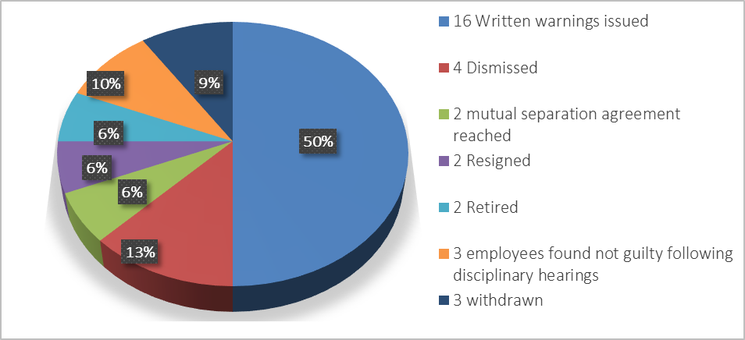
52 cases referred by LCC for disciplinary action to be instituted. Breakdown of the 32 finalised cases as at 31 March 2019:

Slide 36
Outcomes of the 2018/19 AG Report
SITA received unqualified audit report with findings on Audit of Performance Information and compliance with legislation.
SITA received the same audit opinion for the past 3 consecutive years being 2016/17, 2017/18 and 2018/19)
The following includes the control deficiencies raised by AG:
Inadequate process and systems to prevent Irregular expenditure;
Compliance with PFMA and SCM prescripts;
Weakness pertaining to IT Governance and IT general controls;
Effective controls around Contract Management and
Record keeping and reconciliations.
The main root causes for the findings raised by AG includes:
The review and recording processes were not always effective to be able to detect and correct misstatements in the financial statements.
Ineffective contract management and incomplete contract register due to lack of capacity within the Supply Chain Management (SCM) division.
Poor record keeping with the SCM division leading to information not always readily available for audit purposes.
IT Controls had not been adequately designed or implemented to enable an effective IT control environment.
Management developed an action plan to address the deficiencies; SITA Internal Audit Division monitors the implementation plan monthly and report the progress made to EXCO monthly and to the ARCC quarterly;
SITA is working closely with the Auditor General and other stakeholders to address control deficiencies to ensure that SITA receives a clean report
36

Slide 37
Outcomes of the 2018/19 AG Report …
Management developed an action plan to address the deficiencies; SITA Internal Audit Division monitors the implementation plan monthly and report the progress made to EXCO monthly and to the ARCC quarterly;
SITA is working closely with the Auditor General and other stakeholders to address control deficiencies to ensure that SITA receives a clean report

Slide 38
Action plans for the 2018/19 AG findings
The Auditor General raised a total of 72 Audit Findings (Management Letter Points (MLPs) reported in the 2018/19 AG Management report. We have already managed to close 25 findings during the audit.
The Internal Audit Division held workshops with executives and Head of departments (Finance Division, SCM Division, Hosting& Secure Operations, Networks and Service Management and other stakeholders Division) where root causes for each of the findings as well as action plans and implementation dates were discussed, to circumvent repeat of the findings.
Independent monitoring and verification of the resolution of the MLPs and Significant Internal Audit Findings (SIAFs) is carried out by Internal Audit Division; the division independent from management structures.
Progress on the status of implementation of the MLPs is reported monthly to EXCO and regularly to the Audit, Risk and Compliance Committee and Board (as a Standing Item on the agenda).
The monitoring of the status of MLPs is automated and all Lines of Business have access to the system to track and update status as and when required – Team Central.
Lines of Business have identified process owners for each finding within a division to ensure that action plans identified are implemented.
The resolution of the Auditor-General findings (MLPs) forms part of SITA’s Corporate Performance reporting for 2019/20.
MLPs are now part of the performance contract for the Executives, Head of Departments and senior managers.
38

Slide 39
2018/19 AG findings – Total of 72 Findings
Business Unit | Total MLPs | Verified and Closed by IA | IA Verification in progress | Pending Exec/HOD Approval | Not yet due | Outstanding
Finance | 25 | 18 |  |  | 7
Finance - Facilities Management | 1 |  |  |  | 1
Supply Chain Management | 21 | 2 |  |  | 19
Human Capital Management | 5 | 2 |  |  | 3
Company Secretary | 3 | 1 |  |  | 2
Strategy Management | 3 | 2 |  |  | 1
Internal IT | 1 |  |  |  | 1
Hosting and Secure Operations | 11 |  |  |  | 11
Networks & Service Management | 2 |  |  |  | 2
TOTAL | 72 | 25 | 0 | 0 | 47 | 0
39

Slide 40
Progress on 2017/18 AG findings
Area of Audit Finding | Details of Finding | Action Plan to Address Audit Findings | Progress on implementation of Action Plan
Finance – Facilities Management | Data centre fire suppression system has not been serviced | Management will source out external assistance and develop a maintenance plan. | Business case was submitted for approval to source a new supplier to assess the current fire and suppression system. Will go to market in the next 2 months (by end of October 2019). All Gauteng Buildings will be assessed.
Finance | Deficiencies within fixed assets management | *The fixed asset management practice note will be re-issued. * Asset management needs to attend monthly management meetings with lines of business to assist in proper implementation and understanding of the asset management processes. | In progress ( Following up as repeat findings in the 201819 AG report).
40

Slide 41
Progress on 2017/18 AG findings…
Area of Audit Finding | Details of Finding | Action Plan to Address Audit Findings | Progress on implementation of Action Plan
Supply Chain Management | 1. No performance monitoring tools for contracts. The Service Level Agreements/contracts are not monitored | EXCO mandated SCM to interrogate the potential activation of the Oracle ERP CLM module. This will proactively flag LoB’s to initiate the Replacement / renewal of contracts. Furthermore, as an interim measure EXCO also committed to ensure that their divisions timeously inform SCM regarding the way forward on contracts expiring. This will reduce irregular spend. Performance Contract for the Specialists / Buyers will include the submission of files to Document Centre. | In progress
Hosting and Secure Operations | 2 Findings Outstanding | Meeting was held with Executive and management within Hosting and secure operations, we were able to close 14 findings and we now tracking the remaining two with the 201819 AG report. | In progress
41

Slide 42
Progress on 2016/17 AG findings…
Area of Audit Finding | Details of Finding | Action Plan to Address Audit Findings | Progress on implementation of Action Plan
Networks and Service Management | Missing security updates and unsupported software on various systems | (a) Security patches will be applied to ICT devices and/or systems, and controls implemented to mitigate reported vulnerabilities. (b) Results will be recorded and non-compliance (i.e. deviations/exceptions) and potential risks will be reported and managed | Internet Gateway upgrade was done to address the unsupported software version. The IG is now currently on the latest software version. ( Verification in process)
 | Bandwidth Utilisation Assessment | (a) SITA has already began the process of engaging with Provincial government structures with the view of implementing Provincial VPN solutions which will significantly reduce the costs of migrating government departments into individual VPNs by consolidating at a Provincial level. (b) A number of Government departments have already been migrated into dedicated VPNs where QoS has now been implemented. However this depends on budget availability for each department. | Both SITA Internet Breakout (Cape town and Centurion) have both been upgraded from 50Mbps to 100Mbps each which makes a total of 200Mbps. To address the issues of Centurion utilization SITA EC subnets have been moved to SITA WC. Both SITA WC and EC will now use Cape town Breakout. ( Verification in process)
 | Inadequate firewall management controls | (a) Enable audit log on firewalls within limitation perimeters. (b) Implement password management review. (c ) Automate firewall usage and administration monitoring. | The log evaluation tool is included in the SIEM technology stack as long-term service offering prioritised as per SITA’s operating strategy.
42

Slide 43
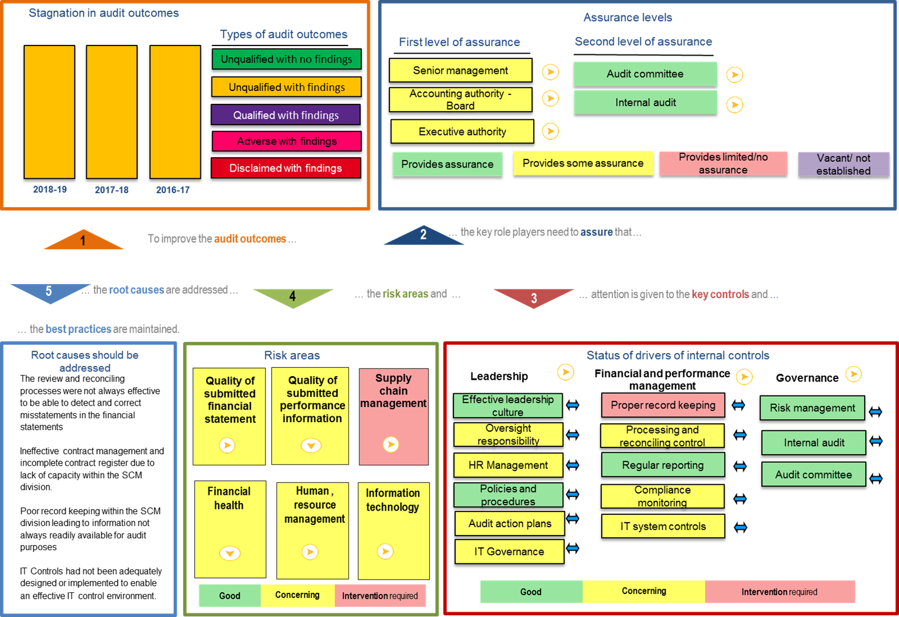
Audit Outcome Summary

Slide 44
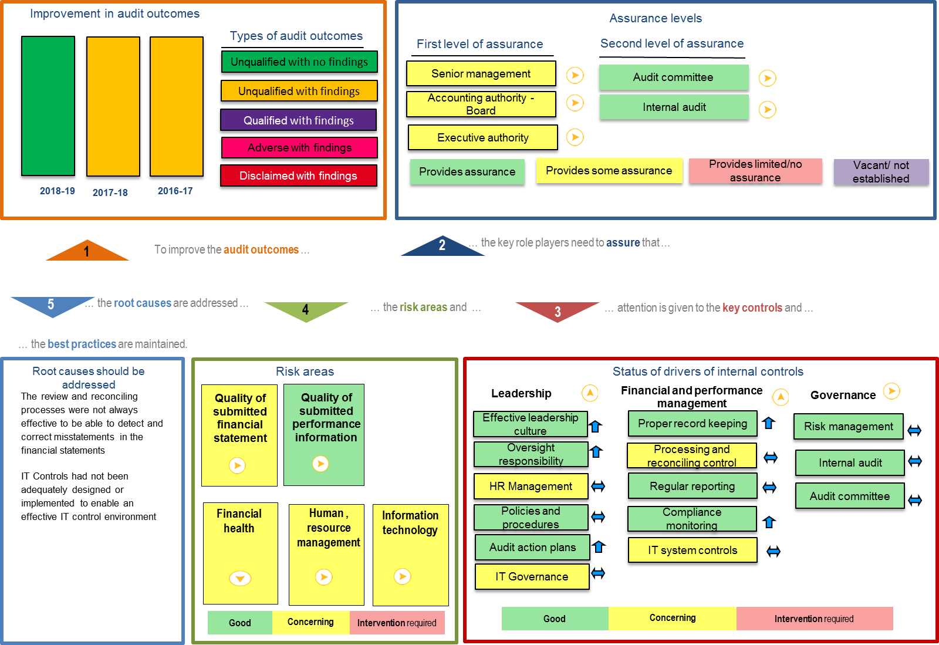
Audit Outcome Summary (excluding SCM assessment)

Slide 45

^{THANK YOU}

