Slide 1
NATIONAL PROSECUTING AUTHORITY (NPA)
ANNUAL REPORT
2018-2019

Slide 2
CONTENTS
Introduction
Policy Mandate
Organisational Overview
Performance Environment
Programme Performance
Budget Overview
Resourcing

Slide 3
INTRODUCTION
Purpose:
The purpose of the NPA is to :
Provide a coordinated prosecuting service that ensures that justice is delivered to the victims of crime through general & specialised prosecutions
Remove the profit from crime, and
Protect certain witnesses
Strategic Objectives (3):
Ensure successful prosecution
Ensure that profit is removed from crime
Ensure that vulnerable and intimidated witnesses and related persons are successfully protected

Slide 4
INTRODUCTION
National Prosecutions Service (NPS) - general & specialised prosecutions, including:
The Sexual Offences and Community Affairs Unit (SOCA)
Specialised Commercial Crimes Unit (SCCU)
The Priority Crimes Litigation Unit (PCLU)
Asset Forfeiture Unit (AFU) seizes assets that are the proceeds of crime/have been part of an offence through a criminal/civil process
Office for Witness Protection (OWP) provides for temporary protection, support and related services to vulnerable and intimidated witnesses and related persons in judicial proceedings in terms of the Witness Protection Act, 1998
Support Services provides administrative support services to the NPA

Slide 5
PROGRAMME 4: NATIONAL PROSECUTING AUTHORITY – POLICY MANDATE
The National Development Plan 2030 (NDP): Government’s long term vision
Outcome 3 of the Medium Term Strategic Framework (MTSF):
“All people in South Africa are and feel safe”
The NPA contributes to the achievement of the following sub-outcomes of the MTSF:
Outcome 1: Reduced level of contact crime
Outcome 2: An efficient and effective criminal justice system
Outcome 4: Secure cyber space
Outcome 5: Ensure domestic stability
Outcome 7: Corruption in the public and the private sectors reduced

Slide 6
PROGRAMME 4: NATIONAL PROSECUTING AUTHORITY – ORGANISATIONAL STRUCTURE
National Director of Public Prosecutions
Adv. S Batohi
Deputy NDPP: NPS
Adv. S Mzinyathi
(Acting)
DNDPP: AFU
Mr. W Hofmeyr
DNDPP: LAD
Adv. N Mokhatla
Head of Administration & OWP
Adv. K van Rensburg
(Acting)
DPPs
SDPP: SOCA
SDPP: PCLU
SDPP: SCCU
SDPP: OWP
Investigating Directorate
Adv. H Cronje

Slide 7
Directors and Special Directors of Public Prosecutions
Directors of Public Prosecutions
Adv. A Chauke (GDP)
Special Directors of Public Prosecutions
Adv. M Doubada (SCCU) (Acting)
Adv. C Macadam (PCLU) (Acting)
Adv. R de Kock (WCD)
Adv. I Thenga (LD)
Adv. B Madolo (ECD-Mthatha)
Adv. I Goberdan (ECD) (Acting)
Adv. N Somaru (FSD) (Acting)
Adv. A Botha (NCD) (Acting)
Adv. P Smith (SOCA) (Acting)
Adv. M Molelle (AFU) (Acting)
Adv. K van Rensburg (OWP) (Acting)
Adv. M Luphondo (MD) (Acting )
Adv. G Baloyi (GLD) (Acting)
Adv. E Zungu (KZND) (Acting)
Adv. M Noko (NWD)

Slide 8
OPERATIONAL ENVIRONMENT
The NPA’s success is critically dependent on its collaboration with all role players in the criminal justice system (CJS).
Ensuring that trial ready cases proceed timeously remains a major challenge
The inability to optimally utilise court hours and days, hampers performance
NPA participates in various structures to collectively address operational challenges
Budgetary constraints resulted in vacant posts not being filled, placing severe strain on the NPA’s ability to function optimally and deliver mandatory services
Notes:
Reasons for decline in court utilisation
The following factors were impacting negatively on the performance of the courts during FY 2018/19:
Unavailability of key role players is still a major concern and addressed at various stakeholder forums.
Poor investigation, delays in finalisation of investigation and unavailability of dockets and witnesses in courts.
Shortage of proper accommodation and resources/facilities/equipment are impacting on the optimum performance of some regions.
Vacancies at managerial level complicates management functions in some regions which result in inadequate monitoring by Senior Prosecutors.
Critical staff shortages are having its toll as staff become exhausted and demotivated. Due to these shortages, leave has to be limited in order to keep productivity relatively high. Apart from the impact of leave on employees, various prosecutors need to act in higher posts which places a bigger burden on them. The serious budgetary constraints place severe strain on its staff establishment with consequences that may turn out to be catastrophic for the NPA and the administration of justice;
Newly demarcated areas without the allocation of necessary resources (Personnel, Infrastructure);
Shortage of foreign language interpreters and outstanding probation and pre-sentence reports impacted negatively on the speedy finalisation of cases.
Contract magistrates not adequately dealing with cases (postponements and partly heard matters etc.)
Increased cycle times of cases due to poor court roll management impacted the speedy finalisation of cases.

Slide 9
NDPP IMMEDIATE OFFICE FUNCTION
Representations: 867 received; 655 files finalised; 212 pending (75% clearance ratio)
Reviews: Reviewed 137 decisions and confirmed the DPP decision in 130 instances
Centralisations: 20 applications authorised
Mutual Legal Assistance and Memoranda of Understanding:
110 new MLA requests received; 82 finalised
MoUs concluded with:
Directorate of Public Prosecutions of the Republic of Botswana;
Public Prosecution Office of the State of Palestine; and
Supreme People’s Procuracy of the Socialist Republic of Vietnam

Slide 10
NDPP IMMEDIATE OFFICE FUNCTION
Extraditions: 28 new requests for extraditions were received and 12 were finalised
International Conferences: hosted IAP’s 23rd Annual Conference in Sandton on 9 – 13 September 2018. Theme: Prosecutorial Independence – the Cornerstone of Justice to Society
Outgoing extraditions 16 new requests were made
Outgoing Mutual Legal Assistance
30 new requests were made

Slide 11
NPA PERFORMANCE APRIL 2018-MARCH 2019
The NPA reported on the targets of 28 indicators
Baseline data was collected for 1 indicator - no target deviation
The NPA achieved 18 targets (67%), and did not achieve 9 targets (33%)
Notes:
The indicator where a target was not determined relates to Conviction rate in private sector corruption

Slide 12
SUB-PROGRAMME 1: NATIONAL PROSECUTIONS SERVICE (NPS)
Strategic Objective 1: Ensure successful prosecution
Performance Indicator | Actual Achievement 2017/18 | Planned Target 2018/19 | Actual Achievement 2018/19 | % Deviation from target
Conviction rate in high courts | 91,7% (890) | 90% (958) | 90% (869/966) | 0%
Conviction rate in regional courts | 81% (24 976) | 78% (23 706) | 81,7% (22 882/ 28 001) | 5%
Conviction rate in district courts | 96,1% (293 234) | 93% (277 819) | 95,7% (236 705/247 342) | 3%
High conviction rates were maintained in all forums
High courts: enrolled 846 new cases, finalised 966 with a verdict, obtaining 869 convictions
Regional courts: enrolled 51 551 new cases; finalised 30 477 cases: 28 001 verdict cases and 2 476 ADRM cases, with 22 882 convictions
District courts: enrolled 740 498 new cases; finalised 394 335 cases: 247 342 verdict cases and 146 993 ADRM cases, with 236 705 convictions

Slide 13
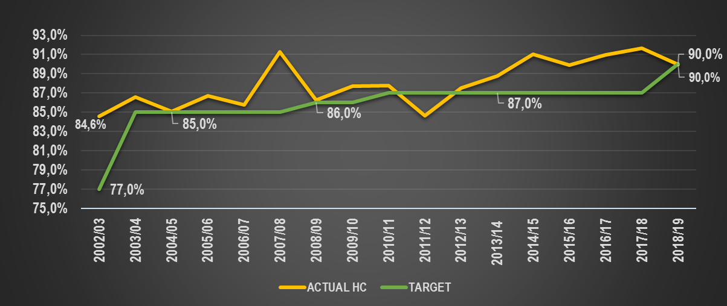
OPERATIONAL ENVIRONMENT
Trend analysis: Conviction Rates in HC

Slide 14
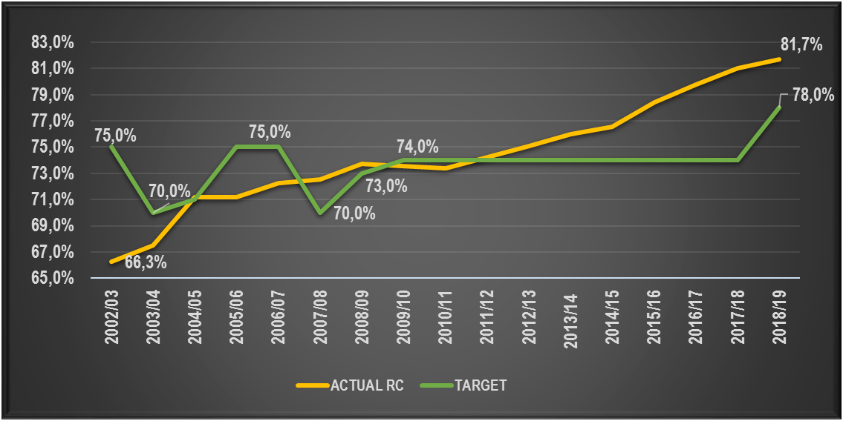
OPERATIONAL ENVIRONMENT
Trend analysis: Conviction Rates in RC

Slide 15
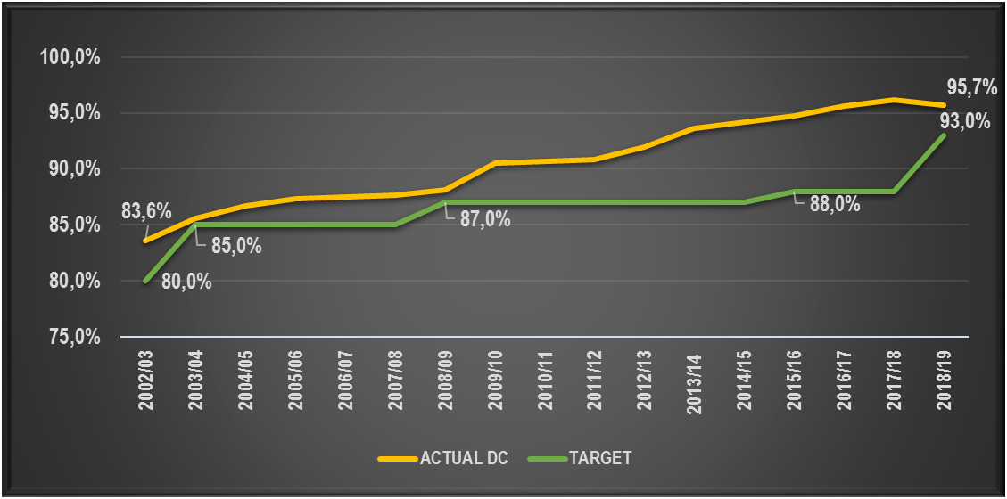
OPERATIONAL ENVIRONMENT
Trend analysis: Conviction Rates in DC

Slide 16
SUB-PROGRAMME 1: NATIONAL PROSECUTIONS SERVICE (NPS)
1 013 928 criminal matters were finalised in the following manner:
Number of criminal matters finalised | 2017/18 | 2018/19 | Percentage deviation
Cases finalised with a verdict | 335 161 | 276 309 | -17,6%
Cases finalised through ADRM | 159 654 | 149 469 | -6,4%
Dockets finalised | 490 794 | 510 856 | 4,1%
Admission of guilt payments | 2 946 | 3 039 | 3,2%
Criminal / court matters finalised | 74 460 | 72 533 | -2,6%
Appeals finalised | 2 225 | 1 722 | -22,6%
Total criminal matters finalised | 1 065 240 | 1 013 928 | -4,8%

Slide 17
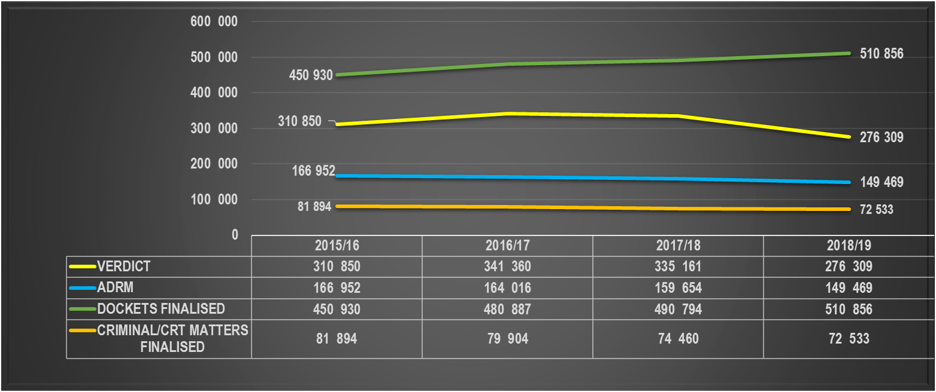
OPERATIONAL ENVIRONMENT
SUB-PROGRAMME 1: NATIONAL PROSECUTIONS SERVICE (NPS)
A total of 1 013 928 criminal matters were finalised by prosecutors during 2018/19:
Notes:
The measure for criminal/court matters finalised reflects the additional effort by prosecutors which do not result in a verdict

Slide 18
OPERATIONAL ENVIRONMENT
SUB-PROGRAMME 1: NATIONAL PROSECUTIONS SERVICE (NPS)
A total of 1 013 928 criminal matters were finalised by prosecutors during 2018/19:
Notes:
The measure for criminal/court matters finalised reflects the additional effort by prosecutors which do not result in a verdict

Slide 19
OPERATIONAL ENVIRONMENT
SUB-PROGRAMME 1: NATIONAL PROSECUTIONS SERVICE (NPS)
Inflow of cases declined although more dockets received for decision during 2018/19:
Notes:
The measure for criminal/court matters finalised reflects the additional effort by prosecutors which do not result in a verdict.

Slide 20
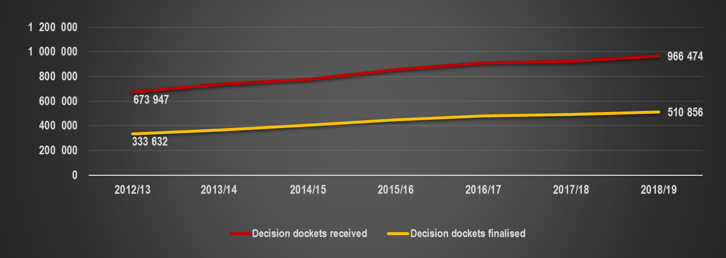
OPERATIONAL ENVIRONMENT
SUB-PROGRAMME 1: NATIONAL PROSECUTIONS SERVICE (NPS)
Inflow of cases declined although more dockets received for decision during 2018/19:
Notes:
The measure for criminal/court matters finalised reflects the additional effort by prosecutors which do not result in a verdict.

Slide 21
OPERATIONAL ENVIRONMENT
SUB-PROGRAMME 1: NATIONAL PROSECUTIONS SERVICE (NPS)
The number of withdrawals declined over the years although a slight increase is noted during current reporting period.
Notes:
The measure for criminal/court matters finalised reflects the additional effort by prosecutors which do not result in a verdict.

Slide 22
SUB-PROGRAMME 1: NATIONAL PROSECUTIONS SERVICE (NPS)
The 72 533 court/criminal matters were finalised in the following manner:
Court/criminal matters finalised | 2017/18 | 2018/19 | Percentage deviation
Formal inquests | 124 | 152 | 22,6%
Committal to mental institution | 783 | 763 | -2,6%
Conversion of maintenance trial to enquiry | 320 | 566 | 76,9%
Application for leave to appeal | 2 699 | 2 042 | -24,3%
Conversion of sentence | 627 | 286 | -54,4%
Suspended sentences | 4,235 | 3 476 | -17,9%
CJA: Preliminary inquiries | 10 083 | 9 406 | -6,7%
Formal bail applications | 55 589 | 55 842 | 0,5%
Total matters finalised | 74 460 | 72 533 | -2,6%

Slide 23
OPERATIONAL ENVIRONMENT
Plea and Sentence Agreements
In 2018/19 –one case involved 75 397 counts of Fraud and one case involving 1 647 counts of Fraud in KZND
Notes:
Drop in agreements during 2010 – 2012 was due to then NDPP Adv M Simelane withdrawing authority of SPP’s to sign agreements
Sometimes a number of counts involved in one agreement e.g.
In 2014/15 – 6 cases total of 16 692 counts (694 + 508 + 6 895 + 7 075 + 493 + 1 027)
In 2016/17 – 6 cases total of 6 000 counts (369+549+3240+441+867+534)
In 2018/19 –one case involved 75 397 counts of Fraud and one case involving 1 647 counts of Fraud in KZND

Slide 24
SUB-PROGRAMME 1: NATIONAL PROSECUTIONS SERVICE (NPS)
Performance Indicator | Actual Achievement 2017/18 | Planned Target 2018/19 | Actual Achievement 2018/19 | % Deviation from target
Conviction rate in organised crime | 93,8% (346) | 90% (384) | 94,8% (294/310) | 5%
Conviction rate in complex commercial crime | 94,1% (911) | 93% (801) | 95% (760/800) | 2%
The NPA finalised 310 organised crime verdict cases, with 294 convictions, (94,8% conviction rate) - special focus on various areas, i.e. illegal precious metal, including copper, rhino-related offences, dealing in drugs, illicit mining and tax matters
The NPA’s impact on serious economic crime is evident in the 800 verdict cases in complex commercial crime, with 760 convictions (95% conviction rate)
Notes:
Breakdown of sentences and offences in organised crime
The offences and sentences were not measured but an audit from the Q1 data this year indicated the following:
The charges mostly include national priority areas which relates to drugs, serious crimes of Aggravated robbery, murder and housebreaking that often are subject to racketeering offences, illegal mining with related offences of fire arms and trespassing; and abalone related offences especially in Western Cape.
Sentences mostly involve direct imprisonment – in 67 of 93 (72%) cases during Q1, direct imprisonment was imposed. (In 28 instances, more than 15 years imprisonment).

Slide 25
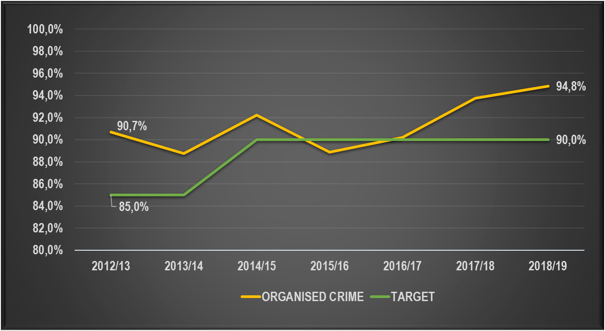
SUB-PROGRAMME 1: NATIONAL PROSECUTIONS SERVICE (NPS)

Slide 26
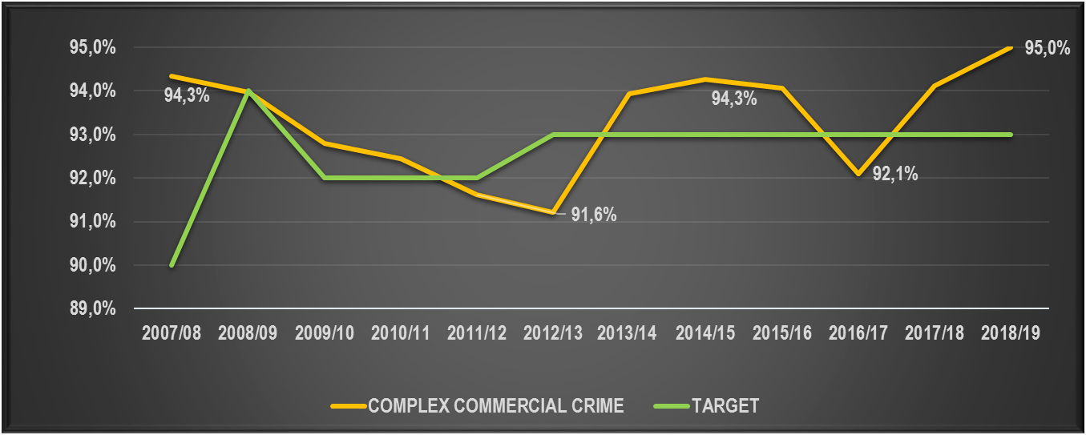
SUB-PROGRAMME 1: NATIONAL PROSECUTIONS SERVICE (NPS)

Slide 27
SUB-PROGRAMME 1: NATIONAL PROSECUTIONS SERVICE (NPS)
Performance Indicator | Actual Achievement 2017/18 | Planned Target 2018/19 | Actual Achievement 2018/19 | % Deviation from target
Number of persons convicted of corruption or offenses related to corruption where the amount involved is more than R5m | 37 | 30 | 17 | (43%)
Number of government officials convicted for corruption or offences related to corruption | 213 | 230 | 210 | (9%)
17 persons were convicted of corruption/offences related to corruption where the amount involved is more than R5m, 43% below the target of 30 persons;
210 government officials were convicted for corruption/offences related to corruption – 115 (National Departments); 46 (Local Authorities); 27 (Provincial Departments); 18 (Government Agencies); 4 (NPA)
Serious corruption cases are complex and take long to finalise, due to inter alia, applications brought by the defense, pre-trial litigation.
Cases have been identified for prioritisation and are being fast tracked
Notes:
Notwithstanding the decrease in the number of persons convicted of corruption or offences related to corruption where the amount involved is more than R5mil, only 2 fewer case was finalised compared to the previous financial year

Slide 28
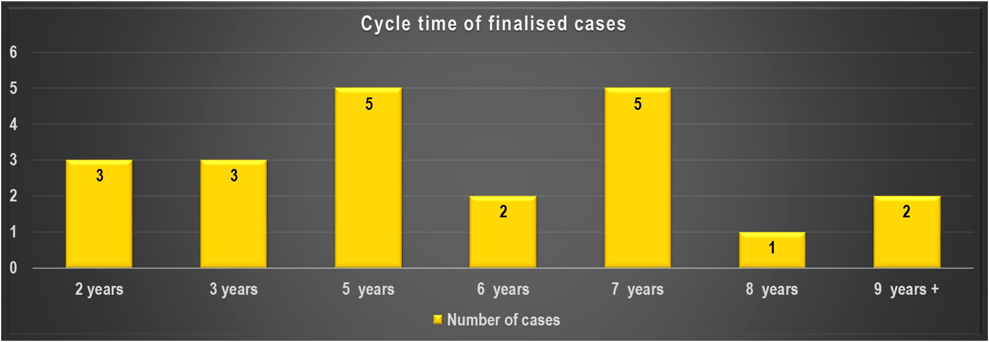
Corruption - R5 mil: Docket registered to sentence (FY2017/18 and FY2018/19)
24 cases with convictions involving 54 accused in 2 years
13 cases in 2017/18 (37 accused)
11 cases in 2018/19 (17 accused)
3 cases awaiting sentence not displayed in graph

Slide 29
SUB-PROGRAMME 1: NATIONAL PROSECUTIONS SERVICE (NPS)
Performance Indicator | Actual Achievement 2017/18 | Planned Target 2018/19 | Actual Achievement 2018/19 | % Deviation from target
Number of persons convicted of private sector corruption | n/a | Baseline | 143 | n/a
Conviction rate in money laundering | n/a | 75% (Baseline) | 100% (84/84) | 33%
Conviction rate in cybercrime prosecution | 98,5% (330) | 95% (268) | 99,1% (440/444) | 4%
The focus on corruption was intensified and private sector corruption also recorded. 143 persons were convicted
100% conviction rate was obtained on the prosecution of money laundering. 84 cases with a conviction
Special focus was placed on the prosecution of cyber crime to curb this growing international phenomenon - 444 cybercrime verdict cases with 440 convictions were finalised (99,1% conviction rate)
Notes:
The focus on corruption was intensified during the 2018/19 financial year and the measure of corruption broadened to include private sector corruption. The NPA convicted a total of 143 persons of private sector corruption. This is a new indicator and the baseline performance will be determined by utilising the performance data of the current financial year.

Slide 30
SUB-PROGRAMME 1: NATIONAL PROSECUTIONS SERVICE (NPS)
Performance Indicator | Actual Achievement 2017/18 | Planned Target 2018/19 | Actual Achievement 2018/19 | % Deviation from target
Conviction rate in sexual offences | 72,7% (5 004) | 70% (4 602) | 74,4% (4 724/6 353) | 6%
Number of victims assisted at TCC sites | 33 973 | 29 800 | 34 558 | 16%
Conviction rate at TCC reported cases | 74,5% (1 899) | 70% (1 633) | 73,5% (1 636/2 225) | 5%
6 353 verdict cases with 4 724 convictions were obtained in sexual offences – 74,4% conviction rate (the highest conviction rate in this crime category to date)
34 558 victims were assisted at the 55 operational TCC sites
A 73,5% conviction rate was achieved in sexual offences cases reported at TCCs (the last 4 years SOCA unit maintained a conviction rate exceeding 70% for TCC-reported cases
The services of the Court Preparation Officers at the courts received a high rating in the CCJS

Slide 31
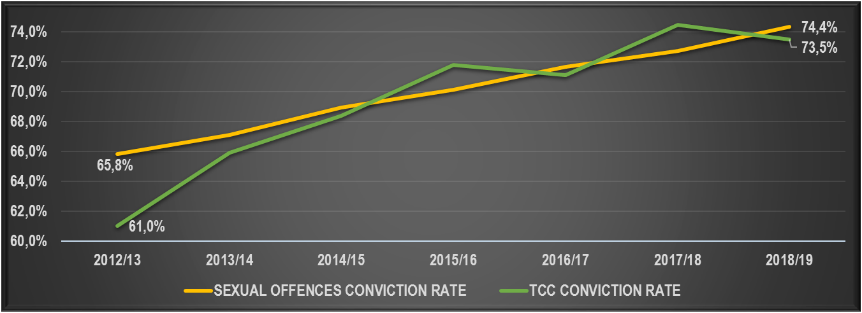
SUB-PROGRAMME 1: NATIONAL PROSECUTIONS SERVICE (NPS)
FY | 2012/13 | 2013/14 | 2014/15 | 2015/16 | 2016/17 | 2017/18 | 2018/19 | Projected change over prev yr | Projected change over period 2012/13-18/19
SEXUAL OFFENCES CONVICTION RATE | 65,8% | 67,1% | 69,0% | 70,1% | 71,7% | 72,7% | 74,4% | 1,6% | 8,5%
CONVICTIONS | 4 670 | 5 484 | 5 084 | 4 978 | 4 780 | 5 004 | 4 724 | -5,6% | 1,2%
TCC CONVICTION RATE | 61,0% | 65,9% | 68,4% | 71,8% | 71,1% | 74,5% | 73,5% | -1,0% | 12,5%
TCC CONVICTIONS | 2 248 | 2 357 | 2 285 | 2 340 | 2 334 | 2 549 | 2 225 | -12,7% | -1,0%

Slide 32
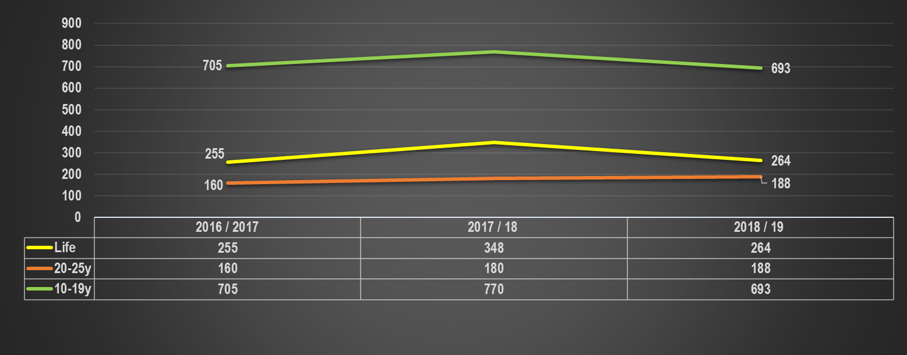
SUB-PROGRAMME 1: NATIONAL PROSECUTIONS SERVICE (NPS)
Sentencing of TCC-cases for the past 3 FYs:

Slide 33
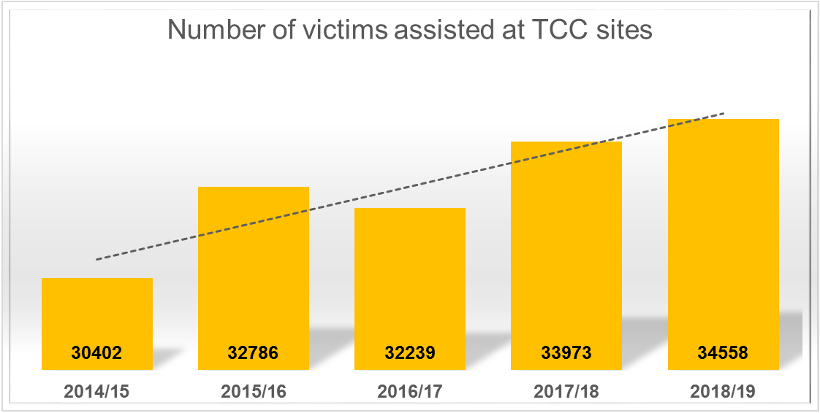
SUB-PROGRAMME 1: NATIONAL PROSECUTIONS SERVICE (NPS)

Slide 34
SUB-PROGRAMME 1: NATIONAL PROSECUTIONS SERVICE (NPS)
The NPA through the SOCA unit will strengthen the following initiatives:
Reprioritise the seriousness of these cases
Continuous stakeholder cooperation between SAPS and NPA is critical
SAPS to review their SGBV strategy and update it accordingly
SAPS’ review of the current status of all SGBV dockets to determine shortfalls & the way forward
Develop and implement an action plan to address SGBV between SAPS & NPA
Prosecutors to oppose bail in serious sexual offences cases - where bail is granted, prosecutors need to request stricter bail conditions
SAPS and NPA play an essential role in bail pending the outcome of appeal applications, specifically in serious sexual offences (linked to Minimum Sentences)

Slide 35
SUB-PROGRAMME 1: NATIONAL PROSECUTIONS SERVICE (NPS)
The NPA through the SOCA unit will strengthen the following initiatives (Cont.):
SAPS and NPA to ensure an increase in dedicated investigators and prosecutors
Prioritize the current skills development programme for investigators and prosecutors on sexual offences
Backlog of SGBV cases to be addressed collectively
The provision/regular availability of the sexual offences rape crime kits was addressed by SAPS
SAPS will implement a “stabilization project” in Limpopo in relation to the quality of investigations to address the current low conviction rates
Roll out of Sexual Offences Courts in conjunction with the DoJ&CD
Internal communication with feedback on sexual offence cases prosecuted and sentencing in the divisions as compiled by NPA Communications unit

Slide 36
SUB-PROGRAMME 1: NATIONAL PROSECUTIONS SERVICE (NPS)
Performance Indicator | Actual Achievement 2017/18 | Planned Target 2018/19 | Actual Achievement 2018/19 | % Deviation from target
Conviction rate in murder prosecutions | 77,7% (3 601) | 75% (3 404) | 78,3% (3 492/4 458) | 4%
Conviction rate in violent protests and industrial action | 68,8% (88) | 74% (75) | 68,8% (95/138) | (7%)
A 78,3% conviction rate in murder prosecutions was achieved by finalising 4 458 verdict cases with 3 492 convictions (4 458 murder verdict cases relate to 4 645 counts of murder - this constitutes on average 1.04 counts per murder case)
Inherent challenges hamper successful prosecution of violent protests - NPA obtained 95 convictions from 138 verdict cases, representing a 68,8% conviction rate
Notes:
Factors that impacted conviction rate in violent protest and industrial action that are being addressed include the reluctance of witnesses to testify, identification of offenders & discrepancies between the evidence of state witnesses) - to improve performance, some regions assigned dedicated prosecutors, assisted by advocates from the DPP offices & other experienced prosecutors

Slide 37
SUB-PROGRAMME 1: NATIONAL PROSECUTIONS SERVICE (NPS)
Performance Indicator | Actual Achievement 2017/18 | Planned Target 2018/19 | Actual Achievement 2018/19 | % Deviation from target
Conviction rate in trio crimes | 82,9% (1 723) | 85% (1 579) | 82,4% (1 578/1 916) | (3%)
NPA finalised 1 916 trio crime cases with a verdict obtaining 1 578 convictions - the 1 916 verdict cases comprise 2 048 trio counts (1 050 counts of house robbery, 608 counts of business robbery & 390 counts of vehicle robbery and hijacking)
Challenges which negatively impacted on performance include: the reluctance of witnesses to testify, incomplete investigations, incomplete collection of evidence at the scene of the crime, absence of corroborating evidence concerning the identity of the offender, discrepancies between the evidence of state witnesses and representations that can result in the withdrawal of cases

Slide 38
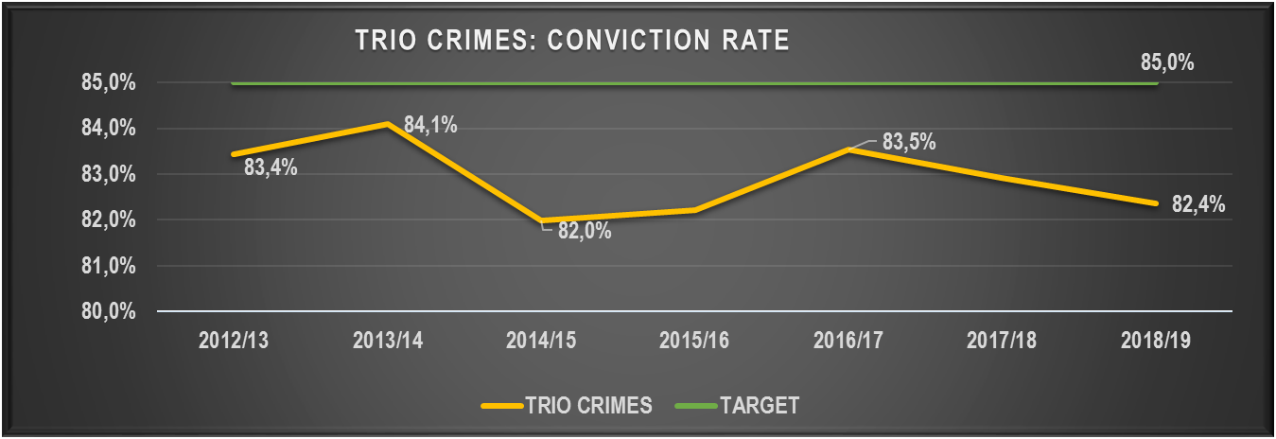
SUB-PROGRAMME 1: NATIONAL PROSECUTIONS SERVICE (NPS)
Trio counts overview:
2018/19 | CONVICTIONS | AQUITTALS | CONVICTION RATE
HOUSE ROBBERIES | 1 045 | 175 | 85,7%
BUSINESS ROBBERIES | 601 | 126 | 82,7%
VEHICLE ROBBERY/HI-JACKING | 382 | 93 | 80,4%
TOTAL TRIO COUNTS | 2 028 | 394 | 83,7%
Notes:
A high conviction rates was also achieved in house robberies. Challenges which negatively impacted on performance include, inter alia, the reluctance of witnesses to testify, incomplete investigations, incomplete collection of evidence at the scene of the crime, the absence of corroborating evidence concerning the identity of the offender, discrepancies between the evidence of state witnesses and representations that can result in the withdrawal of cases

Slide 39
SUB-PROGRAMME 2: ASSET FORFEITURE UNIT (AFU)
Strategic Objective 2: Ensure that profit is removed from crime
Performance Indicator | Actual Achievement 2017/18 | Planned Target 2018/19 | Actual Achievement 2018/19 | % Deviation from target
Number of completed forfeiture cases | 563 | 500 | 495 | (1%)
Value of completed forfeiture cases | R350.95m | R6bn | R3.13bn | (48%)
Litigation and settlement of high value state capture matters take long to finalise due to the size/complexity of cases
Strengthen section 18 initiatives in the DPPs offices
Continue to engage with stakeholders to ensure relevant cases are referred
The high vacancy rate within the AFU

Slide 40
SUB-PROGRAMME 2: ASSET FORFEITURE UNIT (AFU)
Performance Indicator | Actual Achievement 2017/18 | Planned Target 2018/19 | Actual Achievement 2018/19 | % Deviation from target
Number of freezing orders obtained | 324 | 264 | 273 | 3%
Value of freezing orders | R4.4bn | R10bn | R455m | (96%)
Notwithstanding the over-achievement of the number of freezing orders target the value of freezing orders were significantly (96%) below the target of R10bn
Undue delays in the finalisation of high value cases, especially state capture cases, due to performance inhibiting factors such as the complexity/extent of high value cases, delays in criminal investigations and a lack of financial investigator capacity, contributed to the non-achievement of the target
Measures to speed up finalisation of high value state capture cases were implemented - staff was dedicated from regional offices to assist with state capture cases

Slide 41
SUB-PROGRAMME 2: ASSET FORFEITURE UNIT
Performance Indicator | Actual Achievement 2017/18 | Planned Target 2018/19 | Actual Achievement 2018/19 | % Deviation from target
Value of freezing orders obtained relating to corruption where the amount involved is more than R5 million | R3.8bn | R8bn | R262m | (97%)
Value of recoveries in terms of POCA | R302.8m | R3bn | R3.05bn | 2%
Concerted efforts are being made to improve the finalisation rate of cases in the ACTT
Recoveries in terms of POCA to the value of R3.05bn were obtained, exceeding the target of R3bn by 2% - an increased focus on the completion of high value cases using Chapter 6, contributed to the over-achievement of the target

Slide 42
SUB-PROGRAMME 2: ASSET FORFEITURE UNIT
Performance Indicator | Actual Achievement 2017/18 | Planned Target 2018/19 | Actual Achievement 2018/19 | % Deviation from target
Success rate of litigated cases | 99,1% (557/562) | 93% | 98% (497/507) | 5%
Value of recoveries relating to corruption where the amount involved is more than R5 million (proceeds of crime and government losses) | R2.54m | R2.5bn | R2.84bn | 14%
Value of recoveries for government officials convicted of corruption and other related offences | R410k | R2.4m | R172k | (93%)
Good screening processes & consistent high quality litigation cases contributed to the good performance
Recoveries made in the state capture cases contributed to this outstanding performance
While AFU obtained some restraining orders involving complex high value matters, only a few convictions were obtained for which confiscation orders could be secured - AFU is engaging stakeholders to ensure prioritisation & finalisation of convictions in corruption cases involving government officials, as well as that relevant cases are referred to the AFU

Slide 43
SUB-PROGRAMME 3: OFFICE FOR WITNESS PROTECTION
Performance Indicator | Actual Achievement 2017/18 | Planned Target 2018/19 | Actual Achievement 2018/19 | % Deviation from target
Number of witnesses and related persons threatened, harmed or killed while on the Witness Protection Programme | 0 | 0 | 0 | 0%
Percentage of witnesses and related persons that walked off the Witness Protection Programme | 1,2% (9/772) | 1,5% | 0,6% (4/669) | (60%)
Percentage of witnesses and related persons successfully discharged and resettled | 100% | 100% | 100% (166/166) | 0%
During the 2018/19 financial year 389 witnesses and 280 related persons were managed on the Witness Protection Programme (WPP) - none of these witnesses & related persons was threatened, harmed or killed while on the WPP
48 accused persons were convicted, with 2 life terms and 669 sentences of direct imprisonment imposed in cases in which witnesses on the WPP testified
Four witnesses, who no longer wanted to be on the programme, left the programme voluntarily and without notice
90 witnesses and 76 related persons (100%) were successfully discharged and resettled

Slide 44
PRIORITY CRIME LITIGATION
The NPA made a decision to prosecute Rodriquez in the well known Timol case and successfully dealt with an application for a stay of prosecution and the matter is proceeding
The prosecution of former security branch members for the kidnapping and murder of Nokuthula Simelane has not proceeded due to repeated legal challenges
The Missing Persons Task Team (MPTT)
The MPTT made significant progress with the Gallows Exhumation Project in that 15 extra bodies were exhumed
The Minister approved a request by the Angolan Government that the MPTT conduct the exhumation of the remains of the former UNITA leader Jonas Savimbi, his remains were recovered and his identity confirmed by DNA tests
18 other remains were exhumed and positively identified
In 4 cases it was established the deceased died in neighboring States and no further action can be taken in the absence of an executive decision authorising exhumations in such foreign States
9 other cases were closed as the remains could not be located

Slide 45
LEGAL AFFAIRS DIVISION
LAD provides legal advice, monitors and manages civil litigation matters, renders assistance to the NDPP and the NPA in general through legal opinions on case law and high profile cases, and various external parties
Civil Claims
LAD achieved its best ever performance in 2018/19 by dealing with 1 861 cases, an increase of 7.4% compared to 1 732 in the previous reporting period
The LAD saved the NPA R163.9m of the R177.4m claimed (92.4%)
Applications and Agreements
280 applications received and dealt with, compared to 250 in the previous year
38 service level agreements were vetted in 2018/19 compared to 46 service level agreements in 2017/18
Percentage of Civil Claims Won
LAD won 62 out of 82 cases, which is 20,6% above the target of 55%

Slide 46
BUDGET OVERVIEW

Slide 47
NPA Overall Budget vs Expenditure as at 31st of March 2019 per Economic Classification
Economic classification | 2018/19
 | Adjusted Appropriation | Shifting / Virement | Final Appropriation | Actual Expenditure | Variance | Expenditure as % of final appropriation
 | R'000 | R'000 | R'000 | R'000 | R'000 | %
Compensation of employees | 3 240 126 | 77 101 | 3 317 227 | 3 317 227 | 0 | 100,00%
Goods and services | 360 422 | 72 815 | 433 237 | 433 237 | 0 | 100,00%
Departmental agencies and accounts | 9 515 | 43 | 9 558 | 9 277 | 281 | 96,76%
Households | 8 403 | 7 197 | 15 600 | 15 600 | 0 | 100,00%
Machinery and equipment | 30 383 | -10 930 | 19 453 | 19 453 | 0 | 100,00%
Payment for financial assets | 0 | 4 601 | 4 601 | 4 601 | 0 | 100,00%
Total | 3 648 849 | 150 827 | 3 799 676 | 3 799 395 | 281 | 99,99%

Slide 48
NPA Overall Budget vs Expenditure as at 31st of March 2019 per
Sub-Programme
Sub-programme | 2018/19
 | Adjusted Appropriation | Shifting / Virement | Final Appropriation | Actual Expenditure | Variance | Expenditure as % of final appropriation
 | R'000 | R'000 | R'000 | R'000 | R'000 | %
National Prosecutions Service (NPS) | 2 960 676 | 98 076 | 3 058 752 | 3 058 752 | 0 | 100,00%
Asset Forfeiture Unit (AFU) | 130 933 | -3 139 | 127 794 | 127 794 | 0 | 100,00%
Office for Witness Protection (OWP) | 152 329 | 41 210 | 193 539 | 193 539 | 0 | 100,00%
Support Services (SS) | 404 911 | 14 680 | 419 591 | 419 310 | 281 | 99,93%
Grand Total | 3 648 849 | 150 827 | 3 799 676 | 3 799 395 | 281 | 99,99%

Slide 49
MTEF Allocation
2020/21 – 2022/23

Slide 50
Overall Budget growth per Economic Classification: MTEF
R’thousand | 2019/20 | 2020/21 | 2021/22 | 2022/23 | Average % increase over MTEF
 | Adjusted Appropriation | Medium Term estimates
Compensation of employees | 3 486 309 | 3 643 758 | 3 887 469 | 4 031 089 | 4,97%
Goods and services | 391 006 | 411 703 | 434 346 | 450 489 | 4,84%
Households | 8 874 | 9 362 | 9 888 | 10 359 | 5,29%
Machinery & equipment | 32 900 | 35 534 | 37 488 | 39 520 | 6,31%
Departmental agencies and accounts | 10 048 | 10 601 | 11 195 | 11 611 | 4,94%
Total | 3 929 137 | 4 110 958 | 4 380 386 | 4 543 068 | 4,87%
 | 3,41% | 4,63% | 6,55% | 3,71% | 4,87%

Slide 51
Overall Budget split per Economic Classification – 2019/20

Slide 52
Overall Budget growth per sub programme: MTEF
R’thousand | 2019/20 | 2020/21 | 2021/22 | 2022/23 | Average % increase over MTEF
 | Adjusted Appropriation | Medium Term estimates
National Prosecutions Services | 3 186 608 | 3 331 740 | 3 552 866 | 3 684 311 | 4,96%
Asset Forfeiture Unit | 140 992 | 147 479 | 157 162 | 162 980 | 4,96%
Office for Witness Protection | 164 445 | 172 437 | 183 124 | 189 937 | 4,93%
Support Services | 437 092 | 459 302 | 487 234 | 505 840 | 4,99%
Total | 3 929 137 | 4 110 958 | 4 380 386 | 4 543 068 | 4,87%
 | 3,41% | 4,63% | 6,55% | 3,71% | 4,87%

Slide 53
Budget vs Projected Expenditure for 2019/20
PROGRAMMES 4: NATIONAL PROSECUTING AUTHORITY R’000 | 2019/20
 | ENE BUDGET | PROJECTED EXPENDITURE | BUDGET SHORTFALL
Compensation Of Employees | 3 486 309 | 3 450 543 | 35 766
Goods And Services | 391 006 | 451 478 | -60 472
Transfers & Subsidies | 18 922 | 18 922 | 0
Machinery And Equipment | 32 900 | 32 900 | 0
Total | 3 929 137 | 3 953 843 | -24 706
NPA is in process of advertising posts in line with anticipated saving and normal attrition rate
NPA does not have a sufficient Goods & Services Budget for contractual obligations which will have a negative impact on the payments to service providers

Slide 54
Historical Compensation of Employees Shortfall
Compensation of Employees | 2015/16 | 2016/17 | 2017/18 | 2018/19 | 2019/20
 | R'000 | R'000 | R'000 | R'000 | R'000
Adjusted Appropriation | 2 821 407 | 3 007 463 | 3 168 219 | 3 240 126 | 3 486 309
Actual Expenditure | 2 835 971 | 3 039 993 | 3 202 753 | 3 717 227 | 3 450 543
Variance | -14 564 | -32 530 | -34 534 | -77 101 | 35 766
Prior year’s shortfalls were funded through virements from NPA operational budget and 2018/19 shortfall through virement from DoJ&CD
The NPA lost 73 officials from 1 April to 31 August 2019 which equals R42 million

Slide 55
2019 AENE – Additional Funding Allocated
PROGRAMMES 4: NATIONAL PROSECUTING AUTHORITY | 2019/20
Investigating Directorate | 38 000
AFU Capacity | 18 457
SCCU Capacity | 7 280
Safety, security and witness protection | 38 692
Total | 102 429
In process of filling posts within the Investigating Directorate, AFU and SCCU in line with additional AENE allocations

Slide 56
2020 MTEF Budget Request
PROGRAMMES 4: NATIONAL PROSECUTING AUTHORITY | 2020/21 | 2021/22 | 2022/23 | Total MTEF Request (Excl. 2019/20)
Shortfall on Warm bodies 31/08/2019 (Less 73 Officials) | -3 554 | 11 844 | -76 715 | -68 425
Total for Aspirant Prosecutors Programme | 25 793 | 66 530 | 112 062 | 204 385
158 Critical NPS posts | 91 478 | 96 967 | 96 967 | 285 412
Investigating Directorate | 115 276 | 126 601 | 135 463 | 377 341
IT Servers |  |  |  | 0
AFU and SCCU Capacity | 94 793 | 101 429 | 108 529 | 304 751
Safety, security and witness protection | 37 450 | 40 072 | 42 877 | 120 399
Operational Budget Shortfall (Revised after review) | 78 693 | 90 180 | 111 176 | 280 049
Replacement of 4000 laptops | 30 000 | 0 | 35 000 | 65 000
Total | 356 212 | 358 282 | 433 046 | 1 147 540

Slide 57
2020 MTEF BUDGET REQUEST
CoE Budget shortfall of R68,4m based on number of personnel as at the end of August 2019 and operational budget shortfall of R 280m over MTEF period
Aspirant Prosecutors Programme - R 204m over MTEF period, three intakes of 100 Aspirants each and absorption of the Aspirants in the outer years
NPA 158 critical posts – R 285m over MTEF period
Establishment and capacitating the Investigating Directorate – R 377m over MTEF period
Capacitating AFU, SCCU, Safety, security and witness protection Cab Memo – R425,1m over MTEF period
Replacement of 4 000 laptops – R 65m

Slide 58
resourcing
Personnel Position
COE ratio to goods and services is currently at 89:11
The full moratorium on the filling of posts since 2015/2016 impacted on staff morale
Vacancy rate = 21%
Absenteeism, presenteeism and increased cost of Employee Wellness Programme (EWP) services
Suspension of the Aspirant Prosecutor Programme had a tremendous impact on the sustainability of the NPA prosecutorial service delivery – reinstated in 2019
Skills development programme was scaled down due to budgetary constraints within the limits of the budget scenario - various programmes were offered and attended by 3 086 NPA staff

Slide 59
resourcing
BREAKDOWN OF TOTAL EMPLOYMENT IN THE NPA
2018/19 | FILLED | VACANT | TOTAL | VACANCY RATE
 | 4 408 | 1 142 | 5 550 | 21%
BREAKDOWN PER CORE RESPONSIBILITIES
 | TOTAL | FILLED | VACANT & UNFUNDED | VACANCY RATE
PROSECUTORS | 3 620 | 2 958 | 662 | 18%
LEGAL ADMINISTRATION SUPPORT (AFU INVESTIGATORS, CPO, VAO, ETC. | 249 | 188 | 61 | 32%
ADMINISTRATIVE SUPPORT | 1 516 | 1 113 | 403 | 27%
OWP (Incl. Administration) | 165 | 149 | 16 | 10%

Slide 60
Misconduct and disciplinary outcomes
RESOURCING
Number of misconduct cases dealt with and nature of finalisation. Most of the cases were resolved through final written warnings followed by dismissals.
Nature of misconduct | Number of cases | %
Negligence | 9 | 5.6%
Bringing the name of the NPA into disrepute | 2 | 1.25%
Dishonesty | 4 | 2.5%
Incapacity | 1 | 0.6%
Improper conduct | 3 | 1.87%
Reporting under influence | 3 | 1.87%
Failure to comply with instruction | 3 | 1.87%
Off duty misconduct | 2 | 1.25%
Breach of confidentiality | 1 | 0.6%
Sexual harassment | 7 | 4.37%
Unethical conduct | 1 | 0.6%
Absenteeism | 7 | 4.4%
Financial misconduct (failure to declare financial interest) | 116 | 72.5%
Non-compliance with policy | 1 | 0.6%
TOTAL | 160 | 100%

Slide 61
Outcome of disciplinary hearings
RESOURCING
The table below indicates the nature of misconduct cases dealt with and finalised:
Labour Matters
Grievances, total cases 178, resolution rate 90%
Disputes, total cases 42, success rate 98%
Precautionary suspensions, total cases 10, cost of suspensions R7 710 008.64
Outcomes of disciplinary hearings | Number | % of total
Corrective counselling | 0 | 0%
Written warning | 2 | 12.5%
Final written warning | 3 | 18.75%
Suspension | 4 | 25%
Dismissal | 3 | 18.75%
Not Guilty | 0 | 0%
Case withdrawn | 2 | 12.5%
Closed | 2 | 12.5%
Total | 41 | 100%

Slide 62
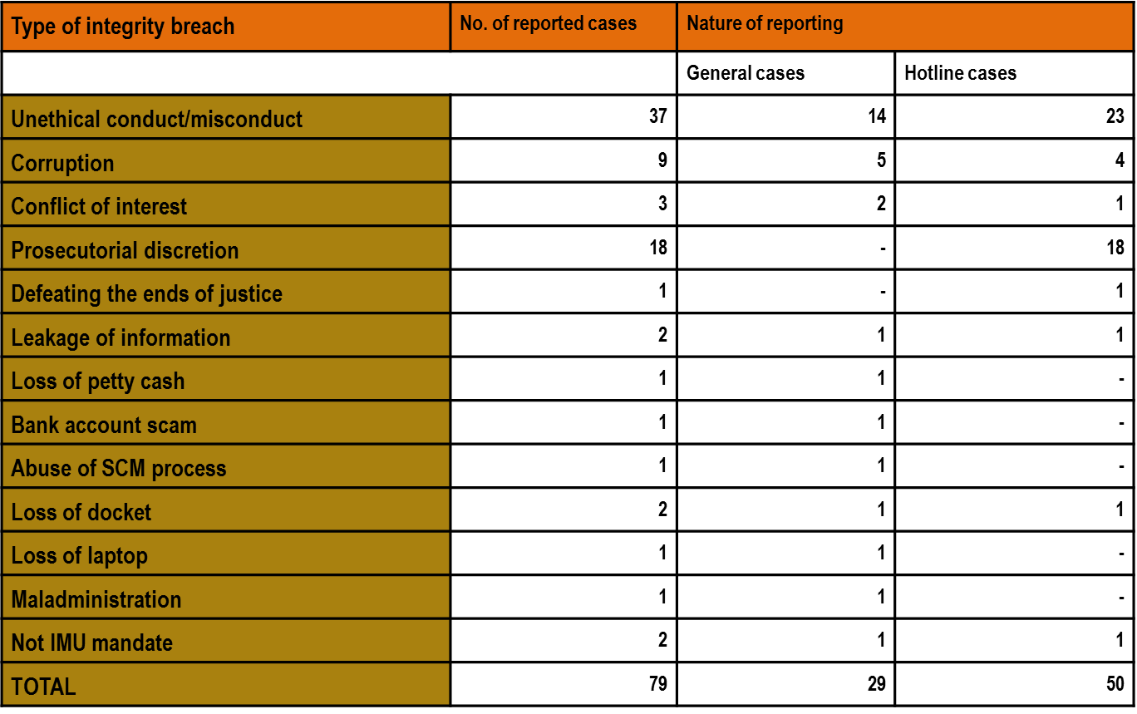
INTEGRITY MANAGEMENT
The Fraud and Corruption Directorate investigated and reported on 75% of its investigation cases and was also able to identify potential fraud and corruption risks through its structured detection programme
100% compliance rate with the financial disclosures of SMS members; 86% compliance of level 12 Non-SMS members

Slide 63
Key challenges
Key Challenges for NPA - Internal
There are high expectations of the NPA, however, the following challenges exist:
Lack of credibility
Divisions within the organisation
Severe budgetary limitations
High vacancy rates
Low staff morale – Staff Survey
Limited professional development and training
Weakened sense of values and identity
Inefficiencies in the NPA (need enhancement)
Efficiency of the JCPS Cluster
Monitoring of performance
Lack of aligned and/or common targets within the JCPS cluster
Lack of allocation of dedicated resources and budget to manage JCPS cluster priorities
Challenges in the CJS
Capacity constraints within partners in the CJS
Lack of resources – human, technical etc.
Lack of skills
Corruption
Demoralisation and apathy

Slide 64
Thank you

