Slide 1
Presentation to the
Health Portfolio Committee
NHLS Annual Report 2018/19
Date: 15 October 2019

Slide 2
NHLS Team Present
Prof Eric Buch Board Chairperson
Ms Nelisiwe Mkhize Chairperson: RHRC
Mr Ian van der Merwe Chairperson: Finance Committee
Ms Simphiwe Mayinga Board Member
Dr Karmani Chetty Acting CEO
Mr Michael Sass Acting CFO
Prof Koleka Mlisana AARQA Executive
Ms Violet Gabashane Senior Manager M&E
Dr Mojaki Mosia HR Executive
Mr Mpho Mphelo Company Secretary
Ms Nasima Mohamed Area Manager

Slide 3
Structure of the presentation
Part 1: Strategic overview
Part 2: Performance highlights
Part 3: Performance by programme
Part 4: Human Resource management
Part 5: Financial information
Part 6: Conclusion

Slide 4
NHLS mandate
To provide cost-effective and efficient health laboratory services, support health research and provide training for health science education.

Slide 5
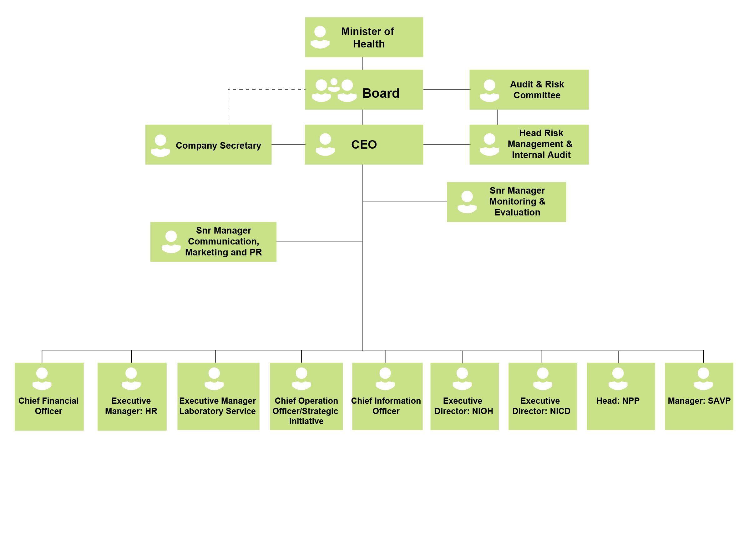
NHLS Structure

Slide 6
Three statutory functions
RESEARCH
DIAGNOSTIC
TRAINING

Slide 7
Institutes of the NHLS
National Institute for Communicable Diseases (NICD)
Surveillance and monitoring of communicable diseases;
The National Cancer Registry; and
The only bio safety level 4 laboratory in Africa.
National Institute for Occupational Health (NIOH)
Investigates occupational diseases and provides services to
support occupational health.
South African Vaccine Producers (SAVP)
Only African producer of equine anti-venoms for
snake bites, spider bites and scorpion stings.
Diagnostic Media Products (DMP)
Main supplier of culture media and reagents to the NHLS
laboratories.

Slide 8
Purpose of the presentation
To brief the Committee on the achievements and progress as well as financial performance realised by the NHLS during the past financial year as outlined in its 2018/2019 Annual Report and audited financial statements.

Slide 9
Vision and mission
Vision
To render efficient patient-centred services and become a global centre of excellence for innovative laboratory medicine.
Mission
Provide quality, affordable and sustainable health laboratory
services through an integrated network of laboratories;
Provide training for health science education; and
Execute innovative and relevant research with a focus on patient
care.

Slide 10
Our values
Care
Caring about the environment and society.
Unity of Purpose
All working together towards a common goal.
Service
Excellence
Valuing good work ethics and striving towards service
excellence for customers.
Transformation
Looking forward to the future and growing together.
Innovation
Pioneering relevant research solutions and training.
Integrity
Working with integrity and responsibility.

Slide 11
The NHLS at a glance
268
Total number of
laboratories
The NHLS is a Section 3A Public Entity.
94 404 922
Total test volumes 2018/19
7532
Total number of employees
8.5 billion
Total revenue
2018/19
35
Total number of intern medical scientists enlisted for training
338
Total number of scholarships and bursaries awarded
59
Total number of registrars enlisted for training
248
Total number of medical Technologist enlisted for training
593
Total number of
peer-reviewed articles
90
Total number of
SANAS accredited pathology laboratories

Slide 12
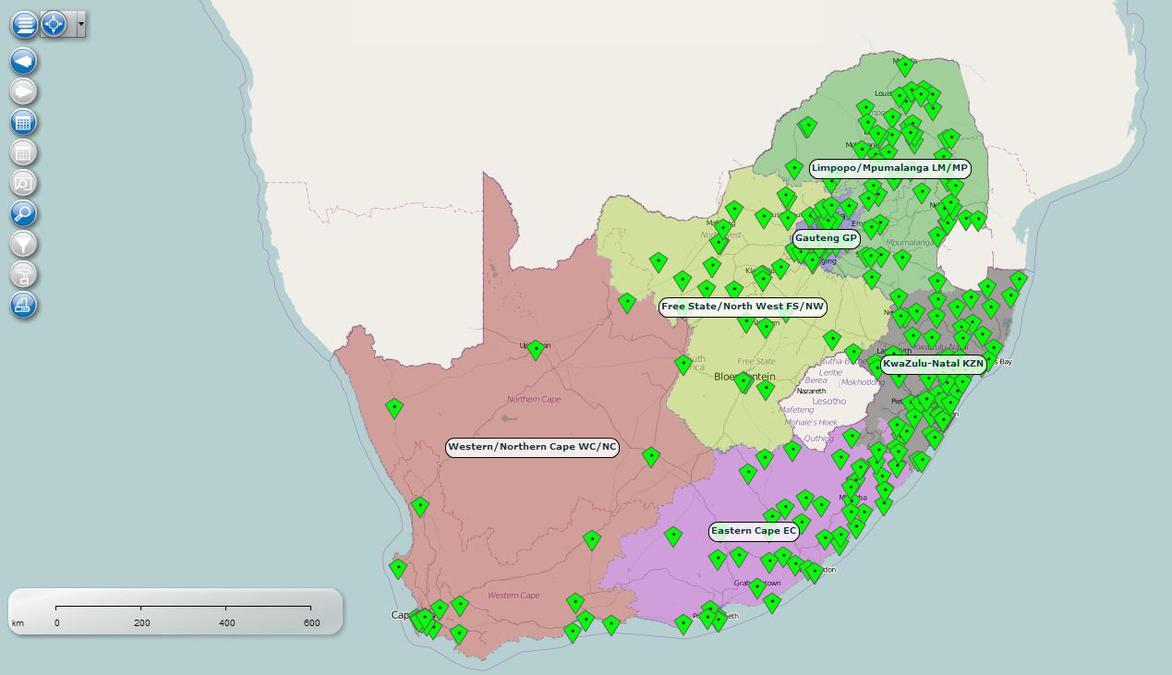
National footprint

Slide 13
Private Pathology market compared to NHLS
Category | National Pathology Group (NPG) | NHLS
Total Number of Employees | 10 993 | 7 101
Total Number of Pathologists | 255 | 203
Medical Scientists | 51 | 224
Medical Technologist | 1 560 | 1 473
Medical Technician | 868 | 859
Phlebotomy Technician | 172 | 248
Nursing Sisters | 2 390 | 42
Tests done per day | 200 000 | 344 537
Tests done per annum | 53 000 000 | 91 302 409
Expenditure | 8 160 000 000 | 7 094 905 000
Exp/Test | 154 | 78
Total Population | 11 624 966 | 46 499 860
Per Capita Expenditure | 702 | 153

Slide 14
Strategic overview

Slide 15
Strategic overview
The Board
The NHLS Board serves as the accounting authority in terms of Section 49 of the Public Finance Management Act, 1999 (Act No. 1 of 1999).
Responsible for providing strategic direction and leadership, ensuring good corporate governance and ethics, determining policy and agreeing on performance criteria.
Board is supported by seven sub-committees to help it meet its mandate, without abdicating its own responsibilities.

Slide 16
Strategic overview: Composition of the Board
Prof Eric Buch
Chairpersons of the Committees
Prof Eric Buch - Governance, Social and Ethics Committee
Nelisiwe Mkhize - Remuneration and Human Resources Committee
Mr Ian van der Merwe - Finance committee
Dr Tim Tucker - National Academic and Pathology Committee
Dr Monde Tom - Audit and Risk
Prof Mary Ross - Research and Innovation Committee
Chairperson of the Board

Slide 17
Strategic overview: Composition of the Board (cont)
Prof Larry Obi
Mr Ben Durham
Dr Gerhard Goosen
Mr Michael Shingange
Dr Zwelibanzi Mavuso
Dr Balekile Mzangwa
Ms Sphiwe Mayinga
Dr Kamy Chetty
Current Board Members

Slide 18
Strategic overview (cont)
Internal leadership updates.
Disciplinary proceedings against suspended CEO and CFO and other officials have been finalised.
Suspended CEO and CFO and other officials have been dismissed.
In the process of appointing key personnel: CEO, CFO and CIO.
NHLS improved on all functions and processes that enable it to carry out its
mandate more effectively and efficiently.
Stability has been brought to the organisation in its finances, management and governance areas.

Slide 19
Strategic overview (cont.)
Key Initiatives
NHLS continues to offer high quality, affordable services with proven value for money.
Focussed attention on service delivery improvement as evidenced by the improved turnaround times for most of the tests.
Financial sustainability and performance has been greatly improved.
Improved relations with organised labour and harmonisation of labour relations.
Key focus on ensuring SANAS accreditation, which shows acceleration of accreditation in preparation for NHI.

Slide 20
Strategic overview (cont.)
Key initiatives
Improved internal operational efficiencies.
Systems improvements in procurement.
Improved policies and systems in Information Technology are being put in place to radically modernise the NHLS IT infrastructure.
The National Institute for Communicable Diseases continues to play an exceptional role in health surveillance.
The National Institute for Occupational Health continues to play a niche role in Occupational Health and Safety.
Established strategic relationships with a number of partners.

Slide 21
Part 2: Performance highlights

Slide 22
Summary of key achievements
Finances:
Financial stability: NHLS financial situation improved significantly in the 2018/19 financial year.
Provincial debt: Through extensive negotiations a number of provinces have substantially reduced their historic debt.
Current debt: Most provinces are adequately paying for current consumption.
Settlement agreement: A settlement agreement was reached with the Gauteng Department of Health (GDoH) in 2017/18. Thus far, two instalments have been received and the department has improved on its payment for current consumption.
Audit Outcome: Improved from Qualified to Unqualified

Slide 23
Summary of key achievements (cont)
Finances:
Revenue and other income: Grew from R7.9 billion to R8.5 billion, with
provinces accounting for 87% of total revenue generated.
Surplus: Amounting to R996 million.
Cash Flow: Increased revenue collection coupled with effective cost-
containment resulted in better cash flow and ensured the 4 month reserves (~R2b) needed to ensure stability.
Creditors days: reduced from 59 days to 29 days and SMMEs are prioritised for payment.
Debtors days: reduced substantially and some of the high
value long outstanding debt has been settled.

Slide 24
Summary of key achievements (cont)
Systems Improvement
Procurement: Electronic Contract Management System was procured and
is being implemented.
Information Technology:
Upgrade of the Laboratory Information System (LIS) to the latest version, to improve user functionality;
Integration of the LIS with the Health Patient Registration System (HPRS).
Partnership with South African National Research and Educational Network (SANReN) to improve bandwidth and speed.

Slide 25
Summary of key achievements (cont)
Service delivery
NHLS delivered the test results within the set turnaround times for most of the tests.
The test volumes increased by 2%, from 92 486 362 in the 2017/2018.
financial year, to 94 404 922 in the 2018/2019 financial year.
The set target for NHLS Annual Performance Plan is that 75% of HIV Viral Load (VL) should be tested within 96 hours. This target was exceeded with ˃80% of HIV VL processed within the requested time period.

Slide 26
Summary of key achievements (cont.)
Academic Affairs, Research and Quality Assurance
Scientists: Number of intern scientists increased by 38% from 47 to a
total of 65.
Journal articles: 593 journal articles were published by NHLS in
collaboration with its academic partners.
SANAS accredited laboratories: 21 new pathology laboratories
accredited by the SANAS. A total of 90 Pathology laboratories
accredited by SANAS.
Proficiency Testing Schemes: 96% of reporting laboratories achieved
results above 80%.
Rollout of the web-based Academic Affairs and Research Management
System (AARMS), to enable online research applications management.

Slide 27
Summary of key achievements (cont.)
Surveillance of Communicable Diseases
Tuberculosis: The Centre for TB (CTB) completed the first ever national TB prevalence survey and the data is being used to find the missing TB patients.
Malaria: The Centre for Emerging Zoonotic and Parasitic Diseases continued to play an important role in supporting the malaria control and elimination agenda of the provincial, national and regional programmes.
Listeriosis: The NICD, through its capable surveillance system, detected the outbreak of Listeria. The Emergency Operations Centre (EOC) was able to effectively pinpoint the source of the Listeria outbreak through the next-generation sequencing technologies.

Slide 28
Summary of key achievements (cont.)
Surveillance of Communicable Diseases
The Minister of Health declared the end of Listeriosis outbreak in September 2018, and for this, NICD received the Alfred Nzo Environmental Health Excellence Award from the NDoH.
Cancer: The National Cancer Registry (NCR) continued to serve as South
Africa’s main source of national cancer incidence data, through pathology-
based cancer surveillance. The NCR released the first Ekurhuleni
Population based Cancer Registry.
NMCSS: The Notifiable Medical Conditions Surveillance System designed
for real-time data reporting was successfully rolled-out and received over 6,500 monthly notifications from NHLS laboratories, and private and public sector clinicians in the past year.
28

Slide 29
Summary of key achievements (cont.)
Occupational Health and Safety
NIOH currently leads the WHO initiative on better Occupational Health
and Safety for vulnerable workers.
The Institute conducted a number of teaching and training initiatives to integrate the local, regional and global changes that have a notable impact on the Occupational Health and safety.
The NIOH Gender Committee conducted an extensive review on Occupational and Environmental Health and Safety Systems, which included participatory gender audit that indicated that gender issues are not sufficiently addressed in the world of work.
Biobank: The Biobank housed within the NIOH has grown significantly in
the year under review, and is successfully housing thousands of specimens
from different government departments.

Slide 30
Part 3: Performance by programme

Slide 31
Summary of performance
Programme | Achieved | Not Achieved | Total number of KPIs | % Score Achieved
Financial Management | 6 | 0 | 6 | 100%
Governance and Compliance | 5 | 0 | 5 | 100%
Information Technology | 5 | 0 | 5 | 100%
Human Resources | 4 | 2 | 6 | 67%
Surveillance of Communicable Disease (NICD) | 6 | 1 | 7 | 86%
Occupational and Environmental Health and Safety (NIOH) | 5 | 1 | 6 | 83%
Academic Affairs, Research and Quality Assurance (AARQA) | 9 | 5 | 14 | 64%
Laboratory Services | 10 | 1 | 11 | 91%
Overall Achievement | 50 | 10 | 60 | 83%
2017/18 Overall Achievement |  |  |  | 60%

Slide 32
Summary of performance
Programme | Achieved | Not achieved
Prog 1: Admin Finance | Financial management policy Ratio of current assets Cash Flow Materials cost to revenue Creditors days Debtors days Contract management system Tender management
Prog 1: Admin Governance and Compliance | Audit opinion Monitoring tool to measure compliance Code of conduct and ethics policy Information collection and collating methodology Integrated reporting system
Prog 1: Admin IT | IT strategy IT roadmap Dashboard System uptime Modernisation

Slide 33
Summary of performance (cont)
Programme | Achieved | Not achieved
Prog 1: Admin HR | Staff turnover ratio Staff recruitment turnaround Workforce model Integrated performance management system | Employment equity Performance Agreements Training as per approved plan
Prog 2: Surveillance of Communicable Disease | Outbreaks responded to SANAS accreditation Annual report of population based on cancer surveillance WHO reference laboratory status Articles published Qualified field epidemiologists | Diseases under surveillance

Slide 34
Summary of performance (cont)
Programme | Achieved | Not achieved
Prog 3: Occupational Health and Safety | No of occupational, environmental health and safety assessments completed Surveillance reports produced % of NHLS laboratories audited Articles published Students and registrars under supervision | Percentage of Occupation and environmental health laboratory tests conducted within predefined turnaround time

Slide 35
Summary of performance (cont)
Programme | Achieved | Not achieved
Prog 4: Academic Affairs, Research and Quality Assurance | Number of regional laboratories with SANAS accreditation status Number of district laboratories with SANAS accreditation status % of laboratories achieving proficiency testing scheme Gap analysis and work plan to support service departments and laboratories for certification and accreditation Number of articles published Research priorities proposal | % compliance achieved by laboratories during annual quality compliance audits % of national central laboratories that are SANAS accredited % of provincial tertiary laboratories that are SANAS accredited Medical scientists admitted and trained Number of student medical technicians admitted and trained Number of bilateral agreements signed with universities and universities of technology

Slide 36
Summary of performance (cont)
Programme | Achieved | Not achieved
Prog 5: Laboratory Service | % TB microscopy tests performed within 40 hours % TB GeneXpert tests performed within 40 hours % CD4 tests performed within 40 hours % Viral Load tests performed within 96 hours % Cervical smear tests performed within 5 weeks % Cervical of laboratory tests ( FBC) performed within 8 hours % Cervical of laboratory tests (U&E) performed within 8 hours Laboratory facilities review Implementation of the pilot specimen tracking system Develop laboratory organogram | % HIV PCR tests performed within 96 hours

Slide 37
Part 4: Human resource management

Slide 38
Overview of HR environment
Total number of employees at end of Fin Year = 7 532; broken down as follows:
Level | 2018/19 No. of employees
Top management | 8
Senior management | 49
Professional qualified | 716
Skilled | 3016
Semi-skilled | 2617
Unskilled | 794
Interns (Learnerships) | 332
Total | 7532

Slide 39
Overview of HR environment (cont)
Personnel expenditure amounted to R3.6 billion.
Personnel expenditure as a % of total expenditure = 46.96%.
Average personnel cost per employee = R 478,360.24

Slide 40
Overview of HR environment (cont)
A total of 5631 employees attended technical and non-technical short learning programmes, workshops, seminars, on-the-job training and conferences during the past financial year.
338 scholarships and bursaries were awarded across the country to study towards a National Diploma in Biomedical Technology, Bachelor of Health Science and career development.
Staff turnover stood at 5.4%, indicating that the NHLS is an employer of choice for professionals in the pathology sector.
Vacancy rate was 9.4% - emphasis was placed on filling critical positions.
The NHLS is still the largest training provider for registrars, medical scientists, medical technologists, medical technicians and laboratory assistants in the country.

Slide 41
Equity target and employment equity status - male
Level | African |  | Coloured |  | Indian |  | White
 | Current | Target | Current | Target | Current | Target | Current | Target
Top Management | 3 | 5 | 0 | 0 | 0 | 0 | 1 | 1
Senior Management | 50 | 14 | 1 | 1 | 4 | 4 | 9 | 7
Professional Qualified | 110 | 148 | 24 | 26 | 50 | 46 | 98 | 88
Skilled | 625 | 705 | 66 | 80 | 51 | 59 | 57 | 75
Semi-skilled | 728 | 767 | 67 | 82 | 42 | 44 | 11 | 22
Unskilled | 293 | 311 | 9 | 11 | 0 | 1 | 1 | 2
Total | 1 767 | 1949 | 167 | 200 | 147 | 154 | 177 | 195

Slide 42
Equity target and employment equity status - male
Level | African |  | Coloured |  | Indian |  | White
 | Current | Target | Current | Target | Current | Target | Current | Target
Top Management | 2 | 3 | 0 | 0 | 1 | 1 | 1 | 1
Senior Management | 8 | 8 | 2 | 1 | 8 | 7 | 20 | 14
Professional Qualified | 258 | 257 | 29 | 28 | 109 | 101 | 205 | 189
Skilled | 1407 | 1401 | 158 | 163 | 162 | 174 | 255 | 255
Semi-skilled | 1413 | 1415 | 184 | 187 | 61 | 64 | 67 | 73
Unskilled | 463 | 463 | 24 | 27 | 1 | 1 | 0 | 1
Total | 3551 | 3547 | 397 | 406 | 342 | 348 | 548 | 538

Slide 43
Equity target and employment equity status - male
Level | Male |  | Female
 | Current | Target | Current | Target
Top Management | 0 | 0 | 0 | 0
Senior Management | 0 | 0 | 1 | 0
Professional Qualified | 1 | 3 | 0 | 3
Skilled | 3 | 8 | 19 | 23
Semi-skilled | 4 | 9 | 5 | 9
Unskilled | 2 | 2 | 3 | 3
Total | 10 | 22 | 28 | 38

Slide 44
Part 5: Financial information

Slide 45
Summary of financial performance
Surplus for the year, amounting to amounting to R996 million compared to a R1.4 billion surplus in the previous financial year.
Revenue and other income R7.9 billion to R8.5 billion, with provinces amounting to 87% of the total revenue generated.
Production costs including direct labour and material grew from R6.2 billion to R6.7 billion. Labour costs constituted 42% of the total revenue compared to 40% in the previous financial year.

Slide 46
Summary of financial performance (cont)
Assets increased from R5.0 billion to R5.9 billion which translates to a 17% increase, mainly due to a 97% (R1.1 billion) increase in cash
Bank balance ended at R2.2 billion compared to R1.1 billion in the previous financial year, which indicates a net cash inflow of R1.1 billion for the NHLS
Test volumes increased by 2%, from 92 486 362 in the 2017/2018 financial year, to 94 404 922 in the 2018/2019 financial year.
Collection from provincial departments amounted R7.5 billion compared R6.4 billion in the prior year.

Slide 47
Summary of financial performance (cont)
Financial Performance (R’000) | 2016 | 2017 Restated | 2018 Restated | 2019 Restated
Revenue | 6 442 194 | 7 094 905 | 7 915 877 | 8 502 008
Other revenue | 523 553 | 269 119 | 327 041 | 288 863
Total revenue | 6 965 747 | 7 364 024 | 8 242 918 | 8829 049
Gross surplus / (loss) | 1 602 546 | 1 262 153 | 1 638 276 | 1 755 629
Operating surplus / (deficit) | 272 946 | (2 029 017) | 1 310 437 | 791 873
Net surplus / (deficit | 272 762 | (1 910 167) | 1 396 604 | 996 412

Slide 48
Summary of financial performance (cont)
Subsidies from government R’000 | 2016 | 2017 Restated | 2018 Restated | 2019 Restated
Government funding of National Institutes | 678 926 | 715 270 | 746 464 | 789 759
Liquidity ratio analysis | 2016 | 2017 Restated | 2018 Restated | 2019 Restated
Current ratio | 2.4:1 | 1.2:1 | 1.9:1 | 3:1

Slide 49
Audit Outcome Improved
Audit outcome 2018 - Qualified
Areas of qualification – Irregular expenditure/SCM and Accruals
Matters of Emphasis – Grants, Utilities, Commitments
Audit outcome 2019.- unqualified
Matters of emphasis – Irregular expenditure/SCM, Grants

Slide 50
Irregular Expenditure
IRREGULAR SPEND | 2018/19 (R’000s) | 2017/18 (R’000s)
Opening balance | 4 445 560 | 1 889 865
Expired contracts | 1 690 132 | 675 805
Contracts that exceed DOA | 104 770 | 118 710
No tender procedures | 800 671 | 794 091
Contract overspend | 361 810 | 730 310
Tender – no signed contract | 19 470 | 18 702
Expenditure before contract | 18 282 | 218 077
Quotation splitting | 1 707 | -
Less: Amount Condoned | -2 310 258 | -
Subtotal | 5 132 144 | 4 445 560
Less: Amount to be Condoned | -2 341 301
Closing Balance | 2 790 843 | 4 445 560

Slide 51
Irregular Expenditure breakdown
IRREGULAR SPEND | 2017/18 (R’000s) | 2018/19 (R’000s) | 2017/18 (R’000s) | TOTAL | CONDONED BY NT | AWAITING CONDONEMENT | OUTSTANDING
Expired contracts | 487 119 | 1 690 132 | 675 805 | 2 853 056 | 2 179 799 | 142 701 | 530 556
Contracts that exceed DOA | 128 171 | 104 770 | 118 710 | 351 651 |  |  | 351 651
No tender procedures | 688 360 | 800 671 | 794 091 | 2 283 122 |  | 1 698 982 | 584 140
Contract overspend | 175 460 | 361 810 | 730 310 | 1 267 580 |  |  | 1 267 580
Tender – no signed contract | 17 037 | 19 470 | 18 702 | 55 209 |  |  | 55 209
Expenditure before contract | 393 718 | 18 282 | 218 077 | 630 077 | 130 459 | 499 618 | 0
Quotation splitting |  | 1 707 | 0 | 1 707 |  |  | 1 707
 |  |  |  |  | 2 310 258 | 2 341 301 | 2 790 843

Slide 52
Irregular Expenditure Action
Condoned expenditure relates mostly to reagents – condoned on basis of sole supplier
Remaining items mostly catalogue – many contracts to regularise
Actions taken:
Criminal charges
Disciplinary – dismissal
Board reports every meeting on progress
New contract management system plus further enhancements (I-Procure) in 2020
Reagents included in all contracts
Catalogue banned (except essential services)
Areas of qualification – Irregular expenditure/SCM and Accruals
Matters of Emphasis – Grants, Utilities, Commitments
Audit outcome 2019.- unqualified
Matters of emphasis – Irregular expenditure/SCM, Grants

Slide 53
Financial performance now stable
NP% | 2013/14 | 2013/14 | 2015/16 | 2016/17 | 2017/18 | 2018/19
 | R'000 | R'000 | R'000 | R'000 | R'000 | R'000
Net Surplus | 154 974 | 176 912 | 272 925 | 1 899 454 | 1 301 280 | 1 415 671
Total Revenue | 5 622 448 | 176 912 | 272 925 | 7 495 136 | 8 323 949 | 9 023 514
Result (%) | -3% | -3% | 4% | -25% | 16% | 16%
In 2016/17, a large bad debt provision was raised for Gauteng and KZN outstanding debt. Subsequently, a settlement has been reached with Gauteng. In the past two financial years, improved liability and expenditure management has led to the stabilisation of the net accounting surplus.

Slide 54
Creditor days now below 30
Creditor days | 2013/14 | 2013/14 | 2015/16 | 2016/17 | 2017/18 | 2018/19
 | R'000 | R'000 | R'000 | R'000 | R'000 | R'000
Result (%) | 82 | 93 | 66 | 60 | 41 | 29
As a result of improved collections, the NHLS was able to make additional payments to its suppliers and settled outstanding accounts in advance of agreed terms which resulted in improved creditors days. Long-outstanding accruals were cleared resulting in a reduction in the current liability. For the first time, NHLS is able to settle its debt within 30 day credit terms.

Slide 55
Debtor days down
Debtor days | 2013/14 | 2013/14 | 2015/16 | 2016/17 | 2017/18 | 2018/19
 | R'000 | R'000 | R'000 | R'000 | R'000 | R'000
Result (in days) | 277 | 335 | 199 | 164 | 114 | 127
The 2017/18 reduction in debtor days was partly due to the debt settlement agreement reached with the Gauteng Department of Health.

Slide 56
Provincial payments reached 100% of billed
Financial Year | Billed | Paid | % Received | % of payment related to historical debt
2008/09 FY | 2 877 927 621 | 2 525 058 466 | 88% | 24%
2009/10 FY | 3 252 160 442 | 3 096 822 395 | 95% | 26%
2010/11 FY | 3 823 082 984 | 3 232 124 957 | 85% | 27%
2011/12 FY | 4 054 934 185 | 3 555 762 785 | 88% | 30%
2012/13 FY | 4 495 749 705 | 3 810 111 353 | 85% | 22%
2013/14 FY | 4 975 934 304 | 3 503 241 175 | 70% | 28%
2014/15 FY | 5 454 183 025 | 4 708 088 908 | 86% | 24%
2015/16 FY | 5 608 915 677 | 4 665 653 928 | 83% | 15%
2016/17 FY | 6 204 260 242 | 5 063 851 728 | 82% | 23%
2017/18 FY | 6 853 179 391 | 6 461 876 449 | 94% | 23%
2018/19 FY | 7 443 862 217 | 7 468 062 744 | 100% | 20%
A key factor in the improved payments is KZN paying its billed amount in full.

Slide 57
Outstanding provincial debt at 31 March 2019
Region | 2016/17 & Prior FY | 2017/18 FY | 2018/19 FY | Total
Eastern Cape | 129 570 | 8 631 249 | 409 669 691 | 418 430 510
Free State | 0 | 0 | 88 213 585 | 88 213 585
Gauteng | 687 807 574 | 519 570 754 | 256 200 812 | 1 463 579 140
KZN | 2 626 854 120 | 10 743 874 | 254 029 562 | 2 891 627 556
Limpopo | 0 | 0 | 117 811 062 | 117 811 062
Mpumalanga | 0 |  | 83 798 275 | 83 798 275
North West | -2 609 | 6 076 231 | 153 619 622 | 159 693 244
Northern Cape | 4 486 857 | 27 069 516 | 45 582 953 | 77 139 326
Western Cape | 0 | -138 900 | 22 612 180 | 22 473 279
Grand Total | 3 319 512 | 571 952 723 | 1 431 537 740 | 5 322 765 976
% Contribution | 62% | 11% | 27% | 100%
In 2018/19, NHLS collections exceeded the billing for the 12 month period as provinces paid for the previous debt.
Most of the debt older than two years relates to the KZN disputed amount and the debt Gauteng has agreed to settle.

Slide 58
Challenges
Supply chain management systems.
Inadequate IT network infrastructure and connectivity .
Attraction and retention of Pathologists especially in Anatomical Pathology.
Attraction and retention of skilled and competent staff in IT and supply chain management.
Pressure on personnel costs.
Long turn around time for awarding tenders.
Backlogs in certain laboratories.

Slide 59
Part 6: Conclusion

Slide 60
Conclusion
The presentation shows that the NHLS has improved substantially both in its service delivery and financial performance.
Measures have already been put into place to stabilise the organisation as evidenced by the improved financial stability of the entity.
The Board and the management of the organisation will continue with the work already started of ensuring that the NHLS is a well run and effective entity.
Internal controls in all areas will continue to be strengthened to ensure smooth delivery on the NHLS mandate.

Slide 61
Conclusion
Accelerated implementation of projects initiated during the period under review to improve the efficiency of the organisation.
Cost containment will remain one of the core focus areas in this financial year.
Operational efficiency and effectiveness will also be the key drivers of performance this year.

Slide 62
The NHLS acknowledges and appreciates the support and guidance from the Portfolio Committee.
The NHLS is appreciative of the positive statements from the Chair of the Portfolio Committee following the last presentation.

Slide 63
THANK YOU!

