Slide 1


PORTFOLIO COMMITTEE ON BASIC EDUCATION
GENERAL EDUCATION CERTIFICATE PRESENTATION

Slide 2
PRESENTATION OUTLINE
Purpose
Introduction
Problem Statement and Rationale for the GEC
Policy and Legislation Framework
The General Education Certificate
International Practice
Skills Revolution
Skills and Competencies for a Changing World
GEC Broad Plan
Recommendation
2

Slide 3
PURPOSE
To make a presentation to the Portfolio Committee on the General Education Certificate qualification.
3

Slide 4

INTRODUCTION
NDP VISION STATEMENT
“We, the people of South Africa, have journeyed far since the long lines of our first democratic election on 27 April 1994, when we elected a government for us all.
We began to tell a new story then. We have lived and renewed that story along the way.
Now in 2030 we live in a country which we have remade…”
National Planning Commission: National Development Plan, November 2011)
4

Slide 5

PROBLEM STATEMENT AND RATIONALE FOR GEC
5

Slide 6

PROBLEM STATEMENT & RATIONALE FOR GEC
    Absence of an accurate recognition of learning achievement of South African learners at end of the compulsory schooling phase i.e. grade 9
Limited facilitation of access, mobility and progression within education, training and career paths.
    Persistent inefficiencies evident from candidates repeating levels 2 and 3 in the FET colleges, after completing Grade 12.
There is a high dropout rate before Grade 12, peaking in Grades 10 and 11 (15,2% in 2012).
About a third of young people aged 15-24 years (3.4 million) , are not in employment, education or training (NEET) - 2 million of them have not finished Grade 12.
Absence of a standardized assessment and a qualification to usher learners into different pathways at the end of compulsory schooling.
The mismatch between available Skills and Competencies and Labour market needs.
6

Slide 7
PROBLEM STATEMENT & RATIONALE…
16 TO 18 YEAR OLD CHILDREN WITH DISABILITIES ATTENDING EDUCATIONAL INSTITUTIONS BY PROVINCE, 2005-2014
Province | 2005 | 2006 | 2007 | 2008 | 2009 | 2010 | 2011 | 2012 | 2013 | 2014
Eastern Cape | 53.4 | 46.9 | 45.7 | 42.0 | 41.4 | 71.0 | 83.0 | 40.2 | 34.5 | 18.9
Free State | 72.0 | 51.5 | 60.6 | 54.8 | 70.2 | 65.2 | 79.4 | 89.5 | 88.8 | 83.5
Gauteng | 100.0 | 95.1 | 91.6 | 70.3 | 75.0 | 71.3 | 90.1 | 74.4 | 92.1 | 92.8
KwaZulu-Natal | 69.7 | 34.5 | 53.4 | 49.5 | 39.3 | 58.6 | 58.0 | 69.3 | 74.2 | 62.9
Limpopo | 32.6 | 43.8 | 42.0 | 40.6 | 65.9 | 61.0 | 83.4 | 87.5 | 43.9 | 19.8
Mpumalanga | 62.2 | 57.1 | 85.1 | 51.1 | 100.0 | 80.7 | 96.1 | 85.7 | 58.5 | 30.1
North West | 80.5 | 100.0 | 82.2 | 48.9 | 18.0 | 77.2 | 46.2 | 50.4 | 78.0 | 75.1
Northern Cape | 79.4 | 75.2 | 61.8 | 44.4 | 0.0 | 57.8 | 100.0 | 73.8 | 49.2 | 100.0
Western Cape | 16.8 | 66.5 | 59.7 | 49.1 | 74.3 | 79.1 | 100.0 | 82.4 | 87.6 | 65.5
National | 61.4 | 57.3 | 64.6 | 52.8 | 54.3 | 68.3 | 80.7 | 66.7 | 70.3 | 54.1
Source: Statistics South Africa, General Household Survey (GHS), DBE own calculations
7

Slide 8
PROBLEM STATEMENT & RATIONALE…
REPETITION RATE
8
8

Slide 9
PROBLEM STATEMENT & RATIONALE…
OUT OF SCHOOL YOUTH (AGE 7-18)
9

Slide 10
PROBLEM STATEMENT & RATIONALE..
PERCENTAGE OF REPEATERS BY GRADE
10

Slide 11
PROBLEM STATEMENT & RATIONALE…
PERCENTAGE OF REPEATERS BY GRADE AND GENDER, 2018
11

Slide 12
PROBLEM STATEMENT & RATIONALE…
PERCENTAGE OF 19 TO 21 YEAR OLDS WHO HAVE
COMPLETED GRADE 9 AND ABOVE BY PROVINCE
12

Slide 13
PROBLEM STATEMENT & RATIONALE…
DROP-OUT RATE
Source: National Income Dynamic Study (NIDS), 2007/08-2011/12
13

Slide 14
UNEMPLOYMENT
14

Slide 15
SOUTH AFRICA’S UNEMPLOYMENT RATE INCREASED BY 1,4 PERCENTAGE POINTS TO 29,0% IN Q2 OF 2019. THE HIGHEST UNEMPLOYMENT RATE SINCE Q1 OF 2008
Unemployment rate from
Q1:2008 to Q2:2019
15

Slide 16
THE NUMBER OF UNEMPLOYED PEOPLE IN SOUTH AFRICA INCREASED FROM 4,3 MILLION IN Q2:2009 TO 6,7 MILLION IN Q2:2019. THE PROPORTION OF THOSE IN LONG-TERM UNEMPLOYMENT INCREASED FROM 60,8% IN Q2:2009 TO 71,5% IN Q2:2019
Number of unemployed for one year or longer
M
28,5%
Number of unemployed
71,5%
39,2%
Short Term Unemployed
60,8%
Long Term Unemployed*
Q2
2009
Q2
2019
* Unemployed for a year or longer
16

Slide 17


Official Unemployment Rate
29,0% (+1,4 % Points Change Q/Q)
Expanded Unemployment Rate
38,5% (+0,5 % Point Change Q/Q)
42,5%
SA: 38,5%
31.3%
35,0%
SA: 29,0%
10,2 million
people were unemployed in Q2:2019
An increase of 232 000 q/q
27,1%
6,7 million
people were unemployed in Q2:2019
An increase of 455 000 q/q
Expanded Definition includes the following
- Official unemployment (searched and available) | 6,7 M
- Available to work but are/or
Discouraged work-seekers | 2,7 M
Have other reasons for not searching | 0,8 M
17

Slide 18
BLACK AFRICAN WOMEN ARE THE MOST VULNERABLE WITH AN UNEMPLOYMENT RATE OF OVER 30%.
Black women are the most vulnerable with unemployment rate of over 30%.
OFFICIAL unemployment rate by population group and sex
18

Slide 19
IRRESPECTIVE OF SEX, THE BLACK AFRICAN AND COLOURED POPULATION GROUPS REMAIN VULNERABLE IN THE LABOUR MARKET
EXPANDED unemployment rate by population group and sex
19

Slide 20
HIGHEST OFFICIAL UNEMPLOYMENT RATES RECORDED IN EC AND HIGHEST EXPANDED UNEMPLOYMENT RATE RECORDED IN NW. LP, KZN AND NC PROVINCES ALL HAVE MORE THAN 15 % POINTS DIFFERENCE BETWEEN THEIR EXPANDED AND OFFICIAL UNEMPLOYMENT RATES
Provincial unemployment rate: Official vs Expanded Q2:2019
Official
Expanded
15,4% points difference
16,0% points difference
20,8% points difference
20

Slide 21


NOT IN EMPLOYMENT, EDUCATION OR TRAINING (NEET)
NEET
Work
Education
Those young people (15-34 years) who are categorised as NEET are considered to be disengaged from both work and education.
?
Youth NEET rate is calculated as the total number of youth who are NEET as a proportion of the total youth-specific working-age population
21

Slide 22
APPROXIMATELY 8,2 MILLION (40,3%) OUT OF 20,4 MILLION YOUNG PEOPLE AGED
15-34 YEARS, WERE NOT IN EMPLOYMENT, EDUCATION OR TRAINING (NEET).
THE OVERALL NEET RATE INCREASED BY 1,0 PERCENTAGE POINT Y/Y.
NEET (15-34 years) by sex
15-34 YEARS
Female NEET
Up by 0,3 of a percentage point
Male NEET
Up by 1,8 percentage points
22

Slide 23
NC RECORDED THE HIGHEST RATE OF YOUNG PEOPLE AGED 15-24 YEARS NOT IN EMPLOYMENT, EDUCATION OR TRAINING IN Q2: 2019.
Provincial NEET rate (Year on Year Change Q2:2018 – Q2:2019)
( ) Y/Y Change
(-1,1)
(-3,4)
(+0,2)
(+0,5)
(-0,3)
(+4,7)
(+0,7)
(+1,8)
(+0,6)
(+1,4)
23

Slide 24
THE NW PROVINCE HAD THE HIGHEST RATE OF YOUNG PEOPLE AGED 15-34 YEARS NOT IN EMPLOYMENT, EDUCATION OR TRAINING AT 45,9%.
THE RATE INCREASED BY 1,8 PERCENTAGE POINTS YEAR-ON-YEAR.
( ) Y/Y Change
(+1,8)
(+0,7)
(+1,5)
(-0,3)
(+4,5)
(+1,3)
(+1,0)
(+1,5)
(+0,4)
(+1,9)
Provincial NEET rate (Year –on – Year Change Q2:2018 – Q2:2019)
24

Slide 25
RATIONALE FOR THE GEC
  Provide accurate indicator of the Recognition of the learning achievement of South African learners at the end of the compulsory schooling phase.
  To be viewed as the DNA of the Three Stream Model by providing reliable data for articulation of learners into Academic, Technical Vocational and Technical Occupational pathways in FET band (both schools and TVET colleges).
  To enable the facilitation of the skills revolution in South Africa
  Provide standardised benchmarks against which schools can compare their internal assessment standards.
  Reduce inefficiencies in the system where candidates are expected to repeat levels 2 and 3 in the FET colleges, after completing Grade 12.
  Allows for alignment of qualifications offered in the schooling system to the South African National Qualifications Framework (NQF)
25

Slide 26
RATIONALE FOR THE GEC ….
  g) The GEC is envisaged to further contribute to the attainment of
  the following objectives of the NQF:
    Creation of an integrated national framework for learning achievements;
    Enhancement of the quality of education and training;
    Facilitation of access, mobility and progression within education, training and career paths;
    Acceleration of redress of past unfair discrimination in education, training and employment opportunities; and
    Contribution to the equitable personal development of each learner and the social and economic development of the nation at large.
26

Slide 27
POLICY AND LEGISLATIVE FRAMEWORK
27

Slide 28
RECONSTRUCTION AND DEVELOPMENT PROGRAMME (RDP)
“The democratic government must enable all children to go to school for at least 10 years. The 10-year compulsory general education cycle should proceed from a pre-school reception year to the present Standard 7. The government must phase in compulsory education as soon as possible.”
Reconstruction and Development Programme (RDP)
1994
28

Slide 29
RDP AND WHITE PAPER 2
Reconstruction and Development Programme
1.4.4 Proper recognition for previously
disregarded skills.
1.4 5 Restructuring training and education to integrate the energies of all the institutions.
Chapter 4 par 6
The system must:
-increasingly open access to education and training opportunities;
-provide means of learners to move from one context to another; and
-increase range of learning possibilities
White Paper 2 on Education and Training
Par 18: Acknowledges that curriculum choice can be diversified.
29

Slide 30
NEPA, NDP AND MTT ON NSC REPORT
-Achieving an integrated approach to education within the NQF;
-Cultivating skills, disciplines and capacities necessary for reconstruction and development;
-Recognizing the aptitudes, abilities, interests, prior knowledge and experience of students; and -Encouraging independent and critical thinking.
National Education Policy Act 27 of 1996
“The different parts of the education system should work together allowing learners to take different pathways that offer high quality learning opportunities.”
The National Development Plan
Ministerial Task Team Report NSC 2014
Recommendation 5 - That an exit certificate for Grade 9 be created to facilitate the learners’ decision-making with respect to available pathways.
30

Slide 31
WHITE PAPER 2 AND NQF
Chapter 5
Par 14: General Education Certificate (GEC
Acquired at the end of compulsory schooling phase; and
through Adult Basic Education and Training programmes
Par 60: Acknowledges flexibility of the NQF which can allow for general education comprising of optional vocational and academic subjects.
White Paper 2 on Education and Training
The National Qualification Framework Act
Objective 1 of the NQF
Create a single integrated national framework for learning achievements
Facilitate access to, and mobility and progression within education training and career paths
31

Slide 32
A RESPONSIVE CURRICULUM
The White Paper on Education and Training (1995) proposed an integrated approach to education and training, thus implying “a view of learning which rejects a rigid division between "academic" and "applied", "theory" and "practice", "knowledge" and "skills", "head" and "hand".
32

Slide 33
GENERAL EDUCATION CERTIFICATE
33

Slide 34
WHAT IS THE GEC
Envisioned to be a registered Level 1 National Qualification.
Consisting of a planned combination of learning outcomes which has defined purposes.
Intended to provide qualifying learners with applied competence and a basis for further learning.
The GEC was registered on 01 July 2009 and the registration ended on 30 June 2012.
(NQFPedia, South African Qualifications Authority: 2017)
34

Slide 35
GEC within the National Qualifications Framework (NQF)
Level | Sub-Framework and Qualification Types
10 | Doctoral Degree
9 | Master’s Degree
8 | Bachelor of Honours Degree/Post Graduate Diploma | Occupational Certificate Level 8
7 | Bachelor’s Degree / Advanced Diploma | Occupational Certificate Level 7
6 | Diploma/Advanced Certificate | Occupational Certificate Level 6
5 | Higher Certificate | Occupational Certificate Level 5
4 | National Certificate | Occupational Certificate Level 4
3 | Intermediate Certificate | Occupational Certificate Level 3
2 | Elementary Certificate | Occupational Certificate Level 2
1 | General Certificate | Occupational Certificate Level 1
35

Slide 36
GENERAL EDUCATION AND TRAINING CERTIFICATE
The primary purpose of the GETC is to equip learners with the values, knowledge and skills that will enable or enhance meaningful participation in society, contribute towards developing sustainable communities, provide a basis for learning in further education and training, and establish a firm foundation for the assumption of a productive and responsible role in the workplace.
GENERAL EDUCATION AND TRAINING CERTFICATE POLICY DOCUMENT (October 2001) SAQA
36

Slide 37
THE GENESIS OF THE GEC
Has links with the GETC proposed in 2002 as generalist qualification
SAQA as the custodian of the NQF presided over the development of the GETC
Different sectors operating at GETC level
Level 1 qualification in:
- formal schooling;
- Adult Basic Education and Training; and
- Learnerships and skills programmes within the Department of Labour
The object of the GETC was to provide access to various learning pathways both Vertical and Horizontal
No GETC qualification was to focus on one “ Stream” at the expense of others.
37

Slide 38
GENESIS OF THE GEC
The argument for the GETC was that a recognition of learning achievement should be provided at the end of compulsory schooling phase
Specific design challenges
An age continuum (from children to adult learners);
A site-of-learning differentiation (from classroom to factory floor to workplace learning centre to community centre); and
A time-of-learning dichotomy (daylight-based versus night-based learning).
GETC was never realised in the formal schooling sector.
The GETC qualification was reconceptualised in to the GEC which takes into cognisance the Three Streams Model.
38

Slide 39
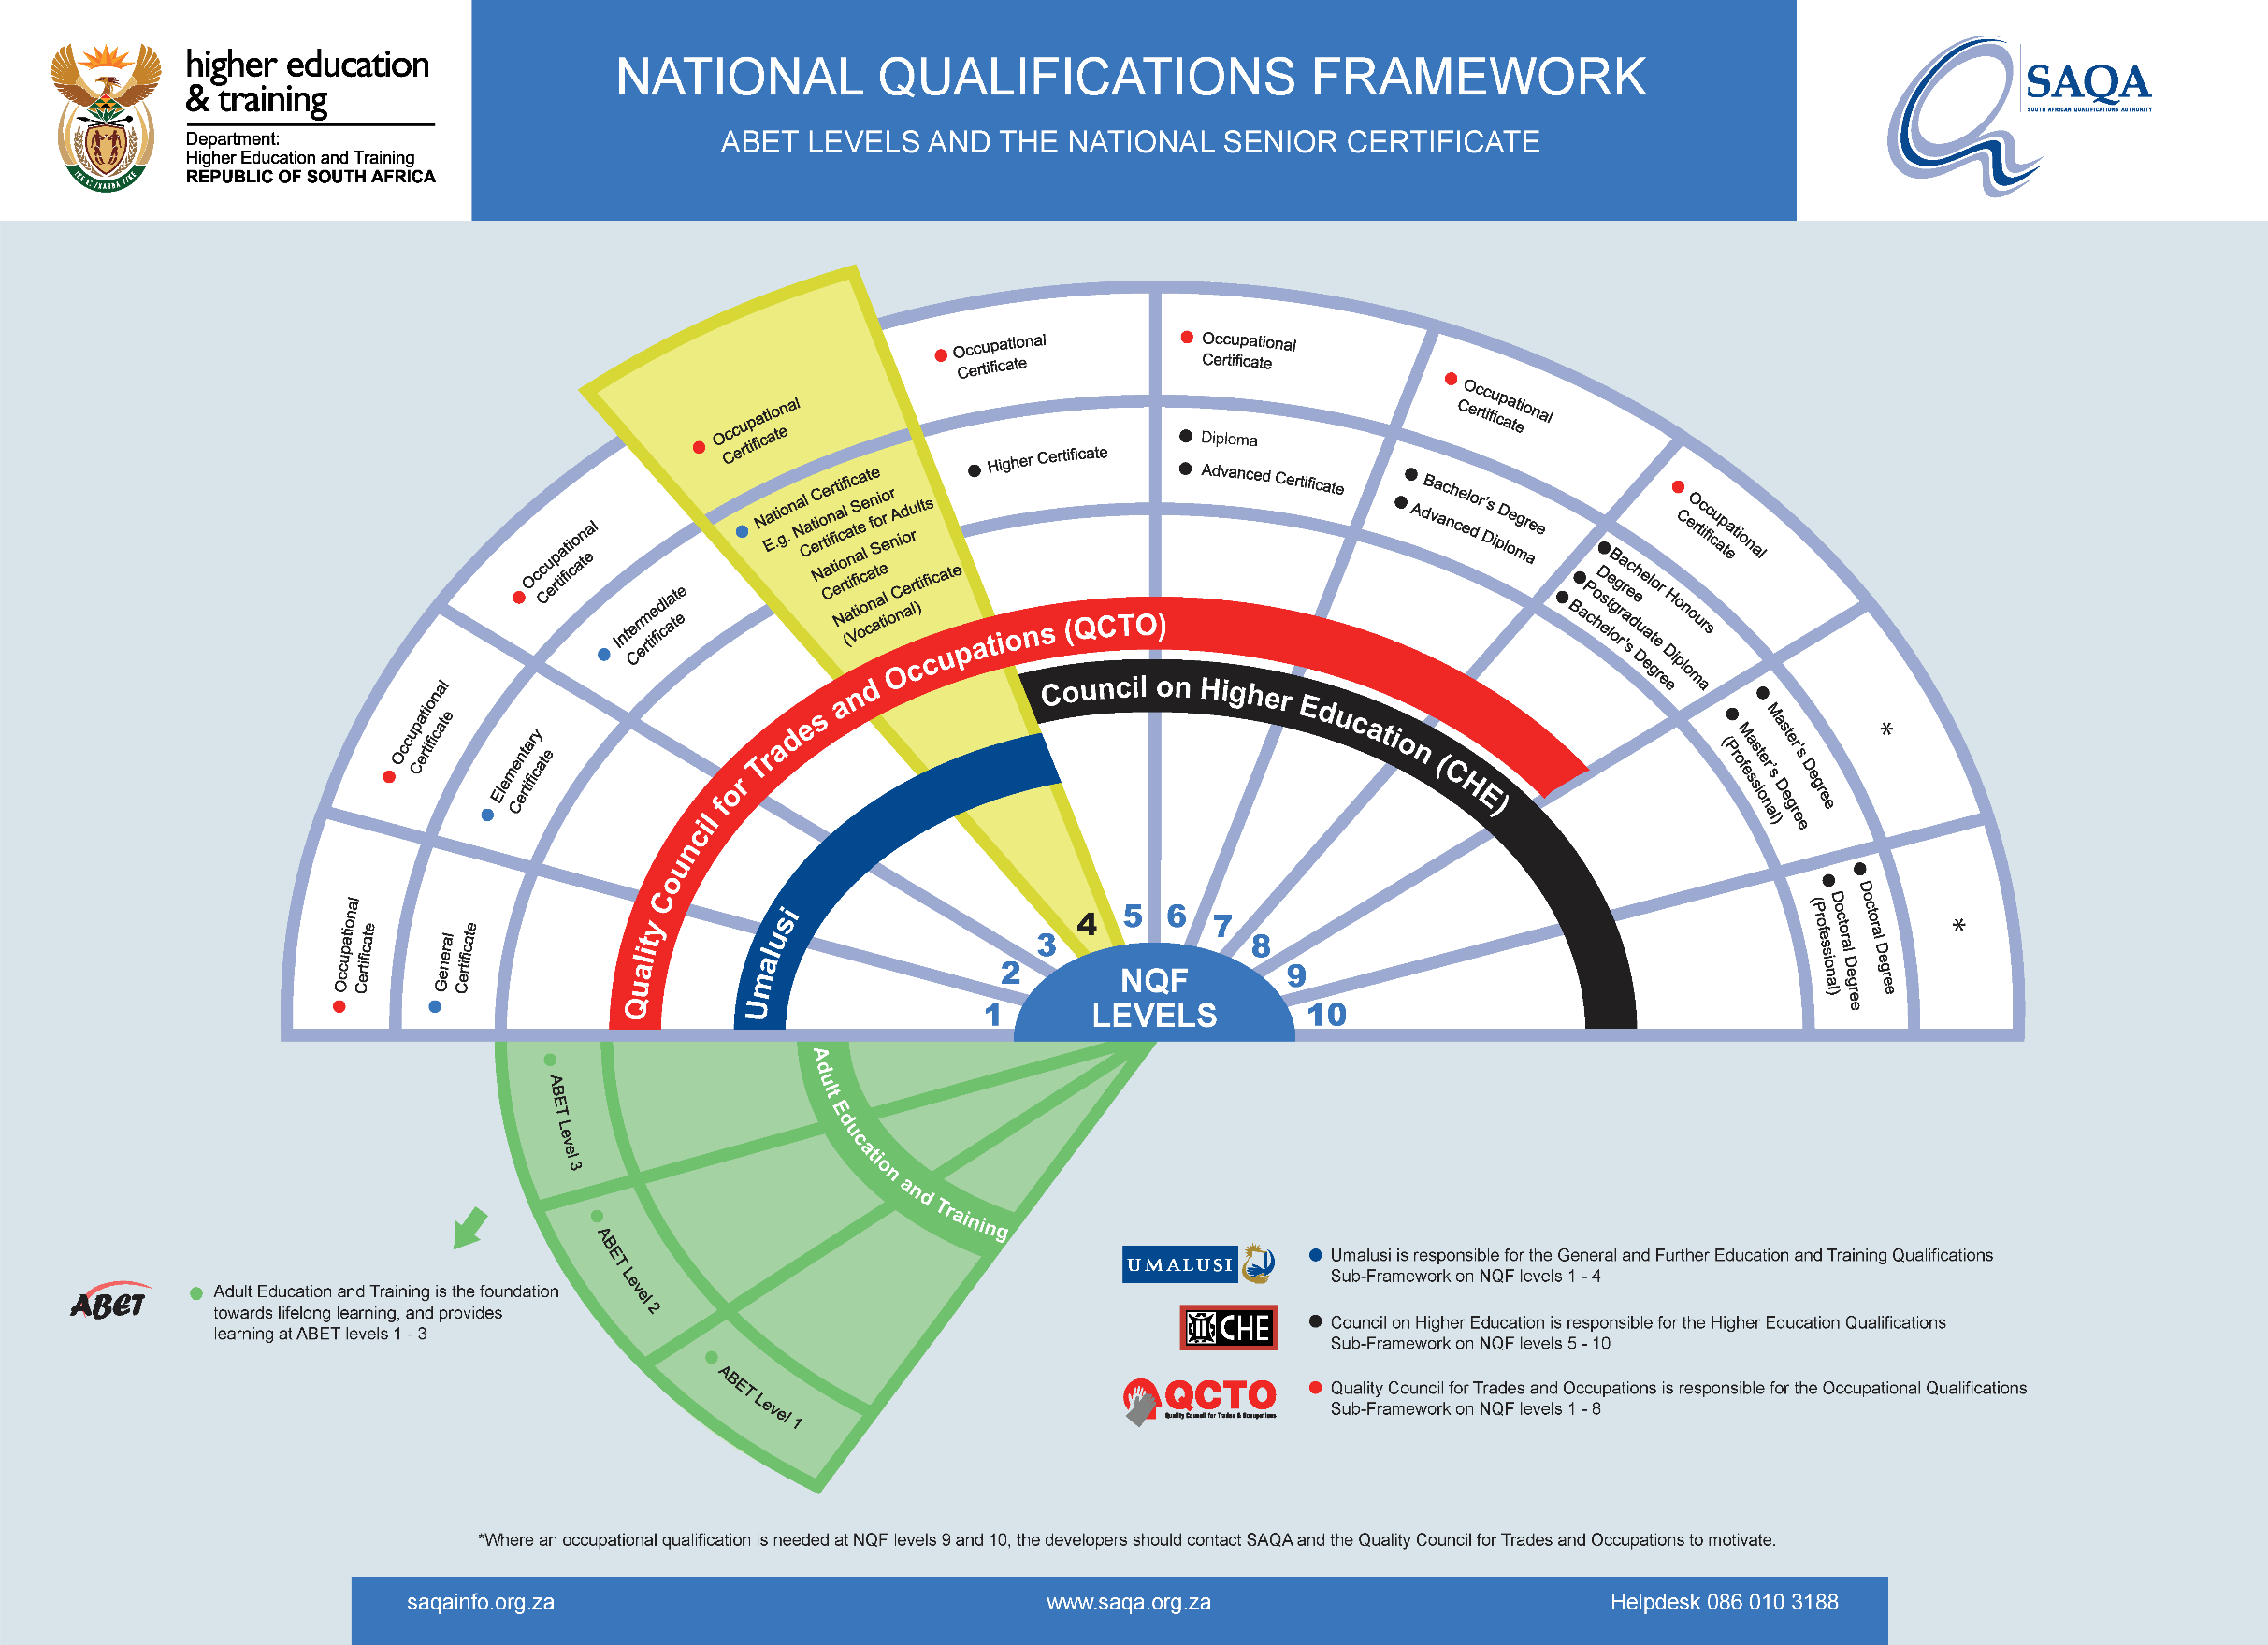
39

Slide 40
GEC QUALIFICATION
PURPOSE
This Qualification provides a foundation certificate for learners in the GET Band to acknowledge the competencies gained from ten years of formal schooling at the end of Grade 9. The achievement of the General Education Certificate (GEC) allows learners to access three learning pathways:
  To continue with an academic route through the completion of a schooling programme, the National Curriculum Statement (NCS), culminating in the achievement of the National Senior Certificate at NQF Level 4.
  To choose a vocational route through completion of the National Certificate: Vocational Qualifications at NQF Levels 2, 3 and 4 which contain vocational specialisations.
  To access Occupational specific qualifications at NQF Level 2, which consist of knowledge, skills and workplace experience and learning.
40

Slide 41
THE AIMS OF THE QUALIFICATIONS
The Qualification aims to:
Give recognition to learners who achieve and meet the necessary requirements and competencies as specified in the NCS for the end of the General Education and Training (GET) phase.
Provide a solid foundation of general education learning which is the basis for access to Further Education and Training learning and qualifications.
Develop an ability to become a lifelong learner.
Prepare learners to function better in society and the workplace.
Provide synergy between the NCS learning content and the qualification outcomes and assessment criteria thereby improving the quality of education.
Provide the learner with a qualification acknowledging the successful completion of his/her period of compulsory schooling.
41

Slide 42
CAVEAT
While the attainment of this Qualification marks the end of the general education band of formal schooling, it is in the learner's best interest if he/she continues with formal schooling to obtain a National Senior Certificate at NQF Level 4, or a National Certificate: Vocational at NQF Level 4, which enables access to learning in Higher Education. Alternatively, learners could access occupational workplace-based qualifications to further their career options and learning and competencies as employees or entrepreneurs.
42

Slide 43
LEARNING ASSUMED TO BE IN PLACE AND RECOGNITION OF PRIOR LEARNING
It is assumed that learners are competent in the National Curriculum Statement at Grade 8 level.
43

Slide 44
QUALIFICATION RULES
The Qualification is designed with Exit Level Outcomes which speak to the CAPS aligned National Curriculum Statement at Grade 9 level.
44

Slide 45
EXIT LEVEL OUTCOMES
Learners will qualify for this GEC qualification by demonstrating competence in Exit Level Outcomes in the 9 subjects.
45

Slide 46
ASSOCIATED ASSESSMENT CRITERIA
Integrated assessment must be designed to achieve the following:
An integration of the achievement of the Exit Level Outcomes in a way that reflects a comprehensive approach to learning and shows that the purpose of the Qualification has been achieved.
Judgement of learner performance to provide evidence of applied competence or capability.
46

Slide 47
INTERNATIONAL BEST PRACTICE
47

Slide 48
INTERNATIONAL BEST PRACTICE
Survey of 18 countries, Asian Tigers (Singapore, Taiwan, South Korea and Hong Kong), administer an exam at the end of primary and secondary school.
Asian Tigers are the four East Asian economies that underwent rapid industrialisation and maintained exceptionally high growth rates (>7%) between 1960s and 1990s).
Also most African countries administer an examination at the end of primary and secondary schooling.
Experience solicited from across the globe including the African continent
48

Slide 49
WHY LOOK EAST?
49
Grade 8 TIMSS Achievement Trends
Leaders

Slide 50
LEARNING FROM BRAZIL, CHILE AND GHANA
Brazil has demonstrated that a developing country can run universal testing and produce comparable results, via a massive external test administration operation. Brazil does have powerful unions!
Chile, to a far greater degree than Brazil, demonstrates how a developing country can comply with the 2014 Standards for Educational and Psychological Testing. This compliance covers reporting on technical details of testing.
Ghana has a relatively advanced sample-based national assessment system at the primary level, and there is a Grade 9 national examination.
In all three countries, grade repetition in the early grades is close to zero!
50

Slide 51
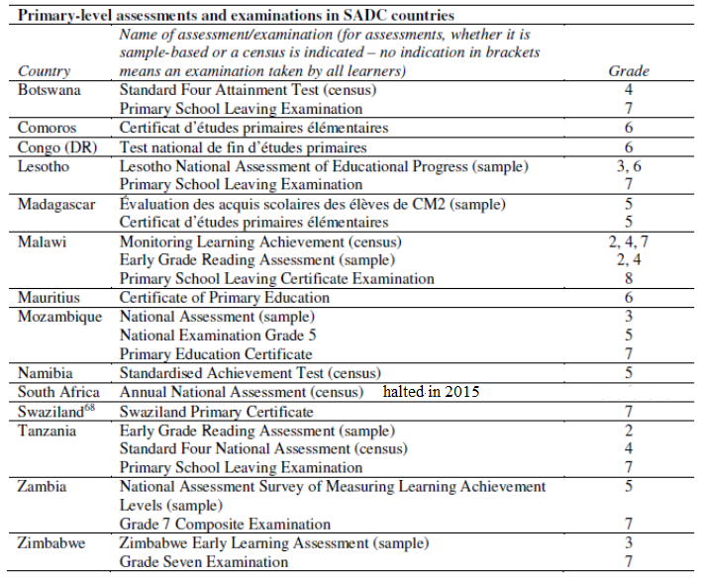
SA AS AN OUTLIER IN SADC
After ANA suspension, SA is an outlier.
Other SADC countries test or examine every primary-level learner through some national system. This national system is an examination in all except Namibia. Of the 12 countries with examinations, eight also run national assessments, mostly sample-based.
51

Slide 52
INTERNATIONAL COMPARABILITY
The General Certificate is compared with similar qualifications in Commonwealth countries and a few non-member countries that are part of the International Curriculum Assessment Frameworks Internet Archive (NCA).
The countries identified were chosen because they form part of the NCA which is an archive system which provides an analysis of certification frameworks.
It shows the links between awarding of a certificate with the currency of the certificate (in terms of providing access and admission to the next phase of education). National examinations or certification frameworks mark the end of an educational phase, and ongoing teacher assessment frequently determines student progression between grades
52

Slide 53
INTERNATIONAL COMPARABILITY
COUNTRY | COMPARABILITY
Australia | In Australia, most states do not have certificates to access upper secondary education with the exception of South Australia which has a primary school certificate. There is open access to upper secondary education. At the end of upper secondary school level learners that are aged 18+ are able to access national assessment or public examinations.
Bangladesh | In Bangladesh at primary school level, learners aged between 5-10 years to experience national assessment or public examinations. However, at lower secondary school level it is compulsory for learners aged between 11-15 years of age in the formal system to undertake assessments/examinations, which gives them admission to upper secondary level. Between the age 16-17 years of age learners undertake formal assessment but no detail of the content of this examination or certification was available.
53

Slide 54

INTERNATIONAL COMPARABILITY
COUNTRY | COMPARABILITY
France | There is no national assessment or public examinations at primary school level. For learners in lower secondary school there is a compulsory formal public examination that is offered to learners who are generally 15 years of age. At upper secondary school level there are two main options open to learners. Learners aged 16+ can choose a vocational route through achieving various vocational qualifications on offer or they can exit the formal schooling system with a Baccalaureat at aged 18.
Korea | In Korea there is no formal assessment or public examination for learners at primary school level. However, at lower secondary level there are entrance tests for learners aged 15+, combined with continuous assessment results and lottery allocation which govern access to high school on completion of this phase. In the upper secondary phase, learners require a certificate to access upper secondary education. Learners undertake a College Scholastic Achievement Test in this phase which I used for higher education entry.

Slide 55
INTERNATIONAL COMPARABILITY
COUNTRY | COMPARABILITY
Sweden | In Sweden the primary and lower secondary compulsory phase education is provided in one “all-through” school known as grundskola. At the end of the lower secondary schooling phase there is a formal assessment or examination for learners generally aged 16 years old. This certificate enables access to upper secondary school.
Wales | Learners in schools generally study for the General Certificate of Education (GCE) “AS” qualification or GCE “A” levels. The GCE “A” levels (sometimes known as A2 examinations) are single subject examinations which usually takes two years to complete (learners are generally aged 18) and comprise six modules or units. The three modules/units taken in the first year of a GCE “A” Level course make up the GCE “AS” qualification, taken at age 17. This is a stand-alone qualification. Consequently, learners may choose not to complete a further three modules to gain the GCE “A” Level in the second year.
55

Slide 56

INTERNATIONAL COMPARABILITY
COUNTRY | COMPARABILITY
Zambia | Certificates in Zambia are awarded at the following levels: Grade 7, Grade 9 and Grade 12. A learner is required to pass in at least six subjects to proceed to the next level. A learner must pass at Grade 7 level to proceed to Grade 8; one must pass at Grade 9 to proceed to Grade 10 and one must pass at Grade 12 to go to college or University. However, it is not automatic that one will proceed to the next level if one passes. At Grades 7 and 9 there is a cut off point, separate for girls and boys. One should be above the cut off point to proceed to the next level. Usually the number of available places at the next level determines the cut off point and this differs from district to district.
Gambia | In Gambia primary education lasts for six years and leads to the Primary School Leaving Certificate. Secondary Education is divided into junior secondary school which offers a three-year course leading to the West African Examinations Council Senior Secondary School Certificate. This is followed by a further two years in the sixth Form leading to West African Examinations Council “A” levels.
56

Slide 57

INTERNATIONAL COMPARABILITY
COUNTRY | COMPARABILITY
Ghana | The educational system in Ghana is made up of 6 years of primary school, 3 years of junior secondary schools (which forms 9 years of basic education) followed by a further 3 years of senior secondary school. This constitutes a total of 12 years of pre-tertiary education. Children start school at the age of 6 years. Basic Education is compulsory and free and it is mandatory for learners to complete the 9 years of primary and junior secondary schooling. However, secondary education is not compulsory.
Kenya | Kenya has free and compulsory primary education as well as a compulsory primary certificate before learners can go to Form 1. This National Certificate is called the Kenya Certificate of Primary Education (KCPE). The selection of learners to Form 1 schools is done by the Department of Education. Thereafter, learners undertake the Form 5 certificate known as the Kenya Certificate of Secondary Education (KCSE). The KCSE is administered by the National Examinations Council with representatives from countries such as Nigeria, Tanzania and Zambia.
57

Slide 58

INTERNATIONAL COMPARABILITY
COUNTRY | COMPARABILITY
Malawi | Malawi has a Primary School Leaving Certificate for Standard 8 which is marked by the Ministry of Education and the Malawian National Examination Board. In the lower secondary phase learners undertake the Junior Certificate examination in Form 2. In Form 4, there is an exit point for learners who have a choice to undertake the Higher Secondary School Certificate examination or the Cambridge International Examination. Thereafter students can go to colleges or universities.
Malaysia | In Malaysia there is a centralised system which is controlled by the national government. Learners can begin pre-school education from the age of 3 years. All learners start schooling at the age of 7. At Year Six of schooling, learners write a (UPSR). This is followed by 5 years of compulsory Primary School Assessment Examination of secondary education. At the end of Form 3 learners undertake the Lower Secondary Assessment Examination. The purpose of the Lower Secondary Assessment Exams is to assist learners to choose Form 4 subjects. In the upper secondary phase learners undertake the Malaysian Certificate of Education at Form 5. Those learners who want to go to university are expected to complete two more years through achieving the Malaysian Higher Certificate of Education or the British O Levels. However, those learners attending independent Chinese schools do not have to complete these additional two years.
58

Slide 59
INTERNATIONAL COMPARABILITY
COUNTRY | COMPARABILITY
Mauritius | Mauritius abolished the primary education certificate and introduced a regional system for secondary schools. These regional secondary schools have equal standards and formal examinations are conducted at the lower secondary and upper secondary phases respectively.
Namibia | There is no Primary Certificate. A Namibian Junior Secondary Certificate is awarded to learners approximately aged 15. admission to senior secondary education is based on the achievement of six best subjects in the Junior Secondary Certificate. Senior secondary education lasts for two years (up to age 17) and leads to the International General Certificate of Secondary Education (GCSE), which gives access to higher education.
59

Slide 60
SKILLS REVOLUTION
60

Slide 61
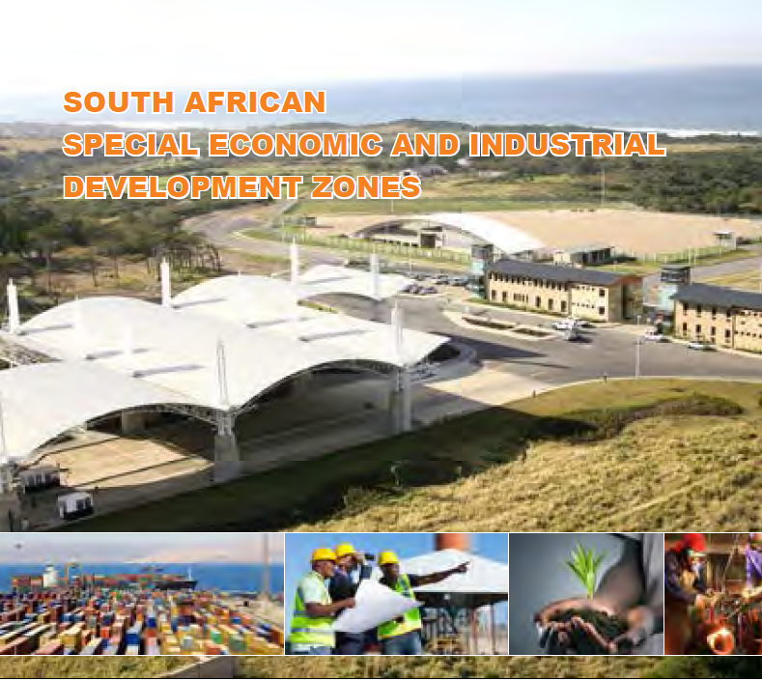
61

Slide 62
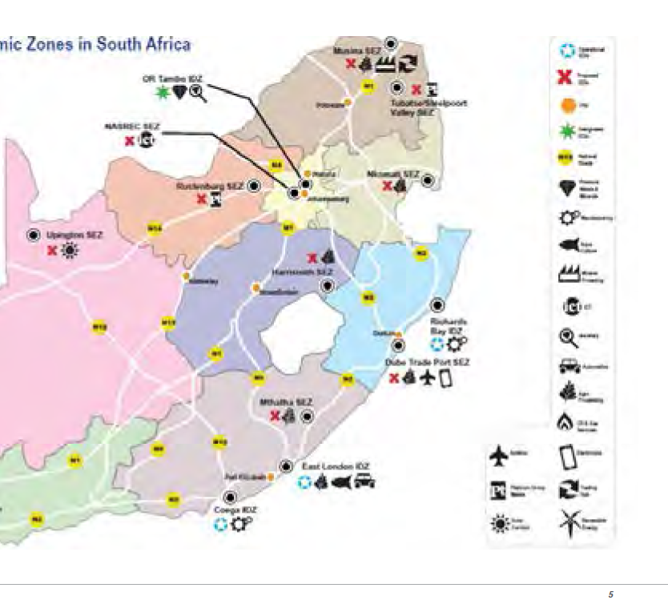
SOUTH AFRICAN SPECIAL ECONOMIC & INDUSTRIAL DEVELOPMENT ZONES…
62

Slide 63
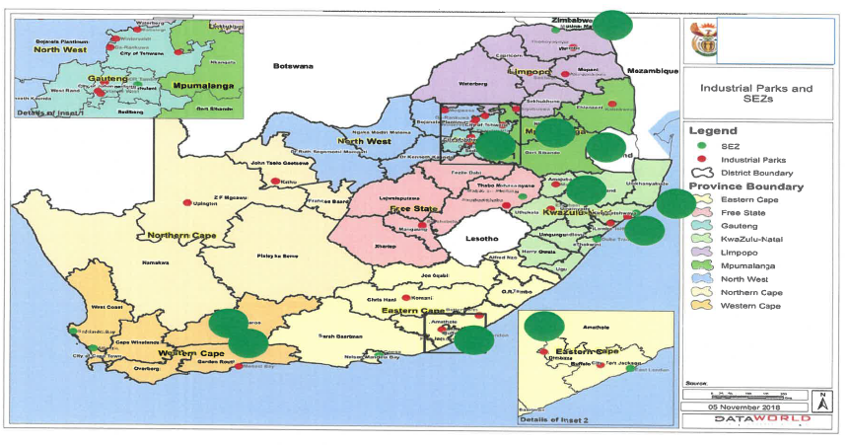
AMBITIOUS APPROACH TO SPECIAL ECONOMIC ZONES
63

Slide 64
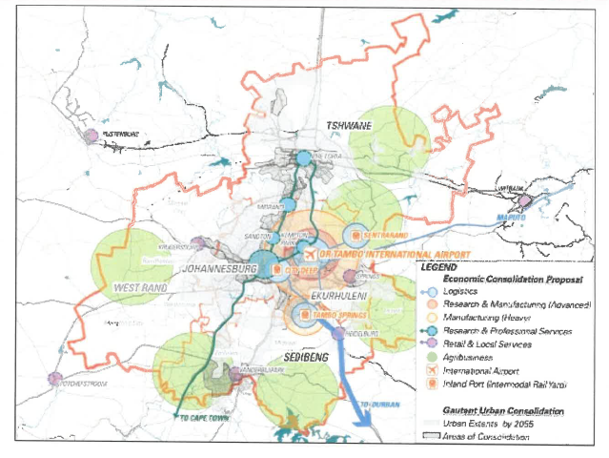
GAUTENG SPECIAL ECONOMIC ZONES
64

Slide 65
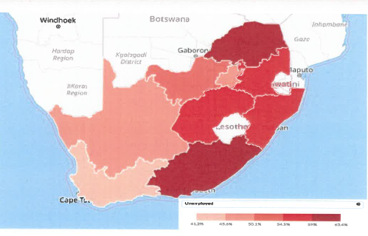
TOWNSHIP AND VILLAGE ECONOMY
65

Slide 66

NEW SCHOOLS FOR NEW & OLD CITIES SERVING COMMUNITIES (FOCUS SCHOOLS/SCHOOLS OF SPECIALIZATION
Mathematics & Science
Agricultural
Engineering
Aviation
Mining
Media
Maritime
High Tech
Commercials
Tourism/Services
Schools of Skill
Arts
Sports School of Excellence
66

Slide 67
NDP AND THREE STREAM MODEL
67

Slide 68
DIFFERENT PATHWAYS
“The different parts of the education system should work together allowing learners to take different pathways that offer high quality learning opportunities.”
(National Planning Commission: National Development Plan, November 2011)
68

Slide 69
ACADEMIC STREAM
69

Slide 70
NDP TARGETS
”The Department of Basic Education plan is to increase the number to 300 000 by 2024, with 350 000 learners passing mathematics and 320 000 learners passing physical science. The Commission proposes a target for 2030 of 450 000 learners being eligible for bachelors programme with maths and science. Action is required throughout the education system, but particularly in early childhood development given that the cohort that will enter university in 2030 has not yet started primary school. Consideration should be given to expanding the Dinaledi Schools initiative, which increases access to maths and science in underprivileged schools.”
National Planning Commission: National Development Plan, November 2011
70

Slide 71
TECHNICAL VOCATIONAL STREAM
71

Slide 72

NDP TARGETS
“One of the targets set for 2014 in the delivery agreement signed by the Minister of Higher Education and Training is to produce 10 000 artisans per year. This target can be met with concerted effort and adequate funding. We propose a target of 30 000 by 2030, subject to demand.”
National Planning Commission: National Development Plan, November 2011)
72

Slide 73
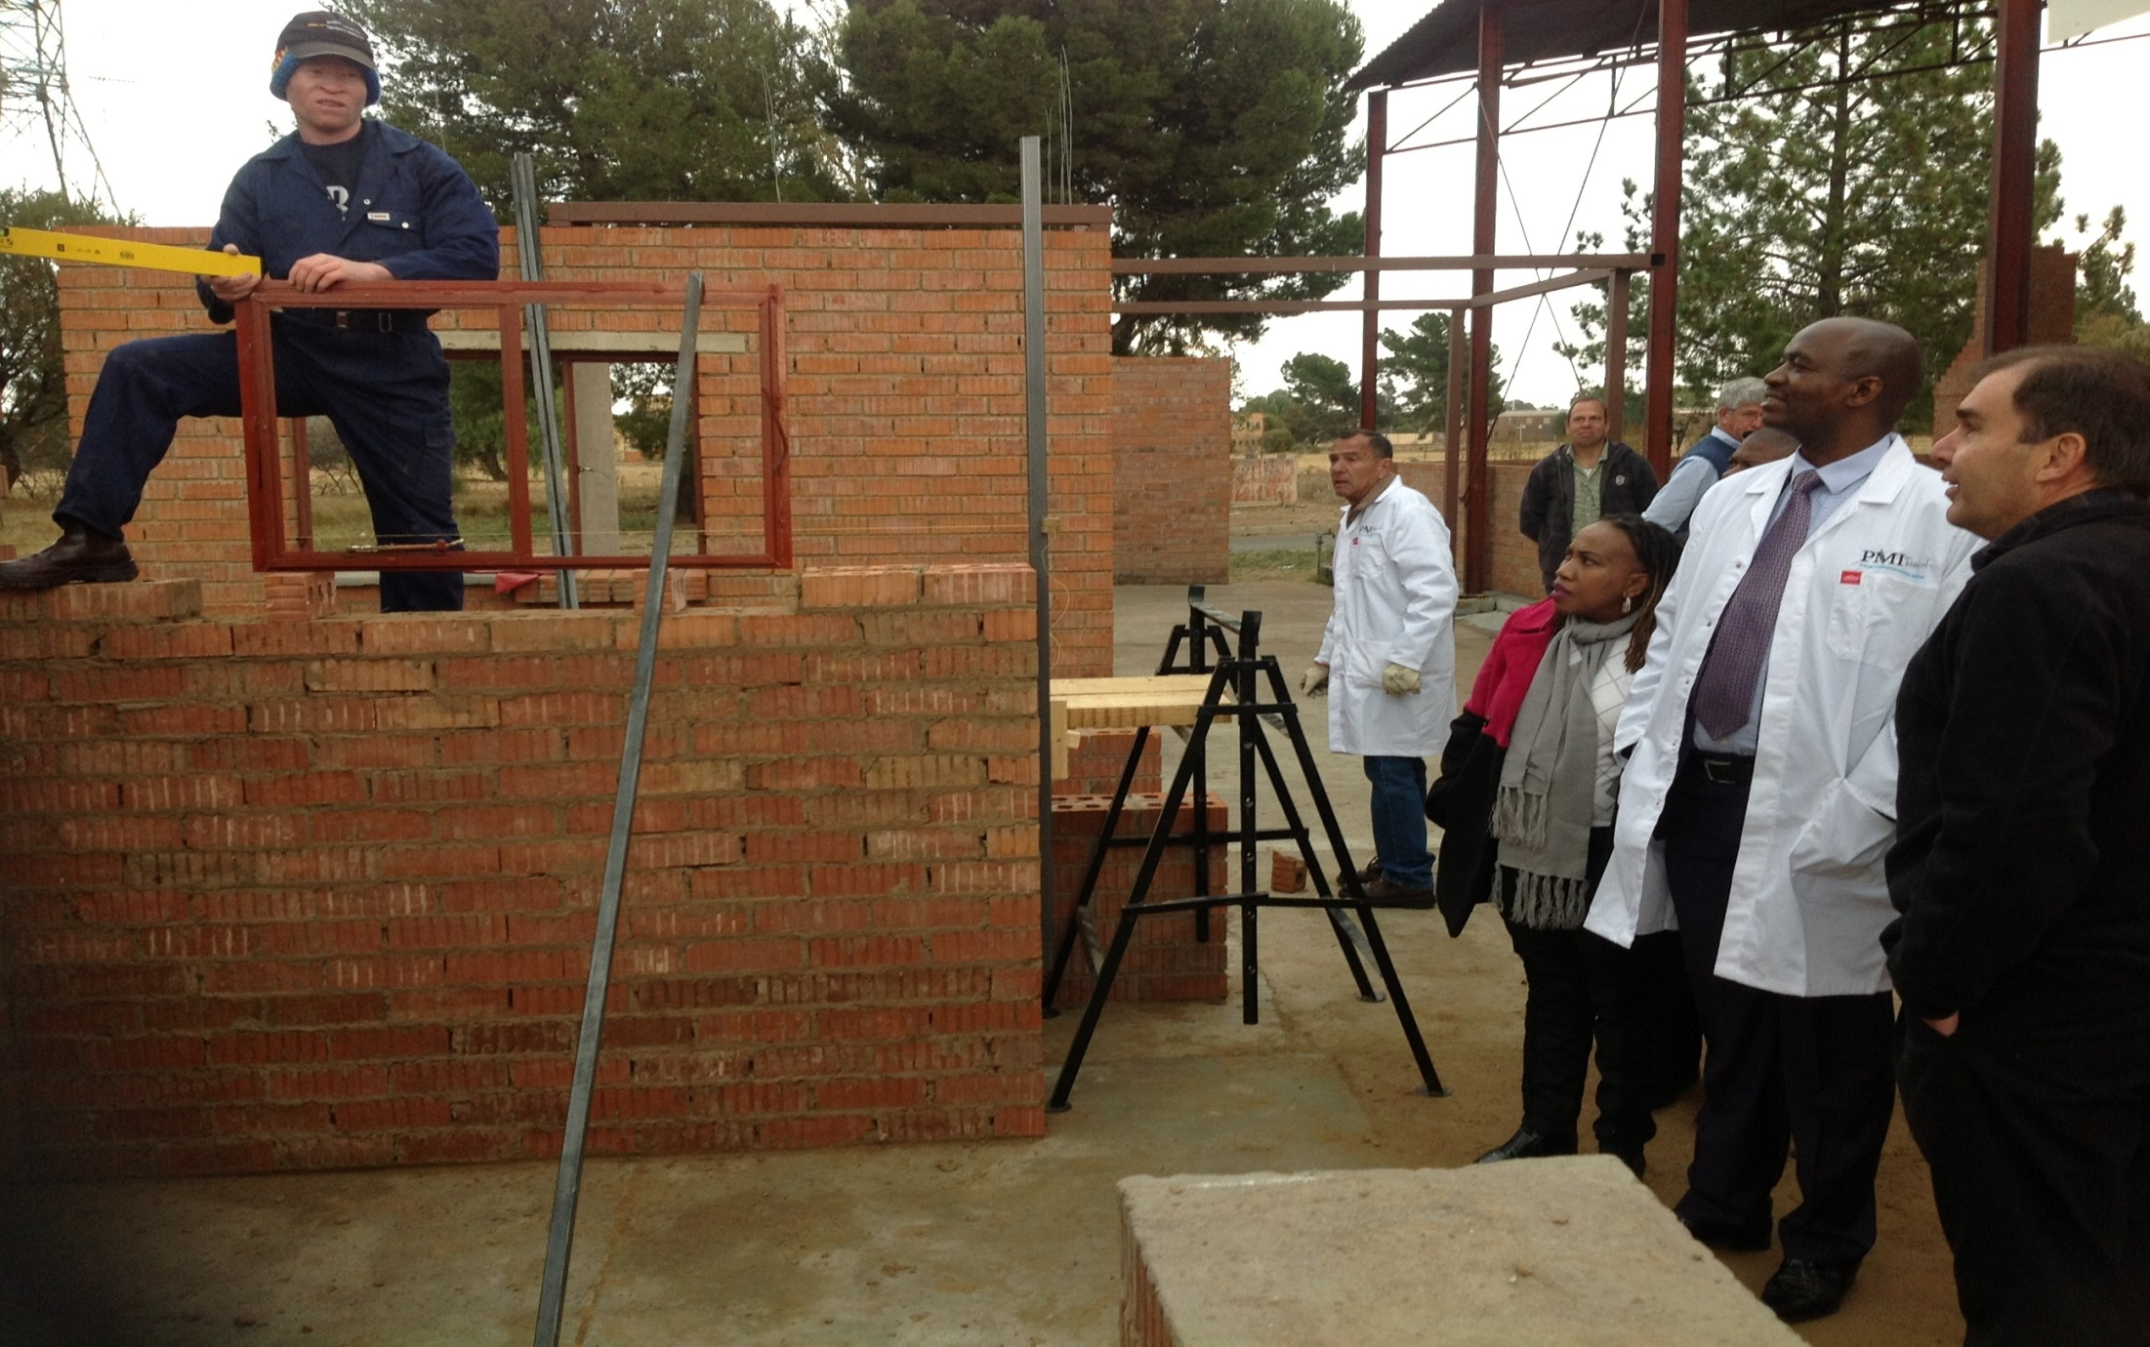
(CIVIL TECHNOLOGY) CONSTRUCTION WORKSHOP
73

Slide 74

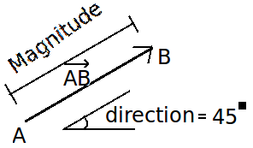

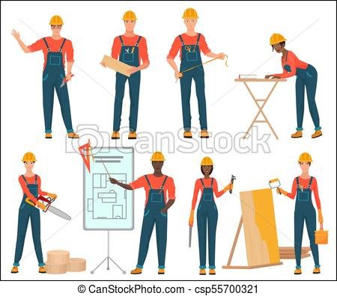


NEW SUBJECTS ENROLMENTS
Technical Mathematics
11 221
Technical Sciences
11 534
Civil Technology (Construction)
4 459
Civil Technology (Civil Services)
929
Civil Technology (Woodworking)
2 658
74

Slide 75
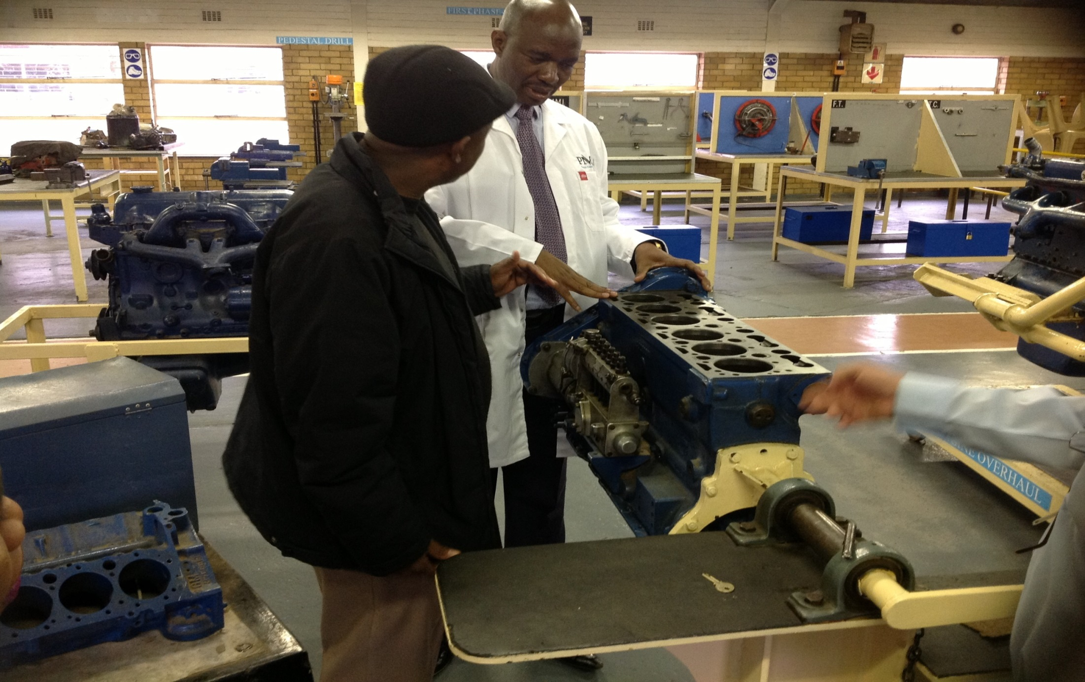
(MECHANICAL TECHNOLOGY) AUTOMOTIVE WORKSHOP
75

Slide 76


NEW SUBJECTS ENROLMENTS…CONT.
Electrical Technology (Digital Systems)
435
Electrical Technology (Electronics)
1 116
Electrical Technology (Power Systems)
5 496
Mechanical Technology (Automotive)
3 173
Mechanical Technology (Fitting & Machining)
2 168
Mechanical Technology (Welding & Metal Work)
2 032
76

Slide 77
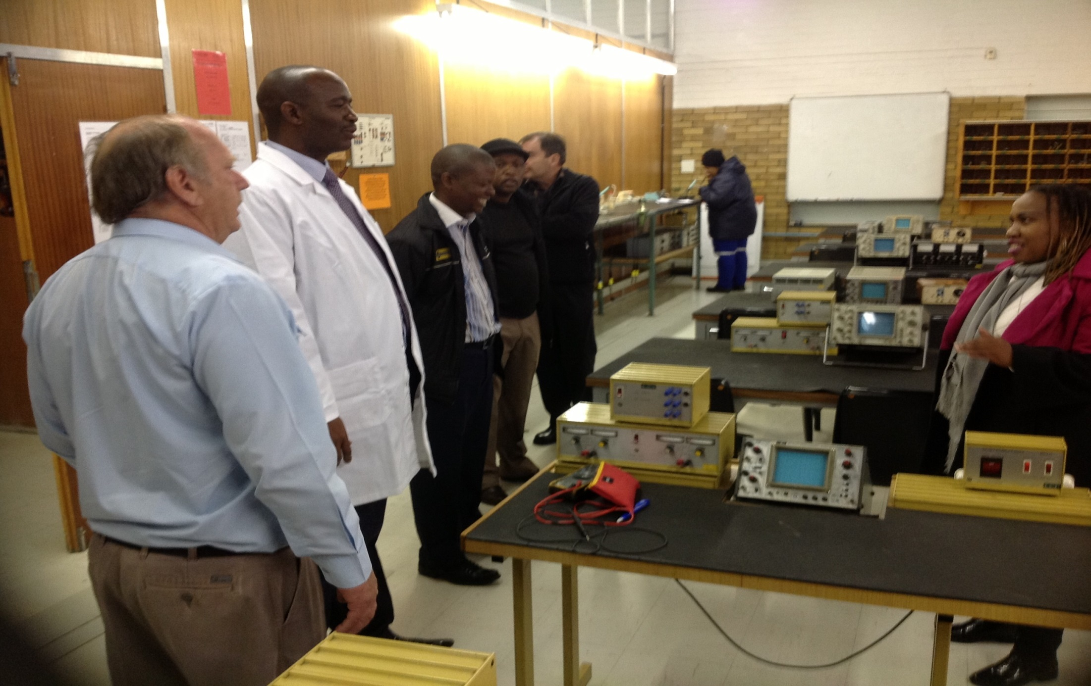
( ELECTRICAL TECHNOLOGY) ELECTRONICS WORKSHOP
77

Slide 78
TECHNICAL AND OCCUPATIONAL STREAM
78

Slide 79

NDP GOAL AND OBJECTIVE
“Provide inclusive education that enables everyone to participate effectively in a free society. Education provides knowledge and skills that people with disabilities can use to exercise a range of other human rights, such as the right to political participation, the right to work, the right to live independently and contribute to the community, the right to participate in cultural life, and the right to raise a family. Ensuring that all children with disabilities have access to quality education will help South Africa meet its employment equity goals in the long run.”
National Planning Commission: National Development Plan, November 2011)
79

Slide 80
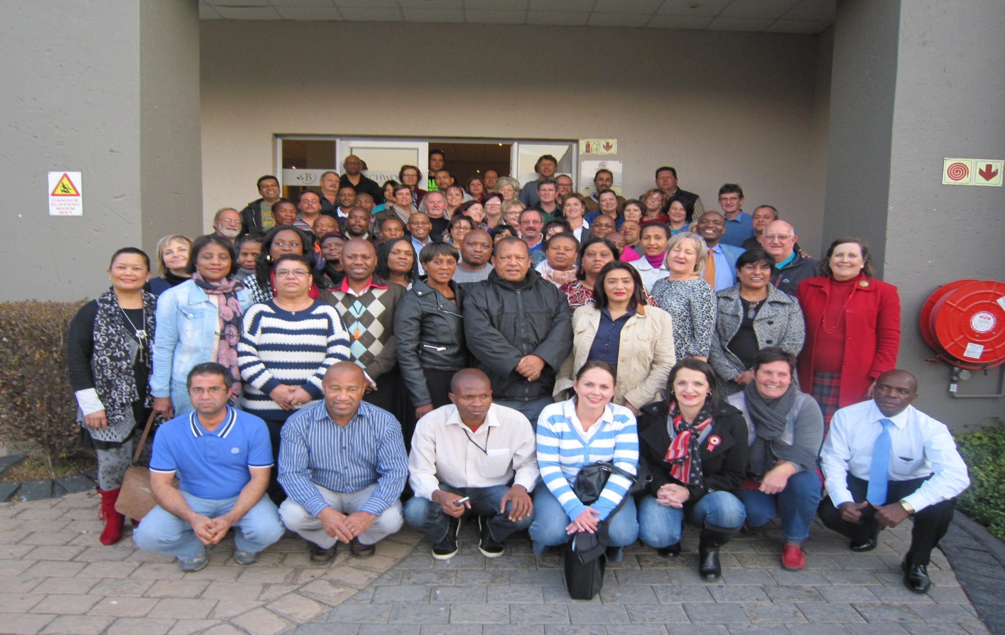
SKILLS AND VOCATIONAL PROGRAMMES WRITTING TEAM
80

Slide 81
CURRICULUM
No | Subjects |  | SPECIALISATION/SUBJECT SUB SECTIONS
General Subjects
1 - 4 | Language Mathematics Life Skills | HL, FAL, Functional Maths, Creative Arts, Social Sciences, Life Skills, Physical Education and Sport, Natural Science, Computer Application Technology
Skills and Vocational Subjects
5. | Agricultural Studies | Plant production, Animal husbandry ,Gardening
6. | Art and Crafts | Craft production, Working in different Materials
7. | Office Administration | Office Practice Computer Application Technology, Client services and communication
8. | Early Childhood Development | Child Development and Care, Resource Development (for learning)
9. | Mechanical Technology: Motor Mechanics | Motor Mechanics,
10. | Mechanical Technology: Body Works | Panel Beating and / or, Spray Painting
11. | Mechanical Technology: Welding | Welding , Metalwork
12. | Mechanical Technology: Sheet metal work | Welding, Sheet metal work
13. | Electrical Technology: Electrical | Electrician Work, Air conditioning and refrigeration
14. | Service / Civil Technology: Woodworking and Timber | Carpentry, Joinery, Shuttering
81
81

Slide 82
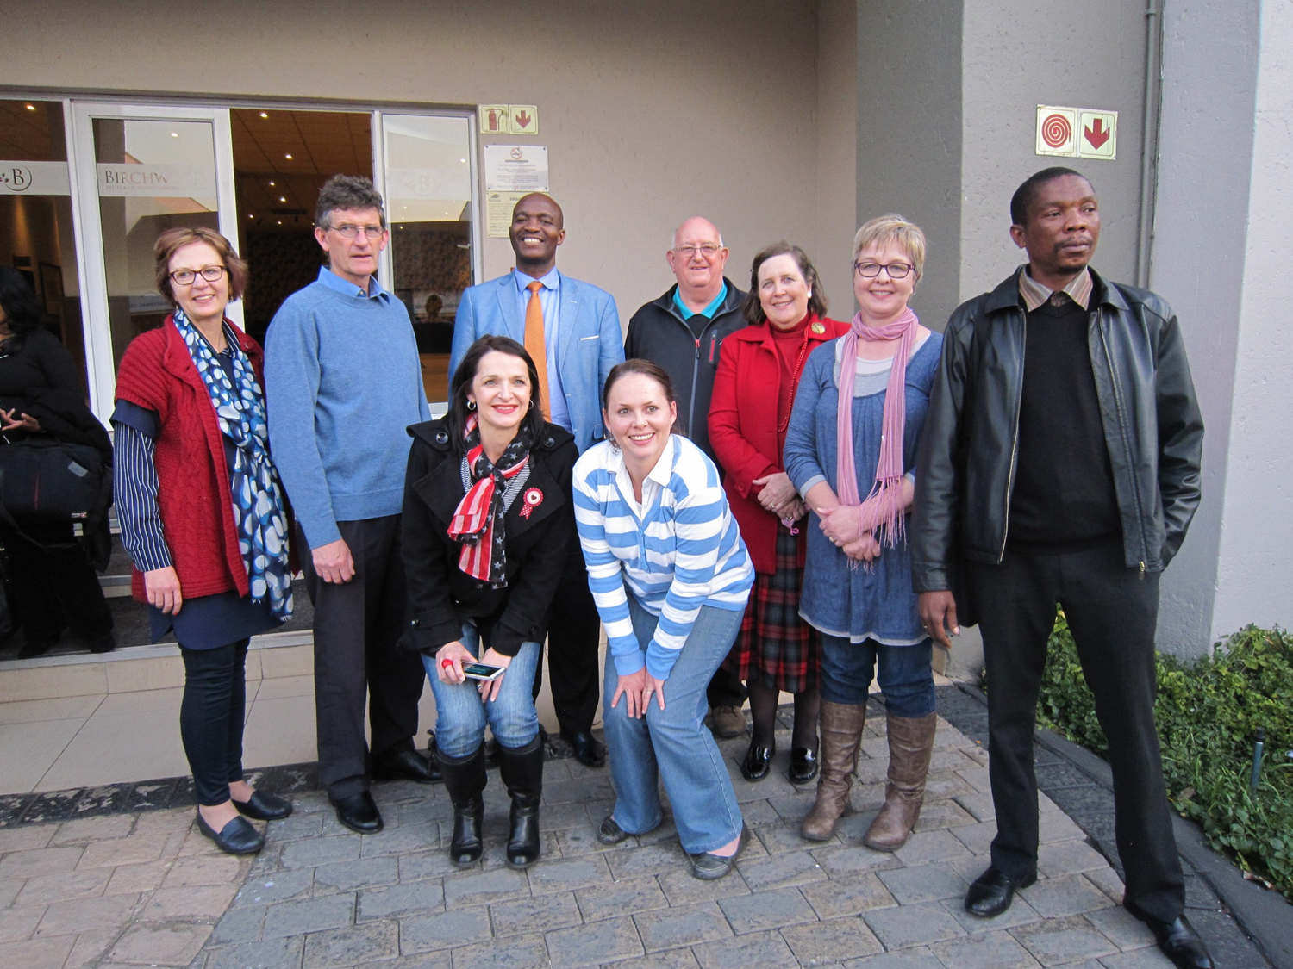
COORDINATING COMMITTEE : SKILLS AND VOCATIONAL PROGRAMMES
82

Slide 83
CURRICULUM…
No | Subjects | SPECIALISATION/SUBJECT SUB SECTIONS
Skills and Vocational Subjects
15. | Personal Care: Hairdressing and Beauty Care | Hairdressing, Cosmetology
16. | Personal Care: Beauty and Nail Technology | Beauty Care, Nail Technology
17. | Personal Care: Ancillary Health Care | -Baby Care: Baby Care, First Aid, Cooking, Cleaning and Housekeeping , -Life Care: Adult/ geriatric care, First Aid, Cooking, Cleaning and Housekeeping, -Personal Care: Disability Care, Technology, First Aid, Cooking, Cleaning and Housekeeping
18. | Service Technology: Upholstery | Upholstery; Leather work; Industrial sewing
19. | Service Technology: Maintenance | Plumbing; Painting; Electrical; Mechanical; Glazing; Tiling and Flooring; Bricklaying and Plastering; Welding; Woodwork
20. | Consumer Studies: Food Production | Food production; Food and nutrition; Entrepreneurship; The consumer
21. | Consumer Studies: Sewing | Machine sewing; Soft furnishing and upholstery; Patchwork, Quilting and Embroidery, Knitting and Crocheting; The consumer
22. | Hospitality Studies | Food and beverages services; Watering; Cleaning and Housekeeping, Client Service and communication
23. | Wholesale and Retail | Wholesale and Retail Studies
24. | Civil Technology: Bricklaying and Plastering | Bricklaying; Plastering, Brickmaking
25. | Civil Technology: Plumbing | Plumbing, Solar Systems
26. | Security Services | Security Services
83
83

Slide 84
LINKING THE GEC TO THE THREE STREAM MODEL
National Vocational Certificates (Levels 1-8)
GEC (NQF 1)
FET (NQF 2 – 4)
HET (NQF 5-10)
General Education &
Training (Grade 9)
(Academic & Technical Occupational Pathways)
Three Learning Pathways
HET
Higher Certificate to Doctorate
Academic Pathway
(Grades 10-12 NSC Academic)
Occupational Certificates (Levels 1-8)
Occupational Certificates (Levels 1-8)
Technical Vocational Pathway
Schools (Grades 10-12 and NSC) & TVET Colleges (N N1-3; NCV 1-3 )
----
World of Work & Work-based Training
Apprenticeships, Learnerships, Internships
----
Technical Occupational Pathway
(NCV 1-3 & NSC)
84

Slide 85


SKILLS AND COMPETENCIES FOR A CHANGING WORLD
85

Slide 86
21ST CENTURY LEARNER
CRITICAL THINKER
COLLABORATOR
PROBLEM SOLVER
COMMUNICATOR
INNOVATOR
DECISION MAKER
PERSONAL, SOCIAL LIFE &CAREER
METACOGNITION
INFORMATION & ICT LITERACY
GLOBAL CITIZENSHIP
86

Slide 87
SKILLS EMBEDDED IN THE CURRICULUM
Innovation and Creativity
Problem Solving
Critical Thinking
Communication and Collaboration
Team Work
Human Rights and Social Justice
Computational Skills
87

Slide 88
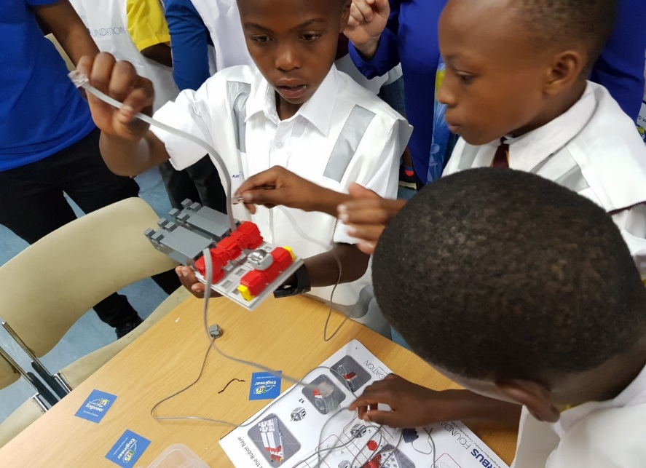

South Africa is refocusing the curriculum towards a competence‐ based approach integrating the 21st century skills and competencies across the subjects and introducing new subjects and programmes that are responsive to the demands of the changing world, these include Coding and Robotics, Marine Sciences, Hydro/Aquaponics, Aviation Sciences, Design across the Curriculum, Mathematics and Science as well as Aviation studies. Working with industry we are developing the curriculum for these subjects that will assist learners to enter the job markets that lack skilled workers to service these industries.
88

Slide 89
MULTIPLE SKILLING & CERTIFICATION
Grades | Swimming | Coding & Robotics | Entrepreneurship | Sign Language | Peer mediation
Grade 1 | X | X
Grade 2 | X | X
Grade 3 | X | X
Grade 4 |  |  | X
Grade 5 |  |  |  | X | X
Grade 6 |  |  |  |  | X
Grade 7 |  | X | X |  | X
89

Slide 90
MULTIPLE SKILLING & CERTIFICATION…
Grades | Coding & Robotics | Drone Tech | Rocketry | Peer Mediation | Diversity | K53 | First Aid | GEC/GOC | Values Excursions | Microsoft Digital | NSC
Grade 8 |  |  |  | X
Grade 9 | X | X |  |  | X |  |  | X | X
Grade 10 |  |  |  |  |  |  | X |  | X
Grade 11 |  |  | X |  |  | X |  |  |  | X
Grade 12 |  |  |  |  |  |  |  |  |  | X | X
90

Slide 91
IMPLICATIONS FOR TVET COLLEGES & EDUCATION & TRAINING SYSTEM
TVET Colleges offer programmes which lead to NQF Level 4 which is the same level as National Senior Certificate (NSC).
This means that Learners who have passed Grade 12 and attend TVET colleges repeat the same level although doing slightly different programmes.
The current policy for TVETs allows them to operate at a level higher than Level 4, which are level 5&6 (Higher Certificate, Diploma and Degrees).
There are 50 TVET Colleges and 265 Campuses which could be used to cater for Post Schooling at Level 5 and higher.
If this happens the TVET sector will become more attractive for Post Schooling and ease the pressure from Higher Education Institutions (HEIs).
This new direction will not only fundamentally/radically change the Education and Training Landscape but will contribute immensely to the skills revolution desperately needed by the country.
91

Slide 92
PROGRESS ON THE GEC QUALIFICATION
The GEC is not a new qualification – it was registered in the NQF in 2008/09 and expired in June 2012
Progress to date:
  The qualification framework has been reviewed.
  Approval has been granted for handing the qualification framework over to Umalusi for further refinement up to registration by SAQA.
  The qualification is being submitted to Umalusi together with the 26 Technical Occupational subjects for appraisal on the alignment with the existing curriculum.
92

Slide 93
GEC BROAD PLAN
Key Deliverable | Time Frame
Curriculum and the GEC Qualification Framework: a) The 26 Technical Occupational subjects , additional to the existing GET curriculum submitted to Umalusi b) Umalusi to finalise the qualification framework in readiness for registration on the NQF by SAQA. c) The qualification is registered on the NQF by SAQA Assessment and the GEC: d) Develop a concept document on the purpose, form, structure administrative and financial implications of the GEC summative assessment | October 2019 December 2020 March 2021 June 2019
e) Develop/Procure a system for On-line writing and Automated marking f) Discussion with Umalusi on their quality assurance role and certification. g) Pilot a national summative assessment in two subjects h) Full- scale implementation of the GEC summative assessment | 2020 2020 2021 2022
93

Slide 94
RECOMMENDATION
It is recommended that the Portfolio Committee discusses the presentation on the General Education Certificate.
94

Slide 95
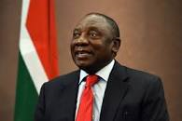

CONCLUSION
“Watch this Space”….
95

Slide 96

96

