Slide 1
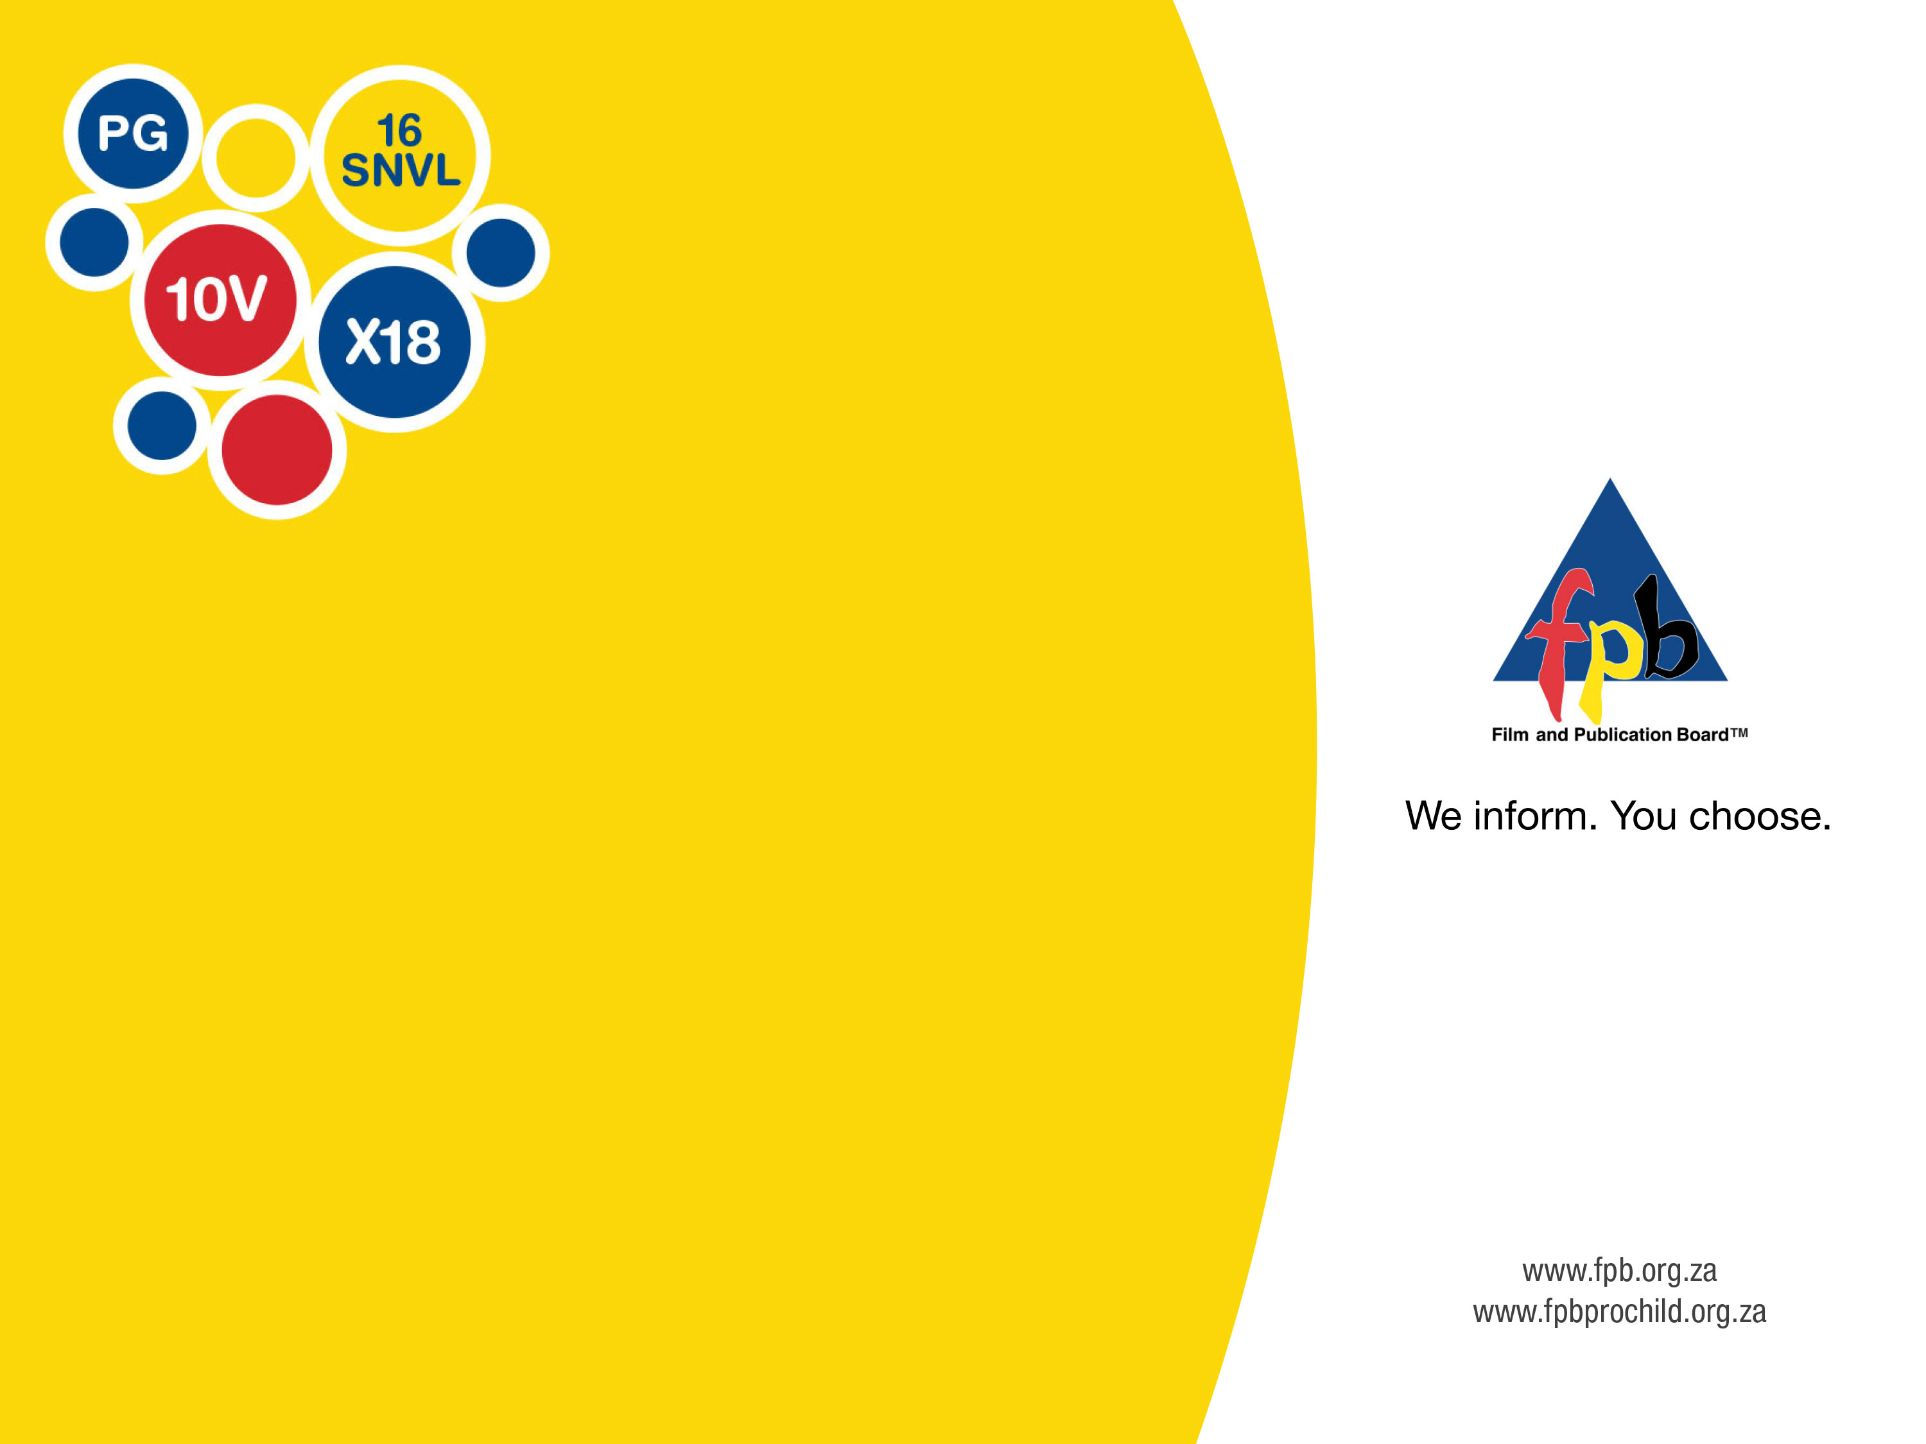
Presentation of the
2018/19 Annual Report to the
Portfolio Committee On Communications

Slide 2
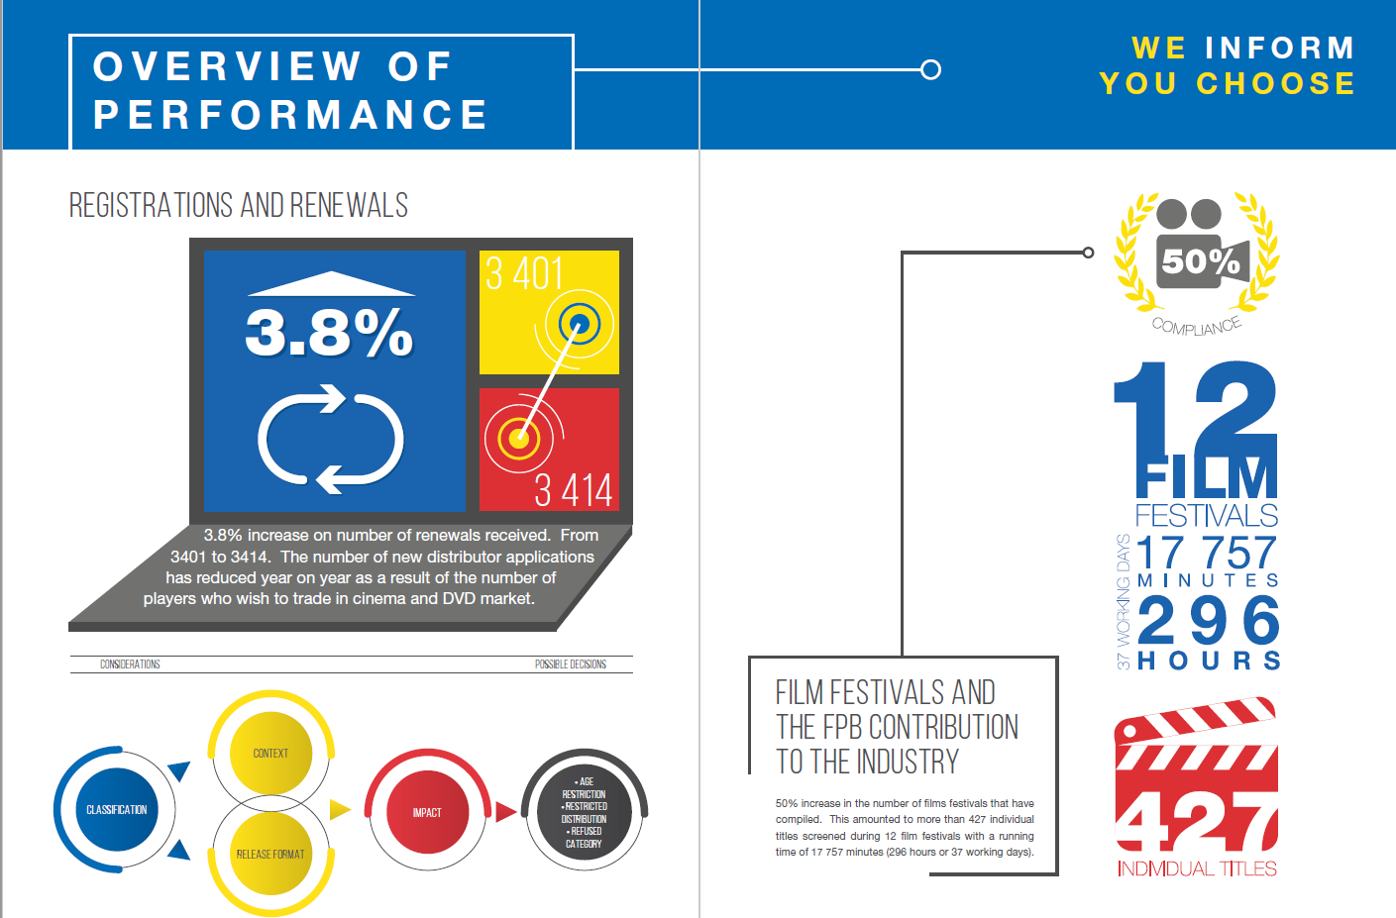



GENERAL INFORMATION

Slide 3
Performance Information
Achieved Targets
“In spite of operational challenges, the FPB has achieved 79% of its annual performance targets. The FPB remains focused on its mandate, the dictates of the Constitution as well as the NDP, underpinned by the principles of Ubuntu and Batho Pele”.
Mrs NF Thoko Mpumlwana
Council Chairperson
Notes:
Request Performance information for the whole Fy
5 SO’s – show achieved and those not achieved
Also add catch up plans

Slide 4
Performance Information
Unachieved Targets
Strategic Outcome 1: Implement a Content regulation framework that ensures 100% of classification and labelling of classification
Planned Target 2018/19 | Actual achievement 2018/19 | Deviation from planned target to actual achievement for 2018/19 | Comments on deviations
100% of eligible submissions (games, films , productions classified) | 98.5% (1540) of all eligible titles submitted to the FPB were classified | Not achieved | Late submission of titles resulted in carrying over material to the next FY
Convergence Surveys targeting at least 9000 respondents concluded | Convergence surveys not concluded | Not achieved | Procurement of service provider process was stalled due to high pricing in submitted proposal which was above the budget allocation
90% of classification decisions issued within 8 days | 83% of Classification decisions issued within 8 days | Not achieved | New Classifiers recruited in the year and on the job training and support led to delay ibn finalisation of classification decisions Unavailability of Chief Classifiers in 4th quarter
Strategic Outcome 2: Informed consumers , general members of the public and industry about the mandate, programmes and operations of the FPB
Engagement on FPB’s digital and social media improved by 20% | Twitter - Tweet impressions decreased by 80.14% Facebook - post engagements increased by 57.13% | Not achieved | Baseline for the 2017/18 financial year was high due to the high twitter engagements on Inxeba debacle and public outcry. Organisation unable to obtain similar traction in 2018/19 FY
Strategic Outcome 3: Effective, efficient and sustainable management of FPB operations
Reviewed and approved structure | Review of structure not completed. OD Survey conducted OD Support for project Acting arrangement for individuals in acting positions | Not achieved | There was insufficient budget for the OD survey – we resorted to doing most of the work internally until a cheaper service provider was sourced. However, the process was concluded in September.
Notes:
Request Performance information for the whole Fy
5 SO’s – show achieved and those not achieved
Also add catch up plans

Slide 5
Performance Information
Unachieved Targets
Strategic Outcome 3: Effective, efficient and sustainable management of FPB operations
Planned Target 2018/19 | Actual achievement 2018/19 | Deviation from planned target to actual achievement for 2018/19 | Comments on deviations
Implement the approved office expansion strategy | Approved office expansion strategy not entirely implemented | Not achieved | Department of Communications halted signing of new long-term lease agreements pending finalisation of the rationalisation process in the Communications portfolio
Strategic Outcome 6: 100% implementation and compliance with the Corporate Governance Framework
100% implementation and compliance with the Corporate Governance Framework | Governance Framework not entirely adhered to | Not achieved | Declaration of interests not submitted by all Council members for the financial year under review
Strategic Outcome 4: Effective and innovative regulation of the content distributed on online, mobile and related platforms for the protection of children, youth and adults through information
Systems availability at 98% and functionality at 80% | 96.6% systems availability 90.8% systems functionality | Not achieved | The systems downtime experienced in Q4 resulted in systems operating from the disaster recovery site and impacted systems functionality
Notes:
Request Performance information for the whole Fy
5 SO’s – show achieved and those not achieved
Also add catch up plans

Slide 6
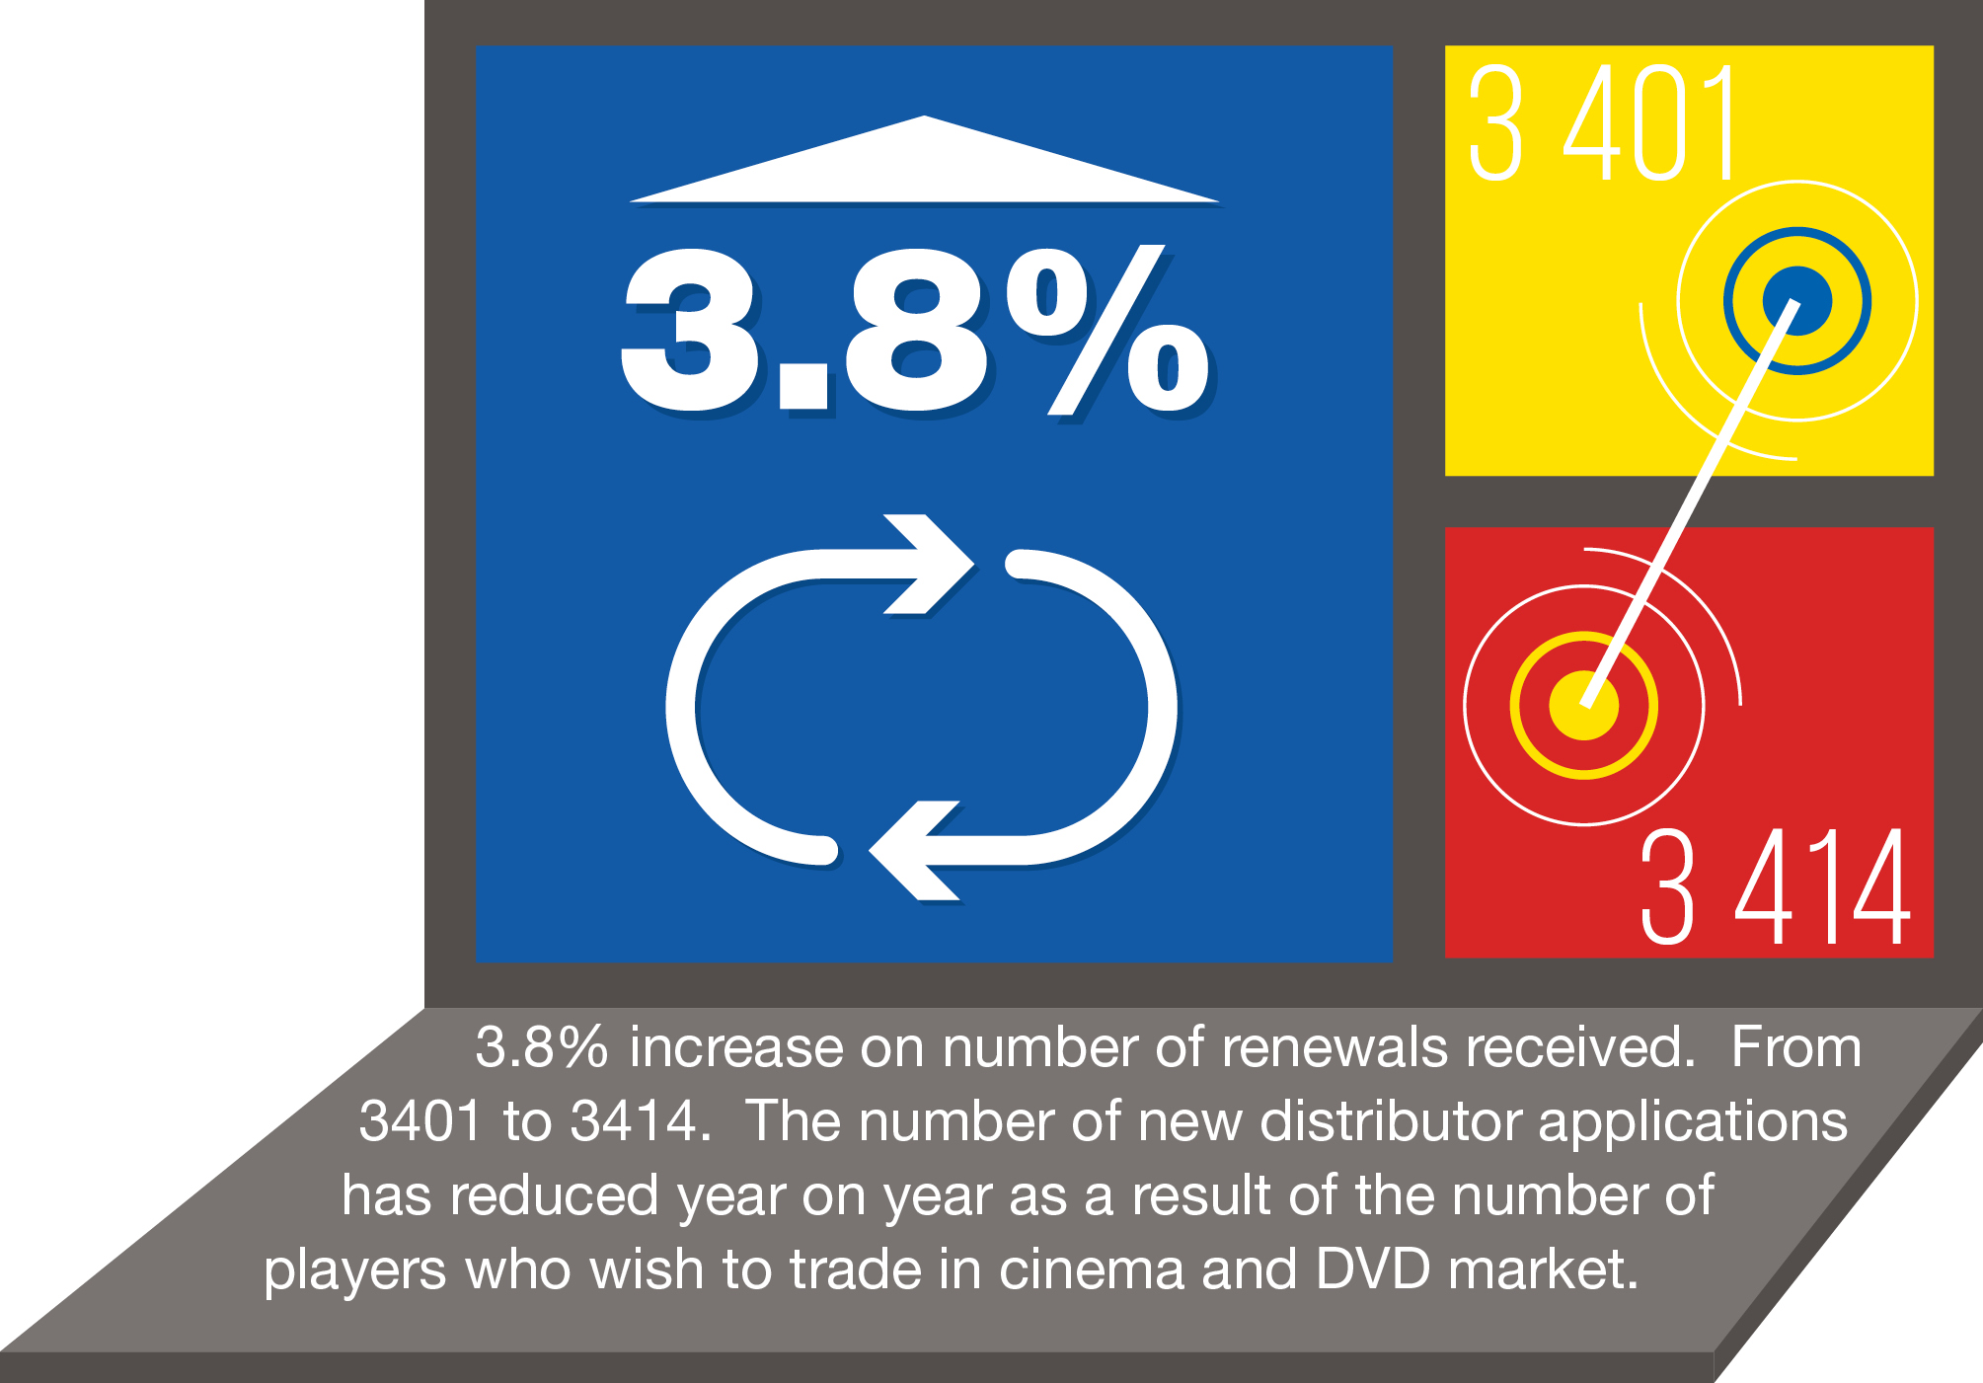
Distributor Registrations and Renewals.

Slide 7


Slide 8
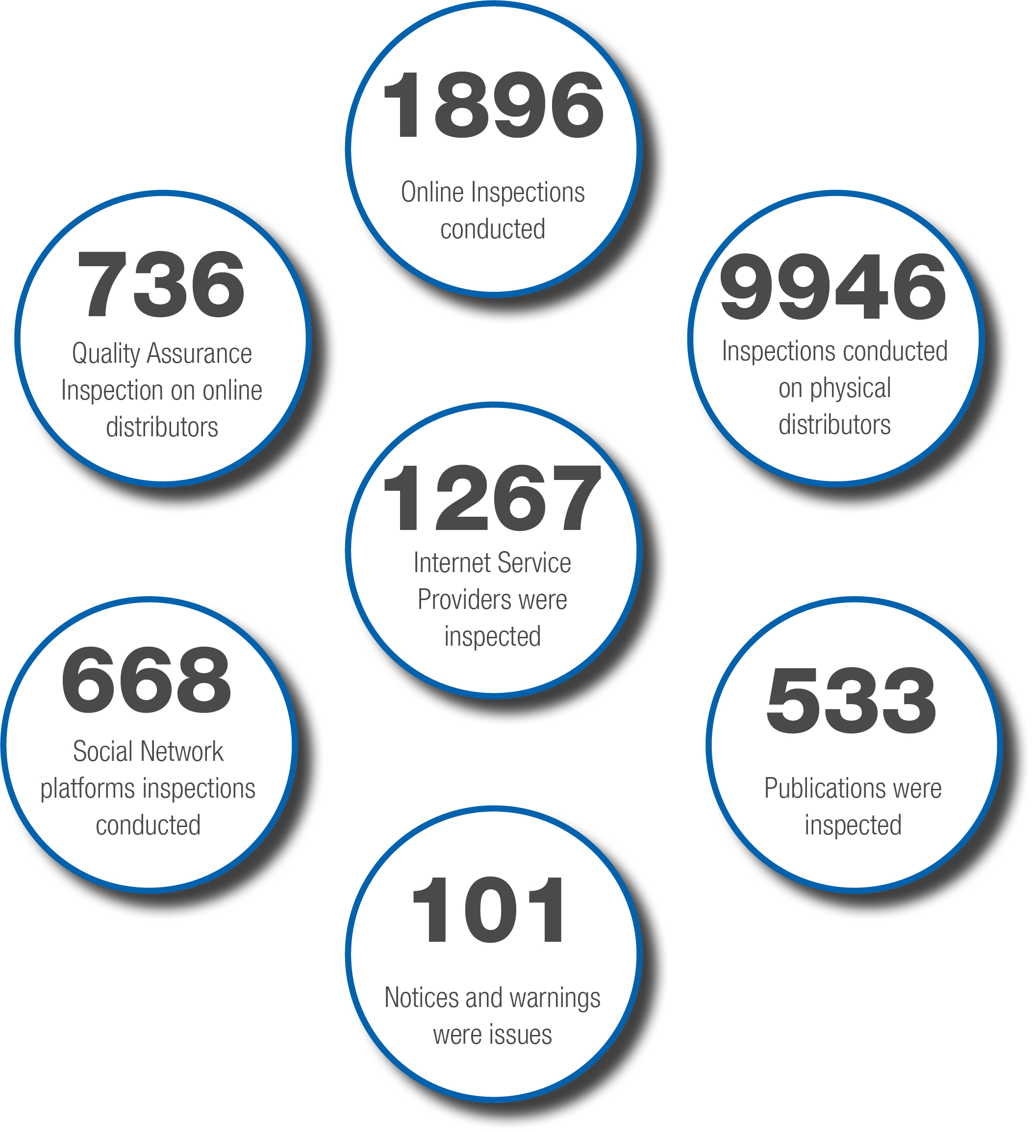
Industry Compliance Monitoring

Slide 9
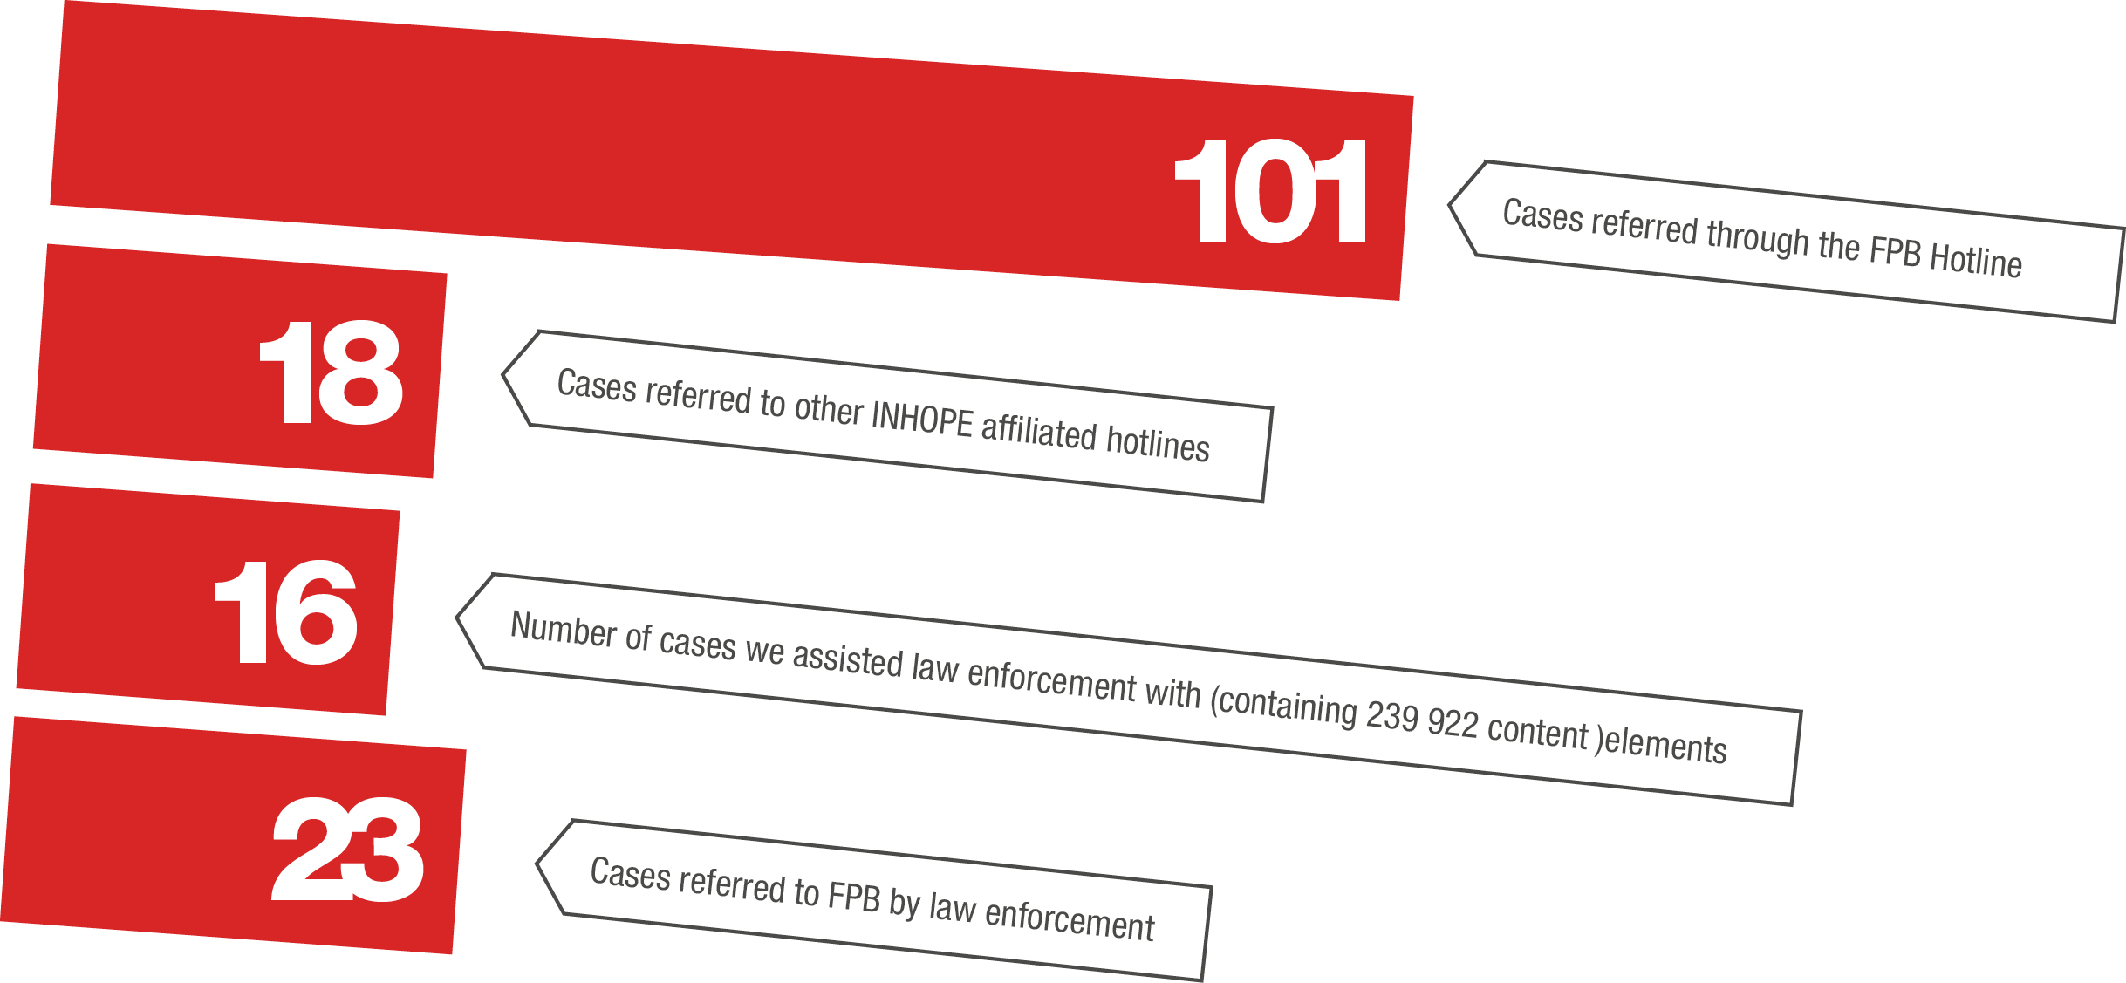
Online Child Protection Services

Slide 10
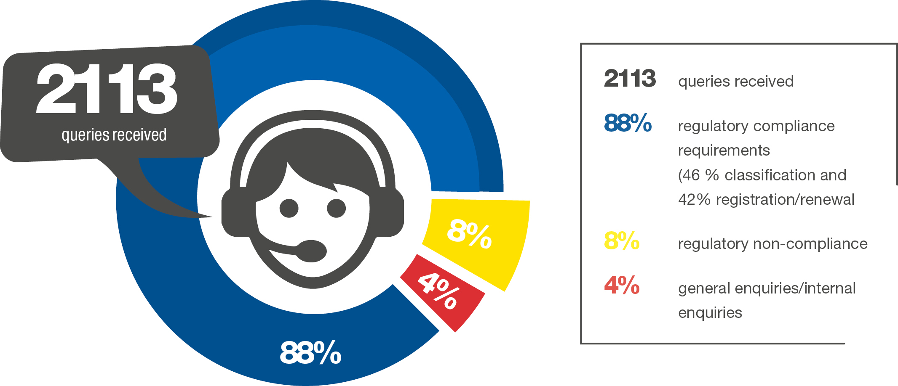
Client Queries and Client Satisfaction

Slide 11
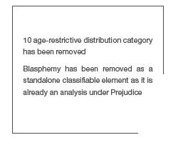

Reviewed Classification Guidelines

Slide 12
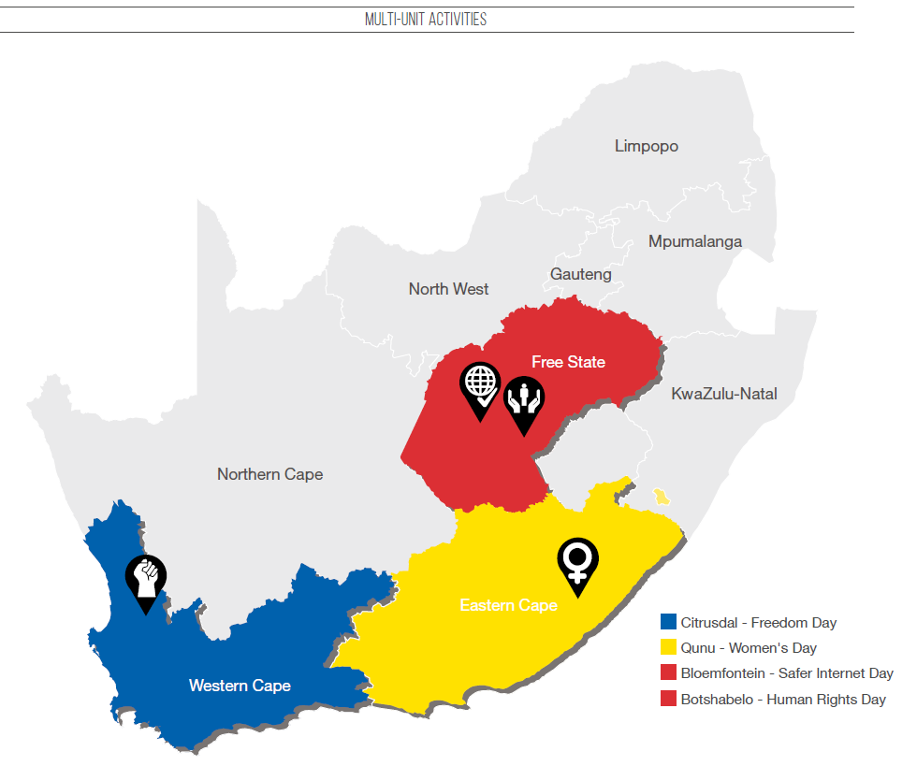
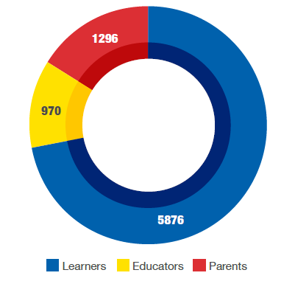
Beneficiaries of FPB Outreach Activities
Multi-Unit Activations in Communities and Schools
Public Education

Slide 13
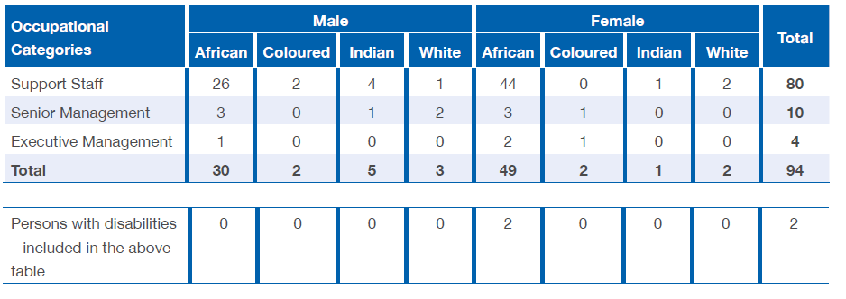
OVERVIEW OF HUMAN RESOURCES
Employment Equity
Total Number of Employees per Occupational Category as at 31 March 2019.

Slide 14
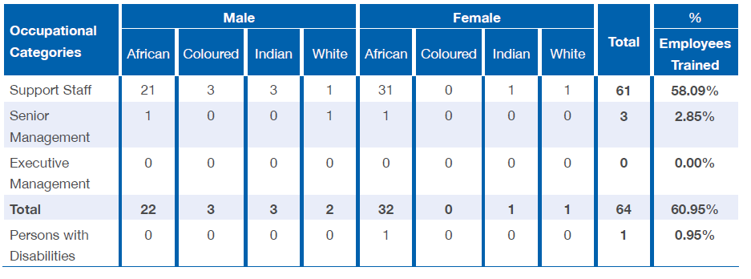
OVERVIEW OF HUMAN RESOURCES
Skills Development
Training and skills development per Occupational Category as at as at 31 March 2019.
Close to R1,4 million spent on training and capacitating staff in 2018/19

Slide 15
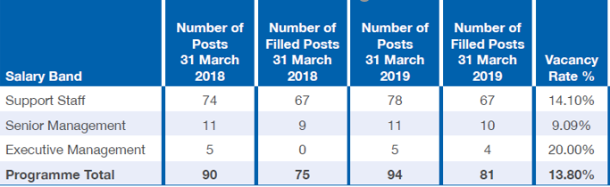
OVERVIEW OF HUMAN RESOURCES
Vacancy Rates
Employment and Vacancies by Salary Band as at 31 March 2019.

Slide 16

GOVERNANCE MATTERS
ISSUES | PROGRESS TO DATE
Annual Declarations of Interest | All Council members had filed their annual declarations as at 30 June 2019
Vacancy on Appeal Tribunal | In terms of section 5(1) of the Act, the Appeal Tribunal shall consist of 9 members, including the Chairperson. 7 of the current members were appointed on 7th December 2016. Unfortunately, one of the appointed declined the appointment, resulting in a vacancy, which has not been filled to date.
Vacancy on Council | Ms Nomvuyo Mhlakaza was elected as the Deputy Speaker of the Gauteng Legislature following the General Elections in May 2019. She subsequently resigned from her position in the FPB Council, leaving a vacancy.

Slide 17

AUDIT
REPORT
Improvement in audit outcomes
Types of audit outcomes
Unqualified with no findings
Unqualified with findings
Qualified with findings
Adverse with findings
Disclaimer with findings
2018/19
2018/17
2017/16

Slide 18
AUDIT
OUTCOME
Quality of submitted financial statements
Quality of submitted performance information
Supply chain management
Risk Areas
Financial health
Human resource management
Information technology
Good
Concerning
Intervention required

Slide 19

OVERALL MESSAGE FROM AG
The entity’s audit opinion has improved from the previous year from unqualified audit with findings to unqualified audit opinion without findings
FPB is encouraged to focus on processes to ensure that information supporting the quarterly reports and annual performance reports is accurate and the APR is consistent with the APP. The entity is further encouraged to ensure record keeping control are strengthened that will enable easily retrievable of information that will be readily available when requested for audit.
FPB should focus on an action plan to address findings on the financial statements to maintain a clean audit outcome in next financial year.

Slide 20
STATEMENT OF FINANCIAL PERFORMANCE
DESCRIPTION (Figures in Rand) | 31 March 2019 | 31 March 2018
REVENUE | 103 414 327 | 100 298 878
Operational grant | 94 577 000 | 91 684 000
Regulation fees | 7 907 284 | 7 741 329
Other income | 930 043 | 873 549
EXPENDITURE | (96 258 023) | (92 832 567)
Personnel (Incl. Classifiers) | (57 932 203) | (53 241 885)
Depreciation and amortisation | (2 419 054) | (2 452 419)
Finance costs | (50 538) | (187 705)
Administrative | (35 856 228) | (36 950 558)
SURPLUS | 7 156 304 | 7 466 311

Slide 21
COST
SAVINGS
Consulting fees – The consulting fees reduction was mainly due to a reversal of a litigation provision in the current year relating to Inceba.
Recruitment – The recruitment fees was reduced because the recruitment process was done inhouse and not through the agencies
Local travel – The travel costs was reduced as a result of costs containment by management.

Slide 22
COST
INCREASE
FPB Council – The council members get paid for attendance of meetings and travel claims.
Public Relations Campaign – Increase in costs of advertising and branding
ICT Expenses – The expense relate to OCR maintenance and license fees.

Slide 23
IRREGULAR
EXPENDITURE
Figures in Rand | 2019 | 2018
Opening Balance | 1270 919 | 50 054
Add: New | 341 853 | 1 220 865
Less: Condoned / reversal | (700 252) | 0
Closing Balance | 912 520 | 1 270 919

Slide 24
IRREGULAR
EXPENDITURE (CONTINUED)
The irregular expenditure declined in the current financial year compared to previous financial year because of the reversal of the amount related to contract for after hours call routing. The entity negotiated a lesser settlement amount than what was initially reported.
The additions to the irregular expenditure is due to the following:
Website Maintenance of R 114 912 that arose due to error between the proposals as they were for 12 months and yet the actual signed SLA were for 24 months
Expenditure incurred without approval relating to training, catering, travel, ICT services recruitment amounted to R226 941

Slide 25
FRUITLESS AND WASTEFUL EXPENDITURE
Figures in Rand | 2019 | 2018
Opening Balance | 2 998 005 | 48 746
Add: New | 563 768 | 2 949 259
Less: Recovered | 0 | 0
Less: Condoned / adjustments | (3 140) | 0
Closing Balance | 3 558 633 | 2 998 005

Slide 26
FRUITLESS AND WASTEFUL
EXPENDITURE (CONTINUED)
Material increase of fruitless and wasteful expenditure is due to:
  Payment of interest and penalty to SARS for late submission of EMP201 to the value of R93 780;
  Payment of acting allowance to for non-vacant posts to the value of R469 988.
Amount recovered relate to missed flight expenditure incurred in the previous year.

Slide 27
CONCLUSION
All the audit findings raised by AGSA in 2017/18 have been addressed.
FPB is in the process of investigating the new irregular and fruitless expenditure and where necessary disciplinary measures will be taken. Internal controls will also be tightened to avoid these expenses.

