Slide 1

2018/19
DEPARTMENT OF DEFENCE
Annual Report
Presentation to the Portfolio Committee on Defence and Military Veterans

Slide 2

Aim
Information brief
to the
Portfolio Committee
on Defence and Military Veterans
on the
DOD Annual Report for FY2018/19

Slide 3
Presentation Structure
Background
  Legislative Requirements
  DOD Annual Report Structure

Slide 4
Presentation Structure
Strategic Overview
  Defence Policy Mandate
  Defence Strategic Deliverables
Non-Financial Performance Information
  DOD Mandate Achievement
    Per Perspective
    Against MTSF Outcomes
    DOD Selected Performance Indicators

Slide 5
Presentation Structure
Non-Financial Performance Information (cont)
  DOD Performance Status
    Analysis of DOD Performance Indicators
    Year-on-Year Performance Comparison
    Summary of Actual Achievement
    Management Performance Assessment Tool (MPAT)
    Human Resource Management

Slide 6
Presentation Structure
Financial Performance Information
  Defence Vote 19
  DOD Year-on-Year Expenditure Comparison
  DOD Allocation and Expenditure per Programme
  DOD Allocation and Expenditure per Economic Classification

Slide 7
Presentation Structure
AGSA Audit Outcomes for the year ended
31 Mar 2019
  Report on the Audit of the Annual Performance Report
  Report on the Audit of the Financial Statements
    Irregular Expenditure Incurred for the Year
    Fruitless and Wasteful Expenditure Incurred for
    the Year
  Conclusion

Slide 8
Background

Slide 9
Background
Government institutions are required by legislation to compile Annual Reports on performance against Annual Performance Plans and are accountable to Parliament and the public at large, as to how, and for what purposes, funds were expended.
Annual Reports are tabled as public documents and should comply with specific legislative requirements, including alignment with the NT Annual Report Guide.
This Annual Report reflects on the fundamental contribution Defence made to the sovereignty of South Africa and the authority of the State.

Slide 10
Legislative Requirements
The DOD Annual Report FY2018/19 was prepared and aligned to the following legislative guidelines and prescripts:
  Public Finance Management Act, 1999
  Treasury Regulations, 2005
  Public Service Regulations, 2001
  National Treasury Annual Report Guide for National and Provincial Departments
  DOD Strategic Plan for 2015 – 2019
  DOD Annual Performance Plan for 2018

Slide 11

Legislative Requirements
The DOD Annual Report Instruction 0001/2019, dated
20 January 2019, gave effect to the legislative framework applicable on Annual Reports, and provided DOD unique guidelines for the compilation of respective Annual Report Inputs.
The following prescribed submission dates for Annual Reports are critical:
  31 May 2019 – PFMA Sec 40(1)(c)
  31 August 2019 – PFMA Sec 40(1)(d)
  30 September 2019 – PFMA Sec 40(1)(e)

Slide 12
Legislative Requirements
The Accounting Officer was unable to submit the DOD Annual Report for FY2018/19 to NT in terms of Sec 40(1)(d) of the PFMA, 1999, by 31 August 2019.
The AGSA audit was not concluded and the Report of the Auditor-General to Parliament on Vote No. 19: Department of Defence was not issued.
The Accounting Officer informed the Executive Authority, NT and AGSA in writing on 21 August 2019.

Slide 13
DOD Annual Report Structure
Part A: General Information
Foreword by the Executive Authority
Strategic Statement by the Head of the Department
Introduction by the C SANDF
Strategic Overview
Organisational and Legislative Mandates
Organisational Structure
Information on the Ministry
Defence Diplomacy

Slide 14
DOD Annual Report Structure
Part B: Performance Information
Financial Performance Information
(including Capital Investment, Maintenance and Asset Management Plan)
Strategic Outcome-orientated Outputs
Overview of Departmental Performance
Non-Financial Performance Information by Programme

Slide 15
DOD Annual Report Structure
Part C: Governance
DOD MPAT Status
Risk Management
Corruption and Fraud Prevention
Code of Conduct
Portfolio Committees
SCOPA Resolutions
Internal Audit and DOD Audit Committee Report

Slide 16
DOD Annual Report Structure
Part D: Human Resource Management
Human Resources Overview
Oversight Statistics
(+/- 64 DPSA prescribed / DOD specific tables including utilisation of consultants)

Slide 17
DOD Annual Report Structure
Part E: Financial Information
Report by the Accounting Officer
Report of the Auditor-General to Parliament on Vote 19
Consolidated Annual Financial Statements: Vote 19
Assurance Report National Conventional Arms Control Committee

Slide 18
Strategic Overview:
Defence Policy Mandate

Slide 19

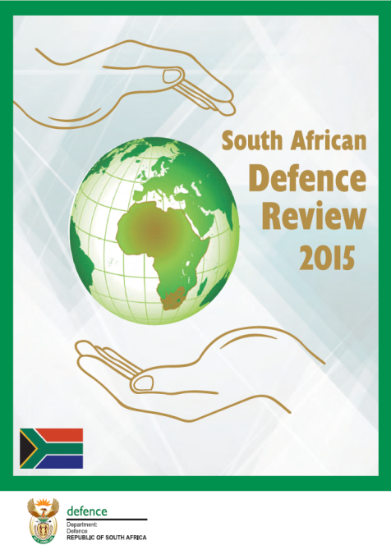
SA Defence Review 2015
The SA Defence Review 2015 is the second comprehensive policy review of this nature in democratic
South Africa.
It maps out the defence direction over the next
20 to 30 years.

Slide 20
SA Defence Review 2015 Implementation Status
The President was formally briefed on the state of the DOD on
15 January 2019.
A number of decisions were taken and specific guidance was given on:
  the strategic focus for the defence function over the next few years,
  the approach to planning and budgeting for the DOD during this period of fiscal constraint
A prioritised Intervention Plan was to be developed.
The Defence Review 2015 ‘Plan to Arrest the Decline’ was confirmed as the point of departure for future planning.

Slide 21
SA Defence Review 2015 Implementation Status
The DOD has responded with further development and refinement of the ‘Arrest the Decline Plan’ focusing on the immediate challenges to current operational commitments that must be resolved in the short-term were completed.
The ‘Arrest the Decline Plan’ addresses operational performance and includes the required interventions that will assist the continued viability of the Defence Industry and the Defence Related Industries being crucial to the enablement of the defence function in the future.

Slide 22
SA Defence Review 2015 Implementation Status
In the absence of additional funding, focus was placed on the non-cost driven aspects wherein particular attention were paid to, inter alia, improving efficiency, organisational restructuring, and improvement of operational support systems.
These deliverables have been embedded in the main Defence Programmes ensuring continued programmatic implementation.
The implementation of the SA Defence Review 2015 remains work in progress and the DOD will continue to pursue this within the resources allocated to it by NT.

Slide 23
Key Policy Developments
The following progress regarding the Constitutional and legislative mandates are reported:
Military Disciplinary Bill – The draft Bill was presented to the JCPS Cabinet Committee on 16 Aug 2018, which recommended further processing of the draft Bill to the Cabinet Committee. The Cabinet approved the draft Bill for introduction to the Parliament on 22 Aug 2018. The DOD advised the Office of the Chief State Law Adviser of the Cabinet approval on 01 Oct 2018 and requested the final certification of the Bill.

Slide 24
Key Policy Developments
Hydrographic Bill – The MOD&MV introduced the draft Bill to Parliament on 01 Jun 2018, whereupon the draft Bill was referred to the PCD&MV for further processing. The Department awaits an invite for further engagements on the draft Bill. The Bill appeared before Parliament for a second reading debate on 30 Oct 2018, whereupon it was fully supported and approved for submission to the NCOP for concurrence.
Defence Amendment Bill – The Bill served before the PCD&MV on 23 Aug 2018, whereby the Committee adopted the Bill to the Parliamentary Legal Advisers before processing it further and for public comments as part of further processing by Parliament. The Bill was introduced by the Minister into the NA on 11 Sep 2018 and was forwarded for adoption by the NCOP.

Slide 25
Strategic Overview:
Defence Strategic Deliverables

Slide 26
Strategic Overview
The DOD Annual Report for the FY2018/19 provides an analysis on the manner in which the DOD performed against its set targets in meeting ordered commitments, providing capabilities, ensuring sound administration and management of the DOD.
During the year under review, Defence’s main focus, in pursuance of its Constitution and legislative mandate, was directed towards its contribution towards national priorities, in areas where Defence could add the most value.

Slide 27
Strategic Overview
In the fulfilment of Madiba’s vision, South Africa endeavoured to promote greater peace, security and stability in the region and on the African continent.
Defence contributed towards diplomatic efforts, which resulted, amongst others, in improved relationships with members of BRICS.
  Collaboration with Russia resulted in a deal with Denel for the establishment of an aircraft repair facility to service helicopters from the African continent.
  Facilitated the lifting of Denel’s blacklisting, allowing it to participate in the military procurement programme of the Indian Minister of Defence.
  Matured Defence relations with China and co-developing self-guided munitions with Brazil.

Slide 28
Strategic Overview
The National Defence Industry Council was established, which has since delivered the SA Defence Industry Strategy, the Defence Broad-Based Black Economic Empowerment Sector Code and the Defence Industry Fund to ensure SMME participation.
The Defence Sector participated in the Public Private Growth Initiative of the Presidency, which aimed to attract US$100 billion worth of domestic and foreign investment.
SA Defence Matériel exports increased from Rb5 to
Rb11 per annum over the last five years. A 45% global market penetration was established.

Slide 29
Strategic Overview
Specific defence technology programmes pursued at Defence Research Institutes to enable operational capabilities that can be utilised as force multipliers and provide benefit and operational advantage to the Defence Force over the long-term.

Slide 30
Strategic Overview
Defence continued to contribute to poverty alleviation and economic growth. In recent times the DOD have:
  Supported Op PHAKISA towards unlocking the Ocean’s Economy, in particular providing a secure environment for this accelerated economic growth initiative.
  Expanded Project KOBA-TLALA to pursue the defence decentralised procurement of goods and services at a local level to be a catalyst for SMME development and job creation.
  Supported the Department of Agriculture, Forestry and Fisheries in protecting South Africa’s wildlife and marine resources.

Slide 31
Strategic Overview
  Supported the National Parks Board in the protection of rhinos and other wildlife against criminal syndicates.
  Contracted Damen Shipyards to build inshore patrol vessels and South Africa Shipyards to build a new hydrographic survey vessel in support of SA’s international obligation to Safety of Life at Sea.

Slide 32
Strategic Overview
The Secretary for Defence ensured the fostering and the management of cooperative government and intergovernmental relations through the Cluster System.
As a changed mandate, in its capacity as the JCPS and IMC Secretariats, the DOD planned and convened several Cluster meetings to manage participation in the appropriate Clusters, as well as the fulfilment of the obligations of the DOD arising from its participation.

Slide 33
Strategic Overview
Defence, as the appointed co-chair of the JCPS Cluster, ensured that the following critical priority combined objectives inter alia continued to be pursued:
  Fighting crime and corruption.
  Defended, protected, secured and well-managed borders.
  Secured cyberspace.
  Assured domestic stability.
  Reducing corruption in the public and private sectors.

Slide 34
Strategic Overview
C SANDF ensured the preparation and employment of forces in pursuance of set missions. The SANDF continued to play a pivotal role in pursuance of Government’s support for peace, security and stability in the region and continent.
The DOD progressed in many areas against set priorities.
  In support of Government’s national imperatives, SANDF soldiers were deployed in a UN Peace Support Operation in the DRC and an Anti-Piracy Operation in the Mozambican Channel.
  The SANDF also deployed in four internal operations. The aim of these operations was twofold; firstly, to safeguard our borders and secondly, to assist other Government departments in areas such as search and rescue, disaster aid and relief as well as safety and security support tasks.

Slide 35
Strategic Overview
Over the last few years, the DOD has been forced to continuously adjust its plans downwards in response to the declining budget.
The DOD is forced to adopt a short-term view with an increasingly constrained value proposition to SA and its people. Strategically, the DOD is forced to transition from being mandate-driven to being funding-driven. Defence can only perform to the extent that it is resourced and funded.
The significant reduction in the defence allocation has resulted in an ever-decreasing ability to execute ordered defence commitments.
The rate of decline has accelerated beyond the DOD’s ability to control and absorb ongoing cuts.

Slide 36
Defence Mandate
The MOD&MV, as a member of the Cabinet, is responsible for Defence (Sec 201 of the Constitution, 1996).
This mandate is given substance by the Defence Act, 2002, the SA Defence Review 2015, amongst others.
The DOD comprises of the Defence “Civilian” Secretariat, established in terms of Sec 204 of the Constitution, and the SANDF, established in terms of Sec 202 of the Constitution.

Slide 37
Defence Mandate
The DOD derives its mandate from Sec 200(2) of the Constitution. The mandate is given substance by:
The Defence Act, 2002
The Defence Amendment Act, 2010
The White Paper on Defence, 1996
The SA Defence Review 2015

Slide 38
Defence Mandate
The DOD executed its mission within a constrained budget allocation:
“To provide, manage, prepare and employ defence capabilities commensurate with the needs of South Africa, as regulated by the Constitution, national legislation and Parliamentary and Executive direction. This will be provided through the proper management, provision, preparedness and employment of defence capabilities that are in line with the domestic and global needs of South Africa.”

Slide 39
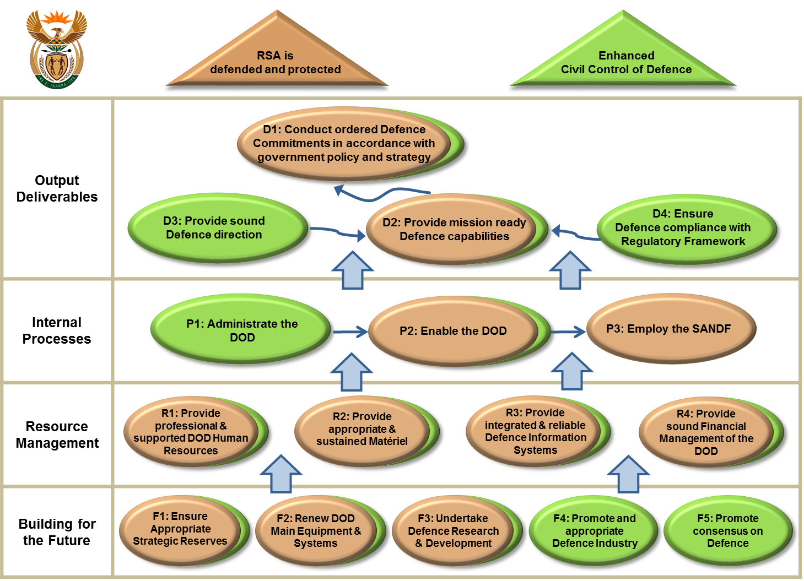
Defence Mandate
Through the Strategy Map, the mandate is translated into the following outcomes:

Slide 40
Defence Outcomes
Defence outcomes are defined as “that which the DOD wishes to achieve” and are the medium-term results for specific beneficiaries that are the consequence of achieving specific outputs and are directly related to/aligned with the Constitutional and legislative mandate of Defence.
Through the DOD Strategy Map, the DOD’s mandate is translated into 2 defence outcomes:
  The RSA is defended and protected (SANDF).
  Enhanced civil control of Defence (Defence Secretariat).

Slide 41
Defence Outputs
Defence outputs are defined as “what the DOD produces or delivers” and include the final products, goods and services produced for delivery. In pursuance of its legislative mandate and utilising its inherent defence capabilities, the DOD supported Government’s MTSF outcomes, relevant to the Defence mandate, by means of 4 output deliverables (sustained agenda):
  Conduct ordered Defence Commitments in accordance with Government policy and strategy.
  Provide mission-ready Defence capabilities.
  Provide sound Defence direction.
  Ensure Defence compliance with regulatory Framework.

Slide 42

Defence Outputs
By achieving these outputs, the DOD contributed towards, and supported the:
National Development Plan, Vision 2030
MTSF Outcomes
  In pursuance of its legislative mandate and utilising its inherent defence capabilities, the DOD continued to provide support to the Government’s MTSF Outcomes relevant to the Defence mandate.
  The MOD&MV is the Chairperson and jointly responsible for the coordination of the JCPS Cluster and member of the ICTS Cluster for the MTSF Outcomes 3 and 11 respectively.

Slide 43
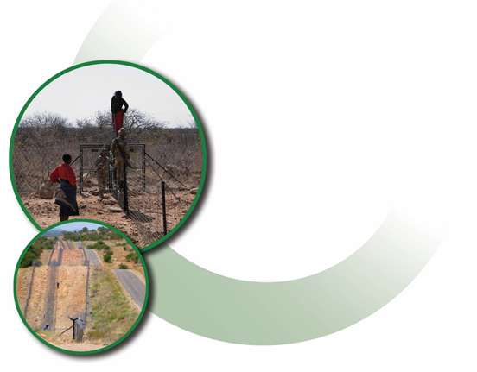

MTSF Outcomes
The DOD outputs express aspects of the MTSF in relation to:
  Outcome 3:
  “All people in South Africa are and feel safe”
  Outcome 11:
  “Creating a better South Africa and contributing to
  a better and safer Africa in a better World”

Slide 44
Outcome 3
Defence continued its efforts to enhance the safeguarding of our land borders and preventing the flow of illicit goods and illegal immigration that compromise South Africa’s economy.
The National Security Strategy requires 22 sub-units, and support thereto, to be deployed for border safeguarding.
To date there has been insufficient funding to realise this and only 15 sub-units were deployed during the period under review.

Slide 45
Outcome 3
The SANDF deploys 15 sub-units to execute resourced border safeguarding (Op CORONA) in Limpopo, Mpumalanga, KwaZulu-Natal, Free State, Eastern Cape, Northern Cape and North West Provinces in an endeavour to safeguard and maintain the integrity of the country’s borderline.
Three maritime patrols, in support of Op CORONA were conducted along the east and west coast of Africa as well as one deployment in support of Op PHAKISA.

Slide 46
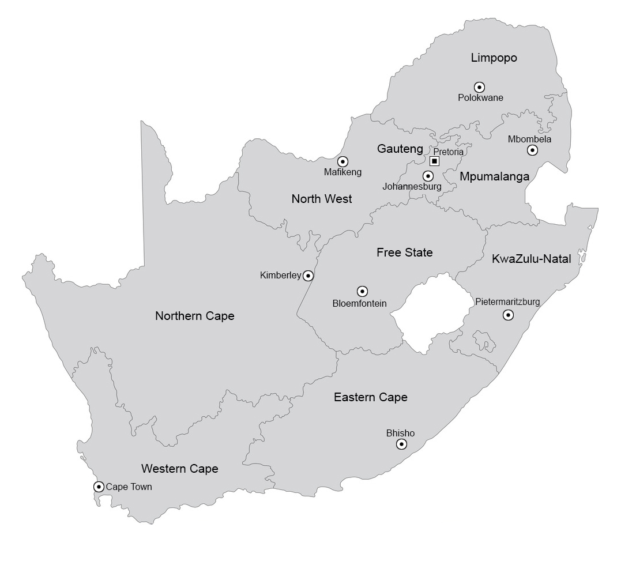
Outcome 3
Rooibokkraal
Pontdrift
Musina
Madimbo
Sandriver
Macadamia
Gopane
Zonstraal
Pongola
Vioolsdrif
Merrivale
Ndumo
Fouriesburg
Wepener
Maluti
Maritime patrols
Maritime patrols

Slide 47
Outcome 3 – Operational Successes
Operational successes recorded during internal deployments, included:
48 weapons recovered
12 953 illegal foreigners apprehended
452 criminals arrested
188 stolen vehicles recovered
8 590kg dagga and 21 976kg dagga plants confiscated
2 974 live-stock recovered
Contraband goods to the value of Rm42,52 confiscated

Slide 48
Outcome 3
Notwithstanding a decline in defence capabilities, the DOD was able to contribute to the RSA’s national security by fulfilling its constitutional mandate. The following support was provided:
Supported the National Parks Board and the SAPS in the protection of rhinos and other wildlife against criminal syndicates.
Assisted in the supply of water to various communities to mitigate the results of drought.
Conducted numerous search and rescue, disaster relief and humanitarian operations across the country and neighbour countries.
Supported the SAPS with focussed crime fighting operations, specialist task teams and major events.
Assisted other Government Departments with service delivery challenges and medical emergencies.

Slide 49
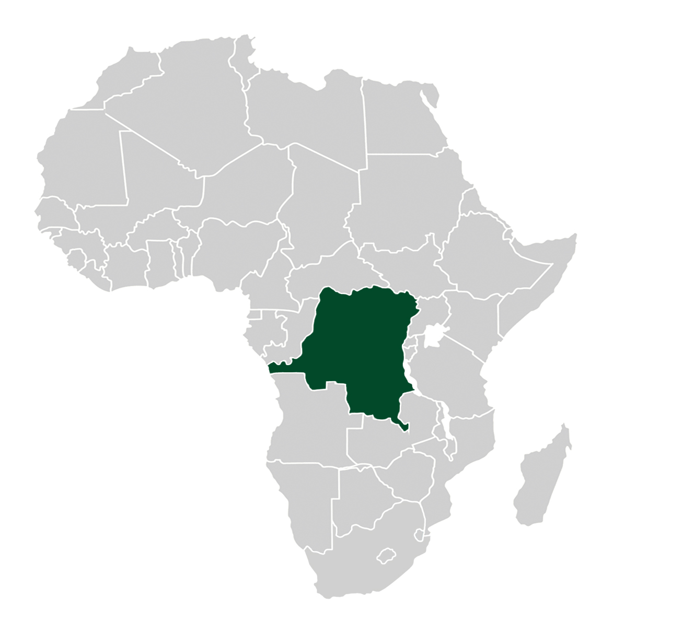
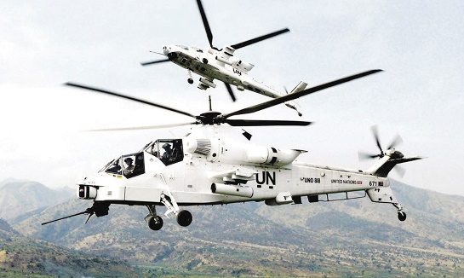
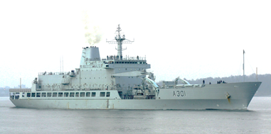

Outcome 11
DRC
Team BULISA
Op MISTRAL
Op
COPPER

Slide 50
Outcome 11
In support of its foreign policy, SA has taken part in a number of peace missions and SANDF troops have served in UN and AU missions on the continent:
Contributed to the FIB under UN Resolution 2098 to neutralise, disarm and prevent the expansion of all armed groups in the eastern parts of the DRC.
Ensured that regional, continental and international peace and security structures were capacitated and strengthened by the appropriate deployment of the SANDF into these structures.
Sustained long-range maritime and air patrols in the Mozambique Channel.

Slide 51
Outcome 11
Continued to provide humanitarian support to countries experiencing natural disasters, such as intermittent flood relief in Mozambique, Zimbabwe and Malawi and many search and rescue missions in international waters.
The prevention and resolution of conflict through an integration of diplomatic, military and other efforts, in a complementary manner, and in instances supported by appropriate military capabilities, that strengthen South Africa’s capacity to influence international developments.
To this extent, the DOD deployed 10 Defence Attachés in the SADC.
The SANDF provided the main stability platform for the ‘peace dividend’ through peace support operations that enhanced stability in the region and the continent, creating the space for South African business to expand, leading to significant potential future growth in GDP.

Slide 52
Non-Financial Performance Information

Slide 53
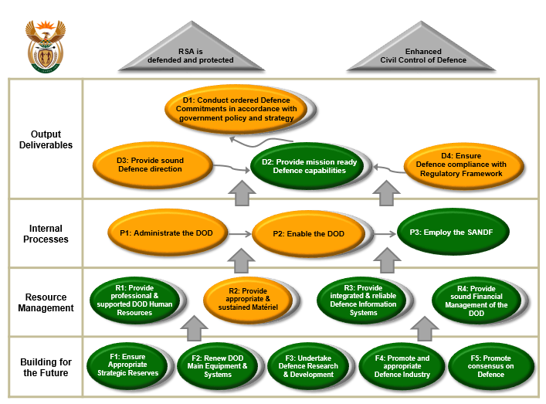
DOD Mandate Achievement

Slide 54
DOD Mandate Achievement per Perspective

Slide 55
Achievement Against MTSF Outcomes

Slide 56
DOD Selected Performance Indicators

Slide 57
DOD Selected Performance Indicators
Defence Foreign Relations Performance Status for FY2018/19
MTSF Outcome to which it contributes: Outcome 11
Output: Employ the SANDF
Performance Indicator | Analysis
Total number of Defence Attaché Offices | Target 44 Actual 44
Comment
SADC – 10 offices. Angola, Botswana, DRC, Lesotho, Mozambique, Namibia, Eswatini, Tanzania, Zambia and Zimbabwe.
Rest of Africa – 13 offices. Algeria, AU, Burundi, Côte d’Ivoire, Egypt, Ethiopia, Ghana, Kenya, Nigeria, Senegal, South Sudan, Sudan and Uganda.
Rest of the World – 21 offices. Argentina, Belgium, Brazil, Cuba, France, Germany, India, Italy, Malaysia, Pakistan, PRC, Russia, Saudi Arabia, Spain, Sweden, Turkey, UAE, UK, UN, USA and Vietnam.

Slide 58
DOD Selected Performance Indicators
Human Resources Support Services Performance Status for FY2018/19
MTSF Outcome to which it contributes: Outcome 5
Output: Provide professional and supported DOD Human Resources
Performance Indicator | Analysis
Number of military skills development members in the system per year | Target 3 568 Actual 3 554
Comment
The underachievement of 14 members can mainly be attributed to higher than expected attrition.
The deviation from the planned target is within acceptable range.

Slide 59
DOD Selected Performance Indicators
Human Resources Support Services Performance Status for FY2018/19
MTSF Outcome to which it contributes: Outcome 3
Output: Provide professional and supported DOD Human Resources
Performance Indicator | Analysis
Number of Reserve Force mandays | Target 2 674 761 Actual 2 574 127
Comment
The difference between the planned and actual achievement is mainly due to exercising prudency in terms of the planned Reserve Force mandays considering the cost of the utilised mandays.
The deviation from the planned target is within acceptable range.

Slide 60
DOD Selected Performance Indicators
Force Employment Performance Status for FY2018/19
MTSF Outcome to which it contributes: Outcome 11
Output: Provide mission ready Defence capabilities
Performance Indicator | Analysis
Percentage compliance with the Southern African Development Community Standby Force Pledge | Target 100% Actual 100%
Comment
The SANDF FSEs deployed in peace missions constituted part of the SANDF’s contribution to the African Standby Force. These pledges were not additional to SANDF force requirements.

Slide 61
DOD Selected Performance Indicators
Force Employment Performance Status for FY2018/19
MTSF Outcome to which it contributes: Outcome 11
Output: Conduct ordered defence commitments in accordance with Government policy and strategy
Performance Indicator | Analysis
Percentage compliance with number of ordered commitments (external operations) | Target 100% Actual 100%
Comment
SANDF forces deployed in the following two external operations during FY2018/19:
Op MISTRAL (UN Peace Support Operation in DRC [MONUSCO]).
Op COPPER (Anti-Piracy Operation in support of the Mozambican Government).

Slide 62
DOD Selected Performance Indicators
Force Employment Performance Status for FY2018/19
MTSF Outcome to which it contributes: Outcome 3
Output: Support to the People
Performance Indicator | Analysis
Percentage compliance with number of ordered commitments (internal operations) | Target 100% Actual 100%
Comment
SANDF forces deployed in the following four internal operations during FY2018/19:
Op PROSPER (Support to Government departments, mainly SAPS [ie Safety and Security Support]).
Op CHARIOT (Disaster Aid and Relief [Humanitarian Assistance]).
Op ARABELLA (Search and Rescue).
Op CORONA (Border Safeguarding).

Slide 63
DOD Selected Performance Indicators
Force Employment Performance Status for FY2018/19
MTSF Outcome to which it contributes: Outcome 11
Output: Employ the SANDF
Performance Indicator | Analysis
Number of Joint, Interdepartmental, Interagency and Multinational military exercises conducted per year | Target 4 Actual 3
Comment
The 5 year target was achieved by the end of FY2018/19 although the annual target was not achieved.
SANDF forces participated in the following three JIIM exercises during FY2018/19:
  Ex ATLASUR (A Multinational maritime exercise between the Brazilian, Uruguayan and SA Naval Forces with the aim to maintain and promote maritime cooperation between the participants).
  Ex IBSAMAR (A Multinational maritime exercise between the Indian, Brazilian and SA Naval Forces with the aim to maintain and promote maritime cooperation between participants).
  Ex NDLOVU (A Joint Interdepartmental and Inter-agency exercise to maintain and promote cooperation between state departments in Support to the People of the RSA).

Slide 64
DOD Selected Performance Indicators
Force Employment Performance Status for FY2018/19
MTSF Outcome to which it contributes: Outcome 3
Output: Support to the People
Performance Indicator | Analysis
Number of landward sub-units deployed on border safeguarding per year | Target 15 Actual 15
Comment
The SANDF deployed 15 sub-units to execute Op CORONA (Border Safeguarding) in Limpopo, Mpumalanga, KwaZulu-Natal, Free State, Eastern Cape, Northern Cape and North West Provinces.

Slide 65
DOD Selected Performance Indicators
Air Defence Performance Status for FY2018/19
MTSF Outcome to which it contributes: Outcome 11
Output: Conduct ordered Defence commitments in accordance with Government policy and strategy
Performance Indicator | Analysis
Number of hours flown per year | Target 25 000 Actual 17 870.20 Force Preparation: 14 882.90 hours Force Employment: 2 441.60 hours VVIP: 545.70 hours
Comment
The 17 870.20 hours flown, represents 71.5% of the planned target. The number of hours flown are dependent on the number of serviceable aircraft and operational taskings received.
The target related to the number of hours flown per year was adjusted to 17 200 hours in future planning instruments.

Slide 66
Year-on-Year Analysis on Number of Hours Flown
Flying Hours Year-On-Year Analysis
Flying Hour Type | FY2015/16 |  | FY2016/17 |  | FY2017/18 |  | FY2018/19 |  | FY2019/20
 | Target | Actual | Target | Actual | Target | Actual | Target | Actual | Planned
Force Employment | 5 700 | 3 893 (68.3%) | 4 000 | 3 692.10 (92.3%) | 4 000 | 3 629.20 (90.7%) | 4 000 | 2 441.60 (61%) | 4 000
VVIP | 800 | 893 (111.6%) | 1 000 | 340.30 (34%) | 1 000 | 496.30 (49.6%) | 1 000 | 545.70 (54.6%) | 1 000
Force Preparation | – | – | – | – | – | – | 20 000 | 14 882.90 (74.4%) | 12 200
TOTAL | 6 500 | 4 785.18 (73.6%) | 5 000 | 4 032.40 (80.65%) | 5 000 | 4 125.50 (82.5%) | 25 000 | 17 870.20 (71.5%) | 17 200

Slide 67
DOD Selected Performance Indicators
Maritime Defence Performance Status for FY2018/19
MTSF Outcome to which it contributes: Outcome 11
Output: Conduct ordered Defence commitments in accordance with Government policy and strategy
Performance Indicator | Analysis
Number of hours at sea per year | Target 12 000 Actual 7 704.13 Force Employment: 4 545.00 Force Preparation: 3 159.13
Comment
The 7 704.13 hours at sea represents 64.2% of the planned target as a result of the unavailability of vessels at the directed level of capability due to maintenance cycle delays.
The target related to the number of hours at sea per year was adjusted to 10 000 in future planning instruments.

Slide 68
Year-on-Year Analysis on Number of Hours at Sea
Sea Hours Year-On-Year Analysis
Sea Hour Type | FY2015/16 |  | FY2016/17 |  | FY2017/18 |  | FY2018/19 |  | FY2019/20
 | Target | Actual | Target | Actual | Target | Actual | Target | Actual | Planned
Force Employment | 12 000 | 10 710.70 (89.3%) | 12 000 | 8 131.55 (67.8%) | 12 000 | 3 470.26 | 12 000 | 4 545.00 | 10 000
Force Preparation |  |  |  |  |  | 2 576.42 |  | 3 159.13
TOTAL | 12 000 | 10 710.70 (89.3%) | 12 000 | 8 131.55 (67.8%) | 12 000 | 6 046.68 (50.4%) | 12 000 | 7 704.13 (64.2%) | 10 000

Slide 69
Non-Financial Performance Information:
Performance Status

Slide 70
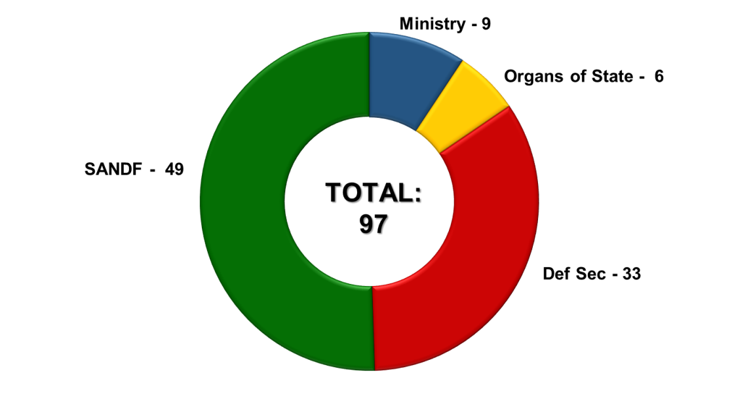
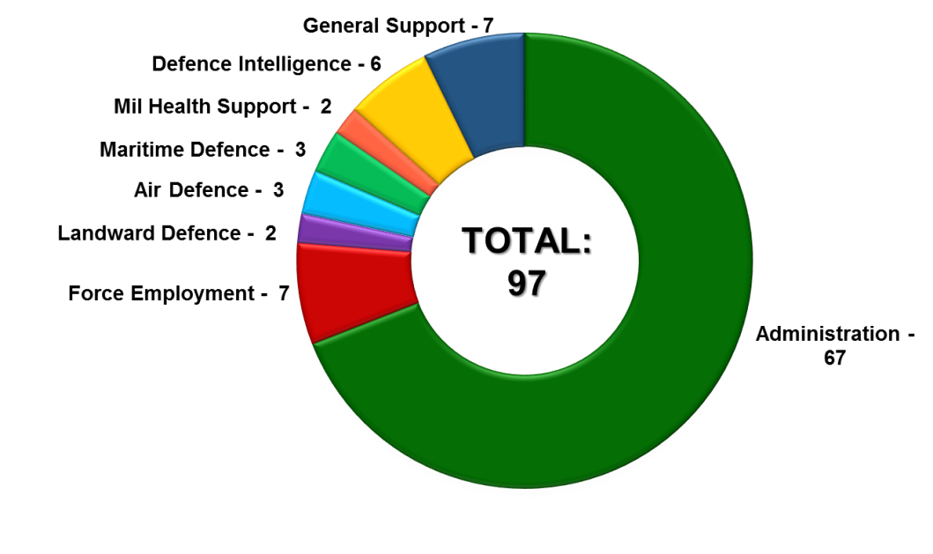
Analysis of DOD Performance Indicators
The DOD reported against 97 Performance Indicators in the FY2018/19.
The following figures provide an analysis on indicators per:
DOD Entity (PInd Owner)
DOD PInds per Main Programme

Slide 71
Year-on-Year Performance Comparison
 | FY2015/16 | FY2016/17 | FY2017/18 | FY2018/19
Achieved | 69 (66%) | 62 (65%) | 64 (64%) | 67 (69%)
Not Achieved | 35 (34%) | 33 (35%) | 36 (36%) | 30 (31%)
Total | 104 | 95 | 100 | 97

Slide 72
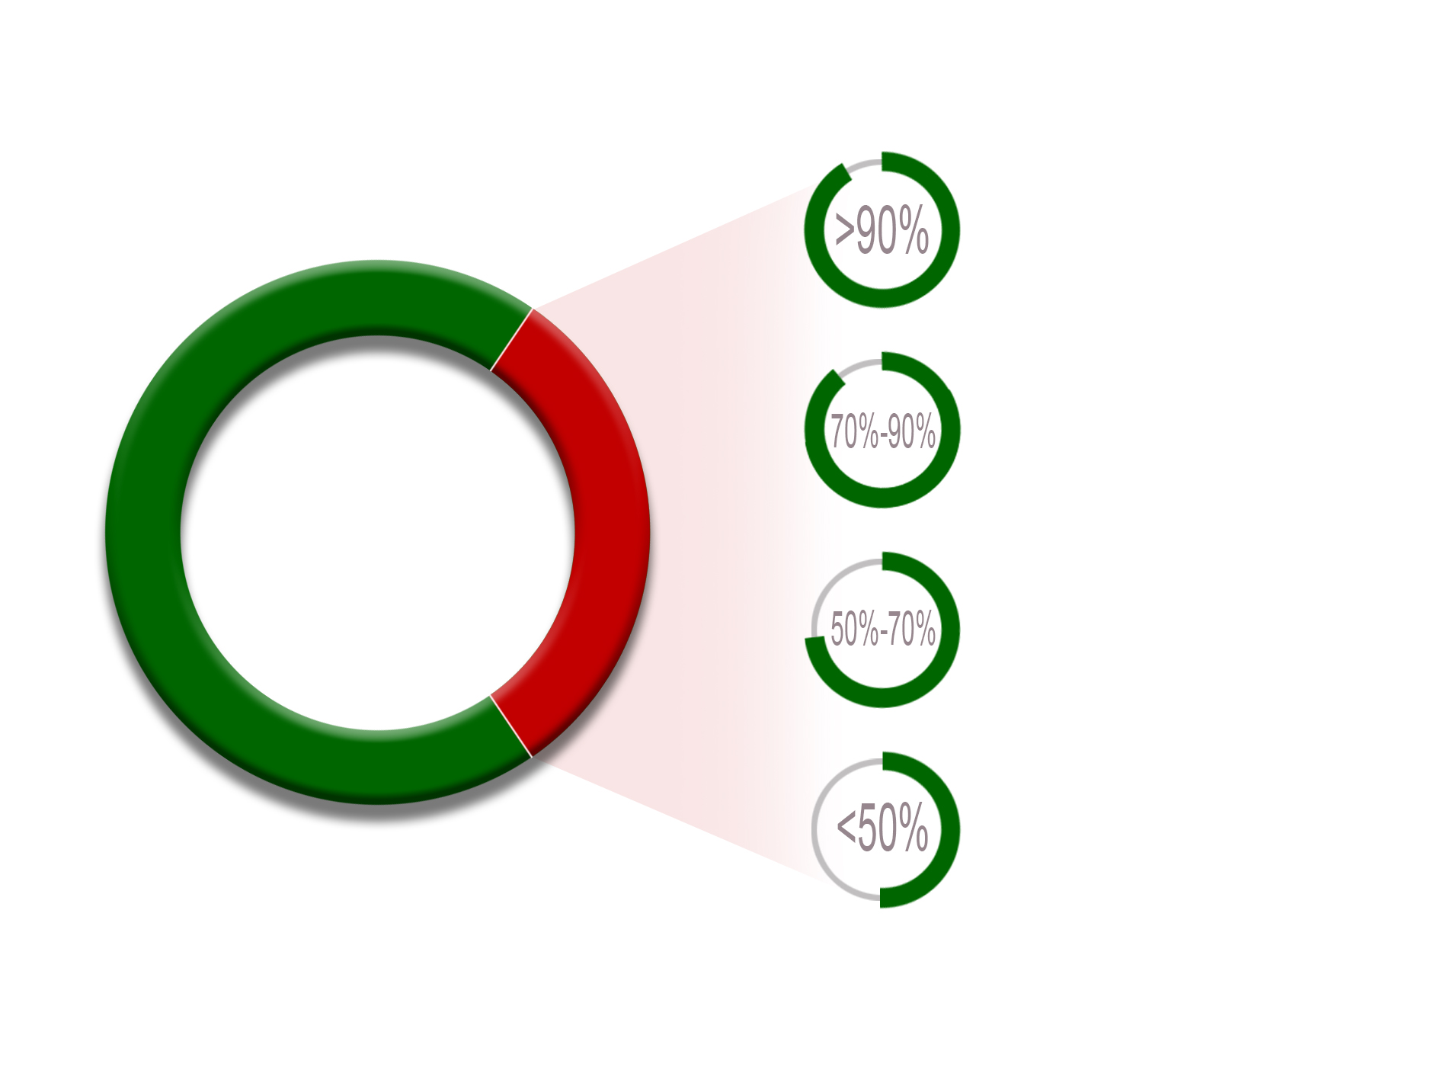
Summary of Actual Achievement
Fully/Overachieved
69%
Achieved greater than 90% = 3
Achieved between 70% & 90% = 8
Achieved between 50% & 70% = 4
Achieved less than 50% = 15
Partially/Not Achieved
31%

Slide 73
Management Performance Assessment Tool
Through the Administration programme, the AO executed civil control over the DOD which include governance risks and compliance functions, the determination of working methods and procedures that improve internal controls and the veracity of information provided.
Management interventions implemented by the AO, as well as regular monitoring of progress with the implementation of improvement plans, resulted in an improved full compliance percentage from 27% in the 2017 cycle to 33% in the 2018 cycle.

Slide 74
MPAT Average Scores: 2012 to 2018

Slide 75
Human Resource Management
The DOD planned and budgeted for an average personnel strength of 75 211 for the FY2018/19 at a cost of Rb30,3.
The NT final letter of allocation allocated Rb27,1 towards the DOD’s CoE for FY2018/19, which was significantly less than the DOD’s planned figures.
The imposed CoE budget ceiling did not take account of ordered commitments, current expenditure and exercises for which trained uniformed personnel are required to assure success.
The CoE budget allocation did not allow the DOD the opportunity to assess the most appropriate means for rejuvenation, since mechanisms considered are unfunded.

Slide 76
Human Resource Management
The DOD maintained an average HR strength of 74 343 during FY2018/19, which resulted in a CoE shortfall of Rb2,9.
In managing the projected CoE shortfall, the Department submitted various requests to NT, requesting approval to reprioritise its allocation internally, without exceeding the Defence Vote.
The matter was deliberated during a tri-ministerial meeting and the MOD&MV and Ministers of Finance and PSA directed that the applicable DGs should further attend to the matter for finalisation.
NT did not approve the DOD’s request to lift its CoE ceiling with an additional amount equal to the shortfall which resulted in the DOD incurring irregular expenditure to the amount of Rb2,895.

Slide 77
Financial Performance Information

Slide 78
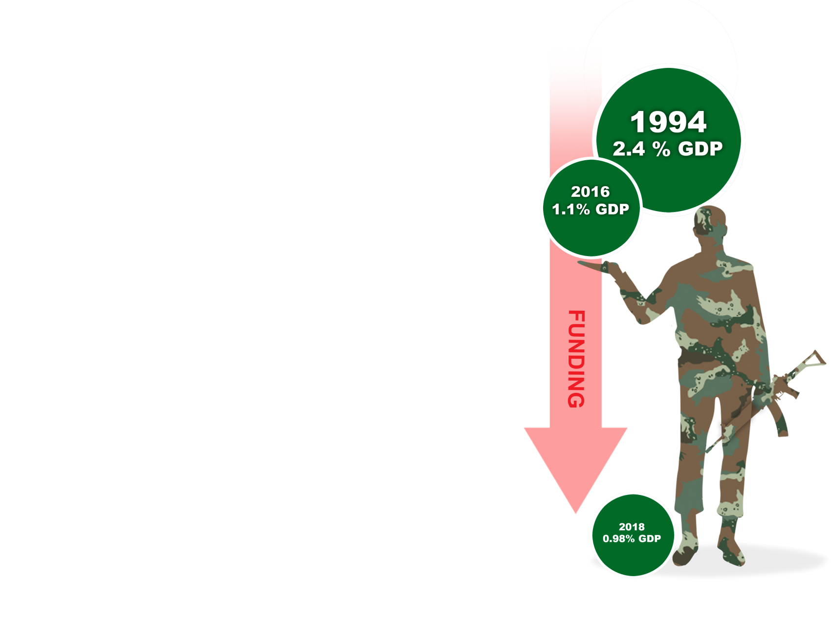

Defence Vote 19
The current budget allocation is deemed to be inadequate
to enable the execution of the
DOD Constitutional mandate.
2018
0.96%GDP

Slide 79
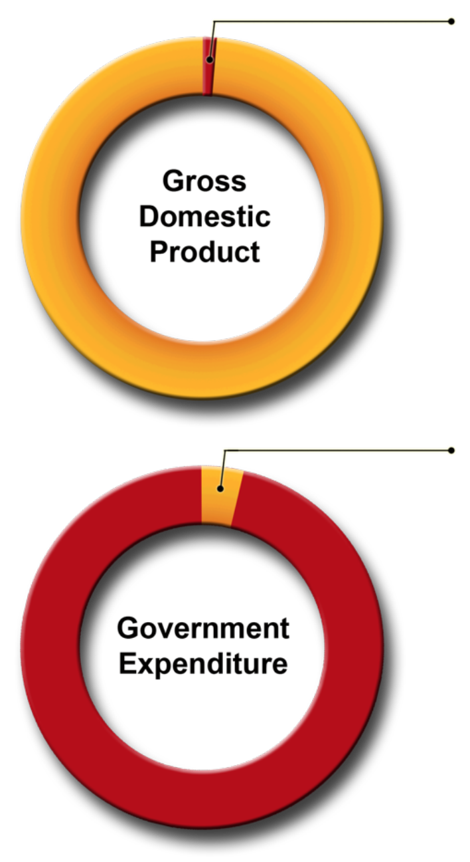
Defence Vote 19
0.96%: Defence
Vote
The Defence Budget Vote for FY2018/19 amounted to R48.5 billion.
The Defence Budget Vote amounted to
0.96% of SA’s GDP
and
2.9% of total GE.
2.9%: Defence
Vote

Slide 80
DOD Year-on-Year Expenditure Comparison
Summary of Actual Expenditure versus Adjusted Appropriation for Current and Prior Years
 | FY2016/17 | FY2017/18 | FY2018/19
 | R’000 | R’000 | R’000
Vote | 47 236 465 | 48 999 560 | 48 496 235
Expenditure | 47 197 094 | 48 977 232 | 48 492 073
Over expenditure | 0 | 0 | 0
Amount overspent as percentage of Vote | 0 | 0 | 0
Amount surrendered | 39 371 | 22 328 | 4 162
Amount surrendered as percentage of Vote | 0.083% | 0.046% | 0.009%

Slide 81
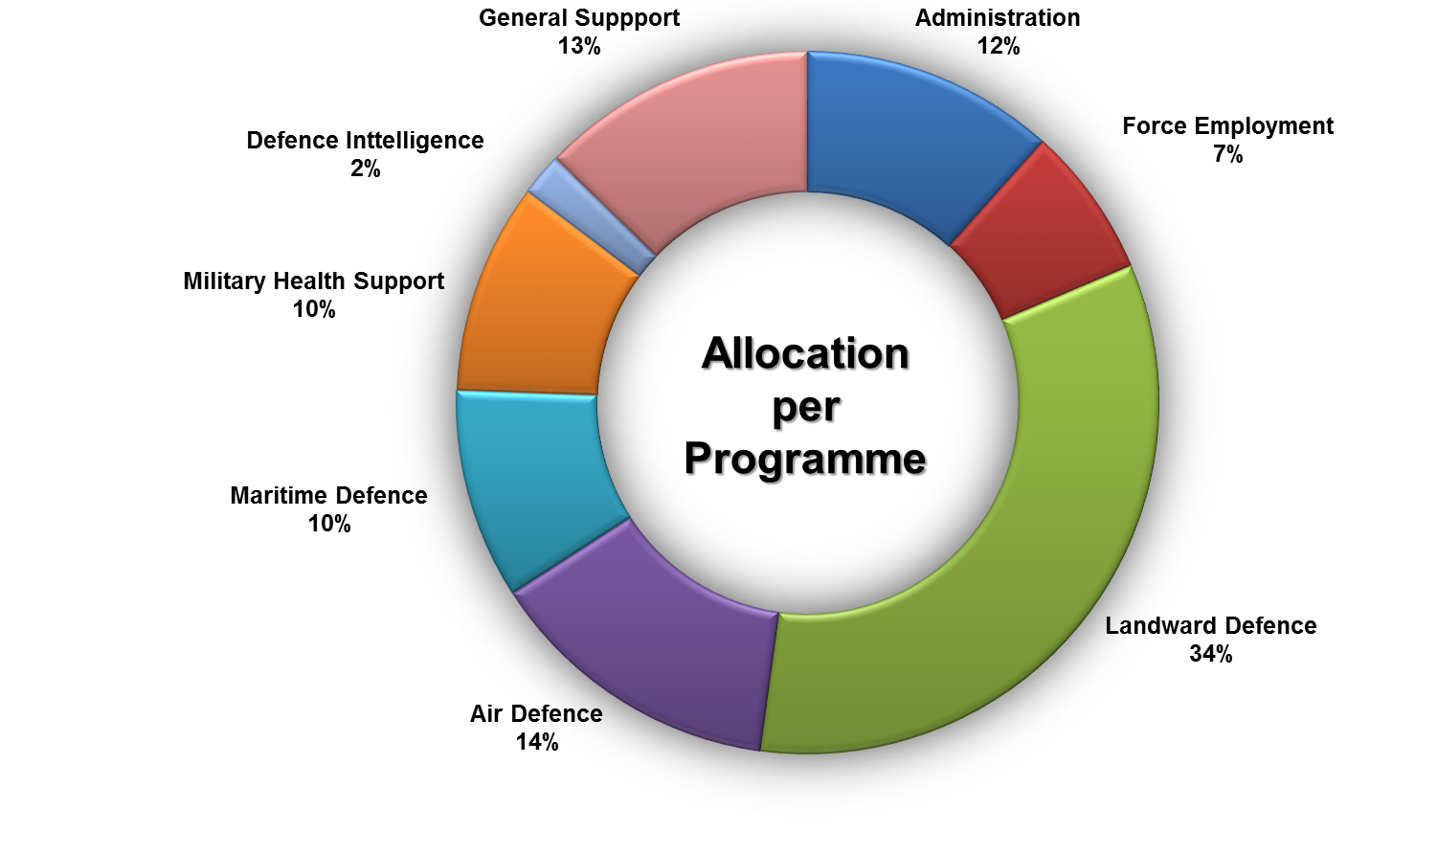
DOD Allocation per Programme

Slide 82
DOD Expenditure per Programme
Actual Expenditure versus Adjusted Appropriation at Programme Level
Programme | FY2018/19
 | Adjusted Appropriation | Final Appropriation | Actual Expenditure | (Over)/Under Expenditure
 | R’000 | R’000 | R’000 | R’000
Administration | 5 653 274 | 5 692 748 | 5 692 748 | 0
Force Employment | 3 375 584 | 3 168 678 | 3 168 678 | 0
Landward Defence | 16 271 221 | 16 427 499 | 16 427 499 | 0
Air Defence | 6 650 779 | 6 261 057 | 6 257 443 | 3 614
Maritime Defence | 4 699 355 | 4 503 930 | 4 503 930 | 0
Military Health Support | 4 714 062 | 5 090 591 | 5 090 591 | 0
Defence Intelligence | 950 364 | 938 173 | 938 173 | 0
General Support | 6 181 596 | 6 413 559 | 6 413 011 | 548
TOTAL | 48 496 235 | 48 496 235 | 48 492 073 | 4 162

Slide 83
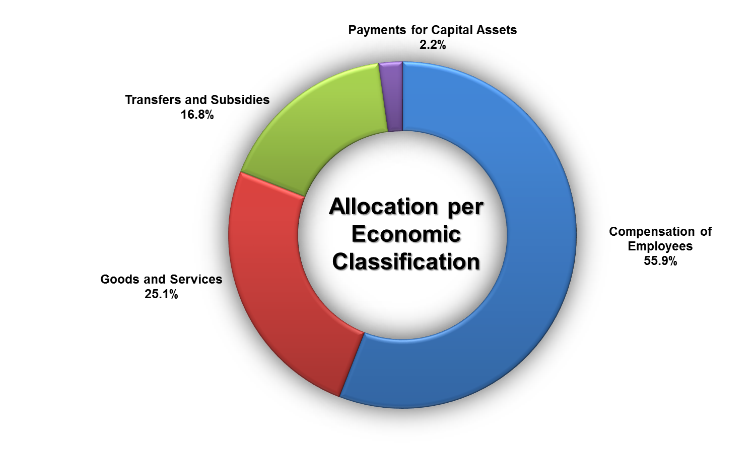
DOD Allocation per Economic Classification

Slide 84
DOD Allocation per Economic Classification
Actual Expenditure versus Adjusted Appropriation per Economic Classification
Economic Classification | FY2018/19
 | Adjusted Appropriation | Final Appropriation | Actual Expenditure | (Over)/Under Expenditure
 | R’000 | R’000 | R’000 | R’000
Current payments | 39 265 532 | 40 385 731 | 40 382 766 | 2 965
Compensation of Employees | 27 116 696 | 27 116 696 | 30 011 960 | (2 895 264)
Goods and Services | 12 148 836 | 13 269 035 | 10 370 806 | 2 898 229
Transfers and Subsidies | 8 160 861 | 6 656 205 | 6 655 008 | 1 197
Payments for Capital Assets | 1 069 842 | 1 442 941 | 1 442 941 | 0
Payment for Financial Assets | - | 11 358 | 11 358 | 0
TOTAL | 48 496 235 | 48 496 235 | 48 492 073 | 4 162

Slide 85

Audit Outcomes for the year ended 31 March 2019
Auditing to build public confidence

Slide 86
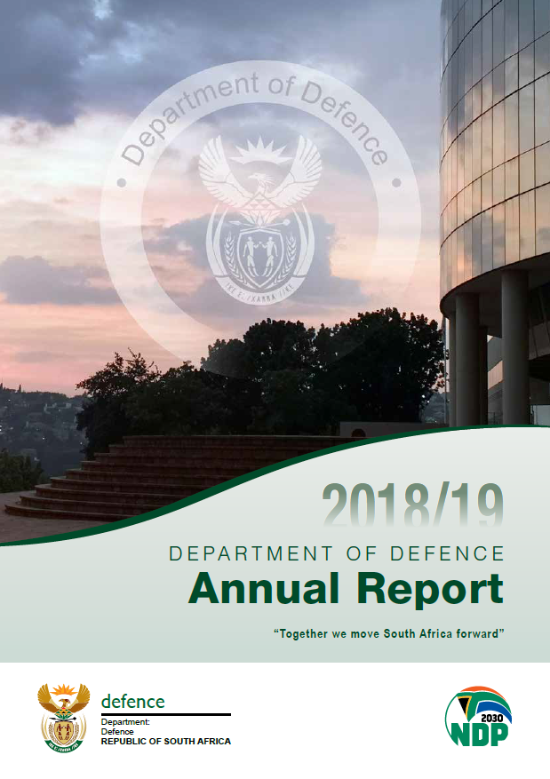
Report on the Audit of the
Annual Performance Report
The usefulness and reliability of the reported performance information was evaluated in accordance with the criteria developed from the performance management and reporting framework.
No material findings was raised on the usefulness and reliability of the reported performance information for the following programmes:
Programme 2 – Force Employment
Programme 3 – Landward Defence
Programme 4 – Air Defence

Slide 87
Report on the Audit of the Financial Statements
Basis for Qualified Opinion
1. Movable Tangible Capital Assets
The department did not disclose the work in progress related to the project assets that are under development within the ARMSCOR and Defence Industry environment.
2. Movable Tangible Capital Assets
The department did not correctly disclose all items relating to tangible capital assets in terms of the MCS. Certain assets that qualify to be recognised as assets have been incorrectly classified as inventory.

Slide 88
Report on the Audit of the Financial Statements
Basis for Qualified Opinion
3. Intangible Capital Assets
The AGSA was unable to obtain sufficient and appropriate audit evidence for the existence and valuation of some software licenses owned by the Department.
4. Goods and services and Investments
The department accounts for non-sensitive and sensitive projects expenditure in connection with special defence activities as per section 2(2)(a) of the Defence Special Account Act of South Africa, 1974 (Act No. 6 of 1974), as amended. Due to the sensitivity of the environment and the circumstances under which the related transactions were incurred and recorded, sensitive projects expenditure and related investments are qualified due to the limitations imposed on the auditors.

Slide 89
Report on the Audit of the Financial Statements
Basis for Qualified Opinion
5. Commitments
In the prior year, the AGSA qualified the DOD on the completeness of commitments recorded in the financial records of the Department. The DOD corrected all misstatements identified; the auditors were however unable to obtain sufficient and appropriate audit evidence that all commitments have been recorded in the financial statements.
6. Irregular Expenditure
The department did not have adequate systems to identify and disclose all irregular expenditure during the year, as required by section 40(3)(b)(i) of the PFMA. The irregular expenditure for the year under review disclosed in note 24 to the financial statements, is not complete.

Slide 90
Conclusion
In order to ensure improved audit outcomes during the FY2019/20, the following actions are taking place:
Implementation of the AO Instruction on the submission and monitoring of action plans relating to AGSA audit findings.
Consequence management through established Departmental processes, where appropriate.
Continued liaison with NT and political oversight bodies regarding an improved Defence allocation.

Slide 91

Thank you…
Questions / Comments

