Slide 1

BRIEFING TO THE PORTFOLIO COMMITTEE
ON MINERAL RESOURCES AND ENERGY
2018/2019 ANNUAL REPORT
10 OCTOBER 2019

Slide 2

TABLE OF CONTENT
Background
SDT Vision & Mission
Governance
Finance
Performance
Our Operations
Key Challenges
Future Focus Areas

Slide 3
BACKROUND
Who we are
A State – owned entity established in 2007 in terms of section 14 of the Diamond Act 56 of 1986 to operate in the diamond industry to support and facilitate growth in local diamond beneficiation.
The SDT is categorized as a schedule 3B entity in terms of the Public Finance Management ACT 1 of 1999 (PFMA)
Mandate is to:
buy and sell rough diamonds for local beneficiation
promote equitable access to and beneficiation of the country’s diamond resources
grow SA diamond cutting and polishing industry by increasing HDSA for beneficiation
address distortion created by excluding previously disadvantages groups from economic participation (transform diamond industry)
purchase up to 10% of the run of mine from SA producers
sell to registered customers through an application and approved process

Slide 4
VISION AND MISSION
VISION
To be a catalyst for transformation and growth of the local diamond beneficiation industry
MISSION
  Ensure acquisition of and equitable access to rough diamonds with particular focus
  on HDSAs.
  Promote the growth of the diamond
  beneficiation industry through relevant interventions.
  Establish and maintain a transformed client base of local diamond beneficiators

Slide 5
GOVERNANCE

Slide 6
GOVERNANCE STRUCTURE

Slide 7
GOVERNANCE
12 Board members appointed by the Minister in 2016 in terms of Section 17 of the Diamonds Act
Board Term ended on 31 August 2019 and was extended by the Minister for a period of 3 months while the appointment process is undertaken

Slide 8
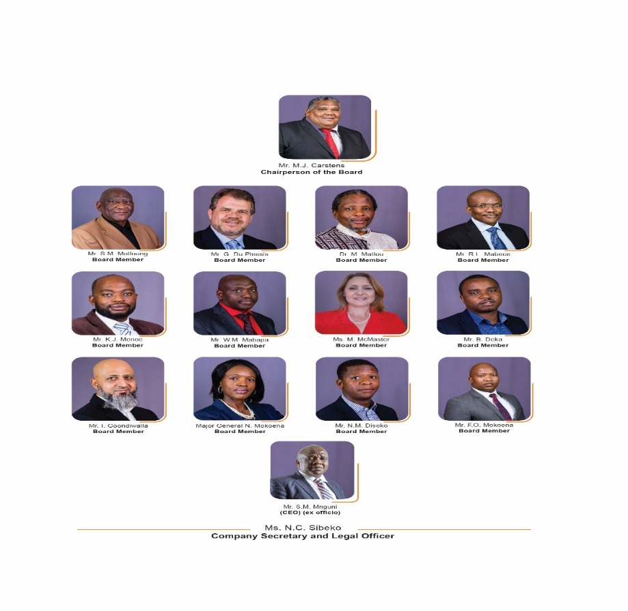
OUR BOARD
NAMES
Mr M.J. Carstens (Chairperson)
Mr G. Du Plessis
Dr M. Matlou
Mr R.L. Mabece
Mr B. Deka
Mr S.M. Motloung
Ms M. McMaster
Mr K.J. Menoe
Major General N. Mokoena
Mr W.M. Mabapa
Mr I. Goondiwalla
Mr C Khosa (CEO) SADPMR
Mr S.M. Mnguni (CEO)
Ms N.C. Sibeko (Company Secretary and Legal Officer)

Slide 9
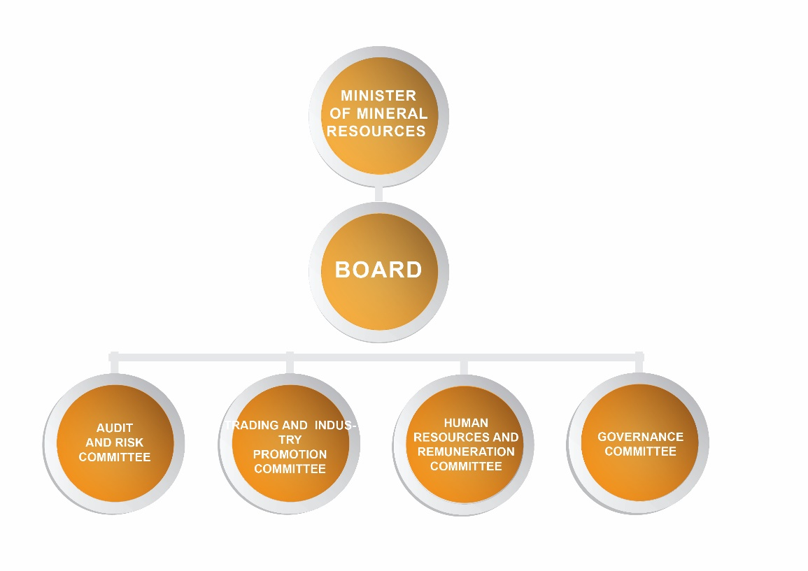
GOVERNANCE STRUCTURE

Slide 10
FINANCE

Slide 11
SUMMARY AND BUDGET COMPARISON OF THE 2018/19
AUDIT OUTCOME | Financially Unqualified | Financially Unqualified | Clean Audit
FINANCIAL POSITION | R'000 | R'000 | R'000
Current Assets | 119 032 | 62 606 | 54 323
Non Current Assets | 695 | 750 | 937
Total Assets | 119 727 | 63 356 | 55 260
Current Liabilities | 61 680 | 2 251 | 1 999
Non Current Liabilities | - | - | -
Total Liabilities | 61 680 | 2 251 | 1 999
Total Net Assets | 58 047 | 61 105 | 53 261
FINANCIAL PERFORMANCE
Total Revenue | 628 747 | 776 739 | 726 266
Exchange Transactions | n/a | n/a | n/a
Non-Exchange Transactions | n/a | n/a | n/a
Total Expenditure | (631 805) | (768 233) | (719 118)
Employee Costs | (14 320) | (14 235) | (10 957)
Surplus/(Deficit) for the year | (3 058) | 8 506 | 7 148
CASH FLOW
Operating Activities | 61 268 | 6 314 | 10 183
Investing Activities | (234) | (81) | (151)
Cash & Equivalent - Year End | 99 743 | 38 709 | 32 476
UIFW EXPENDITURE | 675 | 1 208 | 1 220

Slide 12
Statement of Comprehensive Income Projections as at 31 March

Slide 13
Statement of Financial Position as at 31 March

Slide 14

SUMMARY OF AUDIT ISSUES IDENTIFIED
The State diamond Trader received an unqualified Audit outcome with the following matters of emphasis:
Performance information : Strategic Objective 4
The planned measures on the APP was percentage of total of SDT clients rough diamond requirements met. This measure to apply in 2019/20 once process for meeting clients rough requirements is approved. The recorded achievements referred to is different
Financial Statements
Misstatement of current liabilities, revenues and cost of sales
Expenditure Management
Irregular expenditure of R1883 171 was recognized on the extension of lease agreement with landlord exceeding 15% without approval from Treasury
Procurement and contract Management:
Goods and services procured without following necessary procurement processes

Slide 15
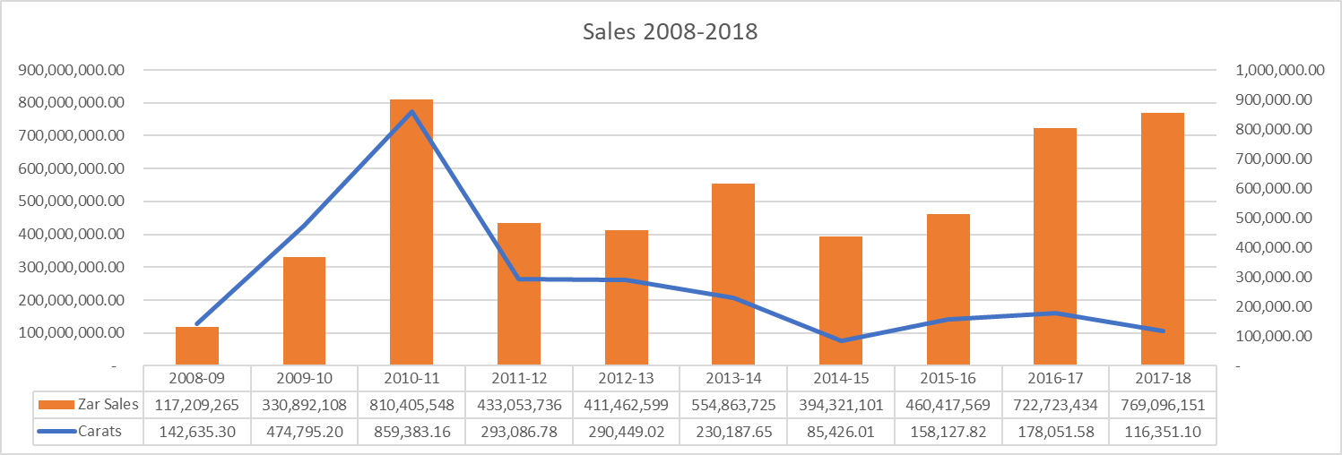
SALES HISTORY 2008-2018

Slide 16
PERFORMANCE

Slide 17
PERFORMANCE

Slide 18
PERFORMANCE

Slide 19
PERFORMANCE

Slide 20

PERFORMANCE

Slide 21
PERFORMANCE

Slide 22


Slide 23
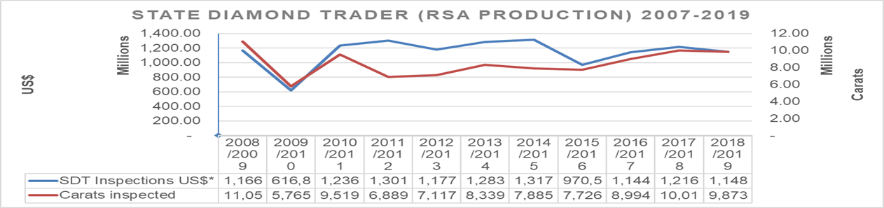
PURCHASING PERFORMANCE

Slide 24
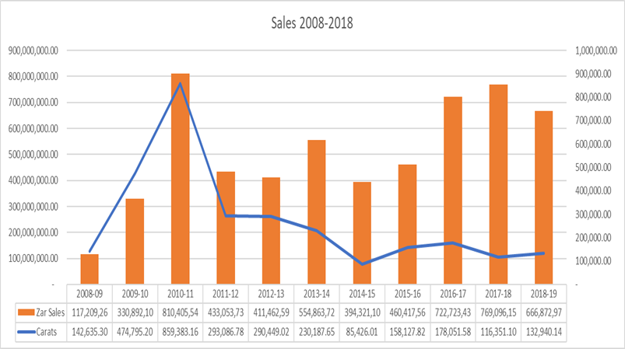
SALES TO CLIENTS 2008-2018
The State Diamond Trader noted a decline in sales in the 2018/2019 financial year . Mainly decline in production levels from De Beers that contributes 60% of State Diamond Trader revenue.

Slide 25
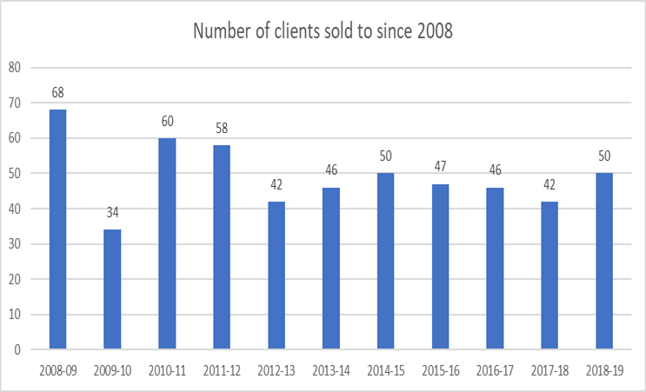
NUMBER OF CLIENTS SOLD TO
The number of clients sold to over the years has declined since inception . The reason for this is clients find it difficult to secure funding to purchase rough diamonds . An increase in the number of clients sold to was noted in the 2018/2019 financial year.

Slide 26
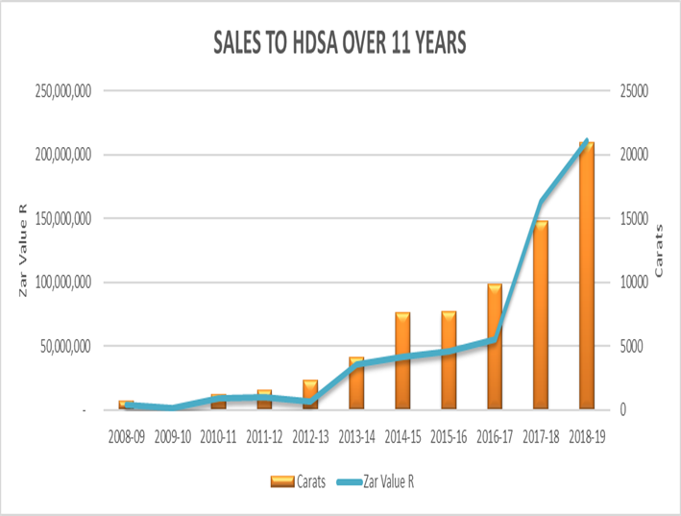
SALES TO HDSA CLIENTS
There has been an increase in sales value from R163M in 2017/2018 to R210M in 2018/2019 (29% increase sales to HDSA).

Slide 27
SKILLS DEVELOPMENT
5 Enterprise Development Trainees were sent to India for further training for 2months
A bench marking visit was conducted to Namibia by SDT officials to better understand the diamond industry outside of South Africa
The Enterprise Development Trainees attended Global Entrepreneurship Week for the first time and this opened their minds up to endless possibilities

Slide 28
ENTERPRISE DEVELOPMENT PROGRAMME
The Enterprise Development Programme was launched in 2015 in response to the fact that the diamond industry had no young people entering the industry.
Intention of programme is to provide technical knowledge of the industry
Exposure to the functioning and processes of a diamond manufacturing company
Development of Business Acumen

Slide 29
ENTERPRISE DEVELOPMENT PROGRAMME
The demographics of the 27 EDP students since the inception of the programme in 2015 are as follows:
Province | No. of Students
GP | 13
NW | 1
KZN | 6
EC | 2
MP | 2
FS | 2
Limpopo | 1
9 students were sent to Surat to further train and understand the Indian Diamond industry

Slide 30
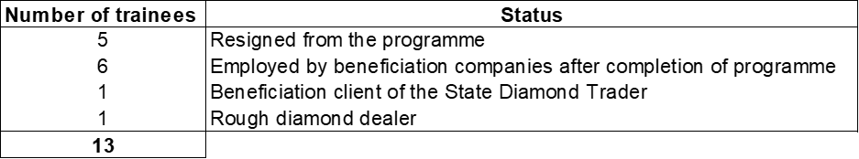
ENTERPRISE DEVELOPMENT PROGRAMME
The State Diamond Trader at the end of the 2018/2019 financial year was left with 14 EDP trainees. The Status of the 13 who are no longer in the programme are as follows:

Slide 31
TARI STUDENTS PROGRAMME
The State Diamond Trader partnered with the Mining Qualifications Authority (MQA) on the TARI Student programme as a vital core for skills development in the country
The programme is a partnership between MQA and the Department of Higher Education whereby jewellery designers and watchmakers were sent to Italy for training in their respective fields
The two-year training programme’s strategic focus is to expose South African designers to world-class designs and impart valuable skills.
There were 19 Jewellers trained and 5 Watchmakers trained in Italy

Slide 32
TARI STUDENTS PROGRAMME
The demographics of the Tari students are as follows:
Provinces | No. of Students
Kwa Zulu Natal | 3
Free State | 3
Limpopo | 5
Gauteng | 4
North West | 1
Western Cape | 1
Eastern Cape | 2
Female | Male
6 | 13

Slide 33
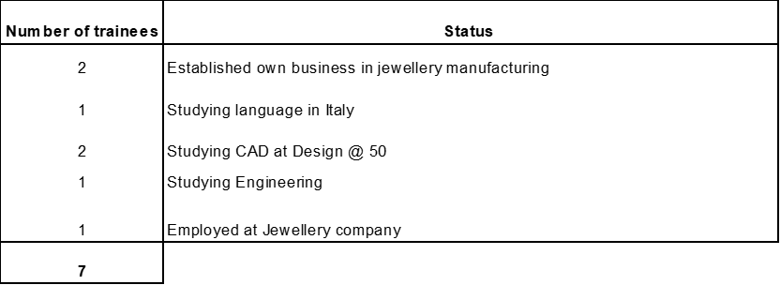
TARI STUDENTS PROGRAMME
The below table indicates the status of the 7 students who left the programme before the term date:

Slide 34
ACCESS TO MARKETS

Slide 35
ACCESS TO MARKETS
Local Markets:
In an effort to raise awareness, promote the entity and the diamond industry; State Diamond Trader continues to participate in local events
The State Diamond Trade once again facilitated a stand at Jewellex Africa for clients to market their businesses
The entity also participated in the Proudly South African Buy Local Summit, invited 6 Tari jewellers to exhibit and market their products
2019 Africa Mining Indaba
Ministerial Budget vote and invited jeweller to show case their products
DMR Learners Focus week

Slide 36
ACCESS TO MARKETS
International Markets:
The State Diamond Trader facilitated the 6th National Pavilion in Hong Kong
The entity invited 10 clients to exhibit and promote South African produced diamonds
The South African delegation was led by the Deputy Minister of Mineral Resources, Mr Godfrey Oliphant (MP)
With the support of the South African Consul General in Hong Kong, the State Diamond Trader and its clients collaborated with the Royal House of Mandela in hosting a Nelson Mandela centenary year under the theme “A Diamond Night”
Clients sold R75 million worth of diamonds at the both the show and the event

Slide 37
KEY CHALLENGES

Slide 38
KEY CHALLENGES
Funding for SDT
Financial model for operations while growing local diamond beneficiation industry
Rough Diamonds
Average of 15% of South African rough diamond production is desired by clients
Clients
Many clients are hard hit by issues of economies of scale impacting on their buying power
Clients do not provide suitable rough diamonds as a result of the run of mine provisions
SDT can only purchase run of mine which means all qualities and all sizes of a production
Current revolving credit facility from IDC limits acquisition
Lack of funding limit their ability to acquire tools and machinery
Lack of start up funding and no funding from commercial banks

Slide 39
KEY CHALLENGES
Decline Production
Industry experiencing a decline in production
Diamond
Prices
This threatens level of supply and growth of industry
Unstable and shrinking markets
Fair Market value not supportive of transformation agenda ( mark up)
Producers always have upper hand over SDT
SDT has to make margins to sustain its operations

Slide 40
MARKET CHALLENGES
The diamond market was faced with several challenges in the 2018/2019 financial year. The price of rough diamonds increased whilst the price for polished diamonds decreased, this led to an imbalance in prices
The US-China trade war affected the Chinese consumption of luxury goods due to them holding on to finances due to uncertainty of what would happen.
The influx of Synethic diamonds being mixed into melee natural diamond parcels led to the demand in these sizes decreasing.
The South African production levels began to decline, with De Beers reducing their production outlook due to them starting underground mining at Venetia.
The impact is still being felt into the 2019/2020 financial year with clients uncertain of where the market is heading.

Slide 41
FUTURE FOCUS AREAS

Slide 42
FUTURE FOCUS AREAS
Rebranding of the entity - reposition and alignment
Conduct feasibility study on beneficiation of -3grainer gem
Establish an Enterprise Hub with access to state of the art technology for new entrance, emerging business and trainees
Purchase rough from other countries with SADC countries being a priority
Development of manufacturing tools and maintenance

Slide 43
FUTURE FOCUS AREAS
Approach government funding agencies and commercial banks to fund SDT clients
Attract youth and women into the industry through incentives of mineral beneficiation
Investment in local and international marketing activities for clients
Strengthen Enterprise Development Programme
Establish proper diamond training academy/school
Establish research, training and development scheme

Slide 44

THANK YOU!!!

