Slide 1


Annual Report
31 March 2019
10 OCTOBER 2019

Slide 2
Introduction
Achievements during the year
Performance report
Financial information
Governance
Going forward

Slide 3
NHFC OVERVIEW
Established: 1996
Type of Organisation: Development Finance Institution (DFI)
Ownership:
Total Assets:
Total liabilities:
Funding Status:
Credit Rating:
Main business:
State Owned Company, 100% SA government
R4,8 billion (31 March 2019 – group)
R409 million (31 Mar 2019 – group)
Self sustaining
Long term A+, short term A1
Broadening and deepening access to affordable housing
finance for the low-to-middle income SA households
Geographic activities: National
Number of Employees: Group 117

Slide 4


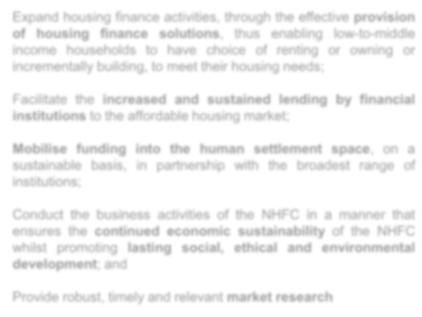
NHFC MANDATE
The National Housing Finance Corporation Soc Ltd (NHFC) is a state owned Development Finance Institution with a principal mandate to broaden and deepen access to affordable housing finance for the low- and middle- income households.
Ta r g e t M a r k e t :
S t r a t e g i c O b j e c t i v e s
Expand housing finance activities, through the effective provision of housing finance solutions, thus enabling low-to-middle income households to have choice of renting or owning or incrementally building, to meet their housing needs;
− The low- to middle-income housing market is any South African household with a monthly income between R800 and R15 000 (from 1 April 2019 R22 000).
Facilitate the increased and sustained lending by financial institutions to the affordable housing market;
Mobilise funding into the human settlement space, on a sustainable basis, in partnership with the broadest range of institutions;
− The market segment is able to contribute towards its housing costs, but unable to access housing finance from commercial financial institutions.
Conduct the business activities of the NHFC in a manner that ensures the continued economic sustainability of the NHFC whilst promoting lasting social, ethical and environmental development; and
Provide robust, timely and relevant market research

Slide 5
Introduction
Achievements during the year
Performance report
Financial information
Governance
Going forward

Slide 6
STRATEGIC ACHIEVEMENTS DURING THE YEAR
Merged with NURCHA and RHLF
  Took over the RHLF loan from KfW (through DBSA)
  Took over the NURCHA loan from PIC
Appointed as national implementing agent for FLISP
6

Slide 7
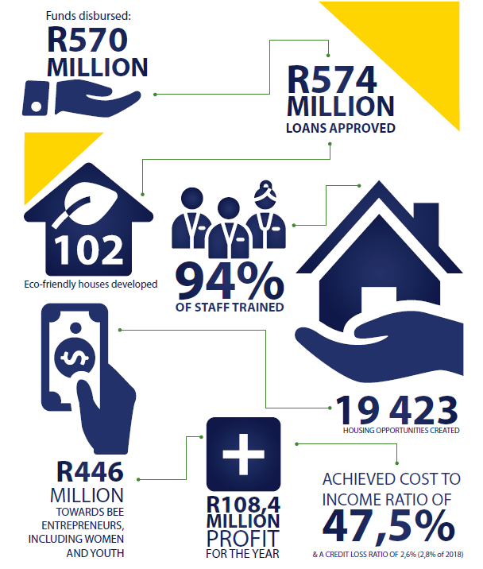
DEVELOPMENT ACHIEVEMENTS DURING THE YEAR
7

Slide 8
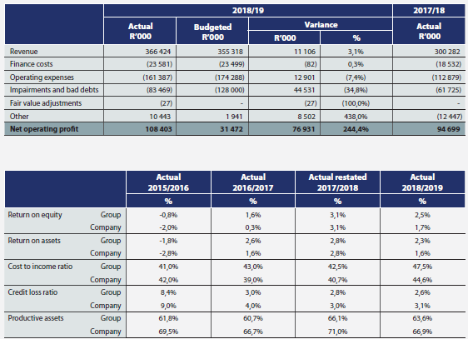
FINANCIAL HIGHLIGHTS DURING THE YEAR
Unqualified financial audit
Combined NHFC, NURCHA and RHLF financials
8

Slide 9
Introduction
Achievements during the year
Performance report
Financial information
Governance
Going forward

Slide 10
PERFORMANCE INDICATORS PROGRAMME 1
Total Units Delivered
10

Slide 11
PERFORMANCE INDICATORS PROGRAMME 2
Crowding in private sector funding
Funding crowded in
R1 billion
Housing units created
2 783
11

Slide 12
OTHER DEVELOPMENT IMPACT
12

Slide 13
Introduction
Achievements during the year
Performance report
Financial information
Governance
Going forward

Slide 14
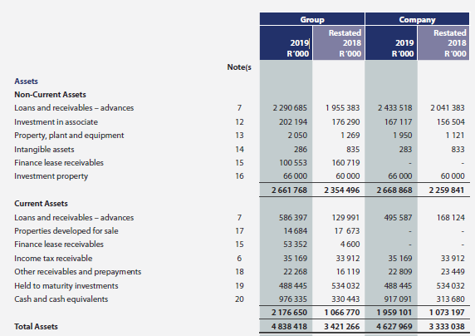
STATEMENT OF FINANCIAL POSITION - ASSETS
14

Slide 15

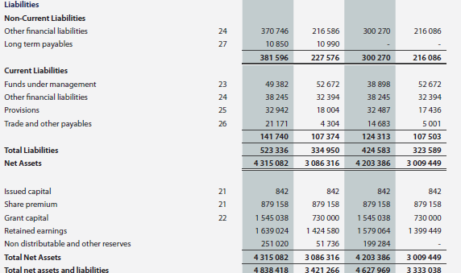
STATEMENT OF FINANCIAL POSITION – LIABILITIES AND EQUITY
15

Slide 16
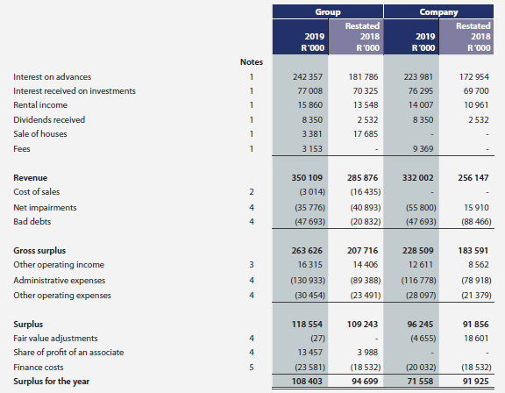
STATEMENT OF FINANCIAL PERFORMANCE
16

Slide 17
Introduction
Achievements during the year
Performance report
Financial information
Governance
Going forward

Slide 18
AUDIT OUTCOMES
Financial report
Unqualified with findings
Performance report
Qualified - APP numbers were not useful (Budget supposed to include ONLY six months numbers for RHLF and NURCHA)
Irregular Expenditure
Numerous changes to the Financials after 31 May 2019
18

Slide 19
2018/19 EXTERNAL AUDIT
Key Areas of Improvement:
Supply Chain Management
  Irregular expenditure identified (R2.95 m in 2017/18 and R 285 775 in 2018/2019)
  Mainly due to non compliance with regulation for 3 way quotation or competitive bid process
  Investigation revealed no financial loss or damages to NHFC
  Action plan in place to strengthen internal controls
Pre-determined outcomes indicators to be well supported by supporting evidence
Tightening or enforcing on the financial reporting deadlines:
  to minimise post 31 May AFS adjustments
19

Slide 20
REMEDIAL ACTION FOR ENHANCEMENT OF THE SUPPLY CHAIN MANAGEMENT (“SCM”)
Overview of priorities
Compliance with Treasury Regulations through either a competitive bid process (Public Tender) or 3 way quotation process for select goods & services (RFQs);
Review and automation of processes – to drive efficiency;
Augmentation of skills base – with staff from NURCHA and RHLF;
SCM Governance enhancement (Policy and Procedure review).

Slide 21
GOVERNANCE STRUCTURE
Minister of Human Settlements
Board of Directors
Audit Committee
Board Risk Committee
Department of Human Settlements
Human Resources and Remuneration Committee
Development Impact and Strategy Committee
Board Credit and Investment Committee
Social and Ethics Committee
21

Slide 22
ORGANISATIONAL STRUCTURE
Chief Executive Officer
Samson Moraba
Company Secretary
Andrew Higgs
Acting Chief Financial Officer
Bruce Gordon
Incremental Lending Executive
Jabulani Fakazi
Strategic Relationships Executive
Viwe Gqwetha
Credit Executive
Zola Lupondwana
Human Resources Executive
Nomsa Ntshingila
Group Risk Executive
Sindisa Nxusani
Strategy Executive
Mandu Mamatela
Lending Executive
Lawrence Lehabe
10

Slide 23

HUMAN RESOURCES ACHIEVEMENTS
23

Slide 24
Introduction
Achievements during the year
Performance report
Financial information
Governance
Going forward

Slide 25
TOWARDS THE HSDB
Reviewing / Enhancing business case for Human Settlement Development Bank (HSDB)
Looking forward to finalization of the Draft Legislation for HSDB
Improved sustainability
Drop-Off obsolete and develop new products
25

Slide 26
CHALLENGES
Economy
Tepid economic growth will continue affecting business confidence and private sector investment. 2019/20, will be challenging and DFI’s will struggle to achieve financial and key impact targets in an economy in recession.
Social Housing
Rising culture of non-payment of rent and illegal occupation of social housing units. The NHFC revenue and loan book will be negatively impacted .
A co-ordinated sector wide approach to the challenge is needed to contain these politically inspired activities.
26

Slide 27

THANK YOU

