Slide 1
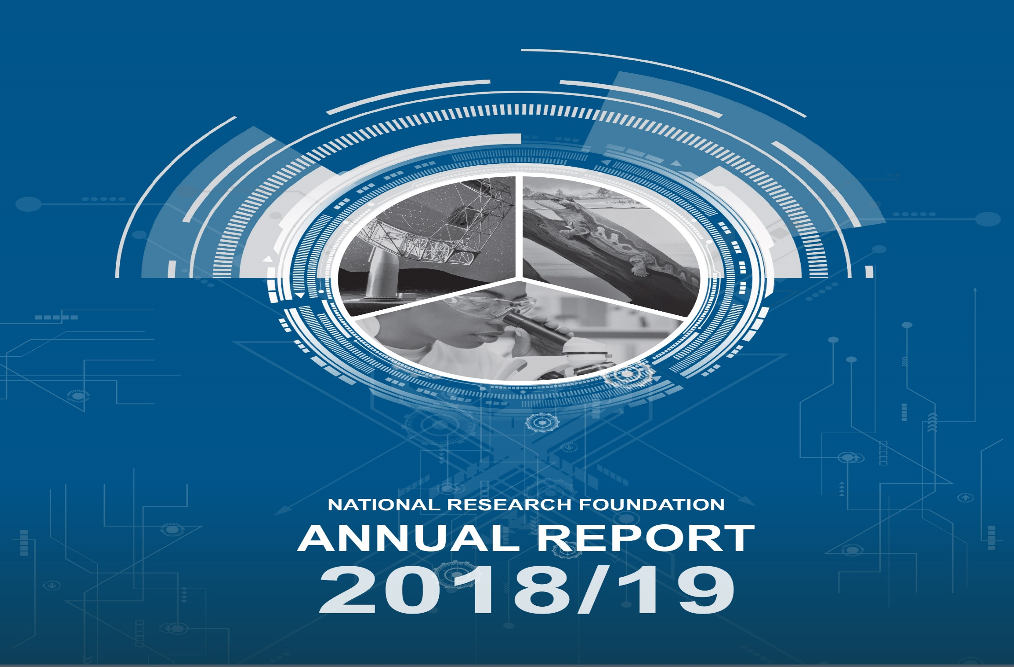
PLANNING AND REPORTING - 2019/20 TIDS & 2024/25 CYCLE W/SHOP

Slide 2
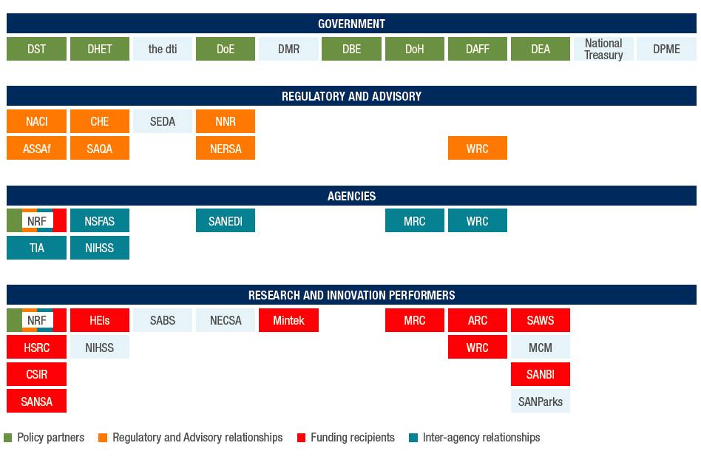
NRF in the Public R&D System

Slide 3
NRF Mandate
Contribute to National Development by:
(a) Supporting, promoting and advancing research and human capacity development, through funding and the provision of the necessary research infrastructure, in order to facilitate the creation of knowledge, innovation and development in all fields of science and technology, including humanities, social sciences and indigenous knowledge;
(b) Developing, supporting and maintaining national research facilities;
(c ) Supporting and promoting public awareness of, and engagement with, science; and
(d) Promoting the development and maintenance of the national science system and support of Government priorities.

Slide 4
Expressing the NRF Mandate
Advancing Knowledge
Support for Research
Provision of Research Infrastructure Platforms
Transforming Lives
Post-graduate support
Inspiring a Nation
Science engagement through:
Strengthening the NSI
Emerging Researcher support
Education
Awareness
Communication
Provision of Research Equipment
NRF Mandate is embedded in the following areas
Building partnerships and synergies
Providing system wide information and intelligence

Slide 5
NRF Governance Structure
NRF BOARD
Internal Audit
NRF CEO
PROGRAMME 1
PROGRAMME 2
PROGRAMME 3
PROGRAMME 4
GROUP EXECUTIVE / CFO
GROUP EXECUTIVE
GROUP EXECUTIVE
GROUP EXECUTIVE
DCEO
RISA
DCEO
NRIP
Finance and Business Systems
Human Resources and Legal Services
Strategy, Planning and Partnerships
Science Engagement & Corporate Relations
Research and Innovation Support and Advancement
National Research Infrastructure Platforms

Slide 6
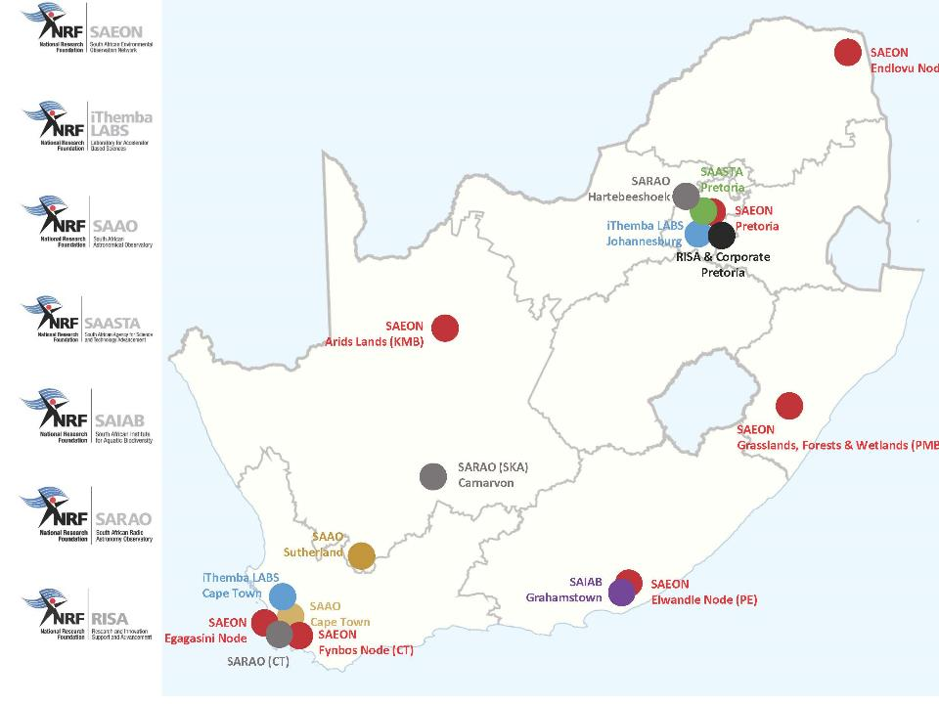

Slide 7
Advancing Knowledge – Performance Overview 2018/19
SUPPORTING AND PROMOTING RESEARCH
RESEARCHER SUPPORT
NRF-RATED RESEARCHERS
PRODUCTIVITY
19 637
Researchers in the system
4 708
Researchers Funded
3 963
Researchers rated
9 159
Publications by NRF-funded researchers
Female
Female
Red border denotes targets not met
Black
Black

Slide 8
Advancing Knowledge - Investment in Knowledge Areas
INVESTMENT 2018/19
R2.32bn

Slide 9
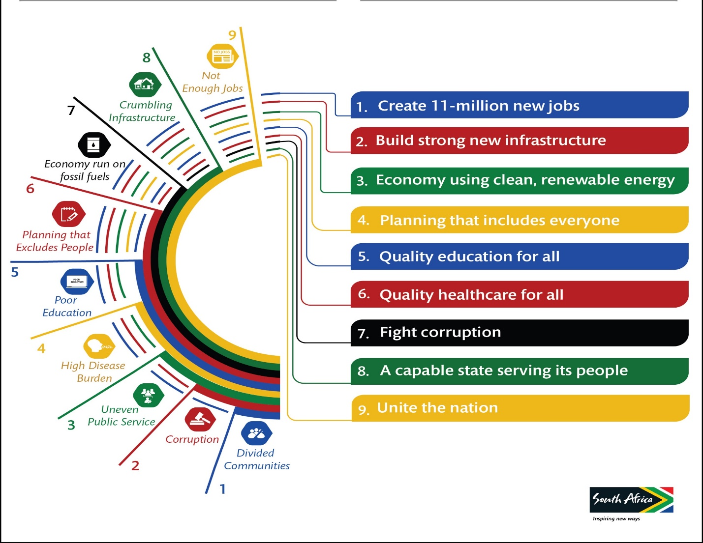

Advancing Knowledge – National and Global Alignment

Slide 10
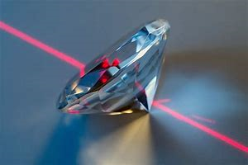


Advancing Knowledge - Research in Health
Strong Materials has developed a diamond sensor for radiography measurements for mammography, thereby increasing the efficiency and effectiveness of such testing for women.
TB Screening Kit developed for Tuberculosis Research enables faster and cheaper diagnosis.
The development of an Antibody (CAP256-VRC26.25.LS ) which neutralizes HIV-1, and represents a significant forward stride in combating the AIDS Pandemic.

Slide 11
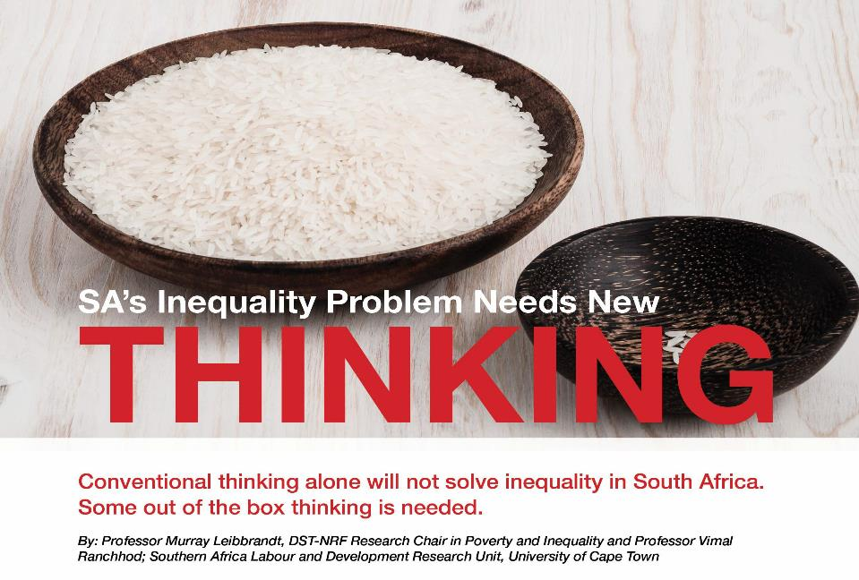
Advancing Knowledge - Research in Poverty and Inequality

Slide 12
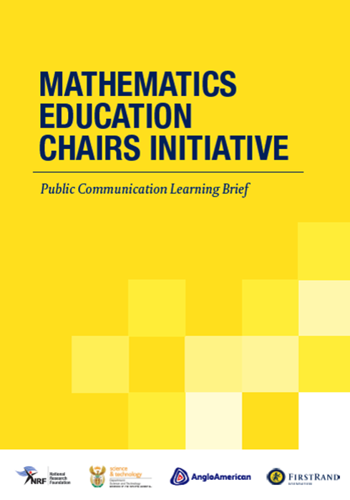
Advancing Knowledge – Research in Education
Community of Practice in Mathematics Education
MECI objectives:
  Training and development of teachers
  Improve mathematics results
  Research sustainable & practical solutions
  Provide leadership on mathematics education
Universities: Pretoria; Nelson Mandela; Rhodes, Western Cape and Witwatersrand
Partnership with First Rand Foundation and Department of Basic Education
Notes:
ISULabaNtu seeks to support communities by strengthening their capacity to guide urban development themselves.
With a focus on Durban Metropolitan Area, South Africa, ISULabaNtu is undertaking research, capacity building and community mapping, in collaboration with residents, to feed into the creation of an integrated environmental and construction management toolkit.

Slide 13
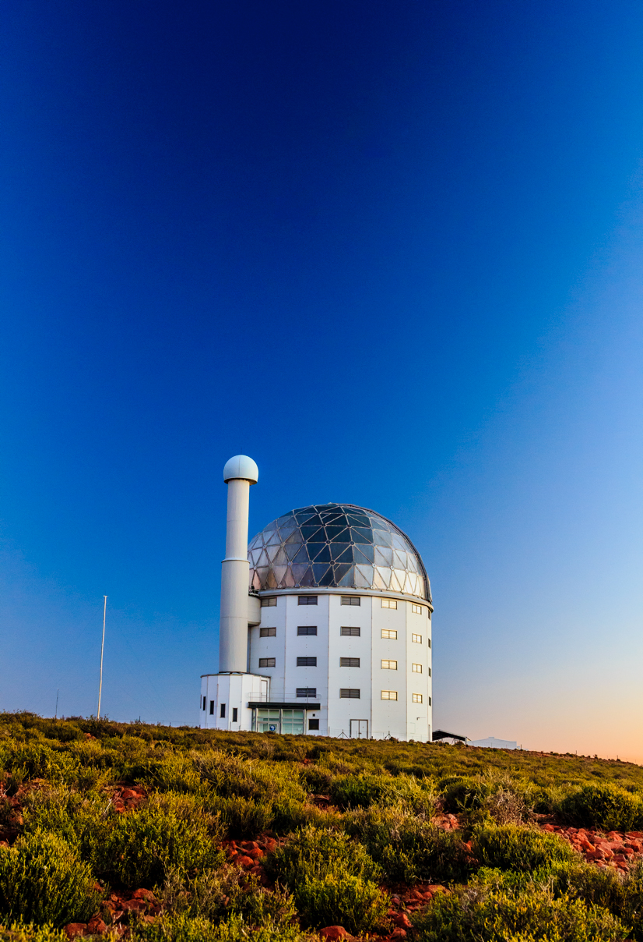

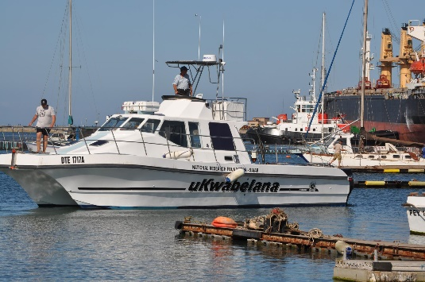
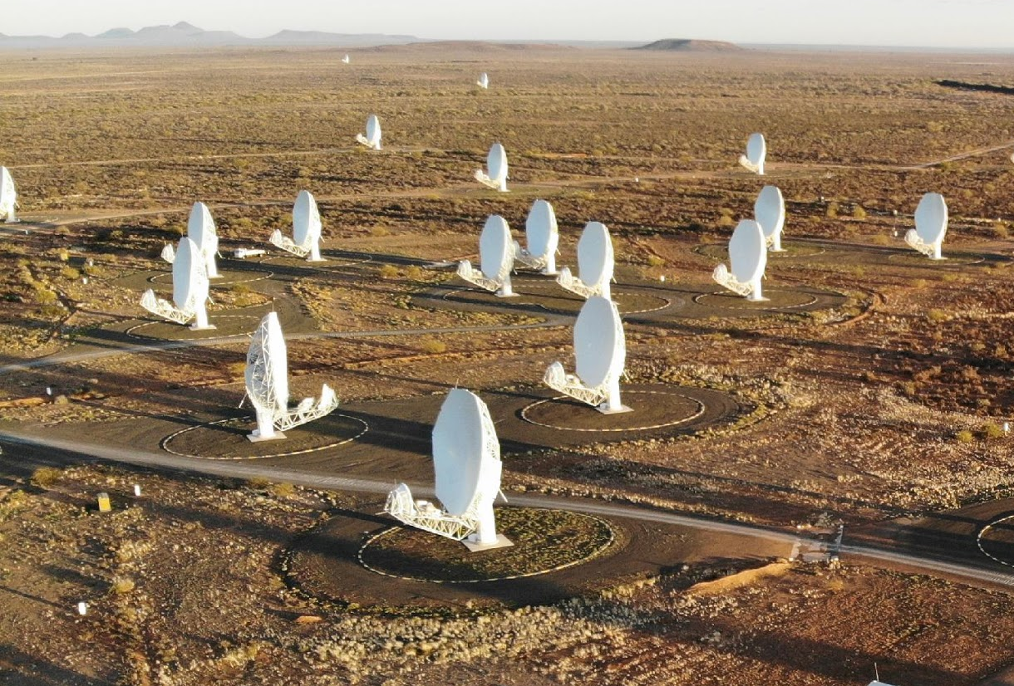


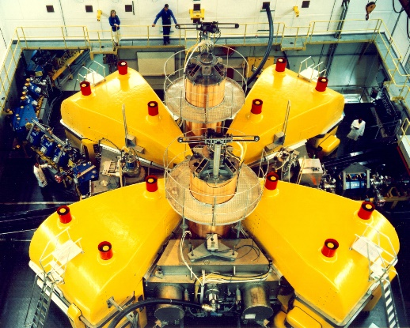


Advancing Knowledge - National Research Facilities
Research Infrastructure provision
Undertake research
Human capacity development
Science Engagement

Slide 14
Advancing Knowledge - National Research Facilities Performance Overview 2018/19
NATIONAL RESEARCH FACILITIES
298
Postgraduate students
1 327
Users
567
Publications
69 Joint international Agreements
Citation Impact* 1.48
*Normalised Citation Impact. A ratio of 1 is considered the global standard
Red border denotes targets not met

Slide 15
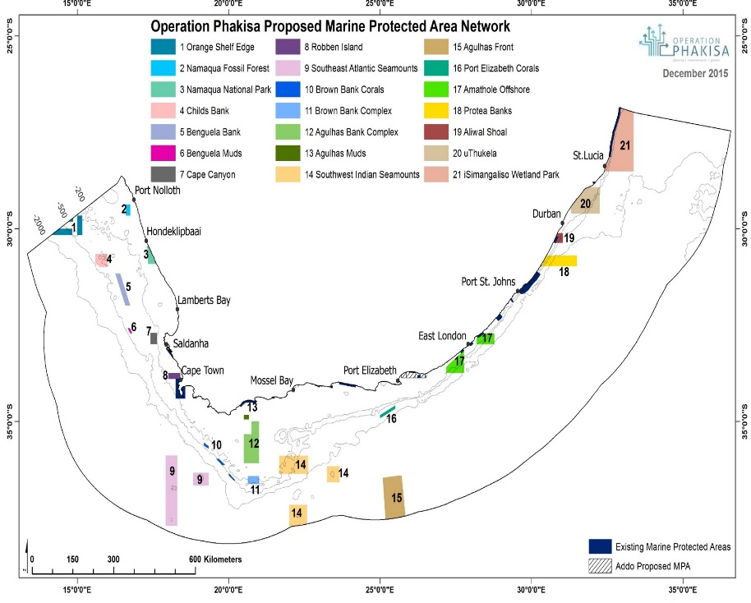
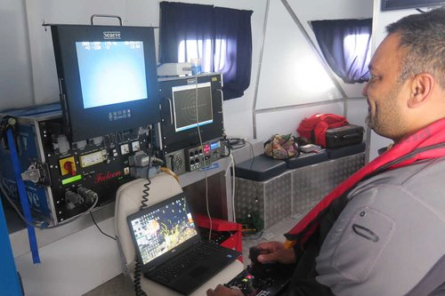
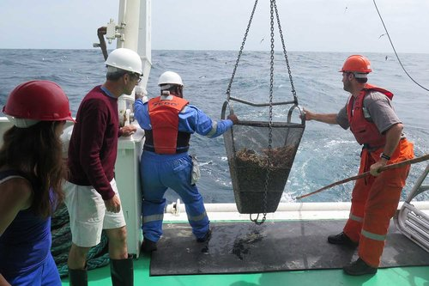
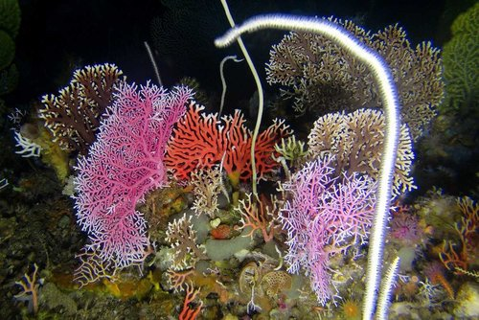
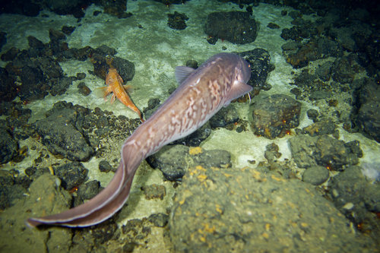
Advancing Knowledge- Environmental Sciences
Marine Research Supporting Sustainable Development
Southern African
Large Telescope (SALT)
Map showing new Phakisa Marine Protected areas. Those circled in red are the ones in which ACEP supported research has taken place, contributing to the science behind their placement and size.

Slide 16
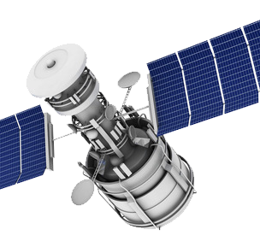
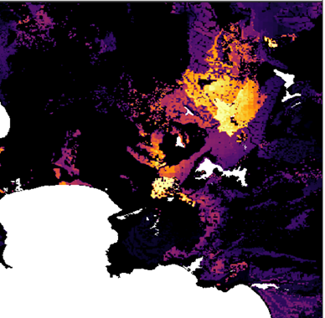
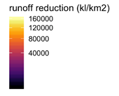
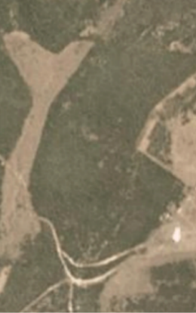
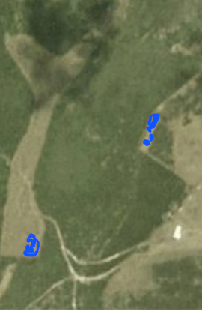
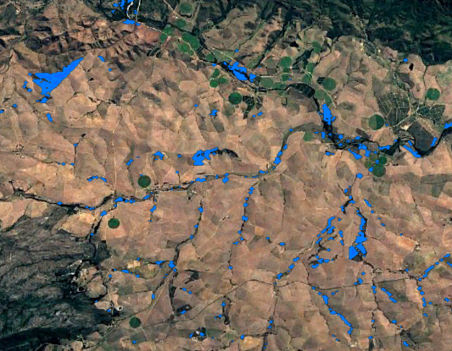
Knowledge Advancement - Environmental Science
Application of Remote Sensing Technology for decision support
Significant finding: water losses to invasive plants are enough to supply Cape Town for between 15 and 40 days.
Automated change detection for rapid law enforcement.
Illegal ploughing, Eastern Cape (left) & Western Cape (right)
Notes:
General text:
- SAEON is using satellite remote sensing to scale up findings from in situ observations to landscape, province and national scales
- These efforts are being packaged into tools for use by government and conservation agencies (National, Provincial and Local) to aid natural resource management, water management and biodiversity conservation
- Existing initiatives include
- mapping invasive species in Strategic Water Source Areas and estimating their impact on water delivery
- mapping the remaining extent of threatened ecosystems and species
- using algorithms to assess daily or weekly satellite imagery for change, alerting enforcement agencies of potentially illegal vegetation clearing, or conservation and other agencies of impacts like invasion by alien plant species or the impacts of drought
several MSc and PhD students are being trained as part of these initiatives, in addition to several broader outreach events
In this slide:
The top-right image shows the prize awarded to the project by the United Nations Global Pulse “Data for Climate Action Competition” (www.dataforclimateaction.org) at the COP23 in Bonn, Germany.
Top-left image shows the reduction of water run-off due to invasive species and thus indicating where clearing efforts should be concentrated.
The two images below-left show a small ploughing event detected in the Thicket Biome. Rates of ecosystem loss to illegal ploughing are exceedingly high in this biome.
The blue patches on the image on the bottom right show the extent of Overberg Ruens Renosterveld lost to ploughing over the period 2016-2019. There is likely to be less than 5% of this ecosystem left and rates of loss are still high. DEA&DP are hoping to use our change detection tool to catch offenders and avoid this being one of the first global cases of an entire ecosystem going extinct.

Slide 17

Advancing Knowledge – Optical Astronomy
Southern African
Large Telescope (SALT)
SALT observation of a small white dwarf star (left) cannibalising a Sun-like
companion star (right) very rapidly improves our understanding of the
different ways stars die.

Slide 18
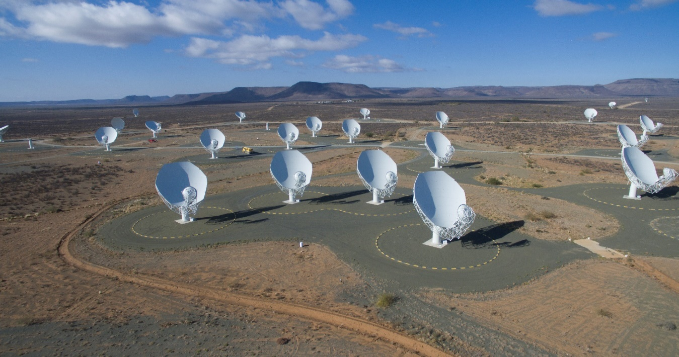
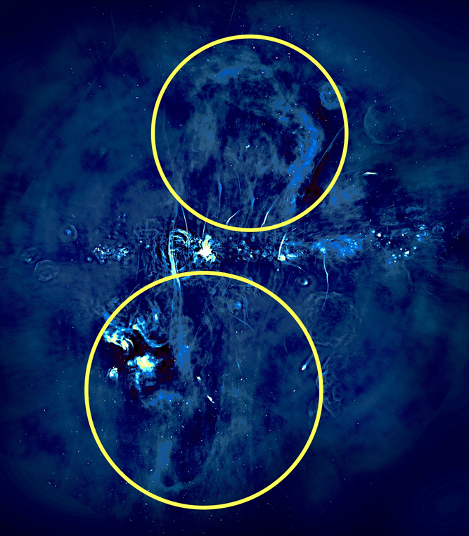
Advancing Knowledge – Radio Astronomy
Southern African
Large Telescope (SALT)
A pair of towering balloon-like structures
have been discovered at the heart of our home galaxy the Milky Way using the MeerKAT telescope.
The discovery improves our understanding of the evolution of galaxies.

Slide 19
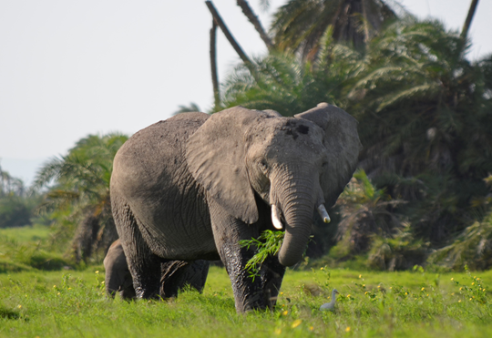
Advancing Knowledge - Radiation Biophysics
Why do elephants develop less cancer than humans?
Evolution has fine-tuned elephants to make them cancer resistant
Southern African
Large Telescope (SALT)
Elephants: More than 20 anti-cancer genes
Humans: Only 1 anti-cancer gene
Blood samples of African elephants are exposed to radiation at iThemba LABS and the effects are compared to human samples
Ultimate goal: Design a drug that duplicates the effect of the anti-cancer gene to prevent and treat human cancer

Slide 20
Advancing Knowledge – Research Equipment
EQUIPMENT GRANTS
2 996
Users of equipment
682
Publications emanating from use of equipment
Red border denotes targets not met

Slide 21
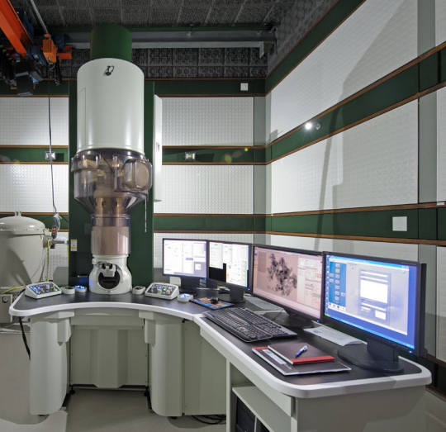
Advancing Knowledge - Research Infrastructure
CHRTEM assisted Sasol in improving their understanding of the crystal structure and catalytic activity of chemicals by applying advanced electron microscopy and these investigations can only be performed at the CHRTEM at NMU as it houses the only such instrument in Africa.
CHRTEM assists Eskom in areas that support the power generation industry and the focus is on the high temperature behaviour of engineering materials with emphasis on materials that are exposed to high temperature and high stress conditions in coal fired power plants.

Slide 22
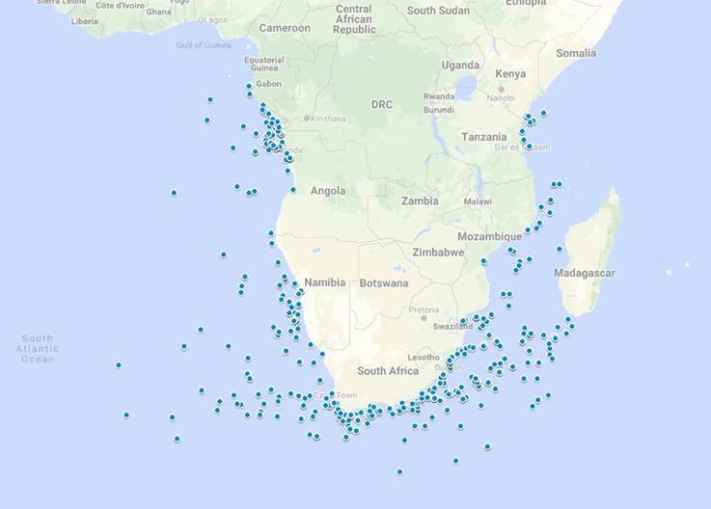

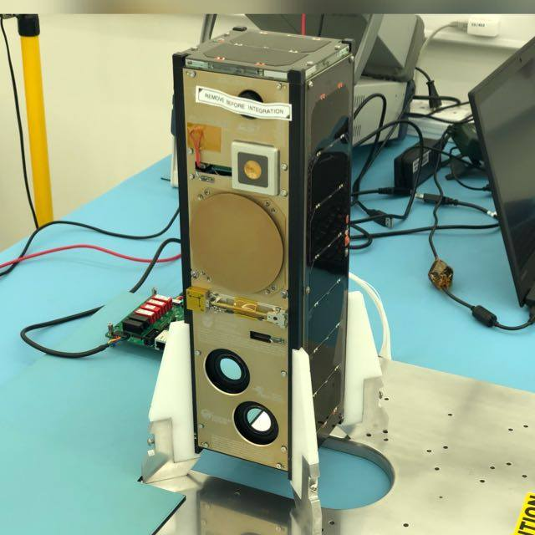
Advancing Knowledge - Research Infrastructure
First satellite data on surveillance of ships along the shoreline
Cube Satellite developed at the Cape Peninsula University of Technology

Slide 23
Transforming lives - PG Students Landscape
Proportion of NRF funded students to national registrations
32 495
1 127
67 224
4 730
Honours
3.5% to 7.0%
26 442
1 929
59 153
5 435
Masters
7.2% to 9.2%
5 492
755
22 572
3 519
Doctoral
13.7% to 15.6%
1998
2017
LEGEND
National registrations
NRF supported
Notes:
Indicate that it is all masters Proportion of

Slide 24
Transforming Lives – Profile of Post-graduate student cohort
BLACK REPRESENTATION
FEMALE REPRESENTATION

Slide 25
Transforming Lives – Trend Profile of Researcher Cohort
BLACK REPRESENTATION
FEMALE REPRESENTATION
19%
0.03%
Legend: The Percentages in the arrows represents:
% growth on 2011 baseline
Average % growth for last two years
2018/19 is the 2018 academic year

Slide 26
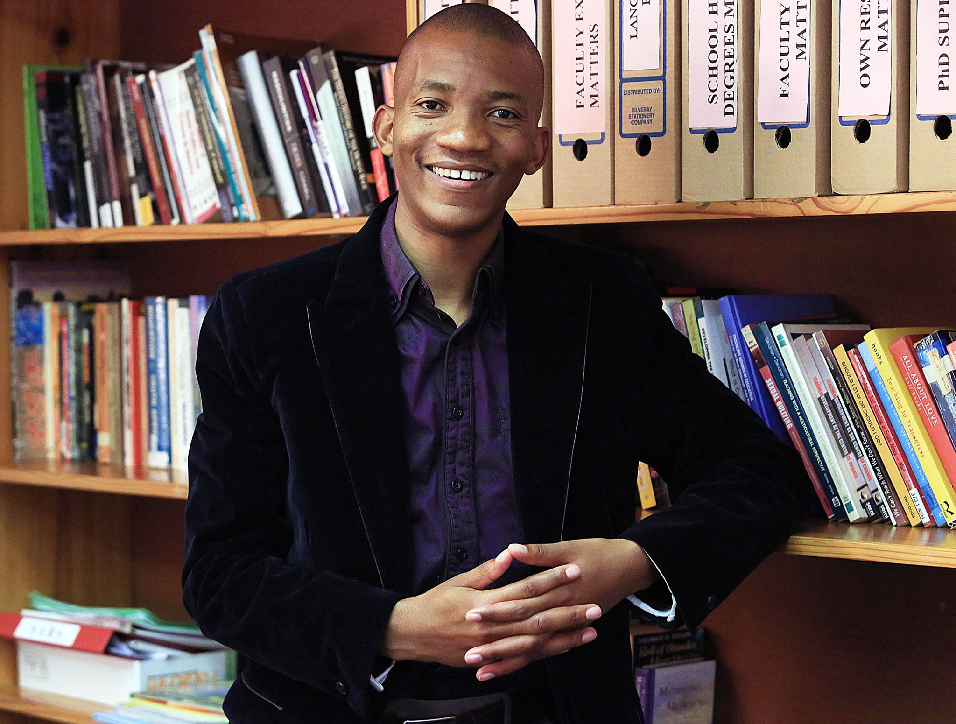
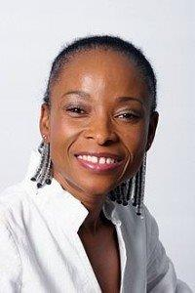
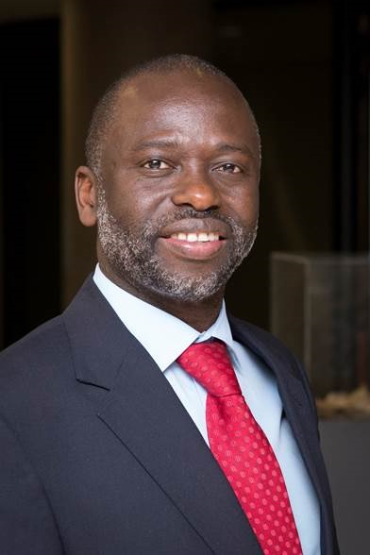
Transforming Lives : Impact of human capacity development
Prof M. Phakeng
Vice Chancellor: UCT
Prof T. Marwala
Vice Chancellor: UJ
Prof T. Msibi
Dean: Education UKZN
NRF Funding – PhD 2009
P- Rating 2019
NRF Funding - PhD 1998
Thuthuka Grant 2003
B1 Rating 2018
Winner Science Olympiad 1989
Masters Scholarship 1996
P-Rating 2003
THRIP Grant 2005
SARChI – Chair 2006

Slide 27
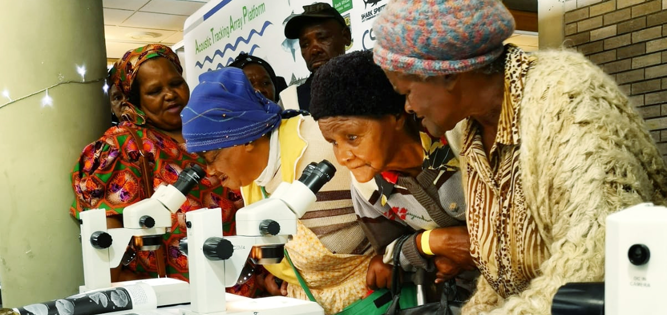
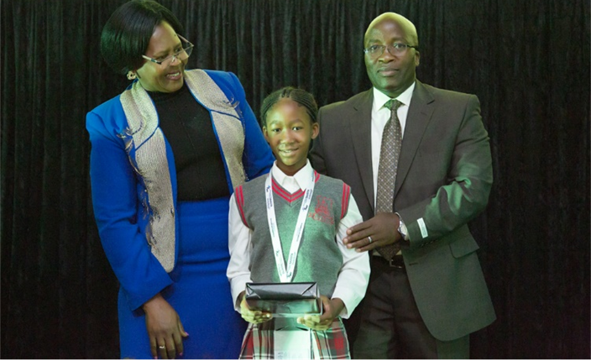
Inspiring a Nation - Science Engagement
Advancing public awareness, appreciation of and engagement with science, technology, engineering, mathematics and innovation in South Africa.
SciFest 2019 – Makhanda
Malebo Debele, Nelson Ngobeni Primary School, Mpumalanga, Top Grade Learner Junior Natural Science Olympiad

Slide 28
Inspiring a Nation -Science Engagement
Performance Overview 2018/19
NRF REACH IN SCIENCE ENGAGEMENT
1 243 876
Public
168 901
Learners
3 372
Educators
Red border denotes targets not met

Slide 29
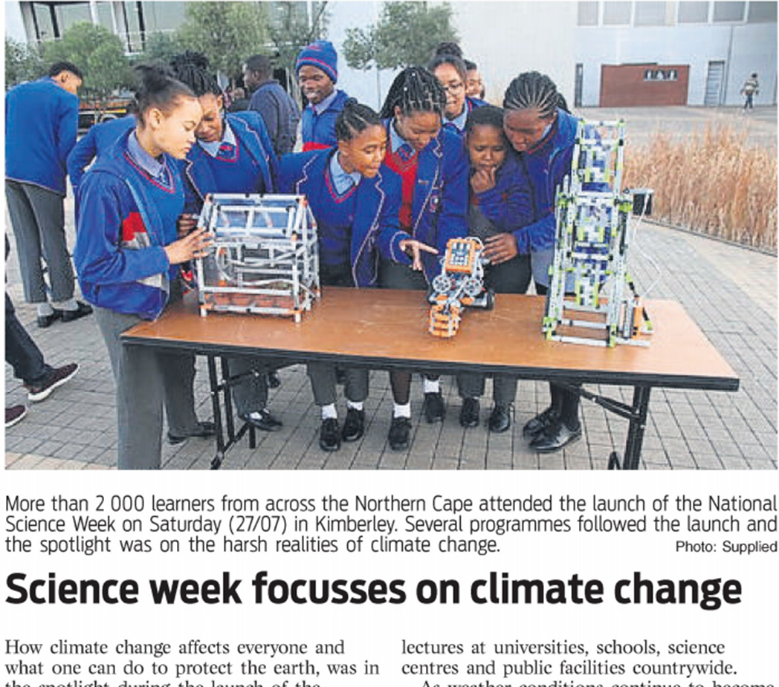
Inspiring A Nation- Science In The Media

Slide 30
Inspiring a Nation - Previous Science Olympiad Winners
1985
1980
1999
1980
Dr Nokuthula Balfour
Head of Health – Minerals Council South Africa
Mr Mteto Nyati
Chief Executive - Altron
Mr Andile Ncontsa
CEO – Litha Communications
Dr Christina Busisiwe Vilakazi
Senior Researcher – (CSIR)

Slide 31
Corporate – Performance Overview 2018/19
Multimedia Coverage
NRF Business Intelligence Systems
130
Number of media items
150
Number of internal and external users
Senior, Technical and Managerial Positions
Operational Efficiency
7.5% (<10%)
Organisational Overheads
2.5% (<3%)
Corporate Overheads
Female
Black
Red border denotes targets not met

Slide 32







Strengthening the NSI - Strategic Partnerships (international)
The Science Granting Councils Initiative is a multi-funder initiative that aims to strengthen the capacities of 15 science granting councils in Sub-Saharan Africa

Slide 33
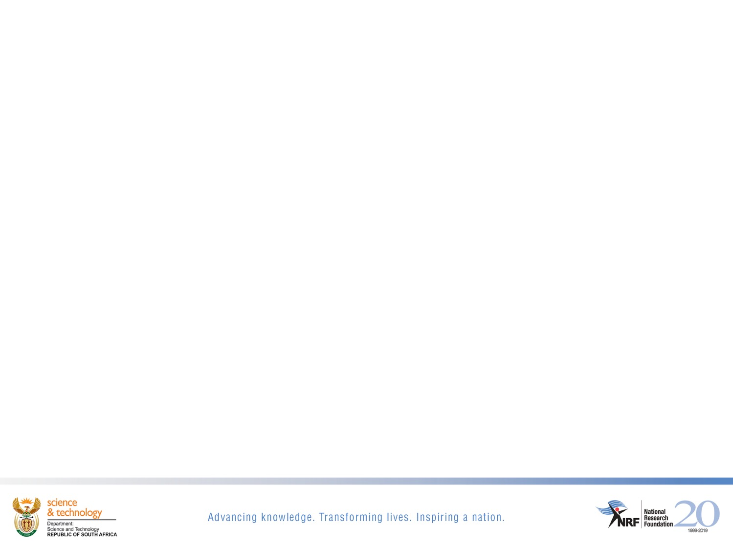











Strengthening the NSI - Strategic Partnerships (Local)

Slide 34
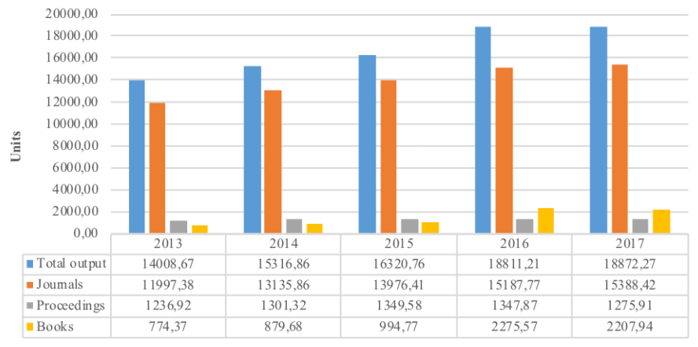
Strengthening the NSI – System wide business intelligence
Developed Research Output Submission System (ROSS) on behalf of the DHET.
ROSS enabled identification and elimination of inaccurate claims to the value of 77 units (R8.5mil) in 2017 and 168 units in 2018 (R18.4mil) due as research output subsidies to universities

Slide 35
Financial Overview - Income
Total income decreased in nominal terms by 13% equating to a decline of 8.6% in real terms.
PG decreased marginally in nominal terms by 2.3% as a result of NZG transferred to SANBI (effective 01 April 2018).
DST Contract funding increased by 9% from the additional funding for NEP.
Other contract income decreased significantly by 62% in nominal terms.
Other income decreased as a result of the exclusion of the NZG by 17%.
R4.116bn

Slide 36
Financial Overview - Expenditure
Operating expenditure as a % of total expenditure (excl. grants)
53%
(<45%)
Salaries as a % of total expenditure
17%
(<22%)
Salaries as a % of total expenditure (excl. grants)
46%
(<55%)

Slide 37
Future Plans - NRF Strategy 2030
Accelerate transformation
Increase influence and impact
Enhance excellence
Assure sustainability
Revised Vision and Mission and new Organising Framework
    People;
    The knowledge enterprise;
    Research infrastructure and technology development;
    The relationship between science & society;
    The organisation we want to be; and
    Resourcing.

Slide 38
Future Plans - New Post Graduate Funding Policy
The objective of this policy is to enhance equity of access, success and throughput, through funding.
Funding to cover full cost of study (FCS);
Facilitate retention of exceptional achievers;
Allow for funding without interruption for postgraduate degrees completed within regulation time;
Encourage higher participation in postgraduate studies, by ensuring that NRF bursary values for partial cost of study (PCS) cover at least tuition and accommodation costs.
Contribute to a reduction in the time to completion, whilst being sensitive to discipline and societal specific norms.
2

Slide 39
Future Plans - New Programme For Exceptional ECRS
The objective of the ECRS programme is to transform the equity profile of South Africa’s LIRS.
A new interconnected, scalable ECRS programme is proposed and anchored on a sustainable partnership model comprising:
  An individual recipient;
  Host universities and/or research institutions; and
  The NRF as a funder and owner of the programme and possibly other resourcing partners.
The ECRS programme intends taking in cohorts of fellows for up to 20 years with fellowship support of up to 15 years, making it a long term intervention.

Slide 40
Future Plans - Development of a Research Agenda
NRF research agenda will
provide the common thread to tie together and integrate all of the organization’s mandated activities;
enable the organization to think, plan, and act for impact by design;
provide a mechanism to give expression to the Strategy 2030 anchors of Transformation, Impact, Excellence & Sustainability;
position the organization to convey coherent evidenced-based impact stories; and
serve as catalyst for transformation of the knowledge enterprise.
Notes:
In order to pursue these goals you need a strategic framework, best served by development and adoption of a research agenda.

Slide 41




Enkosi, Thank you,
Re a leboga, Siyabonga, Dankie

