Slide 1
Department of Higher Education and Training
Annual Report 2018/19
Presentation to the Select Committee on Education and Technology, Sports, Arts and Culture
09 October 2019

Slide 2
Presentation Outline
Strategic Overview
Programme Performance on Predetermined Objectives
Achievements
Reasons for non achievement
Financial Information
A brief summary of each report
A summary of the Financial Statements
The Action Plan to improve audit findings
The impact of the 2018/19 financial outcome on Departmental operations

Slide 3
Strategic Overview
For the financial year ending 31 March 2019, the Department had committed in its Annual Performance Plan to:
Facilitate implementation of the steering mechanisms that the Department has been developing over the five year Strategic Plan period
undertake various interventions to address the challenges of the PSET system
This Annual Report reflects the work of the Department on its oversight of programme implementation during the 2018/19 financial year
The focus of oversight was mainly on:
the utilisation of funds at an institutional level, identifying challenges and areas that need improvement and/or intervention
Teaching and learning support
Institutional governance
Infrastructure development and maintenance

Slide 4
Strategic Overview
Various oversight reports have been produced as planned
On the financial health of our institutions
Universities are required to submit Annual reports (by July each year) in terms of the Reporting Regulations published under the Higher Education Act.
As we interrogate the reports, the critical aspect of the analysis is the financial health of the system against a set of indicators.
The purpose is to identify institutions requiring support or intervention.
The annual financial heath report provides insight into the financing and sustainability of institutions and the sector

Slide 5
Strategic Overview
On Infrastructure development and maintenance
With regard to universities
A grant on infrastructure and efficiency was introduced in 2007/08
Allocation is in 3 year funding cycles to support infrastructure development plans.
Utilization of funds is monitored and progress with respect to infrastructure development of the system is assessed and reported annually
With regard to TVET colleges
A new infrastructure grant has been introduced
The roll-out plan for the construction of new college campuses is being implemented in various provinces
The maintenance of infrastructure at colleges is managed in terms of costed maintenance plans

Slide 6
Strategic Overview
Annually the Department evaluates research outputs of universities against the research outputs policy.
The implementation of the policy has resulted in improvements year-on-year with respect to the quantity of research outputs.
The focus going forward will be on improving the processes of evaluation and the quality of outputs.
Transformation
As part of the staffing South Africa's Universities’ Framework, the Department is implementing a comprehensive programme to transform and develop university staff
We report annually on progress, development and challenges.

Slide 7
Strategic Overview
In total, there were 110 targets in 2018/19 financial year:
75 were the direct outputs of the Department, of which 95%(71) have been achieved
The 3 of the 4 targets that were not achieved are in Programme 1 and the other in Programme 3
35 were system outputs - relating to access, success, transformation and other systemic areas of strategic interest to the Department. Only 46%(16) of the system targets have been achieved
Overall, 79% (87) of the 110 targets have been achieved

Slide 8
Strategic Overview
2017/18 and 2018/19 financial year comparison: DHET Direct Outputs
Performance has been consistent over the past two financial years
There has been a marginal improvement in 2018/19

Slide 9
Strategic Overview
2017/18 and 2018/19 financial year comparisons: System Outputs
The performance of the system has not been consistent over the past two financial years
There has been a drop in performance in 2018/19 financial year on a considerable number of indicators

Slide 10
Strategic Overview
The following slides reflect actual performance at Programme Level
There are six Budget Programmes categorized as follows:
Core Delivery Programmes
Programme 3: University Education
Programme 4: Technical and Vocational Education and Training
Programme 5: Skills Development
Programme 6: Community Education and Training
Support Programmes:
Programme1: Administration
Programme 2: Planning, Policy and Strategy

Slide 11
Programme 3 - University Education
The purpose of the programme is to develop and coordinate policy and regulatory frameworks for an effective and efficient university education system and it provides financial support to universities, the National Student Financial Aid Scheme and National Institutes for Higher Education
Over the five year Strategic Plan a number of steering mechanism have been developed.
The focus of the Branch in 2018/19 was on implementation and oversight, monitoring and evaluation of the programmes that are in place
There were 15 planned outputs for the financial year ending 31 March 2019
These were in the form of oversight reports on various programmes.

Slide 12
Programme 3 - University Education
Performance against planned outputs/targets
Of the 15 planned outputs, 14 (93%) oversight reports were produced as follows:
Higher Education AIDS programme
Financial health of universities
The use of Foundation Provision Grant
Teaching Development Grant
Teaching and learning development capacity improvement programme
Research Development Grant

Slide 13
Programme 3 - University Education
Performance against planned outputs/targets…cnt
Research outputs
Infrastructure and Efficiency Grant
New universities earmarked grant
(10) Ministerial enrolment targets
(11) Institutional governance
(12) Staffing South Africa’s Universities’ Framework
(13) Compliance of PHEIs with the regulations
(14) BRICS partnerships and
(15) Student leadership capacity development programme.

Slide 14
Programme 3 - University Education
The output that was not achieved is a report on the 2017 research outputs of 26 universities approved and published on the Departmental website by 31March 2019
Reason:
A challenge was that a report was not uploaded on the Departments website, because there had been
an earlier decision taken at the Branch strategic planning session that the target should not include the uploading of the report onto the website. However, this had not been carried through into the final APP.
Corrective Action:
In future the Branch will monitor progress towards the attainment of performance targets measured against
the approved APP and ensure that they are realised in all respects.

Slide 15
University System Performance
Of the 16 targets 8 (50%) have been achieved:
Outcome indicator | Target 2018/19 | Actual 2018/19
1. Student enrolled in public higher education institutions (n) | 1 039 500* | 1 036 984
2. Graduates in Engineering Science from universities (n) | 12 590* | 12 955
3. Graduates in Human Health and Animal Health from universities (n) | 10 630* | 10 456
Graduates in Natural and Physical Sciences from universities (n) | 8 490* | 8 601
Graduates in Initial Teacher Education from universities (n) | 22 780* | 25 113
Doctoral graduates from universities (n) | 2 965* | 3 057
7. Proportion of universities meeting standards of good governance( %) | 70%*** | 80%
8. Research Masters graduates (n) | 8 366* | 8 010
9. Success rates at Universities (%) | 78%* | 77%
10. Higher Education undergraduate success rate (contact) (%) | 83%* | 82%

Slide 16
University System Performance
Performance Indicator | Target: 2018/19 | Actual 2018/19
11. Higher Education undergraduate success rate (distance) (%) | 69%* | 67%
12. Universities accredited to offer TVET College lecturer qualifications (n) | 3**** | 5
13. University academic staff with PhDs (%) | 45%* | 46%
14. Additional first-time entrants (black and women) to the academic workforce in addition to normal replacement and plans (n) | 100 | 472
15. First year students in foundation programmes (n) | 22 200 | 21 289
16. Eligible university students obtaining financial aid | 270 000*** | 260 002
*2017 academic year
*** 2017/18 NSFAS Annual Report
**** Verified in 31 March 2019

Slide 17
Reasons for underperformance
Performance Indicator | Reasons for under performance
Students enrolled in public higher education studies at universities | Performance deviated from the target by 0.24%. This deviation is within the acceptable range of 2% of the target in terms of the Ministerial Statement
Research Masters graduate | The Ministerial target in terms of the enrolment plan had been exceeded in the 2017/18. However the target in the Ministerial Statement could not be used to set the 2018/19 target, as it would not have been acceptable to set a target lower than the previous year’s achievement in the 2017/18 financial year. Unfortunately universities did not achieve the higher target. Notwithstanding this, it should be noted that the enrolment planning target was achieved
Success rates at universities | This deviation is within the acceptable range of 2% of the target in terms of the Ministerial Statement
Higher education undergraduate success rate (distance) % | Success of students in distance education programmes has been highlighted as a problem within the system
Higher education undergraduate success rate (contact) % | This deviation is within the acceptable range of 2% of the target in terms of the Ministerial Statement
Students in foundation programme | Vaal University of Technology did not meet the conditions set for their foundation programmes and therefore their enrolments had to be excluded, resulting in a lower number than expected

Slide 18
Reasons for underperformance on university system targets
Performance Indicator | Reasons for under performance
Eligible university students obtaining financial aid | The 2017 cycle was subject to unacceptable delays that resulted in a large number of qualifying students decisions not being finalised by 31 March 2018 and therefore were not included in the 2017/18 NSFAS Annual Report and Financial statement
Graduate in Human Health and Animal from universities | A factor that may have contributed to underperformance is that the Bachelor of Veterinary Sciences was re-curriculated from a 3 year to a 4 year degree which impacted on graduate outputs for a year.

Slide 19
Programme 4 - TVET
The purpose of the programme is to plan, develop, implement, monitor, maintain and evaluate national policy, programmes, assessment practices and systems.
The focus of the branch during the year under review was on oversight monitoring of the TVET colleges system in relation to:
TVET college infrastructure development and maintenance
Teaching and learning support
TVET college sector performance
The branch had 25 planned outputs for the 2018/19 financial year. All have been achieved.

Slide 20
Performance on Infrastructure development
Challenge:
Poor condition of TVET facilities related to repair and maintenance
Increased access required for students
2018/19 Allocation: R1.3 Billion
The allocation of the first tranche (April 2018) to colleges consisted of a conditional allocation of 35% advance (dedicated bank accounts) amounting to R9.1 million per TVET college
The allocation of the balance of the tranches for 2018 was made on the basis of “as is condition assessments” to priority areas:
Bulk Services; Statutory Compliance; Sanitation; Building repairs; and Student Accommodation repairs
The allocation for the next 2 years of the MTEF was to be based on the condition assessment which is about to commence at TVET colleges
Achievements:
Oversight reports on the following have been produced:
Progress on the roll-out plan for the construction of the 9 new campuses
Functioning of the already built new campuses
Infrastructure maintenance

Slide 21
Progress on the construction of the
Nine (9) TVET college campuses
 | CURRENT NINE (9) SITES UNDER CONSTRUCTION |  | CONTRACT VALUE | CONTRACT EXPENDITURE Incl. Retention | % COMPLETION | ANTICIPATED COMPLETION DATES | EMPLOYMENT OF LOCAL LABOUR F= Female M= Male
 |  |  | R` 000 | R`000
 | NEW CONSTRUCTION | REFURISHMENT |  |  |  |  | F + M
1 | Graaff Reinet |  | 108 111 | 72 904 | 85 | 20 February 2020 | 13 + 85
2 | Aliwal North |  | 116 928 | 68 565 | 50 | 20 February 2020 | 23 + 53
3 | Sterkspruit |  | 153 383 | 85 749 | 60 | 30 April 2020 | 20 + 120
4 | Ngqungqushe |  | 156 217 | 58 104 | 36 | 03 October 2019 | 15 + 62
5 | Msinga |  | 130 304 | 76 475 | 70 | 15 November 2019 | 31 + 94
6 | Greytown |  | 113 648 | 72 904 | 85 | 31 December 2019 | 4 + 12
7 | Umzimkhulu |  | 105 921 | 73 602 | 72 | 30 May 2020 | 14 + 90
8 |  | Nongoma | 125 872 | 43 345 | 37 | 20 February 2020 | 20 + 138
9 |  | Kwaqikazi | 113 648 | 20 050 | 22 | 17 February 200 | 10 + 15
 |  |  |  |  |  | TOTAL (F +M) | 150 + 669
 |  |  |  |  |  | GRAND TOTAL(Incl.) | 819
1 124 032
571 698
50%

Slide 22
CHALLEGES & REMEDIAL ACTIONS
NO. | Sites | Challenges/Issues* | Remedial action
1. | Graaff Reinet | No challenges at this stage.
2. | Aliwal North | No challenges at this stage.
3. | Sterkspruit | Obstruction of road by illegal housing and waste water spillages from private septic tanks. | The Department political liaison to engage the municipality to solve the problem, as it is expatiated to trigger health and environmental issues. The engagement with the Municipality is ongoing.
4. | Ngqungqushe | No challenges at this stage.
5 | Msinga | No challenges at this stage.
6. | Greytown | No challenges at this stage.
7. | Umzimkhulu | Site Shutdown by Harry Gwala Business forum on the 29 August 2019 | The Contractor to increase security on site. The Department political liaison is contacts with the forum and the stakeholders to defuse the situation.
8. | Nongoma | No challenges at this stage.
9. | Kwagqikazi | No challenges at this stage.

Slide 23
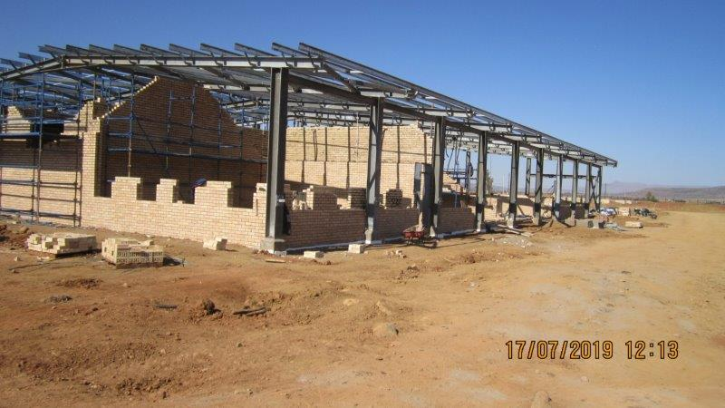
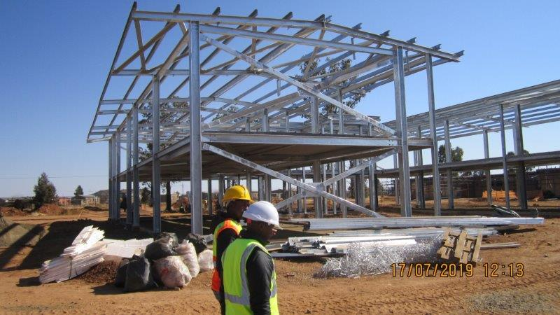
ALIWAL NORTH SITE

Slide 24
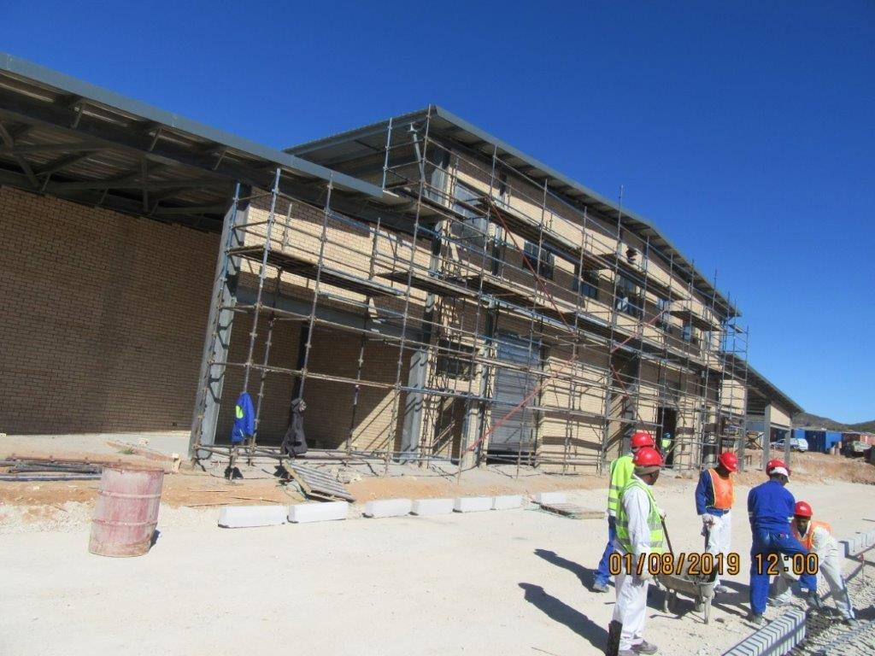
GRAAFF-REINET SITE

Slide 25
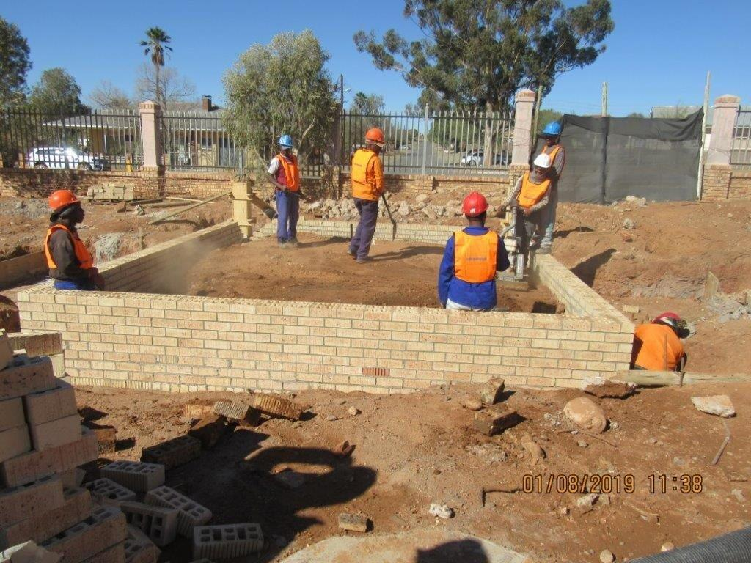
GRAAFF-REINET

Slide 26
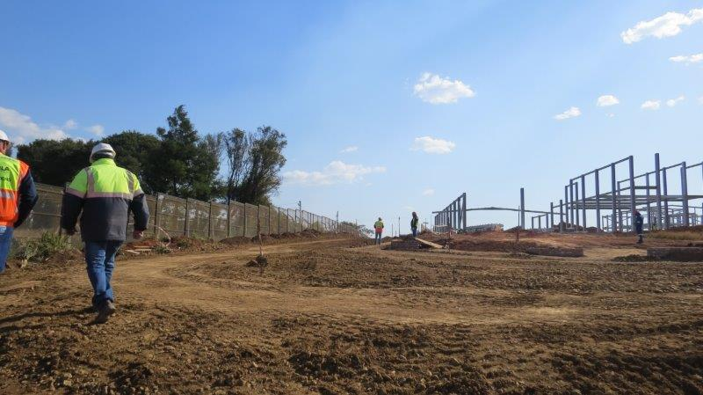
NGQUNGQUSHE SITE

Slide 27
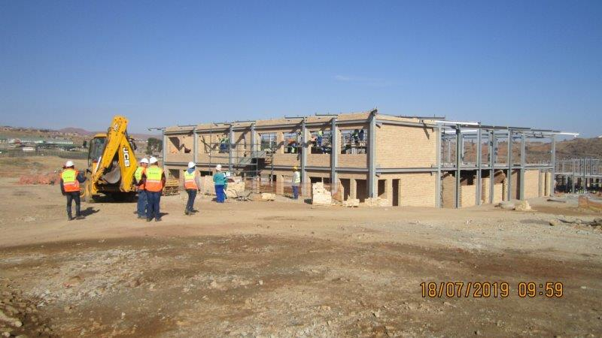
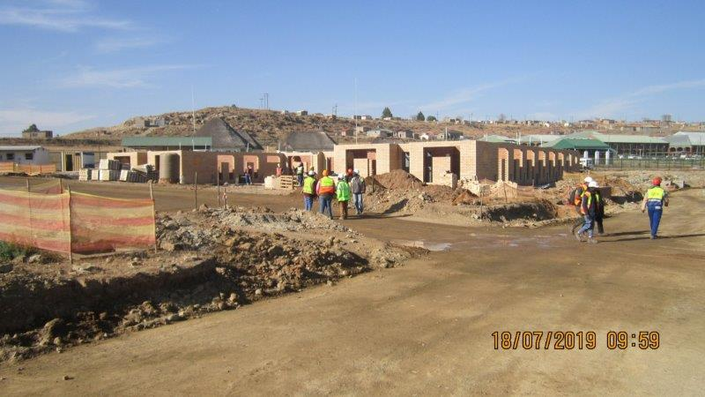
STERKSPRUIT SITE

Slide 28
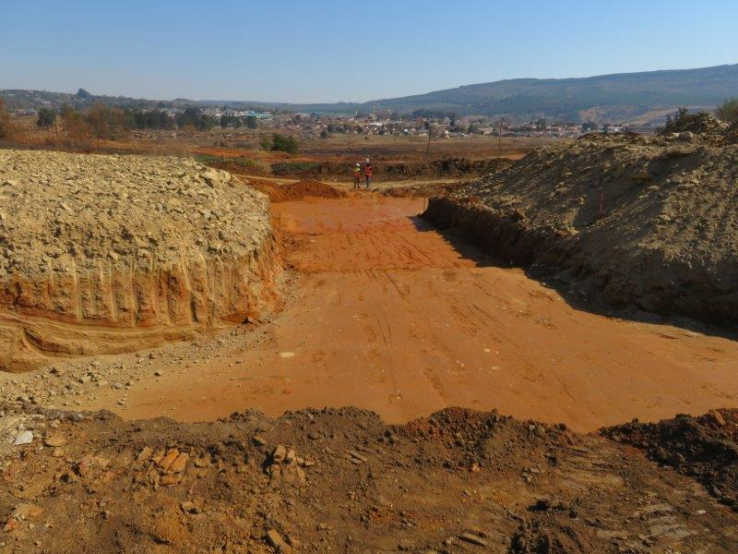
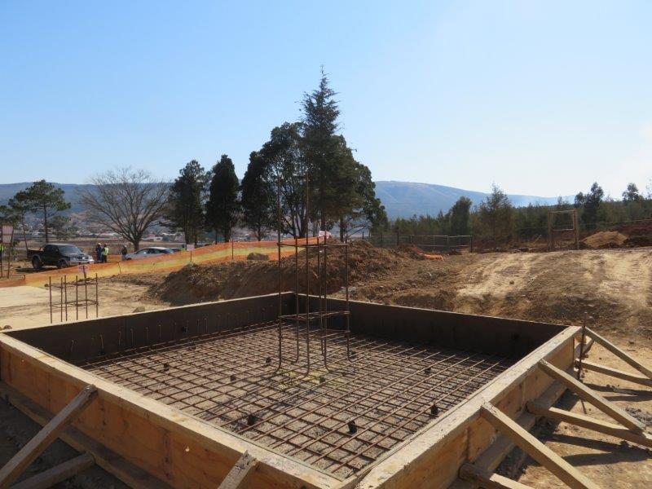
GREYTOWN SITE

Slide 29
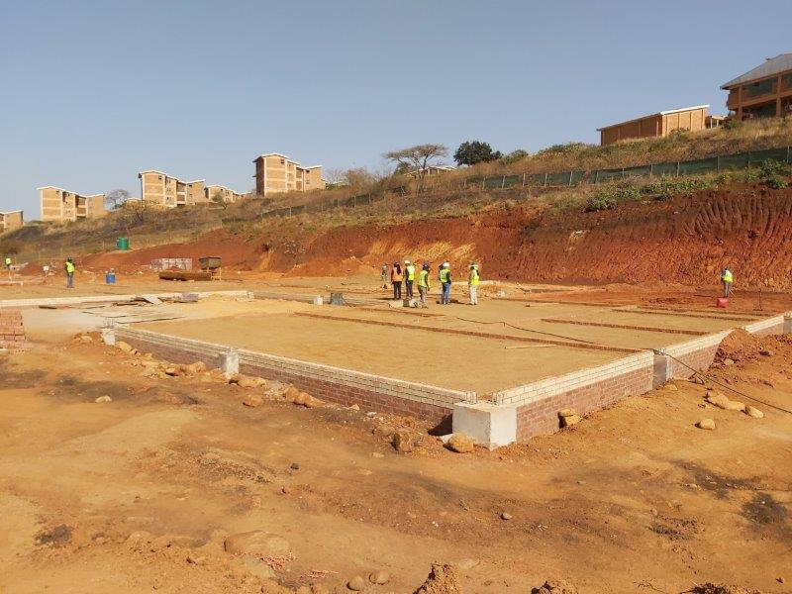
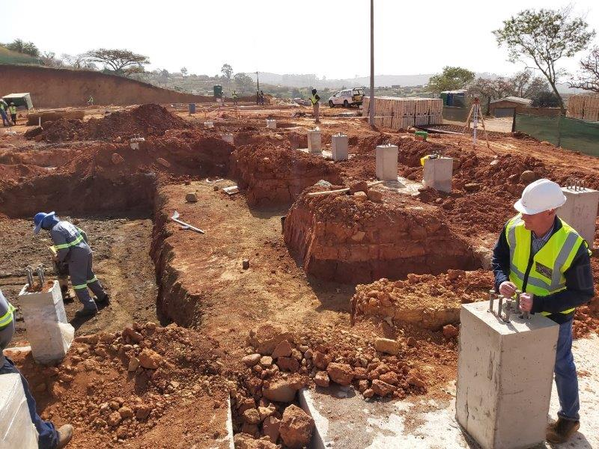
KWAGQIKAZI SITE

Slide 30
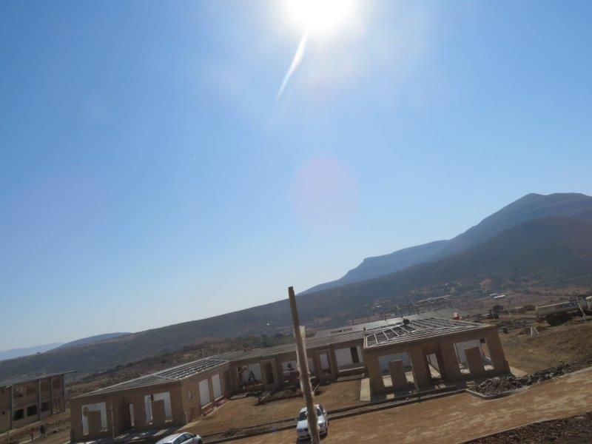
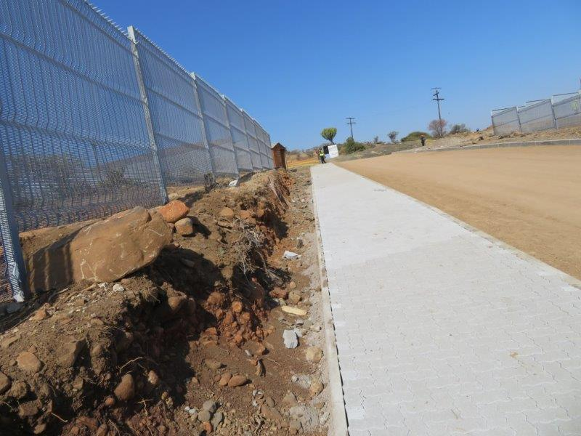
MSINGA SITE

Slide 31
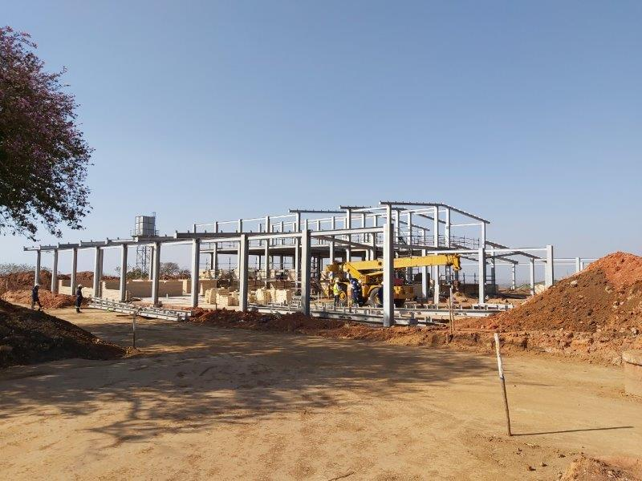
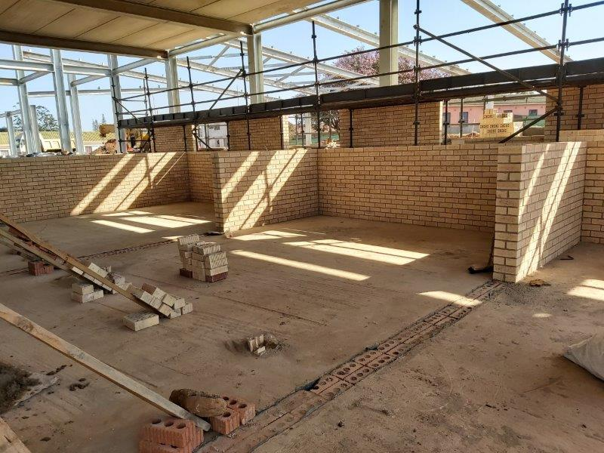
NONGOMA SITE

Slide 32
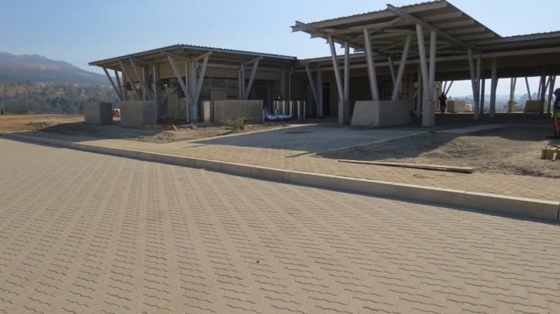
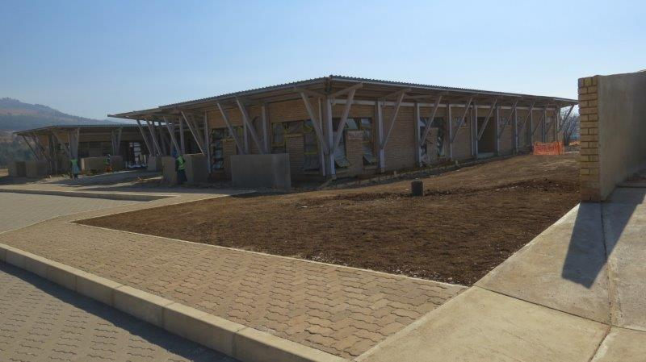
UMZIMKHULU SITE

Slide 33
Performance on Institutional Support
Challenges:
TVET data system compatibility between TVETMIS and institutions which impacts on the collection, generation and provision of quality and reliable data through directives
Various sources of performance data, need for a single framework / model.
Measurement of College Council performance
Various oversight reports have been produced as planned:
Governance of TVET colleges
Conduct of public TVET College examination centres during national examinations and assessments (Quarterly)
Eradication of certification backlog (Quarterly)
Monitoring and evaluation reports on TVET Colleges
Implementation of strategic partnerships
Implementation of IT examination system

Slide 34
Performance on Programmes and Qualifications
Challenges:
Poor throughput rates of NC(V) students
Disbursement of NSFAS grants
Oversight monitoring continued and reports have been produced as planned:
Academic performance of students (bi-annually)
Student support services and teaching and learning support
Throughput rate for TVET college students
Stakeholder engagement (SAIVCET)

Slide 35
Performance on TVET Examinations
Challenges:
Seven exams cycles conducted back-to-back annually
Examinations system outdated and unable to provide reliable and comprehensive reports.
Certification backlog
Exam irregularities including leakages, distribution and marking.
Oversight monitoring continued and reports have been produced as planned:
The conduct of public TVET college examination centres during national examinations and assessments
Eradication of certification backlog (Quarterly)
Functioning of the IT examination services system

Slide 36
Programme 4 - TVET
There were 11 targets in the TVET college system
3 (27%) of the targets have been achieved:
Outcome indicator | Target 2018/19 | Actual 2018/19
Headcount enrolments in TVET Colleges | 710 535 | 687 955
NC (V) L4 certification rates | 50% | 42.8%
N3 Certification rates | 66% | 76.8%
N6 certification rates | 66% | 96.1%
Certificates issued to qualifying candidates within 3 months of publication | 3 months | 4 months
Public TVET Colleges examination centres evaluated in conducting national examinations and assessments in compliance with national policy | 100% | 100%
7. Qualifying TVET students obtaining NSFAS financial assistance per annum | 449 697 | 200 339
8. NSFAS funded NC(V) L4 obtaining qualifications within stipulated time (throughput) | 50% | 31.79%
9. TVET institutions complaint to governance standards by 2019 and increasing every year thereafter | 80% | 66%
10. TVET lecturers undergoing specific hours of work in their industry for specific periods every two year from 2019 | 20% | 8.80%
11. TVET students enrolled in Foundation Programmes | 600 | 371
*2017 academic year

Slide 37
Reasons for underperformance on TVET system targets
Performance Indicator | Reasons for under performance
Headcount enrolments in TVET college | There were fewer enrolments by TVET colleges in occupationally directed programmes than anticipated. It seems colleges are not reporting accurately on occupational enrolments. This is receiving attention through data capture on the TVETMIS
NC (V) L4 certification rates | The target was set ambitiously over the five year period. Whilst year on year certification has improved, it has not reached the projected target.
Certificates issued to qualifying candidates within 3 months of publication | There was a technical error in the method of calculation. Based on “business days”, certificates were issued within 87 days which is within the 3 months target period. However based on The Technical Description for this indicator only refers to “days”, if the concept of “calendar days” is applied , it results in certificates being issued within 4 months. This technical anomaly is being corrected to avoid future re-occurrence.
Qualifying TVET students obtaining NSFAS financial assistance per annum | The NSFAS Central Bursary Management System was implemented for the first time in all TVET Colleges during 2017, which led to data integrity challenges, the late payment of tuition fees to colleges and the delayed disbursement to students. Some improvements were recorded in 2018, with further improvements already evident in 2019

Slide 38
Reasons for underperformance on TVET system targets
Performance Indicator | Reasons for under performance
Funded NC(V) L4 obtaining qualifications within stipulated time | Although the target was not achieved, significant progress regarding the throughput rate has been made. Further interventions such as Prevocational Learning Programme (PLP) should continue to improve the throughput rate
TVET institutions compliant to governance standards by 2019 and increasing every year thereafter | The Colleges are not mandated to adhere to some of the approved financial governance standards, such as policy implementation. The reason being that TVET colleges are juristic entities in their own right and therefore policy design and implementation vests with the Councils. The Department can therefore not impose policy adoption, but rather recommend the Departmentally developed policies as “best practice guidelines”.
TVET lecturers undergoing specific hours of work in their industry for specific periods every two year from 2019 | Lack of centrally-determined protocols between the industry and TVET colleges, while MoU/MoA between TVET colleges and industry do not necessarily cater for Work Integrated Learning (WIL).
TVET students enrolled in Foundation Programmes | The target was set at 65 enrolments per college. There were nine identified colleges of which one college was not ready to commence with the pilot programme in 2018.

Slide 39
Programme 5 - Skills Development
The purpose of the programme is to promote and monitor the National Skills Development Strategy, develop a skills development policy and regulatory framework for an effective skills development system
Its focus during the year under review was on:
Implementation of the National Skills Development Strategy by SETAs
Governance of SETAs
Trade testing at INDLELA
The development of a single National Artisan Development Information Management System
0

Slide 40
Programme 5 - Skills Development
Performance against planned outputs/targets
All 8 planned outputs/targets for the 2018/19 financial year were achieved as follows:
Implementation of the Revised SETA Landscape
Quarterly reports on the implementation of National Skills Development Strategy
A report on the governance of SETAs
Processing trade test applications within an average of 40 days as compared to the planned 80 days

Slide 41
Programme 5 - Skills Development
4 (67%) of 6 targets in the skills development system were achieved during the 2018/19 financial year
Performance indicator | Target 2018/19 | Achievement 2018/19
Number of work based learning opportunities | 135 000 | 182 852
Number of new artisans qualified per annum | 22 188 | 19 625
Number of new artisan learners registered nationally per annum | 28 750 | 29 982
National Artisan Learners Trade Test pass rate (including INDLELA) | 61% | 58%
National artisan learners who employed or self-employed | 75% | 77%
Proportion of SETAs meeting standards of good governance (%) | 65% | 67%
0

Slide 42
Reasons for underperformance on system targets
Performance Indicator | Reasons for under performance
New artisan leaners qualified per annum | The smaller number of learners registered during the 2015/16 financial year had an impact on throughput, as it takes three years for learners to complete their studies.
National Artisan Learners Trade Test pass rate (Including INDLELA) | The introduction of Artisan Recognition of Prior Learning (ARPL) has impacted on the pass rate at INDLELA for the trade in which ARPL was implemented. More people had to go through APRL prior to the trade test in eight specific trades but had limited impact on the average pass rate.

Slide 43
Programme 6 - CET
The purpose of the programme is to plan, develop, implement, monitor, maintain and evaluate national policy, programme assessment practices and systems for Community Education and Training
The focus for the year under review was on oversight monitoring on:
Governance
Teaching and Learning
CET college system performance
Partnership agreements
Infrastructure maintenance
The six targeted oversight reports on the above have been produced as planned

Slide 44
CET College System Performance
The target on headcount enrolment in CET colleges was not achieved.
Poor advocacy, rigid programme offerings, and unavailability of infrastructure may have contributed to the underperformance of the sector
Outcome indicator target | Target 2018/19 | Actual 2018/19
Headcount Enrolment in CET Colleges (n) | 320 000 | 193 185
Certification rate in formal CET qualifications (%) | 40% | 41.7%

Slide 45
Programme 2 - Planning, Policy and Strategy
The purpose of the programme is to provide strategic direction in the development, implementation and monitoring of Departmental policies and the human resource development strategy for South Africa
It is comprised of four sub-programmes as follows:
Policy, Planning, Monitoring and Evaluation
Social Inclusion and Equity
International Relations
Legal and legislative Services

Slide 46
Programme 2 - Planning, Policy and Strategy
Performance against planned outputs/targets
There were 11 planned outputs in 2018/19 financial year. All were achieved as planned:
Three reports have been produced to inform enrolment planning and funding within the PSET system:
Skills Supply and Demand
Statistics on PSET
Macro- Indicator Trends
Produced three oversight reports on the implementation of:
Social Inclusion in PSET
Open Learning in PSET
Career Development Services
Recognition of Prior Learning
Articulation
Produced status report on international relations, reflecting on all international bi-lateral and multi-lateral agreements and conventions
Mainstreaming of career development services

Slide 47
Programme 1 - Administration
The purpose of the programme is to provide strategic leadership, management and support services to the Department
Its focus areas in 2018/19 financial year were:
Filling of funded vacancies
Improving human resource recruitment and selection process
Management of disciplinary cases
Management of creditor payments

Slide 48
Programme 1 - Administration
Performance against targets
7 (70%) of 10 targets were achieved as follows:
The Department has been able to fill funded vacancies within 159 days against the target of 180 days
93,8% of funded vacancies were filled during 2018/19 financial year, exceeding the targeted 90%
Network connectivity uptime has been at 99.5% through out the financial year against the 95% target
Department received an unqualified audit opinion from the Auditor General as planned
Developed and implemented a remedial plan on audit findings of the previous financial year
Report on the corporate governance of ICT policy framework
ICT procurement plan for 2019/20 was developed

Slide 49
Programme 1 - Administration
3 (30%) of the 10 targets were not achieved as follows:
Resolving all disciplinary cases within 90 days
Only 78% of disciplinary cases were resolved within 90 days
Underperformance is attributed to chairpersons who do not prioritise disciplinary hearings, lack of capacity to investigate, initiate and chairing of disciplinary hearings.
Training on investigations, initiating and chairing misconduct hearings will be conducted

Slide 50
Programme 1 - Administration
Percentage of invoices received from creditors paid within 30 days
Only 97.96% of invoices were paid within 30 days
The reason is that there is no compliance by managers on the 30 days turnaround time.
Compliance will be enforced through monthly 30–day memoranda and departmental Newsflashes.

Slide 51
Programme 1 - Administration
Percentage of audit issues received versus attended to
Only 60% of audit issues were attended to against the target of 100%
The reason is that audit issues are not reported on time with the required supporting documentation.
Quality control measures will be applied through interim audit to ensure compliance with the Auditor General’s request.

Slide 52
Annual Report - Part E
Financial Information
Financial information presented in the Annual Report (Part E) comprises of the following:
The Report of the Accounting Officer
The Report of the Audit Committee
The Report of the Auditor-General to Parliament
Financial Statements (including the Appropriation Statement, Notes to the Appropriation Statement, Statements of Financial Performance, Financial Position and Changes in Net Assets as well as the Cash Flow Statement, Accounting Policies, Notes to the Annual Financial Statements and Supplementary Annexures)
The focus on this section is on the following aspects:
A brief summary of each report
A summary of the Financial Statements
The Action Plan to improve audit findings
The impact of the 2018/19 financial outcome on Departmental operations

Slide 53
Report of the Accounting Officer
The Report of the Accounting Officer provides a summary of the financial affairs of the Department including an overview of significant events, key policy decisions and spending trends that includes the matters addressed by the relevant Branch Heads on the performance of each Branch.
It further includes a narrative pertaining to services, capacity constraints and organisational arrangements alongside corporate governance arrangements endorsed within the Department.
The Report of the Accounting Officer is presented from page 150 to 174 of the Annual Report

Slide 54
Report of the Audit Committee
The Report of the Audit Committee expresses the Committee’s views on the effectiveness of internal controls within the Department, the quality of reporting in terms of PFMA requirements, as well as the operations of Internal Audit and Risk Management within the Department.
Based on the information contained in the Report, the Audit Committee has expressed its satisfaction with the unqualified audit opinion.
The Audit Committee expressed concerns of some non-compliance regarding internal controls, information technology and performance information reporting.
The detail of the Report of the Audit Committee is presented on page 175 and 176 of the Annual Report.

Slide 55
Report of the Auditor-General
The Report of the Auditor-General is available from page 177 to 181 of the Annual Report.
The Department received an unqualified audit opinion regarding its financial statements, without material misstatements.
Material findings were, however, identified in respect of the following: (a) The usefulness and reliability of performance information of Programme 3: University Education, Programme 4: Technical and Vocational Education as well as Programme 6: Community Education and Training; and
(b) The erroneous payments made to CET College employees.
The findings for Programmes 3 and 4 are related to the reliability of information originating from the number of students qualifying and receiving financial assistance from the National Student Financial Aid Scheme. The findings for Programme 6 relates to inappropriate audit evidence that did not allow the Auditor-General to confirm reported achievements.

Slide 56
Report of the Auditor-General
With reference to the material finding regarding erroneous payments made to CET College employees, the following:
The Department identified the payments, linked to qualification improvements, during May 2018.
The matter was immediately reported and is currently under investigation by the SAPS in collaboration with the Hawks.
Disciplinary action has been instituted against relevant employees.
The Accounting Officer implemented corrective measures, including revised delegations of authority.
The total fraudulent payment processed amounts to R24.772 million.
Of this amount, R12.834 million has been recovered or opened as debt cases.
The outstanding amount to be resolved is R11.938 million.

Slide 57
Financial Statements -
Appropriation Statement
The Appropriation Statement provides an indication of the Department’s spending against the final Appropriated Funds for the year.
In summary, the position is as follows: R’000
Final Appropriation: 90 603 969
Including Voted Funds 73 124 073
Direct Charges 17 479 896
Actual Expenditure: 90 403 634
Including Voted Funds 72 923 738
Direct Charges 17 479 896
Variance (Underspending) 200 335 (0.22%)
Detailed Information per Programme and Economic Classification is presented from page 186 to 207 of the Annual Report

Slide 58
Financial Statements -
Appropriation Statement
The underspending per programme was as follows:
Programme: R’000
Administration 12 098
Planning, Policy and Strategy 7 835
University Education 18 421
Technical and Vocational Education and Training 19 033
Skills Development 2 914
Community Education and Training 140 016
Total 200 335
The Direct Charges (Skills Levies) were paid in full.

Slide 59
Financial Statements -
Appropriation Statement
Summary of variance of R200.335 million per economic classification:
Economic Classification: R’000
Compensation of Employees
(Natural attrition/Unfilled vacancies/Late submission
of claims) 193 011
Goods and Services
(Mainly Travel and Subsistence) 538
Transfers payments
(Favourable exchange rate for membership fee to the
Commonwealth of Learning and Unclaimed University
interest and redemption payments) 4 941
Capital (Equipment) 1 840
Payments for financial assets(Losses processed) 5
Total 200 335

Slide 60
Financial Statements - Irregular Expenditure
The Irregular expenditure for the 2018/19 financial year amounts to R138.194 million as reflected under Note 25 of the Financial Statements (Page 236).
The detail of the amount of R138.194 million is as follows:
Item | Description and Status | R'000
1 | Appointment of service provider not scoring highest point during evaluation The matter is under investigation by the Accounting Officer | 137 840
2 | Incorrect procurement procedure for appointment of Legal Services The matter is under investigation | 96
3 | Incorrect procurement procedure for appointment of catering services The matter is under investigation | 7

Slide 61
Financial Statements - Irregular Expenditure
Item | Description and Status | R'000
4 | Incorrect procurement procedure for external computer services: Maintenance of a system The matter is under investigation | 18
5 | Incorrect procurement procedure for maintenance and repairs of machinery The matter is under investigation | 5
6 | Incorrect procurement procedure on communication The matter was investigated and the disciplinary process is ongoing | 228
 | Total | 138 194

Slide 62
Financial Statements -
Fruitless and Wasteful Expenditure
Fruitless and Wasteful expenditure is presented in Note 26 of the Notes to the Financial Statements (page 237 of the Annual Report).
The total Fruitless and Wasteful expenditure as at 31 March 2019 amounts to R11.956 million that relates to fraudulent salary overpayments to CET College employees that are under investigation.
A summary of the fraudulent payments is as follows:
R’000
Total payments 24 772
Less: Payments corrected and refunded 5 942
Payments opened as debt cases 6 892 (12 834)
Unresolved cases under investigation 11 938
Also refer to slide 6 of this presentation

Slide 63
Action Plan to improve Audit Findings
Each Branch completed an audit action plan to address the control deficiencies based on the audit findings.
These plans address the areas raised in the Audit Report in conjunction with all other matters identified during the audit resulting in audit queries.
The action plan was approved by the Accounting Officer.
Progress will be monitored and reports will be submitted on a regular basis to the Minister, the Director-General and the Audit Committee.

Slide 64
Financial Statements -
Impact on Operations
The level of spending did not have a negative impact on the operations of the Department.
Strict measures had to be set in place to prevent overspending of the Vote.
When the results of provisions, accruals and commitments are taken into account, the Department could in fact had an overspending (unauthorised expenditure in terms of the PFMA).
The outcome of expenditure within the current economic pressures could place similar pressures on the Department for the 2019/20 reporting period, but all possible measures are being implemented to prevent it.
Significant pressure is still experienced to manage the additional responsibilities and functions for the TVET and CET sectors, the need for regional presence and the monitoring of the entire system (including transfer payments in terms of Treasury Regulation 8.4).

Slide 65
Thank You

