Slide 1



UNEMPLOYMENT INSURANCE FUND
1
PORTFOLIO COMMITTEE PRESENTATION
09 /10/ 2019

Slide 2

FOCUS AREA
2
1.
Legislative Mandate
9.
Vacancy report
2.
Vision, Mission and Values
10.
Progress on Labour Law
3.
Alignment to NDP
11.
Investment Portfolio progress
4.
Internal Audit report
12.
Governance
13.
Audit Outcome
5.
Annual Performance
6.
14.
Comparison 2017/2018 & 2018/2019
Turnaround time
7.
15.
Recurring Findings
Benefit Payment
8.
16.
Audit Action Plans
Finance report

Slide 3
3
INTRODUCTION
THE CONSTITUTIONAL MANDATE OF THE DOL-UIF
Section 27, To provide adequate social security nets to protect vulnerable workers
THE POLICY MANDATE OF THE DOL -UIF
Creation of decent employment
Providing adequate social safety nets to protect vulnerable workers
Unemployment Insurance Act
Purpose
To establish UIF to which employers and employees contribute; and from which employees who become unemployed or their beneficiaries, as the case may be , are entitled to benefits and in so doing to alleviate the harmful economic and social effects of unemployment
Application of the Act
The Fund must be used for the:
1. Payment of benefit in terms of this Act
2. Reimbursement of excess contributions to employers
3. Payment of -
i. remuneration & allowances to members of the UI Board and its committees and
ii. any other expenditure reasonably incurred and relating to the application of this ACT

Slide 4
VISION, MISSION AND VALUES
4
VISION
MISSION
Through multiple channels, we will deliver both financial and social relief, to the right person, at the right time, every time, ensuring high client satisfaction
A caring, accessible and customer centric UIF that contributes towards poverty alleviation.
THE GLUE THAT HOLDS US TOGETHER
Transparency
Open to all stakeholders
Mutual respect
To all colleagues & stakeholders
Client-centres services
by Providing excellent & world class service to all
Integrity
Communicate openly and honestly with relationship based on trust
Accountability
Own up to our responsibilities in relations to our behaviours & actions
Team Work
Involve each other, work together, seek ideas and share solutions
Caring for our people
Treat employees with dignity , care and respect

Slide 5
5
ALIGNMENT TO NATIONAL DEVELOPMENT
PLAN (NDP)

Slide 6
Service Delivery Outcomes & Strategic Goals
1. Outcome 4 : Decent employment through an inclusive
economic growth
2. Outcome 12 : An efficient , effective & development
oriented public service and an empowered
and inclusive citizenship
3. Outcome 13: An inclusive & responsive social protection
system
6
NDP Government Outcomes
Priorities of the Fund
Increase contributions collected by at least a rate equal to the prevailing Consumer Price Index
Contribute in the various schemes designed to alleviate the
harmful effects of unemployment which includes investing
mandated funds in Social Responsibility Investments
DOL
UIF Strategic Objectives
1. Outcome 12
Ensure Financial sustainability
2. Outcome 13
Improve service delivery
Strengthen Institutional capacity of the Fund
Provide easy to use services through multiple
access points.
3. Outcome 13:
Collaborate with Stakeholders to Improve
compliance with UIF acts
4. Outcome 4:
Enhance employability of UIF
beneficiaries, enable entrepreneurship and
preserve jobs
DOL strategic objective 1,
Outcome 4
Contribute to decent employment
creation
2. DOL strategic objective 5,
Outcome 13
Strengthening social protection
3. DOL strategic objective 8,
Outcome 12
Strengthening institutional capacity
of the Department
Increase the rate of processing claims in order to pay within the targeted service levels and turnaround times
Maintain effective systems of internal control as required by the Public Finance Management Act

Slide 7
7
INTERNAL AUDIT REPORT
(Audited Performance Information)

Slide 8
INTERNAL AUDIT REPORT
8
As per our Annual Performance Plan 2018/2019, there are sixteen (16) performance indicators and targets.
Management Assurance:
Management reported that ten (10) performance targets were achieved and six (6) performance targets were not achieved.
Percentage achieved 63%
Internal Audit Assurance:
Internal Audit is providing reasonable assurance on the four (4) performance targets which were achieved and the five (5) which was not achieved.
However, Internal audit could not provide assurance on seven (7) performance indicators due to outstanding evidence.
The table below reflects the details and comments on the performance indicators.
As per our Annual Performance Plan 2018/2019, there are sixteen (16) performance indicators and targets.
Management Assurance:
Management reported that ten (10) performance targets were achieved and six (6) performance targets were not achieved.
Percentage achieved 63%
Internal Audit Assurance:
Subsequent to receipt of the evidence that was outstanding during the initial review of the quarter four performance information, Internal Audit provides reasonable assurance that out of seven (7) performance indicators listed below, six (6) performance targets were achieved and one (1) was not achieved. Internal Audit provides reasonable assurance that the overall annual performance achievement against annual performance plan for 2018/2019 financial year is 63%.
Audit Objective
The objective is to evaluate the adequacy and effectiveness of the control activities relating to the validity, accuracy and completeness of information in the Performance Information process.
2. Audit Scope
The audit scope covers the period of 1 January 2019 to 31 March 2019 and will evaluate the adequacy and effectiveness of control environment encompassing the:
Compliance with reporting requirements;
Reliability of information:
Validity of information;
Accuracy of information; and
Completeness of information.
TOTAL INDICATORS
REVIEW ON OUTSTANDING EVIDENCE
AUDIT OBJECTIVES AND SCOPE

Slide 9
INTERNAL AUDIT VALIDATION OF REPORTED PERFORMANCE
9
NO | Performance Indicator | status as per QPR 4 | Status as per IA | Auditor’s Conclusion/ Comments
1 | Percentage of administrative expenditure (excluding capex) as compared to revenue maintained. |  |  | Satisfactory, Evidence was sufficient and in line with TID.
2 | Percentage of valid invoices paid within 30 calendar days after receipt by the Fund. |  |  | Satisfactory, Evidence was sufficient and in line with TID.
3 | Percentage of total mandated social responsible investment committed |  |  | Satisfactory, Evidence was sufficient and in line with TID
4 | Percentage of vacancy rate reduced. |  |  | Satisfactory, Evidence was sufficient and in line with TID.
5 | Number of provincial sites upgraded with free Wi-Fi to access UIF systems |  |  | Satisfactory, There is no supporting evidence as nothing was done.
6 | Integrated claims management System (ICMS) implemented |  |  | Satisfactory, There is no supporting evidence as nothing was done.
7 | Percentage of valid claims (Unemployment benefit) with complete information approved or rejected within specified time frames |  |  | Could not be validated due to outstanding evidence.
8 | Percentage of valid claims (In-service benefits; Maternity, illness and adoption benefits) with complete information approved or rejected within specified time frames. |  |  | Could not be validated due to outstanding evidence.
9 | Percentage of valid claims (Deceased benefit) with complete information approved or rejected within specified time frames |  |  | Could not be validated due to outstanding evidence.

Slide 10
INTERNAL AUDIT VALIDATION OF REPORTED PERFORMANCE
10
NO | Performance Indicator | status as per QPR 4 | Status as per IA | Auditor’s Conclusion/ Comments
10 | Percentage of payment documents processed after receipt within specified time frames |  |  | Could not be validated due to outstanding evidence.
11 | Percentage of new companies created with a registration document (UI54) within 2 working days. |  |  | Could not be validated due to outstanding evidence.
12 | Percentage of applications with complete information issued with compliance certificates or tender letter within 10 working days |  |  | Satisfactory, Evidence was sufficient and in line with TID
13 | Number of newly registered employers per year. |  |  | Could not be validated due to outstanding evidence.
14 | Number of newly registered employees by the Fund |  |  | Could not be validated due to outstanding evidence.
15 | Number of UIF beneficiaries provided with learning and/or work place experience opportunities |  |  | Satisfactory, Evidence was sufficient and in line with TID
16 | Percentage of Training Lay-off Scheme (TLS) applications with complete information approved or rejected by the delegated authority within specified time frames. |  |  | Satisfactory, Evidence was sufficient and in line with TID

Slide 11
11
INTERNAL AUDIT VALIDATION OF REPORTED PERFORMANCE
1 | Percentage of valid claims (Unemployment benefit) with complete information approved or rejected within specified time frames |  |  | Satisfactory, Evidence was sufficient and in line with the TID
2 | Percentage of valid claims (In-service benefits; Maternity, illness and adoption benefits) with complete information approved or rejected within specified time frames. |  |  | Satisfactory, Evidence was sufficient and in line with the TID
3 | Percentage of valid claims (Deceased benefit) with complete information approved or rejected within specified time frames |  |  | Satisfactory, Evidence was sufficient and in line with the TID
4 | Percentage of payment documents processed after receipt within specified time frames |  |  | Satisfactory, Evidence was sufficient and in line with the TID
5 | Percentage of new companies created with a registration document (UI54) within 2 working days. |  |  | Satisfactory, Evidence was sufficient and in line with the TID
6 | Number of newly registered employers per year. |  |  | Satisfactory, Evidence was sufficient and in line with the TID
7 | Number of newly registered employees by the Fund |  |  | Satisfactory, Evidence was sufficient and in line with the TID

Slide 12
12
2018/19 APP REPORT
(Audited Performance Information)

Slide 13
COMPARATIVE ANALYSIS OF 2018/19 PERFORMANCE PER QUARTER
13
 | 2018/19 1ST QUARTER |  |  | 2018/19 2ND QUARTER |  |  | 2018/19 3RD QUARTER |  |  | 2018/19 4TH QUARTER
STRATEGIC OBJECTIVES | Planned Indicators | Achieved | Overall Achievement | Planned Indicators | Achieved | Overall Achievement | Planned Indicators | Achieved | Overall Achievement | Planned Indicators | Achieved | Overall Achievement
Ensure financial sustainability | 3 | 3 | 100% | 3 | 3 | 100% | 3 | 3 | 100% | 3 | 3 | 100%
Strengthen institutional capacity of the fund | 1 | 1 | 100% | 1 | 0 | 0% | 1 | 0 | 0% | 1 | 0 | 0%
Provide easy to use services through multiple access points | 2 | 1 | 50% | 2 | 0 | 0% | 2 | 0 | 0% | 2 | 0 | 0%
Improve service delivery | 6 | 3 | 50% | 6 | 5 | 83% | 6 | 5 | 83% | 6 | 5 | 83%
Collaborate with stakeholders to improve compliance with UIF Acts | 2 | 1 | 50% | 2 | 1 | 50% | 2 | 2 | 100% | 2 | 1 | 50%
Enhance employability of UIF beneficiaries, enable entrepreneurship and preserve jobs | 2 | 1 | 50% | 2 | 1 | 50% | 2 | 1 | 50% | 2 | 1 | 50%
OVERALL PERFORMANCE | 16 | 10 | 63% | 16 | 10 | 63% | 16 | 11 | 69% | 16 | 10 | 63%

Slide 14
PROGRAMME 1: ADMINISTRATION
14
INDICATOR | ANNUAL TARGET | ACTUAL PERFORMANCE | REASON FOR VARIANCE | REMEDIAL ACTION
Strategic objective 1: Ensure financial sustainability
Percentage of administrative expenditure (excluding capex) as compared to revenue maintained. | ≤ 15% | Achieved. 13%( 2 457 311/ 19 565 207) by March 2019 | None
Percentage of valid invoices paid within 30 calendar days after receipt by the Fund. | 100% within 30 calendar days | Achieved. 100% of valid invoices were paid within 30 calendar days after receipt by the Fund | None
Percentage of total mandated social responsible investment committed | 80% | Achieved. (30 015 088 955 / 31 284 826 085)= 96% of total mandated social responsible investments committed by 31 March 2019. | The SRI Commitment Value increased by 21% in the current financial year.

Slide 15
PROGRAMME 1: ADMINISTRATION
15
INDICATOR | ANNUAL TARGET | ACTUAL PERFORMANCE | REASON FOR VARIANCE | REMEDIAL ACTION
Strategic objective 2: Strengthen institutional capacity of the fund
Percentage of vacancy rate reduced. | Reduce vacancy rate to ≤ 10% | Not Achieved. 13.3 ( 80 vacancies / 602 establishment) | High volumes of applications were received. Recruitment and selection of 68 internship posts additional to the establishment. | The process to appoint 32 call Centre agent posts to be finalized in Q1 of 2019/20.

Slide 16
PROGRAMME 1: ADMINISTRATION
16
INDICATOR | ANNUAL TARGET | ACTUAL PERFORMANCE | REASON FOR VARIANCE | REMEDIAL ACTION
Strategic objective 3: Provide easy to use services through multiple access points
Number of provincial sites upgraded with free Wi-Fi to access | 126 | Not Achieved 33 | There were delays in the appointment of a service provider | Service provider has been appointed and equipment was delivered on 19 March 2019. Implementation to commence in Q1 of 2019/20.
Integrated claims management System (ICMS) implemented | Develop, test and deploy release 1 reports | Not Achieved No post Go-Live support and maintenance done. | Delay with the appointment of a service provider and approval for Accenture to conduct handover to the new service provider. | The target has been revised and rolled over to the 2019/20 APP.

Slide 17
PROGRAMME 2: BUSINESS OPERATIONS
17
INDICATOR | ANNUAL TARGET | ACTUAL PERFORMANCE | REASON FOR VARIANCE | REMEDIAL ACTION
Strategic objective 4: Improve service delivery
Percentage of valid claims (Unemployment benefit) with complete information approved or rejected within specified time frames | 90% within 15 working days | Achieved 94% (628 807/ 671 188 ) within 15 working days | Provincial Support monitoring provinces through visits and OPS Forums. Provinces are also decentralizing claims processing to service points. | None
Percentage of valid claims (In-service benefits; Maternity, illness and adoption benefits) with complete information approved or rejected within specified time frames | 90% within 10 working days | Achieved 92% (121 418/132 158) within 10 working days | Provincial Support monitoring provinces through visits and OPS Forums. Provinces are also decentralizing claims processing to service points. | None
Percentage of valid claims (Deceased benefit) with complete information approved or rejected within specified time frames | 90% within 20 working days | Achieved 92% (13 179/14 397) within 20 working days | Clearing of death claims backlog which resulted in lower turnaround. A catch-up plan by Gauteng implemented to clear backlog | None

Slide 18
PROGRAMME 2: BUSINESS OPERATIONS
18
INDICATOR | ANNUAL TARGET | ACTUAL PERFORMANCE | REASON FOR VARIANCE | REMEDIAL ACTION
Strategic objective 4: Improve service delivery
Percentage of benefit payment documents created after receipt within specified time frame. | 95% within 6 working days | Achieved 99% (2 715 078 / 2 750 601 within 6 working days | Payment forms taken manually and captured directly on to Siyaya | None
Percentage of new companies created with a registration document (UI54) within 2 working days. | 95% within 2 working days | Achieved 99% ( 63 843 / 64 577) within 2 working days | Introduction of manual tool; Registration captured on a first in, first out basis (consideration is also given to the volumes) | None
Percentage of applications with complete information issued with compliance certificates or tender letter within 10 working days | 90% within 10 working days | Not Achieved 79% within 10 working days Applications with complete information = 4 975 Application issued within 10 days = 3930 | The action plan was implemented and improved month-to-month performance but did not yield expected results for cumulative target. | Maintain the strategies that were put in place to ensure month-to-month performance in order to achieve the annual target

Slide 19
PROGRAMME 2: BUSINESS OPERATIONS
19
INDICATOR | ANNUAL TARGET | ACTUAL PERFORMANCE | REASON FOR VARIANCE | REMEDIAL ACTION
Strategic objective 5: collaborate with stakeholders to improve compliance with UIF acts.
Number of newly registered employers per year | 65000 | Not Achieved 64 577 | Performance was impacted by the systems downtime owing to data centre move. | Systems stabilized after the data centre move and introduced online registration
Number of newly registered employees by the Fund | 250 000 | Achieved 838 922 | Amended the TID to reflect the correct coverage of new employees | None

Slide 20
PROGRAMME 3: LABOUR ACTIVATION PROGRAMMES
20
INDICATOR | ANNUAL TARGET | ACTUAL PERFORMANCE | REASON FOR VARIANCE | REMEDIAL ACTION
Strategic Objective 6: Enhance Employability of UIF Beneficiaries, Enable, Entrepreneurship and Preserve Jobs
Number of UIF beneficiaries provided with learning and/or work place experience opportunities | 450 000 | Not achieved 3 823 beneficiaries provided with learning and/or work place experience opportunities. Of these; 3 497 (91%) are UIF contributors and 326 (9%) are non-contributors | Delays due to internal and external probity. | Funding agreements were signed as from February 2019 and will be implemented in 2019/20.
Percentage of Training Lay-off Scheme (TLS) applications with complete information approved or rejected by the delegated authority within specified Timeframes. | 90% within 20 working days | Achieved 100% (13/13 applications received (12 approved and 1 rejected) within 20 working days | None | None

Slide 21
NON-ACHIEVED TARGETS
21
VARIANCES AND ACTION PLAN
NO | PROGRAMME PERFORMANCE INDICATOR | MAJOR VARIANCE AND REASONS THEREOF | ACTION TO BE TAKEN TO RESOLVE THE PROBLEM
1 | Percentage of vacancy rate reduced. | High volumes of applications were received. Recruitment and selection of 68 internship posts additional to the establishment. | The process to appoint 32 call Centre agent posts to be finalized in Q1 of 2019/20.
2 | Number of provincial sites upgraded with free Wi-Fi to access | There were delays in the appointment of a service provider. | Service provider has been appointed and equipment was delivered on 19 March 2019. Implementation to commence in Q1 of 2019/20.
3 | Integrated claims management System (ICMS) implemented | Delay with the appointment of a service provider and approval for Accenture to conduct handover to the new service provider. | The target has been revised and rolled over to the 2019/20 APP.
4 | Number of newly registered employers per year | Performance was impacted by the systems downtime owing to data centre move. | The systems stabilized after the data centre move and introduced online registration.
5 | Percentage of applications with complete information issued with compliance certificates or tender letter within 10 working days | The action plan was implemented and improved month-to-month performance but did not yield expected results for cumulative target. | Maintain the strategies that were put in place to ensure month-to-month performance in order to achieve the annual target
6 | Number of UIF beneficiaries provided with learning and/or work place experience opportunities | Delays with the finalization of Request for proposal. | The Request for proposals one has been finalized. The target has been revised in the 2019/20 financial year.

Slide 22
22
VOLUMES AND TURNAROUND TIME

Slide 23
23
PREVIOUS TARGETS
CHANGING LIVES DRIVE
90% within 5 weeks = 35 days
Unemployed Benefits
90% within 15 days
Provincial Conditions with stretched targets
Capacity remained the same
Process also remained the same
Technological conditions almost worsen
Accommodation challenges continued
In-Service Benefits
90% within 10 days
Deceased Benefit
90% within 20 days
Provincial Teams attitude
Lets give the targets a try
Lets try within our current means to meet the targets
Above all lets be creative; innovate and do more with less where possible
Our targets has been stretched and we are also elastic; so lets go for it and see how far we can be stretched.

Slide 24
24
% STRETCH OF TARGETS
PREVIOUS TARGETS
CHANGING LIVES DRIVE
All Claims Combined
90% within 5 weeks = 35 days
Unemployed Benefits
90% within 15 days
57%
In-Service Benefits
90% within 10 days
85%
Overall for 2017/18 UIF achieved 89% i.e. 89% claims were processed with five weeks of 35 calendar days. Bearing in mind that UIF received just over 720 000 claims per year and 80% of these are unemployment benefit claims and the balance is the other claims categories.
This is also the first time that as UIF we have stratified the claims into categories.
Deceased Benefit
90% within 20 days
71%
Quarter 4 achievements:
Unemployment: 94% within 15 days. 4% above target.
In-Service Benefits: 91% within 10 days, surpassed target by 2%.
Deceased benefits: 91% within 20 days which exceeded by 2%.

Slide 25
Previous Targets
Changing lives drive
Reviewed2018/19 Targets
25
All Claims Combined
90% within 5 weeks = 35 days
Unemployed Benefits
90% within 15 days
Unemployed Benefits
90% within 15 days
Overall for 2018/18 UIF achieved 89% i.e. 89% claims were processed with five weeks of 35 calendar days. Bearing in mind that UIF received just over 720 000 claims per year and 80% of these are unemployment benefit claims and the balance is the other claims categories.
This is also the first time that as UIF we have stratified the claims into categories.
In-Service Benefits
90% within 5 days
In-Service Benefits
90% within 10 days
Deceased Benefit
90% within 10 days
Deceased Benefit
90% within 20 days
Upon analysis of Quarter 2 and Quarter 3 results the stretched targets were reviewed in line with conditions on the ground and consultation with Labour Centre Heads; CDPO and Provincial Leadership at the Dexcom. The above targets are achievable after the proof of concept in 2017/18 year.

Slide 26
UNEMPLOYMENT INSURANCE FUND
26
Unemployment benefits Processed
Quarter 1
Quarter 2
Quarter 3
Quarter 4
Province | Created | Finalised | Finalised % | Created | Finalised | Finalised % | Created | Finalised | Finalised % | Created | Finalised | Finalised %
Eastern Cape | 20 341 | 17 611 | 87% | 17 913 | 16 590 | 93% | 19 101 | 18 689 | 98% | 15 060 | 14 643 | 97%
Free State | 9 339 | 8 504 | 91% | 8 542 | 8 293 | 97% | 7 238 | 7 128 | 98% | 7 966 | 7 631 | 96%
Gauteng | 45 662 | 43 162 | 95% | 45 304 | 43 622 | 96% | 40 601 | 39 701 | 98% | 39 727 | 38 678 | 97%
Head Office | 2 556 | 2 309 | 90% | 2 627 | 2 299 | 88% | 2 513 | 2 272 | 90% | 2 805 | 2 422 | 86%
KwaZulu-Natal | 32 016 | 29 891 | 93% | 28 938 | 27 387 | 95% | 26 698 | 25 356 | 95% | 27 506 | 25 904 | 94%
Limpopo | 14 288 | 11 959 | 84% | 14 306 | 13 569 | 95% | 13 997 | 13 156 | 94% | 8 601 | 6 852 | 80%
Mpumalanga | 11 641 | 8 814 | 76% | 14 922 | 13 349 | 89% | 13 596 | 12 726 | 94% | 13 018 | 11 997 | 92%
North West | 7 353 | 6 936 | 94% | 8 260 | 7 741 | 94% | 6 153 | 5 868 | 95% | 5 570 | 5 192 | 93%
Northern Cape | 5 904 | 5 440 | 92% | 5 371 | 5 103 | 95% | 4 304 | 4 193 | 97% | 4 553 | 4 327 | 95%
Western Cape | 32 009 | 29 937 | 94% | 32 600 | 30 377 | 93% | 27 521 | 26 476 | 96% | 24 768 | 22 927 | 93%
Grand Total | 181 109 | 164 563 | 91% | 178 783 | 168 330 | 94% | 161 722 | 155 565 | 96% | 149 574 | 140 573 | 94%

Slide 27
UNEMPLOYMENT INSURANCE FUND
27
In-Service benefits Processed
Quarter 1
Quarter 2
Quarter 3
Quarter 4
Province | Created | Finalised | Finalised % | Created | Finalised | Finalised % | Created | Finalised | Finalised % | Created | Finalised | Finalised %
Eastern Cape | 2 576 | 2 142 | 83% | 2 309 | 2 172 | 94% | 2 049 | 2 009 | 98% | 1 964 | 1 936 | 99%
Free State | 1 643 | 1 458 | 89% | 1 348 | 1 301 | 97% | 1 091 | 1 067 | 98% | 1 094 | 1 053 | 96%
Gauteng | 10 785 | 10 141 | 94% | 10 026 | 9 558 | 95% | 9 348 | 9 121 | 98% | 8 845 | 8 672 | 98%
Head Office | 1 948 | 1 497 | 77% | 1 984 | 1 400 | 71% | 2 090 | 1 625 | 78% | 2 006 | 1 535 | 77%
KwaZulu-Natal | 5 989 | 5 297 | 88% | 5 518 | 5 039 | 91% | 4 619 | 4 252 | 92% | 4 503 | 4 161 | 92%
Limpopo | 2 225 | 1 796 | 81% | 2 384 | 2 298 | 96% | 1 705 | 1 636 | 96% | 1 308 | 1 160 | 89%
Mpumalanga | 1 809 | 1 422 | 79% | 2 118 | 1 817 | 86% | 1 449 | 1 290 | 89% | 1 343 | 1 259 | 94%
North West | 1 204 | 1 134 | 94% | 1 613 | 1 527 | 95% | 1 088 | 1 028 | 94% | 956 | 923 | 97%
Northern Cape | 711 | 684 | 96% | 774 | 752 | 97% | 607 | 593 | 98% | 592 | 573 | 97%
Western Cape | 7 701 | 6 916 | 90% | 7 488 | 6 761 | 90% | 7 066 | 6 578 | 93% | 6 228 | 5 812 | 93%
Grand Total | 36 591 | 32 487 | 89% | 35 562 | 32 625 | 92% | 31 112 | 29 199 | 94% | 28 839 | 27 084 | 94%

Slide 28
UNEMPLOYMENT INSURANCE FUND
28
Death benefits Processed
Quarter 1
Quarter 2
Quarter 3
Quarter 4
Province | Created | Finalised | Finalised % | Created | Finalised | Finalised % | Created | Finalised | Finalised % | Created | Finalised | Finalised %
Eastern Cape | 492 | 435 | 88% | 479 | 432 | 90% | 352 | 337 | 96% | 485 | 470 | 97%
Free State | 301 | 280 | 93% | 265 | 265 | 100% | 233 | 233 | 100% | 261 | 258 | 99%
Gauteng | 1 160 | 868 | 75% | 862 | 789 | 92% | 679 | 657 | 97% | 706 | 688 | 97%
KwaZulu-Natal | 754 | 707 | 94% | 730 | 692 | 95% | 601 | 562 | 94% | 711 | 671 | 94%
Limpopo | 254 | 225 | 89% | 259 | 237 | 92% | 132 | 115 | 87% | 257 | 215 | 84%
Mpumalanga | 417 | 367 | 88% | 253 | 230 | 91% | 247 | 218 | 88% | 142 | 133 | 94%
North West | 424 | 375 | 88% | 287 | 269 | 94% | 171 | 161 | 94% | 255 | 243 | 95%
Northern Cape | 137 | 132 | 96% | 90 | 86 | 96% | 62 | 57 | 92% | 113 | 105 | 93%
Western Cape | 447 | 416 | 93% | 444 | 404 | 91% | 434 | 381 | 88% | 499 | 465 | 93%
Grand Total | 4 386 | 3 805 | 87% | 3 669 | 3 404 | 93% | 2 911 | 2 721 | 93% | 3 429 | 3 248 | 95%

Slide 29
UNEMPLOYMENT INSURANCE FUND
29
Benefits Payments
Quarter 1
Quarter 2
Quarter 3
Quarter 4
Province | Created | Finalised | Finalised % | Created | Finalised | Finalised % | Created | Finalised | Finalised % | Created | Finalised | Finalised %
Eastern Cape | 58 847 | 56 330 | 96% | 61 688 | 61 242 | 99% | 65 860 | 65 518 | 99% | 57 143 | 53 071 | 93%
Free State | 32 832 | 32 807 | 100% | 34 467 | 34 454 | 100% | 34 034 | 34 018 | 100% | 32 088 | 32 017 | 100%
Gauteng | 216 939 | 215 847 | 99% | 214 338 | 213 758 | 100% | 210 952 | 210 808 | 100% | 188 614 | 188 095 | 100%
Head Office | 13 143 | 13 119 | 100% | 13 867 | 13 741 | 99% | 13 708 | 13 668 | 100% | 11 590 | 11 454 | 99%
KwaZulu-Natal | 127 978 | 125 575 | 98% | 129 816 | 128 302 | 99% | 124 028 | 122 844 | 99% | 107 944 | 104 690 | 97%
Limpopo | 50 013 | 49 960 | 100% | 48 951 | 48 846 | 100% | 51 223 | 51 151 | 100% | 39 911 | 39 687 | 99%
Mpumalanga | 42 310 | 32 381 | 77% | 42 774 | 42 064 | 98% | 44 133 | 43 652 | 99% | 39 313 | 38 602 | 98%
North West | 27 344 | 26 412 | 97% | 30 516 | 30 306 | 99% | 30 160 | 30 101 | 100% | 22 573 | 22 454 | 99%
Northern Cape | 16 340 | 15 248 | 93% | 16 485 | 15 911 | 97% | 14 814 | 14 574 | 98% | 12 336 | 12 097 | 98%
Western Cape | 111 217 | 110 550 | 99% | 122 360 | 122 210 | 100% | 127 551 | 127 429 | 100% | 110 401 | 110 231 | 100%
Grand Total | 696 963 | 678 229 | 97% | 715 262 | 710 834 | 99% | 716 463 | 713 763 | 100% | 621 913 | 612 398 | 98%

Slide 30
UNEMPLOYMENT INSURANCE FUND
30
Registration within 2 working days
Quarter 1
Quarter 2
Quarter 3
Quarter 4
Province | Created | Finalised | Finalised % | Created | Finalised | Finalised % | Created | Finalised | Finalised % | Created | Finalised | Finalised %
Eastern Cape | 2 323 | 2 288 | 98% | 743 | 731 | 98% | 469 | 464 | 99% | 321 | 314 | 98%
 |  |  |  |  |  |  |  |  |  | 426 | 421 | 99%
Free State | 519 | 494 | 95% | 548 | 520 | 95% | 427 | 426 | 100% | 1 010 | 989 | 98%
Gauteng | 1 584 | 1 554 | 98% | 1 578 | 1 551 | 98% | 1 252 | 1 233 | 98% | 7 770 | 7 706 | 99%
Head Office | 13 247 | 13 130 | 99% | 10 129 | 10 048 | 99% | 9 143 | 9 119 | 100% | 1 166 | 1 153 | 99%
KwaZulu-Natal | 1 345 | 1 289 | 96% | 1 349 | 1 336 | 99% | 989 | 984 | 99% | 608 | 604 | 99%
Limpopo | 460 | 458 | 100% | 482 | 482 | 100% | 492 | 488 | 99% | 253 | 248 | 98%
Mpumalanga | 356 | 317 | 89% | 366 | 355 | 97% | 282 | 271 | 96% | 216 | 215 | 100%
North West | 314 | 305 | 97% | 304 | 301 | 99% | 237 | 233 | 98% | 208 | 203 | 98%
Northern Cape | 266 | 257 | 97% | 279 | 266 | 95% | 208 | 199 | 96% | 664 | 655 | 99%
Western Cape | 694 | 678 | 98% | 775 | 771 | 99% | 696 | 685 | 98% | 79 | 79 | 100%
Grand Total | 21 108 | 20 770 | 98% | 16 553 | 16 361 | 99% | 14 195 | 14 102 | 99% | 12 721 | 12 587 | 99%

Slide 31
UNEMPLOYMENT INSURANCE FUND
31
ANNUAL COMPARISONS
 | 2017/18 | 2018/19 | 2017/18 | 2018/19 | 2017/18 | 2018/19 | 2017/18 | 2018/19 | 2017/18 | 2018/19
Province | Ordinary |  | In-Service |  | Deceased |  | Payments |  | Registrations
Eastern Cape | 76% | 93% | 75% | 93% | 78% | 93% | 99% | 97% | 98% | 98%
Free State | 80% | 95% | 66% | 94% | 70% | 98% | 98% | 100% | 94% | 97%
Gauteng | 89% | 96% | 78% | 96% | 69% | 88% | 100% | 100% | 98% | 98%
Head Office | 84% | 89% | 61% | 75% |  |  | 95% | 99% | 99% | 99%
KwaZulu-Natal | 85% | 94% | 68% | 91% | 84% | 94% | 97% | 98% | 96% | 98%
Limpopo | 70% | 89% | 56% | 90% | 71% | 88% | 100% | 100% | 96% | 100%
Mpumalanga | 80% | 88% | 50% | 86% | 75% | 90% | 97% | 93% | 96% | 95%
North West | 79% | 94% | 72% | 95% | 58% | 92% | 99% | 99% | 94% | 98%
Northern Cape | 94% | 95% | 90% | 97% | 93% | 95% | 96% | 96% | 96% | 96%
Western Cape | 84% | 94% | 73% | 92% | 79% | 91% | 99% | 100% | 92% | 99%
Grand Total | 83% | 94% | 71% | 92% | 75% | 92% | 99% | 99% | 98% | 99%

Slide 32
4TH QUARTER CLAIMS
BENEFIT PAYMENTS
32

Slide 33
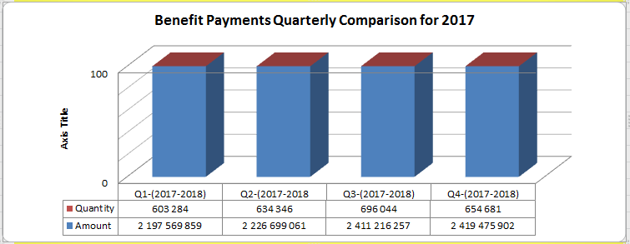
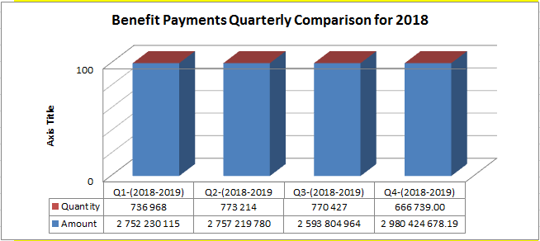
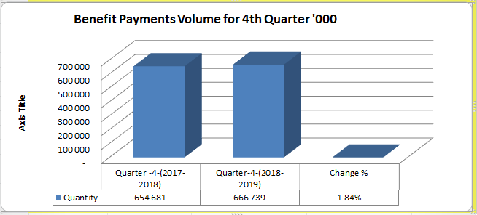
VALUE AND VOLUME OF BENEFITS PAYMENTS
33
There was a growth in payments rand value and volumes for 4th quarter 2018 compared to 4th quarter 2017 of 23.18% and 1.84% respectively.

Slide 34
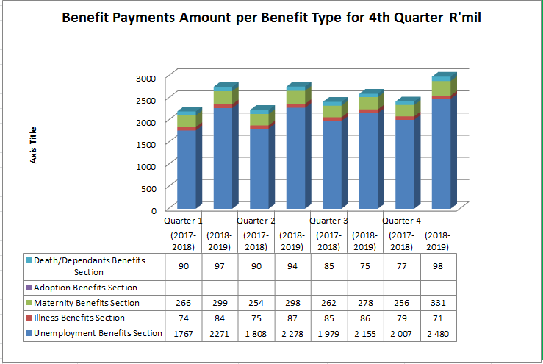
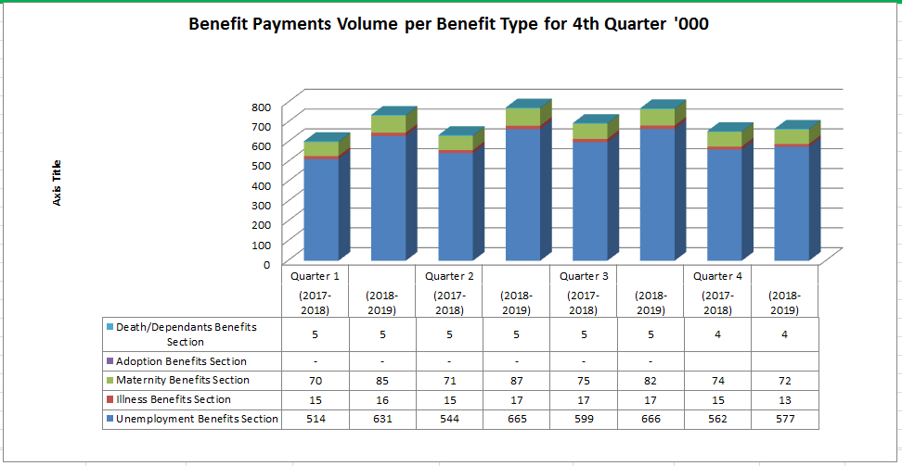
VALUE AND VOLUME OF BENEFITS PAYMENTS
34
VALUE OF THE BENEFITS PAYMENTS
VOLUME OF THE BENEFITS PAYMENTS

Slide 35
FINANCE REPORT
35

Slide 36
FINANCIAL PERFORMANCE 5 YEARS
36
2014/2015
2015/2016
2016/2017
2017/2018
2018/19
INCOME
16 146 737
17 120 381
18 256 811
18 740 065
19 565 214
Contribution Received
16 146 737
17 120 381
18 256 811
18 740 065
19 565 214

Slide 37
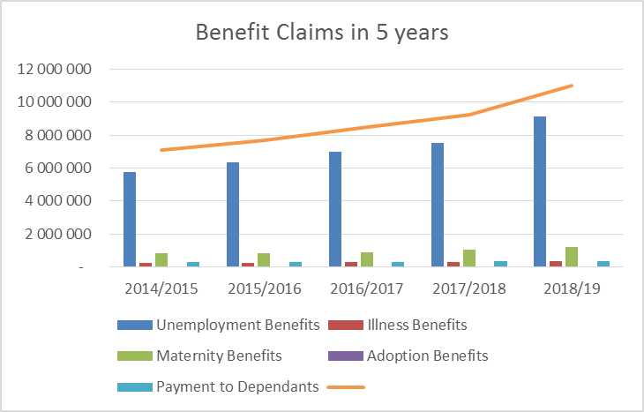
FINANCIAL PERFORMANCE 5 YEARS
37

Slide 38
FINANCIAL PERFORMANCE 5 YEARS
38

Slide 39
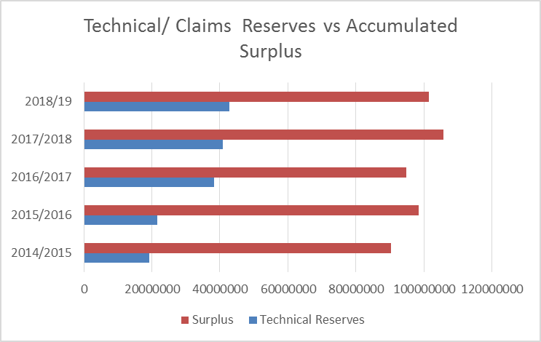
FINANCIAL PERFORMANCE 5 YEARS
39
Year
2014/2015
2015/2016
2016/2017
2017/2018
2018/19
Technical Reserves
19,145,892
21,621,408
38,303,768
40,928,889
42,760,087
Surplus
90,292,812
98,503,433
94,822,326
105,707,027
101,505,203

Slide 40

STATEMENT OF FINANCIAL PERFORMANCE
31 MARCH 2019
40
 | 31 March 2019 R’000 | 31 March 2018 R’000 | Percentage Variance | COMMENTS
Contributions | 19 565 214 | 18 740 065 | 4% | Revenue consists of contributions, interest and penalties received. The % increase is due to increase in numbers of employers.
Investment Revenue | 10 571 813 | 9 354 313 | 13% | Income generated from investments has increased by 12,6% as compared to the last financial year at the same period. The main contributor is interest received on listed Financial assets.
Benefit Claims | 10 992 622 | 9 227 370 | 19% | Benefit claims has increased by 19%. This is due to the increase in Unemployment rate and the implementation of the UI Amendment Act with effect from 01/012019. The amended UI Act was implemented from 01/01/2019. Unemployment benefit = 82% Illness benefits increased by 3% Maternity benefits = 11% Dependant benefit = 4% Year on year increase 8%
Surplus/Deficit from equity accounted investments | (453 264) | 43 334 | -1146% | The surplus /deficit from equity accounted investment has decreased . The main contributors to the deficit are Kefolile Health, Musa Capital , Razorite Health and Bright Glacier

Slide 41
STATEMENT OF FINANCIAL PERFORMANCE
31 MARCH 2019
41
 | Actual 31 March 2019 R’000 | Actual 31 March 2018 R’000 | Percentage Variance | COMMENTS
Employee costs | (1 337 344) | (1 168 993) | 14.4% | There is a 14,4% increase in the staff cost – this is due to the annual salary increases, the filling of vacant posts and the appointment of interns on 1 February 2019.
Poverty Alleviation Schemes | (120 073) | (48 673) | 147% | The increase of 147% is due to the increase in the Training of the Unemployed and Training Lay off Scheme. The Fund has entered into agreements with different training institutions to upskill/train the beneficiaries.
Net Surplus/Deficit | (1 588 048 ) | 12 727 245 | (-113%) | The net deficit is due to unrealised losses in investment/fair value adjustment, impaired SRI and loss in investment in equity accounted investments.

Slide 42




STATEMENT OF FINANCIAL POSITION @ 31 MARCH 2019
42
 | March 2019 R’000 | March 2018 R’000 | PERCENTAGE% | COMMENTS
Non-current Assets | 99 031 514 | 97 125 698 | 1,96% | Non-current assets includes investments, property plan and equipment.
Investment Property | 104 809 | 9 181 | 1041% | The increase in investment property is due to refurbishments done in Bisho (R21 m) and Thoyandou (R18m). The Fund has also acquired two additional properties viz Marshalltown @ R78 m and Annadale @ R10m
Current Assets | 66 434 943 | 62 163 807 | 7% | The increase is due to growth in none current assets (investments)
Current Liabilities | 21 174 196 | 13 409 732 | 58% | Included in the current liabilities is the claims provision of R20,6 billion, provision 57,5% as compared to last year. Impact of the new legislation
Investment in JV | 153 931 | 259 869 | -40% | The decrease of -39% is due to the deficit/loss in Kefolile Consumer Brands of R101 million. The Fund has 2 JV (Kefolile Consumer Brands and Matseke Medical Consultants)
Accumulated Surplus | 101 505 203 | 104 924 450 | -3,25% | The decrease is due to the net deficit of R2,3 billion and increase in technical reserves.
Technical reserves | 42 760 087 | 40 928 889 | 4,4% | Future claims liability/provision as calculated by the Actuaries.
Investment in Associates | 3 698 318 | 2 886 118 | 28% | The fund has acquired additional investment in Associates (Gray Jade Trade & Investment, Bright Glacier Trading, Naturecell Africa)

Slide 43
INVESTMENT IN UNLISTED INVESTMENTS (SRI’S)
43
Investments in Associates
Associates are all entities over which the UIF has significant influence but not control, generally accompanying a shareholding of between 20% and 50% of the voting rights. In circumstances where shareholding is less than 20% but significant influence is present, entities are also classified as associated. Investments in associates are accounted for using the equity method of accounting and are initially recognised at cost.
Investments in jointly controlled entities
Jointly controlled entities are all entities over which the UIF has joint control. Jointly controlled entities are accounted for using equity accounting. Investments in jointly controlled entities are accounted for using the equity method of accounting and are initially recognised at cost.

Slide 44
GRAP 6,7,8 and 20 IMPLEMENTATION.
44
All unlisted investments were reviewed and analysed ( 2015- 2018)
Tested against GRAP 6,7,8 20, and 104.
Investment accounting policy was reviewed.
Disclosures on investments were reviewed.
Final valuation reports and the Financials Statements were used to prepare the adjusting entries.
17 unlisted investments were equity accounted – Associates
2 company was classified as a Joint Venture
No company was classified/ identified as a Subsidiary(in 2016) but discontinued.
The Fair Value accounting treatment was applied for the remaining unlisted investments that met the criteria in line with GRAP.

Slide 45
IRREGULAR EXPENDITURE AS AT
31 MARCH 2019
46

Slide 46
IRREGULAR EXPENDITURE AS AT
31 MARCH 2019
46
Details of irregular expenditure under investigation
 | 2019 | 2018
 | R’000 | R’000
Opening balance | 32 377 | 71 927
Irregular expenditure incurred in 2018/19– under investigation | 6 370 | 6 332
Less Irregular Expenditure confirmed | (2 544) | 45 734)
Less Expenditure confirmed Non Irregular | (22 861) | (148)
Closing balance | 13 342 | 32 377

Slide 47
FRUITLESS AND WASTEFUL EXPENDITURE AS AT
31 MARCH 2019
47
2019 2018
‘000 ‘000
Opening Balance 29 -
Add: Fruitless and wasteful expenditure – Current Year 237 29
Fruitless and wasteful expenditure awaiting condonement 237 29
R28,782,72 in respect of the interest payable to Toyota which accumulated as a result of the delayed payments of the shortfall amount in relation to the Toyota Corolla motor vehicles procured through the RT57 still at the transversal contract, was confirmed by the service provider as incorrect and the fruitless and wasteful expenditure amount subsequently reversed.
An amount of R237,600 was confirmed as fruitless and wasteful expenditure with regards to lease payments made for a parking area – disciplinary action is in process. R79, 587,143 has been identified as possible fruitless and wasteful expenditure is currently under investigation of which R75,018,212 was paid in respect of SAP licenses, support, and a lease agreement that was entered into.

Slide 48
VACANCY RATE AS AT 31ST MARCH 2019
48

Slide 49
VACANCY RATE
49
TOTAL APPROVED POSTS | FILLED | TOTAL VACANCIES | VACANCY RATE %
602 | 522 | 80 | 13.3%

Slide 50
PROGRESS ON LABOUR LAWS
“OPERATIONS & ICT “
50

Slide 51
PROJECT SUMMARY
51
Highlights
R
Next week:
Overall:
G
Last Week:
A
    PID v1 approved
    URS approved
    High level Functional Specification approved
Key Team Deliverables for Project Phase
Deliverable | Expected End Date | % Complete
Schedule | 26.06.2019 | 100%
Development of Parental Benefit | 12.07.2019 | 66%
QA and UAT | 26.08.2019 | 0%
Training Strategy | 24.05.2019 | 0%
Change Strategy | 24.05.2019 | 0%
Comms Strategy | 24.05.2019 | 33%
SOGs | 29.07.2019 | 40%
Regulations |  | 7%
Deployment to PROD | 01.08.2019 | 0%
    Weekly Status
    Draft Project Plan adopted by PMC
    66% of development for parental benefit completed
    Incorporate regulations inputs from internal stakeholders by 28/06/2019
    Revised PID circulated for approval
    Development of a detailed functional specification in progress
    SteerCo postponed to 01/07/2019
Plans for next week
Management Attention/Issues
    Acceptance of Project Plan by SteerCo – 01/07/2019
    100% development progress
    Submission and presentation of Communication , Training & Change Management Strategies.
  Legal timeframes not in line with deployment date
  Non attendance of meetings by some of PMC
  Unavailability of Work streams Strategies & Plans
Notes:
PLEASE ADD COMMENTS .

Slide 52
HIGH-LEVEL PLAN
52
Milestone | Milestone Duration (Development) | Development | Testing | Deployment | Status
Development of Parental Benefit | 6 weeks | 27 May 2019 – 12 Jul 2019 | 13 Jul 2019 – 26 Jul 2019 | 1 Aug 2019 | 66% Development completed
Development of Adoption benefit | 1 month | 2 Aug 2019 – 2 Sep 2019 | 3 Sep 2019 – 16 Sep 2019 | 26 Sep 2019 | Not started
Development of Surrogacy benefit | 3 months | 4 Nov 2019 – 3 Jan 2020 | 6 Jan 2019 – 6 Feb 2020 | 17 Feb 2020 | Not Started
Regulations | 10 Months | 6 Jun 2019 | 24 Mar 2020 |  | Incorporate regulations inputs from internal stakeholders by 28/06/2019
Standard Operating Procedures | 2 Months | 20 May 2019 | 29 Jul 2019 |  | SOGs submitted to Policy & Procedures for presentation on the date to be confirmed to Provincial Support.
Communication | 8 Months | 20 May 2019 | 17 Feb 2020 |  | Draft Strategy submitted for inputs
Training | 8 Months | 20 May 2019 | 15 Feb 2020 |  | No information provided
Change Management | 9 Months | 20 May 2019 | 28 Feb 2020 |  | Development of strategy in progress

Slide 53
PARENTAL BENEFIT: MODULE DEVELOPMENT STATUS
53
Module | Start Date | Expected Completion Date | % Completed | Status
1. Declaration | 27 May 2019 | 30 May 2019 | 100% | Completed
2. Claims | 31 May 2019 | 20 Jun 2019 | 100% | Completed
3. Payments | 21 Jun 2019 | 30 Jun 2019 | 83% | In progress
4. Discrepancies | 1 Jul 2019 | 12 Jul 2019 | 0% | Not started

Slide 54
MODULE STATUS
54
Module | Status of development | Expected completion
New Benefit Type | Completed | Completed
Declaration with New Termination Reason – 19 | Completed | Completed
Claim Registration Page- Parental benefit and sub benefits loading of look up data and corresponding fields | Completed | Completed
Development of claim qualification Rules (91days/Incorrect Termination Reason/Active/12 month rule for application) | Completed | Completed
Claim qualification screen – calculation of credits- Average salary/Daily benefit Amount/Total Benefit Amount | Completed | Completed
Claim Rejection Letter for Refused application – SG3_665 | Completed | Completed
Rejected claim required information storage in claim table - CREATION OF MAIN CLAIMMTABLE/ HISTORY TABLE | Completed | Completed
Module | Status/ Start date of development | Expected completion
Ceiling of Credits for Parental benefits | Completed | Completed
Supporting document screen | Completed | Completed
Configuration of new documents corresponding to Parental Benefit | Completed | Completed
Documents Submitted validation and Date of receipt – Sg3_545 | Completed | Completed
TOP UP Screen | Completed | Completed
Top up Rules | Completed | Completed
Banking Details | Completed | Completed

Slide 55
MODULE STATUS
55
Module | Status of development | Expected completion
Top up contributing Employers Selection | Completed | Completed
Report Page | Completed | Completed
creating Claim/supporting document/Document/Date of receipt Tablet and triggers and Jobs | Completed | Completed
Inserting all claim information, documents and validating the working of history tables/triggers and jobs | Completed | Completed
Payment continuation form | Completed | Completed
Claim Approval letter | Completed | Completed
Payment continuation | Completed | Completed
Module | Status/ Start date of development | Expected completion
Development of payment packages and stored proc | Completed | Completed
Payment Calculation | Completed | Completed
Integration of Payment
Discrepancy detection | 29.6.2019 | 30.6.2019
Adjudicate – Underpayment/Overpayment/Resumed work Total Overpayment Scenarios | 1.6.2019 | 12.6.2019
The duration for development is reduced to one (1) month from 27 May to 12 July 2019 while the testing will start from 13 to 26 July with fixing of defect.
The estimated go live is 1 August 2019

Slide 56
GOVERNANCE
56

Slide 57
UIF BOARD AND COMMITTEE MEETINGS
AS AT 31 MARCH 2019
57
 | TYPE OF MEETING
NAME OF COMMITTEE | NO. OF MEMBERS | SPECIAL | WORKSHOP | NORMAL | TOTAL OF ALL MEETINGS
Board | 13 | 6 | 1 | 4 | 11
Investment Committee | 8 | 2 | 2 | 4 | 8
Financial Advisory Committee | 8 | 1 | 0 | 5 | 6
Labour Activation Committee | 8 | 0 | 1 | 4 | 5
Audit Committee | 4 | 2 |  | 4 | 6
TOTALS |  | 11 | 4 | 21 | 36

Slide 58
UIF BOARD PERFORMANCE
58
The UIF Board recommended the following as its strategic interventions and participation during 2018/19:
Conversion of investments portfolios and asset classes to ensure maximization Return On Investment
Revision of the Social Responsibility Investment (SRI) mandate to ensure positive impact on distressed companies and preserving jobs
Recommended the UIF plan and activities which addresses the implementation of Job Summit and SONA outcomes
Implementation of new Governance Framework
Development of the High Social Impact Portfolio (HSIP) – R3 billion and 2% of portfolio for the outer years
Resulted in Edcon being funded through PIC the 1.2 billion
Launched Project Development Partnership (PDP) – R2 billion and 2% of portfolio for the outer years. The project is aimed at addressing:
Training of Unemployed;
Preservation of Jobs; and
Alleviating Distress Companies.
Monitored the Social investments by visiting and evaluating the selected project sites
Implemented the yearly assessment for each Committee;
Consolidation of the year resolutions in order to track all decisions made for the year and its implementation; and
Recommended the approval and implementation of the Corporate Governance framework and policy.
SWIX investment Portfolio was changed to capped SWIX

Slide 59
UIF BOARD PERFORMANCE
59
Improvement of the audit outcome
Approval of budget, financial statements and performance reports by Accounting Authority
Facilitate stakeholder relations
Approval of LAP Policy Framework and investments
Recommended the approval and implementation of the LAP framework and policy;
Recommended that R8 billion from Free Capital to be allocated for LAP investment projects within 3 years;
Monitored the LAP projects by visiting and evaluating the selected project sites; and
Launched some of the new LAP projects nationally. The Board accompanied by Minister or Deputy Minister on some of the projects that were launched.
.
Developing suitable key indicators performance indicators;
Improved processing time of beneficiaries claims from 35 days to 10 days;
Annual and Quarterly Financial Statements;
Annual MTEF and Annual Revised Budgets; and
Annual and Quarterly performance reports.
Engagements with PSA board through joint meetings in order to ensure continual services to the distressed companies
From disclaimer in 2016/17 to Unqualified in 2017/18 audit opinion:
Fostering and overseeing the audit matrix action plans implementation; and
Monitoring management on expected timelines adherence and deliverables as per agreed action plan through Board Committees

Slide 60
60
AUDIT OUTCOME
2018/2019

Slide 61

61
PICTORIAL SUMMARY OF THE AUDIT RESULTS
Stagnation in audit outcome
Assurance levels
Types of audit
First level of assurance
Second level of assurance
Unqualified
with no findings
Senior
management
with findings
Audit
committee
Unqualified
Accounting authority
Internal audit
Qualified
with findings
Adverse with findings
Executive
authority
Disclaimed with findings
Provides
Provides some assurance
Provides limited/ no
2016/17
2017/18
2018/19
assurance
assurance
1
To improve/maintain the audit outcomes …
2
… the key role players need to assure that …
5
… the root causes are addressed …
4
… the risk areas and …
3
… attention is given to the key controls and …
… the best practices are maintained.
Risk areas
Status of drivers of internal controls
5
Root causes should be addressed
Quality of submitted financial statement
Quality of submitted performance information
Leadership
Financial and performance management
Supply
Chain management
Effective leadership culture
Governance
Proper record keeping
Risk management
Financial Statement
Misstatement over daily and monthly processing and reconciling of transactions
Information Technology
Some IT controls had not been adequately designed and implemented to enable an effective IT control environment
Oversight responsibility
Processing and reconciling control
Internal audit
HR Management
Audit committee
Human ,
resource
management
Policies and procedures
Regular reporting
Financial
health
Information technology
Compliance monitoring
Audit action plans
IT Governance
IT system controls

Slide 62
62
COMPARISION
2017/2018
&
2018/2019

Slide 63
63
COMPARISON 2017/18 AND 2018/2019
2017/18 & 2018/19
71 findings last year
57 findings this year
2017/18 & 2018/19
Senior Management
Audit action plans
Comparison
2017/2018
&
2018/2019
Quality of submitted financial statement
IT Governance
Quality of submitted performance information
Proper record keeping
Supply chain management
Processing and reconciling control
Oversight responsibility

Slide 64
64
RECURRING FINDINGS

Slide 65








RECURRING FINDINGS
65
57 total findings
8 recurring findings
49 new findings
Names of bidders not published within 10 days after closure of advertised competitive bid;
Staff members not appointed in terms of the Unemployment Insurance Act;
Incomplete disclosure of GRAP 7 Investments in associates;
External debt collector not appointed
Interest income receivable: Dividends not accrued for at year end
Limitation of scope on the review of work in progress – PPE;
Incorrectly recorded prepayments
Consolidations: Limitation of scope

Slide 66
66
AUDIT ACTION PLANS

Slide 67
67
POST AUDIT WORKSHOP RECOMMENDATION
The Fund held a Post Audit workshop on the 19th to the 20th September 2019 to discuss findings and develop adequate action plans.
The process followed was as follows:
Received presentations from Auditor-General and Internal Audit on the focus areas to improve audit opinion;
Conducted root cause analysis for each finding;
Developed overarching action plan to address other high risk areas;
Developed main pillars to drive clean audit in support of the government priorities.

Slide 68
68
CLEAN AUDIT PILLARS
The Fund has adopted the following pillars to drive operation clean audit review for the next two years:
.
1. QUALITY OF FINANCIAL STATEMENTS:
Institute Independent Committee to overseer the review of financial statements;
Sign-off process by all sub-module owners.
2. RECORD KEEPING:
Monthly reconciliation for all process;
Keep evidence for all line items on the financials
3. INVESTMENT:
Constant de-brief with AGSA on the GRAP interpretation;
Monthly review of the client report;
Auditing of SRI Companies.
4. LAP:
Proper record keeping of agreements and invoices;
Improve accounting part of LAP invoices.
5. INTERNAL CONTROL (Control Self Assessment):
To utilise Internal Audit dashboard for key controls;
Re-train Officials on CSA.
6. IRREGULAR EXPENDITURE:
Arrange a training with National Treasury;
Re-work on the irregular expenditure process flow.
7. GOVERNANCE:
Improve leadership role;
Constant meetings for each Directorate to discuss findings;
8. CONSEQUENCE MANAGEMENT:
Training on Public Audit Act;
Implementation of the new guidelines on irregular expenditure.

Slide 69
69
CLEAN AUDIT GOVERNANCE
The Fund has instituted a Clean Audit Committee to drive main pillars of the Fund:
The Committee will be chaired by the Chief Operation Officer (COO).
It will meet on a monthly basis and report to EXCO.
The consolidated report will also serve at the Board and Departmental EXCO.
The Committee will report to:
  The Director-General on a monthly basis; and
  Risk and Audit Committee on progress
The Committee will also perform thorough review of the annual financial statement and recommend them to other structures.
The Committee will oversee the implementation of the control self-assessment for each Directorate.

Slide 70

70
Thank You…

