Slide 1

Annual Report Presentation 2018/19 Financial year
Presented by Mr Fundisile Mketeni: CEO
SOUTH AFRICAN NATIONAL PARKS

Slide 2
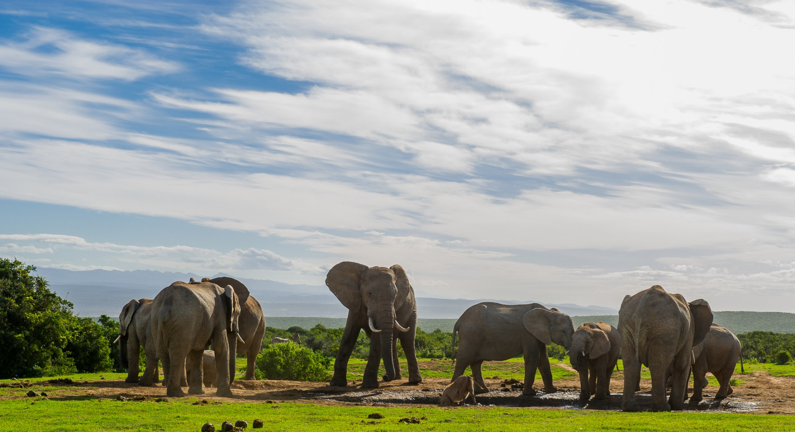
SANPARKS MANDATE
Mandate derived from National Environmental Management: Protected Areas Act, 57 of 2003
Mandate is to conserve, protect, control and manage National Parks and other defined protected areas and their biological diversity.
SANParks is a Schedule 3A Entity in terms of the PFMA. The Board is the Accounting Authority

Slide 3

SANParks vision & mission
VISION
A sustainable national parks system connecting society
1
MISSION
To develop, manage and promote a system of sustainable national parks that represents biodiversity and heritage assets, through innovation and best practice for the just and equitable benefit of current and future generations.
2

Slide 4

SANPARKS STRATEGY MAP
VISION
A sustainable National Parks system connecting society
G1: Sustainable Conservation Asset
G2: Diverse & Responsible Tourism
G3: Radical (equitable& fair) Socio-Economic Transformation
OUTCOMES
G4: Effective Resource Utilisation and Good Governance
Conservation Asset Management
Responsible & Diverse Tourism
Radical Socio-Economic Transformation
SO1: Improved representative conservation estate
SO4: Enhanced tourism returns
SO6: Optimised contribution to the green and blue economy
INTERNAL PROCESSES
SO2: Effectively managed eco-system, species & cultural heritage assets
SO5: Diversified & enhanced tourism opportunities & experience
SO7: Enhanced awareness & skills
SO3: Enhanced knowledge for decision making
SO8: Enhanced Stakeholder Engagement
Achieve synergies, effectiveness and efficiencies through systems and communication
LEARNING & GROWTH
SO9: Adequate, appropriately skilled transformed & diverse human capital
SO10: Conducive working environment
SO11: Optimised business processes & knowledge management systems
SO12: Accountable corporate governance
SO13: Financial sustainability
SANParks Annual Report October 2019 4

Slide 5

GOAL 1: SUSTAINABLE CONSERVATION ASSET
Strategic Objective 1 : Improved Representative Conservation Estate
Performance indicator | Annual target 2018/19 | Annual Progress and Analysis
Total Area Added to National Parks | 2 395 ha added to National Parks | 5 350.87 ha has been purchased and included into the Tankwa Karoo National Park The variance in hectarage is attributed to the addition of 2 portions of Olivierskraal to the national parks estate.
Provide inputs towards the establishment of three MPAs | Engage, provide inputs and give technical inputs as required by DEA and Phakisa team, & any other processes towards declaration of SANParks MPAs: Robben Island Namaqua & Addo Elephant. | Technical inputs relating to the declaration of Robben Island, Namaqua and Addo Elephant MPAs have been provided
% of National Parks assessed with a METT Score of above ≥ 67% | 77% of National Parks assessed have a METT score of ≥ 67% | 84% of national parks achieved a score of above 67% Positive variance of 7% is due to the improvement actions identified and implemented.
States of Area Integrity Assessments (SoAIM) | ≥ 2.8 (Parks) ≥ (KNP) | A SoAim Score of 2.9 for all parks (except KNP) was achieved. Corrective actions were identified for all parks. The progress for the Parks Division against the corrective actions is at 79%. An average score of 3.52 was achieved for the 22 KNP Ranger Section assessments.
    = Achieved
    = Partially achieved
    = Off target

Slide 6
GOAL 1: SUSTAINABLE CONSERVATION ASSET
Strategic Objective 1: Improved Representative Conservation Estate
Performance indicator | Annual target 2018/19 | Annual Progress and Analysis
% Implementation of annual State of Biodiversity Mgmt. (SoB) improvement plan. | 100% implementation of SoB implementation plan. | 100% (19/19) Park-specific SoB reports were developed and circulated to 19 national parks
% Reduction of fossil fuel generated energy consumption | Readiness audit for 4 identified parks. Prepare for baseline determination for five parks (17/18). 2% Reduction on 16/17 baseline for three parks. | A readiness audit was completed in 4 parks, namely Karoo NP, West Coast NP, Bontebok NP and Agulhas NP. A baseline determination was done for 5 parks during the 17/18 financial year: Kgalagadi TNP, Augrabies, Marakele NP, Mapungubwe TNP and Addo Elephant NP. There was a reduction on the 16/17 baseline for 3 parks: Golden Gate HNP (overall average of supply points: - 32.5 %; Mountain Zebra NP (-10%) and Mokala NP (-5%)
 | 2% reduction on baseline for Kruger NP | There was a 3.74% reduction on the baseline for Kruger NP. New pilot solar farms and awareness programmes were implemented.
    = Achieved
    = Partially achieved
    = Off target

Slide 7
GOAL 1: SUSTAINABLE CONSERVATION ASSET
Strategic Objective 1: Improved Representative Conservation Estate
Performance indicator | Annual target 2018/19 | Annual Progress and Analysis
% Reduction of water consumption | Readiness audit for 4 identified parks. Prepare for baseline determination for five parks (17/18). 2% Reduction on 16/17 baseline for three parks. | Readiness Audits were completed in 4 parks: Golden Gate Highlands NP, Marakele NP and Camdeboo NP & Karoo NP. A baseline determination was done for 5 parks during the 17/18 financial year: Addo Elephant NP, Mountain Zebra NP, Tsitsikamma NP, Augrabies Falls NP, Mapungubwe TNP Agulhas NP – (-21%), Bontebok NP – (-49%) & Wilderness NP – (+3%).
 | KNP: 2 % decrease YoY | There was a 1.64% increase on baseline for Kruger Challenges includes: The high temperatures and low rainfall figures during October to March 2019 caused the large camps and staff villages to exceed the previous baselines. The lack of adequate awareness amongst guests and staff about saving water is the main cause of this under-achievement. Corrective Actions: KNP is piloting a different approach to the creation of awareness with the assistance of the research department. Should the outcome be successful, it will be rolled out to all camps. The water tariffs were reviewed as a mechanism of ensuring the reduction of water consumption by staff and clients.
    = Achieved
    = Partially achieved
    = Off target

Slide 8
GOAL 1: SUSTAINABLE CONSERVATION ASSET
Strategic Objective: Improved Representative Conservation Estate
Performance indicator | Annual target 2018/19 | Annual Progress and Analysis
Total Hectares of Land Rehabilitated / Restored | Initial = 34 362 ha | 28,491ha were rehabilitated. The planned target for the year was not achieved. Challenges include: The October fires in Garden Route National Park which destroyed most of the initial planned work areas. In the Frontier Region, specifically Addo, project planned areas had to be changed due to inaccessibility of areas linked to river crossings and limitations put on the number of teams in the Darlington section by the park. Corrective Actions were implemented throughout the year to ensure achievement of targets for land rehabilitation. Project management capacity was increased in the Garden Route Region over the year and assistance to Cape Region management will continue.
 | Follow up = 172 369 ha | 166,897 ha follow up ha were rehabilitated. The late start in Kruger National Park, shortage of capacity in Garden Route Region and management challenges in the Cape were problematic. Remedial interventions assisted in almost achieving the planned target for the year.
 | Wetlands = 6 799 m³ | 7,170 m³ wetlands were rehabilitated . Corrective actions were implemented throughout the year to ensure achievement of targets for land rehabilitation. Project management capacity was increased in the Garden Route Region over the year, and assistance for Cape Region management will continue.
    = Achieved
    = Partially achieved
    = Off target

Slide 9
GOAL 1: SUSTAINABLE CONSERVATION ASSET
Strategic Objective:
Performance indicator | Annual target 2018/19 | Annual Progress and Analysis
Total Number of Park Management Plans Reviewed and Submitted as per annum | 2 drafts revised management plans for GRNP + MPNP submitted to DEA for technical review | The revised Mapungubwe NP, Management Plan has been submitted to DEA for technical review. The Garden Route NP Management Plan is in progress. Challenges: Due to the October/November wildfires in the Garden Route, staff were unable to complete the lower level plans. This influenced both timelines and the requirement to revisit certain draft components in light of the changed post-fire context. A request for an extension of the timeline was approved by the Board. Corrective Actions: A request for extension of timelines was approved by the Board and a revised schedule has been adopted and process will be completed during July 2019
    = Achieved
    = Partially achieved
    = Off target

Slide 10
GOAL 1: SUSTAINABLE CONSERVATION ASSET
Strategic Objective 2: Effectively managed ecosystem, species and cultural heritage assets
Performance indicator | Annual target 2018/19 | Annual Progress and Analysis
% reduction in recorded rhino poached in the KNP | 2% reduction (YoY) | There was a 23.5% (502 to 384) reduction in the number of rhino fatalities due to poaching. Ranger efficiencies, good tracking skills and deployment of K9 resources contributed to the improvements. Support was provided by Operation Rhino 9 (NATJOINTS), SANParks, SAPS and SANDF joint operations both internal and external to park. ECI continues to work successfully with SAPS in external intelligence-driven investigations and operations.
Reduction in the number of rhino fatalities due to poaching in KNP | ≥ 500 | 384 rhino poached: a reduction from the previous year’s total of 502. Rangers efficiency in early detection and successful follow-up operations of poacher incursions and good racking skills. Support from operation from NATJOINTS, SANParks, SAPS, SANDF joint operations both internal and external to the parks .
Number of rhinos poached per annum in 6 Rhino parks (other than KNP) | 0-2 | 3 rhinos were poached. ( 2 x White rhino in Marakele and 1 WR in Mokala) Challenges: Poaching pressures have increased in and around parks significantly. Poachers arrested close to Mokala come as far as Mozambique. Staff remain committed to the cause of rhino protection and work hard to ensure that poaching minimised. Two of the poaching incidents around Marakele were possibly opportunistic as the animals poached were very close to a public road. Corrective Actions: Continued implementation of the Rhino Protection Plan
    = Achieved
    = Partially achieved
    = Off target

Slide 11
GOAL 1: SUSTAINABLE CONSERVATION ASSET
Strategic Objective 2: Effectively managed ecosystem, species and cultural heritage assets
Performance indicator | Annual target 2018/19 | Annual Progress and Analysis
% reduction in recorded elephant poached in the KNP | 2% reduction (YoY) | There was a 35.2% reduction in the number of elephant poached. The positive reduction in recorded elephant poaching incidents, from 74 to 48, is mainly due to: Ranger efficiencies in early detection and follow up operations of poacher incursions, good tracking skills, deployment of K9 resources where available. ECI continues to work successfully with SAPS in external intelligence-driven investigations and operations. Improved movement control in the park. Support from Operation Rhino 9 (NATJOINTS), SANParks, SAPS and SANDF joint operations both internal and external to the park
% Implementation of the annual Rhinoceros Plan | 100% implementation of the annual Rhinoceros Plan. | 90% (36/40) of the annual targets were met. The following activities posed challenges and was therefore not met: 1) Conduct full spectrum integrated anti–poaching operations in rhino parks other than KNP 2) Use and maintain human and technology sourced information to execute the majority of arrests outside of KNP 3) Manage injured and orphaned rhinos. Conduct strategic translocations. 4) Focus donor proposals on specific projects. Corrective Actions : Anti-poaching and management strategies are regularly reviewed and refined to support operations
    = Achieved
    = Partially achieved
    = Off target

Slide 12
GOAL 1: SUSTAINABLE CONSERVATION ASSET
Strategic Objective 2: Effectively managed ecosystem, species and cultural heritage assets
Performance indicator | Annual target 2018/19 | Annual Progress and Analysis
% Implementation of the annual Elephant Plan | 100% Implementation of the annual Elephant Plan. | 74.0% ( 20/27) activities were implemented Challenges : a) Developing best practice interventions to disturb elephants at local scale. Although the intervention proposal to mimic zones of increased vigilance created by historic people in Kruger NP are well advanced in development, evaluation of mechanisms and options are unresolved as considerable analyses are required to confirm the predicted mechanisms for each area of concern. b) Exclusion of elephants from sensitive riverine forest and cultural heritage sites in Mapungubwe. Park management has re-aligned fences, but have challenges finding funding to implement the changes to infrastructure required. c) The sourcing of two elephant bulls from Tembe Elephant Park managed by Ezemvelo KZN Wildlife to Addo Elephant NP did not take place during the reporting period. d) Revision of the original target, which was to assist with an elephant management approach for the Associated Private Nature Reserves, delayed the process. Corrective Actions Developing best practice interventions to disturb elephants at local scale. One exclosure to protect sensitive sites in Mapungubwe to be re-constructed Translocation of bull elephants to AENP from Tembe Elephant Park has been approved by Ezemvelo KZN Wildlife and is scheduled for 2019/20 financial year. Development of a broader Greater Limpopo Elephant Strategy to be incorporated in the 2019-2020 elephant implementation actions.
    = Achieved
    = Partially achieved
    = Off target

Slide 13
GOAL 1: SUSTAINABLE CONSERVATION ASSET
Strategic Objective 2: Effectively managed ecosystem, species and cultural heritage assets
Performance indicator | Annual target 2018/19 | Annual Progress and Analysis
% Increase in SANParks arrests for key spp (+total) | 2% increase year-on-year arrests for key species | There was a 22.6% increase in Arrests for Key species Reasons for exceeding the target: The positive increase in the number of arrests for Key species (rhino & elephant) from 190 to 233 is due mainly to Ranger efficiencies in early detection and successful follow up operations of poacher incursions, good tracking skills and deployment of K9 resources. ECI continues to work successfully with SAPS in external intelligence driven investigations and operations. Support from Operation Rhino 9 (NATJOINTS), SANParks, SAPS and SANDF joint operations both internal and external to park.
% Increase in SANParks fines for key spp (+total) | 2% increase year-on-year arrests for key species | A decrease of 75.5 % fines issued from the previous year. Challenges: The EMI fines shows a major decrease of 75,5 % to the previous year and this is due to the traffic fines no longer recorded due to the legal opinion received indicating that SANParks should stop issuing traffic fines in terms on National Road Traffic Act, but are permitted to issue other fines related to Environmental crime in accordance to NEMPAA.
    = Achieved
    = Partially achieved
    = Off target

Slide 14
GOAL 1: SUSTAINABLE CONSERVATION ASSET
Strategic Objective 2: Effectively managed ecosystem, species and cultural heritage assets
Performance indicator | Annual target 2018/19 | Annual Progress and Analysis
% Implemen- tation of SANParks Wildlife Utilization Strategic Plan | 100% Delivery of annual Wildlife Utilisation Plan | 90% (45/50) activities for 2018/19 were delivered. Challenges: The five (5) activities not implemented, relate to the delivery of wildlife to local communities and emerging game farmers. A total of 567 animals were successfully delivered compared to the total of 957 animals approved for delivery during 2018/2019. The delivery of wildlife to the two local communities was delayed due to governance issues on the part of the community. Whilst the Call for Interest in wildlife loans (Window 2 in 2019) was published in two newspapers, the shortlisting of eligible emerging farmers was not concluded since the bid only closed on 30 April 2019. Corrective Actions : Delivery of outstanding wildlife to the two local communities and emerging farmers will be completed during 2019/2020 game capture season.
% implementation of Cultural Heritage Management Plan | 100% implementation of annual activities in the Cultural Heritage Management Plan. | 100% (40/40) of the planned activities in the Cultural Heritage Implementation Plan were implemented in the reporting period. Activities such as the lower-level cultural heritage management plan for the SKA site, a proposal for an interpretation centre at Thulamela as well as the presentation of a cultural heritage training course for SANParks staff, which were lagging behind in quarters 2 and 3 were subsequently concluded. This equates to 100% of scheduled cultural heritage activities implemented for the reporting period.
    = Achieved
    = Partially achieved
    = Off target

Slide 15
GOAL 1: SUSTAINABLE CONSERVATION ASSET
Strategic Objective 2: Effectively managed ecosystem, species and cultural heritage assets
Performance indicator | Annual target 2018/19 | Annual Progress and Analysis
Air wing strategy developed and approved | Air wing strategy developed and approved | The Airwing strategy has been developed. However the final approval had not been received before the end of the financial year. Challenges: Further consultation was required prior to the approval Corrective Actions: The Airwing Strategy was finalised after the end of the financial year.
    = Achieved
    = Partially achieved
    = Off target

Slide 16
GOAL 1 : SUSTAINABLE CONSERVATION ASSET
Strategic Objective 3: Enhanced Knowledge For Decision Making
Performance indicator | Annual target 2018/19 | Annual Progress and Analysis
% of registered research projects aligned to identified SANParks research themes rated as essential or important (Indicator was revised during Midterm review) | ≥ 75% of registered projects rated as essential or important | 78.02% (245 of the 314) These research themes include: ecosystem structure, function and process, ecosystem services and sustainable use, Global Environmental Change, adaptive governance and organisational function, cultural heritage, integrated land use and effective social engagement. The role of SANParks’ scientists as facilitators of external research efforts to meet organisational needs is demonstrated.
Total Number of Peer Reviewed SANParks Research publications. | ≥ 30 | 53 Peer Reviewed SANParks Research publications 47 peer-reviewed publications and 6 book chapters published. This achievement reflects ongoing, and often long-term work towards published scientific papers over a number of years which have come to publication fruition during this year. It has also been aided by recent appointments of scientists to the group.
    = Achieved
    = Partially achieved
    = Off target

Slide 17
GOAL 2: DIVERSE AND RESPONSIBLE TOURISM
Strategic Objective 4 : Enhanced Tourism Returns
Performance indicator | Annual target 2018/19 | Annual Progress and Analysis
% growth in Gross Operating Tourism Revenue (YoY) | 8% | Tourism Revenue increased by 9.5% from R1 614 204 911 to R1 767 891 657 due to Differential conservation fees were implemented at TMNP in November 2018 resulting in an increase in revenue while contributing to a marginal decline in visitors. Domestic economic conditions such as VAT increase and subsequent increase in the price commodities such as fuel contributed to the declines.
Total Number of Visitors to National Parks | 3% increase YoY on actuals | The number of visitors decreased by 7.74 % to 6,464,305.00 Challenges: 2017/18 being a bumper year that saw the target exceeded by 7.5% due largely to an influx of visitors to the Cape Parks (Table Mountain, West Coast, with a total of 23% increase YoY). According to the Tourism Business Index (TBI), of the Tourism Business Council of South Africa (TBCSA) 2018 has been the worst year for business performance since the inception of the TBI in 2010. The last time the industry performed above “normal” levels was in quarter four of 2016. The major contributions to this is the domestic economic conditions such as VAT increases and subsequent increases in the cost of commodities such as fuel contributed to the declines, although international visitors also declined. Differential conservation fees were implemented at TMNP in November 2018 resulting in an increase in revenue while contributing to a marginal decline in visitors. PTO…
    = Achieved
    = Partially achieved
    = Off target

Slide 18
GOAL 2: DIVERSE AND RESPONSIBLE TOURISM
Strategic Objective 4 : Enhanced Tourism Returns
Performance indicator | Annual target 2018/19 | Annual Progress and Analysis
Total Number of Visitors to National Parks | 3% increase YoY on actuals | Corrective actions: Emphasize enablement of Tourism function by improved service from internal support functions – maintenance (reduction of period inventory is out of service), SCM (increased efficiencies) Equip operational management with enhanced skills for hands-on monitoring & management Enhanced Sales & Marketing Provide value for money product (state of infrastructure in parks) Become more customer-centric
    = Achieved
    = Partially achieved
    = Off target

Slide 19
GOAL 2 : DIVERSE AND RESPONSIBLE TOURISM
Strategic Objective 4: Enhanced Tourism Returns
Performance indicator | Annual target 2018/19 | Annual Progress and Analysis
% Accommodation Occupancy | 75 % | Unit Occupancy decreased from 75.2% to 72.5% . Challenges: Worsening domestic economic conditions such as VAT increases and subsequent increases on commodities such as fuel have certainly contributed to the declines, although international visitors have also declined. Differential conservation fees were implemented at TMNP in November 2018 resulting in an increase in revenue while contributing to a marginal decline in visitors. Corrective Actions: A concerted programme to implement innovative means to attract visitors to national parks, including marketing and promotions, is being implemented.
Total Number of Accommodation Unit Nights Sold | 585,000 | 569,803 Unit Nights were sold during 2018/19. Challenges: Worsening domestic economic conditions such as VAT increases and subsequent increases in the cost of commodities such as fuel contributed to the declines, although international visitors also declined. Differential conservation fees were implemented at TMNP in November 2018 resulting in an increase in revenue while contributing to a marginal decline in visitors. Corrective actions: The same as above
    = Achieved
    = Partially achieved
    = Off target

Slide 20
GOAL 2 : DIVERSE AND RESPONSIBLE TOURISM
Strategic Objective 4: Diverse and Responsible Tourism
Performance indicator | Annual target 2018/19 | Annual Progress and Analysis
Customer Satisfaction Index | 82,0% | The Customer Satisfaction Index (CSI) improved by 0.1% points from 80.8% to 80.9% which is 1.1% points below the target of 82.0%. A Hospitality Leadership Initiative was launched during the year, aiming, inter alia, to improve service and become more customer-centric, not only in Tourism but across all functions.
Strategic Objective 5 : Diversified and Enhanced Tourism Opportunities And Experiences
Total Number of Revenue Generating Products Implemented | 12 | 12 revenue generating products implemented. These are: Skukuza Safari Lodge; Big Tree Curio Shop; Big Tree Tea Room ; Management Agreement Mopani Restaurant; Management Agreement Punda Restaurant ; Management Agreement Shingwedzi Restaurant ; Geelbek Restaurant. West Coast National Park; ; Mountain Zebra Restaurant & Retail Operator; Jack’s Picnic Site Refreshment Kiosk ; Mapungubwe Lecture Series; Boulders retail facility; Golden Gate Classics
Total Number of Park Visitors Management Interpretation Plans Implemented | 6: *3 Parks-Visitors Plans and 3 Interpretation Plans | 4 Park Visitor Management Plans and 4 Interpretation plans were implemented for the following parks: Mountain Zebra, Golden Gate, Garden Route and West Coast National Parks.
    = Achieved
    = Partially achieved
    = Off target

Slide 21
GOAL 3: PROGRESSIVE, EQUITABLE AND FAIR SOCIO ECONOMIC TRANSFORMATION
Strategic Objective 6: Optimised Contribution to the Green and Blue Economy
Performance indicator | Annual target 2018/19 | Annual Progress and Analysis
Total Number of Full-time Equivalent Jobs Created | EPWP = 6 829 FTEs | 6,428 (94%) FTE jobs were created. The target for FTEs was almost achieved with a total of 401 out of 6,829 fewer than planned (94%). All EPWP programmes were active and employed participants for the various projects across all national parks and integrated zones. Challenges: Late appointment of the Environmental Monitor Programme by other hosts Reduced budget of the Eco Furniture Factory Programme No reports received from the Working on Fire Programme
Total Number of SMMEs / Enterprises Supported | EPWP: 500 SMMEs | A total of 703 (141%) SMME’s were supported through the EPWP . Reasons for over achievement The inclusion of the Eco-Furniture Programme increased the number of SMME’s, 35 Working for the Coast SMME’s were accommodated in other projects, when this programme did not start as planned. Additional SMME’s were employed in most projects to counter the late start of the Wetlands projects
Rand value spent on SMME’s through EPWP | R 195 million | R 208.223 million (107%) was spent on SMME’s through the EPWP Reasons for over achievement The continued implementation of the Eco-Furniture contributed to the revised target. The improved performance is ascribed to the DEA NRMP Working for Ecosystems programme where more teams were employed for land rehabilitation.
    = Achieved
    = Partially achieved
    = Off target

Slide 22
GOAL 3: PROGRESSIVE, EQUITABLE AND FAIR SOCIO ECONOMIC TRANSFORMATION
Strategic Objective 6: Optimised Contribution to the Green and Blue Economy
Performance indicator | Annual target 2018/19 | Annual Progress and Analysis
Integrated Transformation Strategy Developed | Status quo concluded on the Integrated Transformation Strategy. | The status quo was not concluded in time. Challenges: We underestimated the complexity of issues related to transformation at SANParks and this required us to review the initial project plan Corrective actions: The status quo was finalised after the end of the financial year
Total number of Green and Blue Project Implemented | 3 Green Economy Projects | Eight (8) green economy projects were implemented, this exceeded the annual target of three projects. The over achievement was due to the number of applications for the game loans received, most of them qualified for loans. There was also sufficient game to loan.
Number of social legacy projects implemented | 5 | Four (4) social legacy projects were implemented. Challenges: The planning process took too long due to prolonged negotiations and discussion on the infrastructure designs. Corrective actions: The projects will be fast tracked for completion during 2019/20.
Beneficiation package implemented as per land claim identified | Beneficiation package implemented as per land claim identified | The beneficiation package as per land claim identified was not implemented. The scheme was drafted and submitted to the Board for noting. Challenges: The beneficiation scheme could not be approved as it is still awaiting the valuation to determine its value. Corrective Actions: The Terms of Reference for the appointment of a service provider for the evaluation has been drafted and funds sought for the appointment.
    = Achieved
    = Partially achieved
    = Off target

Slide 23
GOAL 3: PROGRESSIVE, EQUITABLE AND FAIR SOCIO ECONOMIC TRANSFORMATION
Strategic Objective 7: Enhanced Awareness and Skills
Performance indicator | Annual target 2018/19 | Annual Progress and Analysis
Total Number of Participants in Environmental Education Programme | 140 000 (revised target following Midterm Review) | A total of 217 363 people participated in the EE programme Reasons for exceeding the target. The target was exceeded due to improved governance processes on the processing of data.
Total Number of Free Access Entrants during SANParks week | Parks week: 80 000 | A total of 74 086 people visited the parks for free during SANParks week. Challenges: Poor weather patterns in Frontier region & limited capacity within parks to host.
Strategic Objective 7 : Enhanced Stakeholder Engagement
Total number of proactive media engagements : Articles | 200 | A total of 250 articles were developed. Ad hoc issues not planned for e.g. fires (GRNP); wildlife escaping from the park fences, community unrest an protests , Ministerial and DEA request to attend events or conduct joint media interventions, new product launches contribute to both the additional articles and events.
Total number of proactive media engagements : Events | 40 | A total of 75 events were held. The target was significantly exceeded due to certain issues out of the control of SANParks e.g. fires , wildlife getting out of the parks, community unrest protests and other requests from DEA which required media engagement
    = Achieved
    = Partially achieved
    = Off target

Slide 24
GOAL 4 :EFFECTIVE RESOURCE UTILISATION AND GOOD
GOVERNANCE
Strategic Objective 7 : ENHANCED STAKEHOLDER ENGAGEMENT
Performance indicator | Annual target 2018/19 | Annual Progress and Analysis
Media Reputational Rating | 95% | 96%
% of PAIA requests responded to | 100% | 100% (4/4)
    = Achieved
    = Partially achieved
    = Off target

Slide 25
GOAL 4: EFFECTIVE RESOURCE UTILISATION AND GOOD
GOVERNANCE
Strategic Objective 9 : ADEQUATE, APPROPRIATELY SKILLED AND DIVERSE HUMAN CAPITAL
Performance indicator | Annual target 2018/19 | Annual Progress and Analysis
% of Employees from Designated EE Groups Black as % of Management | Black = 60% | 60.4% (220/364)
Women as % of Management | Women = 40 % | 39.6% ( 144/364)
People with Disabilities as a % of total staff complement | PwD = 2% | 2% (84/4181)
Total Male: Female Ratio | M:F : 1:0.8 | 1:0.6 This target was slightly under-achieved due to the slow staff turn-over as SANParks remains an employer of choice.
% of Employees Meeting Minimum Educational Requirements (C and Upper) | 75% | 75% ( 667/891)
% of payroll spent on the Skills Development Programme | 1.30% | 1.86% (17,484,216.31) of payroll spent (SANParks payroll R940, 556, 535). Target achieved
    = Achieved
    = Partially achieved
    = Off target

Slide 26
GOAL 4: EFFECTIVE RESOURCE UTILISATION AND GOOD
GOVERNANCE
Strategic Objective 10: Conducive Working Environment
Performance indicator | Annual target 2018/19 | Annual Progress and Analysis
% Staff Turnover | ≤ 5% | The staff turnover is at 1.09 %
% Success Rate at CCMA | 85% | 100% ( 14/14) Three (3) were ruled in favour of SANParks, Seven (7) case were withdrawn by the Applicants, Three (3) were settled; and One (1) closed
% reduction in average number of sick leave days taken annually per capita | 2% reduction | 0.42%
Strategic Objective 11: Optimised Business Processes and Knowledge Management Systems
Number of ICT Strategy projects implemented | 4 | 4 cumulative ICT strategic initiative Implemented.
Total number of business processes reviewed | Mapped=4 Automated=4 | 4 Business Process were Mapped and 4 Business Process were Automated
    = Achieved
    = Partially achieved
    = Off target

Slide 27
GOAL 4: EFFECTIVE RESOURCE UTILISATION AND GOOD
GOVERNANCE
Strategic Objective 12 : Accountable Corporate Governance
Performance indicator | Annual target 2018/19 | Annual Progress and Analysis
% Compliance with Governance Requirements | 100% | 100% First Draft,, 2ND Draft and Final 2019/20-2023/24 Strategic Plan and 2019/20 APP was submitted to DEA and parliament for tabling on time. 2017/18 Annual report was submitted to DEA and duly tabled to Parliament. All 2018/19 Quarterly reports compiled and submitted to the Executive Authority in line with PFMA Requirements. The Midterm Review of the 2018/19 was submitted to DEA for approval.
Strategic Objective 13 : Financial Sustainability
Income-to-Cost Ratio | 01:01 | The income to cost ratio is 01.21:01 Reason for exceeding the target. The income to cost ratio is better than expected due to more revenue generated when compared to actual costs incurred.
% Expenditure Budget Variance | ≤ 0% | The expenditure variance is - 8% Reasons for achieving the target SANParks’ total expenditure was R2, 267 billion compared to a budget of R2, 516 billion, resulting in a saving amounting to R249 million. The saving in human resources costs results from postretirement benefit obligation actuarial gain of R69, 775 million; the remainder is due to vacant posts which are yet to be filled. The reason for saving in maintenance costs is due to long procurement processes. The saving in operating costs is mainly as a result of EPWP operating costs which reflect an underspending.
    = Achieved
    = Partially achieved
    = Off target

Slide 28
GOAL 4: EFFECTIVE RESOURCE UTILISATION AND GOOD
GOVERNANCE
Strategic Objective 13: Financial Sustainability
Performance indicator | Annual target 2018/19 | Annual Progress and Analysis
Direct HR cost as % of Total Costs | ≤ 53% | 48%
Own revenue generated as % of Total Revenue | 72% | 79%
Average number of days: Debtor collection | ≤ 30 | 21 days
Average number of days: Creditor payment | ≤ 30 | 25 days
Total Revenue generated from Fundraising per annum | R50,4 million | R63, 148 million The target was exceeded due to the following: Additional human resources added to the unit. Improved coordination, administration and accountability for all donations to SANParks contributed to the improved performance compared to previous financial years.
    = Achieved
    = Partially achieved
    = Off target

Slide 29
OVERALL SUMMARY OF 2018/19 SANParks PERFORMANCE
% Achieved | % Partially achieved | % Not achieved | % No milestone
74% (48/65) | 9 % (6 / 65) | 17% (11/65) | -

Slide 30




Financial performance as at the end of 2018/19 Financial year

Slide 31
Financial Performance – March 2019

Slide 32
Financial Performance – March 2019

Slide 33
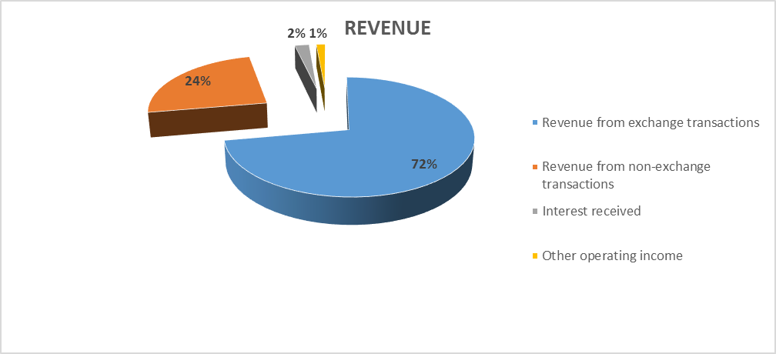
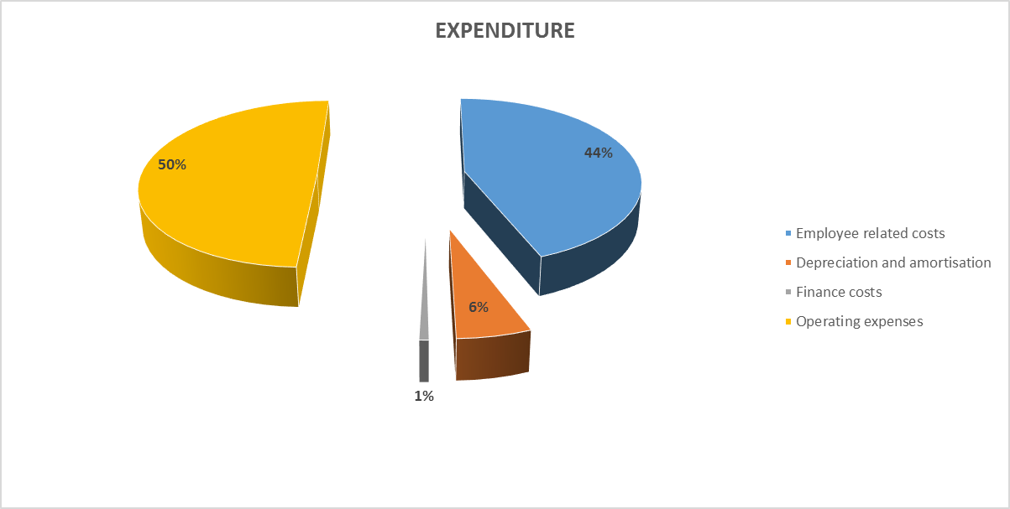
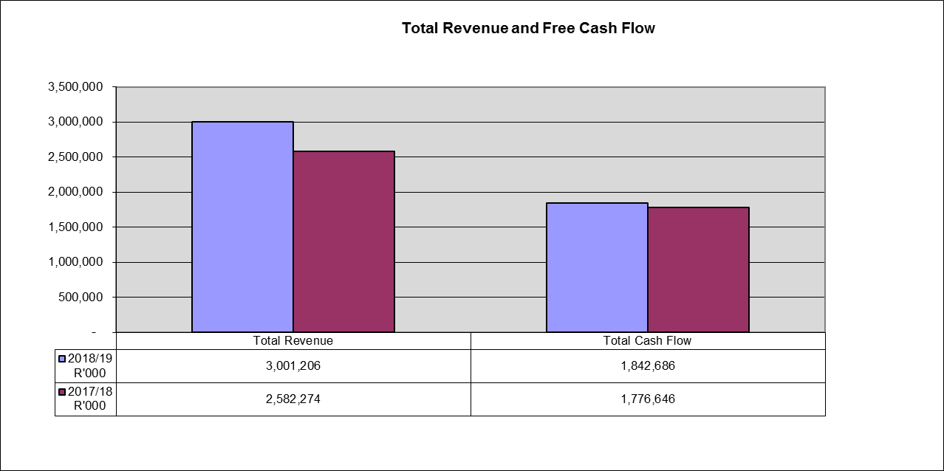
Financial Performance – March 2019

Slide 34
Financial Performance – March 2019

Slide 35
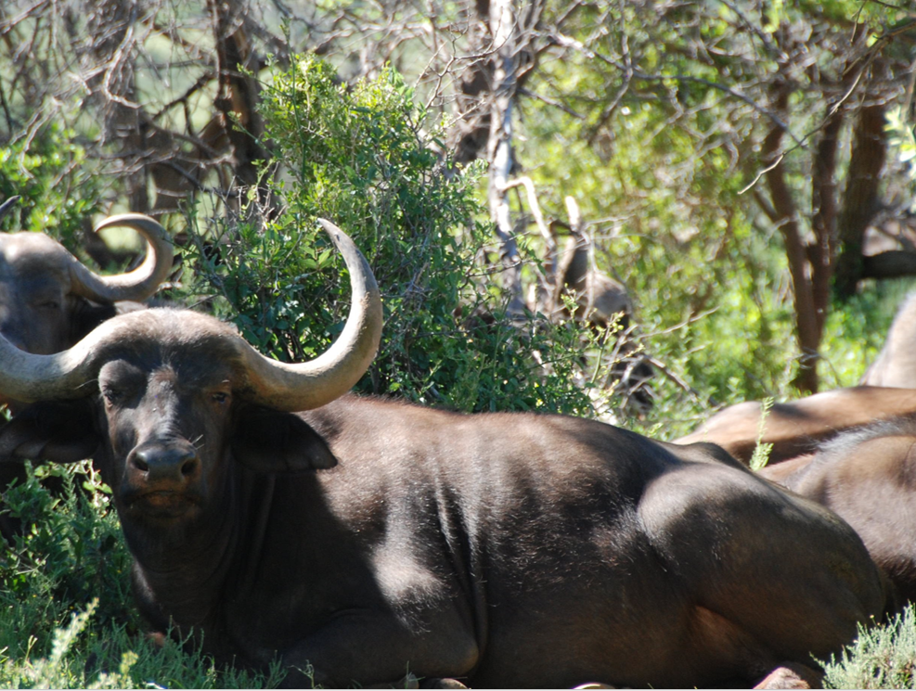
Thank you
THANK YOU

